Slide 1


Sentinel Storyboard
By Mohammad Zeina
Supervised by Dr. Walid Amer

Slide 2
Purpose of the Storyboard
The purpose of this storyboard is to visually and conceptually illustrate the user journey within Sentinel, an AI-powered cybersecurity assistant. It outlines how users interact with the system — from authentication and personalized greetings to module selection and security analysis.
This storyboard aims to:
Demonstrate the logical flow of Sentinel’s interface and functionality.
Highlight how each feature contributes to enhancing user security awareness and protection.
Provide a clear overview of the user experience (UX), emphasizing simplicity, guidance, and proactive threat prevention.
Ultimately, the storyboard serves as a conceptual roadmap for how Sentinel empowers users to identify, understand, and mitigate cybersecurity risks through an intuitive, modular, and intelligent design.

Slide 3
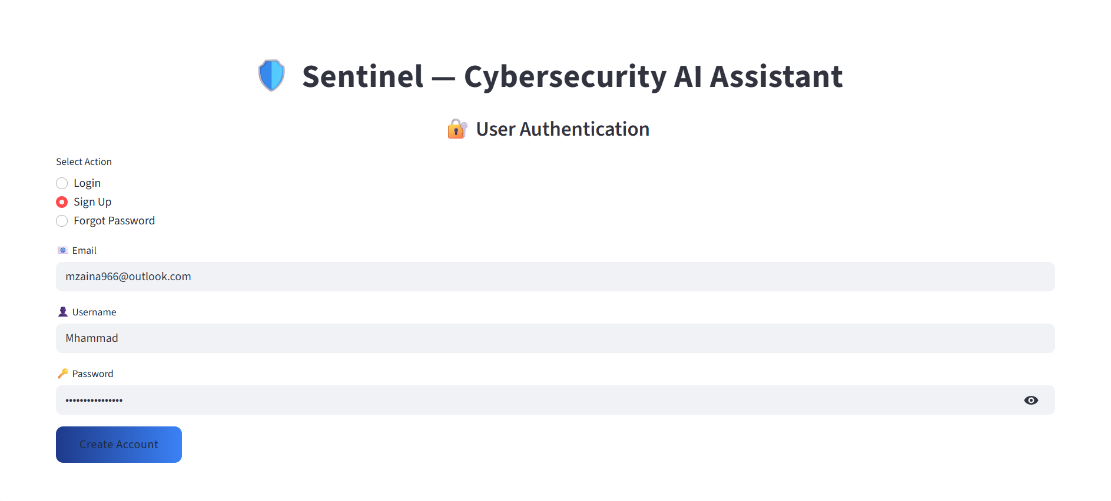
Any user must sign up with an account before using Sentinel.
User enters their email
Chooses their username
Types password
The user clicks Create Account and now anytime they want to use Sentinel they just have to log in.

Slide 4
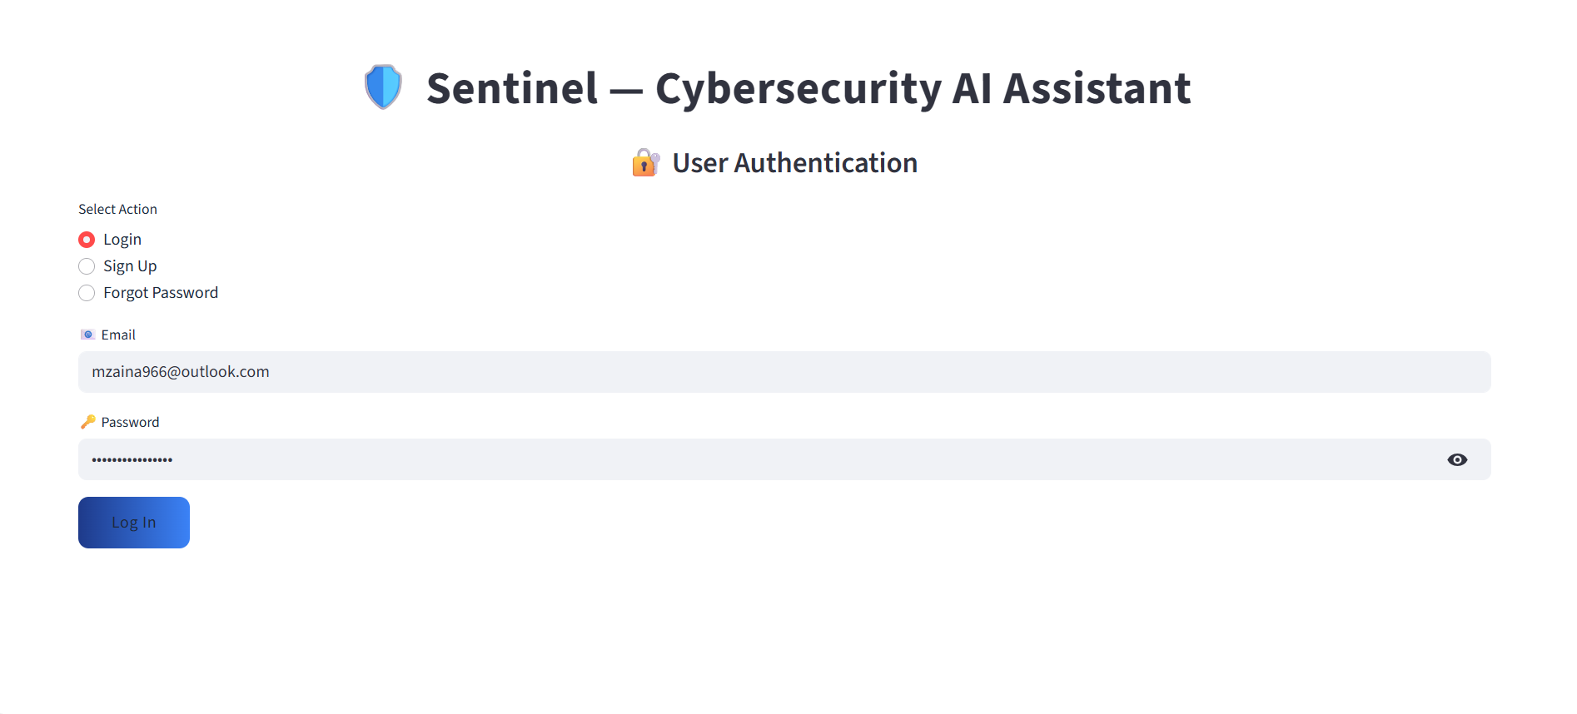
If the user already has an account, they choose login and enter their email and password.

Slide 5
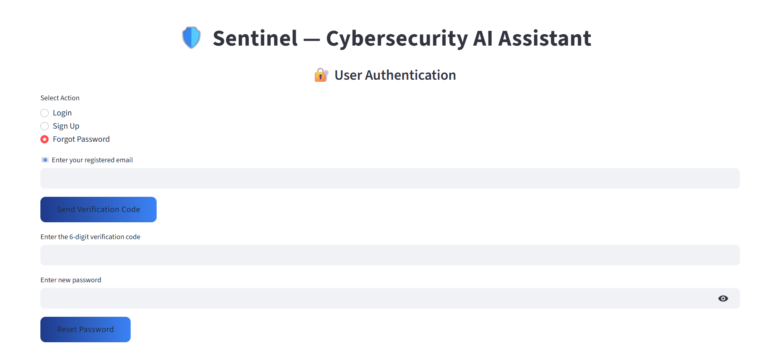
The user have an option where they can change their password if forgotten after verifying their email

Slide 6
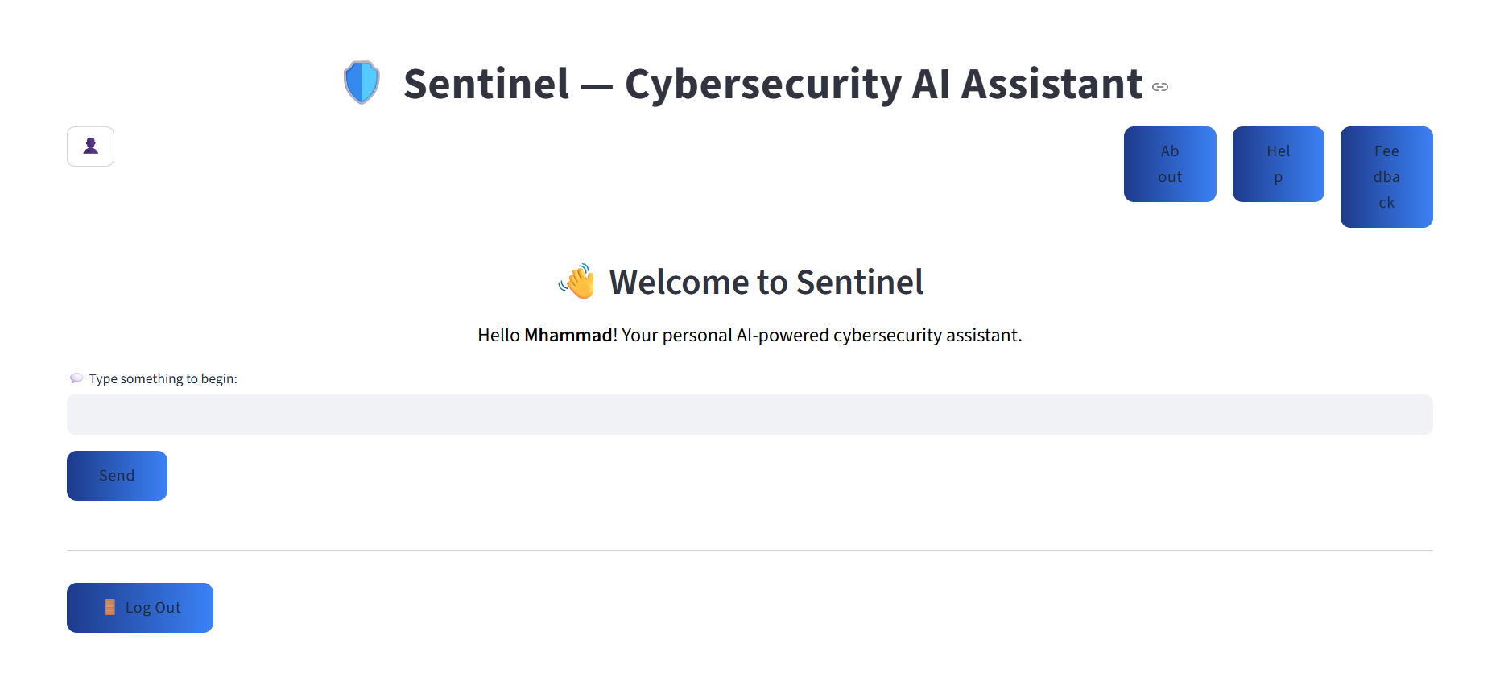
After logging in, the user enters the main page where they can check their profile
Explanation
Guidance
Review
after
The log out button takes the user back to the authentication page

Slide 7
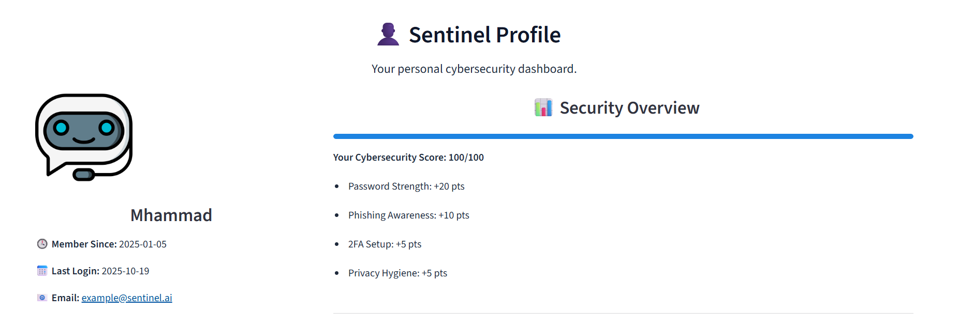
Pressing the profile icon will take the user to the user dashbaord page where they can check profile related things
A score based on the amount of modules the user has used
Profile history
and info

Slide 8
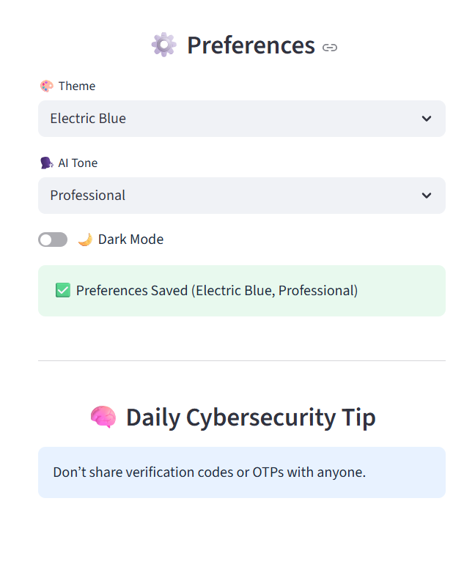

Slide 9
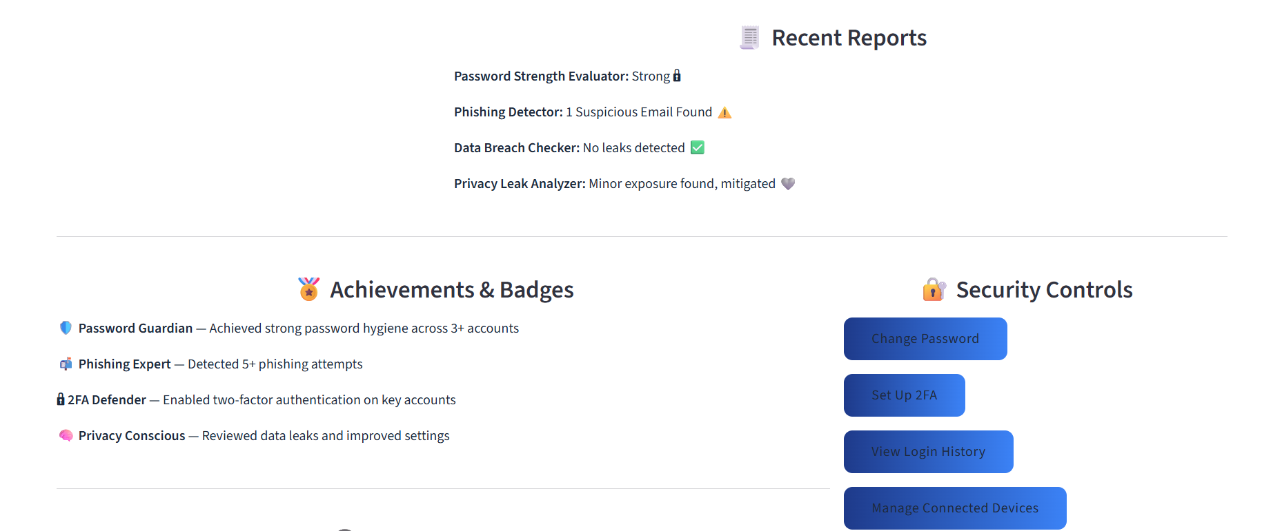
Reports of the modules' recent
results show up here
Users can manage their profile settings here

Slide 10
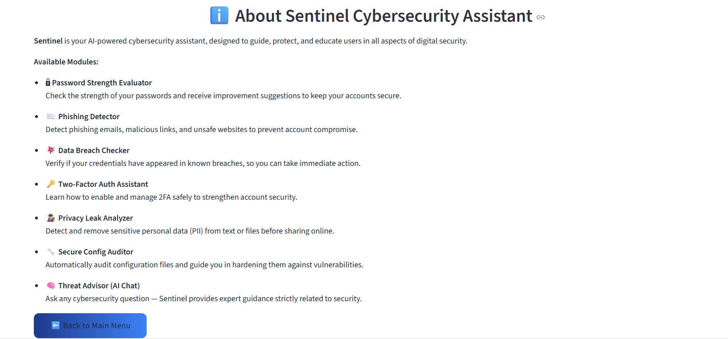
Clicking the about button takes the user to a page that provides a simple explanation about every module.

Slide 11
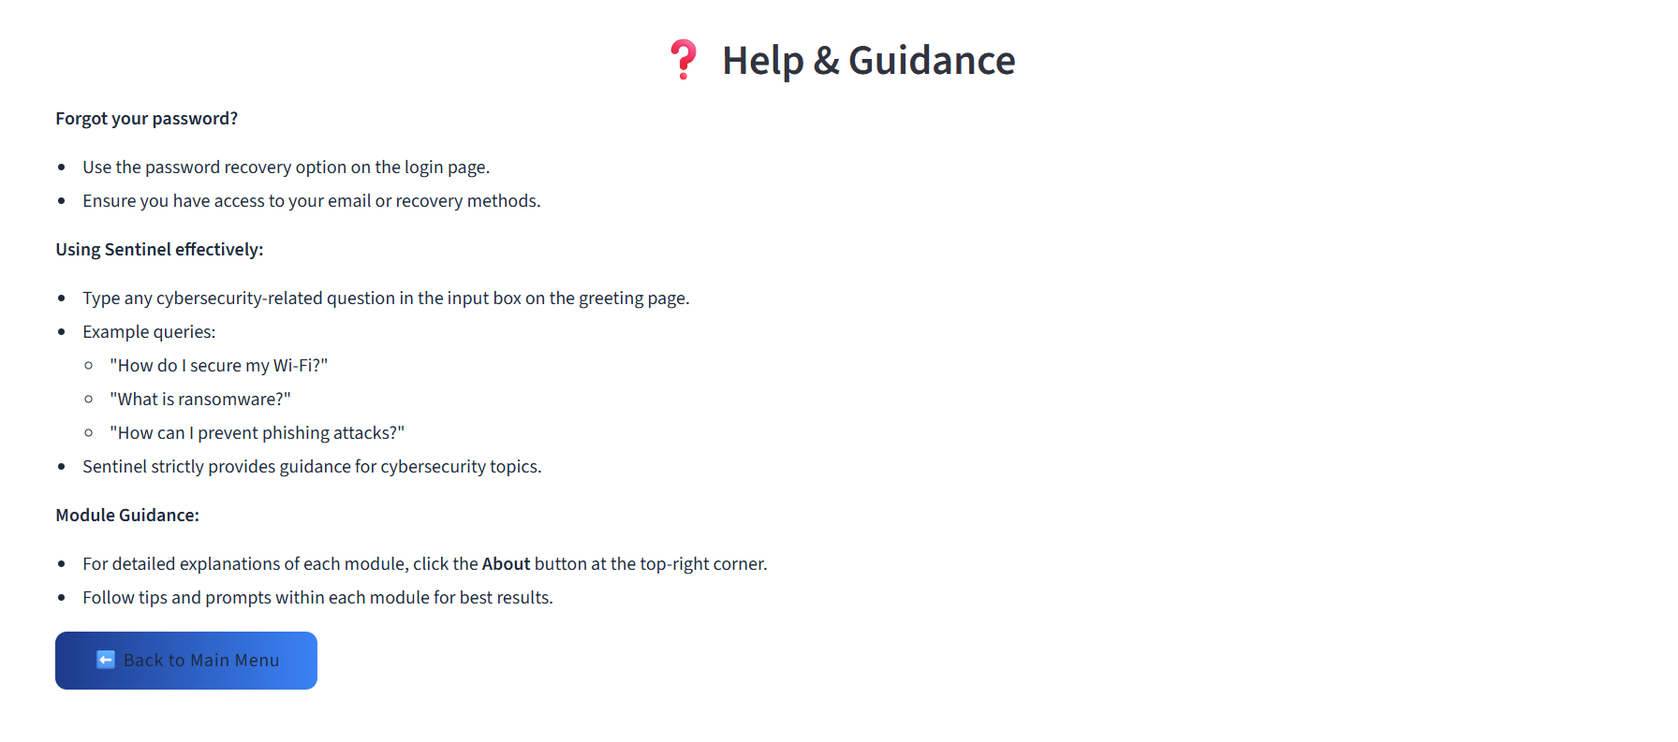
Clicking on the help button takes the user to a page that provides guidance for basic problems.

Slide 12
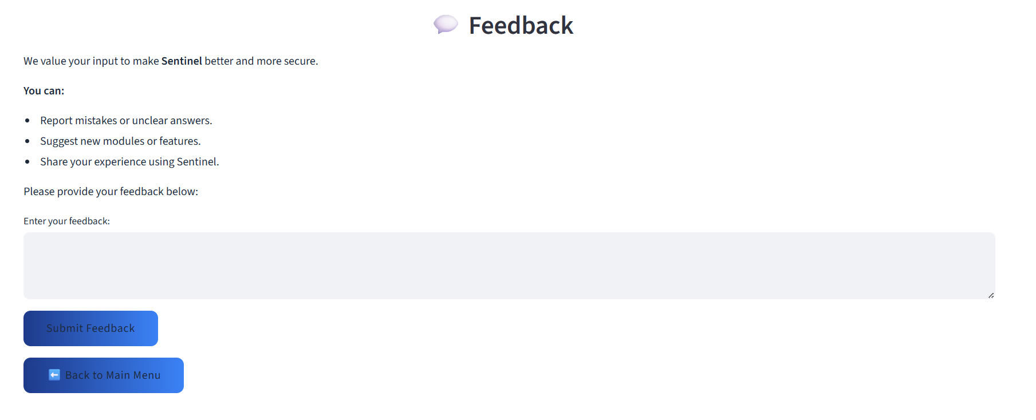
Clicking on the feedback button allows the user to submit a feedback about Sentinel, reporting bugs and mistakes or making new suggestions.

Slide 13
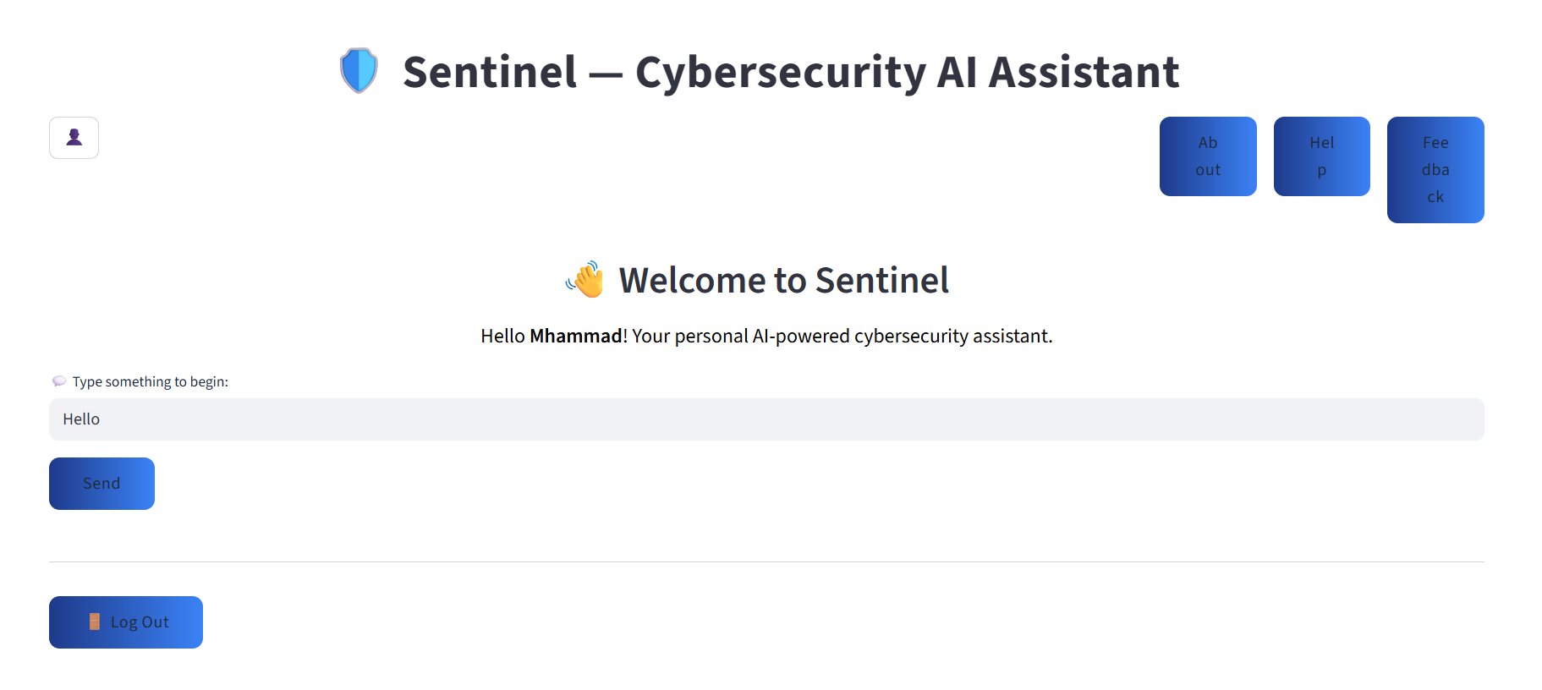
Once the user wants to get started with the modules, they can type anything in the message box and send it.

Slide 14
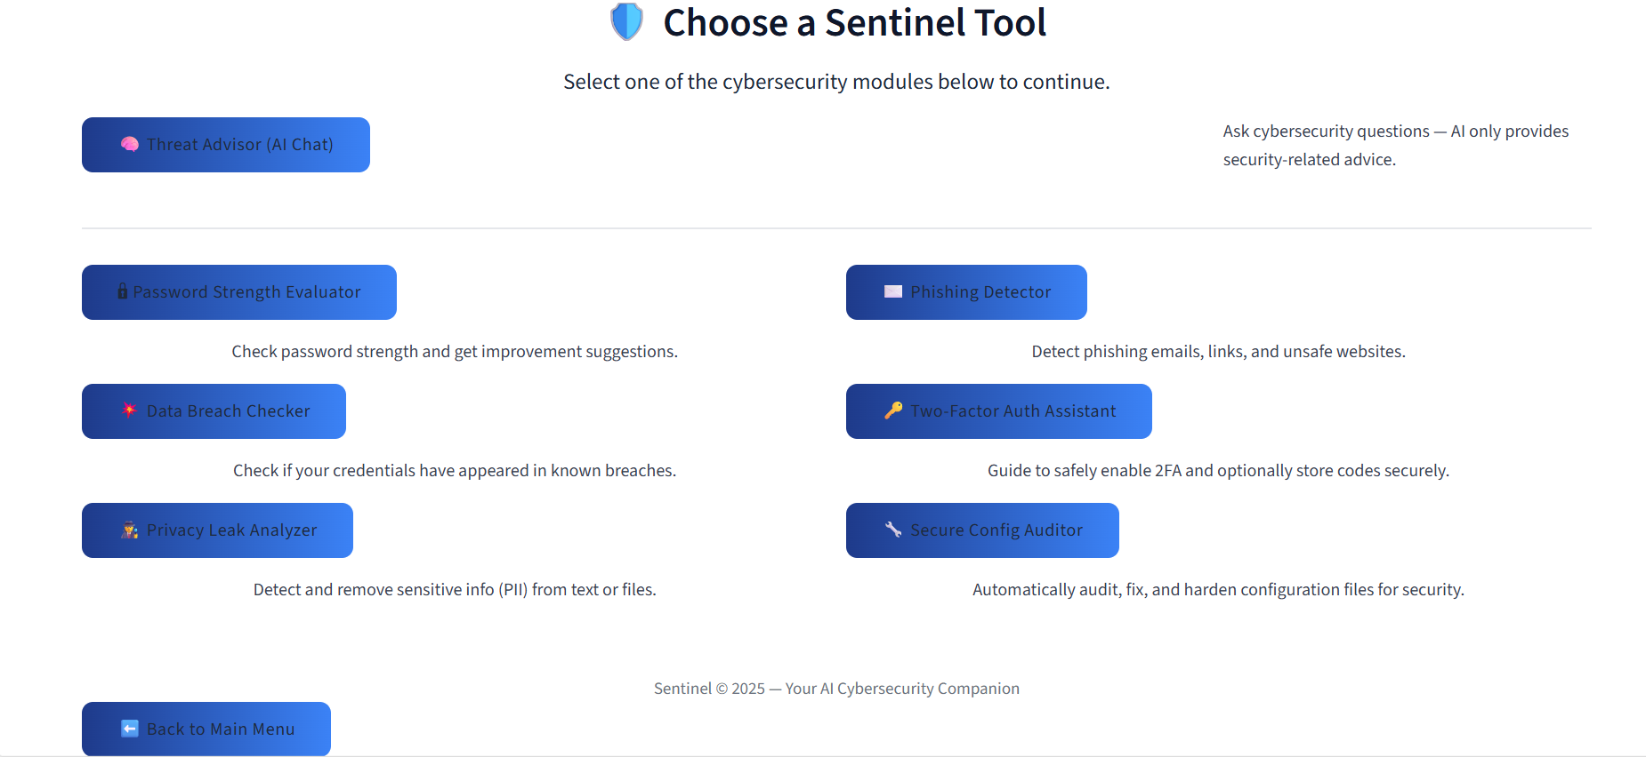
Once the user clicks send, they enter the modules page
They can choose whether to ask Sentinel questions about cybersecurity.
Or to use any of the different sentinel modules.

Slide 15
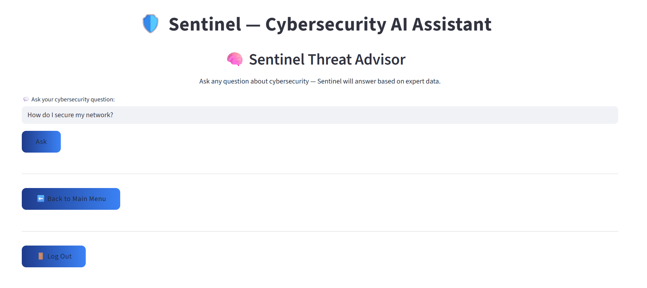
The user types any question in the message box

Slide 16
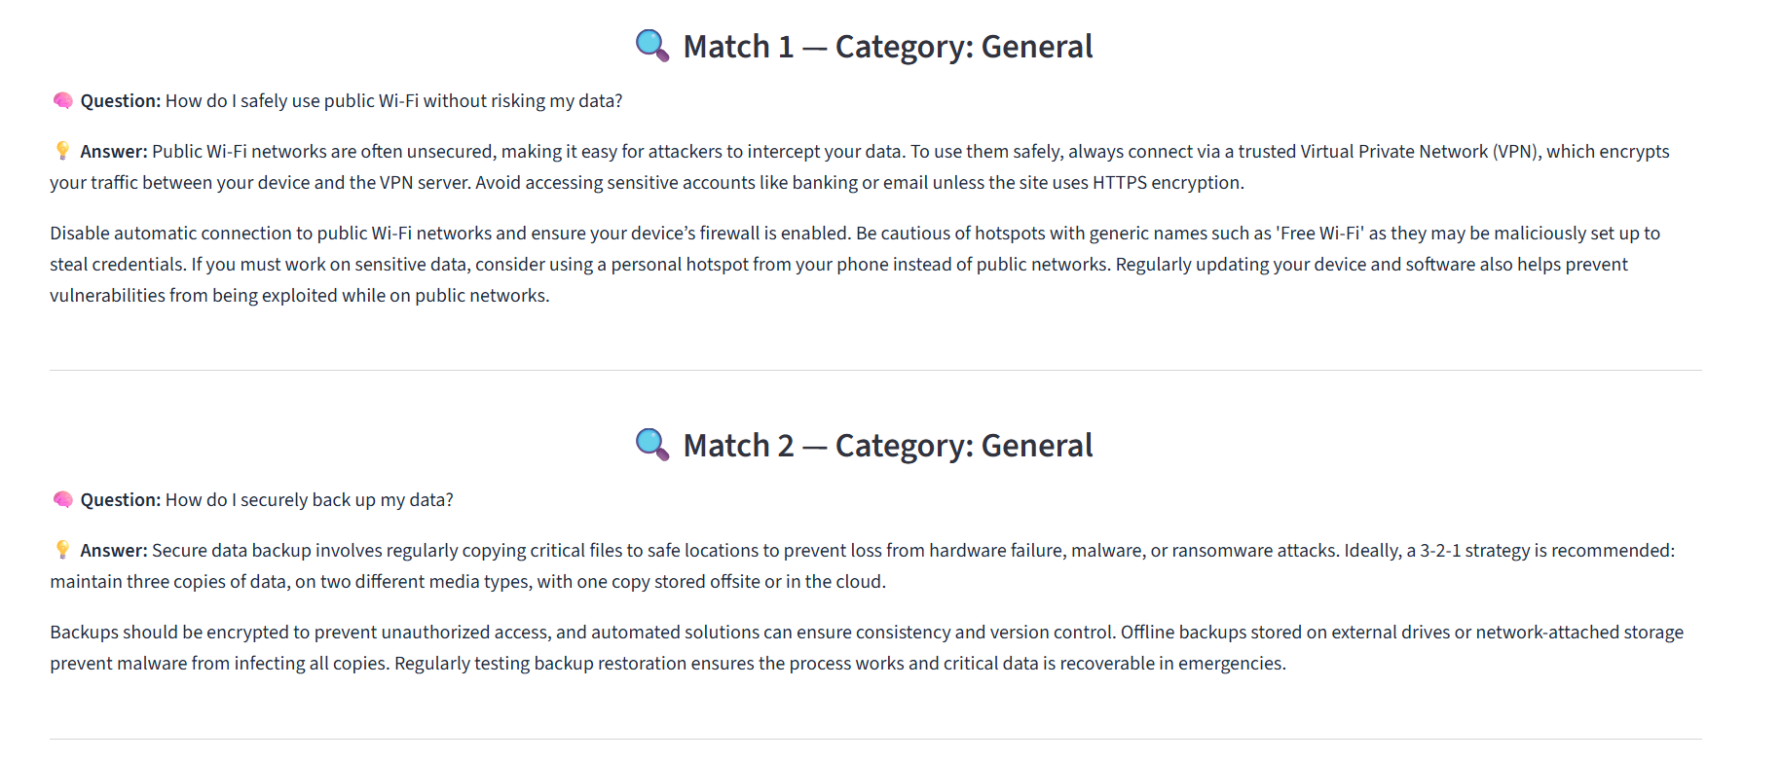
Sentinel responds with the three best matches based on the question asked.

Slide 17
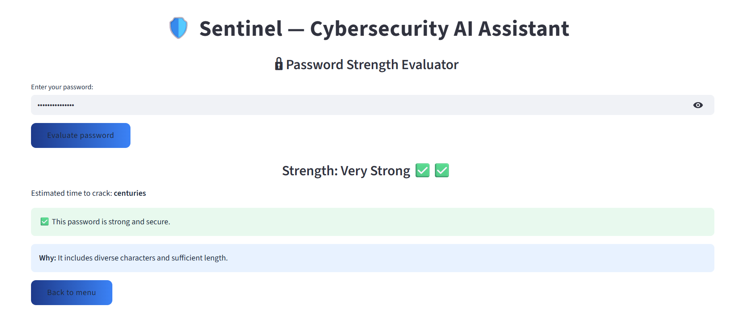

Slide 18
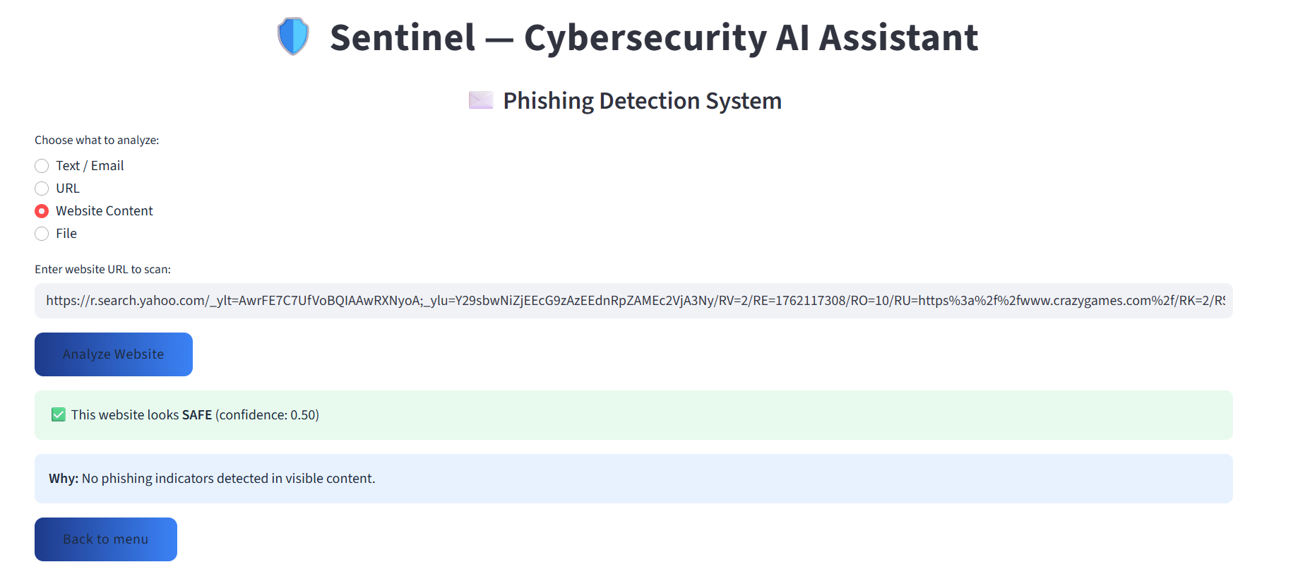

Slide 19
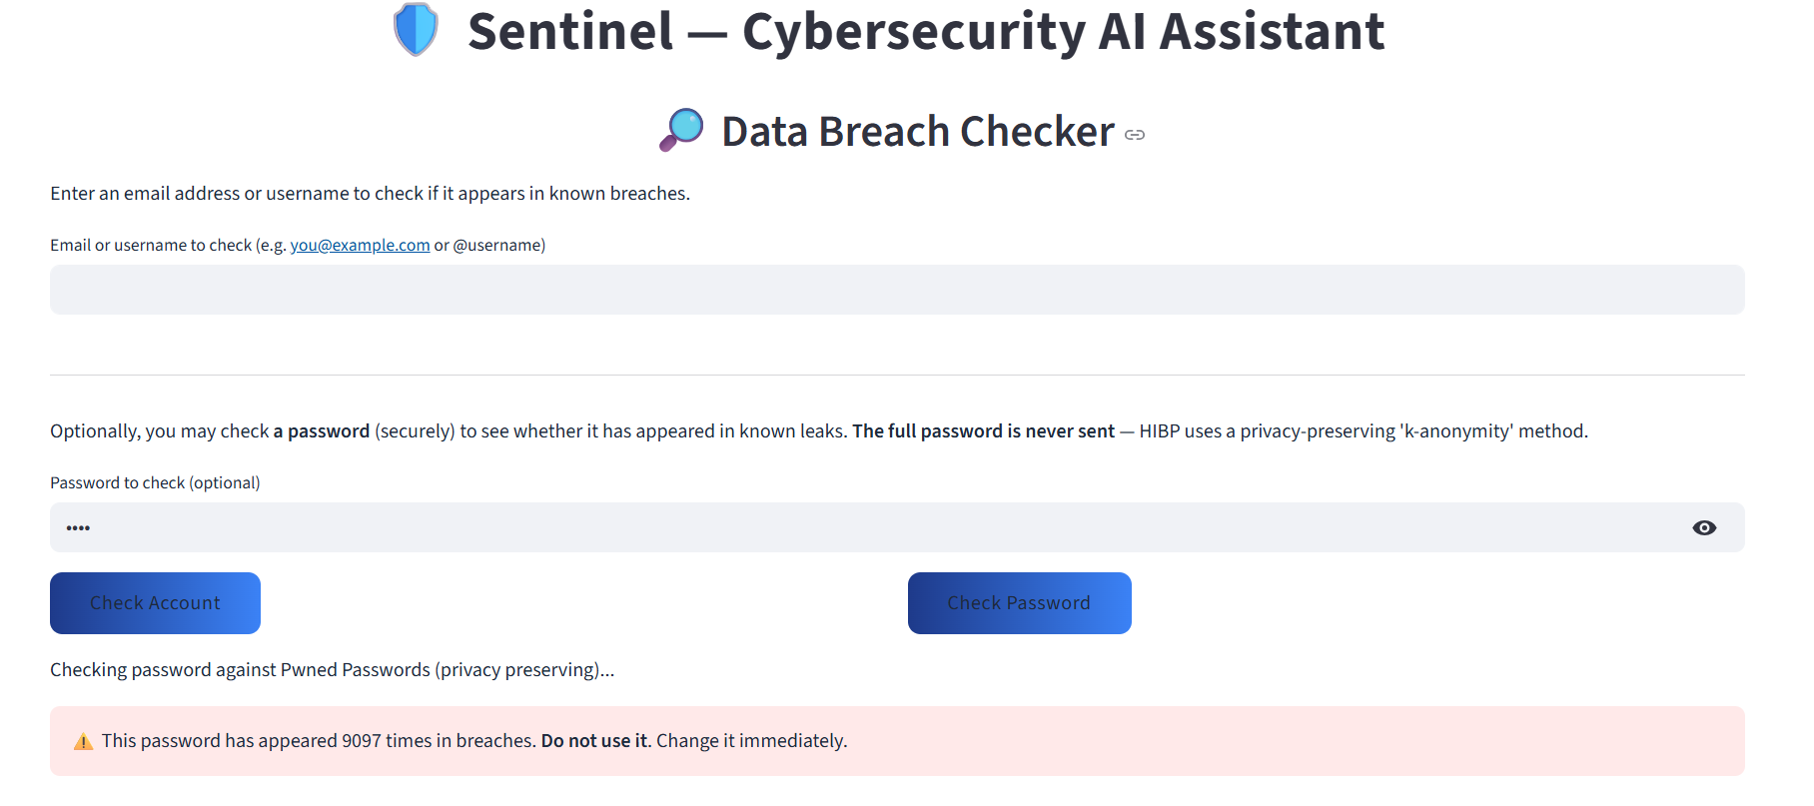

Slide 20
Thank you

