Slide 1
Machine Learning Theory and App
Final Project
by
.Mohammad and Dewan Mohammad Tassinuzaman

Slide 2
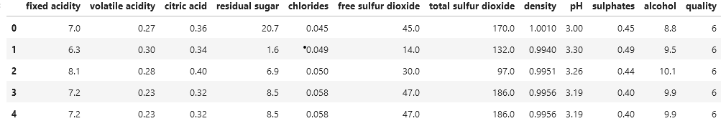
Dataset:White-Wine
The main dataset we have chosen is a record of the quality of white wines.
There are 12 different attributes based on the components of the wine.
Stuff like alcohol level, ph level, citric acid and more.

Slide 3
Problems of Dataset
Predicting the wine's quality using its physicochemical characteristics is the aim of this dataset.
As a result, the learning problem in this dataset is a regression problem, with the objective being to forecast a continuous numerical value (the wine's quality) from a set of input features (its physicochemical characteristics).

Slide 4
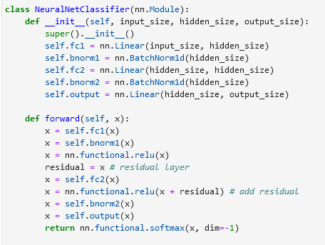
The Model
This is the entire model.
Strata are
3 linear layers
2 batch norm layers
1 Residual layer
The input of each layer is normalized using batchnorm1d.
In an effort to lessen the internal covariate shift.

Slide 5
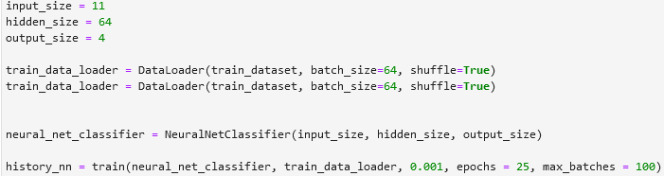
Training
We tried a maximum of 100 batches with 25 epochs for the training.
At its peak, the training accuracy was 77%.

Slide 6
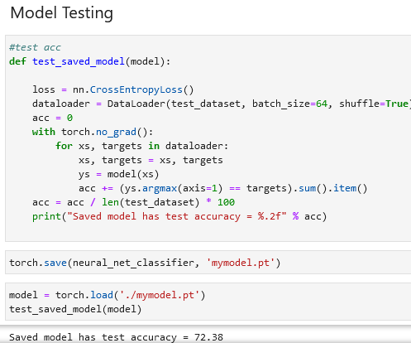
Testing
The model's total test accuracy was 72%.

Slide 7
Development

Slide 8
Thank you for joining today's presentation.

Slide 9
Reference
Agnihotri, P. (Year, if available). White Wine. Kaggle.
https://www.kaggle.com/datasets/piyushagni5/white-wine-quality

