Slide 1
Secured Door: Bangladesh Security System – 2019 (BDSS-19)
Student name: Mohammad Abul Hossain
Student number: 20152785
Dept.: computer engineering
Advising Professor: Dai ki kang

Slide 2
Contents:
Introduction
Weekly task schedules
Door Security System
Project Demo
Conclusion

Slide 3
1. Introduction
The most important issue is now security in every step.
Bangladesh Security System – 2019 (BDSS-19) is introduced from that perspective.
Ensures door security in home and office etc.
Has two way to lock and unlock such as Manually and Using Android Application.
The key feature of the project is to notify the user the last update of the door through notification over phone.

Slide 4
1. Introduction
Objective:
To ensure most latest security for the user.
To get in touch with the door always through Android Application.
To make the Door system modern and upgrade.
To provide the best service within limited budget.

Slide 5
2. Weekly task schedules
No | Contents | Schedule
 |  | week 1 | week 2 | week 3 | week 4 | week 5 | week 6 | week 7 | week 8
1 | Researching on project | .
2 | UML diagram design |  | .
3 | Set up Raspberry Pi |  |  | .
4 | Research on Server/API |  |  |  | .
5 | Account Setting of Mobile Application |  |  |  |  | .
6 | Code conducted with OS(Rasbian) |  |  |  |  |  | .
7 | synchronize hardware and software |  |  |  |  |  |  | .
8

Slide 6
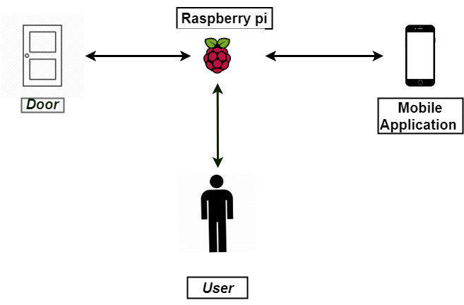
3. Door Security System
System Overview

Slide 7
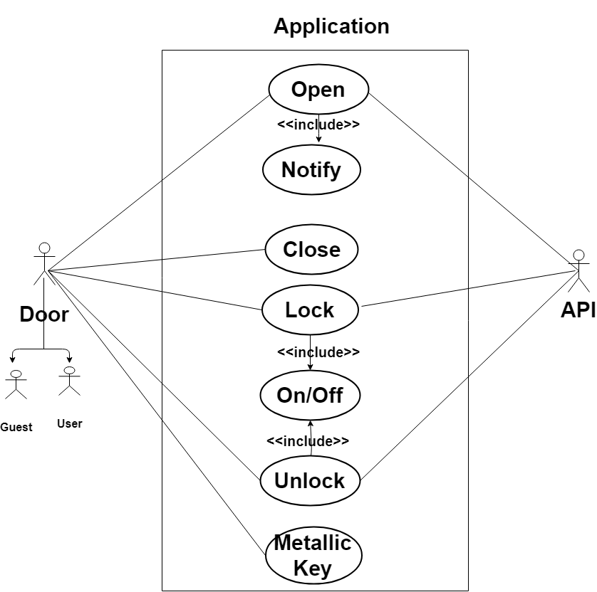
3. Door Security System
Use Case Diagram

Slide 8
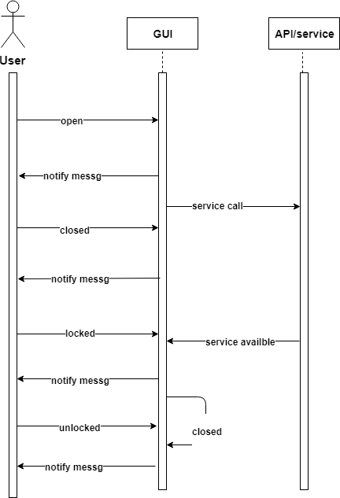
Sequence Diagram
3. Door Security System

Slide 9
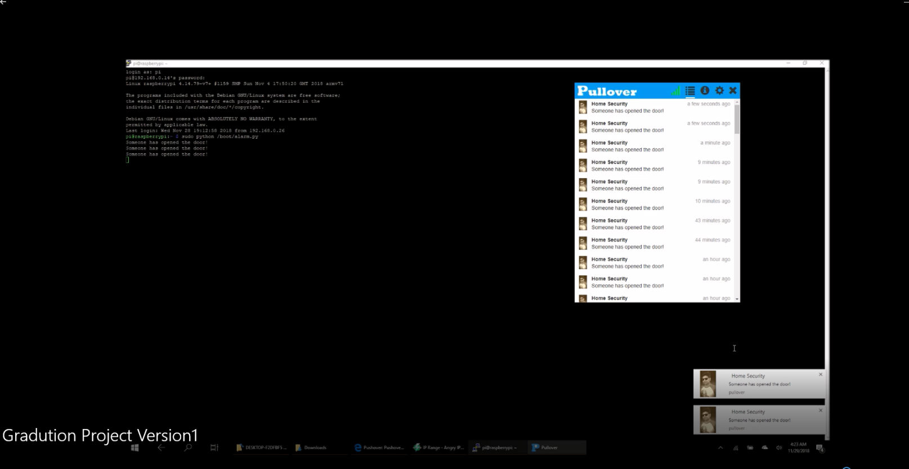
4. Project Demo
https://drive.google.com/drive/folders/1bvecV6WP4phruEAERMSuws7vRMh3mH1e

Slide 10
Conclusion
In the present world, BDSS-19 provides latest and most security.
Notification system makes the product more advance and unique.
For 24/7 certain security, BDSS-19 is the best product since it provides up-to-date news always.
Since it is within lower budget, middle class and higher class both of them can use.
It is less complicated and easy to implement.
Maintenance is easier than any other product.

Slide 11
Thank you
Q&A

