Slide 1
‘‘ wreck’’
Group name: Dragan
Group members:
Mohammad Abul Hossain(20152785)
Tuhtasinov Murodilla(20152784)
Akbarjon:(20152773)

Slide 2

Brief information
Finding cars at the right place, on the right time.
app consists of between customers and drivers
customers basically who are from home ,office and anywhere.
Driver traces the customer place who want to get car and who are nearby.

Slide 3
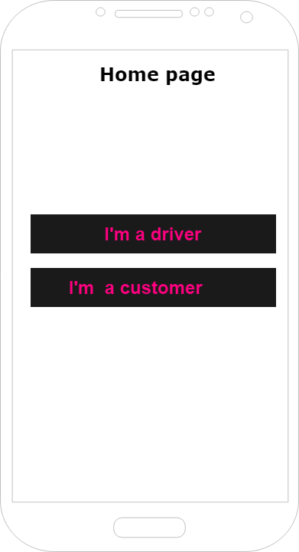
Application features

Slide 4
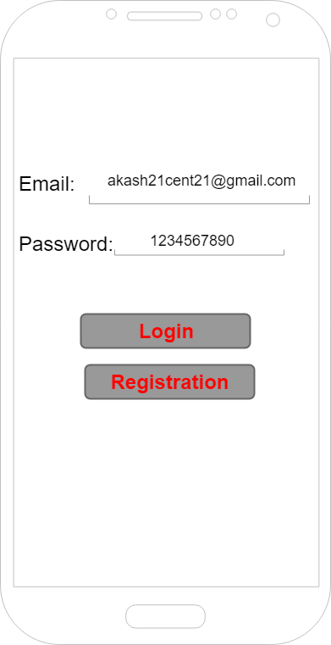

Slide 5
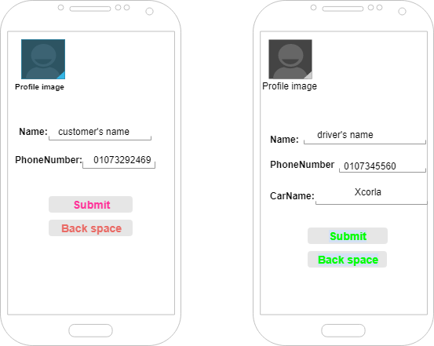

Slide 6
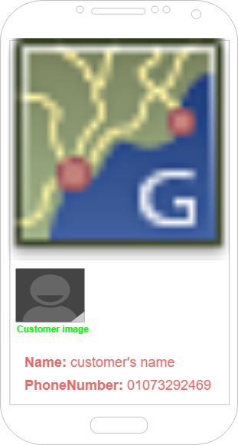

Slide 7
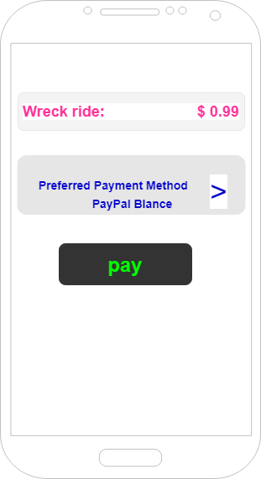

Slide 8
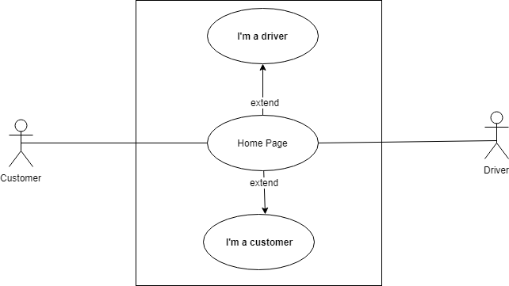
Use case diagrams

Slide 9
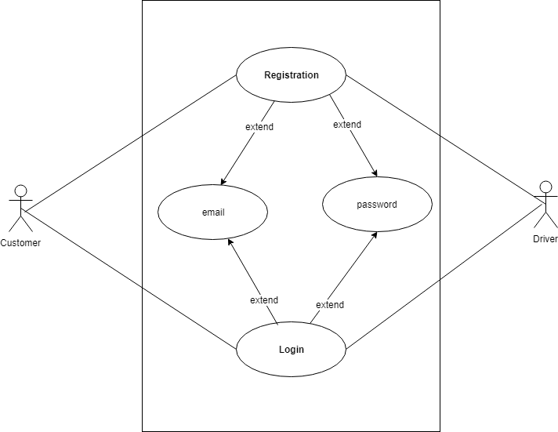

Slide 10
Use case scenario
1. Whenever User open the application <<scenario1>>.
2. Whenever user thumbs up Driver’s Button / Customer’s button <<scenario2>>.
3. If user has already an account<<scenario3>>.
4. If user doesn’t has an account or new<<scenario4>>.
Scenario 1. Main page including (Driver btn & Customer btn).
Scenario 2. Ask for Login or Registered.
scenario 3. Login.
Scenario 4. Registered.

Slide 11
Use case scenario
1.If user already has verified an account <<scenario1>>.
2. If user doesn’t has an account<secnario2>>.
3. If user types incorrect email or password<<secnario3>>.
Scenario1. Login( email, password).
Scenario2. Registered(email, password ,conf.password).
Scenario3. Error occur.

Slide 12
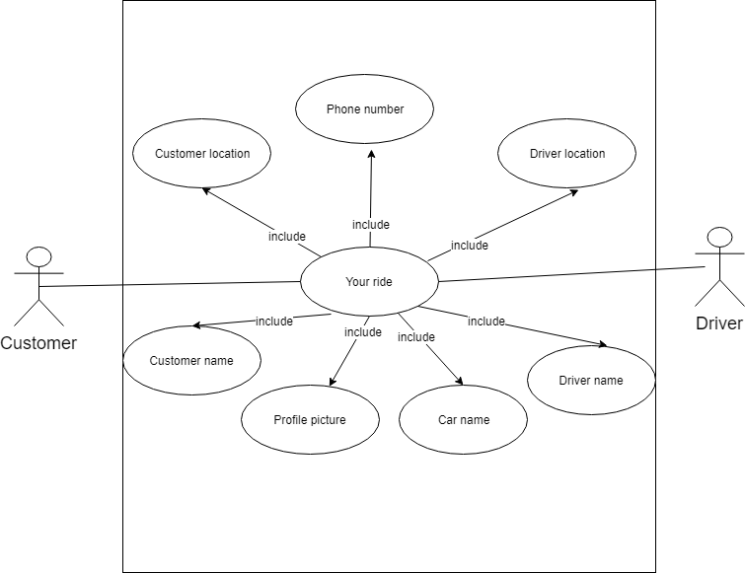
Use Case Diagram

Slide 13
Use case scenario
The customer thumbs up driver <scenario1>
The driver <<scenario>>
The driver get <<scenario>>
4. the customer get<<scenario>>
scenario1. trace driver location
Scenario2. trace the customer location
scenario3. driver information
Scenario4. Customer information

Slide 14
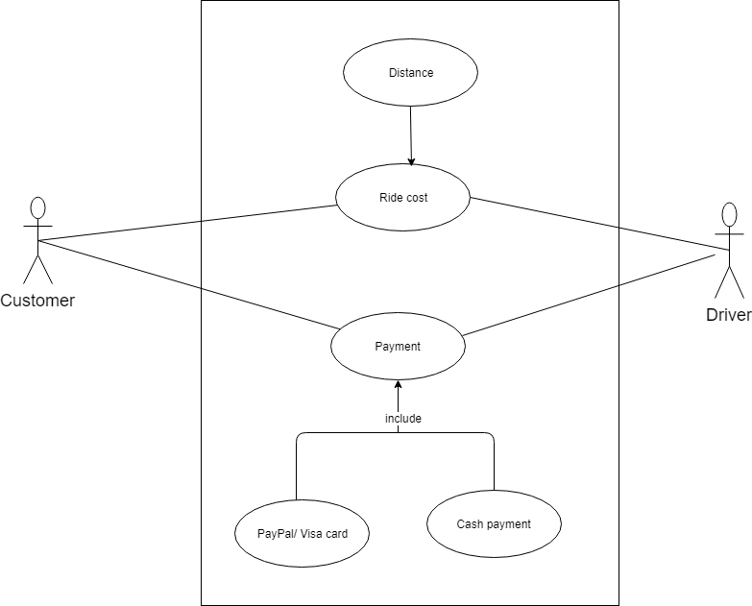
Use Case Diagram

Slide 15
Use case scenario
Destination to pick up equal is to <<scenario>>
Visa card or PayPal <<scenario>>
scenario1. ride cost
Scnario2.payment methods.

Slide 16
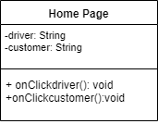
Class diagrams

Slide 17
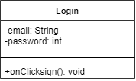

Slide 18
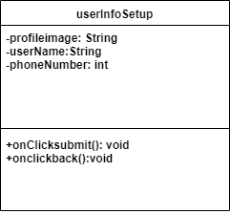

Slide 19
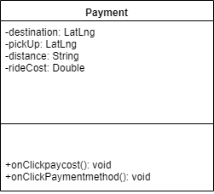

Slide 20
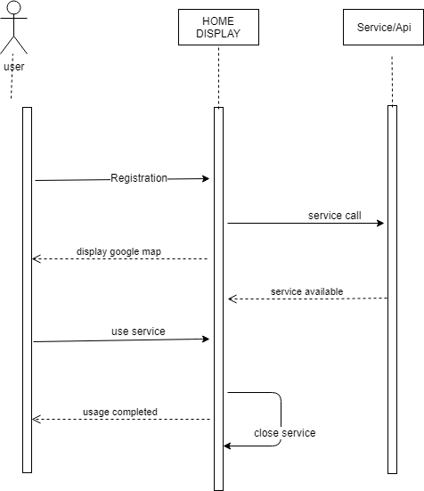
Sequence diagrams

Slide 21

Sign in

Slide 22
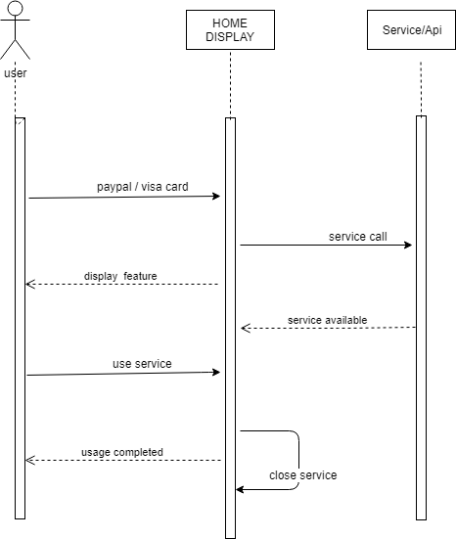
Payment methods

Slide 23
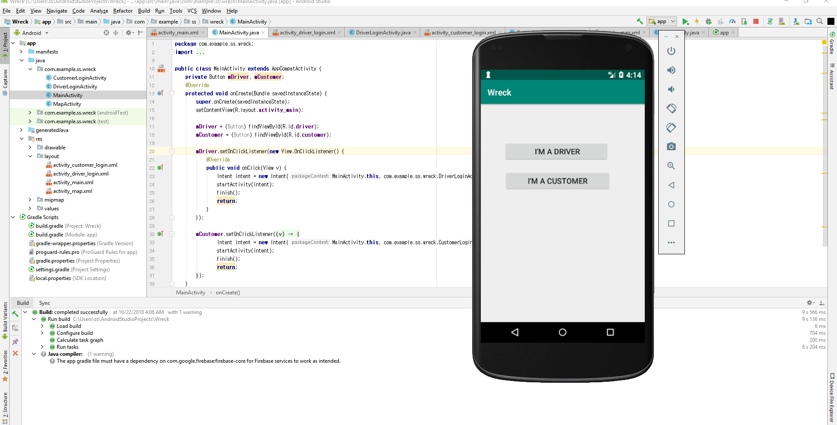
1st Increment Report Home Screen

Slide 24

User information setup

Slide 25
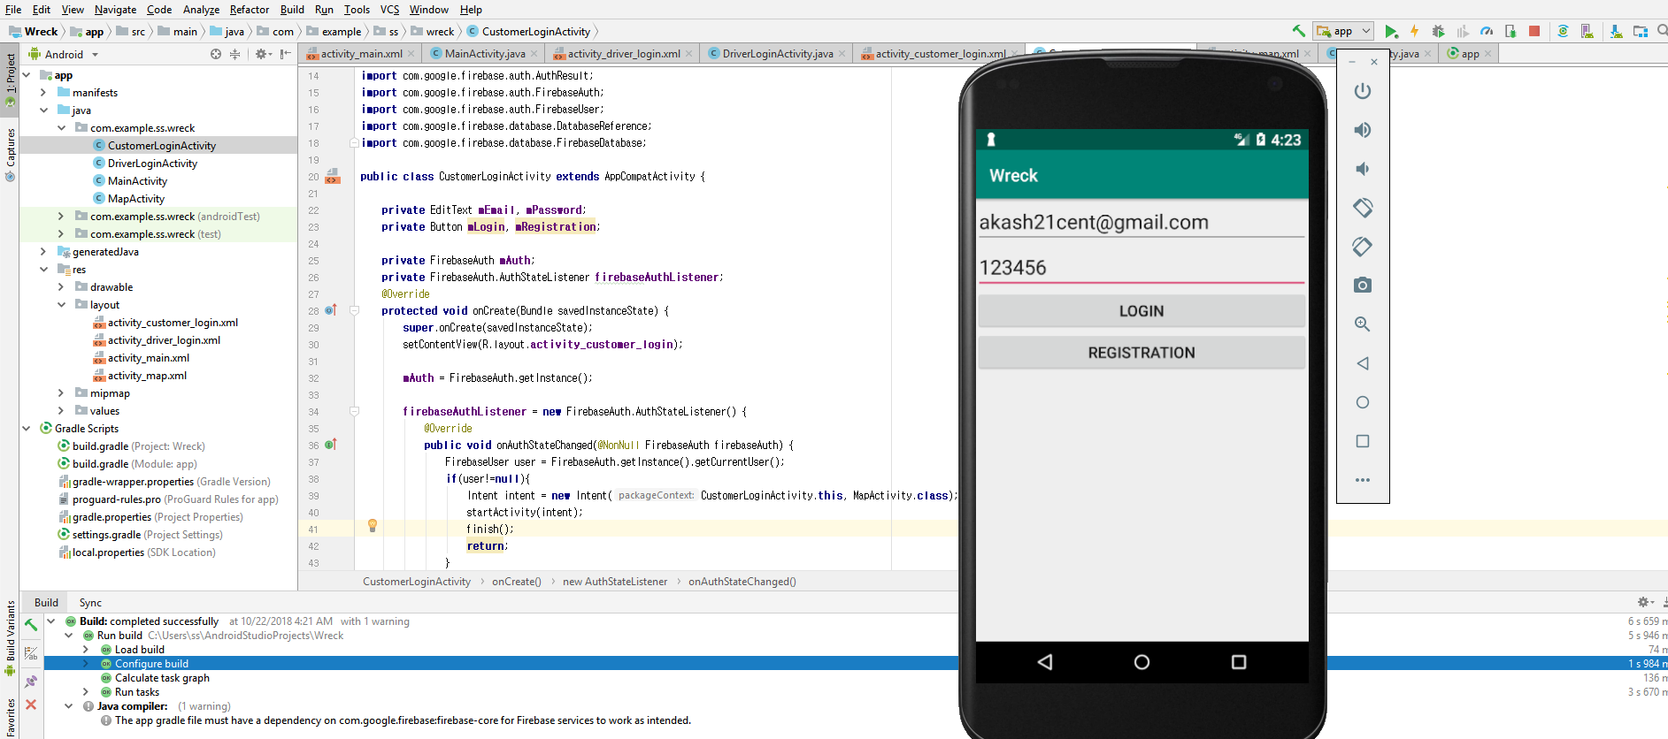
Sign up & sign in

Slide 26
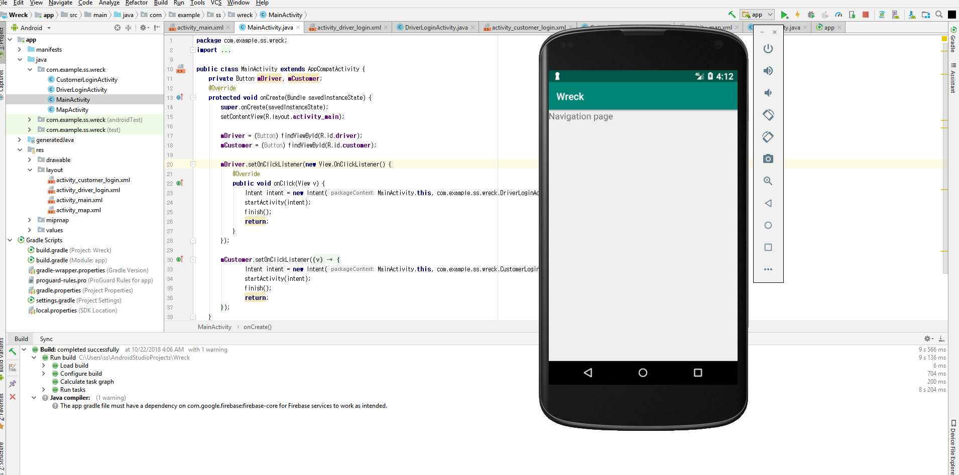
Navigation screen

Slide 27
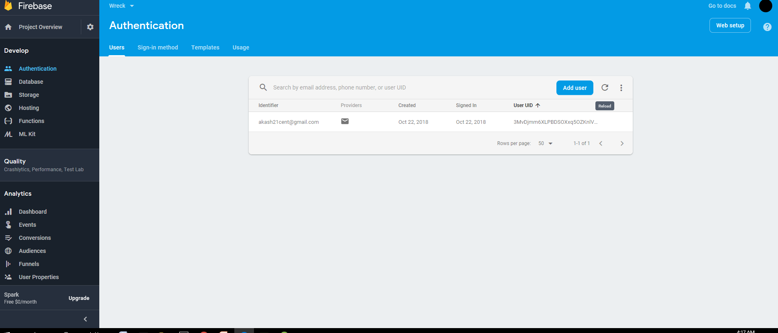
Firebase database Backend

Slide 28
Thanks all for attention

