Slide 1
Writing and Reading To / From Hadoop Docker Containers

Slide 2
Setup Hadoop and Spark Clusters
This presentation shows the setup of HDFS/Spark cluster using docker.
You need to have docker installed or Docker Desktop (on Windows) and Git.
Throughout this tutorial we are going to setup the clusters and read/write data from/to HDFS using Pyspark.
Download the required files from the following git repository:
https://github.com/MohammadAbboud96/SparkWritingReadingHadoop.git

Slide 3
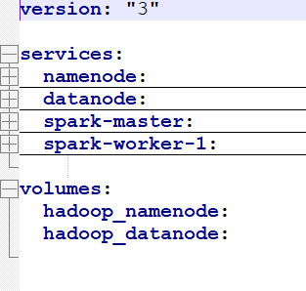
Setup Hadoop and Spark Clusters
The YAML and ENV files (docker-compose.yml and hadoop.env) files are the configuration files needed to start up our clusters.
docker-compose file defines our cluster components. In this demostration we have:
HDFS (one namenode, one datanode)
Spark (master node, worker node)
hadoop.env file contains the required
HDFS cluster configurations.

Slide 4
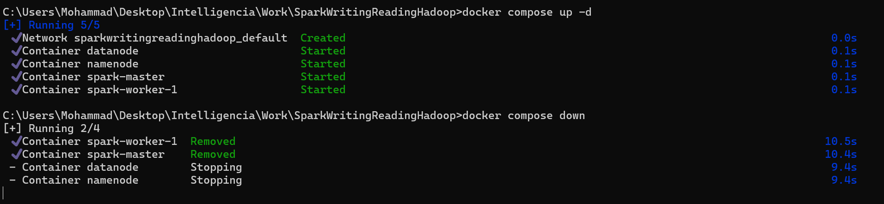
Running Docker Containers
To run the docker containers navigate to the folder containg the configuration files (docker-compose.yml and hadoop.env), then type:
docker compose up -d (to run in background)
To stop the running containers type:
docker compose down

Slide 5
Checking Clusters
After insuring that docker containers are up and running now we should have a SPARK cluster and HDFS cluster.
You can chek the status of both clusters on the
Namenode running on:
http://localhost:9870/dfshealth.html#tab-overview
Spark-Master running on:
http://localhost:8080/
Now to access the bash command line of each container we can run the following:
docker exec (--user=root) -it <container_name> bash [--user=root is optionale]

Slide 6
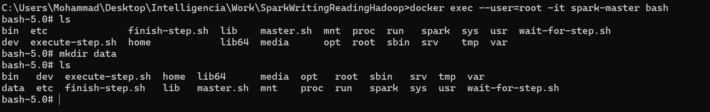
Entering Bash Terminal on Containers
Navigate to the HDFS namenode bash and check if we have data:
docker exec -it namenode bash
In another terminal, navigate to the spark-master bash and create a folder “data” (note here we will enter as root to have the permissions to create and delete files and folders).
docker exec --user=root -it spark-master bash

Slide 7
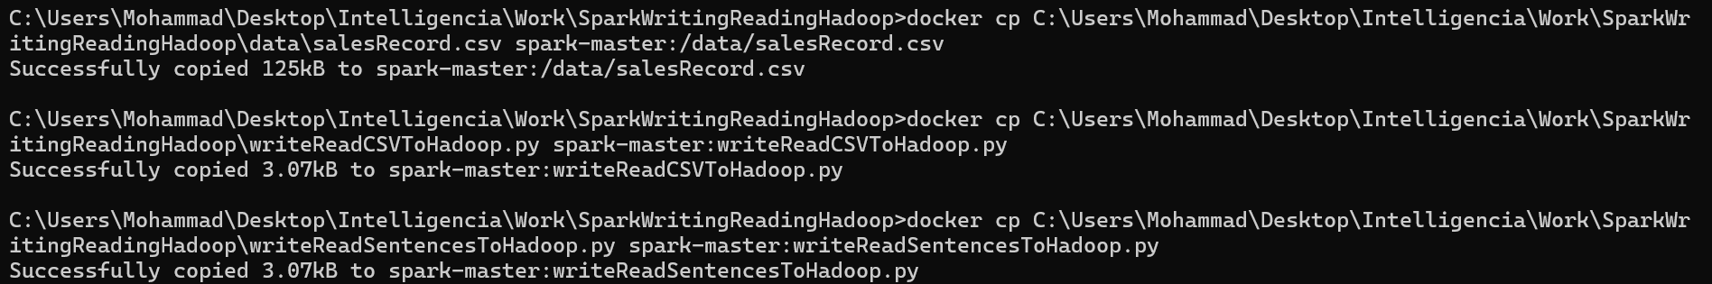
Copying Files From Local to Spark Container
In the folder downloaded from the git you will fing two Pyspark modules and a data folder containing CSV files.
Copy those files into the spark cluster:
docker cp /path/to/file container-name:path/where/to/put/the/file

Slide 8
Writing and Reading Text To/From HDFS
After having our code and data on the spark-master machine we need to submit the job to the spark cluster.
In the spark-master bash terminal run the following command:
./spark/bin/spark-submit <name_of_python_module>

Slide 9
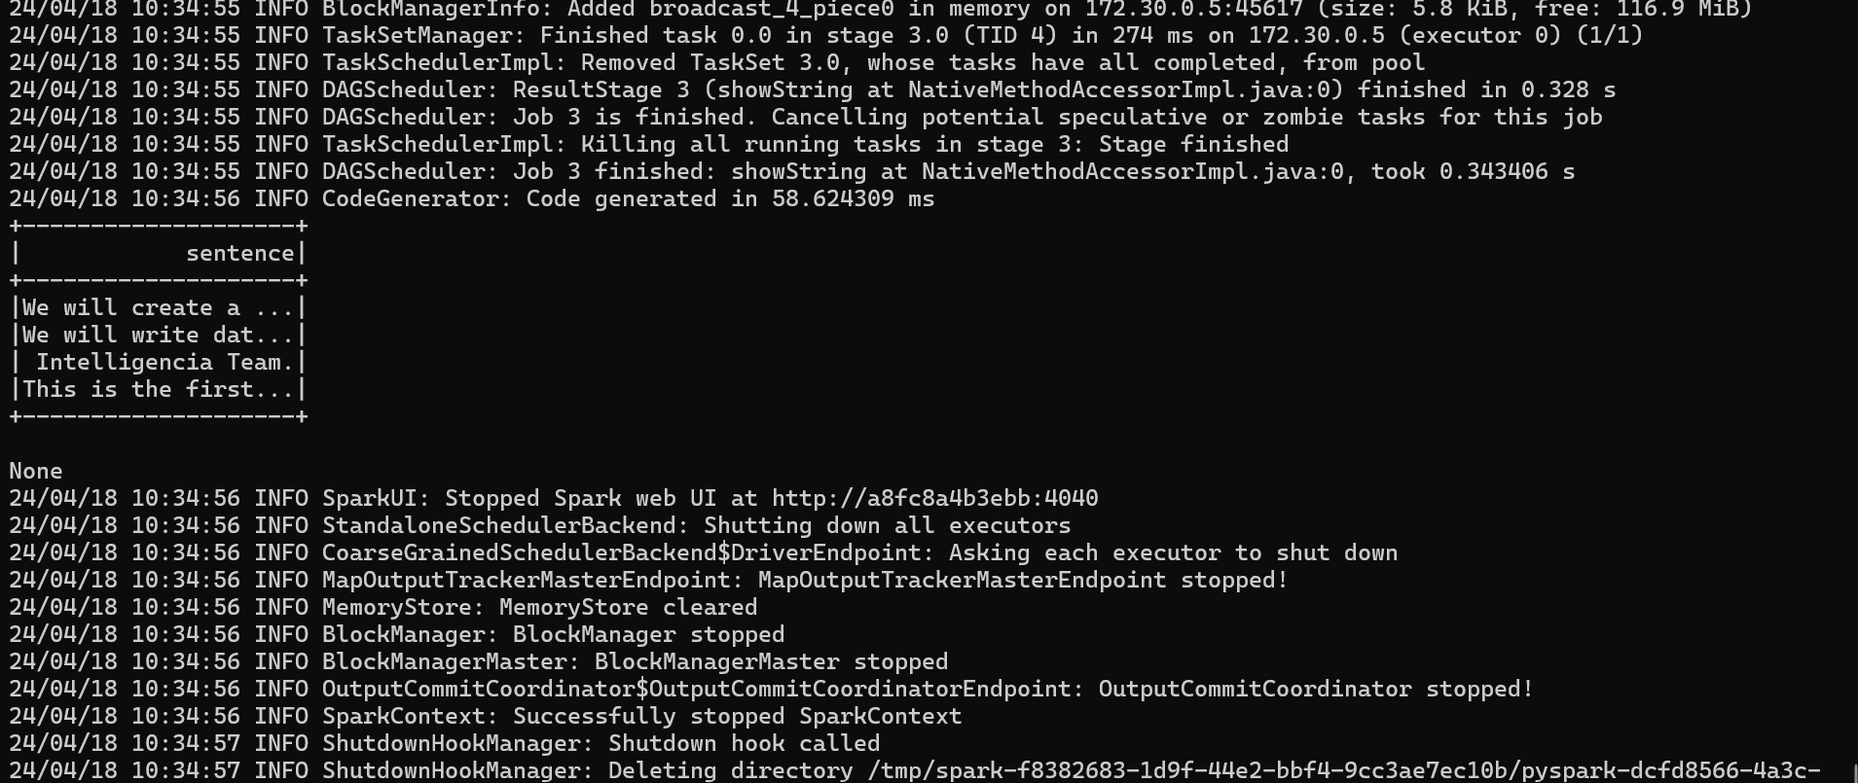
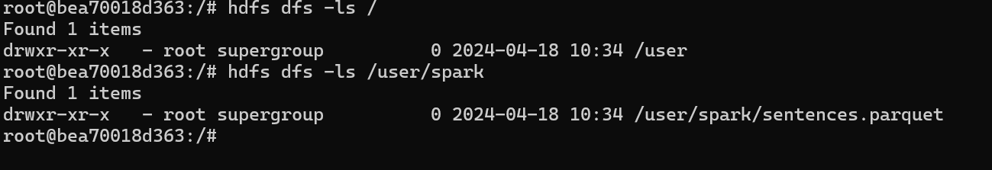
Writing and Reading Text To/From HDFS
Check HDFS name node for the data

Slide 10
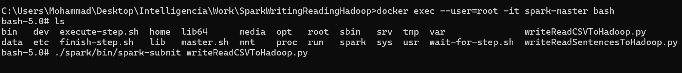
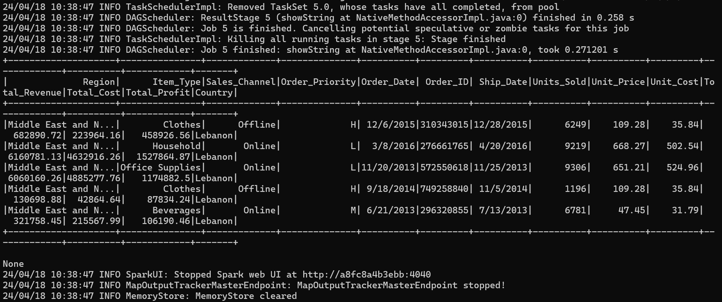
Writing and Reading CSV To/From HDFS
In the spark-master bash terminal run the following command:
./spark/bin/spark-submit <name_of_python_module>
In this example we are partitioning data by country while writing to HDFS and then loading data of Lebanon only.

Slide 11
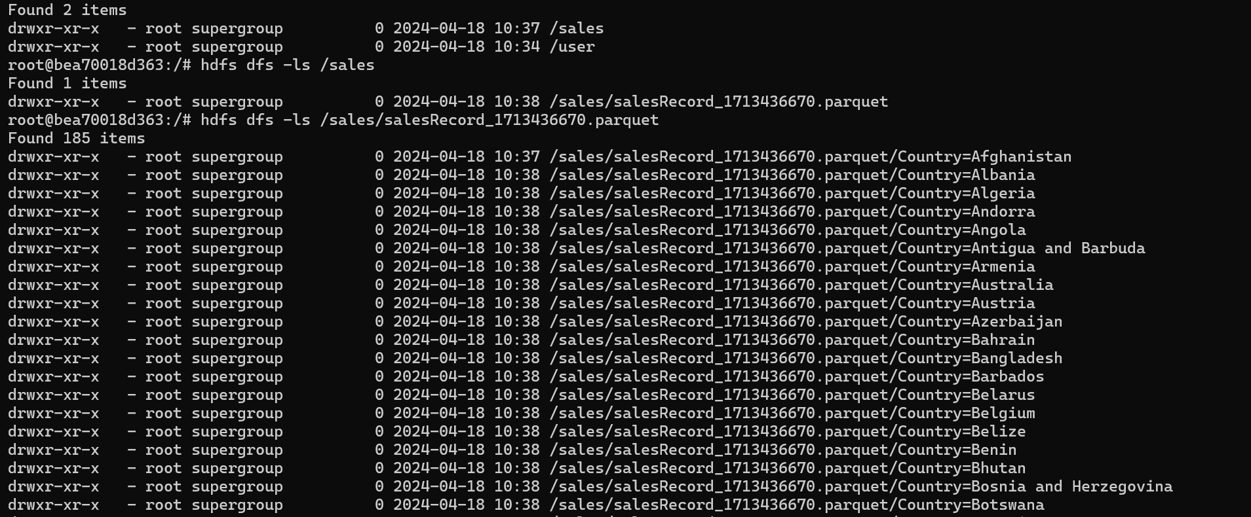
Writing and Reading CSV To/From HDFS
Check HDFS namenode for the data

