Slide 1
AI-based Intelligent Parking Monitoring System
An AI-Driven Solution for Efficient and Secure Parking Monitoring

Slide 2


GROUP MEMBERS
ROBASS ATIF
MOHAMMAD ABDULLAH

Slide 3
Introduction
Objective: An AI-based parking system to ensure smooth operations.
Key Features
AI-based vehicle recognition (registered vs non-registered).
Real-time tracking for vehicle owners.
Admin functionalities for managing vehicles and logs.
Improves parking security and accuracy.

Slide 4
System Overview
Objective: An AI-based parking system to ensure smooth operations.
Key Technologies
Frontend: React for user interaction.
Backend: Node.js to handle server-side processing and database interactions.
Database: MongoDB for storing vehicle data and logs.
Improves parking security and accuracy.
AI Model for vehicle detection and license plate recognition in Flask.

Slide 5
Functional Requirements (Admin)
Authentication: Secure login (email/password).
Authorization: Secure working with functionalities.
CRUD Operations:
Create new vehicle records.
Read/View vehicle details (License Plate, Arrival Logs, Email of Owner).
Update vehicle records (License Plate).
Delete vehicles (decommissioned, no longer needed).

Slide 6
Functional Requirements (Vehicle Owner)
Authentication: Secure login (email/password).
Authorization: Secure working with functionalities.
Track Vehicle: Ability to track vehicle entry/exit times and view historical data.

Slide 7
System Architecture
Frontend (React): Provides the user interface, communicates with the backend through API calls.
Backend (Node.js): Manages data flow, user authentication, CRUD operations, and integrates with the AI model.
Database (MongoDB): Stores and queries vehicle-related data.
Model Integration (Flask): Handles vehicle detection and license plate recognition through AI models.

Slide 8
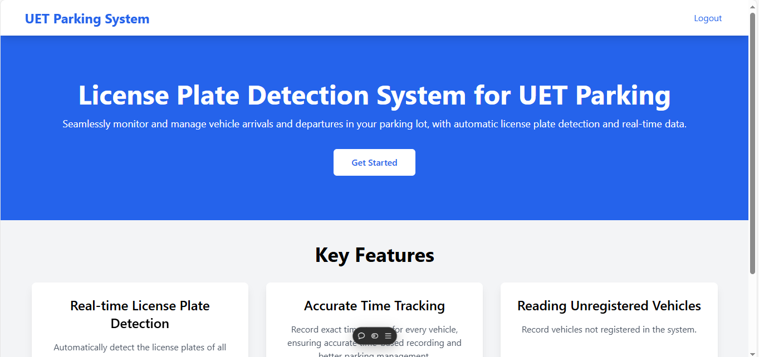
Wireframes (Landing Page)

Slide 9

Wireframes (Login Page)

Slide 10
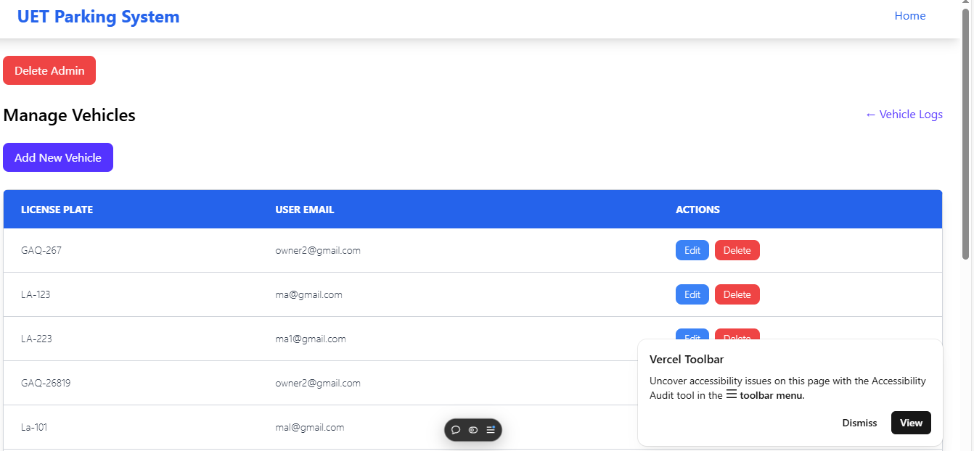
Wireframes (Admin Dashboard)

Slide 11
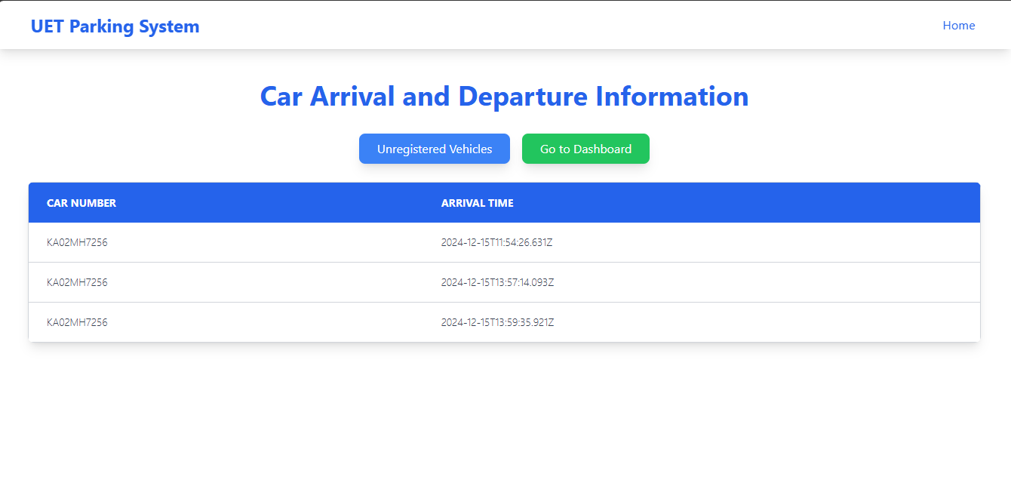
Wireframes (Registered Vehicle Logs)

Slide 12
Conclusion
This project leverages AI to improve efficiency, security, and user convenience in parking monitoring.
Benefits stakeholders with real-time vehicle monitoring.
Improves overall parking management for both administrators and users.
It can be further enhanced to track with real-time video streams.

Slide 13
THANKS!

