Slide 1



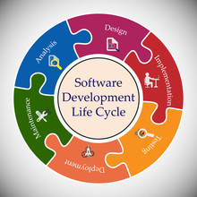


AI-Care Companion
2. System Design
- Determine how the user will interact with the bot (voice or text interaction).
use case
Algorithm design
Planning & Analysis
Defining project objectives and requirements by collecting and analyzing user (patient) requirements. What do they need and how can we make it easier for them?
3. Implementation
Develop language models using GPT.
Develop user interfaces using technologies such as HTML/CSS.
Build databases using SQL .
Implement security features such as encryption.
SDLC
5. Maintenance
Dealing with malfunctions and emergency issues.
Adding new features based on user feedback.
4. Testing
Ensure that the system works as expected by testing each feature individually (unit tests).
This Photo by Unknown Author is licensed under CC BY-SA
This Photo by Unknown Author is licensed under CC BY
This Photo by Unknown Author is licensed under CC BY-SA-NC

