Slide 1
Design of Efficient 4x4 Enhanced Pipeline multiplier Based with Various Optimization Techniques

Slide 2
Team Members:
Mohammed Owda 120089
Mohammad Abu Shams 1200549
Hamza Najar 1192605

Slide 3
TABLE OF CONTENTS
01
02
03
Design History
System Components
Optimization technique

Slide 4
Abstract and Results
Abstract :
We've built a simplified yet advanced 4x4 pipeline multiplier using innovative methods. Our two-stage design not only speeds up calculations but also conserves energy and saves space, outperforming traditional models. This achievement is partly due to an optimized transistor size ratio of 2:1, which we found to balance the inverter's fall and rise times.

Slide 5
Abstract and Results
Result:
Speed: Our design showcases a remarkable increase in speed, thanks to the efficient two-stage structure and optimization techniques.
Power Consumption: The new multiplier consumes significantly less power, demonstrating its environmental friendliness.
Area Efficiency: Despite its high performance, our design occupies a smaller footprint, making it a space-saver.
Test Case: A multiplication of 3 by 2 was accurately computed in just two cycles, emphasizing the efficiency of our approach.

Slide 6
Design History/Comparison of Literatures
Design History
Initial Concepts: Focus on operand fragmentation and power conservation techniques to enhance performance and efficiency.
Development Phase: Incorporation of forward-calculating carry logic for speedy computations.
Optimization: Experimental tuning of PMOS to NMOS transistor size ratio (2:1) for balanced fall and rise times.
Comparison with Existing Literature
Traditional Multipliers: Often limited by slower speeds, higher power consumption, and larger footprints.
Recent Innovations: Mention some advancements and developments that have occurred in the field recently, focusing on power, speed, and area optimization (cite specific works where possible).
Our Contribution: Our design stands apart, thanks to innovative strategies that streamline computations, reduce power consumption, and optimize space usage, as confirmed by direct comparisons with existing models.

Slide 7
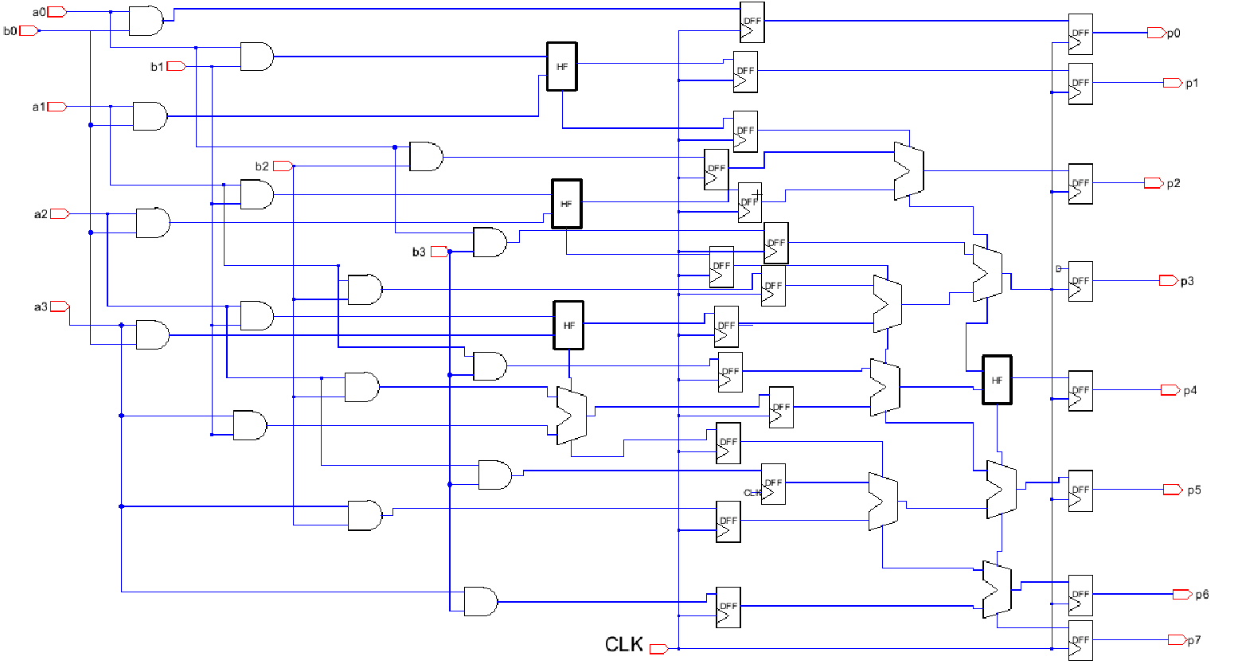
Proposed Design Block Diagram

Slide 8
System Components
01
Circuit schematic, layout, sizing, and simulations

Slide 9
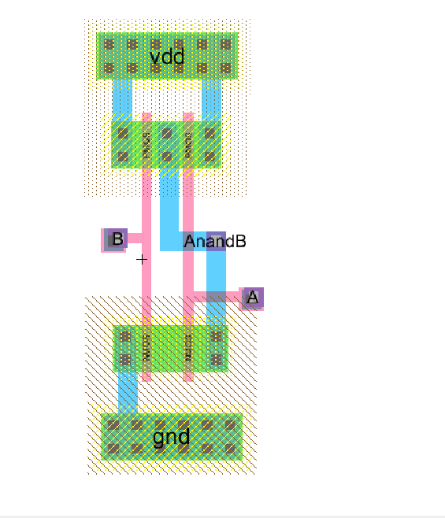
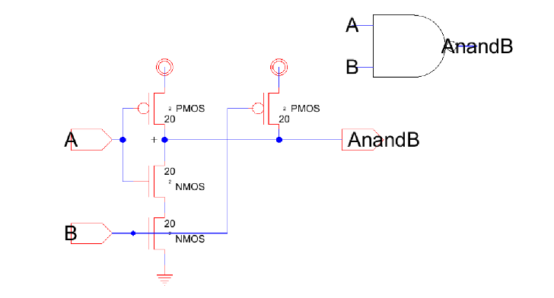
Circuit schematic, layout, and simulations
2-inputs NAND gate
I. schematic
II. Layout

Slide 10
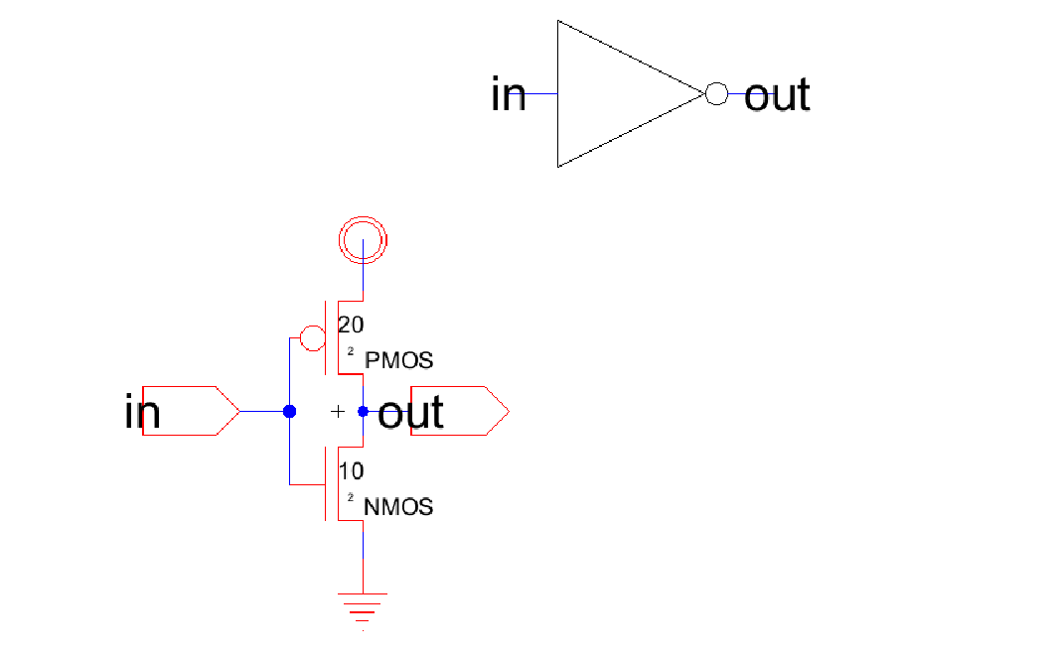
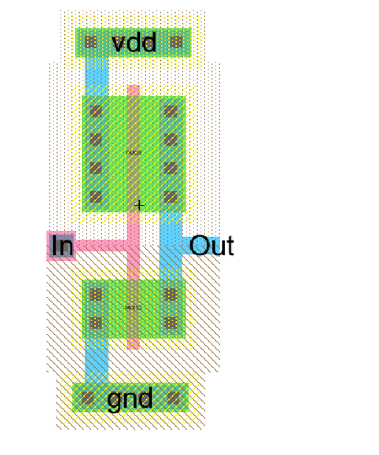
Circuit schematic, layout, and simulations
Inverter
I. schematic
II. Layout

Slide 11
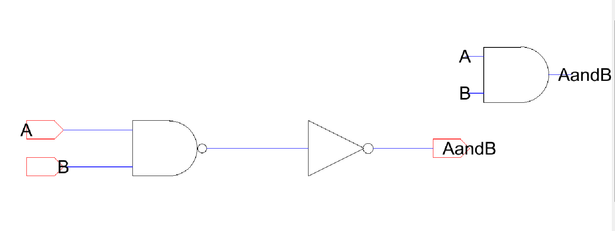
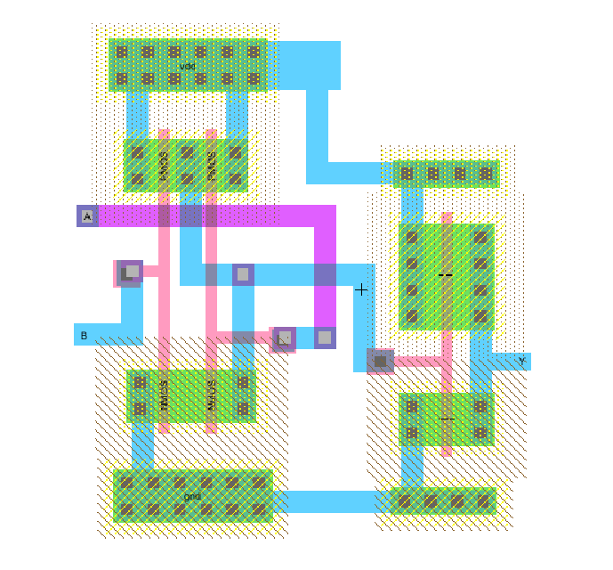
Circuit schematic, layout, and simulations
2- input AND gate
I. schematic
II. Layout

Slide 12
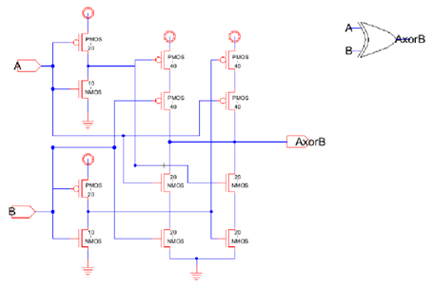
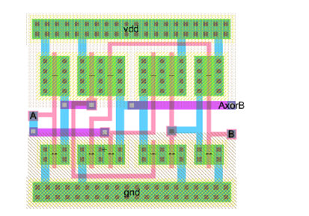
Circuit schematic, layout, and simulations
2-input XOR gate
I. schematic
II. Layout

Slide 13
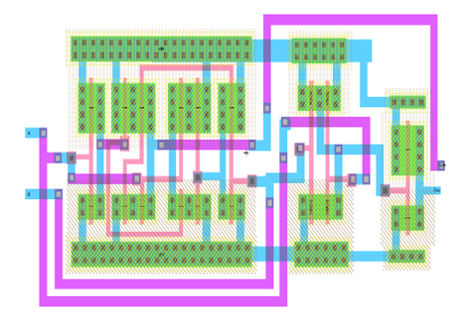
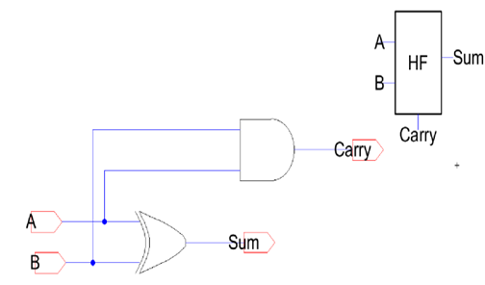
Circuit schematic, layout, and simulations
Half Adder
I. schematic
II. Layout

Slide 14
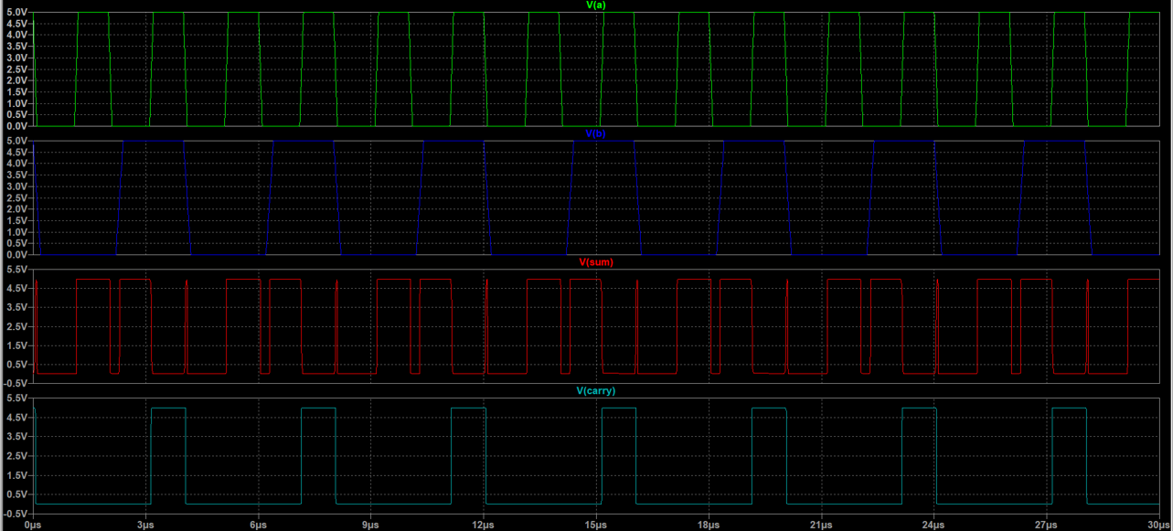
Circuit schematic, layout, and simulations
Half Adder
III. Simulation

Slide 15
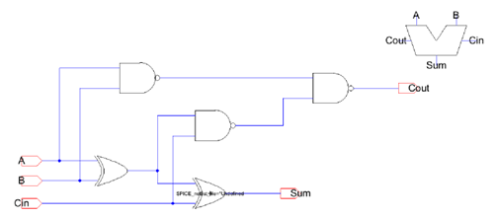
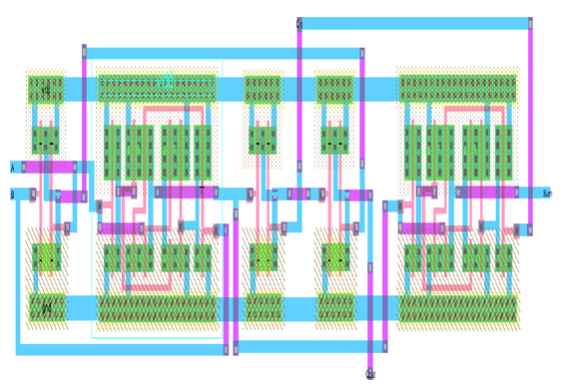
Circuit schematic, layout, and simulations
Full Adder
I. schematic
II. Layout

Slide 16
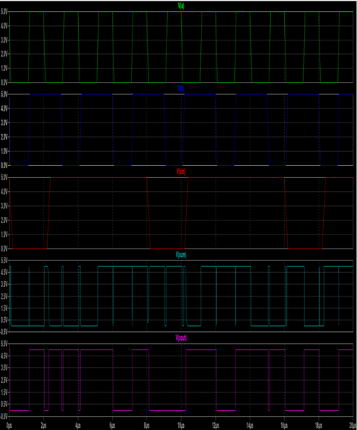
Circuit schematic, layout, and simulations
Full Adder
III. Simulation

Slide 17
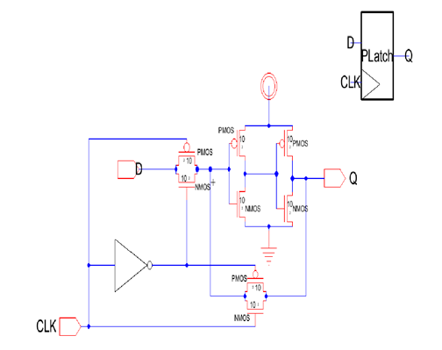
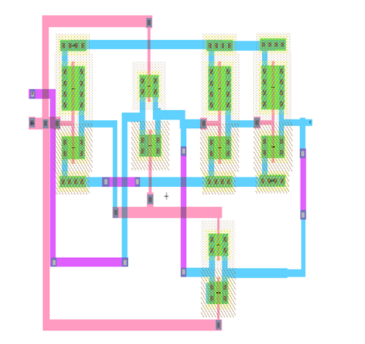
Circuit schematic, layout, and simulations
P Latch
I. schematic
II. Layout

Slide 18
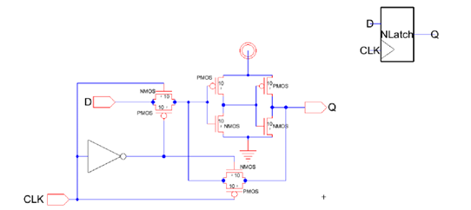
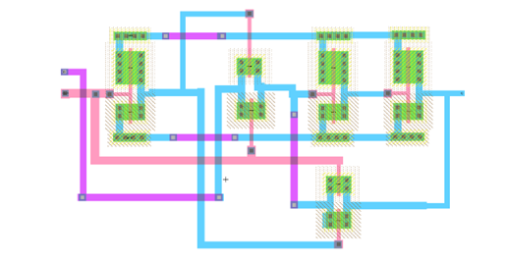
Circuit schematic, layout, and simulations
N Latch
I. schematic
II. Layout

Slide 19
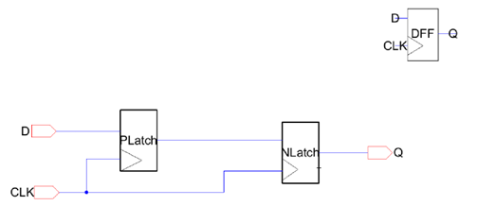
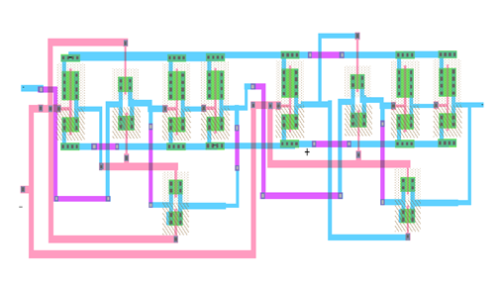
Circuit schematic, layout, and simulations
D-Flip Flop
I. schematic
II. Layout

Slide 20
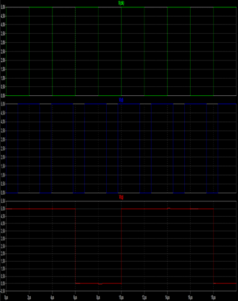
Circuit schematic, layout, and simulations
D-Flip Flop
III. Simulation

Slide 21
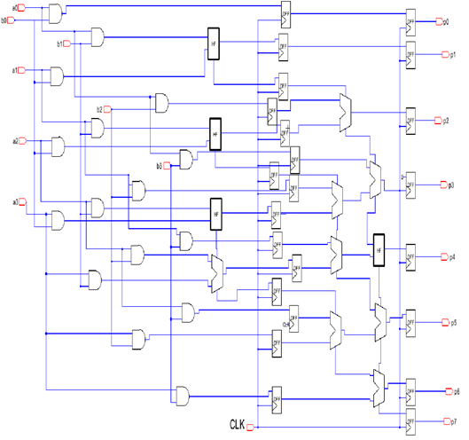
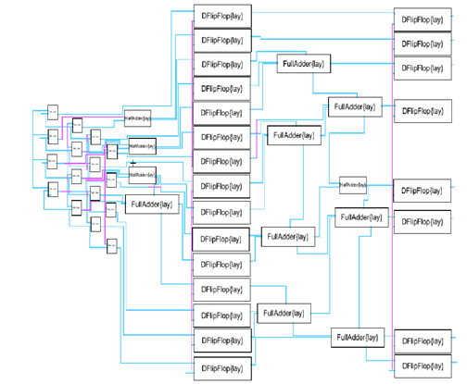
Circuit schematic, layout, and simulations
4x4 Two-stage Pipelined Multiplier
I. schematic
II. Layout

Slide 22
Circuit schematic, layout, and simulations
4x4 Two-stage Pipelined Multiplier
III. Simulation

Slide 23
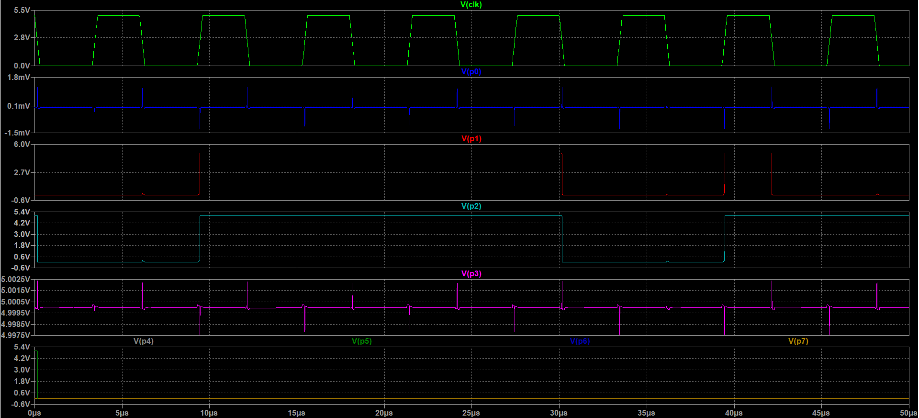
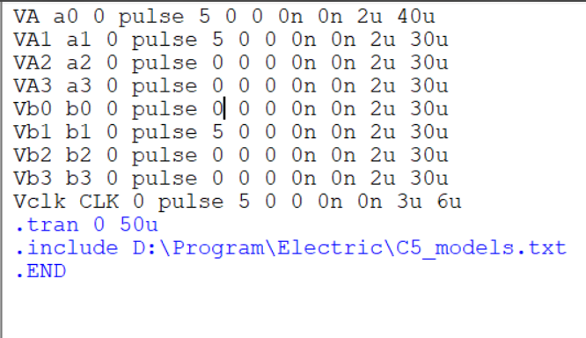
Circuit schematic, layout, and simulations
4x4 Two-stage Pipelined Multiplier
III. Simulation
Inputs:
a = 0011
b = 0010
Output = p = 00000110 = 6 in decimal

Slide 24
Design History/Comparison of Literatures
MARS
VENUS
Despite being red, Mars is a cold place. It’s full of iron oxide dust, which gives the planet its reddish cast
Venus has a beautiful name and is the second planet from the Sun. It’s terribly hot, even hotter than Mercury

Slide 25
Optimization Technique Used
Operand Fragmentation
Adaptive Clock Frequency
Forward-Calculating Carry Logic
Transistor Size Optimization
Layout Efficiency

Slide 26
Optimization Technique Used
Operand Fragmentation
Purpose: To break down complex calculations into simpler parts.
Benefit: Speeds up the computation process significantly, making our design faster than traditional multipliers.
Adaptive Clock Frequency
Purpose: Adjusts clock frequency based on the complexity of the task being performed.
Benefit: Allows for energy conservation while maintaining optimal performance levels, thus lowering power consumption.
Forward-Calculating Carry Logic
Purpose: To eliminate the delays commonly experienced in step-by-step carry computations.
Benefit: Facilitates quicker and more efficient multiplication processes, contributing to the overall speed enhancement of the system.

Slide 27
Optimization Technique Used
Transistor Size Optimization (2:1 PMOS to NMOS)
Purpose: To achieve balanced fall and rise times in the inverter.
Benefit: Enhances the operational efficiency and stability of the multiplier circuit, aiding in power conservation and reducing delay times.
Layout Efficiency
Purpose: Streamlining layout for compact integration.
Benefit: Reduces the space needed on the chip, promoting a more environmentally friendly approach to microelectronics development.

Slide 28
Conclusion
In this venture, we successfully embarked on the creation of a groundbreaking 4x4 pipeline multiplier, which demonstrates substantial improvements in speed, power efficiency, and area utilization compared to traditional multipliers. This project stands as a testament to innovative engineering, leveraging advanced techniques to pave the way for the future of microelectronics.

Slide 29
Summary of Achievements
 | 90-T 4x4 Multiplier 65-nm technology. | Our 4x4 Multiplier 300-nm technology.
Avg Power | 18.156mW | 1.59839mW
Max Power | 0.2267W | 3.147mW
Min Power | 0.6970mW | 49.78uW
Rise Time Delay | 1.3875ns | 1.23ns
Fall Time Delay | 1.2046ns | 1.004ns

Slide 30
Summary of Achievements
Speed
Power
Area

Slide 31
Summary of Achievements
Speed
Reduced Delay: The forward-calculating carry logic and optimized transistor sizes have markedly reduced computation delays, promising quicker data processing.
Two-Stage Pipelined Structure: Ensures faster calculations by breaking down complex computations into simpler, manageable tasks, thereby expediting the overall multiplication process.
Power
Energy Conservation: The adaptive clock frequency strategy has been a cornerstone in ensuring that our multiplier doesn't consume unnecessary power, fostering energy-efficient operations.
Balanced Transistor Sizes: The 2:1 PMOS to NMOS transistor size ratio has been instrumental in achieving a system that harmonizes power consumption with performance, thereby promoting energy conservation.

Slide 32
Summary of Achievements
Area
Compact Design: Through ingenious layout planning, we have managed to design a multiplier that takes up significantly less space on the silicon chip, paving the way for more intricate and multifaceted integrated circuits.
Component Integration: Efficient integration of fundamental components like half-adders, and gates, and full adders, resulting in a compact, yet powerful multiplier setup.

Slide 33
Summary of Achievements
Our project represents not just a technical success, but a step forward in creating more sustainable and efficient electronic devices. It sets a benchmark in the sector, encouraging further innovation and development in the field. The promising test results affirm the potential of our design in revolutionizing the landscape of digital product development in the microelectronics industry.

Slide 34
Thanks

