Slide 1


Mobile&Performance Project Presentation
Document Version: 1
Date: 23 September 2025

Slide 2



Introduction
The Redz app is a location-based social media app that lets you explore trending videos and posts happening around you or in any city you choose. It’s designed to keep you updated on the latest content, hot topics, and real moments shared by people nearby, while also giving you the option to change location and see what’s happening elsewhere. With Redz, you can share your own videos to reach local audiences and discover authentic, relevant content wherever you go.
This Project included some tested functions like:
Requirement 1: User Interaction with Content
Like & Dislike video
Comment on video (Add, Edit, Delete)
Reply to comment
Like comment
Save video
Share video
Requirement 2: User Account Management
Log in (via Data Provider)
Log out
Requirement 3:
Social Features
Follow & Unfollow other users
Send message to other users
Requirement 4: Location & Preferences
Change location
Requirement 5: Content Management
Upload video
Delete video
Requirement 6: Search
& Discovery
Search for content, users
The project follows an Agile approach, with daily iterations. At the end of each day, specific requirements for that iteration will be delivered to the team for validation. The testing process will include Functional Testing to ensure that the workflows mentioned above are working correctly from start to finish.

Slide 3
Function Excluded from test “ Out of Scope”:
Notifications
Explore Page (discover/trending content)
Verified Accounts
Performance Testing
Security Testing
Test Environment & Tools Our testing was conducted in an Android environment using a combination of powerful tools and frameworks. The setup included Eclipse, Appium, Android Studio, UiAutomator2, Emulator, Java, Maven, and Appium Inspector, ensuring robust automation, efficient execution, and comprehensive validation of app performance
Milestones / Deliverables:
Before Testing:
User Stories, Test Plan, Test Cases
During Testing:
Execute Test Cases, Bug Reports, RTM
After Testing:
Test Summary Report

Slide 4
Test Case Design:
A total of 35 test cases were written for the Redz app, covering all major functional areas:
🔹 Location Management (Change location, error handling, network issues)
🔹 Follow / Unfollow (valid users, invalid users, offline scenarios)
🔹 Messaging (send, invalid inputs, offline handling)
🔹 Comments & Replies (add, edit, delete, reply, like/unlike)
🔹 Reels Interactions (like, dislike, save, share, nested replies)
🔹 Authentication (login, logout, invalid credentials, cancel logout)
Execution Result: ✔️ Most test cases passed successfully. ⚠️ A few failures were observed (e.g., incorrect behavior for location content and empty message validation).
Sample of Test Case
Verify message shown when changing location with invalid characters
Status: ✅ Pass
Verify that user can follow another user from their profile page
Status: ✅ Pass
Verify that sending an empty message is prevented and an error is shown
Status:❌ Fail

Slide 5
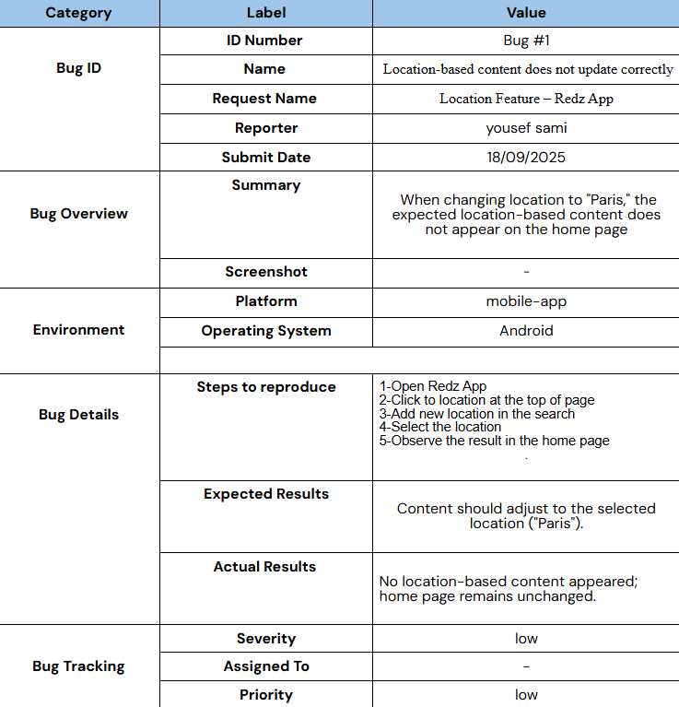
Test Case Execution:
All planned test cases for the Redz app were executed automated across key modules, and results were systematically recorded. A bug report was produced for any failed cases, documenting defects for review and resolution.
During execution of previous test cases , we found “Two bugs”
Sample Of Bugs Found:

Slide 6
Test Closure: All planned test cases for the Redz app have been executed, and results documented. Open issues have been reported, and the testing phase is formally concluded, marking the app ready for the next stage of release or deployment.
Test Summery Report was produced:
 | Test Report
 | Test Cycle | System Test
 | Executed | Passed |  |  | 35
 |  | Failed |  |  | 2
 |  | Total Tests Executed (Passed + Failed) |  |  |  |  | 35
 | Pending
 | In Progress |  |  |  |  |  | 0
 | Blocked |  |  |  |  |  | 0
 | (Sub-Total) Test Planed |  |  |  |  |  | 27
 | [Pending - In Progress - Blocked - Test Executed]
After completing the mobile app testing, we proceeded to conduct performance testing on the Contact List app to evaluate its responsiveness, speed, and stability under various conditions.

Slide 7
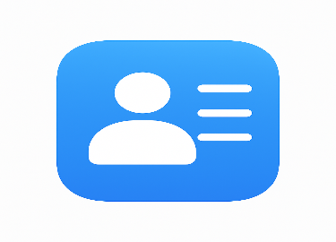
Introduction:
The Contact List app is a user-friendly mobile application that helps you manage, organize, and access your contacts efficiently. It’s designed to keep all your contacts in one place, allowing you to add, edit, search, and categorize them quickly. With the Contact List app, you can call, message, or email contacts directly, and easily import or sync contacts from different sources, making it simple to stay connected wherever you go.
This Project included some tested functions like:
Requirement 1:
POST Add User (create a new user)
Requirement 4: POST Log in User (authenticate user)
Requirement 2:
GET User Profile (retrieve user information)
Requirement 3:
PATCH Update User (update user details)
Requirement 5: POST Log Out User (terminate user session)
Requirement 6: D
ELETE User
(remove a user account)

Slide 8
Function Excluded from test “ Out of Scope”:
UI Testing (API-level only).
Security Penetration Testing
Database performance tuning
Test Environment & Tools
Our performance and functional testing for the Contact List API was conducted using JMeter, configured with HTTP Request Defaults pointing to the test server. This setup included HTTP Request samplers, JSON Extractors, Response Assertions, and HTTP Header Managers, ensuring reliable execution, accurate validation of responses, and comprehensive assessment of API performance under expected load conditions.
Milestones / Deliverables:
Before Testing:
User Stories, Test Plan, Test Cases
During Testing:
Execute Test Cases, Bug Reports, RTM
After Testing:
Test Summary Report

Slide 9
Test Case Design:
A total of 8 test cases were designed for the Contact List API, covering all major functional areas:
🔹 User Registration & Login (register new user, login with correct credentials, login with wrong password) 🔹 Profile Management (get user profile, update user profile, get profile without token) 🔹 Session Management (logout user) 🔹 User Deletion (delete user account)
Execution Result: ✔️ All happy path scenarios passed successfully. ⚠️ Negative or validation scenarios (e.g., login with wrong password, profile access without token) also behaved as expected.
Sample of Test Case
Verify Register New User
Status: ✅ Pass
Verify Login with Wrong Password
Status: ✅ Pass
Verify Login User
Status: ✅ Pass

Slide 10
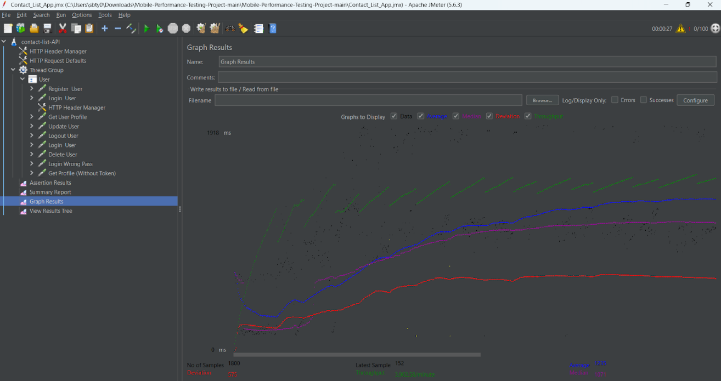
Test Case Execution:
All planned test cases for the contact list app were executed automated across key modules, and results were systematically recorded.
During execution of previous test cases , All test cases was passed
Test Closure: All planned test cases for the the contact list app have been executed, and results documented.
the testing phase is formally concluded, marking the app ready for the next stage of release or deployment.

Slide 11
Closing & Acknowledgments
Thank you for your attention!
On behalf of our entire team, we sincerely appreciate your time and engagement throughout this presentation.
We would also like to recognize and thank the following team members for their outstanding contributions:
Mohammed
Lina
Yousef
Hazem
Their dedication and hard work were crucial to the success of this Mobile app testing project.
We now welcome your questions, comments, or feedback to help us further improve our work.

