Slide 1

OrangeHRM — Automation Testing Project
Prepared by:
Mohammad Saif Lina Mesk
Date: 5/9/2025

Slide 2

Agenda
Application Overview
Testing Process & Plan
Test Implementation & Tools
Test Execution & Results
Test Summary & Next Steps
Team & Contact

Slide 3

Application Details
Human Resource Management System (HRMS) designed to streamline HR tasks across organizations of all sizes. — Admin Capabilities:
Employee Management: Add Employees
Admin Management: Users, Jobs, Pay Grades, Work Shifts
Organization Management: General Info, Locations

Slide 4

Testing Process
Test Plan — Defined scope, schedule, responsibilities, resources
SRS — Captured business & functional requirements
Test Case Design — Functional test cases designed
Test Execution — Selenium WebDriver + Java + TestNG with POM
Test Summary — Reports and recommendations

Slide 5

Test Execution Setup & Tools
Selenium WebDriver + Java + TestNG
Page Object Model (POM)
Maven for build & dependency management
Reporting: TestNG reports, ExtentReports

Slide 6

Test Implementation
Maven project; modular packages per feature (e.g., User_Management_module)
Page Object Model (POM) for reusable locators & methods
TestNG framework with descriptive annotations linked to test cases
Centralized testng.xml to run suites

Slide 7
gf
Total number of bugs we found during execution Test Cases is:5 Bugs!
Admin Module:
When Admin try to add over night shift From: 10:00pm To: 06:00am, system reject it with an error message""Platform: Asus Laptop
BIM Module: When admin add employee with name included 2 chars , the system should reject it
سسس
Sample of Bugs Found

Slide 8
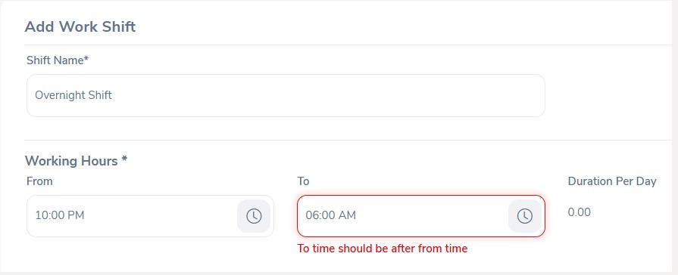
BUG_05

Slide 9
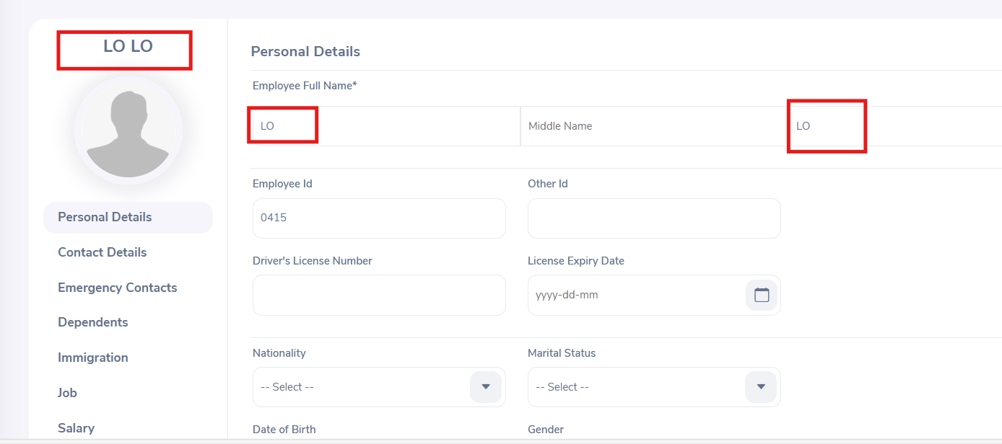
BUG_04

Slide 10
Test Summary Report
Total Executed = 71
Passed= 66
Failed= 5

Slide 11
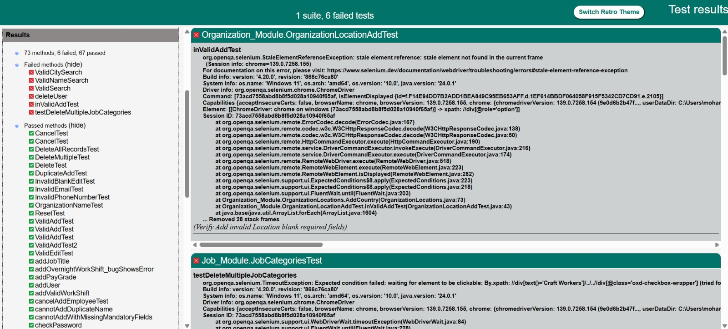
Test Result

Slide 12
Lessons Learned
Start automation early in the project.
Use stable test data.
Keep locators and POM updated as app changes.

Slide 13

Thank You
Any Questions?

