Slide 1
Enhanced particle swarm optimizer incorporating a weighted particle
Mohamad Ahmadi ganjei

Slide 2
Abstract
Optimization
PSO
EPSOWP
Algorithm
Test functions
Results

Slide 3
Optimization Goal
Finds the values of the variables that minimize or maximize the objective function while satisfying the constraint

Slide 4
PSO
Algorithm
Advantages
Disadvantages

Slide 5

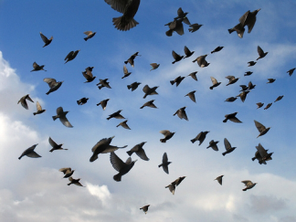
PSO

Slide 6
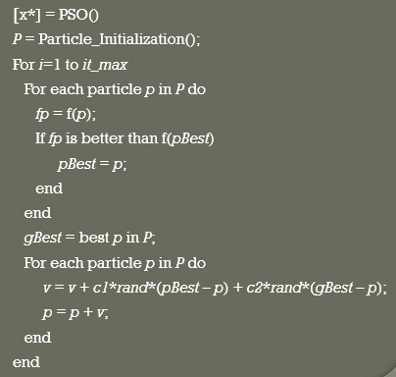
PSO Algorithm

Slide 7
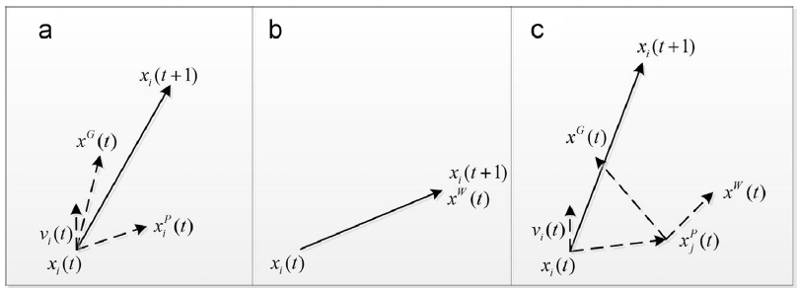
PSO

Slide 8
Advantages
Insensitive to scaling of design variables
Simple implementation
Easily parallelized for concurrent processing
Very few algorithm parameters

Slide 9
Disadvantages
Tendency to a fast and premature convergence in mid optimum points
Slow convergence in refined search stage (weak local search ability)

Slide 10
EPSOWP
Why?
Algorithm

Slide 11
Algorithm
Initialize particles
Do until convergence{
Evaluate particles
Update personal best particles
Calculate weighted particles
Update global best
Update velocity
}

Slide 12
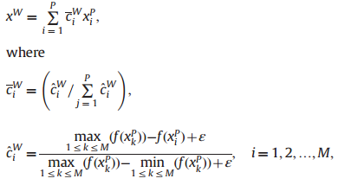
Algorithm

Slide 13
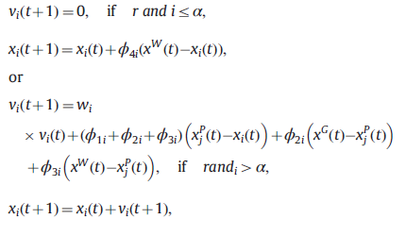

Algorithm

Slide 14
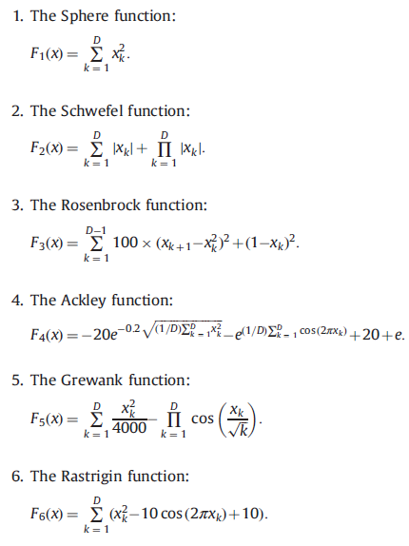
Test Functions

Slide 15
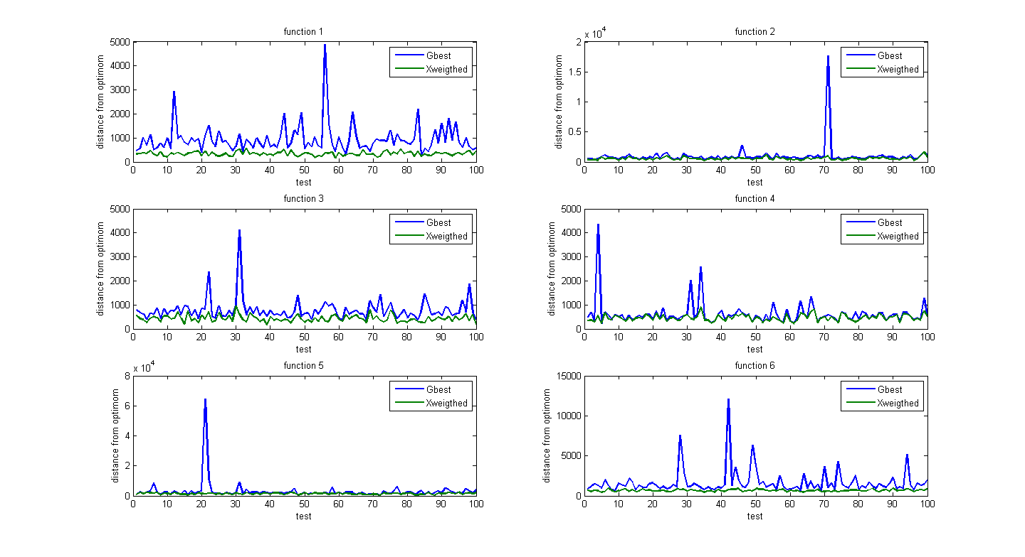
Results

Slide 16
Function |  | 0.2 | 0.3 | 0.4 | 0.5 | 0.6 | 0.7 | 0.8
F1
 | Best | 3.5494e-23 | 3.3354e-24 | 3.1982e-23 | 3.3627e-24 | 2.4652e-23 | 5.3161e-23 | 2.5544e-26
 | Worst | 2.1694e-19 | 6.4307e-20 | 3.9307e-20 | 4.9463e-20 | 2.0058e-19 | 5.3825e-19 | 7.6053e-22
 | Mean | 4.8791e-20 | 1.4632e-20 | 9.5651e-21 | 1.1693e-20 | 4.7441e-20 | 1.0173e-19 | 1.8968e-22
 | Std | 3.6805e-20 | 1.0865e-20 | 7.3582e-21 | 8.8447e-21 | 3.5241e-20 | 7.8356e-20 | 1.4097e-22
F2
 | Best | 7.1411e-23 | 3.6428e-23 | 2.3041e-24 | 5.0994e-24 | 2.6864e-23 | 7.458e-23 | 2.2527e-23
 | Worst | 4.9186e-19 | 1.869e-19 | 1.1199e-19 | 3.5391e-20 | 1.1149e-19 | 3.6259e-19 | 5.2764e-20
 | Mean | 1.0916e-19 | 3.5465e-20 | 2.2887e-20 | 8.2858e-21 | 2.6311e-20 | 7.8924e-20 | 1.0907e-20
 | Std | 8.4969e-20 | 2.6839e-20 | 1.759e-20 | 6.2836e-21 | 1.9739e-20 | 5.8801e-20 | 8.2553e-21
F3
 | Best | 0.00033997 | 7.4305e-14 | 2.6457e-10 | 0.0012996 | 4.9122 | 6.1632 | 6.4426
 | Worst | 2.2877 | 3.6434e-11 | 7.3715e-08 | 4.3595 | 7.9995 | 9.0743 | 9.2862
 | Mean | 0.54803 | 1.453e-11 | 3.1064e-08 | 1.0617 | 6.458 | 7.6427 | 7.8685
 | Std | 0.41879 | 6.0427e-12 | 1.4164e-08 | 0.74771 | 0.49776 | 0.42743 | 0.46422
F4
 | Best | 8.8797e-16 | 8.8781e-16 | 8.8816e-16 | 8.8797e-16 | 8.878e-16 | 8.8802e-16 | 8.8814e-16
 | Worst | 8.884e-16 | 8.8859e-16 | 8.8818e-16 | 8.8837e-16 | 8.8856e-16 | 8.8837e-16 | 8.882e-16
 | Mean | 8.8817e-16 | 8.8817e-16 | 8.8817e-16 | 8.8817e-16 | 8.8817e-16 | 8.8817e-16 | 8.8817e-16
 | Std | 6.3915e-20 | 1.2621e-19 | 2.7976e-21 | 6.2745e-20 | 9.9812e-20 | 4.6027e-20 | 8.2363e-21
F5
 | Best | 3.4253e-05 | 2.3013e-05 | 3.8721e-06 | 3.7323e-05 | 2.5368e-05 | 8.4628e-05 | 0.00017577
 | Worst | 0.20917 | 0.16304 | 0.11901 | 0.17038 | 0.26828 | 0.25824 | 0.8257
 | Mean | 0.052013 | 0.038171 | 0.0271 | 0.044083 | 0.067786 | 0.060804 | 0.21275
 | Std | 0.038704 | 0.028156 | 0.020372 | 0.031703 | 0.050445 | 0.045997 | 0.15627
F6
 | Best | 0.0010791 | 0.00058151 | 0.013599 | 0.0040666 | 0.0010312 | 0.0031756 | 0.0040023
 | Worst | 18.2927 | 16.7391 | 18.8543 | 19.7147 | 19.3193 | 14.2259 | 15.5748
 | Mean | 6.4278 | 5.7202 | 5.8035 | 6.4399 | 5.7213 | 3.6946 | 3.5629
 | Std | 3.6926 | 3.4609 | 3.3479 | 3.6124 | 3.3453 | 2.6825 | 2.6415

Slide 17
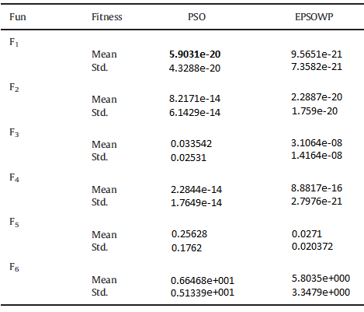
Results

Slide 18
Result
Function | D | Best | Worst | Mean
F1
 | 10 | 0 | 0 | 0
 | 20 | 1.0319e-278 | 5.7243e-274 | 1.226e-274
 | 30 | 5.452e-118 | 2.4718e-114 | 6.4231e-115
F3
 | 10 | 0.00082479 | 5.6005 | 1.4994
 | 20 | 0.00058285 | 7.0406 | 1.7928
 | 30 | 0.00085537 | 31.7404 | 8.1927
F4
 | 10 | 6.5908e-20 | 3.2571e-15 | 7.1561e-16
 | 20 | 1.5641e-20 | 2.9928e-15 | 7.0432e-16
 | 30 | 2.9671e-18 | 3.1632e-15 | 7.3529e-16
F5
 | 10 | 8.3373e-06 | 0.17772 | 0.04684
 | 20 | 0.00022539 | 0.19683 | 0.057639
 | 30 | 7.8045e-05 | 0.33186 | 0.084225
F6
 | 10 | 0.0010345 | 22.5904 | 5.1018
 | 20 | 0.0013269 | 37.048 | 8.8921
 | 30 | 0.0048124 | 23.3423 | 7.0028

Slide 19
References
1 - Enhanced particle swarm optimizer incorporating a weighted particle (Nai-Jen Li , Wen-June Wang)
2 - J. Kennedy, R.C. Eberhart, Particle swarm optimization, in: Proceeding of 1995 IEEE International Conference on Neural Networks, 4 (1995)
3 – slides

