Slide 1
CHAPTER 1
Databases and Database Users
Slide 1- <number>

Slide 2
OUTLINE
Types of Databases and Database Applications
Basic Definitions
Typical DBMS Functionality
Example of a Database (UNIVERSITY)
Main Characteristics of the Database Approach
Types of Database Users
Advantages of Using the Database Approach
Slide 1- <number>

Slide 3
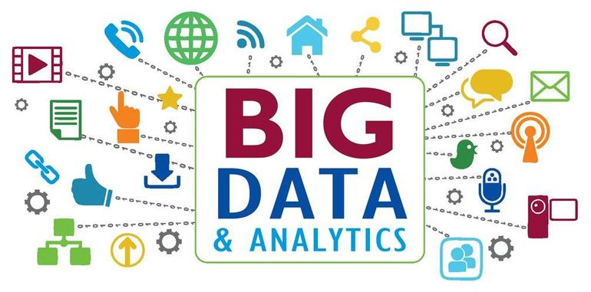
Types of Databases and Database Applications
Traditional Applications:
  Numeric and Textual Databases
More Recent Applications:
  Multimedia Databases
  Geographic Information Systems (GIS)
  Biological and Genome Databases
  Data Warehouses
  Mobile databases
  Real-time and Active Databases
Slide 1- <number>

Slide 4
Recent Developments (1)
Social Networks started capturing a lot of information about people and about communications among people-posts, tweets, photos, videos in systems such as:
- Facebook
- Twitter
- Linked-In
All of the above constitutes data
Search Engines- Google, Bing, Yahoo : collect their own repository of web pages for searching purposes
Slide 1- <number>

Slide 5
Recent Developments (2)
New Technologies are emerging from the so-called non-database software vendors to manage vast amounts of data generated on the web:
Big Data storage systems involving large clusters of distributed computers
NOSQL (Not Only SQL) systems
A large amount of data now resides on the “cloud” which means it is in huge data centers using thousands of machines.
Slide 1- <number>

Slide 6
Basic Definitions
Database:
  A collection of related data.
Data:
  Known facts that can be recorded and have an implicit meaning.
Mini-world:
  Some part of the real world about which data is stored in a database. For example, student grades and transcripts at a university.
Database Management System (DBMS):
  A software package/ system to facilitate the creation and maintenance of a computerized database.
Database System:
  The DBMS software together with the data itself. Sometimes, the applications are also included.
Slide 1- <number>

Slide 7
Impact of Databases and Database Technology
Businesses: Banking, Insurance, Retail, Transportation, Healthcare, Manufacturing
Service Industries: Financial, Real-estate, Legal, Electronic Commerce, Small businesses
Education : Resources for content and Delivery
More recently: Social Networks, Environmental and Scientific Applications, Medicine and Genetics
Personalized Applications: based on smart mobile devices
Slide 1- <number>

Slide 8

Simplified database system environment
Slide 1- <number>

Slide 9
Typical DBMS Functionality
Define a particular database
Construct or Load the initial database contents on a secondary storage medium
Manipulating the database:
  Retrieval, Modification and Accessing the database
Processing and Sharing by a set of concurrent users and application programs
keeping all data valid and consistent
Slide 1- <number>

Slide 10
Application Activities Against a Database
Applications interact with a database by generating
  Queries: that access different parts of data and formulate the result
  Transactions: that may read some data and update generate new data
Applications must not allow unauthorized users
DBMS may additionally provide:
    Protection or Security
    “Active” processing to take internal actions on data
    Presentation and Visualization
    Maintenance of the database and associated programs over the lifetime of the database application
Slide 1- <number>

Slide 11
Example of a Database
(with a Conceptual Data Model)
Mini-world for the example:
  Part of a UNIVERSITY environment.
Some mini-world entities:
  STUDENTs
  COURSEs
  SECTIONs (of COURSEs)
  (academic) DEPARTMENTs
  INSTRUCTORs
Slide 1- <number>

Slide 12
Example of a Database
(with a Conceptual Data Model)
Some mini-world relationships:
  SECTIONs are of specific COURSEs
  STUDENTs take SECTIONs
  COURSEs have prerequisite COURSEs
  INSTRUCTORs teach SECTIONs
  COURSEs are offered by DEPARTMENTs
  STUDENTs major in DEPARTMENTs
Note: The above entities and relationships are typically expressed in a conceptual data model, such as the ENTITY-RELATIONSHIP data model
Slide 1- <number>

Slide 13

Example of a simple database
Slide 1- <number>

Slide 14
Main Characteristics of the Database Approach
Self-describing nature of a database system:
  A DBMS stores the Meta-data description (e.g. structures, types)
  This allows the DBMS to work with different database.
Insulation between programs and data:
  Called program-data independence.
Data Abstraction:
  A data model - hides storage details and - present the users with a conceptual view of the database.
Support of multiple views of the data:
  Each user may see a different view of the database that describes the data of interest to that user.
Sharing of data and multi-user transaction processing:
Slide 1- <number>

Slide 15

Example of a simplified database catalog
Slide 1- <number>

Slide 16

Database Users
Users may be divided into
  Actors on the Scene: Those who actually use and control the database content
  Workers Behind the Scene : Those who design and develop the DBMS
Slide 1- <number>

Slide 17
Database Users – Actors on the Scene
Actors on the scene
  Database administrators:
    Responsible for authorizing access to the database, for coordinating and monitoring its use, controlling its use and monitoring efficiency of operations
  Database Designers:
    Responsible to define the content, the structure, the constraints, and functions or transactions against the database.
  End-users: They use the data for queries, reports and some of them update the database content.
  System Analysts and Application Developers
    System Analysts: They understand the user requirements
    Application Programmers: Implement the specifications developed by analysts and test deployment.
    Business Analysts: analyze vast amounts of business data and real-time data (“Big Data”) for better decision making related to planning, advertising, marketing etc.
Slide 1- <number>

Slide 18
Database Users – Actors behind the Scene
  System Designers and Implementors: Design and implement DBMS packages in the form of modules and interfaces and test and debug them.
  Tool Developers: Design and implement tools for modeling and designing databases, performance monitoring, simulation etc. that facilitate building of applications and allow using database effectively.
  Operators and Maintenance Personnel: They manage the actual running and maintenance of the database system hardware and software environment.
Slide 1- <number>

Slide 19
Advantages of Using the Database Approach
Controlling redundancy in data storage
Sharing of data among multiple users.
Restricting unauthorized access to data.
Providing persistent storage for program Objects
Providing Storage Structures (e.g. indexes) for efficient Query Processing
Providing optimization of queries for efficient processing.
Providing backup and recovery services.
Providing multiple interfaces to different classes of users.
Representing complex relationships among data.
Enforcing integrity constraints on the database.
Drawing inferences and actions from the stored data using deductive and active rules and triggers.
Slide 1- <number>

Slide 20
Chapter Summary
Types of Databases and Database Applications
Basic Definitions
Typical DBMS Functionality
Example of a Database (UNIVERSITY)
Main Characteristics of the Database Approach
Types of Database Users
Advantages of Using the Database Approach
Slide 1- <number>

