Slide 1
A Short Introduction
To ngrok SetUp

Slide 2
ngrok Tunneling (Turn Your Machine into a Public Server)
If you want to host the app directly from your computer but still give people all over the world access to it, you can tunnel your local port to a public URL.

Slide 3
Go to ngrok and create a free account to get an auth token.
Download and install ngrok on your computer.
Run your Streamlit app locally in your terminal:
Bash
> streamlit run app.py
5) Open a second terminal window and run:
> ngrok http 8501
ngrok will immediately generate a public URL (e.g., https://ngrok-free.app).
Anyone clicking that link can view the app running on your computer.

Slide 4
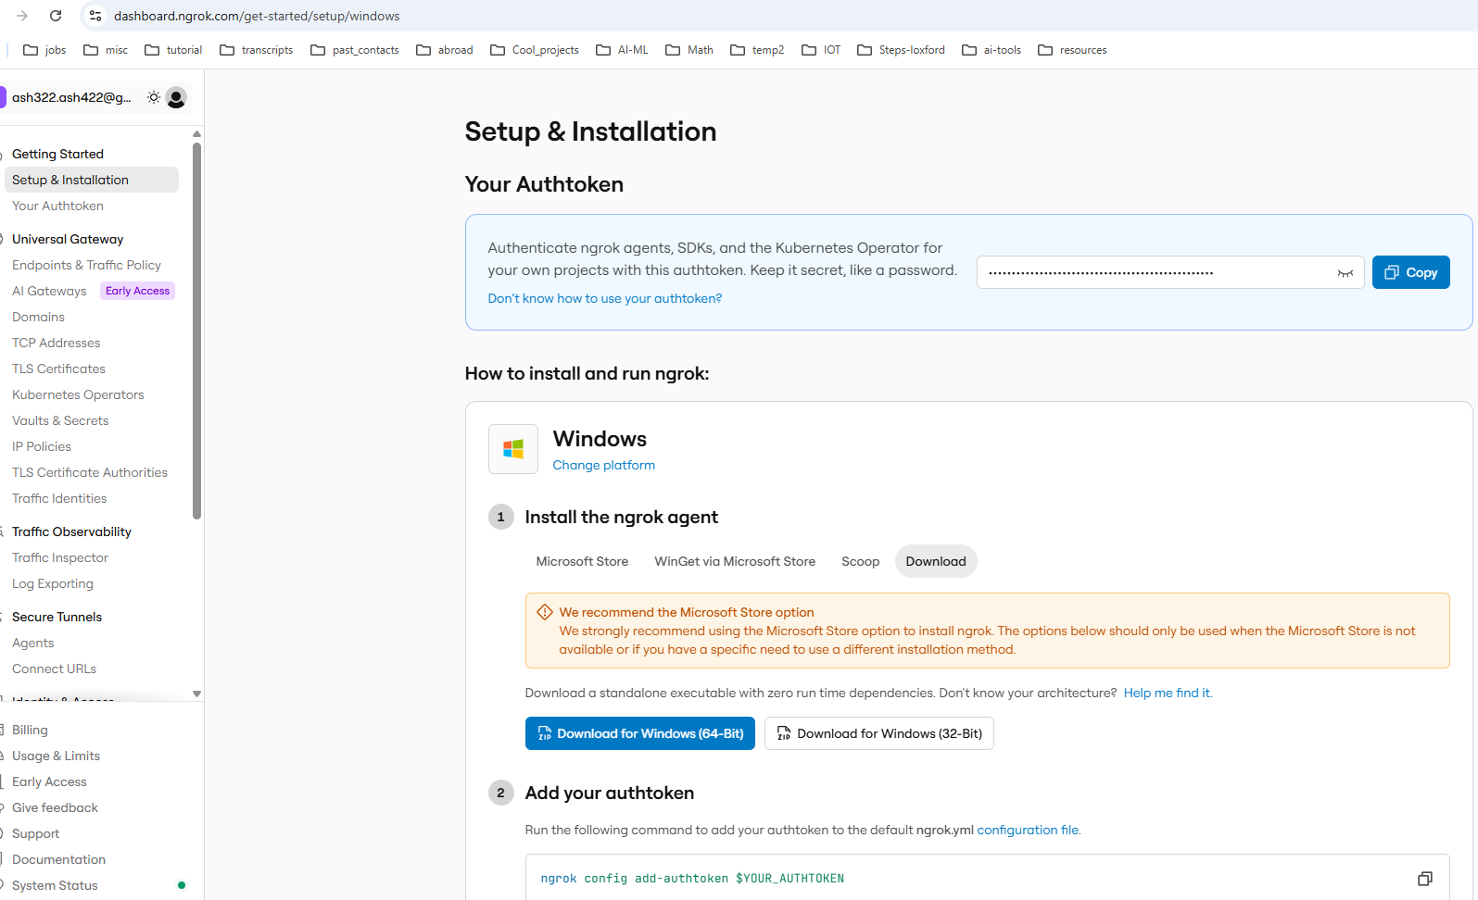










Slide 5
