Slide 1


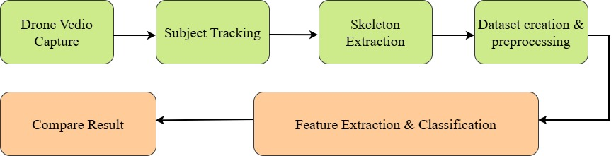
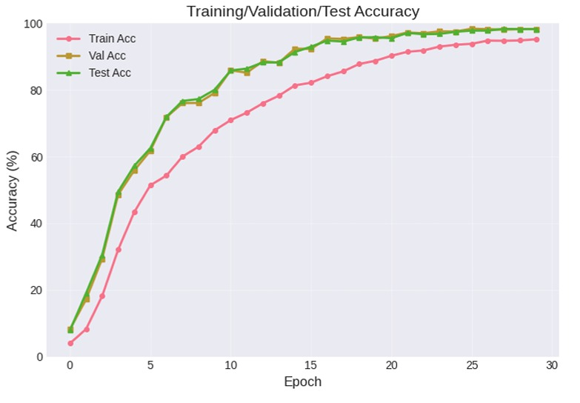
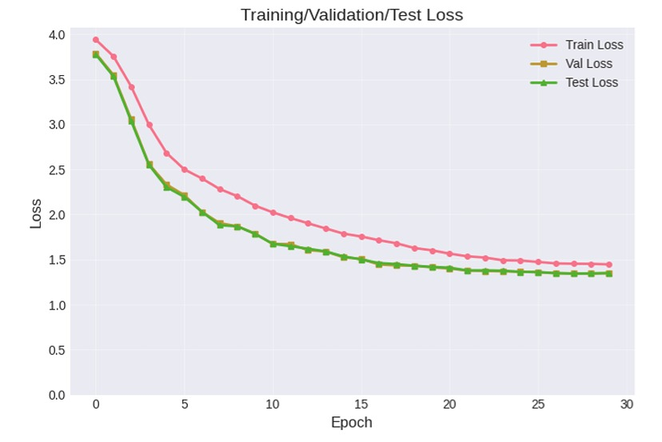
Paper ID: 2342
Paper Title :EfficientNet-B0 for Drone-Based Skeleton Gait Recognition: A Robust Framework for Aerial Person Identification
Authors Name: Mohammad Ali Sakib , Samia Khondoker , Maisha Mobashira , Rafiur Rahaman , Nakib Aman , Md. Abu Johab
Abstract & Introduction
Methodology
Results
97.79% test accuracy · 99.71% Top-3 · 99.86% Top-5 ROC AUC: 1.0000, perfect class separability across all 50 subjects
Per-Class Performance Precision 97.77% · Recall 97.55% · F1-Score 97.59%
Confidence Calibration Correct predictions 85.36% vs incorrect 45.25%, gap of 40.11%
Model Comparison EfficientNet-B0 (97.8%) · ResNet-50 (96.9%) · DenseNet-121 (91.2%) · MobileNet V3 Large (85.2%)
Abstract: This paper introduces a robust person identification system based on skeleton gait recognition from drone-captured videos. Using a custom dataset of 9,343 skeletal images from 50 subjects, we fine-tuned an EfficientNet-B0 model optimized for real-world conditions. The system achieves 97.8% accuracy, 97.6% precision, and 97.8% recall, demonstrating strong performance even in challenging environments. Our model’s effectiveness is validated through precision-recall and ROC curves, making it suitable for privacy-preserving aerial surveillance.
Introduction: Aerial drone surveillance faces challenges in person identification due to occlusion, distance, and viewpoint changes. Traditional biometrics, like facial recognition, struggle in these conditions. Skeleton-based gait recognition offers a privacy-preserving solution by utilizing unique movement patterns for identification. This work aims to enhance identification accuracy in drone surveillance by improving viewpoint invariance and generalization across diverse conditions..
Dataset & Architecture
9,343 skeleton images from 50 subjects, drone-captured on a university campus. Skeletons extracted using MediaPipe Pose (33 landmarks/frame) — background removed for privacy. Split: 70% train · 15% val · 15% test
Preprocessing: Resize to 224×224 · ImageNet normalization
Augmentation (train only) Random crop · Flip · Rotation · Brightness/contrast jitter · Affine · Gaussian blur · Random erasing
Architecture
EfficientNet-B0 pretrained on ImageNet, with a custom 3-stage classifier head. Backbone early layers frozen; deeper layers fine-tuned for skeleton-specific patterns.
Classifier Head FC(1280→512) · FC(512→256) · FC(256→50 classes) Dropout (0.5 / 0.3 / 0.2) · BatchNorm · ReLU at each stage
Feature Flow 7 MBConv blocks → 7×7×1280 → Global Avg Pooling → Classifier
Related Work
Gait recognition methods degrade under viewpoint changes and outdoor conditions. Skeleton-based approaches offer privacy preservation but struggle to generalize beyond lab environments. This work addresses these gaps with a diverse drone-captured dataset and EfficientNet-B0.
Objectives
Conclusion & Future Work
Address the performance gap between controlled lab gait recognition and real-world aerial conditions.
Build a privacy-preserving biometric system using skeleton stickman representations extracted from drone footage.
Propose a fine-tuned EfficientNet-B0 model with custom
multi-layer classifier optimized for 50-subject skeleton identification.
Provide a comprehensive evaluation protocol beyond standard accuracy: ROC, Precision-Recall, confidence calibration, and confusion matrix analysis.
Result
Conclusion & Future Work
A drone-optimized, privacy-preserving person identification system using skeleton gait and EfficientNet-B0, achieving 97.8% accuracy under real-world aerial conditions without compromising subject privacy.
Limitations: Single-dataset evaluation · No extreme viewpoint handling · Weather/lighting not controlled
Future Work Cross-dataset validation · Multi-modal fusion (RGB + skeleton + optical flow) Edge deployment optimization · Self-supervised pre-training · View-invariant modules
References
2026 IEEE International Conference on Quantum Photonics, Artificial Intelligence, and Networking

