Slide 1



International Conference on Power, Electronics, Communications, Computing, and Intelligent Infrastructure 2026 (PECCII 2026)
Paper ID – 764
A Deep Learning Framework for Skeleton-Based
Gender Recognition from Drone Videos
Mohammad Ali Sakib, Rafiu Mollick, Md Redwan Hussain, Md. Zillur Rahaman, Md. Abdullah Al Mahim, Nakib Aman
Presented by Mohammad Ali Sakib (1st Author & Presenter)
Dept. of Computer Science & Engineering, Pabna University of Science and Technology, Pabna-6600, Bangladesh
17–18 June 2026

Slide 2
Table of Contents
01
Introduction & Motivation
08
Results — Precision-Recall & ROC Curves
02
Literature Review
09
Comparison with Existing Methods
03
Methodology & System Workflow
10
Limitations
04
Model Architecture
11
Future Work
05
Results — Classification Performance
12
References
06
Results — Confusion Matrix
13
Conclusion
07
Results — Training Curves (Accuracy & Loss)

Slide 3
Introduction & Motivation
🚶 Gait-Based Recognition
🚁 Drone-Based Approach
🦴 Skeleton Representation
Gait can be captured remotely without subject cooperation — ideal for surveillance, security, and healthcare monitoring.
Traditional cameras miss top-down/oblique views. Drones enable open-area aerial gait capture — a novel contribution.
Skeleton-based processing reduces effects of lighting, background, and clothing — preserving only movement and joint dynamics.
🎯 Goal: Classify gender from drone-captured aerial gait video using EfficientNet-B0 on skeleton stickman images

Slide 4
Literature Review — Summary of Existing Methods
Ref. | Citation | Method | Accuracy
[6] | Kumar & Verma (2024) | CNN + LSVM | NR
[7] | Yu et al. (2009) | Static + Dynamic Gait Features | ~90%
[9] | Kwon & Lee (2021) | Joint Swing Energy Model | 93–95%
[10] | Choi et al. (2019) | Frame-level Skeleton Matching | >95%
[11] | Ahmed & Sabir (2017) | Kinect Gait Features | ~90%
[12] | Alrashed & Inan (2023) | Modified CNN + Face Segmentation | ~97%
[15] | Nutakki et al. (2018) | Torque Analysis + ML | NR
🎯 Our Research Gap & Focus: All existing methods use ground-based, frontal/lateral-view data (CASIA-B, Kinect, GEI) with controlled conditions. None address top-down/oblique aerial gait captured by drones — our work targets this gap by combining skeleton-based privacy-preserving extraction with drone-specific challenges (altitude, motion, outdoor lighting).

Slide 5
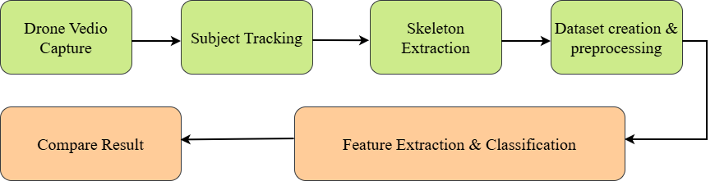
Methodology & System Workflow
1
Data Collection
System Workflow
Drone videos at PUST campus. 4,680 skeleton images labeled male/female.
2
Skeleton Extraction
MediaPipe Pose: 33 landmarks/frame → color-coded stickman images.
3
Preprocessing
Resize 224×224px, normalize. Augment: flip, rotate ±15°, color jitter, affine.
🔒 Privacy-Preserving Pipeline
4
Dataset Split
Background removed → skeleton only
No facial or personal identity data retained
Privacy-safe surveillance application
Stratified: 70% Train / 15% Validation / 15% Test.

Slide 6
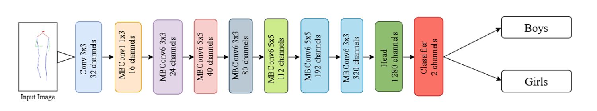
Model Architecture — EfficientNet-B0
ŷ = σ( W · D( f_EfficientB0(X) ) + b )
Optimizer
Batch Size
AdamW
32
LR Scheduler
Epochs
Cosine Annealing
30
Label Smoothing
Classes
0.1
Boys / Girls

Slide 7
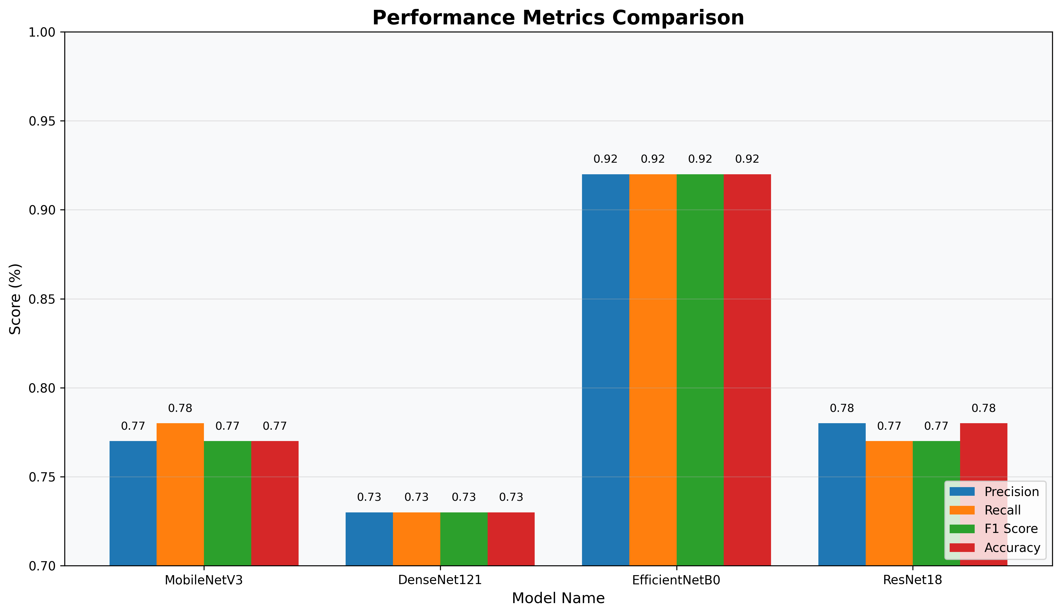
Results — Classification Performance
Class | Precision | Recall | F1-Score | Support
Boys | 0.93 | 0.92 | 0.92 | 372
Girls | 0.91 | 0.92 | 0.91 | 330
Overall | 0.92 | 0.92 | 0.92 | 702
Key Takeaways
✅ EfficientNet-B0: 92% across all metrics
📊 MobileNetV3 & ResNet18: ~77–78%
📉 DenseNet121: only 73%
🏆 EfficientNet-B0 clearly outperforms all baselines

Slide 8
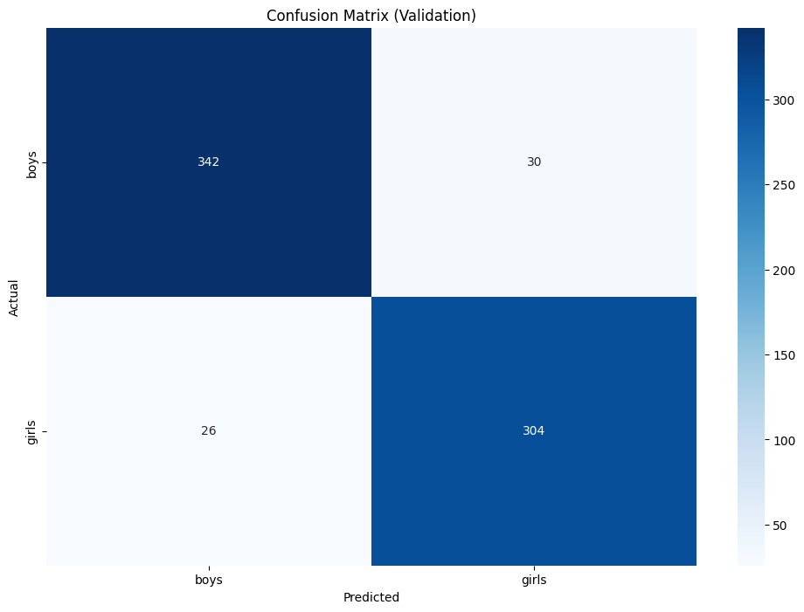
Results — Confusion Matrix
📊 Key Observations
✅ 342 / 372 boys correctly classified (91.9%)
✅ 304 / 330 girls correctly classified (92.1%)
🔵 Only 30 boys misclassified as girls (8.1%)
🔵 Only 26 girls misclassified as boys (7.9%)
⚖️ Balanced — model not biased toward either class
💡 Large diagonal values confirm strong skeleton feature discrimination

Slide 9
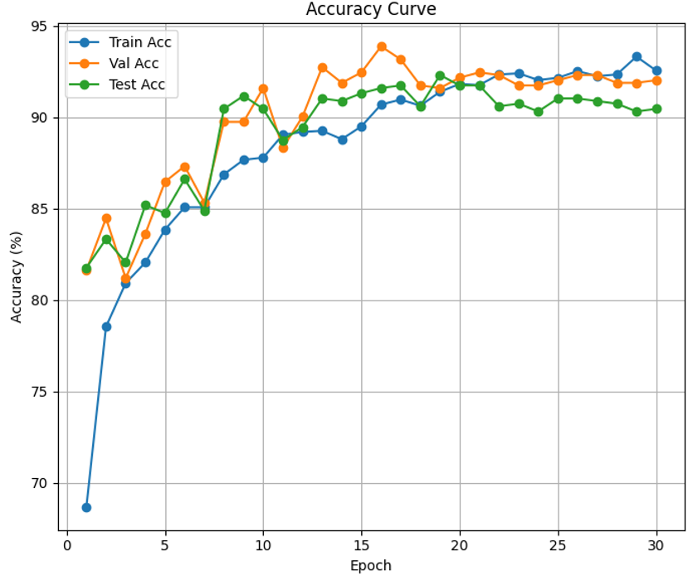
Results — Training & Validation Accuracy
📈 Key Observations
🚀 Starts ~69%, rises steeply in first 10 epochs
📊 Converges above 92% from epoch 15 onwards
🔗 Train, Val & Test curves closely aligned — minimal overfitting
🎯 Consistent test accuracy proves strong generalization
⚙️ Cosine Annealing LR ensures smooth convergence

Slide 10
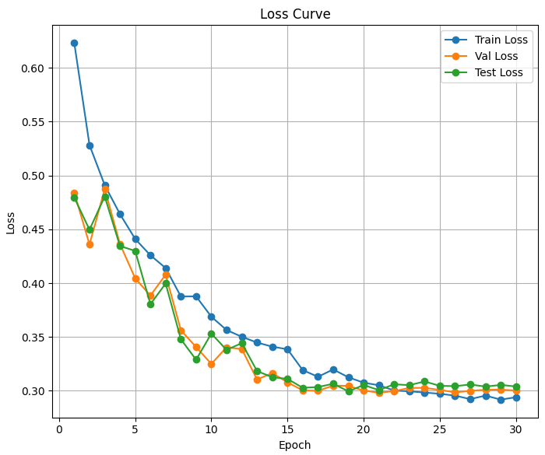
Results — Training Loss Curve
📉 Key Observations
📉 Loss drops from ~0.62 to ~0.30 — continuous healthy decline
🔗 Train, Val & Test loss converge — no divergence
⚖️ Final convergence at ~0.30 for all splits
🛡️ Label smoothing (0.1) prevents overconfidence and loss spikes
✅ Smooth decline confirms stable optimization

Slide 11
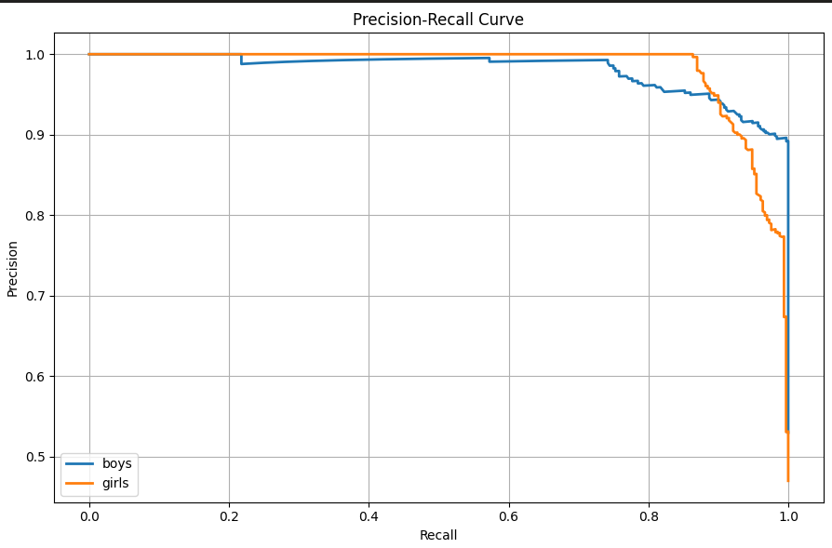
Results — Precision-Recall Curve
🎯 Key Observations
📈 High precision at most recall levels (>0.90) for both classes
👦 Boys: more stable PR curve
👧 Girls: slight precision drop at very high recall — acceptable
⚖️ No severe class imbalance or disproportionate misclassification
✅ Properly calibrated — reliable trade-off at all thresholds

Slide 12
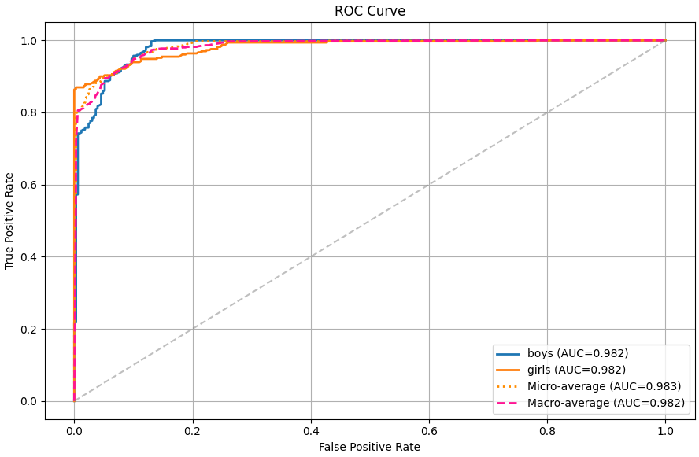
Results — ROC Curve
🏆 Key Observations
🌟 AUC = 0.982 for both Boys and Girls — near-perfect
📊 Micro-avg AUC = 0.983, Macro-avg = 0.982
↗️ Curves hug upper-left — high TPR with very low FPR
⚖️ Minimal gap between classes — no decision boundary bias
✅ Reliable across diverse thresholds — ready for real-world use

Slide 13
Comparison with Existing Methods
Method | Dataset | Approach | Accuracy
Kitchat et al. (2019) | Silhouette Gait | CNN Silhouette | 90.74%
Bekhouch et al. (2025) | Skeleton Gait | Skeleton + ML | 95.19%
Sun et al. (2019) | GEI-Based | Two-Stream CNN | 91.8%
Kumar & Verma (2024) | Public Gait | CNN + LSVM | 94.5%
Proposed (Ours) | Drone-Based (Custom) | EfficientNet-B0 | 92% ★
★ Our model achieves 92% on challenging drone-captured aerial footage — no existing benchmark contains this data type

Slide 14
Limitations
📍
Single-Environment Dataset
Data collected only at PUST campus — limited demographic and environmental diversity may reduce generalization to other settings.
📐
2D Pose Estimation Only
MediaPipe extracts 2D landmarks. Depth information is not captured, limiting the richness of skeletal features.
🚁
Drone-Specific Challenges
Aerial perspective, varying altitudes, camera movement, smaller subject scale, and outdoor lighting affect skeleton extraction quality.
⚧️
Binary Classification
The current system only distinguishes male vs. female. Non-binary or multi-class identity scenarios are not addressed.
🌐
Limited Cross-Domain Generalization
The model was not tested on established benchmark datasets (CASIA-B, OULP), making direct comparison challenging.

Slide 15
Future Work
📦
Expand Dataset
Collect drone footage from diverse campuses, cities, and demographics to improve robustness and generalizability.
🧠
3D Pose & Temporal Modeling
Incorporate 3D skeleton data and temporal sequence models (LSTM, Transformer) to capture motion dynamics over time.
📡
Real-Time Drone Integration
Deploy the model onboard drones for real-time inference — enabling live surveillance and crowd monitoring applications.
🔗
Multi-Modal Fusion
Combine inertial sensor data (accelerometer/gyroscope) with visual skeleton features for richer gait representation.
🌍
Broader Human Analysis
Extend beyond binary gender — incorporate age estimation, gait-based identity recognition, and activity detection.

Slide 16
References
[1] M. Azhar et al., "A gait-based real-time gender classification system," Sensors, vol. 22, no. 23, 2022.
[7] S. Yu et al., "A study on gait-based gender classification," IEEE Trans. Image Processing, 2009.
[2] K. Kitchat et al., "Gender classification from gait silhouette using GEIs," IEEE CIS & RAM, 2019.
[9] B. Kwon & S. Lee, "Joint swing energy for skeleton-based gender classification," IEEE Access, 2021.
[3] A. Bekhouch et al., "Few skeleton features for gait-based gender recognition," IEEE IPAS, 2025.
[10] S. Choi et al., "Skeleton-based gait recognition via robust frame-level matching," IEEE Trans. IFS, 2019.
[4] R. Delgado-Escano et al., "Multi-task and fusion CNN for inertial-based gait recognition," IEEE Access, 2018.
[12] A. Alrashed & T. Inan, "Age and gender detection by face segmentation and modified CNN," HORA, 2023.
[5] B. Sun et al., "Gender recognition via fused silhouette features," IEEE Sensors Journal, 2019.
[15] C. Nutakki et al., "Torque analysis of male-female gait using ML," ICACCI, 2018.
[6] D. Kumar & R. Verma, "Walking patterns and gender: CNN+LSVM framework," CYBERCOM, 2024.
Full reference list available in the conference paper — PECCII 2026, PUST, Pabna, Bangladesh

Slide 17
Conclusion
🦴 First work applying skeleton gait analysis to drone-captured aerial footage
🎯 EfficientNet-B0 achieved 92% accuracy — outperforming CNN, MobileNetV3, ResNet18, DenseNet121
📡 MediaPipe-based privacy-preserving extraction — no personal identity data retained
🌍 Applicable to surveillance, crowd analytics & biometric intelligence
🔮 Foundation for future multi-modal, real-time drone-based human analysis

Slide 18
Thank You!
A Deep Learning Framework for Skeleton-Based Gender Recognition from Drone Videos
Presenter
Mohammad Ali Sakib
Dept. of CSE, Pabna University of Science and Technology
📧 sakib.cse04@gmail.com
PECCII 2026 • 17–18 June 2026 • PUST, Pabna, Bangladesh

Slide 19
Any Questions?
92%
0.982
4,680
Accuracy
AUC Score
Dataset Size
Feel free to ask about the methodology, dataset, model, or results!
Mohammad Ali Sakib | sakib.cse04@gmail.com

