Slide 1



2nd Undergraduate Conference on Intelligent Computing and Systems (UCICS 2026)
HOSTED BY: Varendra University, Rajshahi, Bangladesh
17-18 January, 2026
Paper ID:
Paper Title :
075
Elevated View Gait Biometrics: Efficient Skeleton-Based Recognition Using UAV Captured Videos.
Mohammad Ali Sakib
Department of CSE
Pabna University of Science and Technology
Pabna, Bangladesh

Slide 2
Outlines :
Motivation & Problem Statement
Literature Review
Dataset Overview
Methodology
Proposed Work
Results and Discussion
Limitations & Future Directions

Slide 3
Motivation & Problem Statement
Why do we do this?
We need a contact-free way to identify people
Gait (walking style) can be seen from far away
UAVs (drones) are widely used for surveillance
What are the challenges?
Drone videos are taken from high and different angles
People appear small and unclear
Background, shadows, and clothing affect accuracy
Our solution
Use skeleton (stickman) images instead of raw videos
Apply efficient deep learning models
Use Grad-CAM to understand what the model learns

Slide 4
RELATED WORK / LITERATURE REVIEW
Limitations of Existing Works
Traditional datasets: low camera angles
Appearance-based methods: background sensitive
Heavy models: not suitable for edge/UAV deployment
Main Research Gap : Efficient & explainable skeleton-based gait recognition from aerial views.

Slide 5
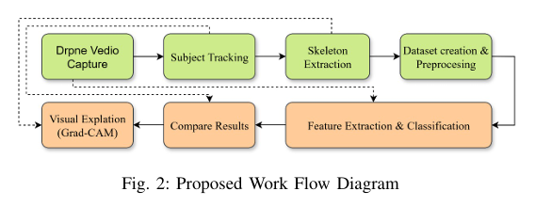
METHODOLOGY
Overall Pipeline
UAV video input
Pose estimation (stickman)
Deep learning model
Classification + Explainability

Slide 6
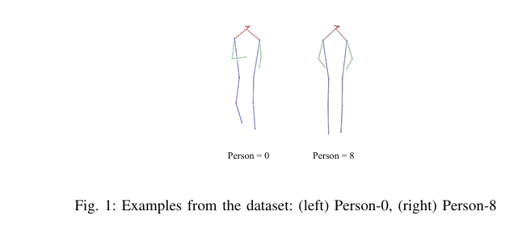
Dataset Overview :
DroneGait Dataset
13 subjects
UAV-captured outdoor videos
High elevation & multiple angles
Skeleton keypoints extracted

Slide 7
Data Preprocessing :
Subject-wise split (no data leakage)
Resize: 224 × 224
Normalization
Data augmentation (train only)

Slide 8
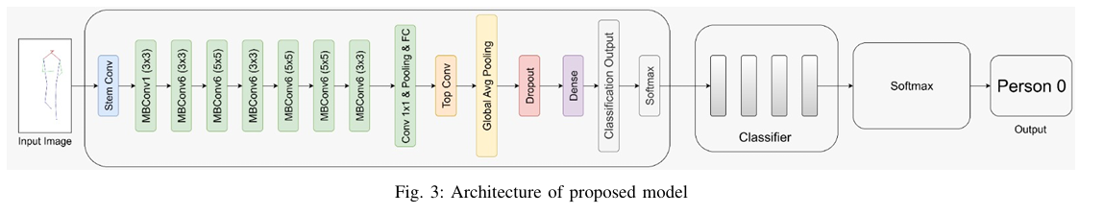
Deep Learning Models Used :
Models Evaluated
MobileNetV3 (lightweight)
ResNet-50 (deep CNN)
Vision Transformer (global attention)
EfficientNet-B3 (proposed)
Why EfficientNet-B3?
Key Advantages
Balanced depth, width & resolution
Lightweight yet powerful
Suitable for resource-constrained UAV systems

Slide 9
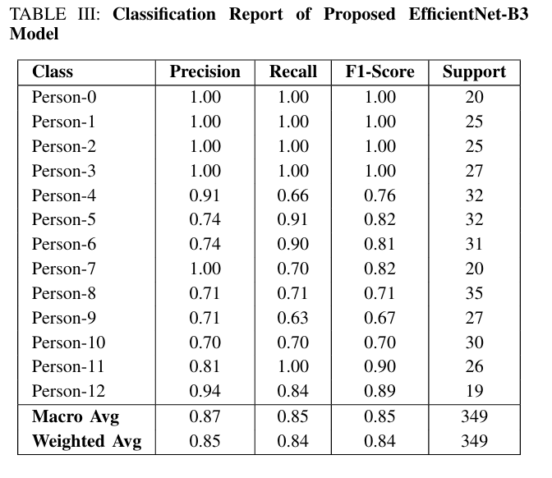
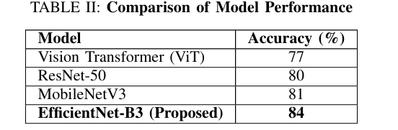
Performance Comparison

Slide 10
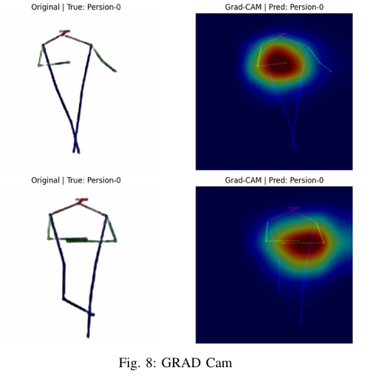
Explainable AI (Grad-CAM)
Why Explainability?
Trustworthy biometric decisions
Visual understanding of predictions
Grad-CAM Highlights
Focuses on upper body joints
Confirms meaningful gait patterns

Slide 11
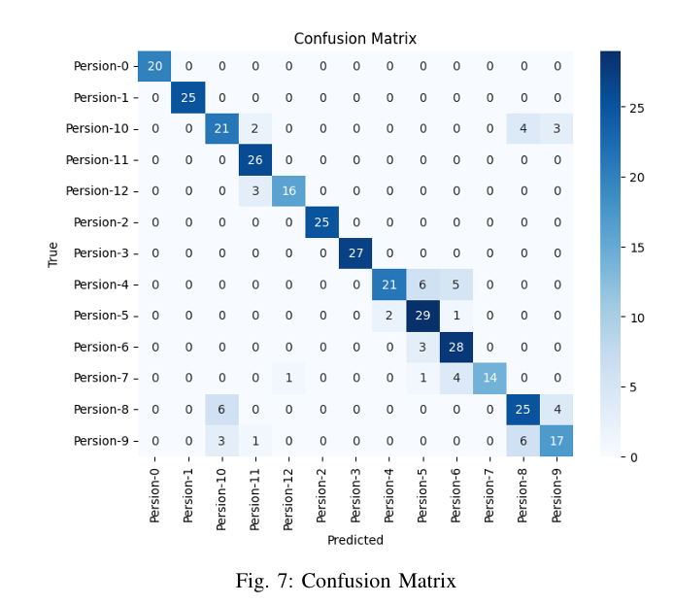
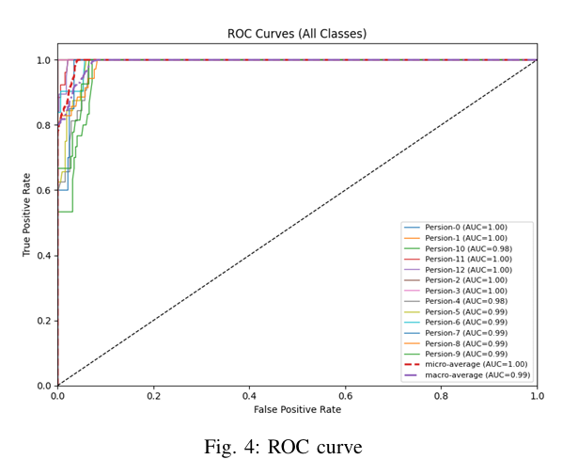
Confusion Matrix Analysis
ROC Analysis
Observations
Strong diagonal dominance
Minor confusion among similar subjects
Key Observation
Macro-average AUC = 0.99
Strong class separability

Slide 12
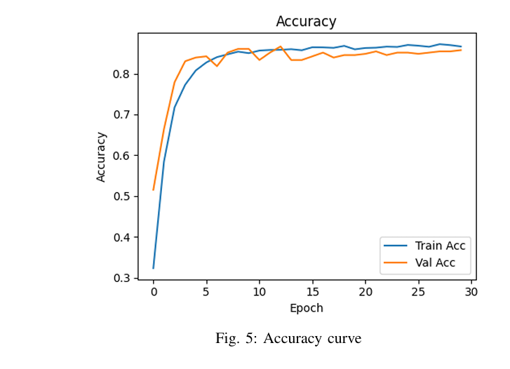
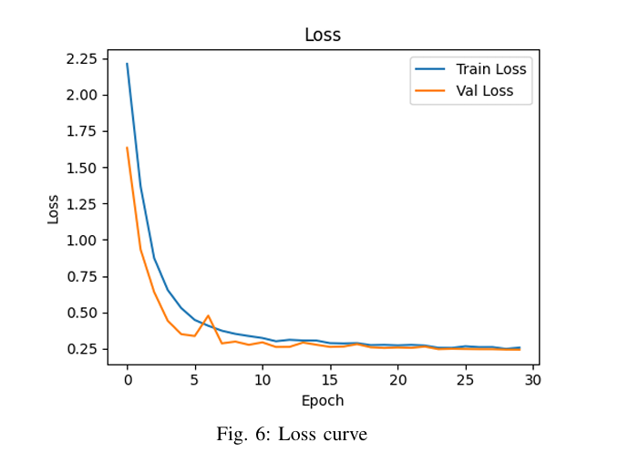
Accuracy & Loss Curves
Accuracy & Loss Curves
Fast convergence
Stable validation accuracy
Minimal overfitting

Slide 13
Current Limitations
Frame-level analysis only
No explicit temporal modeling
Small number of subjects
Future Directions
Temporal modeling (CNN-LSTM, Transformers)
Larger & diverse UAV datasets
Real-time edge deployment

Slide 14
REFERENCE
[1] Li, A., Hou, S., Cai, Q., Fu, Y., & Huang, Y. (2023). Gait recognition with drones: A benchmark. IEEE Transactions on Multimedia, 26, 3530-3540.
[2] An, W., Yu, S., Makihara, Y., Wu, X., Xu, C., Yu, Y., ... & Yagi, Y. (2020). Performance evaluation of model-based gait on multi view very large population database with pose sequences. IEEE transactions on biometrics, behavior, and identity science, 2(4), 421-430.
[3] Chao, H., He, Y., Zhang, J., & Feng, J. (2019, July). Gaitset: Regarding gait as a set for cross-view gait recognition. In Proceedings of the AAAI conference on artificial intelligence (Vol. 33, No. 01, pp. 8126-8133).
[4] Hsu, H. M., Wang, Y., Yang, C. Y., Hwang, J. N., Thuc, H. L. U., & Kim, K. J. (2022, October). GAITTAKE: Gait recognition by temporal attention and keypoint-guided embedding. In 2022 IEEE International Conference on Image Processing (ICIP) (pp. 2546-2550). IEEE.
[5] Zhang, C., Chen, X. P., Han, G. Q., & Liu, X. J. (2023). Spatial transformer network on skeleton-based gait recognition. Expert Systems, 40(6), e13244.

Slide 15
Thank You!

