Slide 1



International Conference on Power, Electronics, Communications, Computing, and Intelligent Infrastructure 2026 (PECCII 2026)
Paper ID – 538
A Deep Learning Approach to Silhouette-Based
Gender Classification from Aerial Gait Videos
Md. Abdullah Al Mahim, Zareen Tasnim, Mohammad Ali Sakib, Nakib Aman, Md. Shah Alom, Touhid Hossain
Presented by Md. Abdullah Al Mahim (1st Author & Presenter)
Dept. of CSE, Pabna University of Science and Technology, Pabna-6600, Bangladesh
17–18 June 2026

Slide 2
Table of Contents
01
Introduction & Motivation
07
Results — Loss Curve
02
Methodology & System Workflow
08
Results — Precision-Recall & ROC Curves
03
Model Architecture — EfficientNet-B0
09
Comparison with Existing Methods
04
Results — Classification Performance
10
Limitations
05
Results — Confusion Matrix
11
Future Work
06
Results — Training Accuracy Curve
12
References

Slide 3
Introduction & Motivation
🚶 Gait Biometrics
🔲 Silhouette Approach
🤖 Deep Learning Advantage
Gait can be recorded remotely without subject cooperation — ideal for surveillance, security, forensic investigation, and smart environments.
Silhouettes store only body shape and contour — no texture or face features. Privacy-preserving and computationally inexpensive for gender classification.
CNNs automatically learn hierarchical discriminative features from silhouette data, overcoming limitations of handcrafted descriptors and manual classifiers.
🏆 Best Result: EfficientNet-B0 achieves 97.14% test accuracy on self-collected drone-captured silhouette gait images

Slide 4
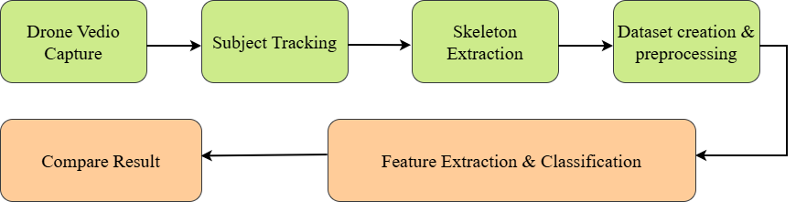
Methodology & System Workflow
1
Data Collection
System Workflow
Drone-captured outdoor videos at PUST campus. 30 subjects (20 male, 10 female). 6,760 silhouette images extracted.
2
Silhouette Extraction
Foreground segmentation isolates human body — removes face, clothing texture & identity-related information.
3
Preprocessing
Resize 224×224px, ImageNet normalization. Augment: flip, rotate ±15°, brightness/contrast jitter, affine transforms.
🔒 Privacy-Preserving Design
4
Dataset Split
No facial or texture information retained
Silhouette = body shape & contour only
Compliant with privacy-safe surveillance
Stratified 70% Train / 15% Validation / 15% Test. 4,663 male + 2,097 female silhouettes.

Slide 5
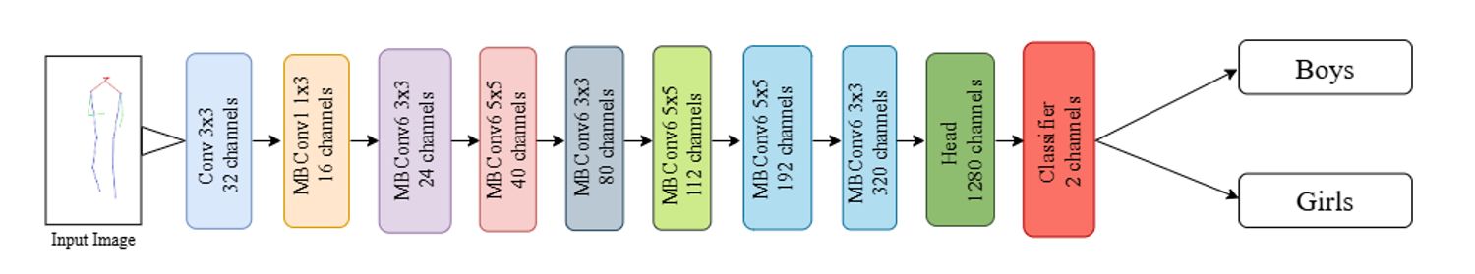
Model Architecture — EfficientNet-B0
ŷ = σ( W · D( f_EfficientB0(X) ) + b )
Optimizer
Batch Size
AdamW
32
LR Scheduler
Epochs
Cosine Annealing
30
Label Smoothing
Input Size
0.1
224 × 224 px

Slide 6
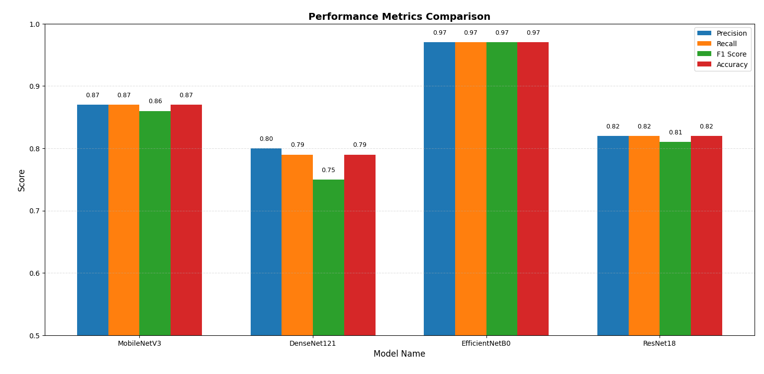
Results — Classification Performance
Class | Precision | Recall | F1-Score | Support
Men | 0.98 | 0.98 | 0.98 | 699
Women | 0.95 | 0.96 | 0.96 | 315
Overall | — | 0.97 | 0.97 | 1014
Key Takeaways
✅ EfficientNet-B0: 97% across all metrics
📊 MobileNetV3: 87% — competitive but lower
📉 DenseNet121: only 79% F1-score
🏆 EfficientNet-B0 clearly outperforms all baselines

Slide 7
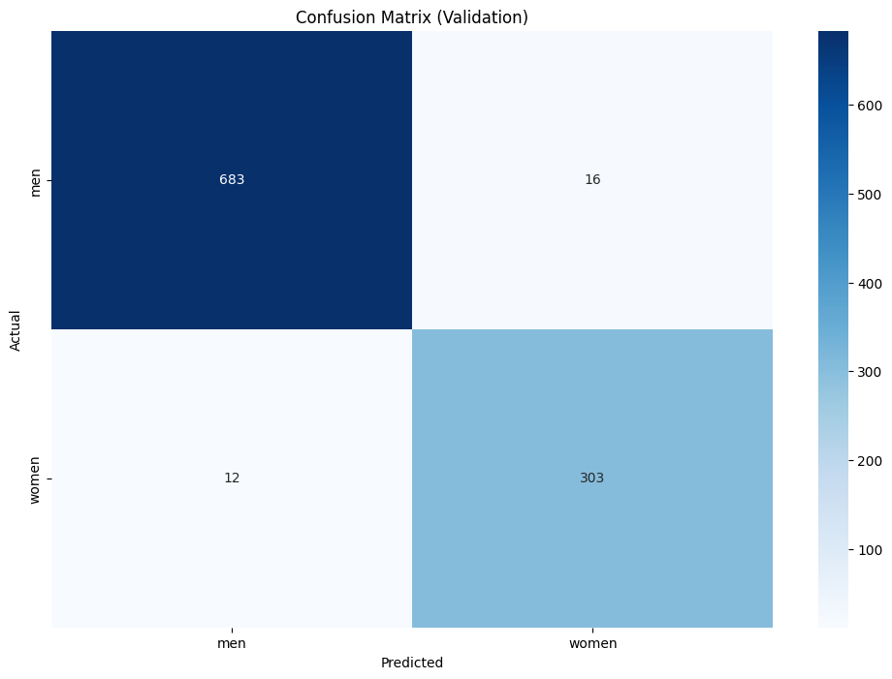
Results — Confusion Matrix
📊 Key Observations
✅ 683 / 699 men correctly classified (97.7%)
✅ 303 / 315 women correctly classified (96.2%)
🔵 Only 16 men misclassified as women (2.3%)
🔵 Only 12 women misclassified as men (3.8%)
⚖️ Balanced performance — model not biased toward either class
💡 Large diagonal values confirm strong silhouette feature discrimination

Slide 8
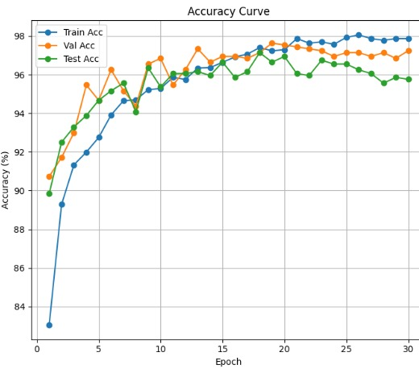
Results — Training & Validation Accuracy
📈 Key Observations
🚀 Starts ~83%, rises steeply in first 5 epochs
📊 Converges at ~97–98% from epoch 10 onwards
🔗 Train, Val & Test curves closely aligned — minimal overfitting
🎯 Consistent test accuracy 95–97% confirms strong generalization
⚙️ Cosine Annealing LR scheduler ensures smooth, stable convergence

Slide 9
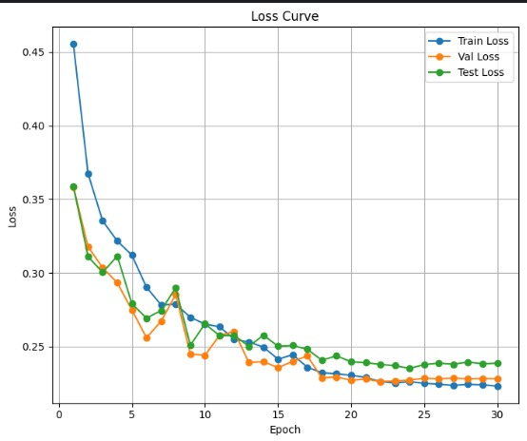
Results — Training Loss Curve
📉 Key Observations
📉 Loss drops sharply from ~0.45 to ~0.22 — rapid healthy decline
🔗 Train, Val & Test loss converge closely — no divergence
⚖️ Converges at ~0.22 for all splits after epoch 20
🛡️ Label smoothing (0.1) prevents overconfidence and loss spikes
✅ Smooth, stable decline confirms correct optimization dynamics

Slide 10
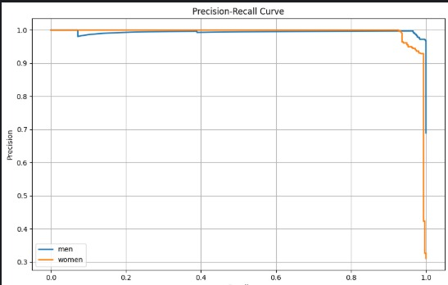
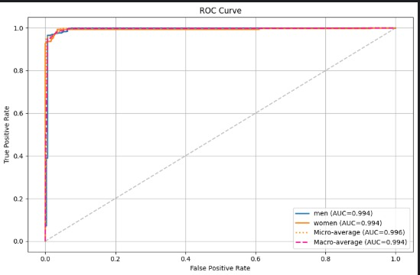
Results — Precision-Recall & ROC Curves
Precision-Recall Curve
ROC Curve
🌟 AUC = 0.994 (Men & Women) | Micro-avg AUC = 0.996 | Macro-avg AUC = 0.994 | Curves hug upper-left — near-perfect discrimination

Slide 11
Comparison with Existing Silhouette-Based Methods
Ref. | Dataset | Method | Accuracy (%)
Hou et al. [2] (2022) | Silhouette Gait Dataset | CNN-based Silhouette Classification | 90.74
Baghezza et al. [5] | GEI Benchmark Dataset | Two-Stream CNN (GEI + sub-GEI) | 91.80
Ahammed et al. [6] (2021) | Public Silhouette Dataset | Hybrid CNN–LSVM | 94.50
Proposed (Ours) | Silhouette Image Dataset | EfficientNet-B0 | 97.14% ★
💡 Why EfficientNet-B0 wins: Compound scaling (depth × width × resolution) provides a systematic balance that extracts fine-grained structural and motion features from silhouette inputs. Unlike uniform CNN scaling, EfficientNet achieves higher representational capacity without significantly increasing parameters — resulting in better generalization and consistent convergence.

Slide 12
Limitations
📦
Small Self-Collected Dataset
Only 30 subjects (20 male, 10 female) from a single university campus — limited demographic diversity and environmental variability.
🌐
No Cross-Dataset Validation
The model was evaluated only on the self-collected dataset. Performance on public benchmarks (CASIA-B, OULP) has not been tested.
⏱️
No Temporal Modeling
Frame-level classification only — stride rhythm, step frequency, and other dynamic gait cues are not explicitly captured.
📷
Viewpoint & Environmental Sensitivity
Aerial perspective introduces scale variation, occlusion, and lighting changes that may affect silhouette extraction quality.
⚧️
Binary Classification Only
The system classifies only male vs. female. Multi-class demographics (age, identity) are not addressed in the current framework.

Slide 13
Future Work
📦
Expand Dataset with Public Benchmarks
Validate on publicly available gait datasets (CASIA-B, OULP, TUM-GAID) to establish cross-dataset generalizability and robustness.
⏱️
Temporal Sequence Modeling
Incorporate LSTM, BiGRU, 3D CNN, or Transformer-based models to capture stride rhythm, step frequency, and temporal gait dynamics.
🌍
Multi-View & Cross-View Training
Train on silhouettes from multiple drone angles to improve robustness to viewpoint variation in real-world aerial surveillance.
🔍
Attention-Based Feature Refinement
Integrate spatial attention mechanisms to focus on the most discriminative silhouette regions — improving classification in complex scenarios.
🌐
Broader Demographic Analysis
Extend beyond binary gender — incorporate age estimation, identity recognition, and behavioral activity detection from silhouette gait.

Slide 14
References
[1] M. Azhar et al., "A gait-based real-time gender classification system using whole body joints," Sensors, 2022.
[7] R. Alguliyev et al., "Human gender classification and age estimation using deep learning," Multimedia Tools & Applications, 2025.
[2] S. Hou et al., "A comprehensive study on silhouette-based gait recognition," IEEE Trans. Biometrics, 2022.
[8] B. Kwon & S. Lee, "Joint swing energy for skeleton-based gender classification," IEEE Access, 2021.
[3] A. Bekhouch et al., "Few skeleton features for gait-based gender recognition," IEEE IPAS, 2025.
[9] M. Azhar et al., "Real-time dynamic multi-view gait-based gender classification," Electronics, 2022.
[4] K. Ahmed & M. Saini, "FCML-gait: fog computing and ML for gait recognition," Signal, Image & Video Processing, 2023.
[10] O. Alsaif et al., "Using skeleton model to recognize human gait gender," IAES Int. J. AI, 2023.
[5] R. Baghezza et al., "Gait-based age, gender recognition using CNN-BGRU on thermal silhouettes," SSRN, 2022.
[11] C. Xu et al., "Real-time gait-based age estimation and gender classification," IEEE WACV, 2021.
[6] J. Ahammed et al., "Human gait detection using silhouette image recognition," Turkish J. Comp. & Math. Education, 2021.
Full reference list available in the conference paper — PECCII 2026, PUST, Pabna, Bangladesh

Slide 15
Conclusion
🔲 Novel silhouette-based pipeline: drone video → foreground segmentation → EfficientNet-B0 classification
🎯 97.14% test accuracy — outperforms CNN (90.74%), two-stream GEI (91.80%), and CNN-LSVM (94.50%)
📊 AUC = 0.994 for both Men and Women — near-perfect class discrimination confirmed by ROC analysis
🔒 Privacy-preserving design: no facial or clothing texture — only body shape and contour used
🤖 EfficientNet-B0's compound scaling outperforms uniform CNN architectures on silhouette gait features
🔮 Future: expand to public benchmarks, temporal modeling, multi-view training, and attention refinement

Slide 16
Thank You!
A Deep Learning Approach to Silhouette-Based Gender Classification from Aerial Gait Videos
Presenter
Md. Abdullah Al Mahim
Dept. of CSE, Pabna University of Science and Technology
📧 mahim.cse0@gmail.com
PECCII 2026 • 17–18 June 2026 • PUST, Pabna, Bangladesh

Slide 17
Any Questions?
97.14%
0.994
6,760
Test Accuracy
AUC Score
Dataset Size
Feel free to ask about the methodology, dataset, model architecture, or results!
Md. Abdullah Al Mahim | mahim.cse0@gmail.com

