Slide 1
Artificial Intelligence and Machine Learning
Applications

Slide 2
Lecture Outline
Linear Regression Tutorial & Playground
Image Compression
Logistic Regression Interactive Demo
Neural Network Regression Tutorial & Playground
Auto-Encoders

Slide 3
Linear Regression Tutorial
https://mlu-explain.github.io/linear-regression/

Slide 4
Linear Regression Playground
https://observablehq.com/@yizhe-ang/interactive-visualization-of-linear-regression

Slide 5
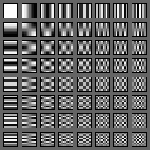
Image Compression with Linear Regression
An image can be transformed into the frequency domain and represented as a combination of some basic components.
Cosine Basis Functions and Discrete Cosine Transforms (DCT) can enable this.
The human eye is most sensitive to low frequencies. Therefore, most of the high frequencies can be ignored.
Principal behind JPEG Image Compression.
https://bengarney.com/2016/06/25/video-conference-part-2-joint-photographic-hell-for-beginners/

Slide 6
Image Compression with Linear Regression
Using linear regression, we can learn the weight of each of these cosine basis.
We only need to store the weights of the basis frequencies.
The image is reconstructed using these weights.

Slide 7
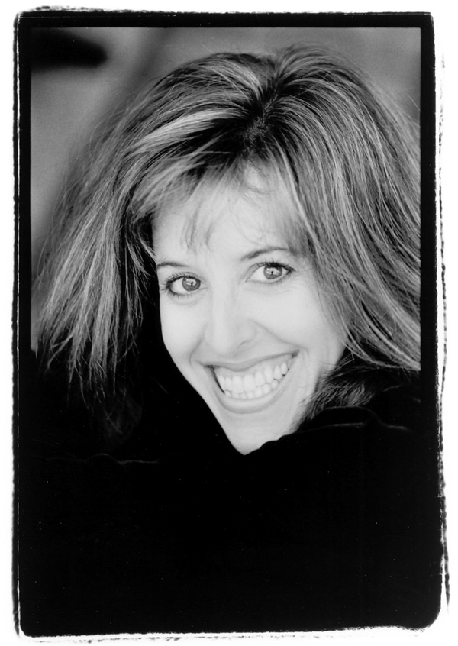
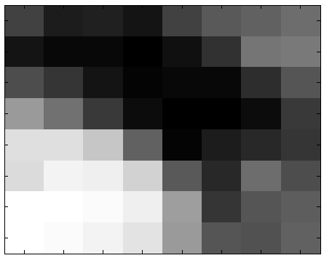
Image Compression
8 x 8 Pixels Image
Slide based on Discrete Cosine Transform and Image Compression by Thomas Buck et. Al.

Slide 8
Image Compression
Gray-Scale Example:
Value Range 0 (black) --- 255 (white)
63 33 36 28 63 81 86 98
27 18 17 11 22 48 104 108
72 52 28 15 17 16 47 77
132 100 56 19 10 9 21 55
187 186 166 88 13 34 43 51
184 203 199 177 82 44 97 73
211 214 208 198 134 52 78 83
211 210 203 191 133 79 74 86
Slide based on Discrete Cosine Transform and Image Compression by Thomas Buck et. Al.

Slide 9
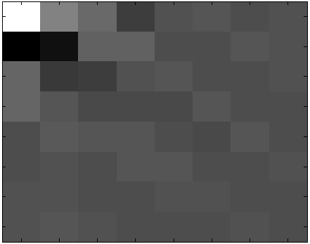
Image Compression
2D-DCT of matrix
-304 210 104 -69 10 20 -12 7
-327 -260 67 70 -10 -15 21 8
93 -84 -66 16 24 -2 -5 9
89 33 -19 -20 -26 21 -3 0
-9 42 18 27 -7 -17 29 -7
-5 15 -10 17 32 -15 -4 7
10 3 -12 -1 2 3 -2 -3
12 30 0 -3 -3 -6 12 -1
Numbers are coefficients of polynomial
Slide based on Discrete Cosine Transform and Image Compression by Thomas Buck et. Al.

Slide 10
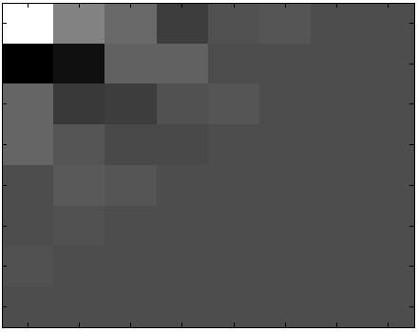
Image Compression
Cut the least significant components
-304 210 104 -69 10 20 -12 0
-327 -260 67 70 -10 -15 0 0
93 -84 -66 16 24 0 0 0
89 33 -19 -20 0 0 0 0
-9 42 18 0 0 0 0 0
-5 15 0 0 0 0 0 0
10 0 0 0 0 0 0 0
0 0 0 0 0 0 0 0
As you can see, we save a little over half the original memory.
Slide based on Discrete Cosine Transform and Image Compression by Thomas Buck et. Al.

Slide 11
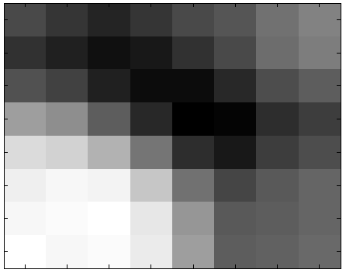
Reconstructing the Image
New Matrix and Compressed Image
55 41 27 39 56 69 92 106
35 22 7 16 35 59 88 101
65 49 21 5 6 28 62 73
130 114 75 28 -7 -1 33 46
180 175 148 95 33 16 45 59
200 206 203 165 92 55 71 82
205 207 214 193 121 70 75 83
214 205 209 196 129 75 78 85
Slide based on Discrete Cosine Transform and Image Compression by Thomas Buck et. Al.

Slide 12
Can You Tell the Difference?
Original Compressed
Slide based on Discrete Cosine Transform and Image Compression by Thomas Buck et. Al.

Slide 13
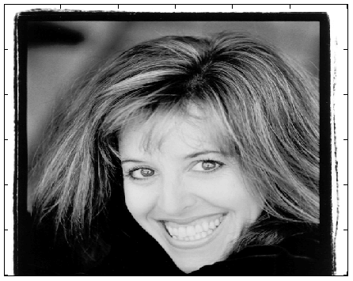
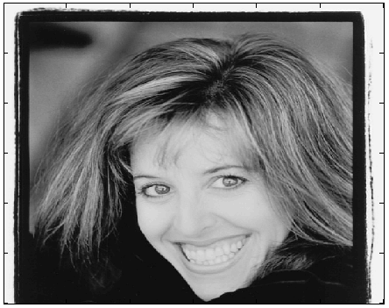
Image Compression
Original Compressed
Slide based on Discrete Cosine Transform and Image Compression by Thomas Buck et. Al.

Slide 14
Logistic Regression Interactive Tutorial
https://mlu-explain.github.io/logistic-regression/

Slide 15
Neural Networks Tutorial
https://mlu-explain.github.io/neural-networks/

Slide 16
Neural Networks Playground
https://playground.tensorflow.org/

Slide 17
Try it Yourself – Digit Classification
https://trekhleb.dev/machine-learning-experiments/#/experiments/DigitsRecognitionMLP

Slide 18
Try it Yourself – Sketch Recognition
https://trekhleb.dev/machine-learning-experiments/#/experiments/SketchRecognitionMLP

Slide 19
Applications – AutoEncoders
Autoencoders are a type of neural networks where the input is also the output.
They come under unsupervised learning and there are no labels involved.
An autoencoder consists of two parts: encoder and decoder.
The idea here is that you take a higher dimensional input, project it into a lower dimensional space and then project it back into the input space.

Slide 20
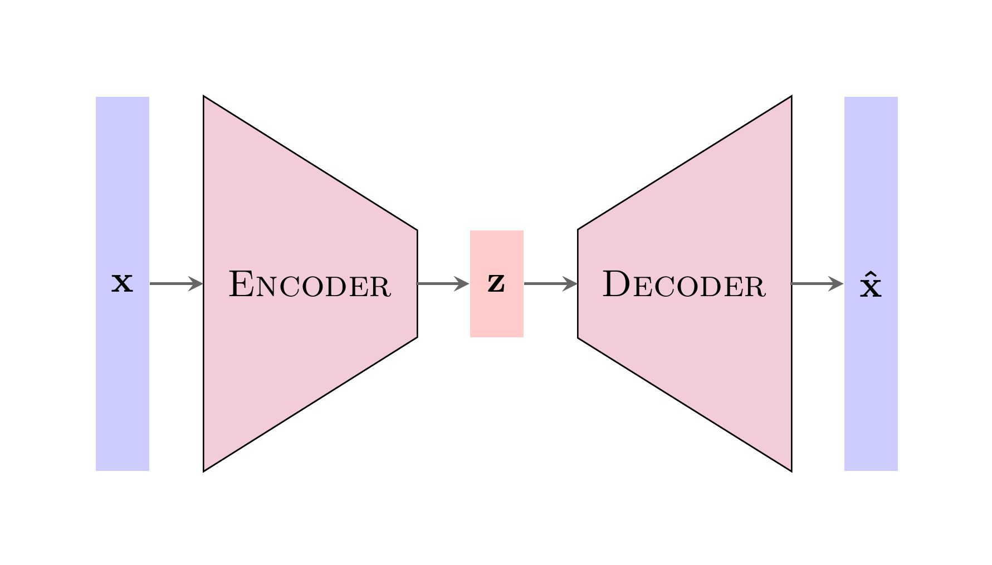
Applications – AutoEncoders
https://github.com/JamesAllingham/LaTeX-TikZ-Diagrams

Slide 21
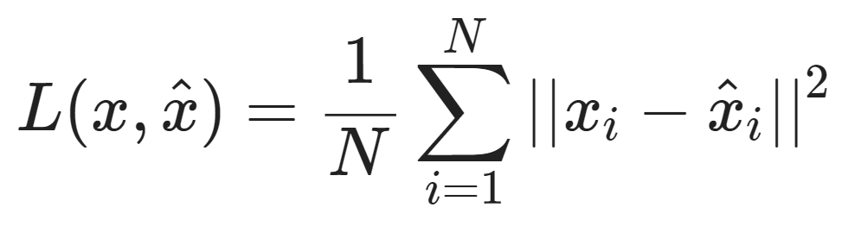
Applications – AutoEncoders
The autoencoder model tries to minimize the reconstruction error (RE).
Typically, mean squared is used as the loss function for autoencoders.
The objective is to minimize the following:

Slide 22
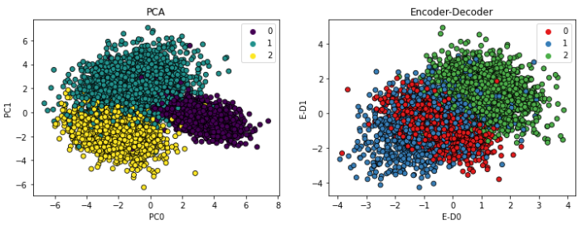
AutoEncoders for Dimensionality Reduction
The encoder output can be used for dimensionality reduction
https://towardsdatascience.com/dimensionality-reduction-with-autoencoders-versus-pca-f47666f80743

Slide 23
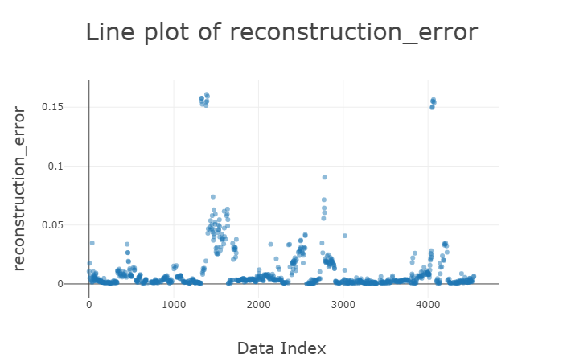
AutoEncoders for Outlier Detection
The reconstruction error can be used to detect outliers. Out of distribution samples will have high Reconstruction error.
Outliers
https://towardsdatascience.com/dimensionality-reduction-with-autoencoders-versus-pca-f47666f80743

Slide 24
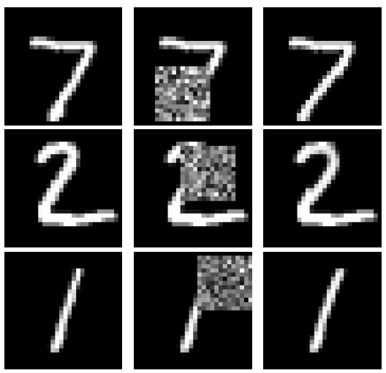
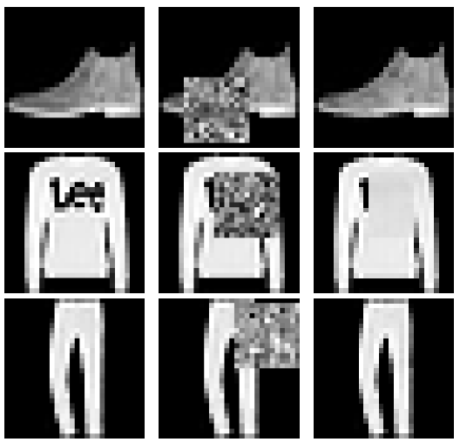
AutoEncoders for Image Completion
Corrupted Input
Corrupted Input
Original
AE Output
Original
AE Output
Smieja et. al. Can auto-encoders help with filling missing data?

Slide 25
Summary

