Slide 1
Artificial Intelligence and Machine Learning
Neural Networks

Slide 2
Lecture Outline
Logistic Regression Review
Neural Networks
Forward pass
Backward pass

Slide 3
Review: Logistic Regression

Slide 4

Introduction to Deep Learning
What is a
Neural Network?
deeplearning.ai

Slide 5
Housing Price Prediction
price
size of house

Slide 6
Housing Price Prediction

Slide 7
Housing Price Prediction
size
$$x_{1}$$
#bedrooms
$$x_{2}$$
y
zip code
$$x_{3}$$
wealth
$$x_{4}$$

Slide 8
Introduction to Deep Learning
Supervised Learning
with Neural Networks
deeplearning.ai

Slide 9
Supervised Learning
Input(x)
Output (y)
Application
Home features
Price
Real Estate
Ad, user info
Click on ad? (0/1)
Online Advertising
Image
Object (1,…,1000)
Photo tagging
Audio
Text transcript
Speech recognition
English
Chinese
Machine translation
Image, Radar info
Position of other cars
Autonomous driving

Slide 10
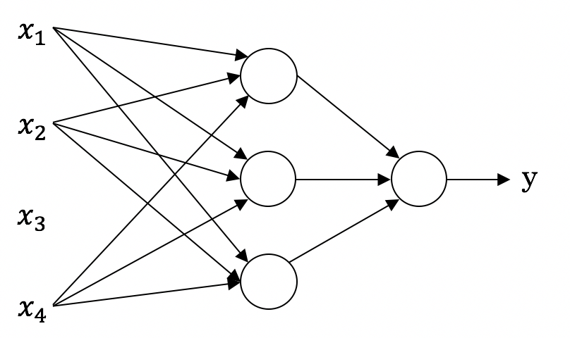
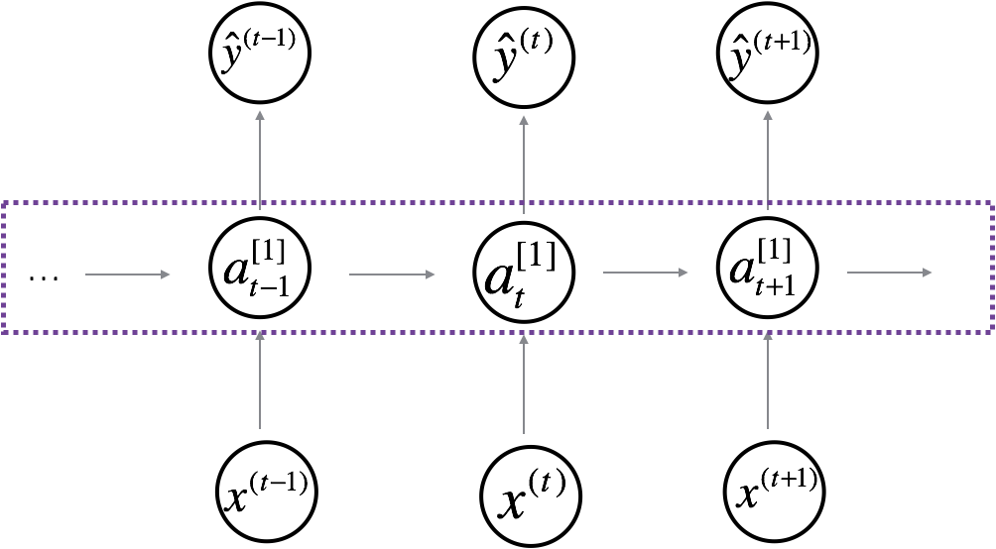
Neural Network examples
Standard NN
Convolutional NN
Recurrent NN

Slide 11
One hidden layer
Neural Network
Neural Networks
Overview

Slide 12
What is a Neural Network?
$$x_{1}$$
$$x_{2}$$
$$\hat{y}$$
$$x_{3}$$
x
w
$$z=w^{T}x+b$$
$$a=σ(z)$$
$$ℒ(a,y)$$
b
$$x_{1}$$
$$x_{2}$$
$$\hat{y}$$
$$x_{3}$$
x
$$W^{[1]}$$
$$z^{[1]}=W^{[1]}x+b^{[1]}$$
$$a^{[1]}=σ(z^{[1]})$$
$$z^{[2]}=W^{[2]}a_{ }^{[1]}+b^{[2]}$$
$$a^{[2]}=σ(z^{[2]})$$
$$ℒ(a^{[2]},y)$$
$$b^{[1]}$$
$$W^{[2]}$$
$$b^{[2]}$$

Slide 13
One hidden layer
Neural Network
Neural Network
Representation

Slide 14
Neural Network Representation
$$x_{1}$$
$$x_{2}$$
$$\hat{y}$$
$$x_{3}$$

Slide 15
One hidden layer
Neural Network
Computing a
Neural Network’s
Output

Slide 16
Neural Network Representation
$$x_{1}$$
$$x_{1}$$
$$x_{2}$$
$$σ(z)$$
$$a=\hat{y}$$
$$x_{2}$$
$$\hat{y}$$
$$w^{T}x+b$$
$$z$$
$$a$$
$$x_{3}$$
$$x_{3}$$
$$z=w^{T}x+b$$
$$a=σ(z)$$

Slide 17
Neural Network Representation
$$x_{1}$$
$$x_{1}$$
$$x_{2}$$
$$σ(z)$$
$$a=\hat{y}$$
$$x_{2}$$
$$\hat{y}$$
$$w^{T}x+b$$
$$z$$
$$a$$
$$x_{3}$$
$$x_{3}$$
$$z=w^{T}x+b$$
$$x_{1}$$
$$a=σ(z)$$
$$x_{2}$$
$$\hat{y}$$
$$x_{3}$$

Slide 18
Neural Network Representation
$$a_{1}^{\left[1\right]}$$
$z_{1}^{\left[1\right]}=w_{1}^{{\left[1\right]T}^{ }}x+b_{1}^{[1]}, a_{ 1}^{[1]}=σ(z_{1}^{\left[1\right]}$)
$$x_{1}$$
$$a_{2}^{\left[1\right]}$$
$z_{2}^{\left[1\right]}=w_{2}^{{\left[1\right]T}^{ }}x+b_{2}^{[1]}, a_{ 2}^{[1]}=σ(z_{2}^{\left[1\right]}$)
$$x_{2}$$
$$\hat{y}$$
$$a_{3}^{\left[1\right]}$$
$z_{3}^{\left[1\right]}=w_{3}^{{\left[1\right]T}^{ }}x+b_{3}^{[1]}, a_{ 3}^{[1]}=σ(z_{3}^{\left[1\right]}$)
$$x_{3}$$
$$a_{4}^{\left[1\right]}$$
$z_{4}^{\left[1\right]}=w_{4}^{{\left[1\right]T}^{ }}x+b_{4}^{[1]}, a_{ 4}^{[1]}=σ(z_{4}^{\left[1\right]}$)

Slide 19
Neural Network Representation learning
$$a_{1}^{\left[1\right]}$$
Given input x:
$$x_{1}$$
$$a_{2}^{\left[1\right]}$$
$$z^{\left[1\right]}=W^{\left[1\right]}x+b^{\left[1\right]}$$
$$x_{2}$$
$$\hat{y}$$
$$a_{3}^{\left[1\right]}$$
$$x_{3}$$
$$a^{\left[1\right]}=σ(z^{\left[1\right]})$$
$$a_{4}^{\left[1\right]}$$
$$z^{\left[2\right]}=W^{\left[2\right]}a^{\left[1\right]}+b^{\left[2\right]}$$
$$a^{\left[2\right]}=σ(z^{\left[2\right]})$$

Slide 20
One hidden layer
Neural Network
Vectorizing across
multiple examples

Slide 21
Vectorizing across multiple examples
$$z^{\left[1\right]}=W^{\left[1\right]}x+b^{\left[1\right]}$$
$$x_{1}$$
$$a^{\left[1\right]}=σ(z^{\left[1\right]})$$
$$x_{2}$$
$$\hat{y}$$
$$z^{\left[2\right]}=W^{\left[2\right]}a^{\left[1\right]}+b^{\left[2\right]}$$
$$x_{3}$$
$$a^{\left[2\right]}=σ(z^{\left[2\right]})$$

Slide 22
Vectorizing across multiple examples
for i = 1 to m:
$$z^{\left[1\right](i)}=W^{\left[1\right]}x^{(i)}+b^{\left[1\right]}$$
$$a^{\left[1\right](i)}=σ(z^{\left[1\right]\left(i\right)})$$
$$z^{\left[2\right](i)}=W^{\left[2\right]}a^{\left[1\right](i)}+b^{\left[2\right]}$$
$$a^{\left[2\right](i)}=σ(z^{\left[2\right]\left(i\right)})$$

Slide 23
One hidden layer
Neural Network
Explanation
for vectorized
implementation

Slide 24
Justification for vectorized implementation

Slide 25
Recap of vectorizing across multiple examples
for i = 1 to m
$$x_{1}$$
$$z^{\left[1\right](i)}=W^{\left[1\right]}x^{(i)}+b^{\left[1\right]}$$
$$x_{2}$$
$$\hat{y}$$
$$x_{3}$$
$$a^{\left[1\right](i)}=σ(z^{\left[1\right]\left(i\right)})$$
$$z^{\left[2\right](i)}=W^{\left[2\right]}a^{\left[1\right](i)}+b^{\left[2\right]}$$
$$a^{\left[2\right](i)}=σ(z^{\left[2\right]\left(i\right)})$$
$$X=$$
$$x^{(1)}$$
$$x^{(2)}$$
…
$$x^{(m)}$$
$$Z^{\left[1\right]}=W^{\left[1\right]}X+b^{\left[1\right]}$$
$$A^{\left[1\right]}=σ(Z^{\left[1\right]})$$
$$Z^{\left[2\right]}=W^{\left[2\right]}A^{\left[1\right]}+b^{\left[2\right]}$$
$A^{[1]}=$
$$a^{[1](1)}$$
$$a^{[1](2)}$$
$$a^{[1](m)}$$
…
$$A^{\left[2\right]}=σ(Z^{\left[2\right]})$$

Slide 26
One hidden layer
Neural Network
Activation functions

Slide 27
Activation functions
$$x_{1}$$
$$x_{2}$$
$$\hat{y}$$
$$x_{3}$$
Given x:
$$z^{\left[1\right]}=W^{\left[1\right]}x+b^{\left[1\right]}$$
$$a^{\left[1\right]}=σ(z^{\left[1\right]})$$
$$z^{\left[2\right]}=W^{\left[2\right]}a^{\left[1\right]}+b^{\left[2\right]}$$
$$a^{\left[2\right]}=σ(z^{\left[2\right]})$$

Slide 28
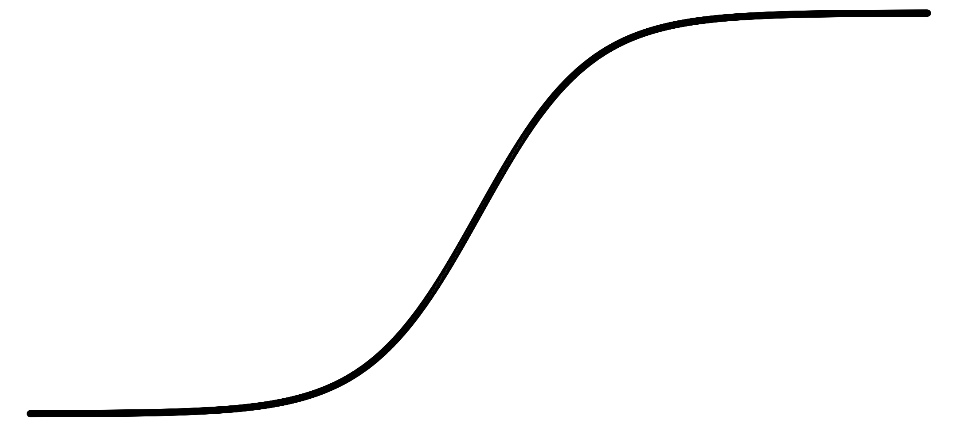
Pros and cons of activation functions
a
a
x
z
$$a= \frac{1}{1+e^{−z}}$$
sigmoid:
a
a
z
z

Slide 29
One hidden layer
Neural Network
Why do you
need non-linear
activation functions?

Slide 30
Activation function
$$x_{1}$$
$$x_{2}$$
$$\hat{y}$$
$$x_{3}$$
Given x:
$$z^{\left[1\right]}=W^{\left[1\right]}x+b^{\left[1\right]}$$
$$a^{\left[1\right]}=g^{[1]}(z^{\left[1\right]})$$
$$z^{\left[2\right]}=W^{\left[2\right]}a^{\left[1\right]}+b^{\left[2\right]}$$
$$a^{\left[2\right]}=g^{[2]}(z^{\left[2\right]})$$

Slide 31
One hidden layer
Neural Network
Gradient descent for
neural networks

Slide 32
Gradient descent for neural networks

Slide 33
Formulas for computing derivatives

Slide 34
One hidden layer
Neural Network
Backpropagation
intuition

Slide 35
Computing gradients
Logistic regression
$$x$$
$$w$$
$$z=w^{T}x+b$$
$$a= σ(z)$$
$$ℒ(a,y)$$
$$b$$

Slide 36
Neural network gradients
$$W^{[2]}$$
$$x$$
$$b^{[2]}$$
$$W^{[1]}$$
$$z^{[1]}=W^{[1]}x+b^{[1]}$$
$$a^{[1]}= σ(z^{[1]})$$
$$z^{[2]}=W^{[2]}x+b^{[2]}$$
$$a^{[2]}= σ(z^{[2]})$$
$$ℒ(a^{[2]},y)$$
$$b^{[1]}$$

Slide 37
Summary of gradient descent
$$dz^{[2]}=a^{[2]}−y$$
$$dW^{[2]}=dz^{[2]}a^{{\left[1\right]}^{T}}$$
$$db^{[2]}=dz^{[2]}$$
$$dz^{[1]}=W^{\left[2\right]T}dz^{[2]}∗g^{[1]}′(z^{\left[1\right]})$$
$$dW^{[1]}=dz^{[1]}x^{T}$$
$$db^{[1]}=dz^{[1]}$$

Slide 38
Summary of gradient descent
$$dz^{[2]}=a^{[2]}−y$$
$$dZ^{[2]}=A^{[2]}−Y$$
$$dW^{[2]}=dz^{[2]}a^{{\left[1\right]}^{T}}$$
$$dW^{[2]}=\frac{1}{m}dZ^{[2]}A^{{\left[1\right]}^{T}}$$
$$db^{[2]}=dz^{[2]}$$
$$db^{[2]}=\frac{1}{m}np.sum(dZ^{\left[2\right]},axis=1, keepdims=True)$$
$$dz^{[1]}=W^{\left[2\right]T}dz^{[2]}∗g^{[1]}′(z^{\left[1\right]})$$
$$dZ^{[1]}=W^{\left[2\right]T}dZ^{[2]}∗g^{[1]}′(Z^{\left[1\right]})$$
$$dW^{[1]}=dz^{[1]}x^{T}$$
$$dW^{[1]}=\frac{1}{m}dZ^{[1]}X^{T}$$
$$db^{[1]}=dz^{[1]}$$
$$db^{[1]}=\frac{1}{m}np.sum(dZ^{\left[1\right]},axis=1, keepdims=True)$$

Slide 39
Introduction to Neural Networks
Why is Deep Learning taking off?
deeplearning.ai

Slide 40
Scale drives deep learning progress
Performance
Amount of data

Slide 41

Scale drives deep learning progress
Idea
Data
Computation
Algorithms
Experiment
Code

Slide 42
One hidden layer
Neural Network
Random Initialization

Slide 43
What happens if you initialize weights to zero?
$$x_{1}$$
$$a_{1}^{[1]}$$
$$a_{1}^{[2]}$$
$$\hat{y}$$
$$x_{2}$$
$$a_{2}^{[1]}$$

Slide 44
Random initialization
$$x_{1}$$
$$a_{1}^{[1]}$$
$$a_{1}^{[2]}$$
$$\hat{y}$$
$$x_{2}$$
$$a_{2}^{[1]}$$

Slide 45
Deep Neural Networks
Getting your matrix
dimensions right

Slide 46
Parameters $W^{[l]}$ and $b^{[l]}$
$$x_{1}$$
$$\hat{y}$$
$$x_{2}$$

Slide 47
Vectorized implementation
$$x_{1}$$
$$\hat{y}$$
$$x_{2}$$

Slide 48
Deep Neural Networks
Why deep
representations?

Slide 49

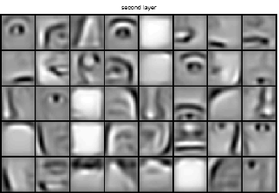
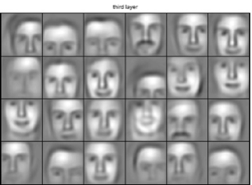
Intuition about deep representation
$$\hat{y}$$

Slide 50
Circuit theory and deep learning
Informally: There are functions you can compute with a “small” L-layer deep neural network that shallower networks require exponentially more hidden units to compute.

Slide 51
Deep Neural Networks
Building blocks of
deep neural networks

Slide 52
Forward and backward functions
$$x_{1}$$
$$x_{2}$$
$$\hat{y}$$
$$x_{3}$$
$$x_{4}$$

Slide 53
Forward and backward functions

Slide 54
Deep Neural Networks
Forward and backward
propagation

Slide 55
Forward propagation for layer l
Input $a^{[l−1]}$
O$utput a^{[l]},$cache ($z^{[l]}$)

Slide 56
Backward propagation for layer l
Input ${da}^{[l]}$
O$utput {da}^{\left[l−1\right]},dW^{\left[l\right]},db^{[l]}$

Slide 57
Summary

