Slide 1


Medical Diagnosis using Bayesian networks
Muhammad Asad (222211825)
EECS 6327 - Probabilistic Models & Machine Learning
York University

Slide 2




Introduction

Slide 3
Problem statement
To predict whether a patient is diagnosed with a disease based on the relevant medical record.
Particularly, to diagnose heart disease, breast cancer and diabetes.

Slide 4

Motivation
According to WHO, over 17.9 million deaths globally are due to cardiovascular diseases.
Heart disease is the 2nd leading cause of death in Canada (canada.ca).
Globally around 2.3 million new breast cancer cases occur and estimated 670,000 deaths annually (2022 data) (WHO).
A system that can take quicker decision and help clinicians detect these diseases more quickly and with greater confidence.

Slide 5
Proposal
To build a reliable decision support system to help physicians give quantitative probabilistic risk profiles for heart disease and breast cancer patients
  Bayesian Network
  Heart disease and breast cancer dataset from UCI Machine learning repository
    https://archive.ics.uci.edu/dataset/45/heart+disease
    https://archive.ics.uci.edu/dataset/17/breast+cancer+wisconsin+diagnostic
  Diabetes dataset from kaggle
    https://www.kaggle.com/datasets/uciml/pima-indians-diabetes-database

Slide 6
Dataset
Heart Disease
Diabetes
13 features among them 5 features are considered continuous.
Target attribute is named as ‘num’ having values:
  0 absence of disease
  1, 2, 3, 4 presence of disease
Few missing values in 2 features.
8 features among them 4 features are considered continuous.
Target attribute is named as ‘Outcome’ having values:
  0 non-diabetic
  1 Diabetic
No missing values.

Slide 7
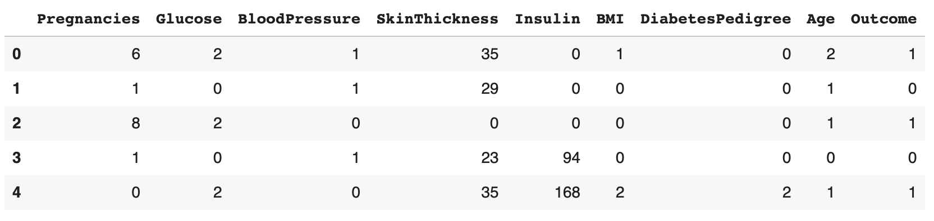
Diabetes dataset

Slide 8
Methodology
Preprocessing
Remove all records with missing values
Discretization
Using KBinsDiscretizer, transform all the continuous columns into ‘n’ bins discrete values
Bayesian Network
Structure learning
Manually or by using HillClimbSearch and K2 scoring method to learn the Bayesian structure
Parameter learning
Use MLE or BE to train the model on the learned structure
Conditional probability Querying
Inference
Use VariableElimination to establish an inference
Based on the inference, evidence and outcome variable; posterior probabilities are calculated
Classification and Evaluation
The patient is classified and then the model is evaluated based on the ground truths

Slide 9

What is Bayesian network?
A graphical model that represents the probabilistic relationships among a set of variables.
It combines probability theory and graph theory to reason about uncertainty efficiently.
A Bayesian Network is a directed acyclic graph (DAG) where:
  Nodes represent random variables (features, target).
  Edges represent conditional dependencies between variables.
  Each node has a conditional probability distribution the quantifies the effect the parents on the node.

Slide 10


Mathematical representation
If the network has variables X₁, X₂, …, X_{n}, the joint probability distribution is:
$$P\left(X_{1}, X_{2}, …, X_{n}\right)= \prod_{i=1}^{n}{P\left(X_{i} \right| Parents(X_{i}))}$$

Slide 11
Current progress and implementation
Complete basic pipeline has been implemented starting from preprocessing to the classification
Currently 2 datasets are used to test the approach (Heart and Diabetes). Breast cancer dataset will be used in future.
Accuracy for the current approach is measured around 60%.

Slide 12
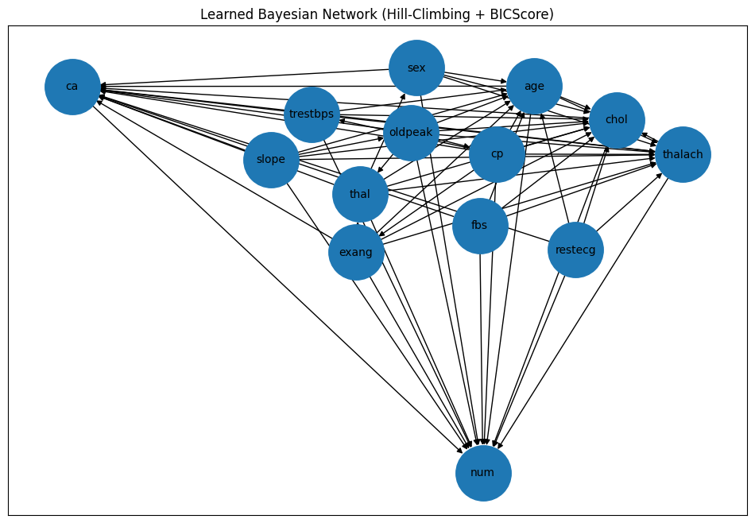
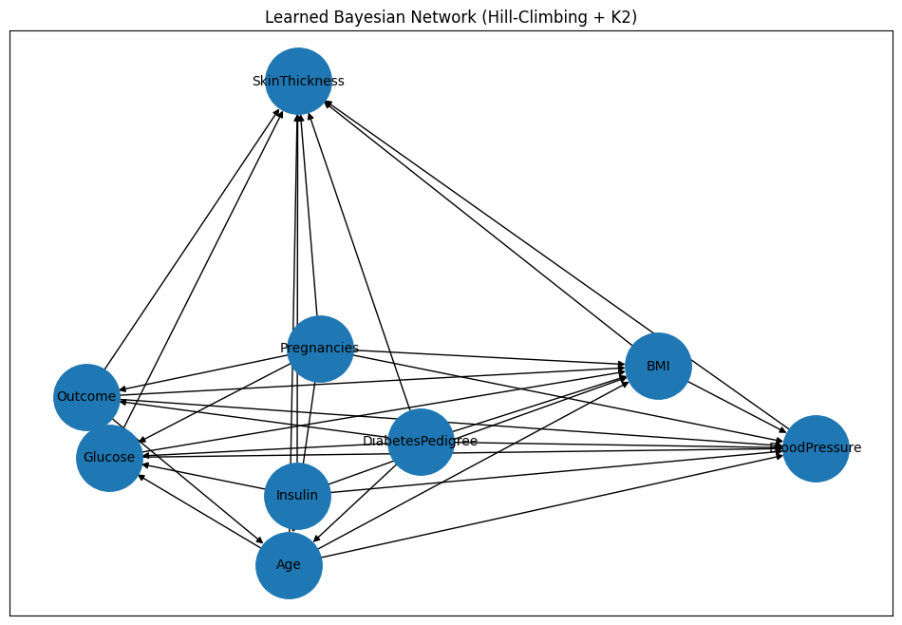
Learned Bayesian network
Learned structure on the heart disease and diabetes dataset

Slide 13

Challenges & FUTURE milestones
Datasets mostly contain continuous values whereas, Bayesian Network works on discrete values. So better discretization can help improve the model.
Current structure contain many edges (dependencies). Improving the graph structure can improve the model.
Bonus: Using random forest or any one other ML model to compare the results.

Slide 14

Thank you for your attention!
Any Questions?

