Slide 1
Nawy Data Science Task
Mohammad Ashraf

Slide 2
Appendix
Problem Statement
Data Exploration/Wrangling/Insights
Final Features
Model Explanation
Next Steps and Recommendations (Important)

Slide 3
Problem Statement
In Nawy we are initiating targeting campaigns on a daily basis to generate Real estate leads. The main pain is generating qualified leads. So we need to build a model to classify the received leads into two categories: low qualified and high qualified leads.

Slide 4
Data Exploration
Most columns don’t suffer from missing values except message, ad_group, campaign, location.
Our target column (low_qualified) suffer from huge imbalance in the data where:
0 (75136) -> high qualified leads
1 (15985) -> low qualified leads
At this problem, we care the most about miss classifying high quality leads. Meaning we care the most about minimizing "False Positives“. Therefore, our main performance metric is the "Recall" metric
We mean by False Positive that a lead is classified (1) (i.e. low qualified) while it should have been (0) (i.e. high qualified lead)

Slide 5
Data Exploration
While we have 91121 rows, we actually only have 72288 unique leads as we have 18833 duplicate leads.

Slide 6
Data Wrangling – Lead Time
When grouping the data by month-year we got the following graph (in the next slide), you will notice some trend happening during months 5-9 in the years provided in the dataset
Given the above, the month column will most probably have a big impact on the leads’ quality
Also it would have been useful to detect leads' workdays/holidays using pypi's "holidays" package, but we don't know exactly where each lead is located since there a re a lot of international leads in the Gulf, Europe, US and Canada. It would be useful to know where exactly each lead reside. Knowing the lead’s exact location (country of residence) will allow us to determine his timezone, thus we can discover trends within the buying habits of leads/customers like (maybe more open to hear deal in the weekends)

Slide 7
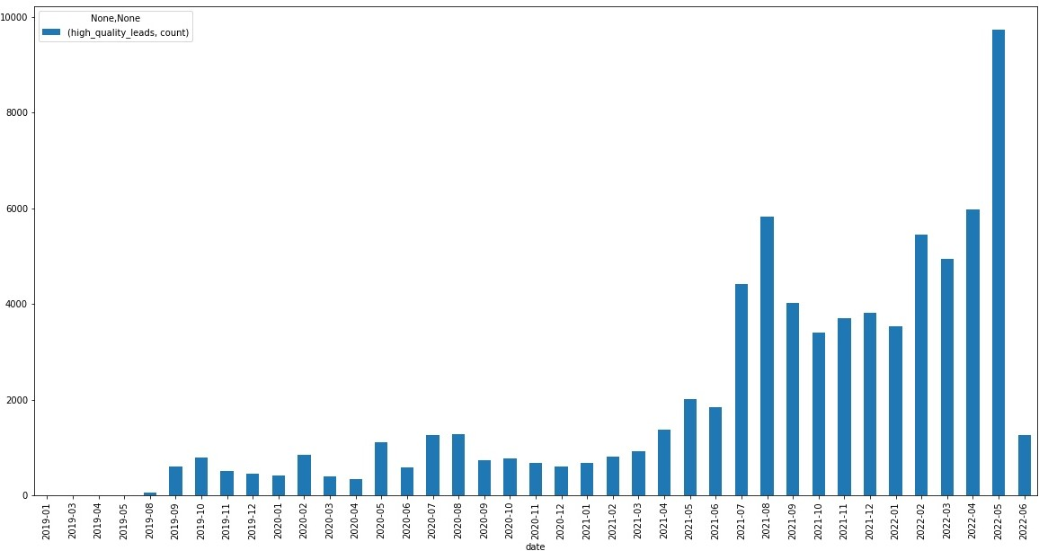
Month-Year Grouped

Slide 8
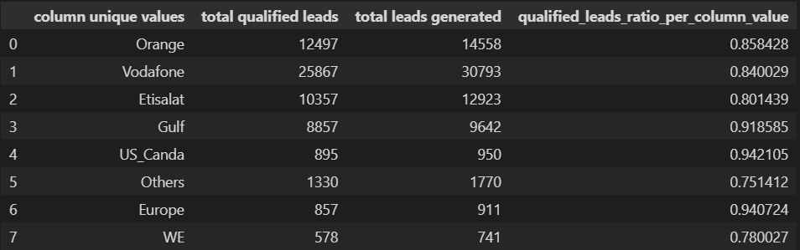
Data Wrangling – Lead Mobile Network
The following statistics shows how many leads uses each network
While it Gulf, US, Canada, Europe have so little amount of leads, they are considered the highest leads quality

Slide 9
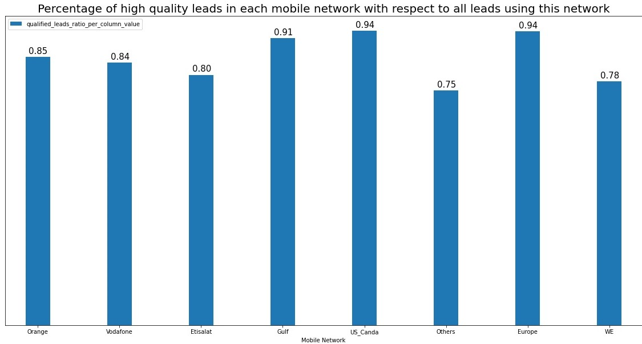

Slide 10
Data Wrangling – Lead Mobile Network
From the previous table and graph we notice the following:
Gulf, US, Canada, Europe have the highest quality customers but the don't necessarily generate the most leads.
Vodafone generates the most leads but and with a high quality leads
WE and "Others" leads generate the lowest quality leads
Therefore, Lead Mobile Network type will affect the lead quality.

Slide 11
Data Wrangling – Lead Source & Method of Contact
Both columns are almost of the same values and values distribution.
Their values are so messy with a lot of typos and redundancy, so it is best to group similar values together if and only if we made sure they actually generate leads in the same quality range
Eg: personal/rafea , personal/rafae , personal/reafea , personal referral / amany , …..etc should be grouped in one value “personal”
Organic form , customer form , type form , … etc should be grouped in one value “forms”

Slide 12
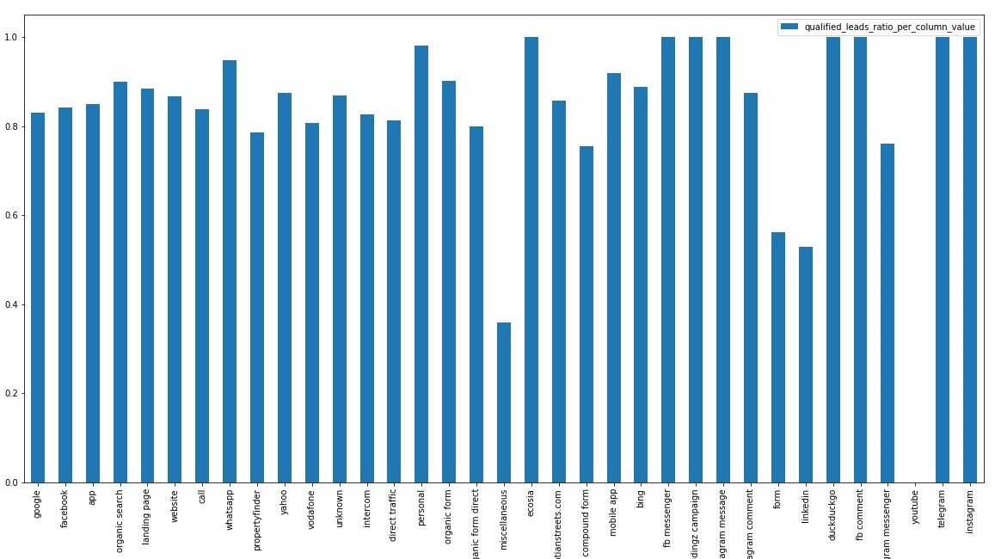
After grouping all values in those columns we ended up with the following 2 graphs

Slide 13
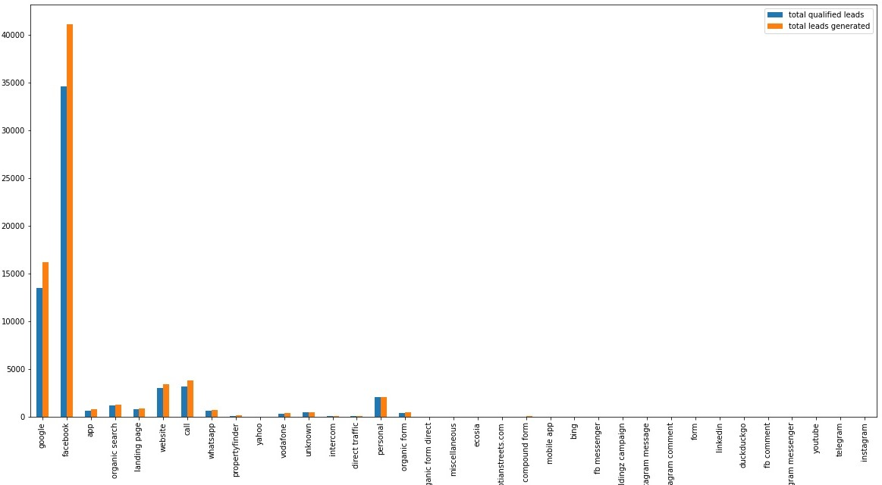

Slide 14
Data Wrangling – Lead Source & Method of Contact
Observations from the above 2 graphs:
Although the 1st graph may show that all source are within the same range, the 2nd graphs which visualizes the absolute count of high leads and absolute count of total leads shows that only few channels really make a difference while almost more than half of the sources are useless.

Slide 15
Final Features
I decided to end up with those features only (lead_time, lead_source, method_of_contact, lead_mobile_network); although I think that ad_group and location columns are so important, those columns are so messy and need some hacky NLP ways to try to organize them (I’ve got some idea, check the last section, but I didn’t have much time)

Slide 16
Model Explanation
I decided to train a Random Forrest Classifier because decision tree algorithms perform well with imbalanced classes.
I split the data randomly 77 % training and 33 % testing.
I ended up with a Recall Score of 0.076 on the test set.
If I had more time I would have tried penalized SVM where I would assign a higher penalty on the majority class.

Slide 17
Features Importance After Training
The following graphs shows the features importance after model training, it also proves most of our assumptions where we will see that “month” and “year” have the most impact on the model, followed by high quality mobile networks like Gulf, Europe, Us, Canada, Vodafone, Orange.
We Can also observe that only limited sources/methods have a noticeable impact on the model like call, facebook, whatsapp and personal/referrals.

Slide 18
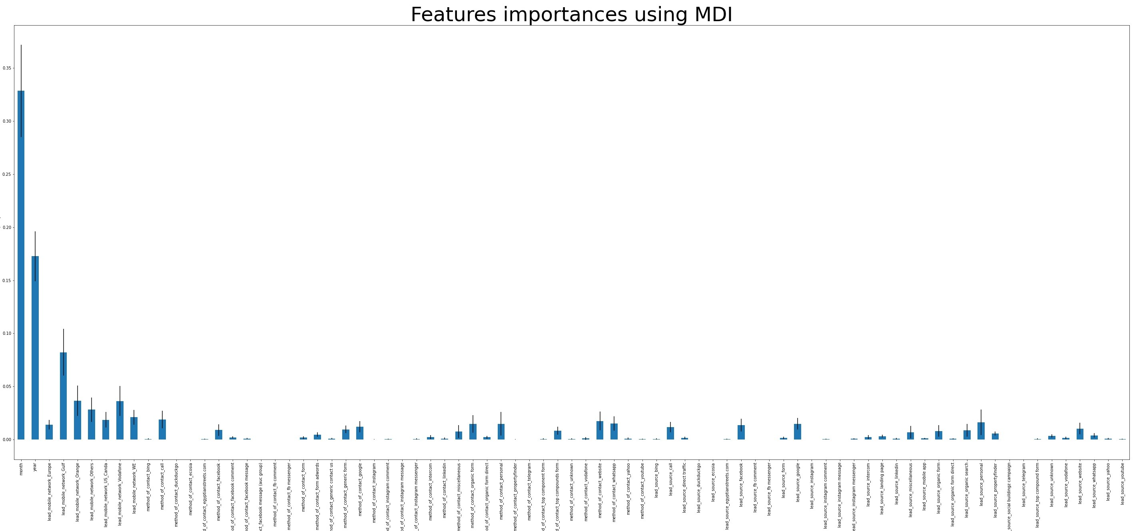

Slide 19
Next Steps and Recommendations
I think having more information about the lead like (lead_age, lead_gender, lead_country_of_residence) will be so important.
Knowing the lead’s exact location (country of residence) will allow us to determine his timezone, thus we can discover trends within the buying habits of leads/customers like (maybe more open to hear deal in the weekends)
Regarding the “location” column, to limit the messiness and redundancy, I think it would be a better strategy to try to group compounds and districts into zones; like downtown Cairo Zone, Upper Cairo Zone, East Giza Zone.

Slide 20
Thank You

