Slide 1
DATABASE DESIGN FOR TAXI SERVICE
CS/SE 6360.003-FINAL PROJECT
Submitted by:
MOHAMMAD ATIF HUSSAIN atifhussain@utdallas.edu

Slide 2
ENHANCED ER DIAGRAM

Slide 3
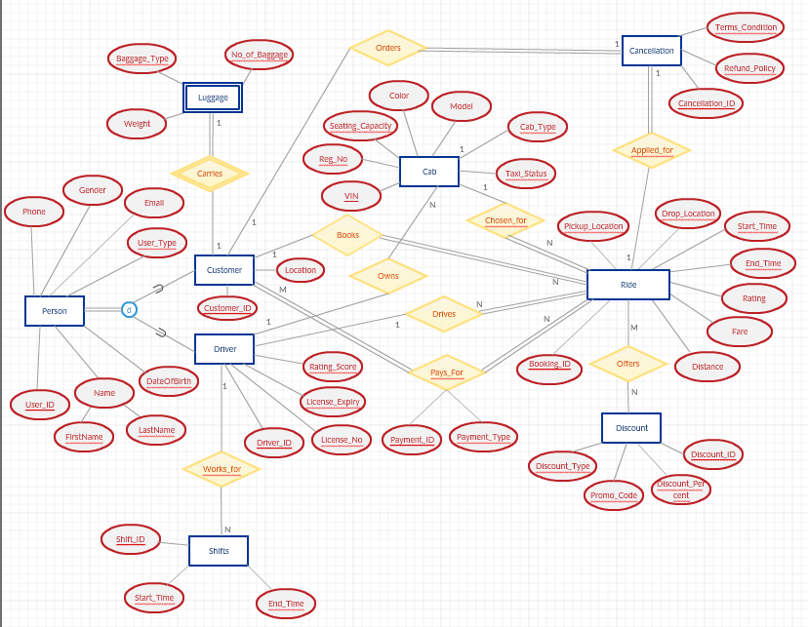

Slide 4
REQUIREMENTS FROM ER MODEL
A Customer can book 1 ride at a time and a ride can be booked by only one customer (1:1).
A Driver can work for many shifts and only 1 shift can be taken by a driver at a time (1:N).
Only 1 cab can be chosen for a ride and one ride can have only 1 cab at a time. (1:1).
A Driver can own N cabs and 1 cab cannot be owned by more than 1 driver at once (1:N).
A driver can drive only 1 ride at a time and only 1 driver can be used for a specific ride (1:1).
A customer can pay for any rides and a ride can be paid by any customers (M:N).
A ride can be chosen for any amount of discount and a discount can be offered to any ride (M:N).
One ride can be applied for cancellation and only one ride can be cancelled at a time(1:1).

Slide 5
NORMALIZED RELATIONAL SCHEMAS

Slide 6
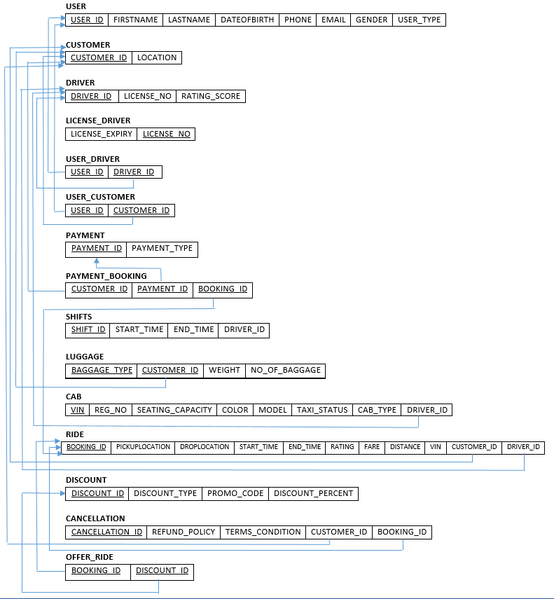

Slide 7
PL/SQL- PROCEDURES

Slide 8
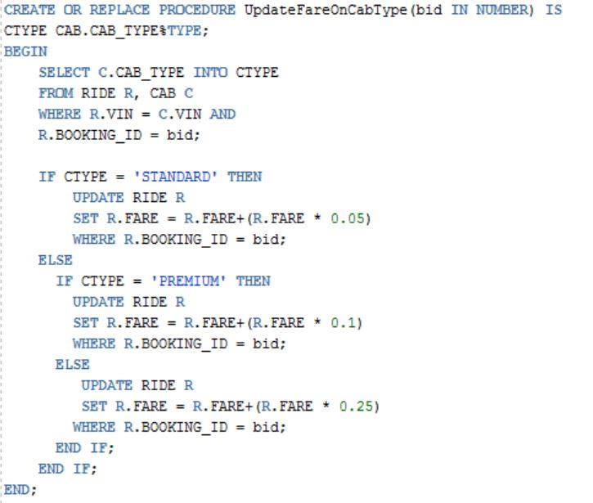

→This procedure increases fare according to the type of the cab used in the ride.
Arg: (bid IN NUMBER)

Slide 9
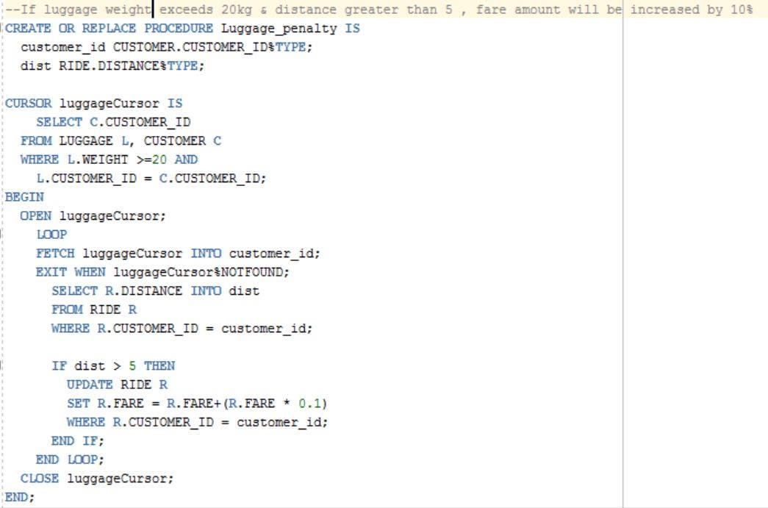
→This procedure aims to increase the fare of the ride by 10% if the luggage exceeds 20kgs & distance is more than 2km.
Arg: None

Slide 10
PL/SQL- TRIGGERS

Slide 11
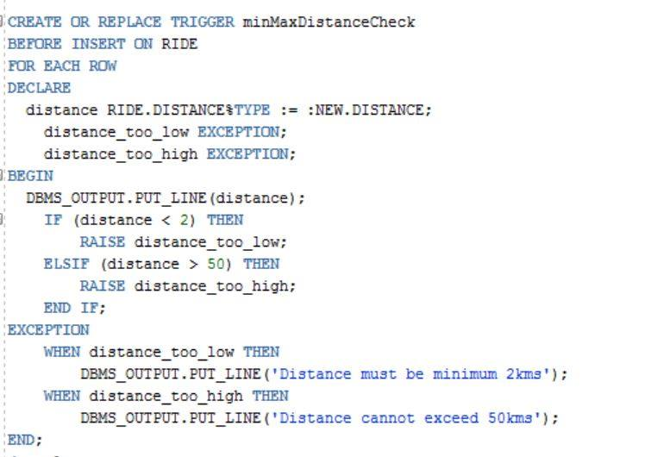
→ This triggered is triggered when the distance of the ride is less than 2km or greater than 50kms.

Slide 12
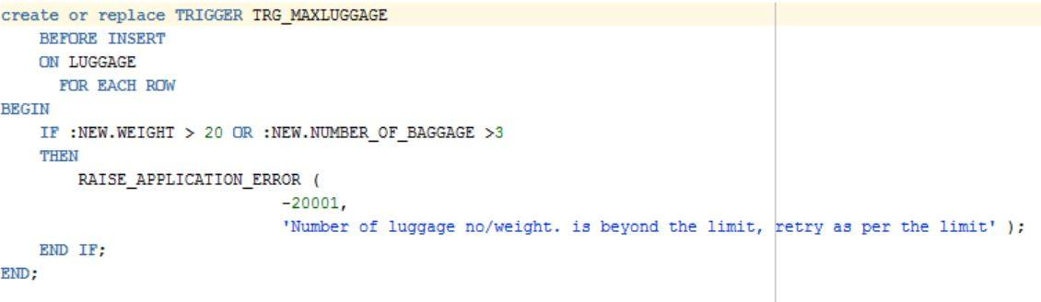
→ When the total weight of a luggage is greater than 20 kgs or the number of baggage are greater than 3, the trigger raises an application error.

Slide 13
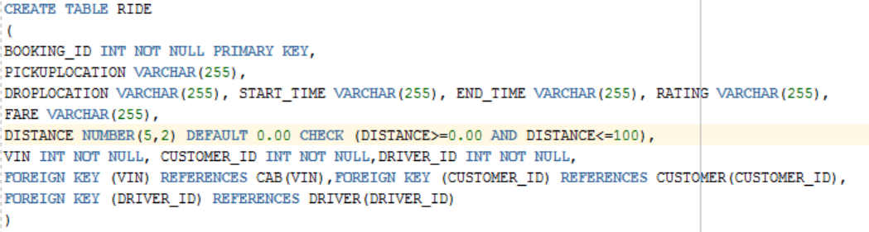
Check constraint: The distance has to be zero or a positive value and cannot be greater than 100 kms.
Implemented using check constraint on the RIDE table DDL statement highlighted below.

