Slide 1

Faster tests, greener cars
Can we predict how long a Mercedes-Benz car stays on the test bench?
Mohammad Bajbouj · ML project (Kaggle: Mercedes-Benz Greener Manufacturing) · neuefische AI PM bootcamp · October 2026
© 2026 Mohammad Bajbouj. All rights reserved. Decisions by Mohammad Bajbouj; drafted with Claude by Anthropic (Cowork, Claude Code); winner research drafted by Gemini (Google). Practice project, neuefische AI PM bootcamp. Kaggle data (Mercedes-Benz) is not covered by this copyright notice.
Notes:
Welcome. Our project asks whether machine learning can predict how long each Mercedes-Benz car stays on the end-of-line test bench. If we know this in advance, the bench can be planned better. I will show what the data allows, what our model reaches, and what we propose next.
Internal: v8 (D67) = changes 38, 41; v7 (D66) = changes 34–37 + speaker notes; v6 (D64), v5 (D59) see change lists in my_notes.

Slide 2
Our hypothesis (H2)
Main · H2
H2: Does the same car configuration always need the same test time?
Why it matters
How we test it
Where we answer it
If identical cars get different test times, that part cannot be predicted from the configuration – it sets a limit for every model.
Find cars with identical configurations (all 376 columns the same) and compare their test times. Then predict with three different algorithms: Ridge, Random Forest and XGBoost.
Identical cars: slide 5. Three algorithms compared: slide 11.
Meaning: one hypothesis, three different algorithms – as the coaches asked.
→ explained on slides 17–18 Source: H2 chosen: D13; three algorithms: D15, D33; question: framing_h2_v3.md; slide added: change 11 (D59)
Notes:
Our hypothesis H2 asks: does the same car configuration always need the same test time? If not, part of the test time can never be predicted from the configuration, and that part sets a limit for every model. We test this with cars that are identical in all 376 columns, and then with three different algorithms, as the coaches asked.

Slide 3



M0 – the data
Main · M0
4,209
376
72–265 s
tested cars
columns per car (8 text + 368 yes/no (0/1)); Mercedes-Benz hid the real names and replaced them with X0, X1, X2 …
test time per car (what we predict): shortest 72.11 s, longest 265.32 s
Meaning: we have the official Kaggle data – each car's configuration and its measured test time (→ slide 19).
→ explained on slide 19 Source: content list #5 (D37); 4,209 cars: Step 10; 376 columns: Step 1 (D17); 72.11 s / 265.32 s: D50, Step 9 (D23); data: D4; merged with #4: change 14 (D59)
Notes:
This is the data: 4,209 tested cars from the official Kaggle competition. Each car is described by 376 columns – Mercedes-Benz hid the real names, so they are just called X0, X1 and so on. For each car we know the measured test time, between 72 and 265 seconds. That test time is what we predict.

Slide 4
M1 – what the data tells us
Main · M1
1
Even identical cars get different test times → at most about 60 % of the differences in test time can be explained by the configuration (→ slide 22)
2
Most test times cluster around 75, 90, 100 or 108 seconds (→ slide 6)
3
One test of 265 seconds (next longest: 170 seconds) was removed as a likely faulty test (→ slide 6)
4
One column, X0, sorts the cars into these time groups – alone it explains 57.5 % of the differences (→ slide 7)
5
Of 368 yes/no (0/1) columns, 65 never change, copy or mirror another column; the strong ones only repeat what X0 already says (→ slide 27)
Meaning: at most about 60 % of the differences can be predicted, and the column X0 alone already explains 57.5 %.
→ explained on slides 25–27 Source: content list #14 (D37; pointers: change 25, D64); 60 %: Steps 5–6 (R8); groups: Step 11 (R18); faulty test: Steps 8–9 (D23); X0: Steps 11–12 (D25); yes/no: Steps 13–16 (D27, D29)
Notes:
What the data tells us in five points. First, even identical cars get different test times, so at most about 60 % of the differences can be explained. Test times cluster in a few groups, and one column, X0, sorts the cars into these groups. Many yes/no columns carry no information of their own. I will show the key plots on the next three slides.

Slide 5
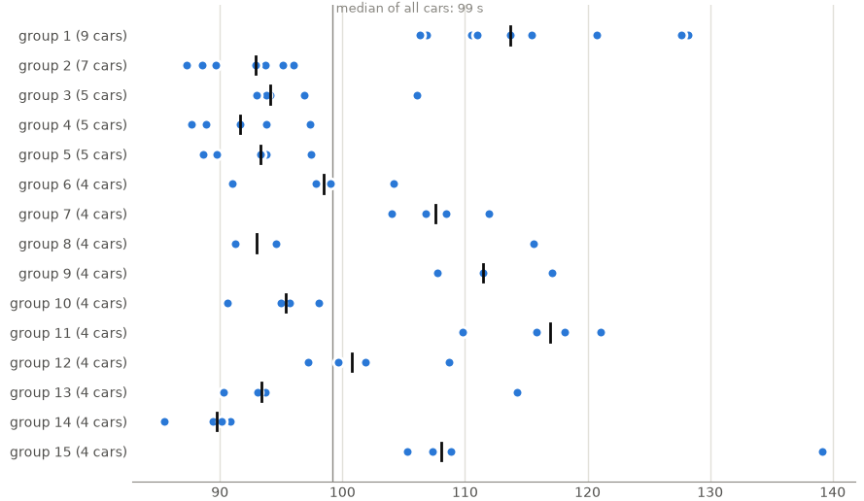
Key finding: same car ≠ same time
Main · M1
≈ 60 %
Using the configuration as indicator, we can predict up to about 60 % of the differences in test time between different cars (range 60–70 %; slides 22–23).
Each row = one group of identical cars; each dot = one car. Top row = the 9 identical cars (slide 21).
Expert view (Mohammad Bajbouj, automotive R&D): even identical cars can get different test times for reasons the data does not record, e.g. human error.
test time (seconds); dot = one car, dark tick = group median
→ explained on slides 21–23 Source: content list #6; plot: Step 4 (R5); ≈ 0.6, range 0.6–0.7: Steps 5–6 (R6, R8, R9; D18, D19); expert view: his statement, change 13 (D59); 60 % sentence: change 38 (D67)
Notes:
Each row is one group of identical cars, each dot is one car. Even inside the same group the times spread – the largest group of nine identical cars ranges from 106 to 128 seconds. From my experience in automotive R&D: reasons like human error at the bench are not recorded in the data. This is why at most about 60 % of the differences can be predicted.

Slide 6
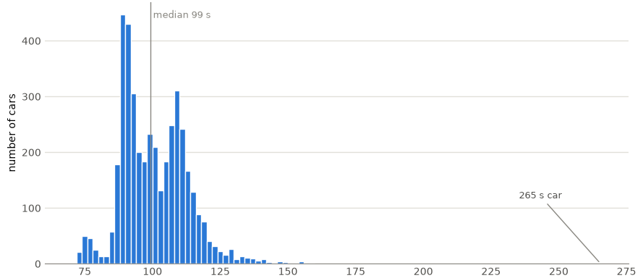
Test times come in groups, one unusual test
Main · M1
Most cars need about 75, 90, 100 or 108 s
One car took 265 s (next longest 170 s) → removed from training as a likely faulty test (our assumption – no column records it)
The other 49 long tests stay
test time (seconds) of all 4,209 cars, 2-second groups
Source: content list #8; peaks: Step 11 (R18, D28); 265 s car ID 1770: Step 9 (R13, D23); 169.91 s: Step 5 (R7); 49 long tests: Step 8 (R11, D22); assumption: R12; histogram: Step 7 (R10)
Notes:
Most cars need about 75, 90, 100 or 108 seconds – the test times come in groups. One car took 265 seconds while the next longest took 170 seconds; we removed it from training as a likely faulty test. This is our assumption, because no column records a faulty test. The other 49 long tests stay in the data.

Slide 7
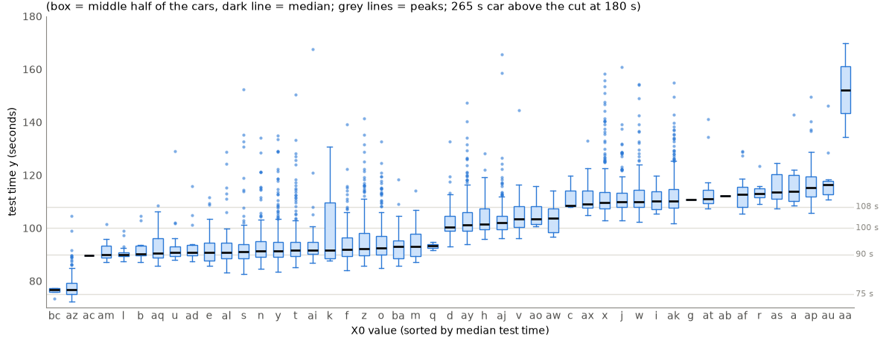
One column sorts the cars
Main · M1
Meaning: X0 alone explains 57.5 % of the differences (measured on the same cars it describes); the column X2 explains 22.6 %, every other text column at most 4.2 % (→ slide 24).
→ explained on slide 24 Source: content list #10; X0 57.5 %: Steps 11–12 (R20, D25); X2 / other text columns: key M1.5 result (D25); box plot: Step 11 (R19, y-axis cut at 180 s)
Notes:
This box plot shows the test time per X0 code, sorted from fast to slow. The X0 code alone explains 57.5 % of the differences between cars. The next best text column, X2, explains 22.6 %, every other text column at most 4.2 %. So one column already carries almost everything that can be predicted.

Slide 8
M2 – first predictions
Main · M2
1
Predicting the same average time for every car misses by about 12.4 seconds and explains nothing (0 %) (→ slide 9)
2
Predicting the average of the car's X0 group cuts the typical miss from 12.43 to 7.97 seconds – about 4.5 seconds better per car – and explains 58.7 % of the differences (→ slide 9)
3
The remaining 8 seconds are the noise floor: identical cars still differ by 8.1 seconds, so no model can explain much more than the limit of 59.7 % (→ slide 22)
4
A real model (Ridge) with X0 alone gives exactly the same result as the X0 group averages (7.97 seconds, 58.7 %) – the same rule, written as a formula (→ slide 9)
5
Adding all 310 columns (376 − 66 removed in M1) does not help: typical miss 7.97 → 8.09 seconds (→ slide 29)
Meaning: X0 carries almost all predictable information; the rest is test-bench scatter the data does not record.
→ explained on slide 29 Source: content list #16 (D37; reworded: changes 21, 22, D59; 24, 25, 28, D64); 4.5 s = 12.43 − 7.97 = 4.46 s: Steps 19–20; 8.1 s noise: Step 5, handover 28; 12 s / 8 s / 0.59: Step 19; limit: Steps 5–6 (R8, R37); Ridge 0.587 vs 0.574: Step 20 (R47); D32
Notes:
Our first predictions. Giving every car the same average time misses by about 12.4 seconds. Using the average of the car's X0 group cuts this to about 8 seconds – about 4.5 seconds better per car. The remaining 8 seconds are the noise floor, because identical cars differ by about 8.1 seconds. Adding all 310 columns does not help.

Slide 9
Baseline: simple predictions
Main · M2
Same average for every car (no columns used)
12.43 s · explains 0 %
Average per X0 group
7.97 s · 58.7 %
Ridge: X0 only
7.97 s · 58.7 %
Ridge: all 310 columns
8.09 s · 57.4 %
noise floor 8.1 s (identical cars)
Typical miss in seconds · share of the differences explained. Our own test: 5-fold cross-validation on 4,208 cars (→ slide 32). 58.7 % is about 98 % of the limit 59.7 %. The official Kaggle test: slide 13.
Meaning: knowing only X0 cuts the typical miss by about 4.5 seconds per car (12.43 → 7.97 s); the remaining 8 seconds are the noise floor.
Source: content list #15; chart redrawn with plain labels from Step 21 values (changes 26–28, D64); Step 19 (R49); Step 20 (R47); chart: Step 21 (R50); 98 %: handover 16 result; CV ≠ Kaggle: D44; D32
Notes:
Here are the four simple predictions side by side, tested with 5-fold cross-validation on 4,208 cars. The average per X0 group and Ridge with X0 give exactly the same result: 7.97 seconds and 58.7 % explained. With all 310 columns Ridge gets slightly worse, 8.09 seconds. 58.7 % is about 98 % of the limit of 59.7 %.

Slide 10
M3 – best model
Main · M3
1
Ridge, Random Forest and XGBoost all miss by about 8 seconds (4.5 s better than one average for all) and explain 58.7 %, 58.9 %, 59.3 % – equal (→ slide 11)
2
So we keep the simplest model: Ridge, using only the column X0 (→ slide 31)
3
Tested on cars the model had not seen: for 62 of every 100 cars the prediction is at most 5 seconds off, for 91 of every 100 at most 10 seconds (→ slide 12)
4
The 10 biggest misses are all long tests (over 136 seconds) that took longer than predicted – they cannot be predicted from the configuration (→ slide 34)
5
Official Kaggle test on 4,209 hidden cars: our model explains 54.1 %, the winner 55.6 % → 97 % of the winner and 91 % of the limit, with one column (→ slide 13)
Meaning: the data, not the choice of algorithm, sets the limit – this answers H2.
Source: content list #21 (D37; reworded: changes 22, 23, D59; 25, 27, 28, D64); long tests not predictable: Step 29 (D61); test basis ±5 / ±10 s: Step 26 (out-of-fold, 4,208 cars); Steps 20, 23, 24 (D40); final model D43; ±5 / ±10 s: Steps 26–27 (D42); Kaggle 0.54107 vs 0.55550: D47, D44; 91 % = 0.54107 / 0.5965: handover 23 Part B (D50)
Notes:
Our best model. Ridge, Random Forest and XGBoost all miss by about 8 seconds and explain about 59 % – they are equal. So we keep the simplest: Ridge with only X0. On cars it had not seen, 62 of 100 cars are within 5 seconds and 91 within 10 seconds. On Kaggle's hidden cars we reach 97 % of the winner's score with one column.

Slide 11
Three models compared
Main · M3
Same average for every car
12.43 s · 0 %
Typical miss · share explained (our own test, 4,208 cars)
All three miss by about 8 seconds. The differences (at most 0.6 percentage points) are smaller than the normal variation between the 5 test rounds (about ± 3.5 points) → equal. (→ slide 32)
Average per X0 group
7.97 s · 58.7 %
Ridge: X0 only
7.97 s · 58.7 %
Ridge: all 310 columns
8.09 s · 57.4 %
Random Forest: all 310 columns
7.95 s · 58.9 %
XGBoost: all 310 columns
7.91 s · 59.3 %
noise floor 8.1 s
Meaning: we keep the simplest model: Ridge with X0 only.
→ explained on slides 31–33 Source: content list #19; chart redrawn with plain labels from the Step 25 table (changes 26, 27, D64); R²: Steps 20, 23, 24 (D40); ± 0.035–0.042 per model: handover 28 (D58); seconds per model: Step 25 chart; equal within noise: R54, D40; final model: D43
Notes:
Six results in one chart: the two simple rules and four models. All models end between 7.91 and 8.09 seconds typical miss. The differences are at most 0.6 percentage points, smaller than the normal variation between the 5 test rounds of about 3.5 points. The dashed line is the noise floor of 8.1 seconds that no model can pass.

Slide 12
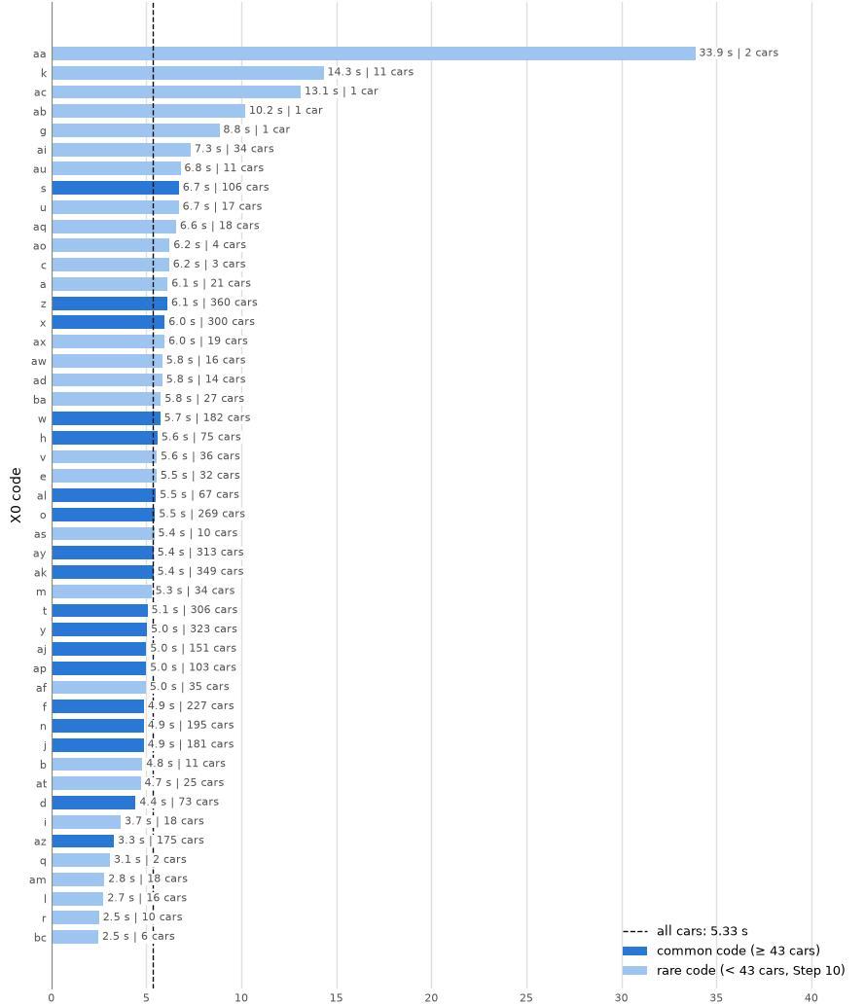
Where the model fails
Main · M3
62 %
91 %
of cars: prediction at most 5 seconds off
of cars: at most 10 seconds off
Tested on cars the model had not seen (5-fold cross-validation, 4,208 cars) (→ slide 32)
The 10 biggest misses are all long tests (over 136 seconds), and all took longer than predicted (→ slide 34)
Cars with rare X0 codes are not the problem: average miss 5.7 seconds vs 5.3 seconds for common codes
average miss per X0 code (seconds)
→ explained on slide 34 Source: content list #20; out-of-fold test: Step 26 (each car predicted by the model that did not see it); 62.1 % / 90.8 %, 10 worst > 136.30 s: Steps 26–27 (R59–R63, D42); 5.72 s rare vs 5.29 s common: Step 27 (D42)
Notes:
Where does the model fail? It was tested on cars it had not seen. For 62 of 100 cars the prediction is at most 5 seconds off, for 91 of 100 at most 10 seconds. The 10 biggest misses are all long tests that took longer than predicted. Rare X0 codes are not the problem.

Slide 13
What is a good score?
Main · M3
Our final model (Ridge, X0 only)
54.1 %
≈ 97 %
Kaggle winner
55.6 %
of the winner's score (54.1 % / 55.6 %)
≈ 91 %
Limit (identical cars)
59.7 %
of the limit (54.1 % / 59.7 %; winner: ≈ 93 %)
share of the differences in test time explained, Kaggle's 4,209 hidden cars; limit explained on slide 22
In seconds (own test): typical miss 12.4 → 8.0 s, about 4.5 s better per car. Same average for every car = 0 %.
Source: content list #7; percentages + gain in seconds: changes 27, 28 (D64); winner 0.55550: D44 (verified on Kaggle by Mohammad; Gemini draft checked by Cowork); ours 0.54107: D47; limit 0.5965: Step 5; 93 % / 91 %: handover 23 Part B (D50)
Notes:
What is a good score? On Kaggle's 4,209 hidden cars our model explains 54.1 %, the competition winner 55.6 %, and the limit from identical cars is about 59.7 %. So we reach 97 % of the winner's score and 91 % of what is possible, with one single column. In seconds, the typical miss drops from 12.4 to 8 seconds.

Slide 14




Data product: test-bench planner
Main · product
Car order
Prediction
Bench plan
configuration (X0 code)
Ridge with X0: about 4.5 s closer per car than the average (miss 12.4 → 8 s)
slot per car + about 10 s buffer (covers 91 of 100 cars)
Stakeholder (draft): test-bench planning engineer at the plant
Expert view (Mohammad Bajbouj, automotive R&D): plan each car with its predicted test time to reduce energy use in the end, and keep a buffer for extraordinary test times.
The test itself does not get shorter – the plan gets more accurate (less waiting or overrun on the bench)
Less energy and CO₂ = hypothesis (the data has no energy values) → pilot (→ slide 15)
Source: content list #22; stakeholder story = O6 (draft); 4.5 s: Steps 19–20; 91 % within 10 s: Step 26 (D42); expert view: his statement, change 29 (D64)
Notes:
The data product is a test-bench planner. The car order brings the configuration, the model predicts the test time about 4.5 seconds closer than the average, and the plan gets a slot per car plus a buffer of about 10 seconds, which covers 91 of 100 cars. My expert view: plan with predicted times to reduce energy use, and keep a buffer for extraordinary tests. The test itself does not get shorter – the plan gets more accurate.

Slide 15
Recommendations and next steps
Main · next
1
2
3
4
Plan with predictions
Pilot (hypothesis)
Record more (future work)
Know the limits
Expert view (M. Bajbouj): plan each car with its predicted time (about 4.5 s closer than the average) + about 10 s buffer (91 of 100 cars). Scale: about 300,000 cars a year ≈ 1,300 a day → about 1.6 h more accurate plan per day
One bench, one day, then one month: measure idle time and energy before and after planning with predictions
Long tests cannot be predicted from the configuration (→ slide 34) → record bench, tester and day; then test a targeted buffer in the pilot
Limit from 515 identical cars of 20 of 47 X0 types; the 57.5 % for X0 is measured on the same cars it describes; our own test and the Kaggle test use different cars
Source: content list #23; changes 30, 31 (D64); expert view: his statement; ~300,000 cars (Sindelfingen, 2017): Wikipedia 'Mercedes-Benz-Werk Sindelfingen'; 1,300/day = Cowork assumption 230 working days; 1.6 h = 4.5 s × 1,300; long tests: Step 29 (D61); ~8 s: Steps 20, 25; long tests: D42; 515 cars: Step 3 (D18); 20 of 47: handover 26 (D52, R72/D53); 57.5 % in-sample: Step 11 (R20); CV ≠ Kaggle: D44
Notes:
Four recommendations. Plan with predictions: at about 1,300 cars a day, 4.5 seconds per car add up to about 1.6 hours of more accurate planning per day. Test the energy saving in a pilot on one bench, first for a day, then a month. Record test-run data, because long tests cannot be predicted from the configuration. And keep the limits in mind.

Slide 16
M0 – the data: explanation slides
Backup for the M0 summary slide. Each slide names the main slide it belongs to and its source (content list #, notebook 04 step, decision log D-/R-IDs).
Notes:
Backup section – used only when questions come up. Each slide names the main slide it belongs to and its sources.

Slide 17

The problem
Backup · M0
Many configurations
Every car is tested
Time = energy
Almost every car is configured differently
Each car runs on the test bench before delivery
Longer bench time means more energy and CO₂
Meaning: test times differ from car to car, which makes the test bench hard to plan.
→ belongs to main slide 2 Source: content list #2; problem statement, framing_h2_v3.md
Notes:
Backup for the problem. Almost every car is configured differently, every car is tested before delivery, and a longer bench time means more energy and CO2. So differing test times make the bench hard to plan.

Slide 18
Our question
Backup · M0
Configuration
Predicted test time
all 376 column values of one car
seconds on the test bench
Can we predict each car's test-bench time from its configuration?
→ belongs to main slide 2 Source: content list #3; framing_h2_v3.md; hypothesis H2 chosen: D13
Notes:
Backup for the question. The input is a car's configuration – all 376 column values. The output is the predicted test time in seconds. Everything in this project tries to learn this link.

Slide 19
The data
Backup · M0
4,209
376
72–265 s
tested cars (train.csv)
anonymised columns: 8 text + 368 yes/no (0/1)
test time; shortest 72.11 s, longest 265.32 s
Meaning: Mercedes-Benz hid the column names (X0, X1 …) – we see the values, not what they mean.
→ belongs to main slide 3 Source: 4,209: Step 10 (R17); 376 = 8 + 368: Step 1 (R1, D17); 265 s: Step 9 (R13); 72.11 s, ID 3185: handover 23 Part B (D50)
Notes:
Backup for the data. 4,209 tested cars, 376 anonymised columns – 8 text and 368 yes/no – and test times from 72.11 to 265.32 seconds. We see the values, but not what the columns mean.

Slide 20
M1 – EDA: explanation slides
Backup for the M1 summary slide. Each slide names the main slide it belongs to and its source (content list #, notebook 04 step, decision log D-/R-IDs).
Notes:
Backup section – used only when questions come up. Each slide names the main slide it belongs to and its sources.

Slide 21
How we found identical cars
Backup · M1
1 Each car's 376 column values are written in one row → one configuration key per car
2 Cars with exactly the same key are identical (all 376 columns match) – a person can also check every group by hand
cars per group | groups | cars
2 (pairs) | 167 | 334
3 | 30 | 90
4 | 15 | 60
5 | 3 | 15
7 | 1 | 7
9 | 1 | 9
total | 217 | 515
4,209
cars in total
3,694
515
one-of-a-kind cars
identical cars (12 %) in 217 groups
Largest group: 9 identical cars (X0 = x), test times 106–128 s – up to 22 seconds apart.
Second largest: 7 identical cars (X0 = n), test times 87.27–96.03 s – up to 8.8 seconds apart. Twins come from 20 of 47 X0 types.
→ belongs to main slide 5 Source: content list #5a; Steps 2–3 (R2, R3; D17, D18); 9-car group, 20 of 47: handover 26 (D52, D53); cars per size + 7-car group (IDs 689, 692, 735, 802, 821, 873, 964): handover 28 (D58); changes 12, 15 (D59)
Notes:
How we found identical cars: we wrote all 376 values of a car into one key and compared the keys. 515 cars have at least one identical twin, in 217 groups – from 167 pairs to one group of 9 cars. A person can check every group by hand. The two examples show identical cars up to 22 and 8.8 seconds apart.

Slide 22
From identical cars to the 60 % limit
Backup · M1
1
Average test time of all 4,209 cars: 100.7 s. Spread around it: 160.8 s² (seconds squared, the variance – not an error). Its square root, 12.7 s, is the typical distance of a car from the average
2
Inside the 217 groups of identical cars the spread is still 64.9 s² (square root 8.1 s) – the configuration is the same, so this part is noise: reasons the data does not record, e.g. human error
3
Noise share: 64.9 s² out of 160.8 s² = 40 %. The other 60 % (95.9 s²) is the most the configuration can explain → limit about 60 %
noise 64.9 s² (40 %)
explainable from the configuration 95.9 s² (60 %)
total spread of all 4,209 cars: 160.8 s²
The 515 identical cars (12 %) are only the sample that measures the noise: they spread like all cars (12.6 s vs 12.7 s); with only these 515 cars the limit is 59 %. The noise (8.1 s) is close to our model's typical miss (about 8 s). Step by step: slide 23.
→ belongs to main slide 5 Source: content list #5b; 160.8 / 64.9 / 0.5965: Step 5 (R6, D18); 100.7 s, divisors, √ = 12.7 / 8.1 s: handover 28 (D58, R76 = all cars); 0.59: R6; 12.6 vs 12.7 s: handover 26; changes 13, 16 (D59)
Notes:
Where the 60 % comes from. All cars spread about 12.7 seconds around the average of 100.7 seconds, which is 160.8 seconds squared. Identical cars still spread 8.1 seconds, 64.9 seconds squared – that part is noise. 64.9 out of 160.8 is 40 % noise, so at most 60 % can be explained.

Slide 23
How the noise is measured
Backup · M1
1
For each group of identical cars: calculate the group's average test time
Example (illustration only)
3 identical cars: 100 s, 104 s, 108 s
Average: (100 + 104 + 108) / 3 = 104 s
Distances: 100 − 104 = −4; 104 − 104 = 0; 108 − 104 = +4
Squared: (−4)² + 0² + 4² = 16 + 0 + 16 = 32 s²
Divide by 3 − 1 = 2: the 3 distances always add up to 0, so once 2 are known the 3rd is fixed → only 2 are free
32 / 2 = 16 s² → square root: 4 s
2
For each car: its distance to the group average (e.g. −4, 0, +4 s), then squared (16, 0, 16) – squaring stops + and − from cancelling
3
Add the squared distances of all 515 identical cars in all 217 groups: 19,332.3 s²
4
Divide by 515 − 217 = 298: the 515 identical cars minus one value per group (217 groups), because each group's average is calculated from its own cars → 19,332.3 / 298 = 64.9 s²
Equation (real data)
noise = sum of (test time − group average)² ÷ (identical cars − groups) = 19,332.3 ÷ (515 − 217) = 64.9 s²
5
Compare with the spread of all 4,209 cars (160.8 s², slide 22): 64.9 / 160.8 = 40 % noise
→ belongs to main slide 5 Source: content list #5c; Step 5 (R4, R6; D18); 64.9 / 160.8 s²: Step 5; 19,332.3 s², divisor 298: handover 28 (D58); example values made up for illustration; change 17 (D59)
Notes:
This is the noise calculation step by step. For each group of identical cars we take the group average, square each car's distance to it, and add everything up: 19,332.3 seconds squared. We divide by 515 cars minus 217 groups, because each group uses up one value for its own average. That gives 64.9 seconds squared.

Slide 24
What is X0?
Backup · M1
X0 is not an algorithm – it is one column of the data
Mercedes-Benz hid the real column names, so they are called X0, X1, X2 …
X0 is one of the 8 text columns: every car has exactly one X0 code; there are 47 codes
For the models every X0 code becomes its own yes/no (0/1) column (one-hot encoding); a code never seen in training counts as an average car
Car | X0 | X1 | … | X10 | X11 | … | X385 | test time
one car | bc | v | … | 0 | 1 | … | 0 | y (s)
Example row – values for illustration only (text codes + yes/no (0/1) columns).
→ belongs to main slide 7 Source: content list #9; 8 text columns: Step 1 (D17); 47 codes, e.g. bc / aa: Step 22 (D36); one-hot + unseen codes: Steps 12, 20 (R21, D25); unseen code → base value: Step 28 (R65, D46)
Notes:
X0 is not an algorithm – it is one column of the data. Every car has exactly one X0 code, and there are 47 codes. For the models each code becomes its own yes/no column, which is called one-hot encoding.

Slide 25
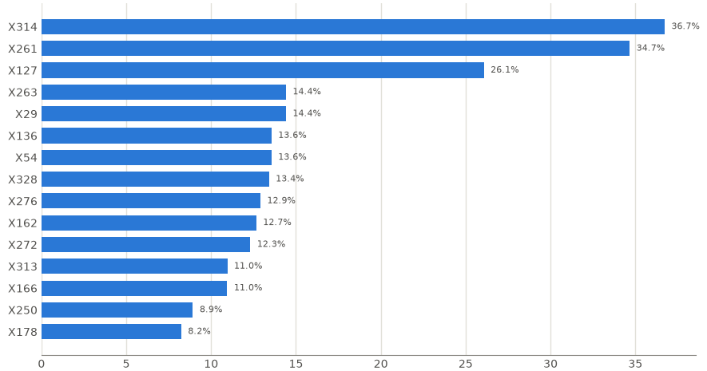
A strong column that tells nothing new
Backup · M1
X314 | cars | avg time
with | 1,817 | 109.5 s
without | 2,392 | 94.0 s
X314 alone explains 36.7 %. But every X0 code is always with or always without X314 → once X0 is known it adds nothing (X0 alone explains 57.48 %; with X314 at most 57.52 %).
Lesson: a strong single link is not new information.
→ belongs to main slide 4 Source: content list #11; X314: Step 15 (R29); 57.48 % → 57.52 %: Step 16 (R32, D29); bar chart: Step 15
Notes:
A strong column that tells nothing new: X314 alone explains 36.7 % of the differences. But every X0 code is always with or always without X314. So once X0 is known, X314 adds nothing – the lesson is that a strong single link is not new information.

Slide 26
X0 already decides X314
Backup · M1
X0 code | X314 = 1 | X314 = 0
z | 0 | 360
ak | 349 | 0
y | 0 | 324
ay | 313 | 0
t | 0 | 306
x | 300 | 0
o | 0 | 269
f | 0 | 227
n | 0 | 195
w | 182 | 0
0 of 47
X0 codes have both X314 values
14 X0 codes: X314 always 1 (1,817 cars)
33 X0 codes: X314 always 0 (2,392 cars)
Meaning: once X0 is known, X314 adds nothing (X0 alone 57.48 %, X0 + X314 57.48 %).
Top 10 X0 codes by number of cars. The other 37 codes: also always one value.
→ belongs to main slide 4 Source: content list #11a; table and counts: handover 27 result (D55, D56; R74); 57.48 % / +0.00 pp: Step 16 (D29)
Notes:
This table proves the point: 0 of the 47 X0 codes have both X314 values. 14 codes always have X314, 33 never. So X0 already decides X314.

Slide 27
Why we removed 0/1 columns
Backup · M1
368
− 12
− 45
− 8
303
yes/no (0/1) columns
never change
exact copies
exact opposites
kept
Outcome: the strong columns only repeat X0. All columns together did not beat X0 alone: share explained 57.4 % vs 58.7 %, typical miss 8.09 s vs 7.97 s (→ slide 29).
→ belongs to main slide 4 Source: content list #12; 12 / 45 / 8 → 303: Steps 13–15 (R25, R28, R30; D27); repeat X0: Step 16 (D29); 0.574 / 8.09 s vs 0.587 / 7.97 s: Step 20 (R47, D32)
Notes:
Why we removed yes/no columns: of 368, 12 never change, 45 are exact copies and 8 are exact opposites of another column, so 303 stay. The strong ones only repeat X0. All columns together did not beat X0 alone.

Slide 28
M2 – baseline: explanation slides
Backup for the M2 summary slide. Each slide names the main slide it belongs to and its source (content list #, notebook 04 step, decision log D-/R-IDs).
Notes:
Backup section – used only when questions come up. Each slide names the main slide it belongs to and its sources.

Slide 29
Feature engineering: only cleanup
Backup · M2
Dropped the 265 s car
Left out X4
1
2
likely faulty test
almost always the same value
0/1 columns 368 → 303
No new features, no scaling
3
4
constant, copies, opposites
inputs are 0/1 or codes
Where the 310 columns come from: 376 − X4 − 65 yes/no columns (12 never change, 45 copies, 8 opposites) = 7 text + 303 yes/no.
Why they made it slightly worse (8.09 s vs 7.97 s): they bring no new information beyond X0, but the model must learn hundreds of weights from 4,208 cars instead of 47 values → it learns some noise (overfitting). Ridge needed a strong penalty for them (alpha 10–100 vs 0.1).
Meaning: more columns did not help (57.4 % with all columns vs 58.7 % with X0 alone) → we keep X0 only.
→ belongs to main slide 8 Source: content list #13; 310 + overfitting reason: change 24 (D64), alpha per fold: handover 28 (D58); 265 s car: Step 9 (D23); X4: Step 10 (R17, D25); 368 → 303: Steps 13–15 (D27); 0.574 vs 0.587: Step 20; X0 only: D40
Notes:
Feature engineering was only cleanup: we dropped the 265-second car, left out X4 and reduced the yes/no columns to 303 – 310 columns in total. More columns made the model slightly worse, because it has to learn hundreds of weights from 4,208 cars and starts to learn noise. That is overfitting, so we keep X0 only.

Slide 30
M3 – model: explanation slides
Backup for the M3 summary slide. Each slide names the main slide it belongs to and its source (content list #, notebook 04 step, decision log D-/R-IDs).
Notes:
Backup section – used only when questions come up. Each slide names the main slide it belongs to and its sources.

Slide 31


Why Ridge, Random Forest and XGBoost
Backup · M3
Ridge
Random Forest
XGBoost
one straight-line formula: each column adds a fixed number of seconds. It cannot see combinations (e.g. an X0 code that makes the test longer only together with a certain option)
many decision trees, averaged. Trees split the cars step by step, so they can catch combinations and uneven effects that Ridge misses
trees built one after another, each fixing the errors of the ones before – usually the strongest method for table data like ours
Meaning: if hidden combinations existed, Random Forest or XGBoost would score clearly better – they did not (58.9 % and 59.3 % vs 58.7 %): the limit is in the data, so the simplest model, Ridge, is enough (→ slide 11).
→ belongs to main slide 11 Source: content list #17; requirement: D15; choice: D33; XGBoost install: D34; wording: change 34 (D66); 58.7 / 58.9 / 59.3 %: Steps 20, 23, 24
Notes:
Why three algorithms? Ridge is one straight-line formula and cannot see combinations of columns. Random Forest averages many decision trees and can catch combinations that Ridge misses. XGBoost builds trees that correct each other and is usually the strongest for table data. If hidden combinations existed, the two tree methods would score clearly better – they did not.

Slide 32
How the models were trained and tested
Backup · M3
Cross-validation is a testing method, not part of any model: the 4,208 training cars are split into 5 parts.
round 1
test
train
train
train
train
Each round: train on 4 parts (about 3,367 cars), test on the 5th (about 842 cars) → every car is tested once by a model that did not see it
The same 5 parts for Ridge, Random Forest and XGBoost → a fair comparison; settings chosen in a second cross-validation inside the 4 training parts
Kaggle test: only the final Ridge (X0 only), retrained on all 4,208 cars, predicted the 4,209 hidden cars → explains 54.1 % (Kaggle holds their real times)
round 2
train
test
train
train
train
round 3
train
train
test
train
train
round 4
train
train
train
test
train
round 5
train
train
train
train
test
Training data: 4,208 cars (265 s car removed), 310 columns. Ridge: Step 20 · Random Forest: Step 23 · XGBoost: Step 24.
Meaning: all three models were trained and tested the same way; only the winner, Ridge, went to Kaggle.
→ belongs to main slide 11 Source: Steps 17, 18 (KFold 5, shuffle, random_state 42), 20, 23, 24, 28: handover 28 (D58); final model D43; Kaggle 0.54107: D47; changes 19, 20 (D59)
Notes:
How training and testing worked. Cross-validation is a testing method, not part of a model: the 4,208 cars are split into 5 parts, and each round trains on 4 parts and tests on the fifth. The same 5 parts were used for all three models, so the comparison is fair. Only the final Ridge model, retrained on all 4,208 cars, predicted Kaggle's 4,209 hidden cars. Internal note (R77): in Step 28 alpha was chosen on the same 5 folds that gave the 0.587 score; it does not change the model.

Slide 33

Hyperparameter tuning
Backup · M3
Each model got a small grid of settings, tested inside the same 5-fold cross-validation – the test part is never used to choose settings
The best settings were at the simple end of each grid
A wider grid was not needed – no setting can pass the limit of about 0.60. Example Ridge: the penalty setting (alpha) 0.1 vs 1 changes the typical miss by only 0.007 s
Same 5 parts for every model and every setting
Ridge: alpha 0.1 / 1 / 10 / 100 → 0.1
Random Forest: depth 5 / 10 / no limit × leaf size 5 / 20 → depth 5
XGBoost: depth 2 / 4 × 200 / 500 trees → depth 2, 200 trees
→ belongs to main slide 11 Source: content list #18; grids and chosen settings: Steps 20, 23, 24, handover 28 (D58); best at simple edge, no wider grid: R55–R56, D40; alpha 0.1 vs 1: Step 28 (R64, D46)
Notes:
Each model got a small grid of settings, tested inside the same cross-validation so the test part is never used to choose settings. The best settings were always at the simple end. A wider grid was not needed, because no setting can pass the limit of about 60 %.

Slide 34
Can long tests be predicted?
Backup · M3
0 of 9
Warning rule (tested on unseen cars) | flagged | caught (of 49) | false alarms | right per flag
X0 code with above-average share | 1,369 | 35 | 1,334 | 2.6 %
X0 code with ≥ 3× the share | 578 | 17 | 561 | 2.9 %
Small model on all 310 columns | 435 | 9 | 426 | 2.1 %
Chance (flag at random) | – | – | – | 1.2 %
identical twins of long-test cars were long too – they ran 26–58 s faster
Same configuration, normal time → a long test comes from the test run itself (bench, tester, day), not from the configuration
12 X0 codes hold 43 of the 50 long tests – but also a third of all cars (1,395)
So a warning rule is only about 2× better than chance
Long test = over 136.3 s (50 of 4,209 cars). Targeted buffer of 32.6 s: 14 of 49 long tests still get none, and more than 97 % of buffered cars would not need it.
Meaning: long tests cannot be predicted from the configuration → record test-run data and test a targeted buffer in a pilot (future work, slide 15).
→ belongs to main slide 12 Source: Step 29 (D61; R78–R81); handover 29 result (D60): Parts 1, 3, 4; future work: changes 31, 32 (D64)
Notes:
Can long tests be predicted? Six long-test cars have identical twins, and all 9 twins ran normally – 26 to 58 seconds faster. The best warning rule is right for only 1 in 39 flagged cars, about twice as good as chance. So long tests come from the test run itself, and we propose recording test-run data as future work.

