Slide 1
William Rodriguez
Two-House Buyer Recommendations
Data-Driven Home Recommendations Based on Market Hypotheses
Done by Mohammad Bajbouj & Tim Pfeifer

Slide 2
Overview
Contents
1. Workflow Overview
2. H1 Analysis, Recommendations & Charts
3. H2 Analysis, Recommendations & Charts
4. H3 Analysis, Recommendations & Charts
5. Two-House Strategy Summary

Slide 3
Workflow
Data Analysis Pipeline
1
2
3
4
5
Data Prep
→
Cleaning
→
H1 Analysis
→
H2 Analysis
→
H3 Analysis
Load King County
~21K properties
IQR outliers
Duplicate check
Renovation vs price
Rural homes
Distance vs lot size
+1,440 sqft/mi
Floors vs lot size
Urban compact
William's Targets:
H1: Rural, Non-Renovated
H2: 10mi+, Large Lot
H3: 2+ Floors, Urban

Slide 4
H1: Price vs Renovation Status
Country House Analysis
Testing whether non-renovated rural homes are cheaper, controlling for size

Slide 5
H1 Analysis
Price vs Renovation - Findings
Key Findings
Key Metrics
• Rural = RUCA-classified (849 houses, 49 zips)
Test Used
Mann-Whitney U
• Effect direction inconsistent by size
Medium n
279 houses
• Medium homes: $1.55K cheaper (non-reno)
p-value
0.752
• Large homes: $12.5K pricier (non-reno)
Significant?
No
• Small homes: $5.8K pricier (non-reno)
Median Gap
$1,550
Rural Def.
RUCA codes

Slide 6
H1 Analysis
House Selection Criteria
Property Targets
Selection Criteria
✓ Location: Rural (quiet, private)
Criteria
Target
✓ Renovation: Non-Renovated
Location
✓ Rural
✓ Size: Medium (1,740-2,550 sqft)
Renovation
✓ Non-Renovated
✓ Sorted by price (best value)
Size Range
✓ Medium
✓ Matches "space over polish" persona
Zipcodes
✓ 98014 / 98045
Homes Found
✓ 2

Slide 7
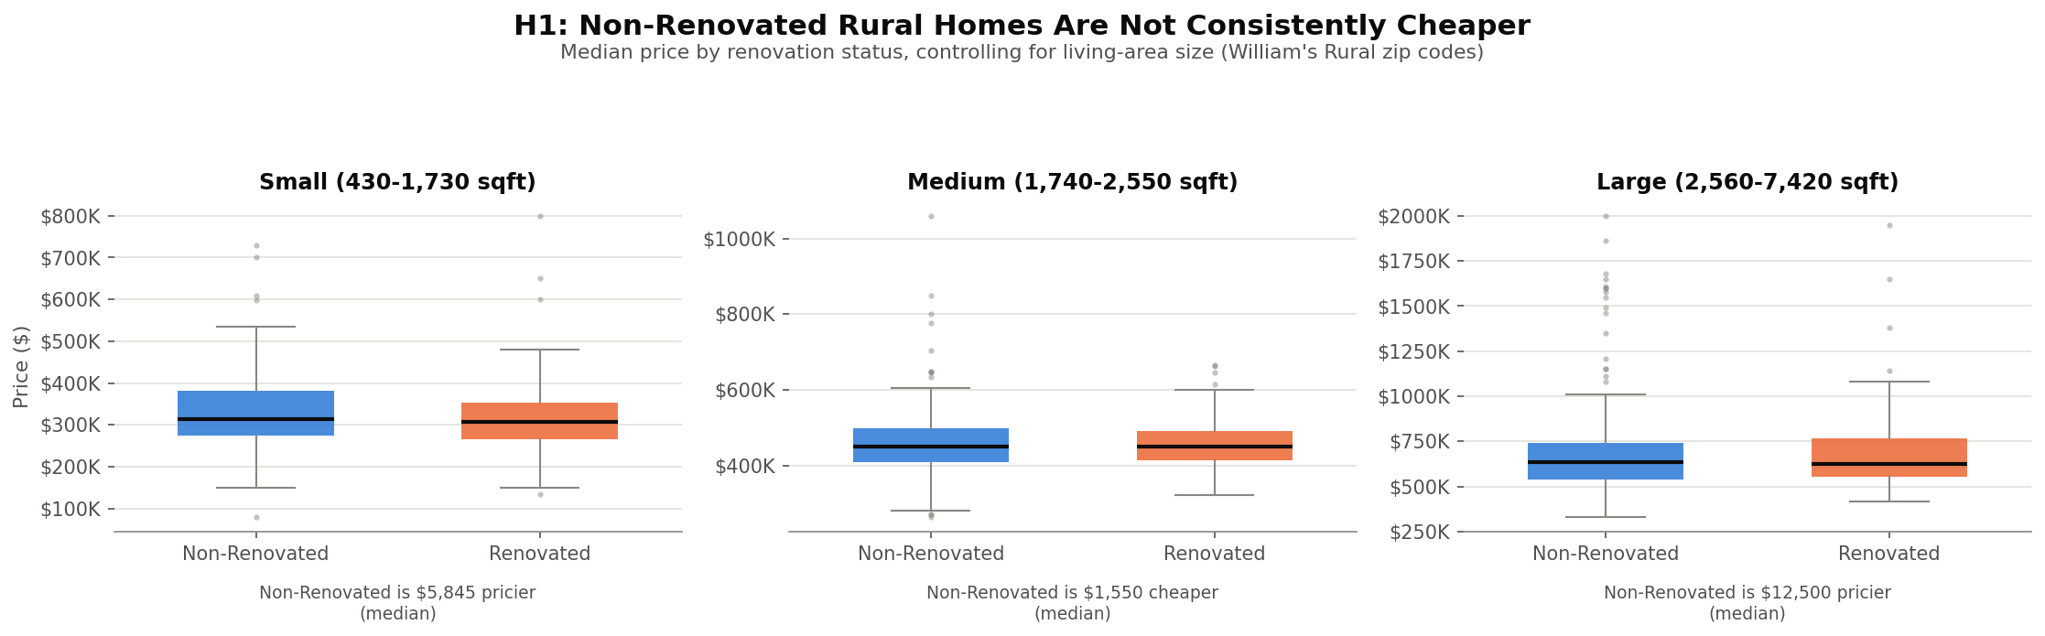
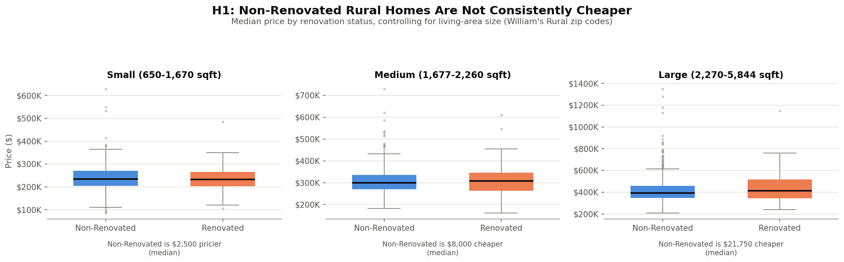
H1 Chart
Price by Renovation Status (by Size)
Effect direction is mixed across Small / Medium / Large rural homes

Slide 8
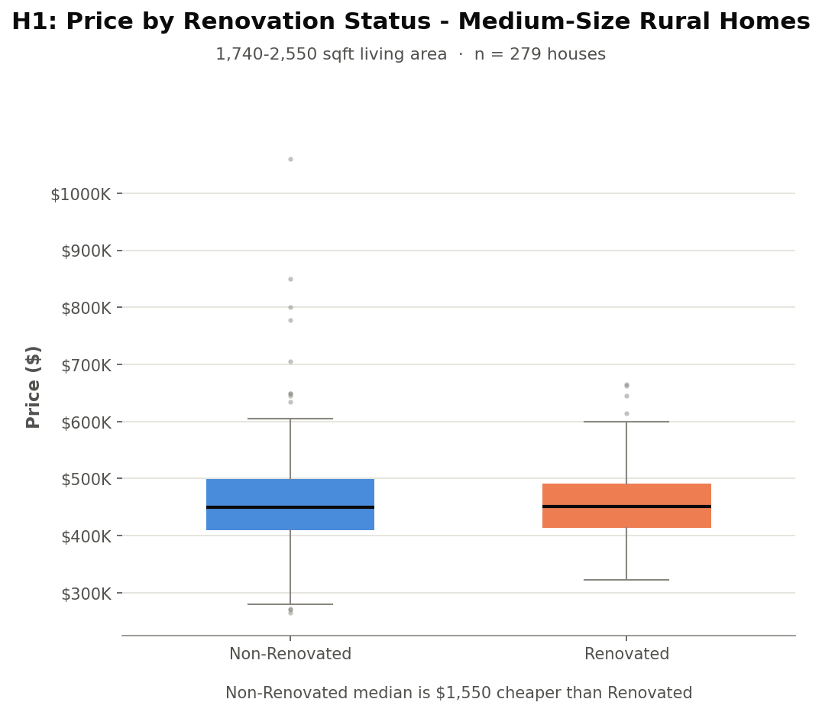
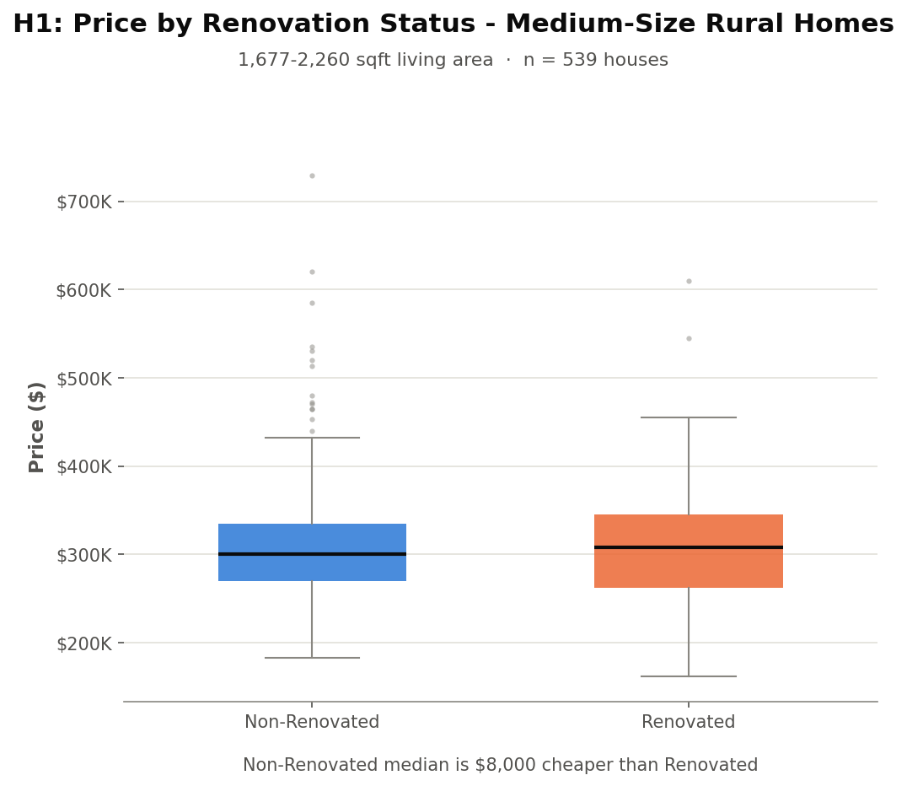
H1 Chart
Price by Renovation Status (Medium Only)
Focus view: the size band actually used for William's two candidates

Slide 9
H1 Recommendations
Two Rural Homes for William
House #1 - Zip 98014
House #2 - Zip 98045
Price
$265,000
Price
$271,000
Living Area
1,850 sqft
Living Area
1,800 sqft
Bed / Bath
3 / 2.0
Bed / Bath
4 / 1.5
Year Built
1992
Year Built
1977
Lot Size
16,535 sqft
Lot Size
9,576 sqft
Why William will love it:
Why William will love it:
✓ Genuinely rural (RUCA-classified)
✓ More bedrooms, similar price
✓ Non-renovated = lower price
✓ Genuinely rural (RUCA-classified)
✓ Lowest price in candidate pool
✓ Second-lowest price in pool

Slide 10
H2: Lot Size vs Distance
From Downtown Seattle
Testing whether lot size grows the farther a home is from downtown

Slide 11
H2 Analysis
Distance vs Lot Size - Findings
Key Findings
Key Metrics
• Positive correlation confirmed
Distance
Avg Lot Size
• Effect: +1,440 sqft/mile out
5 mi
~5,000 sqft
• Highly significant (p < 0.001)
10 mi
~14,400 sqft
• ~20,900 houses analyzed
15 mi
~19,000 sqft
• H2 hypothesis confirmed
20 mi
~23,600 sqft
Correlation
r = 0.2435

Slide 12
H2 Analysis
House Selection Criteria
Two Distance Tiers
Selection Criteria
→ Suburban: ~10-15 miles out
Criteria
Target
→ Rural: 15+ miles out
Suburban Dist.
✓ ~14.6 mi
→ Pick largest lot in each band
Rural Dist.
✓ ~29.7 mi
→ Both Non-Renovated
Suburban Lot
✓ 641,203 sqft
→ Two distinct price/space tiers
Rural Lot
✓ 1,651,359 sqft
Homes Found
✓ 2

Slide 13
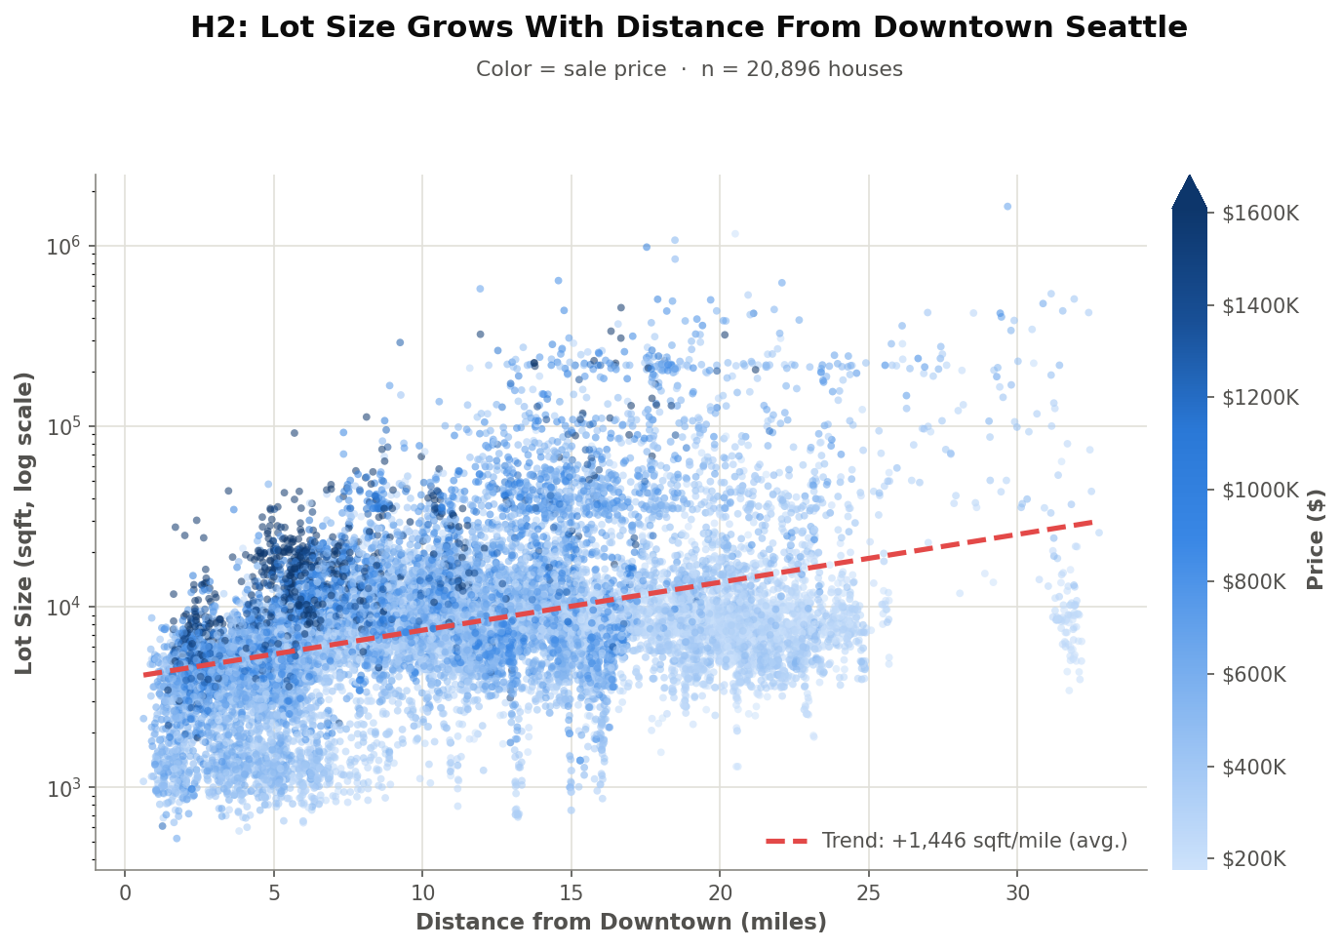
H2 Chart
Lot Size Grows With Distance (Colored by Price)
An interactive Seattle map version (zoomable) is also available in work_and_report/figures/

Slide 14
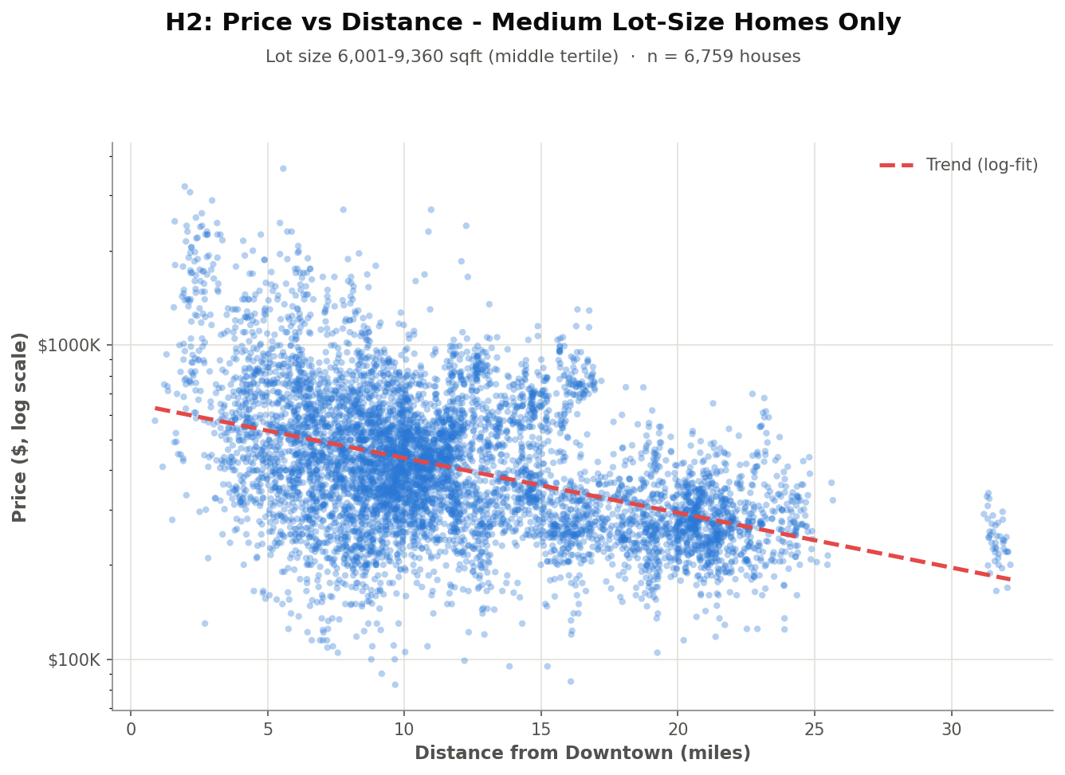
H2 Chart
Price vs Distance (Medium Lot-Size Homes)
Among similarly-sized lots, price still drops sharply the farther out you go

Slide 15
H2 Chart - Interactive
Explore the Map Yourself
H2_plot_lotsize_geographic_map.html
Click to open (works in PowerPoint/Keynote)
Every house in Seattle, zoomable and pannable.
Toggle the color between Lot Size and Price.
Hover any point for price, lot size, and distance.
If the link doesn't open (common in PDF viewers like Preview):
Open Finder → navigate to the project folder → work_and_report → figures
then double-click H2_plot_lotsize_geographic_map.html

Slide 16
H2 Recommendations
Suburban and Rural Options
Suburban - Zip 98070
Rural - Zip 98022
Price
$849,900
Price
$700,000
Distance
14.56 mi
Distance
29.66 mi
Lot Size
641,203 sqft
Lot Size
1,651,359 sqft
Living Area
2,280 sqft
Living Area
1,300 sqft
Bed / Bath
2 / 2
Bed / Bath
4 / 1
Why William will love it:
Why William will love it:
✓ Quiet and peaceful, not too far
✓ Maximum quiet and solitude
✓ Large lot for outdoor space
✓ Huge lot: maximum privacy
✓ Confirmed by H2: closer-in large lot
✓ Cheaper than the suburban option

Slide 17
H3: Floors vs Lot Size
Urban City House Analysis
Testing whether multi-floor homes sit on smaller, more compact lots

Slide 18
H3 Analysis
Floors vs Lot Size - Findings & Criteria
Key Findings
Selection Criteria
Negative correlation: r = -0.316
Floors
✓ ≥ 2
Highly significant: p < 0.0001
Lot Size
✓ ≤ 7,200 sqft (median)
18,404 Urban houses analyzed
Location
✓ Urban (RUCA 1)
4,706 houses match criteria
Sort Order
✓ Price descending
Compact lots = vertical living
Assumption*
✓ Pricier sells faster
Homes Found
✓ 2 (tied at $2.95M)

Slide 19
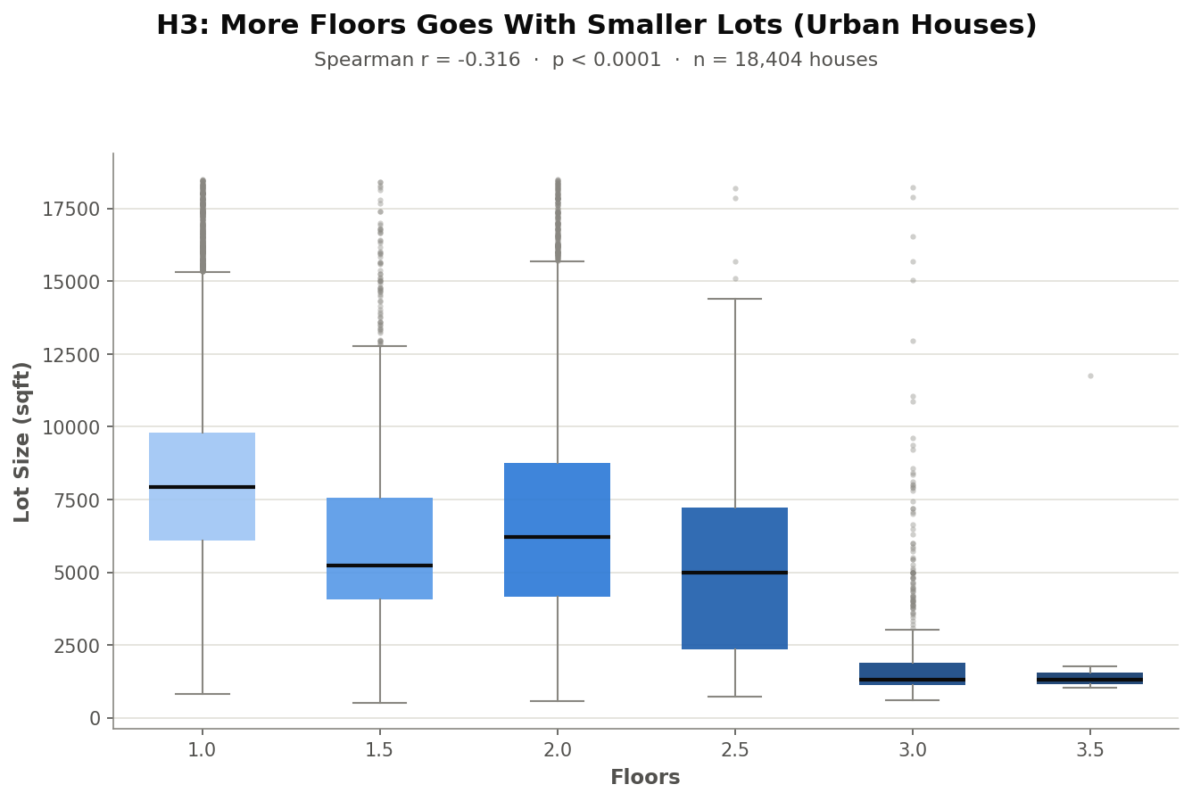
H3 Chart
Lot Size by Floor Count (Urban Houses)
More floors goes with smaller lots - r = -0.316, p < 0.0001, n = 18,404

Slide 20
H3 Recommendations
Two Compact City Homes
House #1 - Zip 98107
House #2 - Zip 98199
Price
$2,950,000
Price
$2,950,000
Floors
3.0
Floors
2.0
Lot Size
5,722 sqft
Lot Size
5,884 sqft
Living Area
4,340 sqft
Living Area
4,470 sqft
Bed / Bath
5 / 4.5
Bed / Bath
4 / 4.25
Why William will love it:
Why William will love it:
✓ Genuinely vertical, compact footprint
✓ Slightly larger living area
✓ Well below the Urban median lot
✓ Well below the Urban median lot
✓ Tied for highest price - assumed fastest sale
✓ Tied for highest price - assumed fastest sale

Slide 21
Insights
Two-House Strategy Summary
William's Country House + City House
🌳 Country House - H1
📍 Country House - H2
🏙️ City House (H3)
• Rural, Non-Renovated
• 10mi+ = bigger lots
• 2+ floors, compact lot
• Medium size preferred
• Suburban or Rural tiers
• Urban core (RUCA 1)
• $265K - $271K range
• $700K - $850K range
• Candidates: tied at $2.95M

Slide 22
Q&A
Thank you for listening and paying attention

