Slide 1
William Rodriguez
Two-House Buyer Recommendations
Data-Driven Home Recommendations Based on Market Hypotheses
Done by Mohammad Bajbouj & Tim Pfeifer

Slide 2
Overview
Contents
1. Workflow Overview
2. H1 Analysis, Recommendations & Charts
3. H2 Analysis, Recommendations & Charts
4. H3 Analysis, Recommendations & Charts
5. Two-House Strategy Summary

Slide 3
Workflow
Data Analysis Pipeline
1
2
3
4
5
Data Prep
→
Cleaning
→
H1 Analysis
→
H2 Analysis
→
H3 Analysis
Load King County
~21K properties
IQR outliers
Duplicate check
Renovation vs price
Rural homes
Distance vs lot size
+1,440 sqft/mi
Floors vs lot size
Urban compact
William's Targets:
H1: Data-Driven Home Recommendations Based on Market Hypotheses
H2: Testing whether lot size grows the farther a home is from downtown
H3: 2+ Floors, Urban

Slide 4
H1: Price vs Renovation Status
Country House Analysis
Testing whether non-renovated rural homes are cheaper, controlling for size

Slide 5
H1 Analysis
Price vs Renovation - Findings
Key Findings
Key Metrics
• Rural houses only (7 zip codes, by density)
Test Used
Mann-Whitney U
• Effect direction varies by size
Medium n
354 houses
• Medium homes: $5K pricier (non-reno)
p-value
0.918
• Large homes: $5K cheaper (non-reno)
Significant?
No
• Small homes: $3K pricier (non-reno)
Median Gap
$5,000
→ Conclusion: data does not support H1 - no tier is significant, and the effect direction flips between tiers
Rural Zips
7 zips (density)

Slide 6
H1 Analysis
House Selection Criteria
Property Targets
Selection Criteria
✓ Location: Rural (quiet, private)
Criteria
Target
✓ Renovation: Non-Renovated
Location
✓ Rural
✓ Size: Medium (1,570-2,280 sqft)
Renovation
✓ Non-Renovated
✓ Sorted by price (best value)
Size Range
✓ Medium
✓ Matches "space over polish" persona
Zipcode
✓ 98022
Homes Found
✓ 2

Slide 7
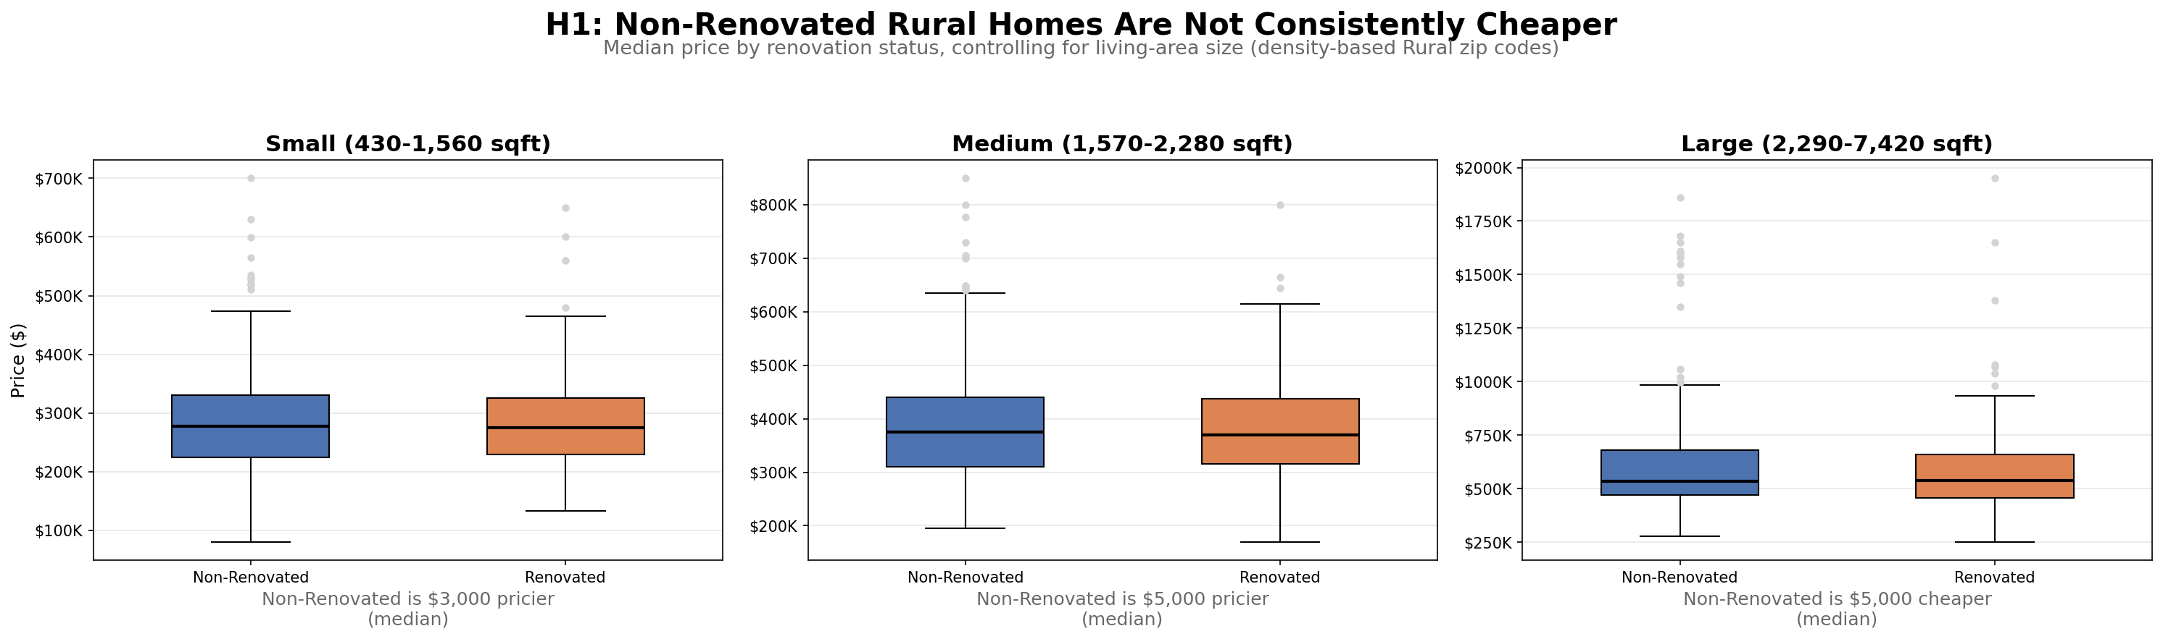
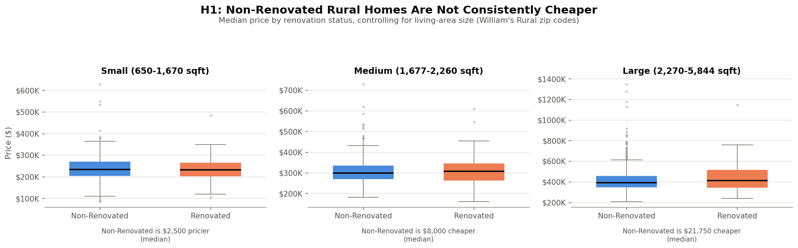
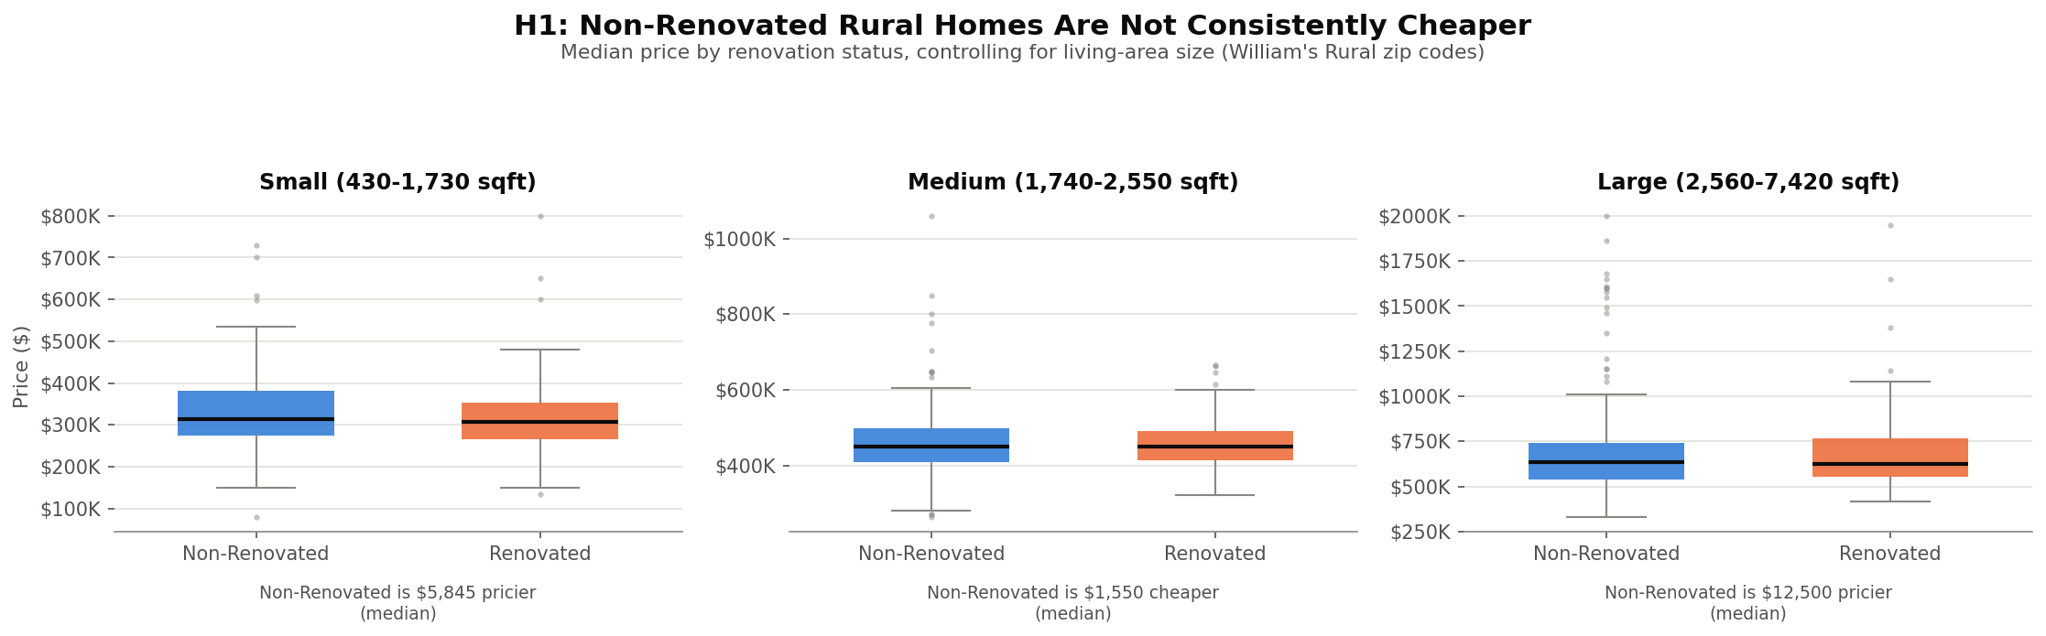
H1 Chart
Price by Renovation Status (by Size)
Effect direction is mixed across Small / Medium / Large rural homes

Slide 8
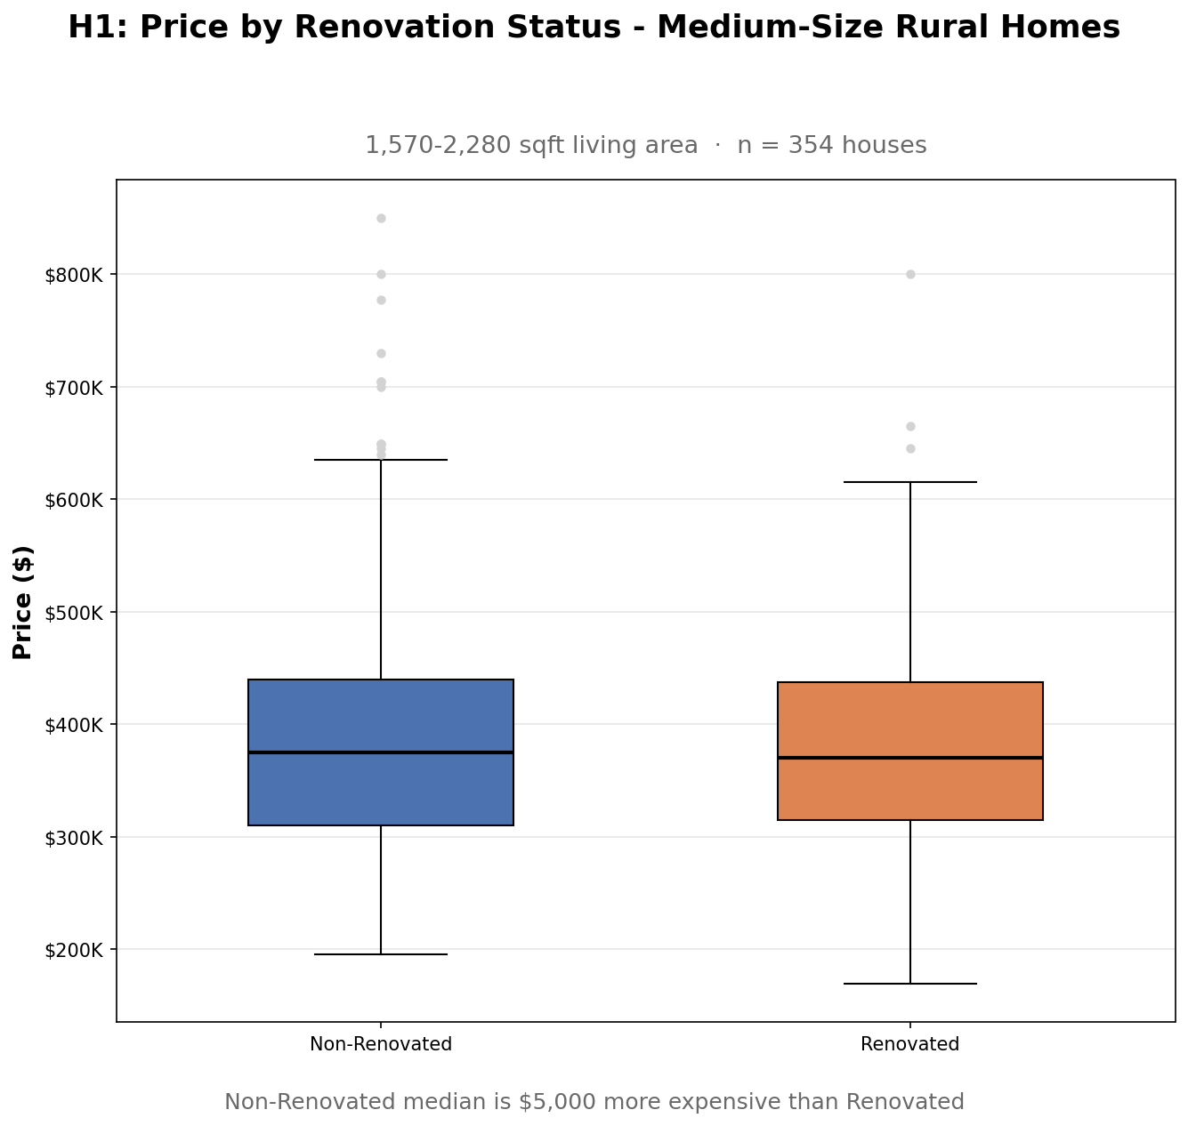
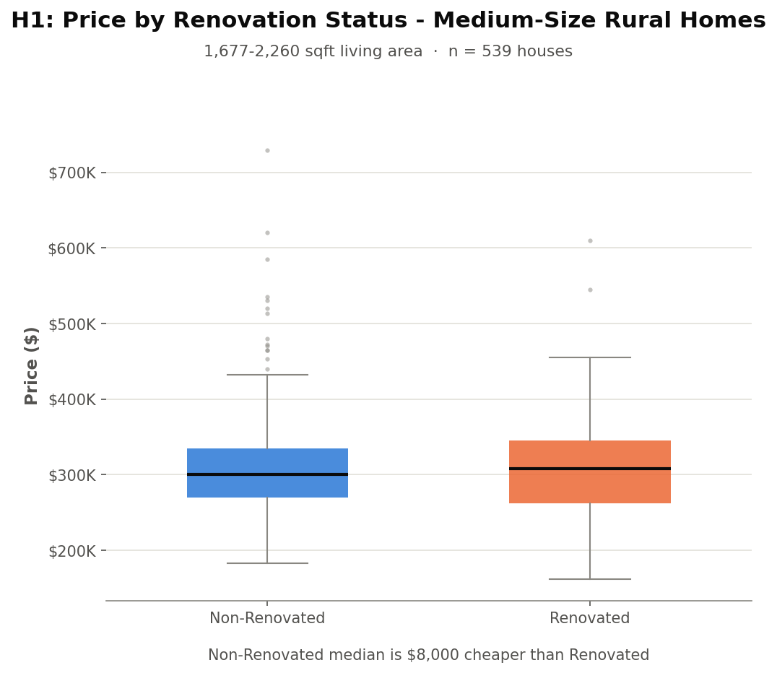
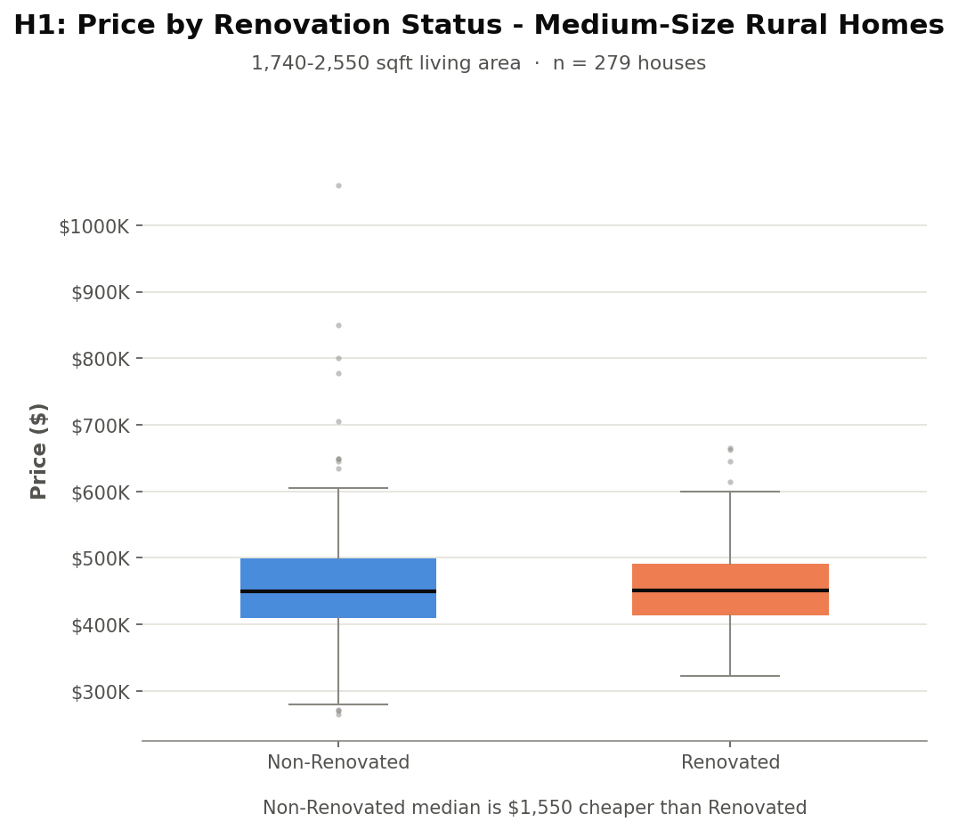
H1 Chart
Price by Renovation Status (Medium Only)
Focus view: the size band actually used for William's two candidates

Slide 9
H1 Recommendations
Two Rural Homes for William
House #1 - Zip 98022
House #2 - Zip 98022
Price
$195,000
Price
$195,000
Living Area
1,580 sqft
Living Area
1,570 sqft
Bed / Bath
3 / 1.75
Bed / Bath
3 / 1.75
Year Built
1979
Year Built
1991
Lot Size
7,875 sqft
Lot Size
8,459 sqft
Why William will love it:
Why William will love it:
✓ Rural, quiet, no close neighbors
✓ Newer build, slightly larger lot
✓ Non-renovated = lower price
✓ Same price as House #1
✓ Tied for lowest price in candidate pool
✓ Tied for lowest price in candidate pool

Slide 10
H1 Methodology Note
Housing Density Identifies Rural vs Urban
• Earlier attempts using single features (lot size, distance from downtown, sales per zip) didn't reliably separate Rural from Urban.
• Instead, we use housing density: sales per km2, from each zip code's own lat/long bounding box - no external data needed.
• The Rural/Urban split point also comes from the data itself: the largest natural gap in the density distribution, at 1.04 houses/km2.
• This identifies 7 Rural zip codes: 98010, 98014, 98019, 98022, 98024, 98045, 98070.
• Checked against the official RUCA classification (for validation only): 80% recall, 94.3% accuracy - beating the 92.9% “always Urban” baseline.
• Conclusion: housing density, derived entirely from the original dataset, is a real way to identify Rural vs Urban zip codes.

Slide 11
H2: Lot Size vs Distance
From Downtown Seattle
Testing whether lot size grows the farther a home is from downtown

Slide 12
H2 Analysis
Distance vs Lot Size - Findings
Key Findings
Key Metrics
• Positive correlation confirmed
Distance
Avg Lot Size
• Effect: +1,440 sqft/mile out
5 mi
~5,000 sqft
• Highly significant (p < 0.001)
10 mi
~14,400 sqft
• ~20,900 houses analyzed
15 mi
~19,000 sqft
• H2 hypothesis confirmed
20 mi
~23,600 sqft
Correlation
r = 0.2435

Slide 13
H2 Analysis
House Selection Criteria
Two Distance Tiers
Selection Criteria
→ Suburban: ~10-15 miles out
Criteria
Target
→ Rural: 15+ miles out
Suburban Dist.
✓ ~14.6 mi
→ Pick largest lot in each band
Rural Dist.
✓ ~29.7 mi
→ Both Non-Renovated
Suburban Lot
✓ 641,203 sqft
→ Two distinct price/space tiers
Rural Lot
✓ 1,651,359 sqft
Homes Found
✓ 2

Slide 14
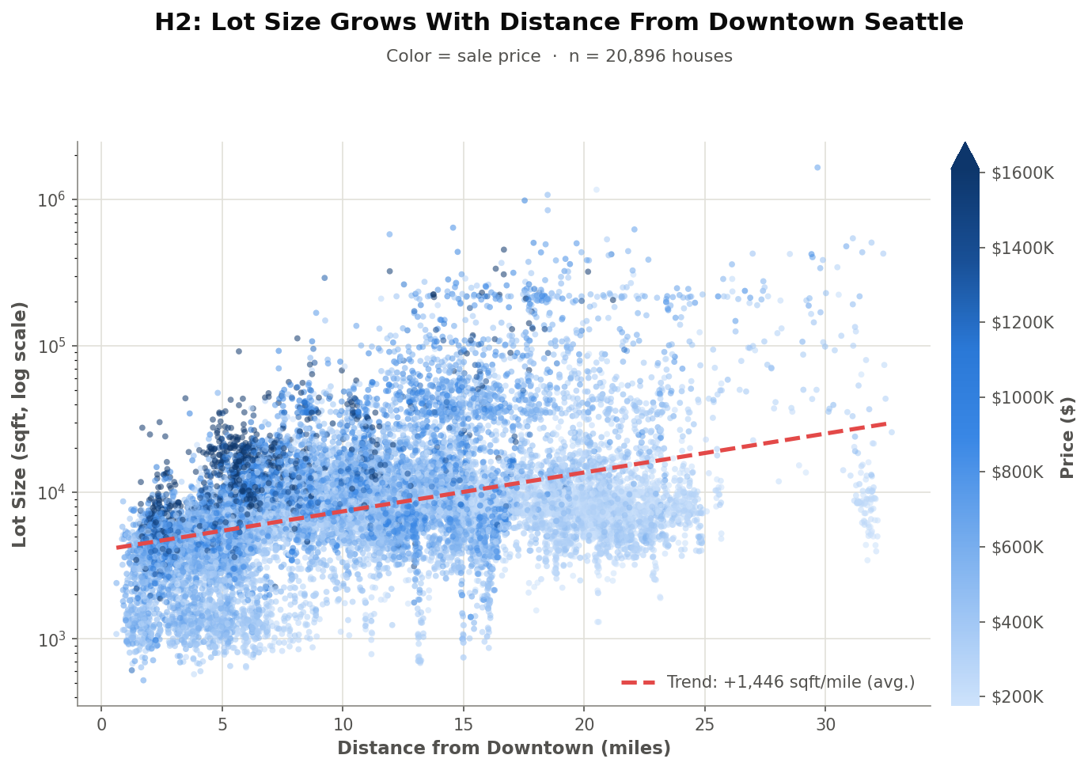
H2 Chart
Lot Size Grows With Distance (Colored by Price)
An interactive Seattle map version (zoomable) is also available in work_and_report/figures/

Slide 15
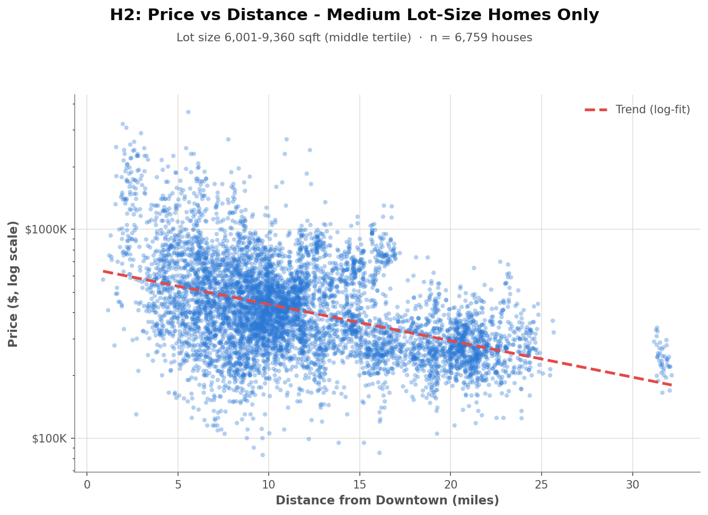
H2 Chart
Price vs Distance (Medium Lot-Size Homes)
Among similarly-sized lots, price still drops sharply the farther out you go

Slide 16
H2 Chart - Interactive
Explore the Map Yourself
H2_plot_lotsize_geographic_map.html
Click to open (works in PowerPoint/Keynote)
Every house in Seattle, zoomable and pannable.
Toggle the color between Lot Size and Price.
Hover any point for price, lot size, and distance.
If the link doesn't open (common in PDF viewers like Preview):
Open Finder → navigate to the project folder → work_and_report → figures
then double-click H2_plot_lotsize_geographic_map.html

Slide 17
H2 Recommendations
Suburban and Rural Options
Suburban - Zip 98070
Rural - Zip 98022
Price
$849,900
Price
$700,000
Distance
14.56 mi
Distance
29.66 mi
Lot Size
641,203 sqft
Lot Size
1,651,359 sqft
Living Area
2,280 sqft
Living Area
1,300 sqft
Bed / Bath
2 / 2
Bed / Bath
4 / 1
Why William will love it:
Why William will love it:
✓ Quiet and peaceful, not too far
✓ Maximum quiet and solitude
✓ Large lot for outdoor space
✓ Huge lot: maximum privacy
✓ Confirmed by H2: closer-in large lot
✓ Cheaper than the suburban option

Slide 18
H3: Floors vs Lot Size
Urban City House Analysis
Testing whether multi-floor homes sit on smaller, more compact lots

Slide 19
H3 Analysis
Floors vs Lot Size - Findings & Criteria
Key Findings
Selection Criteria
Negative correlation: r = -0.316
Floors
✓ ≥ 2
Highly significant: p < 0.0001
Lot Size
✓ ≤ 7,200 sqft (median)
18,404 Urban houses analyzed
Location
✓ Urban (RUCA 1)
4,706 houses match criteria
Sort Order
✓ Price descending
Compact lots = vertical living
Assumption*
✓ Pricier sells faster
Homes Found
✓ 2 (tied at $2.95M)

Slide 20
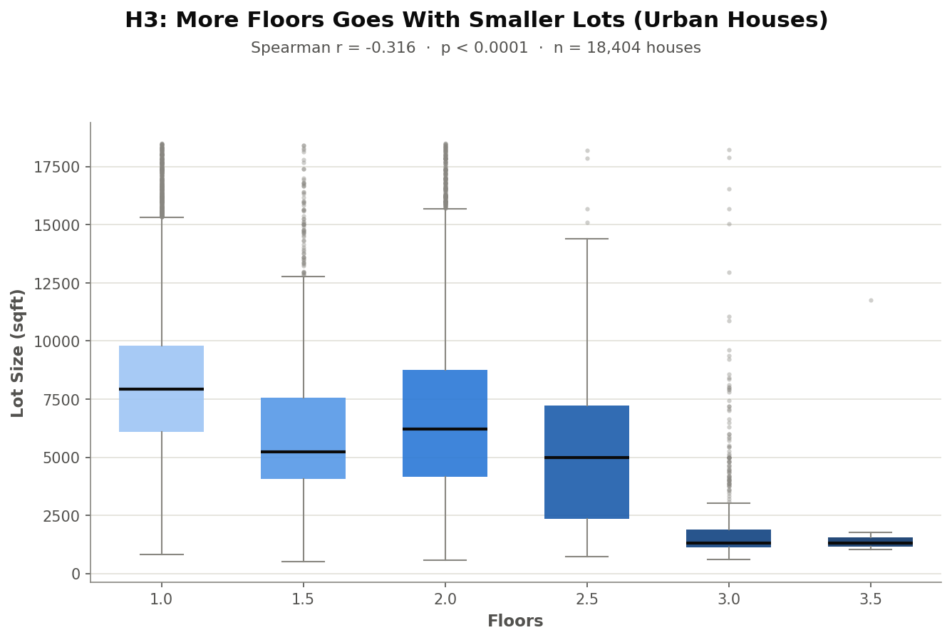
H3 Chart
Lot Size by Floor Count (Urban Houses)
More floors goes with smaller lots - r = -0.316, p < 0.0001, n = 18,404

Slide 21
H3 Recommendations
Two Compact City Homes
House #1 - Zip 98107
House #2 - Zip 98199
Price
$2,950,000
Price
$2,950,000
Floors
3.0
Floors
2.0
Lot Size
5,722 sqft
Lot Size
5,884 sqft
Living Area
4,340 sqft
Living Area
4,470 sqft
Bed / Bath
5 / 4.5
Bed / Bath
4 / 4.25
Why William will love it:
Why William will love it:
✓ Genuinely vertical, compact footprint
✓ Slightly larger living area
✓ Well below the Urban median lot
✓ Well below the Urban median lot
✓ Tied for highest price - assumed fastest sale
✓ Tied for highest price - assumed fastest sale

Slide 22
Insights
Two-House Strategy Summary
William's Country House + City House
🌳 Country House - H1
📍 Country House - H2
🏙️ City House (H3)
• Rural, Non-Renovated
• 10mi+ = bigger lots
• 2+ floors, compact lot
• Medium size preferred
• Suburban or Rural tiers
• Urban core (RUCA 1)
• $195K (both candidates)
• $700K - $850K range
• Candidates: tied at $2.95M

Slide 23
Q&A
Thank you for listening and paying attention

