Slide 1
William Rodriguez
Two-House Buyer Recommendations
Data-Driven Home Recommendations Based on Market Hypotheses
Done by Mohammad Bajbouj & Tim Pfeiffer

Slide 2
Overview
Contents
1. Persona William Rodriguez
2. Workflow Overview
3. Hypothesis 1 Analysis: Price vs Renovation Status
4. Hypothesis 2 Analysis: Lot Size vs Distance
5. Hypothesis 3 Analysis: Floors vs Lot Size

Slide 3
Persona
Buyer William Rodriguez
What he wants
William Rodriguez is house-hunting for two people and wants to buy two homes: a non-renovated country house he can purchase at the right time, and a fast-moving, centrally located city house.

Slide 4
Workflow
Data Analysis Pipeline
1
2
3
4
5
Data Prep
→
Cleaning
→
H1 Analysis
→
H2 Analysis
→
H3 Analysis
Load King County
~21K properties
IQR outliers
Duplicate check
Renovation status vs price
Rural homes
Distance vs lot size
Rural homes
Floors vs lot size
Urban homes
Our Hypotheses
H1: The more renovated, the higher the price
H2: The farther from downtown, the bigger the lot
H3: The more floors, the smaller the lot

Slide 5
H1: Price vs Renovation Status
Country House Analysis
The more renovated, the higher the price

Slide 6
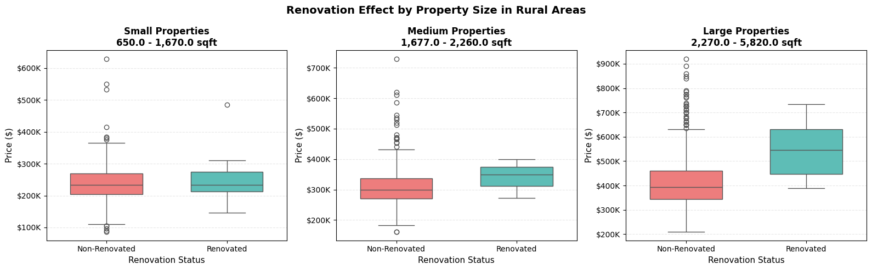
H1 Chart
Price by Renovation Status
Key Findings: The more renovated, the higher the price

Slide 7
H1 Analysis
House Selection Criteria
Selection Criteria
Criteria
Target
Location
✓ Rural
Renovation
✓ Non-Renovated
Size Range
✓ Medium
Zipcode
✓ 98022
Homes Found
✓ 2

Slide 8
H1 Recommendations
Two Rural Homes for William
House #1 - Zip 98022
House #2 - Zip 98022
Price
$195,000
Price
$195,000
Living Area
1,580 sqft
Living Area
1,570 sqft
Bed / Bath
3 / 1.75
Bed / Bath
3 / 1.75
Year Built
1979
Year Built
1991
Lot Size
7,875 sqft
Lot Size
8,459 sqft
Why William will love it:
Why William will love it:
✓ Rural, quiet, no close neighbors
✓ Newer build, slightly larger lot
✓ Non-renovated = lower price
✓ Same price as House #1
✓ Tied for lowest price in candidate pool
✓ Tied for lowest price in candidate pool

Slide 9
H2: Lot Size vs Distance
From Downtown Seattle
The farther from downtown, the bigger the lot

Slide 10
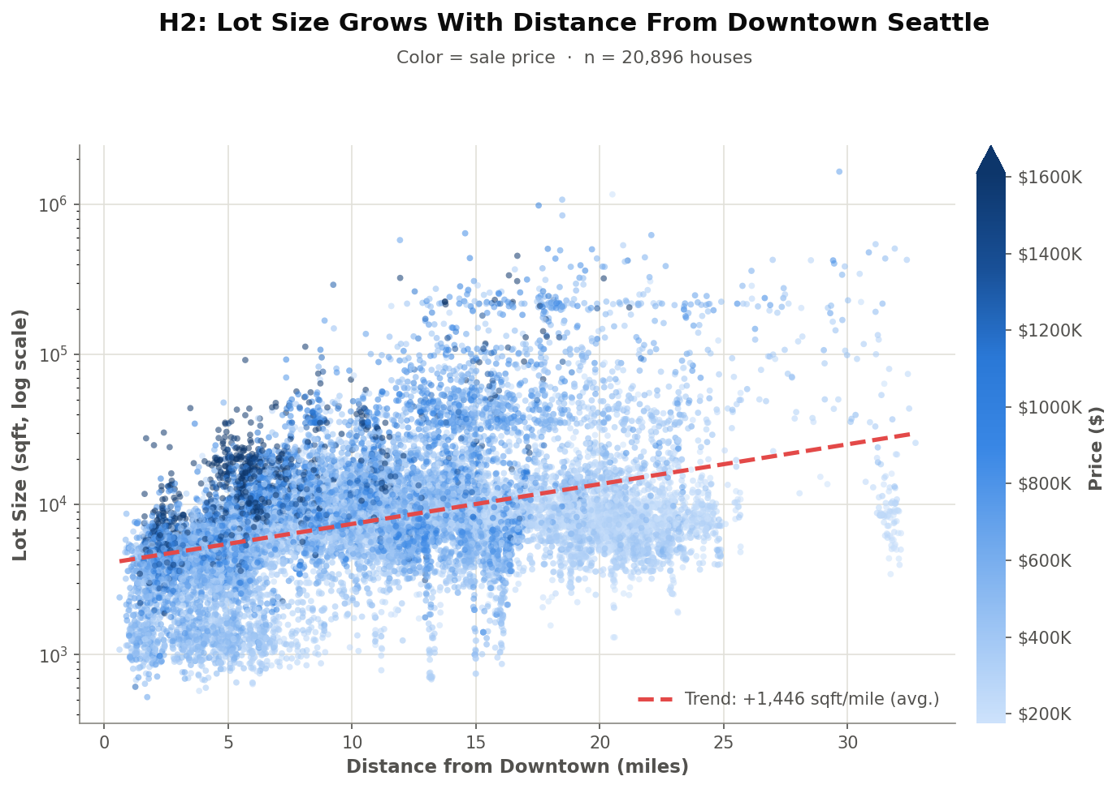
H2 Chart
Lot Size Grows With Distance (Colored by Price)
Key Findings:
The bigger the distance from downtown, the bigger the lot size
Trend: +1,446 sqft/mile (avg.)

Slide 11
H2 Analysis
House Selection Criteria
Selection Criteria
Criteria
Target
Suburban Dist.
✓ ~14.6 mi
Rural Dist.
✓ ~29.7 mi
Suburban Lot
✓ 641,203 sqft
Rural Lot
✓ 1,651,359 sqft
Homes Found
✓ 2

Slide 12
H2 Recommendations
Suburban & Rural Options
Suburban - Zip 98070
Rural - Zip 98022
Price
$849,900
Price
$700,000
Distance
14.56 mi
Distance
29.66 mi
Lot Size
641,203 sqft
Lot Size
1,651,359 sqft
Living Area
2,280 sqft
Living Area
1,300 sqft
Bed / Bath
2 / 2
Bed / Bath
4 / 1
Why William will love it:
Why William will love it:
✓ Quiet and peaceful, not too far
✓ Maximum quiet and solitude
✓ Large lot for outdoor space
✓ Huge lot: maximum privacy
✓ Confirmed by H2: closer-in large lot
✓ Cheaper than the suburban option

Slide 13
H3: Floors vs Lot Size
Urban City House Analysis
The more floors, the smaller the lot

Slide 14
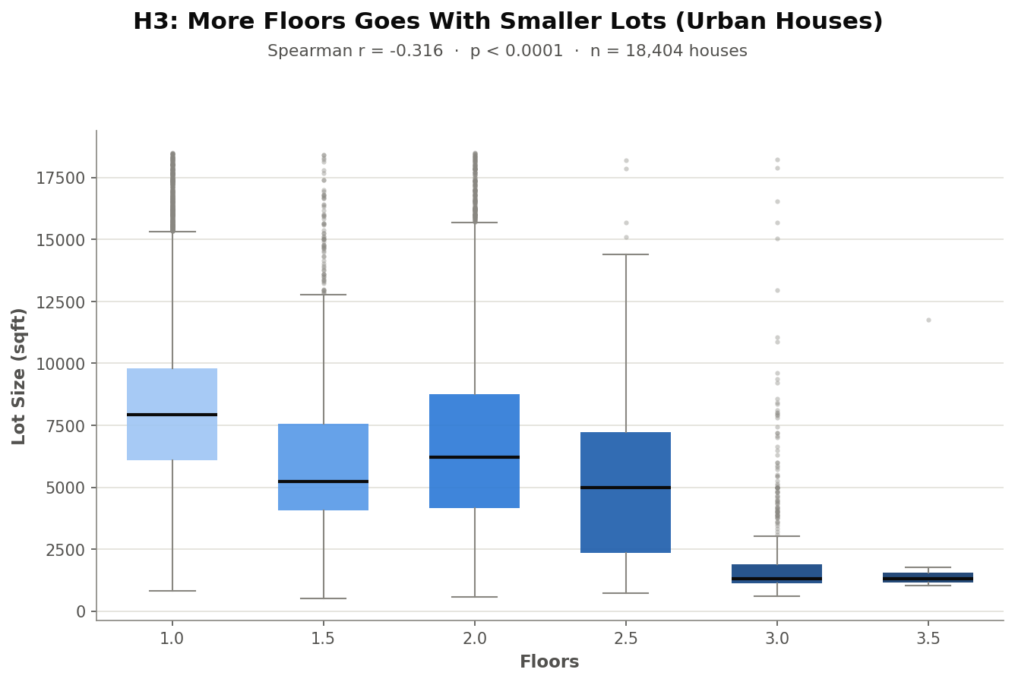
H3 Chart
Lot Size by Floor Count (Urban Houses)
Key Findings:
The more floors, the smaller the lot
Pearson’s r = - 0.316

Slide 15
H3 Analysis
Floors vs Lot Size - Selection Criteria
Selection Criteria
Floors
✓ ≥ 2
Lot Size
✓ ≤ 7,200 sqft (median)
Location
✓ Urban (RUCA 1)
Sort Order
✓ Price descending
Assumption
✓ Pricier sells faster (proxy for demand)
Homes Found
✓ 2 (tied at $2.95M)
18,404 Urban houses analyzed
4,706 match criteria; top 2 by price shown

Slide 16
H3 Recommendations
Two Compact City Homes
House #1 - Zip 98107
House #2 - Zip 98199
Price
$2,950,000
Price
$2,950,000
Floors
3.0
Floors
2.0
Lot Size
5,722 sqft
Lot Size
5,884 sqft
Living Area
4,340 sqft
Living Area
4,470 sqft
Bed / Bath
5 / 4.5
Bed / Bath
4 / 4.25
Why William will love it:
Why William will love it:
✓ Genuinely vertical, compact footprint
✓ Slightly larger living area
✓ Well below the Urban median lot
✓ Well below the Urban median lot
✓ Tied for highest price - assumed fastest sale
✓ Tied for highest price - assumed fastest sale

Slide 17
Q&A
Thank you for listening and paying attention

