Slide 1
Smart House.
By:
Mohammed Ma’moun Zyoud 201910443
Mohammed Fawzi Daraghmeh 201911182
Mohammad Mohyee Majed 201920057

Slide 2
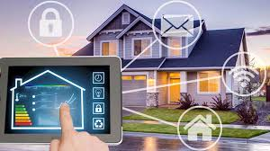
Introduction.
Smart Houses has become popular worldwide because the time it saves for us even if it is a minute it will be important in another aspect of life like work or get some rest…, and the comfortable it gives us. and all of this comes from the advance in the technology.

Slide 3
Project Pre-Initiation and Initiation.
Some points from the Business Case:
Business Objective The project aims to make a smart house controlled by smart phone and voice command
3.0 Current Situation and Problem/Opportunity Statement Opportunity: There are opportunities for businesses to change their product management approach by giving a free base and then selling their services, for example, a home monitoring base station may be installed for “free,” but services that send alerts such as burglar alarms, and smoke detection alarms are billed.
4.0 Critical Assumption and Constraints 1- Unstable prices of used tool’s 2- Internet connection interruption. 3-Area of building.
6.0 Preliminary Project Requirements Establish the budget and schedule. Hiring a highly experienced consultant with extensive technical knowledge. Central Hub: A central hub is the brain of the smart home. Sensors and Devices: Sensors and devices such as motion sensors, temperature sensors, smart thermostats, smart lighting etc. Voice Control: The smart home should have the option of voice control Mobile Control: The smart home should also have the option of controlling and monitoring the devices

Slide 4
Planning.
Scope Product-related deliverables:
Smart House System Architecture: A detailed architecture diagram and documentation outlining the overall structure and components of the smart house system.
User Interfaces: the creation of user interfaces for interacting and controlling the smart house system
Installation Instructions: Detailed instructions and suggestions, including any hardware devices, wiring, or networking needs, are provided for installing the smart home system's component parts.
Configuration and setup instructions: instructions for setting up and customizing the smart home system in detail. This covers system initialization procedures, device pairing, network configuration, and user account creation.
User Guides and Manuals: Information geared at end-users that explains how to use and operate the smart home system's capabilities.
Testing and Validation Reports: Documentation summarizing the testing done on the smart home system, including performance testing, security testing, integration testing, and functional testing.

Slide 5
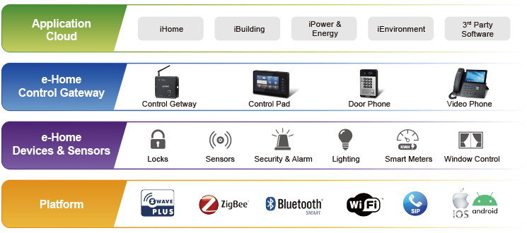
Device used to build the smart house

Slide 6
WBS Dictionary Entry Execution Part

Slide 7
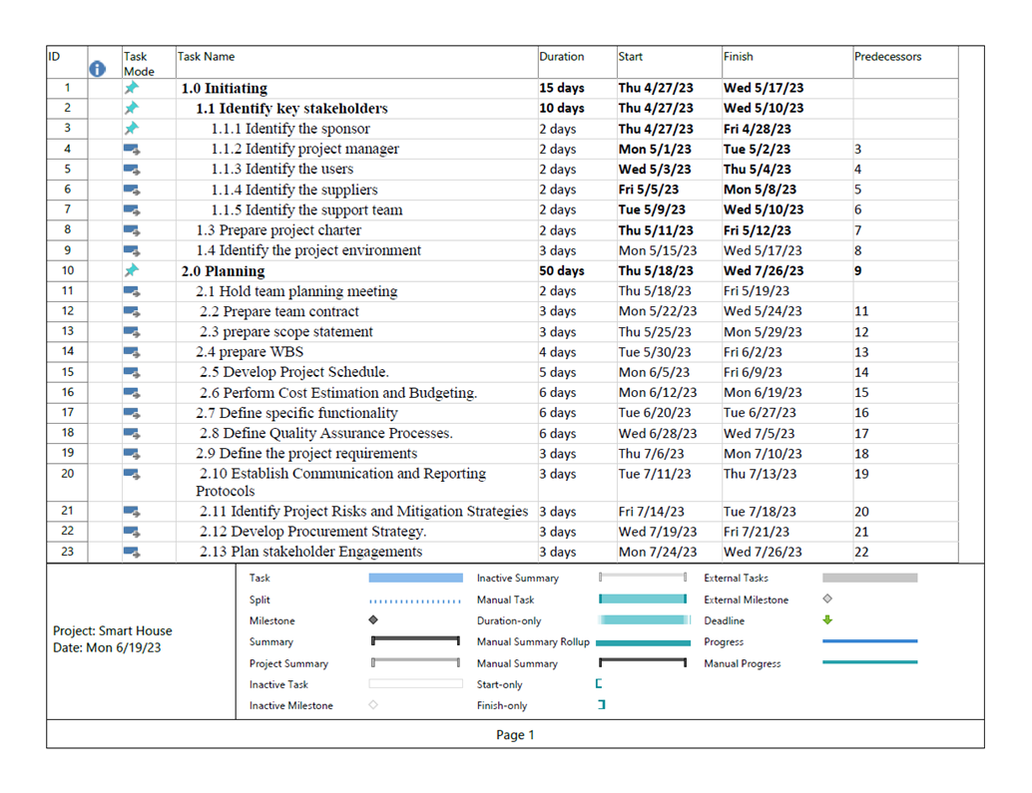
Project Schedule

Slide 8
Project Financial Analysis

Slide 9
Project Monitoring and Controlling
Our plan to monitor and control the project is by a reviewing what it is done the previous week and continue from there. Of course we intend to finish it within the given time by the sponsors. And the every week there will be report given to the project-manager or above to see if the project failing behind or not.
Closing
In this stage we must conform with customer if the house is build and integrated as he would like it to be. Which means the coffee-machine must produce the coffee in the morning when he wake up so that his day will be great for him or the lambs turn on or off when the customer tell them to and so on.

Slide 10
Expected Risks
Data Privacy and Security Risks
Technical Risks
User Acceptance and Usability Risks
Project Management Risks
Infrastructure and Connectivity Risks
Regulatory and Compliance Risks
External Risks
Difficulties in importing some tools.
Internet connection problem.
the prices of tools

Slide 11
Any
Questions?

