Slide 1
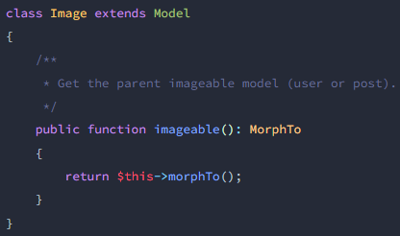
Relations
images
users
posts

Slide 2
Log::info(print_r($var, true));
php artisan optimize:clear
php artisan db:seed --class=UserSeeder
npm cache clean --force
php artisan migrate:refresh --path=/database/migrations/2024_07_28_130648_create_buys_details_confirms_table.php
git rm -r --cached storage/logs
وقتی یک پرمیشن جدید مزنم
php artisan cache:forget spatie.permission.cache

