Slide 1
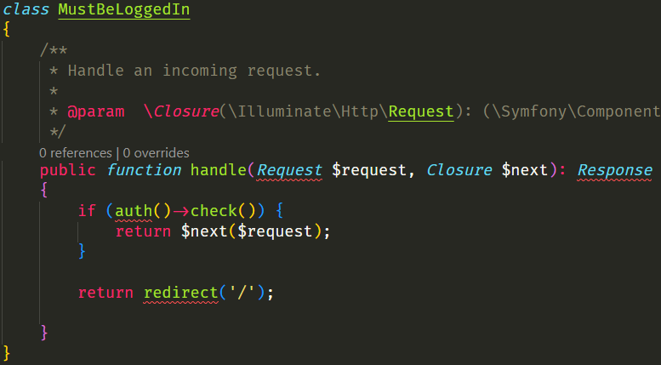

Middleware
Path: \bootstrap\app.php
php artisan make:middleware MiddleWareName

Slide 2
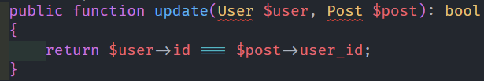
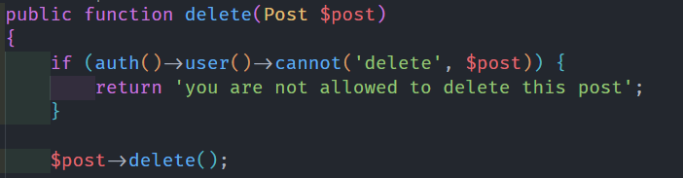

Policy
Path: app/policies
php artisan make:policy ModelNamePolicy –-model=ModelName

Slide 3
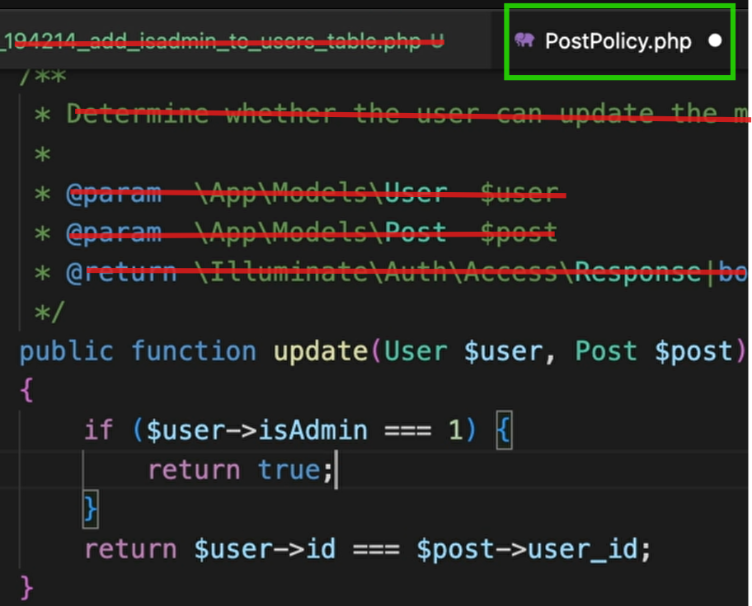
Moderator and gate
Path: app/policies

Slide 4
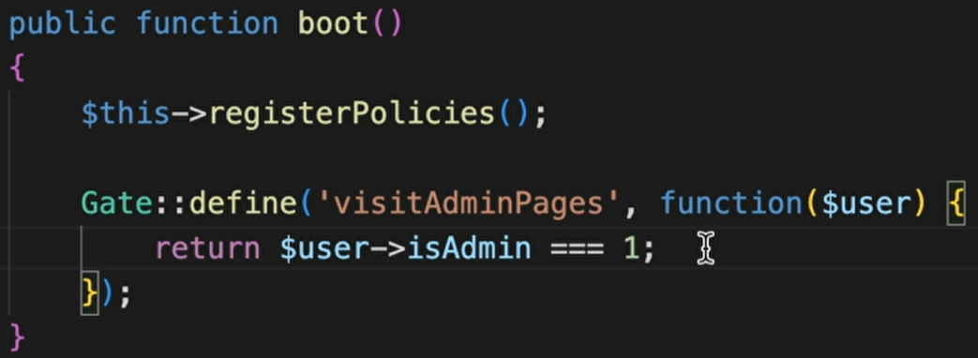
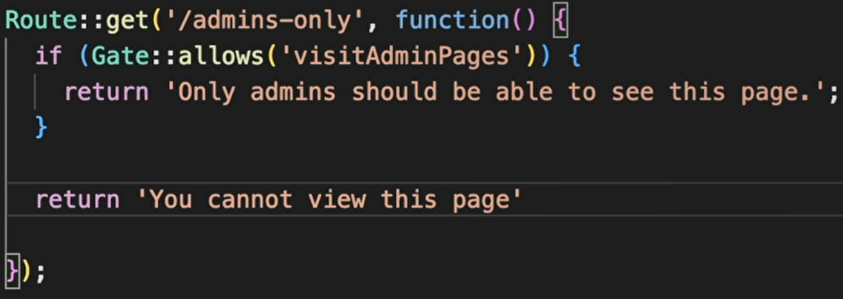
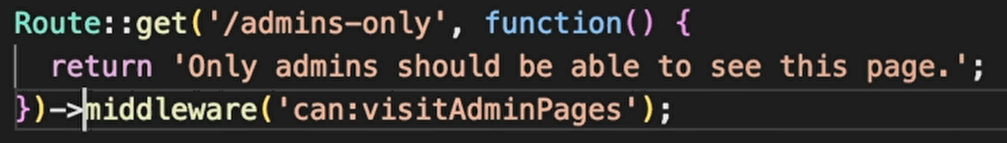
Gate
Path: app/providers/AuthServiceProvider

Slide 5

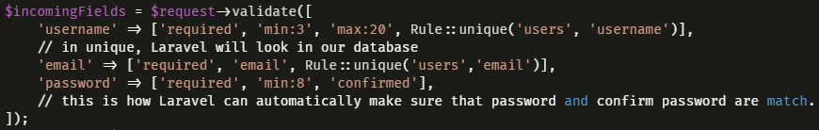

Create a request
Path:
php artisan make:request RequestnameRequest
Go to path and edit it.

Slide 6
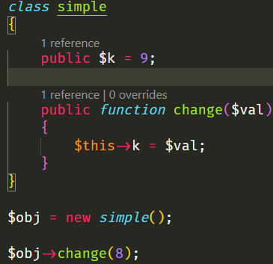
php basics

Slide 7
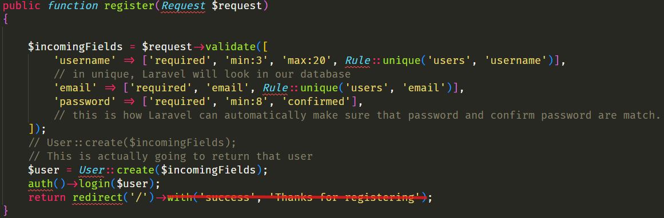
Register

Slide 8
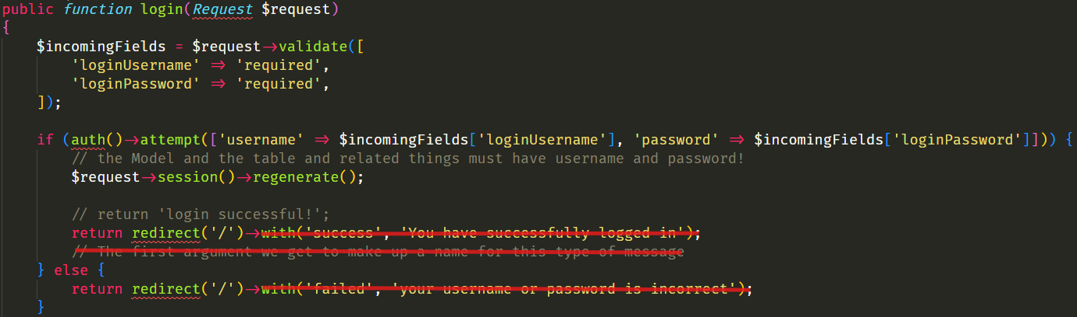
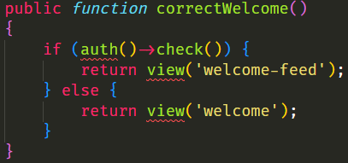
Log in

Slide 9
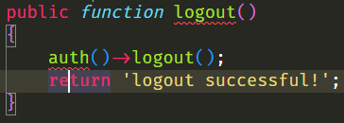
Log out

Slide 10
Repository
public function model()
{
return ModelNameThatWasImported::class;
}
public function methodNameInThatRepository($data)
{
return $this->model()::all();
return $this->model()::create($data);
return $this->model()::destroy($data);
return (new $this->model())->update($data);
return $this->model()::where([
‘nameOfFieldInTable' => ‘something’
])->get();
return $this->model()::find($data);
}
that should be $id
that should be $id (primary id of table)
return $this->model()::all('name');
just ‘name’ field in table
Auth()->user()->username or id

Slide 11
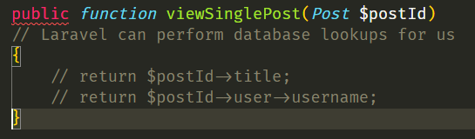
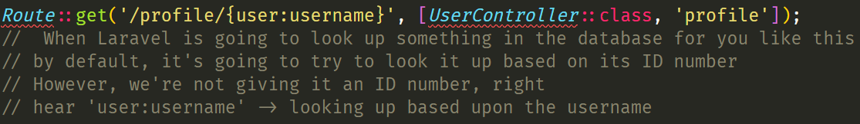
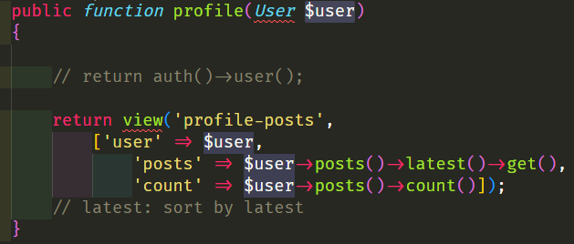
Repository
$user -> delete()
$user -> update($incomingFields)

Slide 12
Relations
statuses
users
accounts
hasMany
belongsTo
hasOne
belongsTo
hasMany
posts
belongsTo

Slide 13
Relations
product_supplier
belongsTo
belongsTo
product
supplier
hasMany
belongsToMany

Slide 14
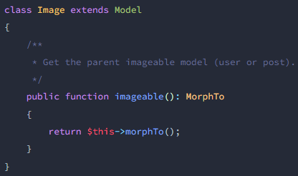
Relations
images
users
posts

Slide 15
Log::info(print_r($var, true));
php artisan optimize:clear
php artisan db:seed --class=UserSeeder
npm cache clean --force
php artisan migrate:refresh --path=/database/migrations/2024_07_28_130648_create_buys_details_confirms_table.php
git rm -r --cached storage/logs
وقتی یک پرمیشن جدید مزنم
php artisan cache:forget spatie.permission.cache

