Slide 1
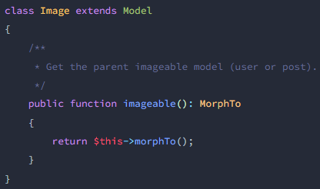
Relations
images
users
posts

