Slide 1
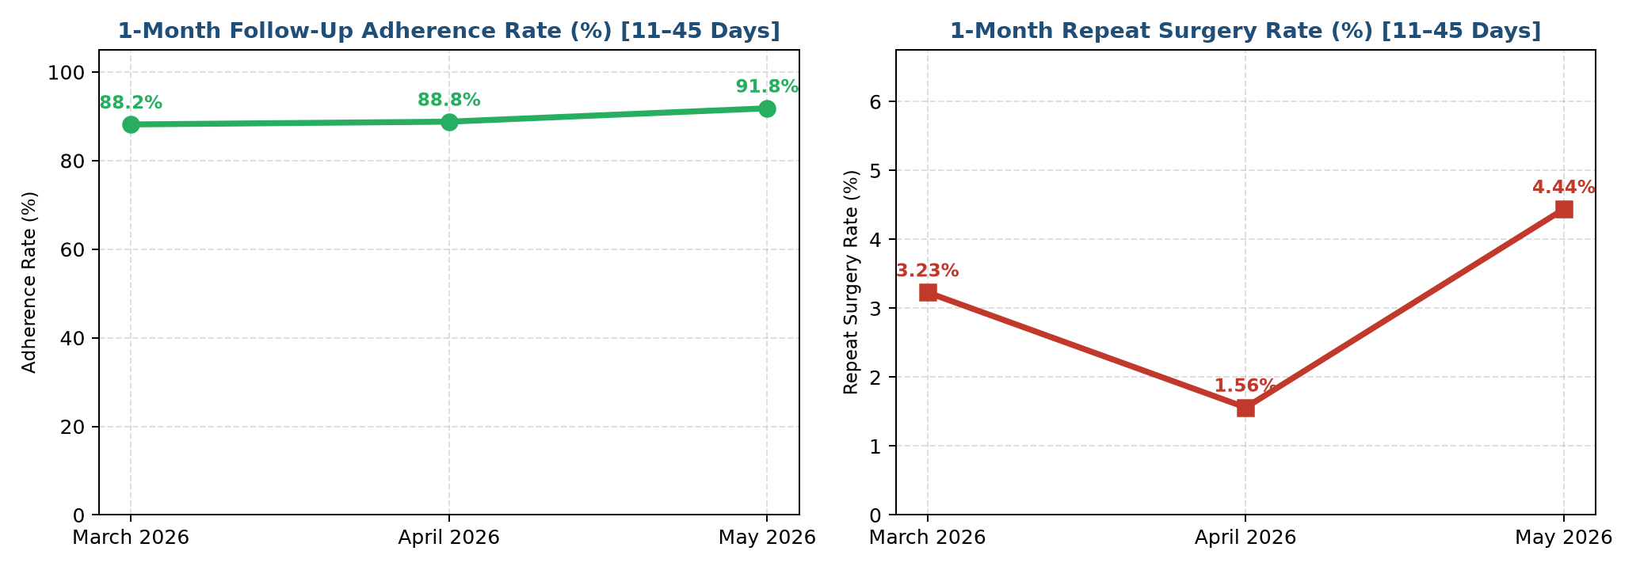
Corneal Transplantation Quality Trends | Multi-Month Executive Report
Criteria: Clinical Window: 1-Month Follow-Up Adherence & Resurgeries strictly evaluated between 11 and 45 Days Post-Surgery
3-MONTH PRIMARY SURGERIES
893
Across March 2026, April 2026, May 2026
1M ADHERENCE RATE (11–45D)
89.59%
3-Month Pooled (Trend: +3.64%)
1M IDENTIFIED RESURGERIES
27 (3.02%)
Rebubbling, Resuturing, KP
1M REPEAT KERATOPLASTY (KP)
12 (1.34%)
Specific Repeat KP / Graft Replacement

Slide 2
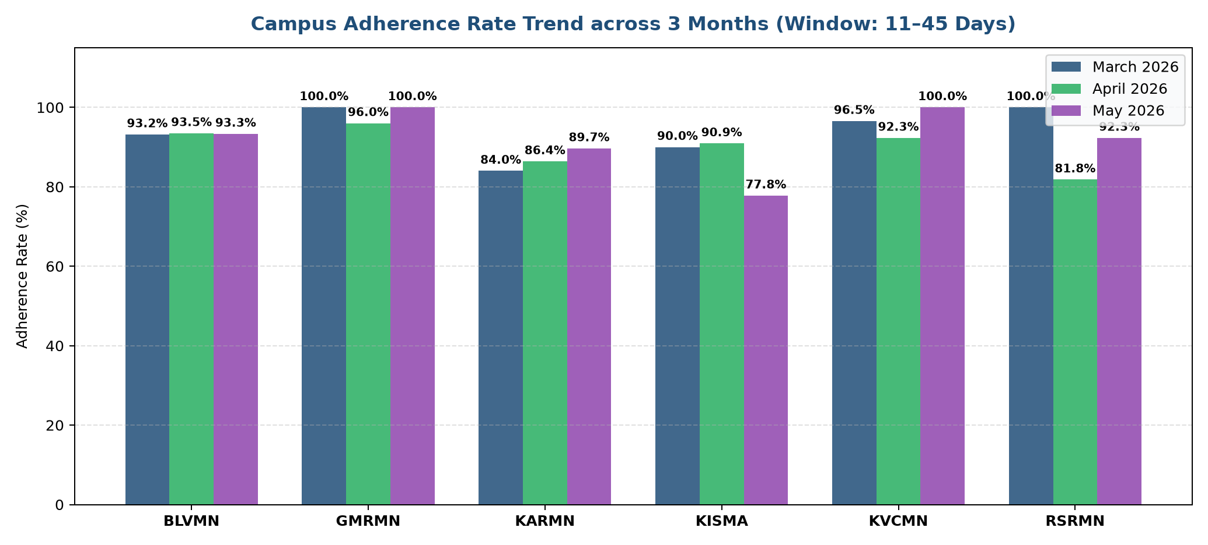
1-Month Follow-Up Adherence Rate by Campus (11–45 Days Post-Surgery)
Criteria: Evaluation Criteria: 1-Month Follow-Up & Resurgeries strictly between 11 and 45 Days Post-Surgery

Slide 3
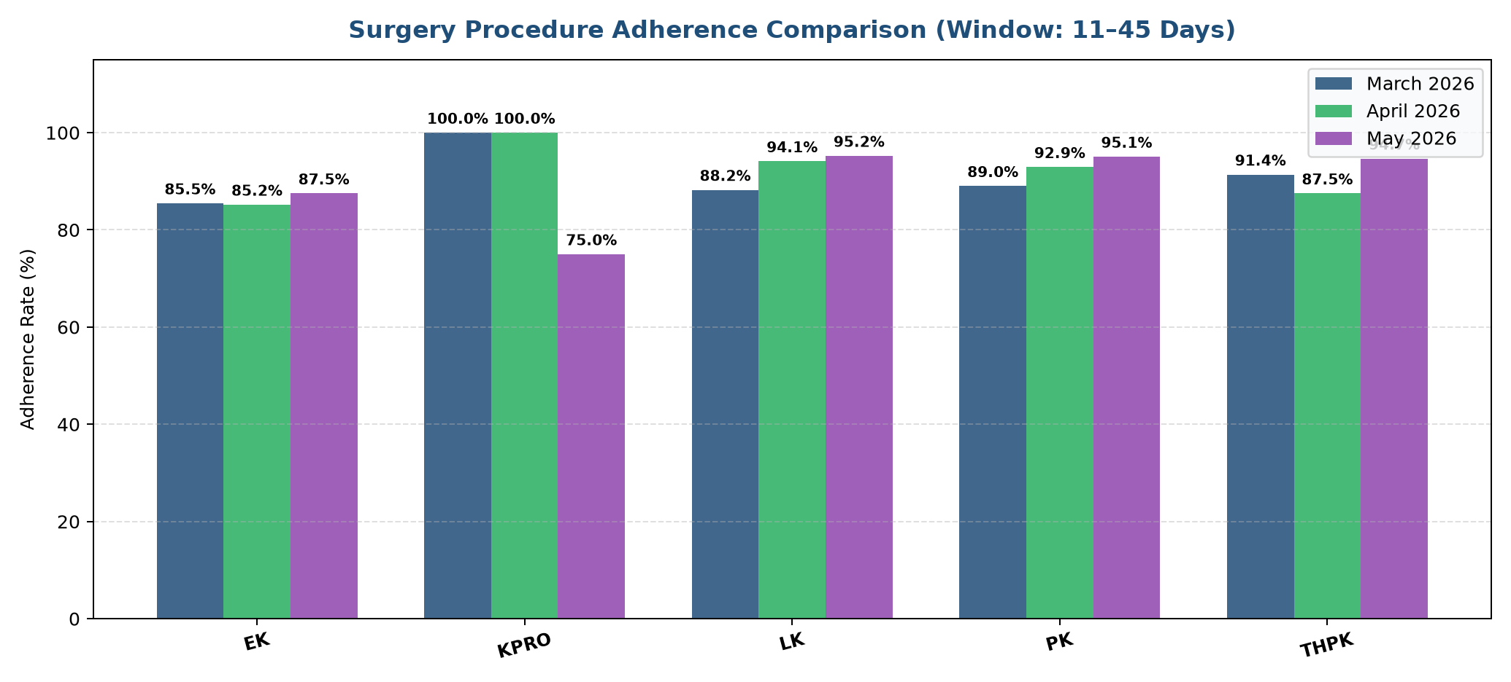
1-Month Follow-Up Adherence by Surgical Procedure (11–45 Days Post-Surgery)
Criteria: Evaluation Criteria: 1-Month Follow-Up & Resurgeries strictly between 11 and 45 Days Post-Surgery

Slide 4
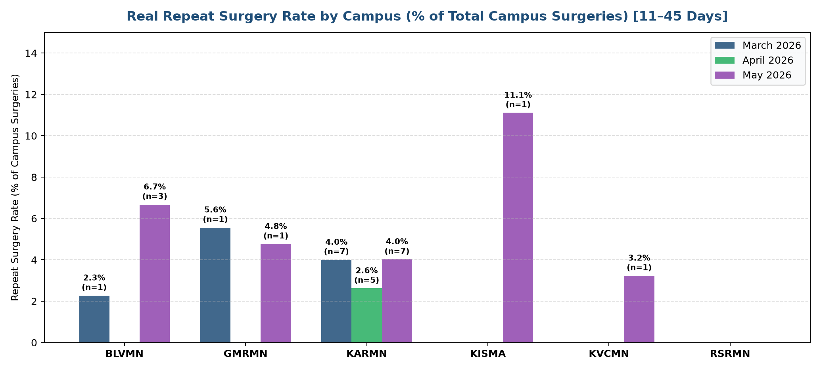
1-Month Graft Resurgery Rate by Campus (11–45 Days Post-Surgery)
Criteria: Re-surgeries shown as a proportion (%) of Total Surgeries for each Campus (Rebubbling, Resuturing, KP)

Slide 5
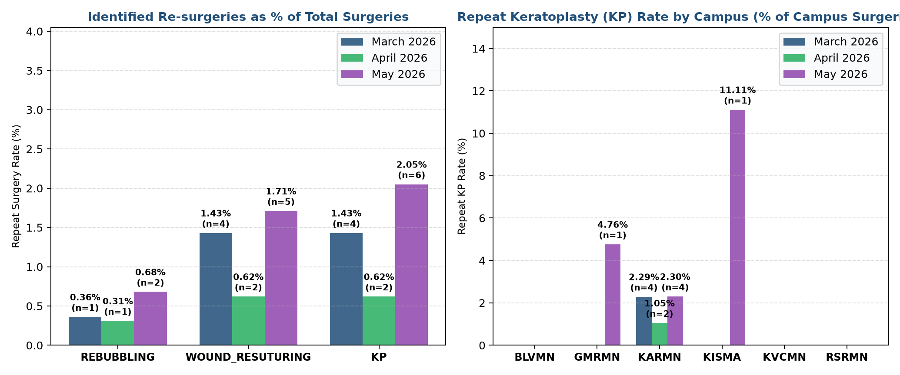
Repeat Surgery Rates by Specific Identified Category (11–45 Days Post-Surgery)
Criteria: Proportions (%) of Total Primary Surgeries: Rebubbling, Wound Resuturing, and Repeat Keratoplasty (KP)

Slide 6
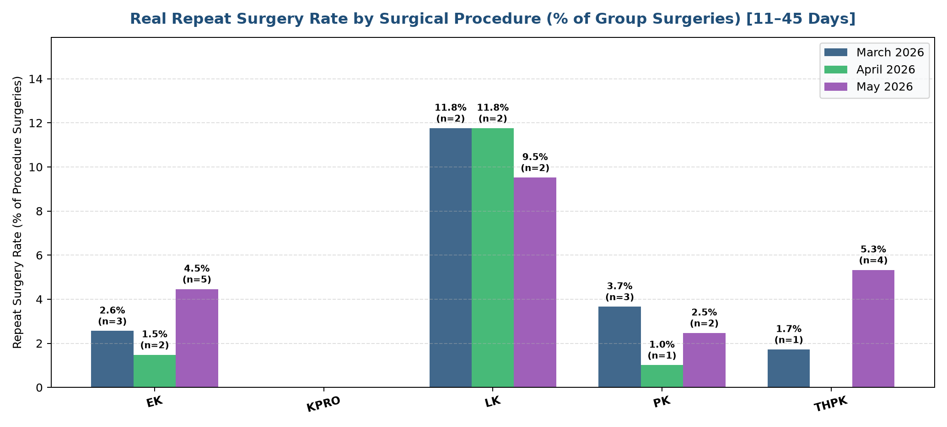
Graft Resurgery Rate by Primary Surgical Procedure (11–45 Days Post-Surgery)
Criteria: Re-surgeries shown as a proportion (%) of Total Surgeries for each Surgery Type

