Slide 1
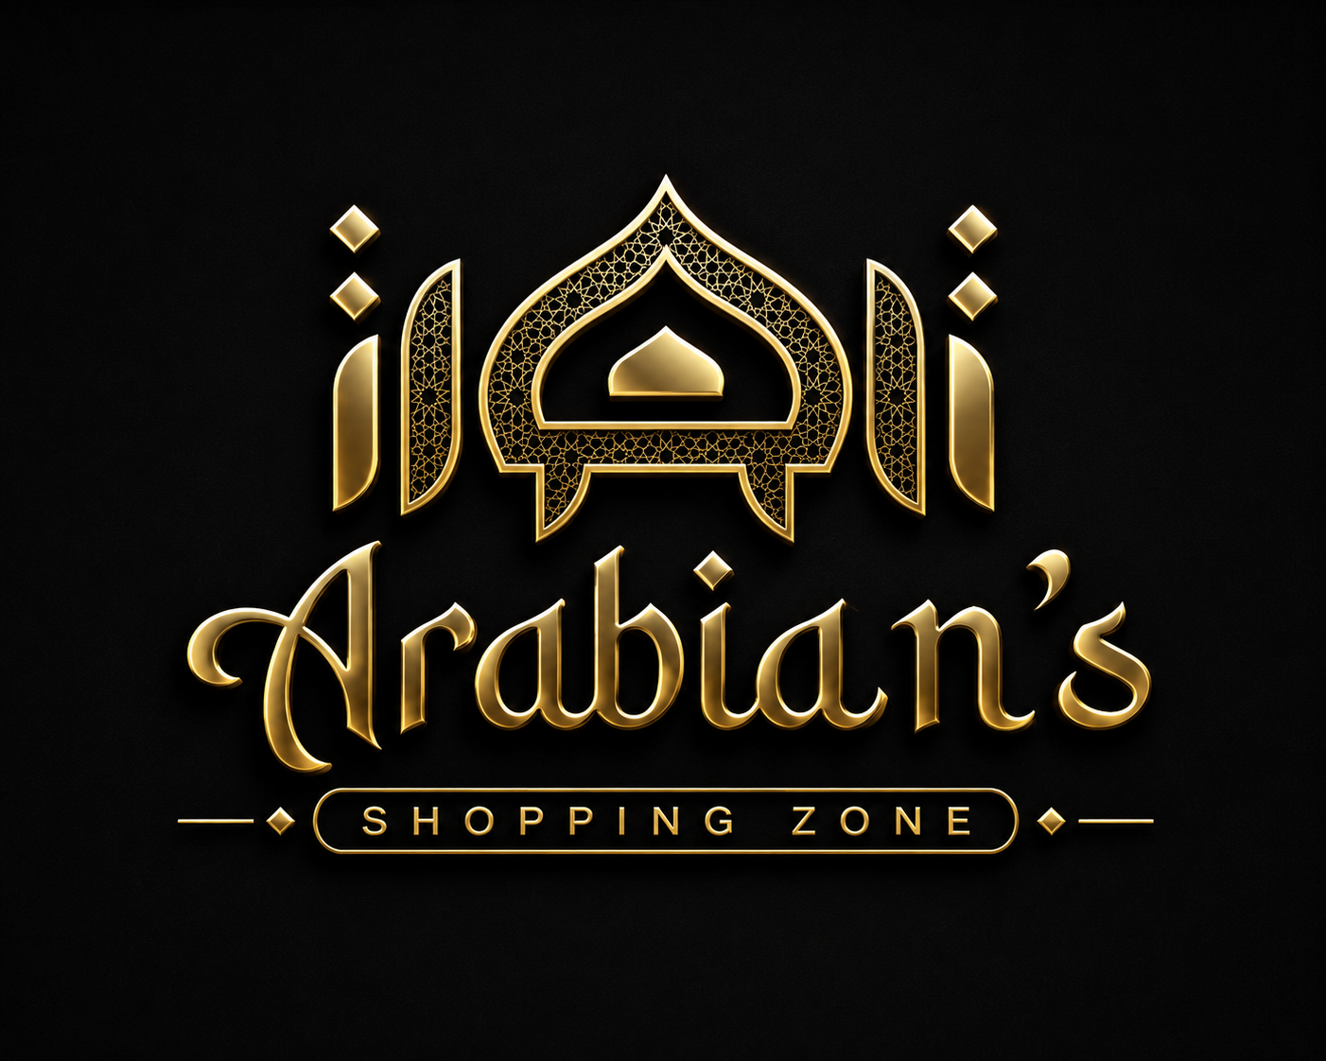
ARABIANS SHOPPING ZONE
India's Premier Royal Sunnah Lifestyle Boutique & E-Commerce Platform
Complete Website Walkthrough & Client Presentation
100% Halal Certified
Lab-tested pure products
Pan-India COD
19,000+ Pincodes serviced
4.9★ Customer Rating
328+ Verified Reviews
Live Bilal AI Advisor
Voice & Chat Assistance
🌐 LIVE: arabiansshoppingzone.shop
🌐 arabiansshoppingzone.shop | Arabians Shopping Zone — Official Client Presentation Deck | Slide 1 of 12

Slide 2
MARKET OPPORTUNITY
The Problem in Islamic Lifestyle Retail vs. Our Solution
How Arabians Shopping Zone solves the biggest trust and access bottlenecks in Indian e-commerce
⚠️ Traditional Market Bottlenecks (The Problem)
[HIGH CONSUMER SKEPTICISM]
• Unregulated Dupes & Adulteration: Massive influx of synthetic attars containing alcohol and low-grade talbina filled with white flour and artificial sugars.
• Unreliable Thobe Sizing: Arab Gulf garments often fail to fit Indian builds; sizing guides are absent, and returns are strictly disallowed.
• Fragmented Islamic Shopping: Customers forced to hunt 5 different local bazaars or unverified WhatsApp sellers with zero buyer protection.
• Lack of Consumer Trust: No verified lab reports, no genuine customer reviews, and no physical store accountability.
✅ The Arabians Shopping Zone Solution
[PROVEN TRUST ENGINE]
• 100% Halal Certified & Lab Tested: Zero alcohol in scents, whole sprouted barley with authentic Hadith 5417 compliance.
• Royal Sizing & Free Exchange Guarantee: Standard Arab Gulf shoulder-to-ankle sizing (52–62) backed by 100% Free Doorstep Size Exchange.
• All-in-One Luxury Ecosystem: Attire, Nutrition, Fragrances, Home Calligraphy, and Wedding Hampers in one frictionless catalog.
• Verified Omnichannel Backing: Flagship boutique in Jaipur + Pan-India express Cash on Delivery (COD) across 19,000+ pincodes.
🌐 arabiansshoppingzone.shop | Arabians Shopping Zone — Official Client Presentation Deck | Slide 2 of 12

Slide 3
PRODUCT ECOSYSTEM
5 Curated Royal Collections
A diverse, high-AOV product matrix serving daily lifestyle, personal wellness, and milestone celebrations
👔 Men's Royal Attire
[Free Size Exchange]
• Saudi Thobes, Emirati Jubbas, Madani Green Amamas, Omani Caps. Handcrafted sizes 52 to 62.
🌾 Sunnah Talbina
[High Repeat Consumable]
• Sprouted roasted barley porridge with premium California dry fruits. 5 flavours. Zero refined sugar.
🕌 Pure Attar & Oud
[Halal Certified]
• 100% Alcohol-free aged Dehnul Oud, Cambodian blends, Taif Rose. 24–48hr projection.
🖼️ Islamic Decor
[High AOV Gift Item]
• 3D Mirror Acrylic Ayatul Kursi, Islamic wall clocks, luxury calligraphy art frames.
💍 Nikah Hampers
[15% Seasonal Bundle]
• Custom gold-foil named Nikah Nama certificates, Haq Mehar boxes, royal presentation sets.
🌐 arabiansshoppingzone.shop | Arabians Shopping Zone — Official Client Presentation Deck | Slide 3 of 12

Slide 4
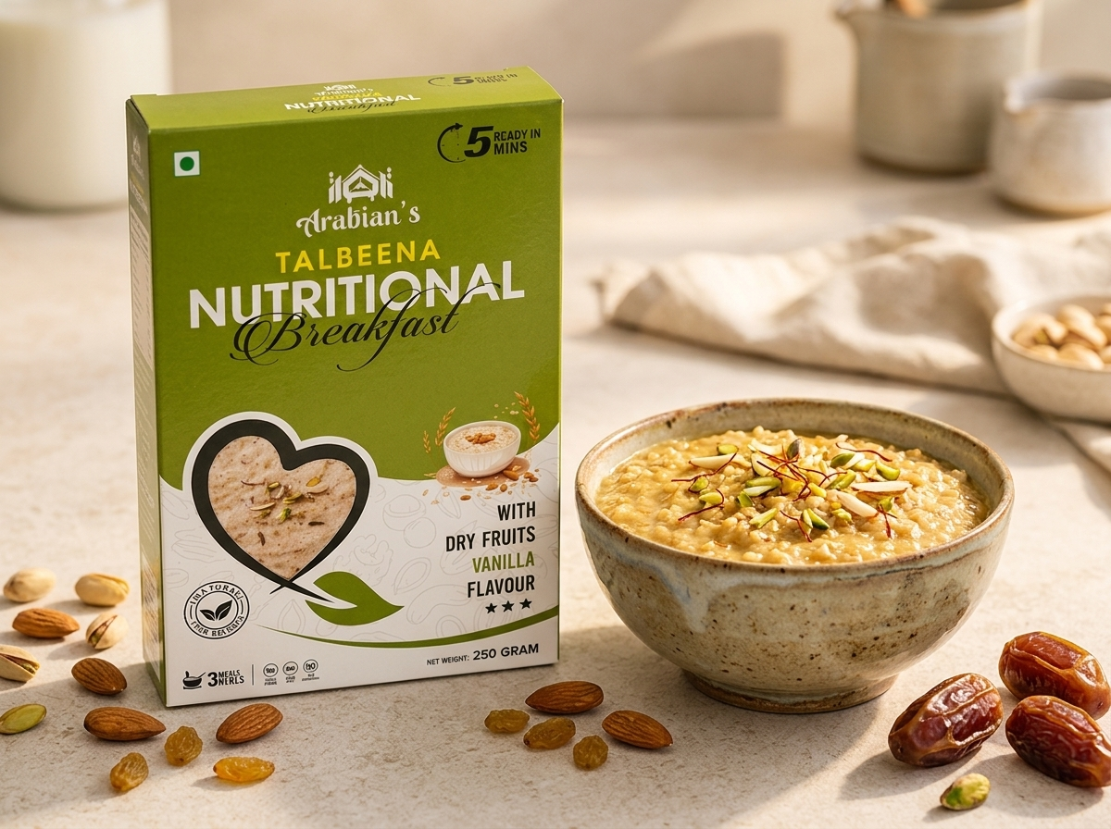
HERO PRODUCT SPOTLIGHT
Arabian's Sprouted Barley Talbina Nutrition
A high-frequency repeat purchase item backed by prophetic tradition (Hadith 5417) and certified lab testing
🥣 Nutrition, Flavors & Commercial Significance
[HIGH REPEAT ORDER DRIVER]
• Authentic Formulation: Stone-ground roasted sprouted barley (Jau), enriched with California almonds, pistachios, dates, pumpkin seeds and saffron.
• Prophetic Comfort (Hadith 5417): Recommended by the Prophet (ﷺ) for soothing hearts during times of illness, stress, and physical fatigue.
• 5 High-Demand Flavor Variants: Vanilla Dry Fruits, Milk Mawa, Chocolate (for Kids), Dry Dates Vanilla, and Baby Barley.
• 100% Natural Guarantee: Zero white refined sugar, zero preservatives, and zero artificial coloring agents.
• Commercial Moat: Low customer acquisition cost with very high 30-day replenishment repeat orders (consumable FMCG model).
🌐 arabiansshoppingzone.shop | Arabians Shopping Zone — Official Client Presentation Deck | Slide 4 of 12

Slide 5

AI INNOVATION SPOTLIGHT
Bilal AI — India's First Islamic E-Commerce AI Voice Advisor
Revolutionary conversational voice & chat intelligence guiding shoppers 24/7 with zero human overhead
🎙️ Real-Time Voice Assistant Powered by ElevenLabs
[VOICE CALLING ENABLED]
• Live Natural Voice Calls: Instant two-way spoken conversation in Hindi, Urdu and Hinglish.
• Persona-Driven Interaction: Friendly, respectful 'Brother Bilal' store head persona building authentic consumer trust.
• Smart Instant Fallbacks: 100-second session limits to manage operational cost with automatic fallback to direct WhatsApp helpline.
💬 Conversational Multi-Turn Shopping Guidance
[INTEGRATED IN MENU & HOME PAGE]
• Sizing Guidance: Explains exact shoulder-to-ankle Saudi sizing based on user height.
• Sunnah Education: Explains Talbina prep recipes, Hadith citations, and attar longevity tips.
• Order & Tracking Support: Answers delivery timelines, COD queries, and returns policies.
🌐 arabiansshoppingzone.shop | Arabians Shopping Zone — Official Client Presentation Deck | Slide 5 of 12

Slide 6
CONTENT-TO-COMMERCE
Instagram Viral Reels & Video Shopping
Seamlessly turning 28 Lakh+ organic social views into direct on-site shopping conversions
🎬 28 Lakh+ Views Spotlight
[VIRAL HIT #1]
• Viral Saudi Thobe & Amama styling tutorial embedded directly into the website with native mobile playback.
📹 11 Lakh+ Views Spotlight
[VIRAL HIT #2]
• Luxury Holy Quran presentation gift set and velvet presentation box demonstration.
🛒 Instant 'Buy Now' Modal
[ZERO FRICTION]
• When users watch a reel, the exact featured product card appears with price and a 1-tap 'Buy Now' button.
⚡ Native Video CDN Hosting
[LIGHTNING FAST]
• All reels served from high-speed local assets for instantaneous buffering on 4G/5G mobile devices.
🌐 arabiansshoppingzone.shop | Arabians Shopping Zone — Official Client Presentation Deck | Slide 6 of 12

Slide 7
UX & ENGINEERING
Conversion-Focused Mobile-First Architecture
Engineered specifically for high smartphone traffic and seamless purchasing in the Indian demographic
📱 Mobile App-Like Interface
[SMARTPHONE OPTIMIZED]
• Fixed bottom navigation bar (Home, Catalog, Track, Franchise, Cart)
• Instagram-style circular category avatar stories
• Full-screen modals for product quick view and checkout
🔍 Predictive Header Search
[INSTANT RESULTS]
• Instant visual drop-down search showing thumbnails, pricing, and titles as users type
• Zero-delay search querying names, categories, and ingredients
⏱️ Urgency & Flash Sale Engine
[CONVERSION MULTIPLIER]
• Real-time countdown timer resetting at midnight to induce purchase urgency
• Dynamic announcement ticker highlighting Free Shipping & Halal Certification
💬 Frictionless Direct WhatsApp
[INSTANT ASSISTANCE]
• Floating WhatsApp support button on every screen
• Pre-filled product inquiry links for custom bespoke sizes and wedding bulk orders
🌐 arabiansshoppingzone.shop | Arabians Shopping Zone — Official Client Presentation Deck | Slide 7 of 12

Slide 8
FULFILLMENT & OPERATIONS
Pan-India Express Delivery & Cash on Delivery (COD)
Robust national logistics infrastructure removing purchase barriers for every Indian household
19,000+
Pincodes Covered Across India
₹0
Free Express Delivery on ₹999+
24–48h
Guaranteed Dispatch Window
7 Days
100% Free Doorstep Replacement
💵 Full Cash on Delivery (COD)
[ZERO PAYMENT RISK]
• Customers pay only when the package arrives at their door.
• Eliminates online payment trust hesitation in tier 2 and tier 3 cities.
• Pre-delivery SMS & WhatsApp tracking updates sent to every customer.
📦 Tier-1 Courier Partnerships
[SAFE TRANSPORT]
• Direct integrations with BlueDart, Delhivery, DTDC, and Express Air.
• Secure tamper-proof sealed packaging ensures attar and food purity.
• Self-service AWB order tracking page on the website (/track).
🔄 100% Free Size Replacement
[RISK-FREE BUYING]
• Hassle-free exchange policy if the Saudi thobe size does not fit.
• Reverse pickup arranged at no extra cost to the customer.
• Builds lasting confidence for first-time clothing shoppers.
🌐 arabiansshoppingzone.shop | Arabians Shopping Zone — Official Client Presentation Deck | Slide 8 of 12

Slide 9
CREDIBILITY & SOCIAL PROOF
Why Customers Unconditionally Trust Arabians
Blending digital convenience with tangible brick-and-mortar credibility
⭐ 4.9★ from 328+ Reviews
[UNSHAKABLE SOCIAL PROOF]
• Unfiltered verified buyer testimonials across India.
• Detailed feedback praising authentic talbina quality and true-to-size Saudi stitching.
• Dedicated customer review hub (/reviews).
🛡️ 100% Halal Lab Certified
[COMPLIANCE & PURITY]
• All fragrance oils guaranteed 100% alcohol-free (suitable for Namaz & Ibadat).
• Nutritional talbina lab-certified for pure whole grain purity.
• Quality assurance certificates prominently shown.
🏪 Flagship Store — Jaipur
[OFFLINE ANCHOR]
• Physical boutique located in Jaipur with dedicated store page (/store).
• Customers can try on thobes, sample pure dehnul oud oils, and verify the brand in person.
• Hyderabad partner distribution hub.
📜 Transparent Guarantees
[CLEAR POLICIES]
• Published shipping policy, 7-day return policy, and direct grievance escalation.
• Official customer helpline and WhatsApp contact on every page footer.
🌐 arabiansshoppingzone.shop | Arabians Shopping Zone — Official Client Presentation Deck | Slide 9 of 12

Slide 10
B2B BUSINESS MODEL
Wholesale Dealership & Franchise Network
Enabling retailers, Islamic bookstores, and distributors across India to profit from the Arabians brand
💰 Attractive Profit Margins
[HIGH ROI FOR RESELLERS]
• High-margin wholesale discount tiers for bulk orders.
• Strong retail demand for fast-moving Talbina boxes and Attar bottles.
• Transparent wholesale pricing catalog accessible via the /distributor portal.
🤝 End-to-End Partner Support
[MARKETING & ASSETS PROVIDED]
• High-resolution marketing banners, product display material, and social media reels provided.
• Product training on Sunnah benefits and sizing recommendations.
• Priority bulk logistics dispatch with insured shipping.
📈 Expanding Retail Footprint
[RAPID PAN-INDIA EXPANSION]
• Flagship presence in Jaipur and partner channels in Hyderabad.
• Actively appointing regional city distributors across UP, Maharashtra, Bihar, Gujarat, and Telangana.
• 1-Click dealership inquiry form embedded right on the website.
🌐 arabiansshoppingzone.shop | Arabians Shopping Zone — Official Client Presentation Deck | Slide 10 of 12

Slide 11
COMMERCIAL STRENGTH
Key Performance Indicators & Competitive Moats
The quantitative and structural advantages positioning Arabians Shopping Zone for scalable growth
28L+
Viral Social Reach
Instagram video engine driving steady organic acquisition
4.9★
Customer Satisfaction
Over 328+ real buyer reviews confirming product purity
19,000+
Pincodes Covered
Full India reach with Cash on Delivery integration
5 Core
Category Verticals
Balanced portfolio across clothing, wellness, scent & decor
24/7
Bilal AI Engagement
Instant voice & chat support converting hesitant visitors
Zero
Added Preservatives
100% natural Talbina building loyal repeat subscribers
🌐 arabiansshoppingzone.shop | Arabians Shopping Zone — Official Client Presentation Deck | Slide 11 of 12

Slide 12
EXPERIENCE THE LIVE PLATFORM
Visit the live website on any mobile phone or browser to test Bilal AI, explore collections, and review customer feedback.
🌐 Live Website
arabiansshoppingzone.shop
Explore the live catalog, mobile drawer, and checkout engine.
📞 Direct Helpline & WhatsApp
+91 92360 28318
Available for retail customer support and custom wedding hamper inquiries.
🏪 Flagship Store
Jaipur, Rajasthan
Physical store location and pan-India distribution headquarters.
🌐 arabiansshoppingzone.shop | Arabians Shopping Zone — Official Client Presentation Deck | Slide 12 of 12

