Slide 1
Visualizing Global Lead Pollution Policy
A Comparative Study of Lead Paint Regulation
Statistical Analysis using Global Health and Policy Data Mohamad A. Hijazi | DSC 604 (Statistics for Data Science)

Slide 2
Motivation & Research Question
Lead exposure is a global public-health concern with no known safe level.
Lead paint is a major preventable source of exposure.
Only about half of countries have legally binding lead paint regulation.
Research question: Do regulated countries exhibit lower lead-related health burden?

Slide 3
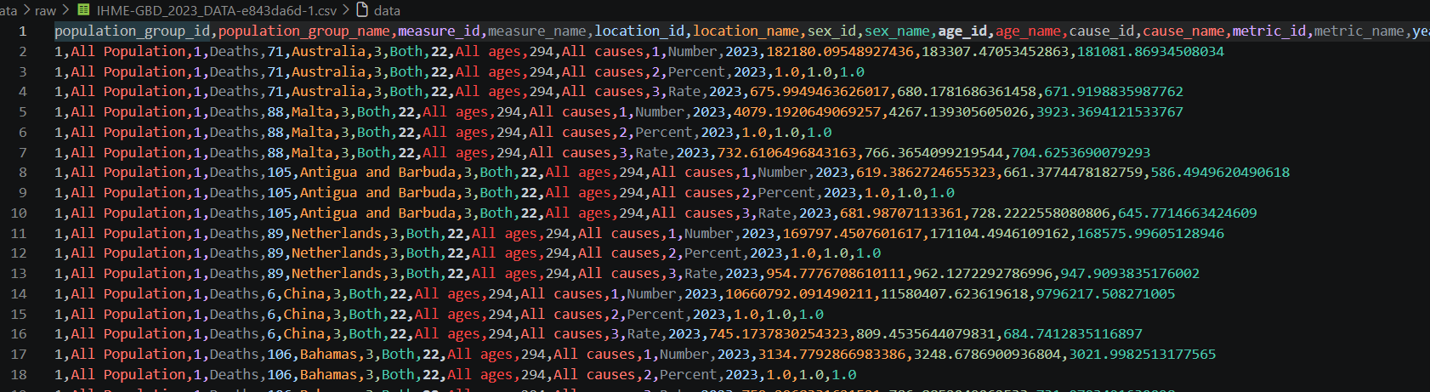
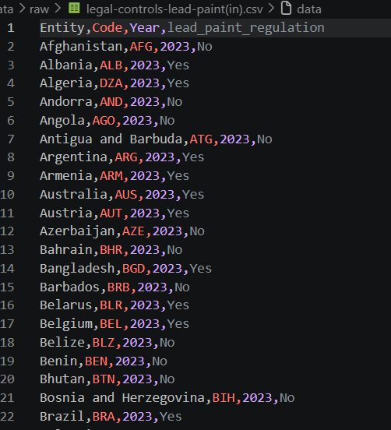
Data Sources
Our World in Data / WHO: lead paint regulation (Yes / No).
IHME Global Burden of Disease 2023: lead-attributable DALY and death rates.
Unit of analysis: country-level cross-section for year 2023.

Slide 4
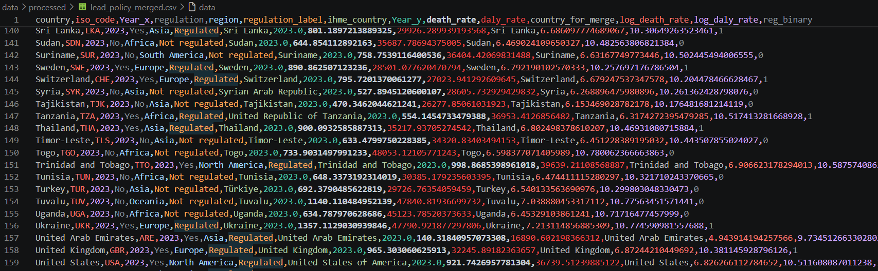
Data Preparation
Filtered IHME data to 2023, all ages, both sexes, and rate metrics.
Extracted DALY rate and death rate from long-format IHME data.
Harmonized country names across datasets.
Derived regions from ISO-3 country codes.
Log-transformed outcomes for regression modeling.

Slide 5
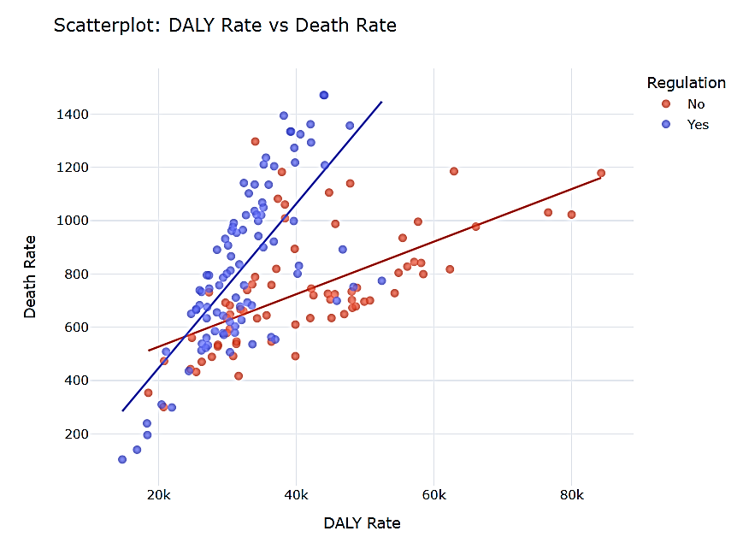
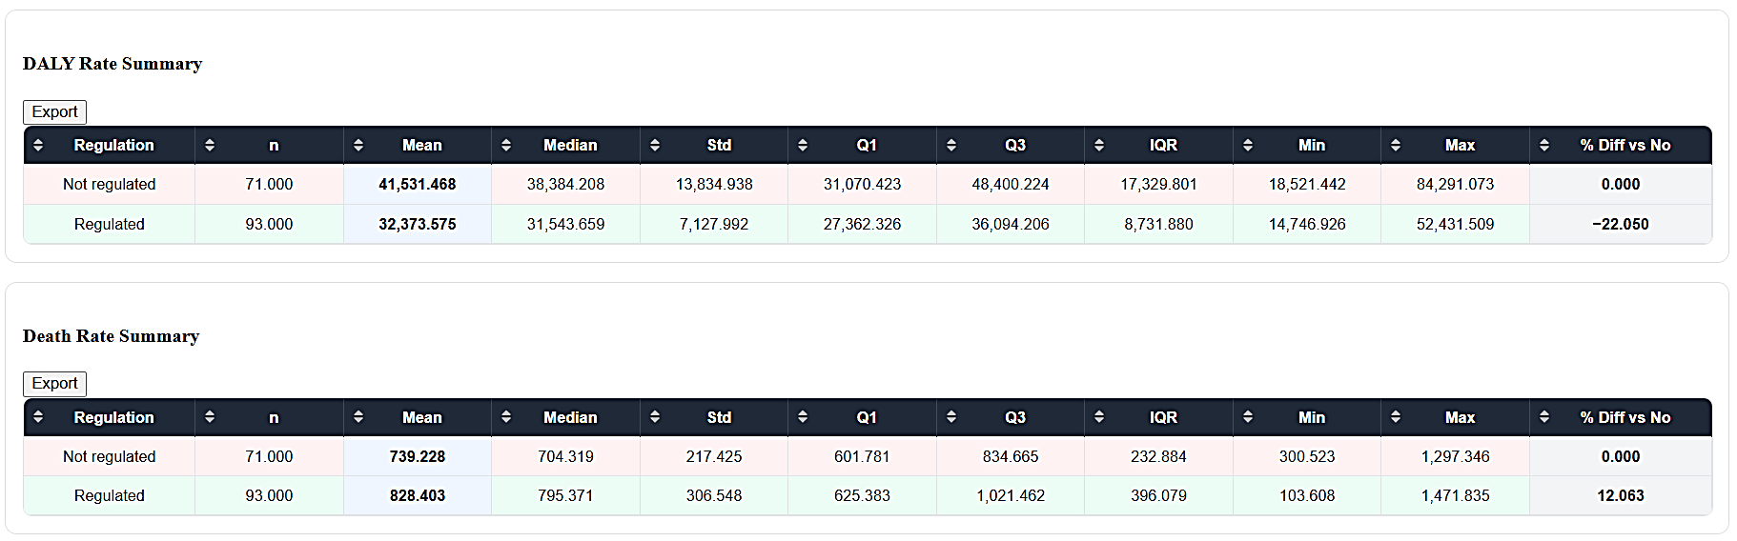
Exploratory Analysis Highlights
Regulated countries show substantially lower mean and median DALY rates.
Death-rate differences are weaker and less consistent.
DALY rate and death rate are moderately positively correlated (~0.48).

Slide 6
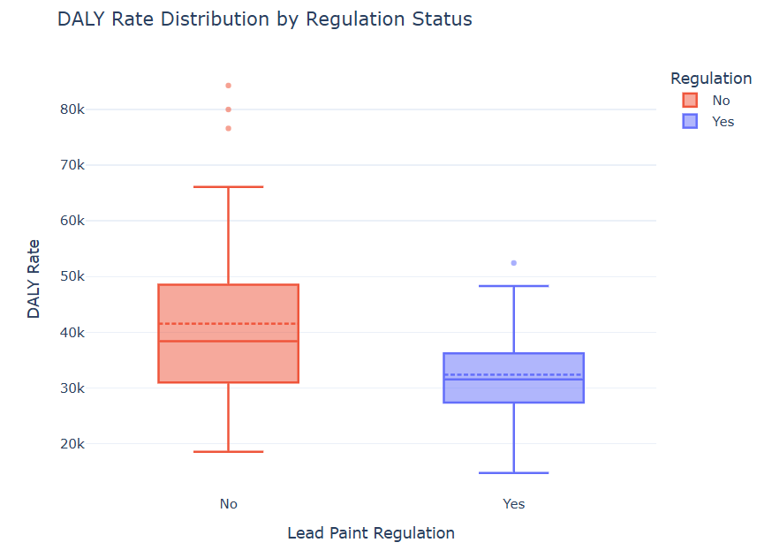
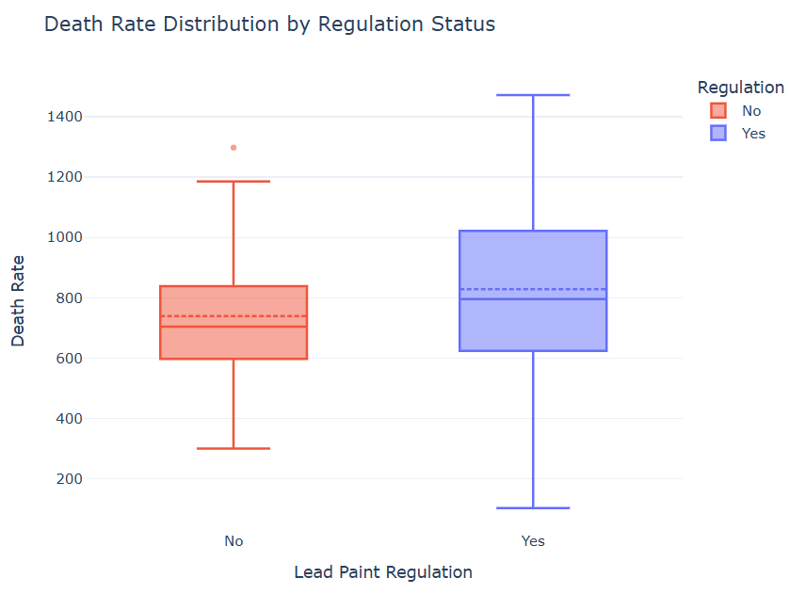
Exploratory Analysis Highlights

Slide 7
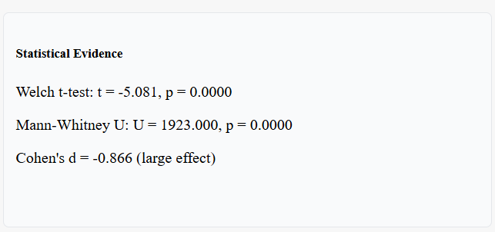
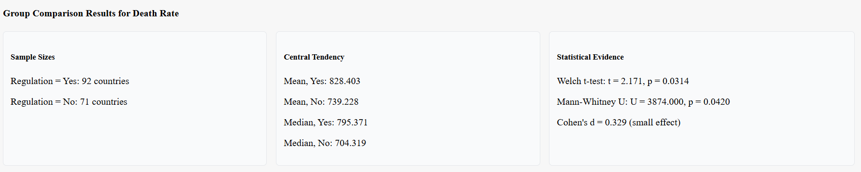
Hypothesis Testing
Welch’s t-test and Mann–Whitney U test used for robustness.
DALY rate: strong statistical evidence of lower burden in regulated countries.
Death rate: statistically significant difference but small effect size.

Slide 8


Effect Size (Cohen’s d)
DALY rate: large negative effect (regulated countries lower burden).
Death rate: small positive effect.
Effect sizes help interpret practical importance beyond p-values.

Slide 9
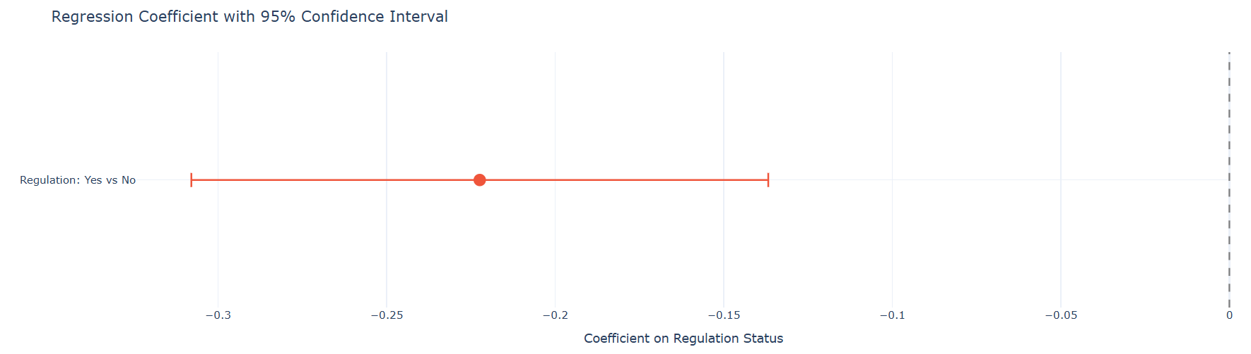
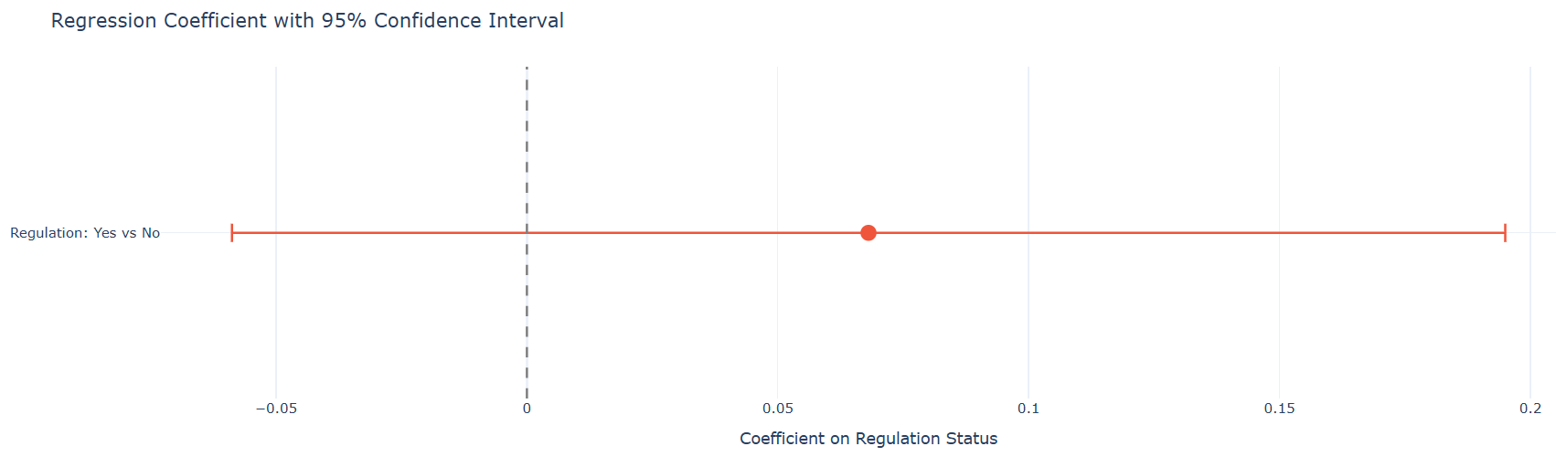
Regression Modeling
Model: log(outcome) ~ regulation status.
DALY model: significant negative coefficient, ~20% lower burden.
Death model: non-significant coefficient, very low R².

Slide 10
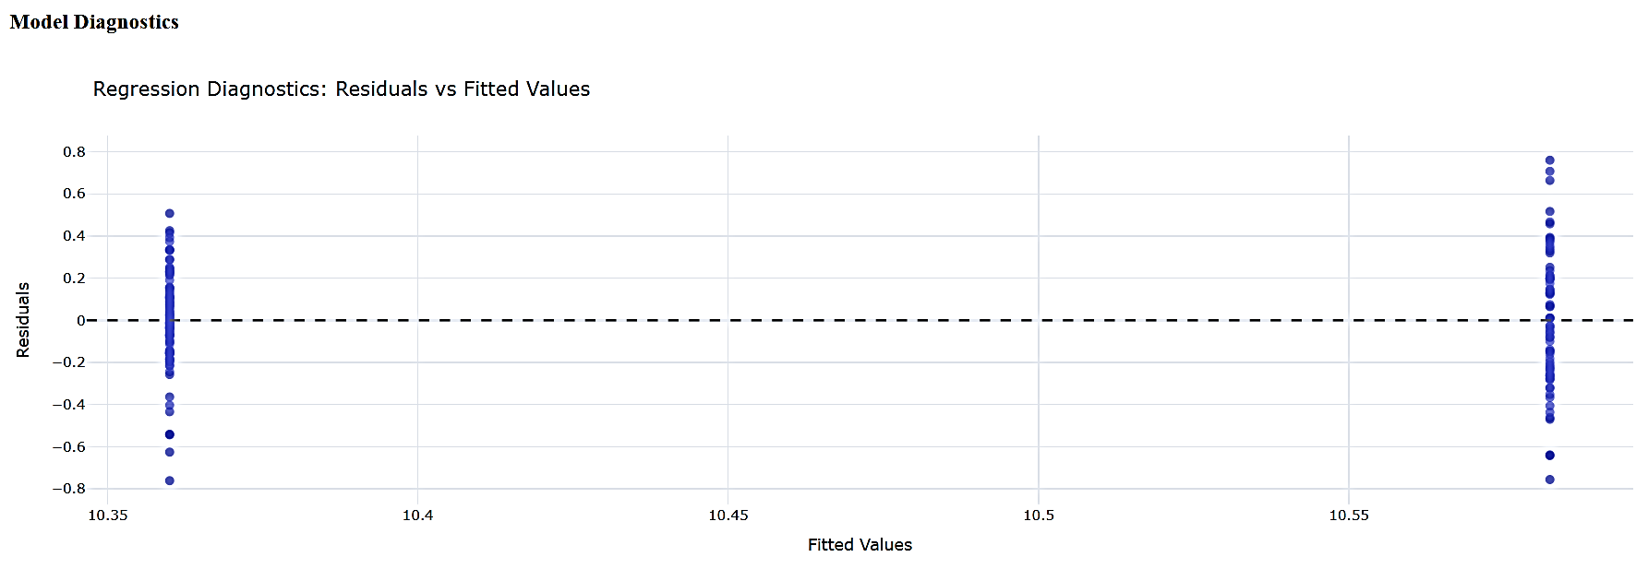
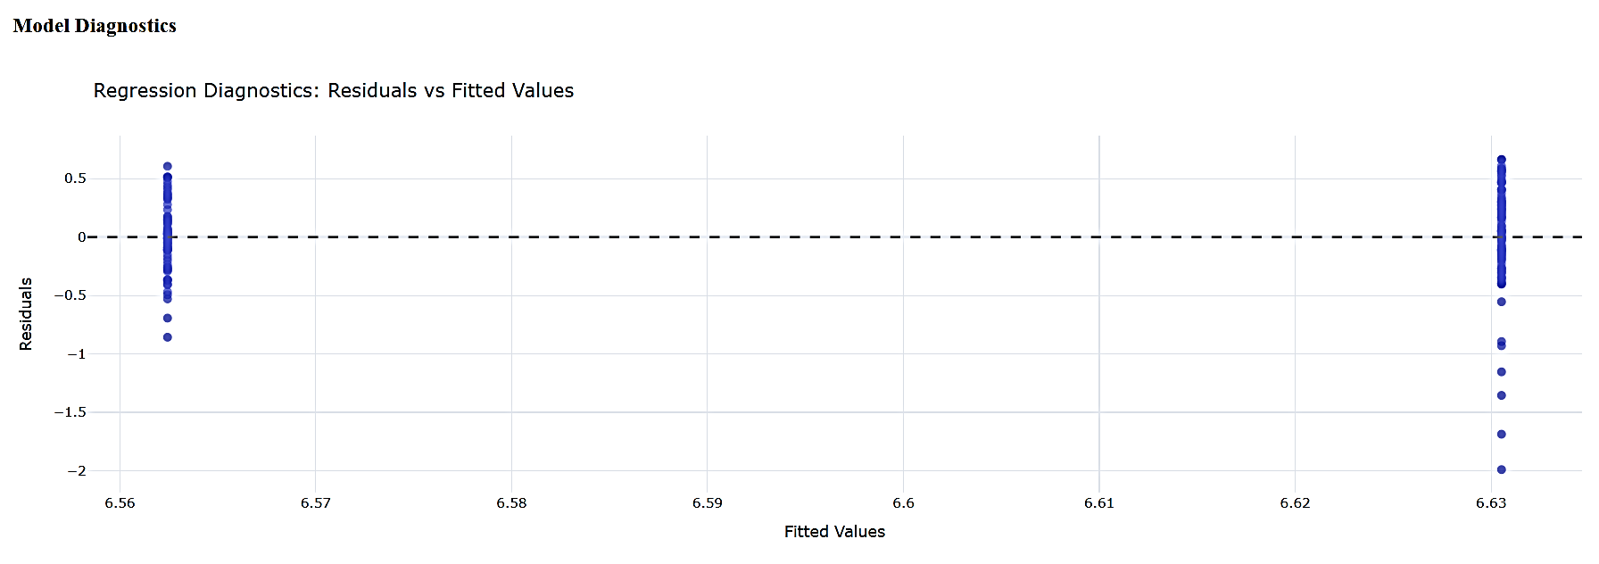
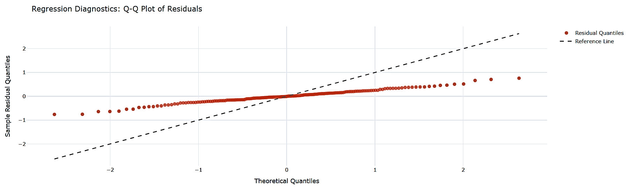
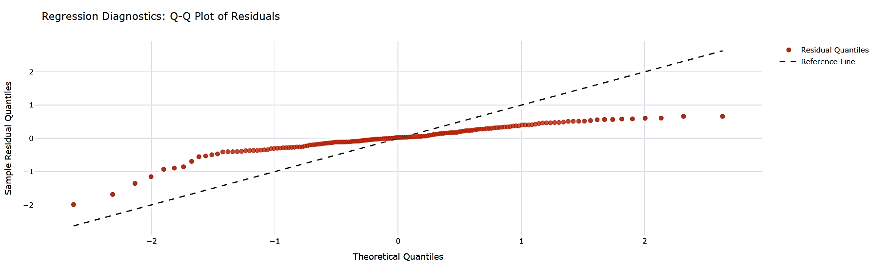
Regression Diagnostics
Residuals vs fitted: two bands expected due to binary predictor.
Q–Q plots show tail deviations typical of cross-country data.
Models suitable for exploratory association, not causal inference.

Slide 11
Interpretation & Discussion
Strong evidence linking regulation to lower DALY burden.
Weaker and more complex relationship for death rates.
Multiple country-level factors influence mortality beyond regulation status.

Slide 12
Limitations
Cross-sectional design (single year).
Binary regulation variable does not measure enforcement quality.
DALY and death rates reflect total lead exposure, not only paint.
Omitted variables such as income, age structure, and healthcare access.

Slide 13
Conclusion
Lead paint regulation is strongly associated with lower DALY burden.
Evidence for death-rate reduction is weaker.
Results are associative, not causal.
Findings motivate richer models and longitudinal analysis.

Slide 14
References Included
World Health Organization – Lead poisoning and lead paint regulation.
Our World in Data – Lead pollution and disease burden.
IHME Global Burden of Disease Study 2023.

