Slide 1
Visualizing Global Lead Pollution Policy A Comparative Study of Lead Paint Regulation
Analyzing worldwide regulations on lead paint safety
Notes:
AI-generated content may be incorrect. ---

Slide 2
Introduction and Motivation
Notes:
--- This slide references information from the following file: https://ghdx.healthdata.org/record/ihme-data/gbd-2023-lead-exposure-estimates-1990-2023,https://ourworldindata.org/grapher/legal-controls-lead-paint,https://www.sec.gov/Archives/edgar/data/1699963/000169996326000020/filename1.htm Why Lead Paint Regulation Matters

Slide 3

Why Lead Paint Regulation Matters
Health Risks of Lead Exposure
No safe level of lead exposure exists; children's neurological and cognitive development is permanently affected.
Lead Paint as Exposure Source
Lead-based paint is a major preventable source of lead exposure through dust and peeling surfaces.
Uneven Global Regulation
Less than half of countries have laws regulating lead paint, creating geographic disparities in protection.
Visualization for Awareness
Integrating regulation data with health outcomes encourages clearer understanding and informed public health decisions.
Notes:
--- This slide references information from the following file: https://ghdx.healthdata.org/record/ihme-data/gbd-2023-lead-exposure-estimates-1990-2023,https://ourworldindata.org/grapher/legal-controls-lead-paint,https://www.sec.gov/Archives/edgar/data/1699963/000169996326000020/filename1.htm Lead pollution remains a critical but often under-recognized global public health challenge. Scientific and public-health institutions consistently emphasize that there is no known safe level of lead exposure, particularly for children, whose neurological development, cognitive function, and long-term wellbeing can be permanently affected. Among the many sources of lead exposure, lead-based paint stands out as one of the most preventable. Paint is widely used in homes, schools, and public spaces, and when it contains lead, it creates long-lasting exposure risks through dust, peeling surfaces, and environmental contamination. Despite decades of evidence and international advocacy, legally binding controls on lead paint remain uneven across the world. According to the World Health Organization, as of early 2024, fewer than half of all countries had confirmed laws regulating the production, import, sale, and use of lead paint. This uneven policy landscape creates geographic disparities in protection, leaving many populations exposed to avoidable health risks. The motivation for this project is therefore twofold. First, it seeks to make visible where regulatory protections exist and where they are absent, using spatial and comparative visualizations rather than static tables. Second, it aims to contextualize regulation status alongside health-burden indicators—specifically lead-attributable Disability-Adjusted Life Years (DALYs) and death rates—derived from the Global Burden of Disease Study. By integrating policy data with health outcomes, the project supports a richer, more nuanced understanding of global lead exposure. Importantly, the project adopts a careful interpretive stance: visual associations are presented to support exploration and insight generation, not to claim direct causality. This framing aligns with best practices in data visualization and public-health communication, emphasizing clarity, honesty, and responsible interpretation while demonstrating how visualization can elevate complex policy and health data into actionable knowledge.

Slide 4
Problem Formulation and Task Abstraction
Notes:
--- This slide references information from the following file: https://lauedu74602-my.sharepoint.com/personal/mohamad_hijazi05_lau_edu/Documents/Microsoft%20Copilot%20Chat%20Files/dashboard_visual_enhancements.py,https://lauedu74602-my.sharepoint.com/personal/mohamad_hijazi05_lau_edu/_layouts/15/Doc.aspx?sourcedoc=%7B4DAF4099-1CCA-45AB-8BB4-C5B1FD3F1B1B%7D&file=Project%20-%20MH.docx&action=default&mobileredirect=true From Policy Question to Visualization Tasks

Slide 5

From Policy Question to Visualization Tasks
Task Abstraction Importance
Task abstraction breaks complex policy questions into clear visualization goals for better data interpretation.
Mapping Tasks to Visuals
Each analytical task is matched with a specific visualization type to enhance clarity and insight generation.
Key Visualization Types
Choropleth maps, bar charts, scatterplots, lollipop charts, and heatmaps are used for different data tasks.
Analytical Workflow
A coherent workflow guides users from broad overview to detailed insights through structured visual analysis.
Notes:
--- This slide references information from the following file: https://lauedu74602-my.sharepoint.com/personal/mohamad_hijazi05_lau_edu/Documents/Microsoft%20Copilot%20Chat%20Files/dashboard_visual_enhancements.py,https://lauedu74602-my.sharepoint.com/personal/mohamad_hijazi05_lau_edu/_layouts/15/Doc.aspx?sourcedoc=%7B4DAF4099-1CCA-45AB-8BB4-C5B1FD3F1B1B%7D&file=Project%20-%20MH.docx&action=default&mobileredirect=true The central analytical question guiding this project is how global lead paint regulation status can be effectively visualized and communicated, and how this policy information appears when examined alongside lead-attributable DALY and death-rate patterns across countries and regions. Translating this broad policy and health question into concrete visualization tasks is a critical step. The raw data involved are country-level, categorical, geographic, and quantitative, making them difficult to interpret through text or tables alone. Task abstraction enables the decomposition of the domain problem into a structured set of analytical goals that visual encodings can support. These tasks include categorical lookup, spatial pattern detection, quantitative comparison, regional aggregation, relationship exploration, ranking, and multivariate summarization. Each task maps directly to a visualization component in the dashboard. For example, identifying whether a country is regulated or not corresponds to a lookup task best served by a choropleth map. Detecting geographic gaps in regulation aligns with spatial pattern recognition, again supported by mapping. Comparing how many countries are regulated versus not regulated is a categorical comparison task, addressed through bar charts and KPI cards. Regional differences in regulation coverage require proportional comparison, motivating a 100% stacked bar chart. Exploring how DALY rates relate to death rates is a relationship task, for which a scatterplot with trend lines is appropriate. Ranking countries by burden aligns with ordered comparison, implemented through lollipop charts. Finally, comparing regions across multiple indicators requires multivariate summarization, addressed through a normalized heatmap. This structured task abstraction ensures that each visualization is purpose-driven rather than decorative. It also provides a clear rationale for chart selection, aligning with the course emphasis on formal abstraction, analytical clarity, and cognitive efficiency. By explicitly mapping questions to tasks and tasks to visuals, the dashboard forms a coherent analytical workflow that guides users from overview to detail and from exploration to insight.

Slide 6
Data Description and Preparation
Notes:
--- This slide references information from the following file: https://iris.who.int/server/api/core/bitstreams/6bd617d9-cc9b-4626-aa90-5a27901a837a/content,https://lauedu74602-my.sharepoint.com/personal/mohamad_hijazi05_lau_edu/Documents/Microsoft%20Copilot%20Chat%20Files/DSC604_Summary_Sp2026.pdf Integrating Policy and Health-Burden Data

Slide 7
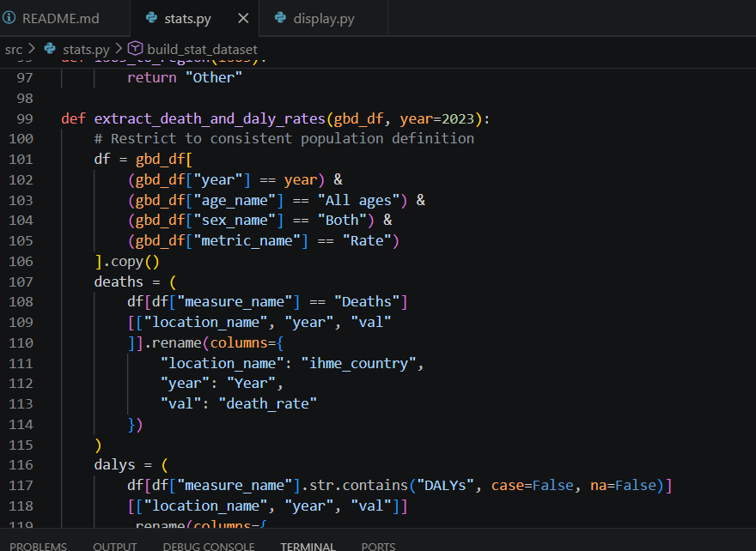
Integrating Policy and Health-Burden Data
Dataset Integration
Two key datasets on lead paint policy and health burden were combined for comprehensive analysis.
Data Preprocessing
Data was filtered for 2023, harmonized for country names, and formatted for comparability across nations.
Harmonization Challenges
Country name differences and ISO code inconsistencies were resolved with crosswalks and manual overrides.
Final Dataset Output
The final dataset includes policy status, regional data, and health-burden metrics for each country.
Notes:
--- This slide references information from the following file: https://iris.who.int/server/api/core/bitstreams/6bd617d9-cc9b-4626-aa90-5a27901a837a/content,https://lauedu74602-my.sharepoint.com/personal/mohamad_hijazi05_lau_edu/Documents/Microsoft%20Copilot%20Chat%20Files/DSC604_Summary_Sp2026.pdf This project integrates two authoritative open datasets to support its analysis. The first is the Our World in Data dataset on legally binding controls on lead paint, which records whether each country has adopted laws regulating lead paint. This dataset provides a clear, binary policy indicator—Yes or No—that is well suited for categorical and spatial visualization. The second dataset comes from the Institute for Health Metrics and Evaluation’s Global Burden of Disease (GBD) 2023 study, which provides country-level estimates of lead-attributable death rates and DALY rates. DALYs represent the total burden of disease by combining years of life lost due to premature mortality and years lived with disability, making them a comprehensive indicator of health impact. Preparing these datasets for visualization required careful preprocessing. The IHME data were filtered to the year 2023, all ages, both sexes, and rate-based metrics to ensure comparability across countries. Because the GBD dataset is structured in long format, deaths and DALYs were extracted separately and merged into a single wide table keyed by country. A major challenge involved harmonizing country names between datasets, as the IHME and OWID sources use different naming conventions. A crosswalk was implemented to align names such as “Russian Federation” with “Russia” and “Lao People’s Democratic Republic” with “Laos.” ISO-3 country codes were cleaned and corrected where necessary, including special cases such as Timor-Leste. Regional information was not present in the original datasets, so continent-level regions were derived from ISO codes using pycountry and pycountry_convert libraries, with manual overrides for edge cases. The final processed dataset contains one row per country with policy status, region, and health-burden indicators, saved as a reproducible CSV file. This rigorous preparation step underpins the validity of the visualizations and ensures that subsequent comparisons are meaningful and transparent.

Slide 8
Dashboard Overview and Visual Architecture
Notes:
--- This slide references information from the following file: https://lauedu74602-my.sharepoint.com/personal/mohamad_hijazi05_lau_edu/Documents/Microsoft%20Copilot%20Chat%20Files/ProjectProposal%20-%20MH.pdf Overview-First Interactive Design

Slide 9
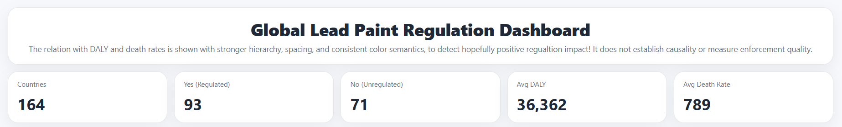
Overview-First Interactive Design
Modular Data Handling
Data is prepared once and reused across visual components, ensuring consistency and efficiency in the dashboard.
Overview-First Layout
Users first see KPI cards summarizing key metrics, providing high-level context for further exploration.
Coordinated Visualizations
Sequence of linked views like maps, bar charts, and heatmaps allow detailed, multi-faceted data analysis.
Visual Consistency and Ethics
Consistent color coding and framing notes prevent misinterpretation and support ethical data visualization.
Notes:
--- This slide references information from the following file: https://lauedu74602-my.sharepoint.com/personal/mohamad_hijazi05_lau_edu/Documents/Microsoft%20Copilot%20Chat%20Files/ProjectProposal%20-%20MH.pdf The dashboard was implemented using Python with Dash and Plotly, emphasizing modular design and clear separation between data preparation and visualization logic. The processed dataset is loaded once and then reused across all visual components, ensuring consistency in counts, categories, and metrics. The layout follows an overview-first principle: users are initially presented with KPI cards summarizing the total number of countries, the number with and without regulation, and average DALY and death rates. This high-level context prepares users for deeper exploration. Below the KPIs, the dashboard presents a sequence of coordinated views, including a global choropleth map, categorical bar charts, regional comparisons, relationship plots, rankings, and a regional heatmap. Visual hierarchy, spacing, and consistent color semantics are used throughout to reduce cognitive load. Blue is consistently used to represent regulated countries, while red indicates not regulated countries, supporting rapid categorical recognition. Interactive features such as tooltips allow users to inspect individual countries without cluttering the main view. Responsiveness and layout adjustments ensure that charts remain readable across different screen sizes. Importantly, the dashboard includes explicit framing notes clarifying that observed patterns represent associations rather than causal effects. This design choice reinforces ethical visualization practice by preventing overinterpretation. Overall, the dashboard architecture demonstrates how multiple visualization structures can be orchestrated into a coherent analytical interface, guiding users from global overview to specific insights while maintaining visual consistency and analytical rigor.

Slide 10
Spatial and Comparative Visualizations
Notes:
--- This slide references information from the following file: https://iris.who.int/server/api/core/bitstreams/6bd617d9-cc9b-4626-aa90-5a27901a837a/content Maps, Counts, and Regional Comparisons

Slide 11
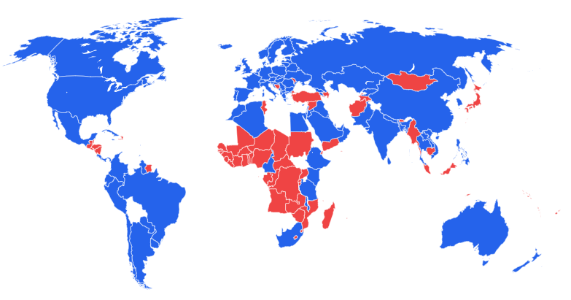
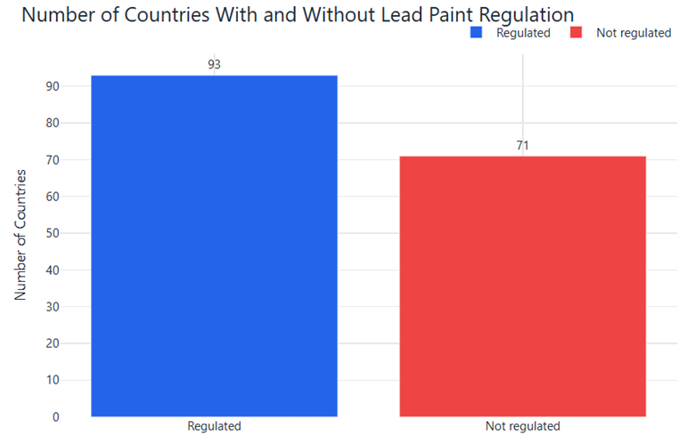
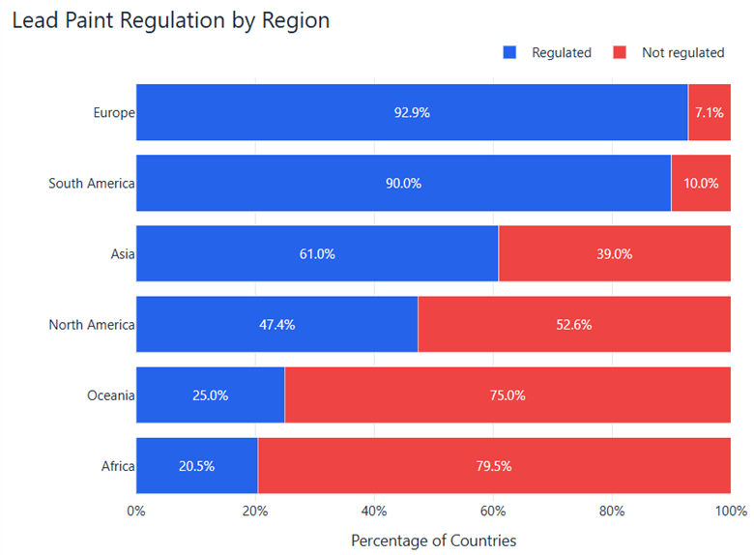
Maps, Counts, and Regional Comparisons
Choropleth Map Visualization
The choropleth map uses color-coded countries to show where lead paint regulations exist, revealing global policy gaps.
Country Regulation Counts
A bar chart summarizes the number of countries with and without lead paint regulations, showing the global law coverage.
Regional Proportional Comparison
A horizontal stacked bar chart displays the proportion of regulated versus unregulated countries per continent to highlight disparities.
Notes:
--- This slide references information from the following file: https://iris.who.int/server/api/core/bitstreams/6bd617d9-cc9b-4626-aa90-5a27901a837a/content Spatial and comparative views form the backbone of the dashboard’s policy analysis. The choropleth world map uses country polygons colored by regulation status to reveal where legally binding lead paint controls exist and where major gaps remain. Geographic position combined with color hue is highly effective for spatial pattern detection, enabling users to quickly identify clusters of regulated and unregulated countries. Complementing the map, a bar chart summarizes the total number of countries with and without regulation, directly answering the question of how widespread lead paint laws are globally. This categorical comparison uses bar length on a common baseline, one of the most perceptually accurate encodings for quantity. To extend the analysis to the regional level, a horizontal 100% stacked bar chart shows the proportion of regulated versus unregulated countries within each continent. Regions are sorted by the percentage of regulated countries, allowing immediate identification of disparities. The horizontal orientation avoids rotated labels and improves readability, especially for long region names. Together, these three views—map, count bar chart, and regional stacked bar—provide complementary perspectives on the same policy data. The map emphasizes geography, the bar chart emphasizes magnitude, and the regional chart emphasizes proportional comparison. This combination illustrates how multiple coordinated views can collectively support deeper understanding than any single chart alone. Global choropleth map illustrating which countries have legally binding controls on lead paint, highlighting geographic disparities in policy coverage.

Slide 12
Relationship and Ranking Analyses
Notes:
--- This slide references information from the following file: https://lauedu74602-my.sharepoint.com/personal/mohamad_hijazi05_lau_edu/Documents/Microsoft%20Copilot%20Chat%20Files/Dashboard.html DALY–Death Relationships and High-Burden Countries

Slide 13
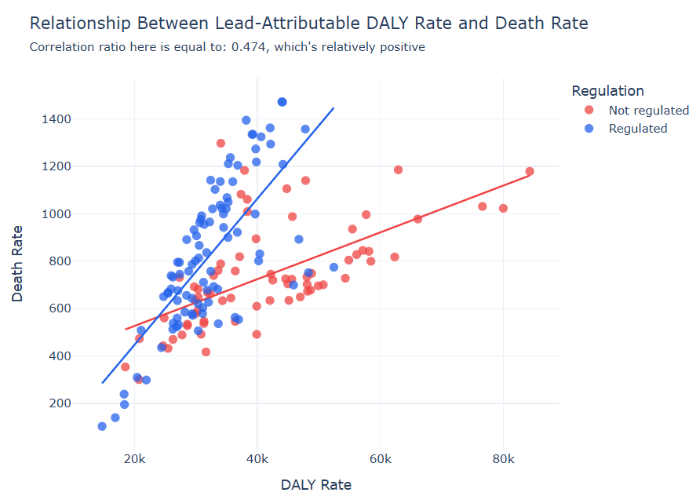

DALY–Death Relationships and High-Burden Countries
Scatterplot Analysis
The scatterplot visualizes the positive association between DALY rates and death rates across countries.
Regulation Status Visualization
Color coding distinguishes countries by lead paint regulation, facilitating comparison within health outcome data.
High-Burden Country Rankings
Ranked lollipop charts highlight countries with the highest DALY and death rates, emphasizing extremes.
Notes:
--- This slide references information from the following file: https://lauedu74602-my.sharepoint.com/personal/mohamad_hijazi05_lau_edu/Documents/Microsoft%20Copilot%20Chat%20Files/Dashboard.html Beyond policy coverage, the dashboard explores how lead paint regulation status appears alongside lead-attributable health outcomes. A scatterplot plots DALY rate against death rate for each country, using position on two quantitative axes to reveal the relationship between these indicators. Color hue encodes regulation status, enabling visual comparison between regulated and not regulated countries within the same relationship space. A fitted trend line highlights the overall positive association: countries with higher DALY rates tend to also have higher death rates, reflecting the shared burden captured by these metrics. However, the scatterplot also reveals substantial variation, underscoring that regulation status alone does not determine health outcomes. To focus attention on extremes, ranked lollipop charts display the countries with the highest DALY rates and the highest death rates. Lollipop charts were chosen over full bar charts to reduce visual weight while preserving precise positional encoding. Direct value labels next to points reduce reliance on tooltips and improve readability. Color again indicates regulation status, making it clear that some of the highest-burden countries are regulated while others are not. These views collectively support nuanced interpretation: they highlight where lead-related health burdens are greatest while reinforcing the importance of cautious, non-causal analysis. By juxtaposing policy status with outcome indicators, the dashboard encourages users to think critically about the complexity of environmental health challenges. Scatterplot showing the relationship between lead-attributable DALY rate and death rate, with points colored by regulation status.

Slide 14
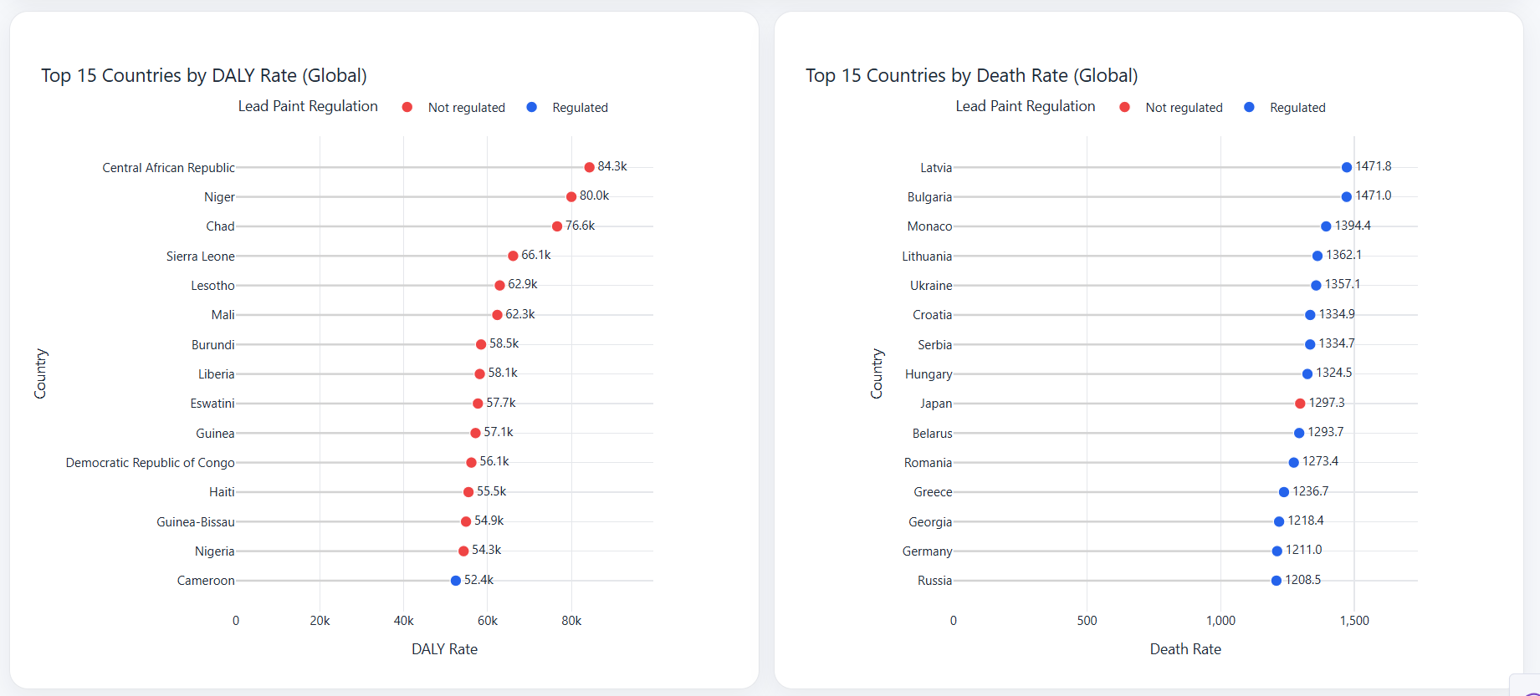

Slide 15
Multivariate Regional Summary
Notes:
Regional Heatmap of Policy and Burden

Slide 16
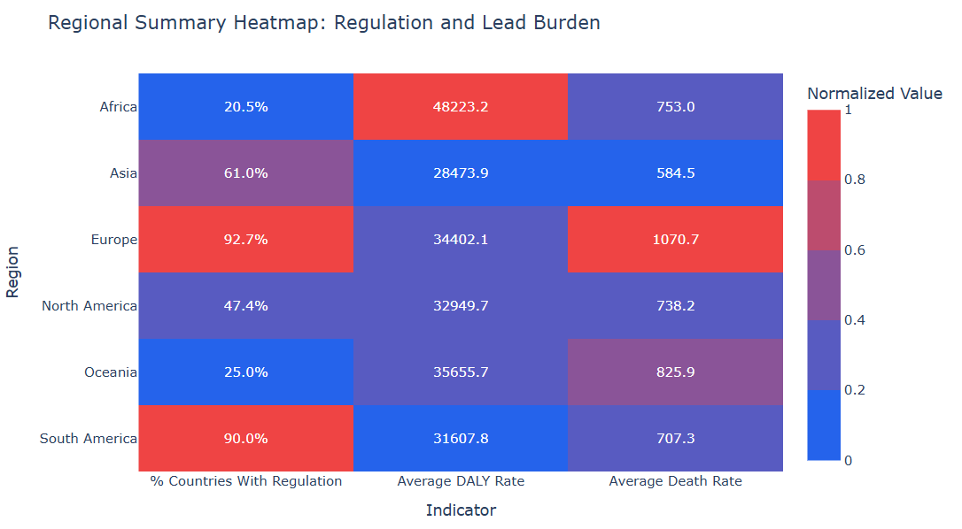
Regional Heatmap of Policy and Burden
Multivariate Regional Summary
Heatmap combines regulation share, average DALY rate, and death rate for comprehensive regional comparison.
Normalization for Comparability
Indicators are normalized to avoid misleading comparisons while preserving actual values in each cell.
Insightful Pattern Recognition
Heatmap reveals complex patterns linking regulation coverage to health burdens across regions.
Notes:
To synthesize multiple indicators at the regional level, the dashboard includes a regional heatmap that summarizes regulation share, average DALY rate, and average death rate for each continent. Heatmaps are well suited for compact multivariate comparison, allowing users to scan patterns across rows and columns. In this case, each cell represents a region–indicator combination. Because the indicators have different units and scales, values are normalized within each indicator before being mapped to color intensity. This normalization prevents misleading comparisons that could arise from directly encoding raw values of incomparable metrics. At the same time, actual values are displayed as text within each cell, preserving transparency and interpretability. The heatmap reveals patterns that are less obvious in single-indicator charts, such as regions that combine relatively high regulation coverage with moderate or high health burdens, or regions with low regulation and high burden. By presenting policy and outcome indicators together, the heatmap supports holistic regional assessment and reinforces the value of integrated visualization approaches. This multivariate summary aligns with the project’s goal of moving beyond isolated charts toward richer analytical insight. Regional heatmap summarizing percentage of countries with regulation, average DALY rate, and average death rate, with normalized color intensity and displayed actual values.

Slide 17
Validation, Insights, and Conclusion
Notes:
--- This slide references information from the following file: https://lauedu74602-my.sharepoint.com/personal/mohamad_hijazi05_lau_edu/Documents/Microsoft%20Copilot%20Chat%20Files/dashboard_visual_enhancements.py Key Insights, Limitations, and Takeaways

Slide 18

Key Insights, Limitations, and Takeaways
Multilevel Data Validation
The project includes harmonization of country data and validation to ensure accurate mapping and visualization.
Key Analytical Insights
Lead paint regulation shows uneven global coverage with regional disparities and complex health burden patterns.
Project Limitations
Regulation data is binary and does not capture enforcement strength; health outcomes have multiple exposure sources.
Effective Data Visualization
The project transforms complex data into accessible narratives using spatial, comparative, and multivariate visualizations.
Notes:
--- This slide references information from the following file: https://lauedu74602-my.sharepoint.com/personal/mohamad_hijazi05_lau_edu/Documents/Microsoft%20Copilot%20Chat%20Files/dashboard_visual_enhancements.py The project applies validation at multiple levels to ensure analytical and visual soundness. Data validation involved careful harmonization of country names, ISO codes, and regional derivations to support accurate mapping and aggregation. Task validation ensured that each visualization directly supports a defined analytical goal, from spatial detection to ranking and multivariate comparison. Encoding validation emphasized perceptual effectiveness, favoring position and length for quantitative comparisons and hue for categorical distinctions. Interpretation validation was addressed through explicit non-causal framing notes embedded in the dashboard. The resulting insights are both substantive and nuanced. Globally, lead paint regulation is clearly uneven, with substantial regional disparities. Europe and South America show high regulation coverage, while other regions lag behind. Health-burden patterns do not align perfectly with regulation status, underscoring that legal controls are necessary but not sufficient to eliminate lead exposure risks. DALY and death rates are positively related, reinforcing their joint interpretation as burden indicators. At the same time, the project acknowledges important limitations. Regulation status is binary and does not capture enforcement strength or policy quality, and lead-attributable health outcomes reflect multiple exposure sources beyond paint. In conclusion, this project demonstrates how principled data visualization can transform complex policy and health data into an accessible analytical narrative. By integrating spatial, comparative, relational, and multivariate views within a coherent dashboard, the project fulfills the course goals of abstraction, encoding justification, validation reasoning, and insight generation, while maintaining responsible and transparent interpretation.

Slide 19
ThANKS All ☺
Don’t hesitate if you’ve any questions or notes

