Slide 1

Online Booking System
Booking.in
Cars , Movies & Rooms
Created By:
Mohammad Husain
Sadik Ali

Slide 2
Current Scenario :
Cars:
This is not possible for an individuals having own car who are interested in tour and travelling.
Movies:
The craze of movies is rising now a days and everyone need first day first show without waiting’s headache.
Rooms:
This is not possible to visit in every hotel at a time and find a desire rooms at reasonable price.
So, we are going to solve all the problems.
Notes:
2

Slide 3
Need For System Development
There are a few website which are proving an online booking for a particular sector.
But we are providing the 3 in 1 facilities to those people who like to enjoy weekends.
We are providing facilities to book Rental Cars, Movie Shows & Hotel Rooms on the same platform. Using our web application people can book stuffs within no second.
This process reduce the workload of paper work, reduce time and available for 24/7.

Slide 4
Types of Users
Admin:
Admin is a first user who can update following things:
Update page
Update records
Manage advertisement records
Take a feed back from end users
Add paid promotion
End User:
End users are the user who is actually use the web application. Here, in our case end user are the user who book Cars, Movies & Rooms.
Can see information which are shown on the web page.
Can see past history of booking done by him.
Can also create a watch list.

Slide 5
System Investigation
We have visited a ZOOMCAR.COM to implement the car system of our project.
We have also visited MakeMyTrip.in, BookMyShow.in which provide a third party platform to book Trips, flights & more.
Our project is inspire from Booking.com (international booking platforms) which provide many services at one location.
We have tried to solve many limitations of above visited website and integrated all the website’s services in single web application

Slide 6
System Investigation (Cont.)
Advantages :
Tickets are booked online without physically visiting place so, It is less Time Consuming .
You can compare price of Movies, Cars & Rooms from different places & more options are available.
The role of agent is neglected between the users and firms. So you can book at a Reasonable price .

Slide 7
Content:
Data Flow Diagram
Data Dictionary
ER Diagram
Form Design

Slide 8
Data Flow Diagram
Context Level Diagram (Zero Level)
Booking.in (process)
Request
Insert, Delete ,Update
Customer
Admin
Response
Response

Slide 9
Zero Level Diagram (Customer)
1.0
Registration
Register
Customer
Insert User Detail
user
Response
2.0
Login
Login
Check Detail
Response
Confirmation
3.0
Request
View
&
Book car
Request for Detail
cars_list
Response
Response
4.0
Request
View &
Book Movies
Request for Detail
movies_list
Response
Response

Slide 10
First Level Diagram (Customer)
Register Process 1.0
1.1
Register
Customer
Registration
No
Validation
Yes
1.2
Save Detail
Save User Detail
user
Acknowledgement
Response

Slide 11
First Level Diagram (Customer)
Login Process 2.0
2.1
Login
Customer
Registration
2.2
Verify
Verify Detail
Acknowledgment
user
Response
No
Email &
Password
Is valid
Yes
2.3
Create
Session
Cookie
Login Acknowledgment

Slide 12
First Level Diagram (Customer)
View & Book Car Process 3.0
3.1
Request
Search car by city
Customer
Request to retrieve data
cars_list
3.2
Display selected
car
Response
3.3
Enter
customer
detail
No
Is valid
3.4
Update table
yes
Payment
Insert Record
car_transaction
3.5
Acknowledgement
Print
document
Retrieve Record

Slide 13
First Level Diagram (Customer)
View & Book Car Process 3.0 (cont.)
3.6
Request
Add To List
Customer
Insert data
cars_addtolist
Request
3.7
Cancel
Booking
Acknowledgement
cars_list
No
Is valid
Yes
cars_transaction

Slide 14
First Level Diagram (Customer)
View & Book Movie Process 4.0
4.1
Request
Search movie by city
Customer
Request to retrieve data
movies_list
4.2
Display selected
movie
Response
4.3
Enter
customer
detail
No
Is valid
4.4
yes
Select
seat
Seat available
seat_tracking
4.5
movies_transaction
Payment

Slide 15
First Level Diagram (Customer)
View & Book Movie Process 4.0 (cont.)
4.6
Customer
Acknowledgement
Print
document
Retrieve Record
movies_transaction
4.7
Add To List
Request
Insert data
movie_addtolist
4.8
Request
Cancel
Booking
Acknowledgement
movies_list
No
Is valid
Yes
movies_transaction

Slide 16
Data Dictionary
List of Tables :
# | Table Name | Description
1 | user | Use to hold user detail(user name, user Email, Password)
2 | cars_list

Slide 17
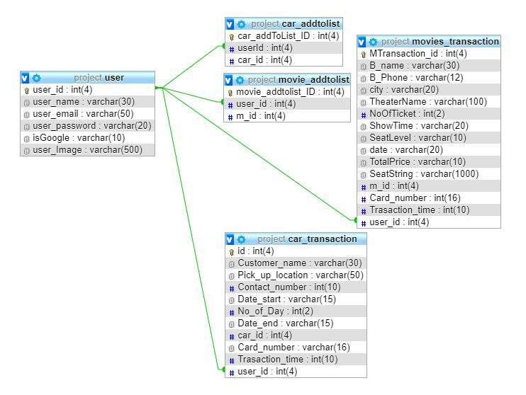
Entity Relationship Diagram

Slide 18
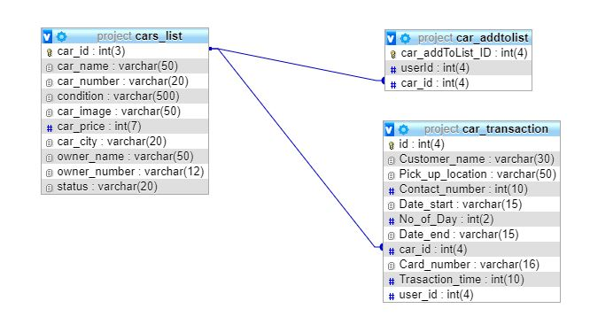
Entity Relationship Diagram (cont.)

Slide 19
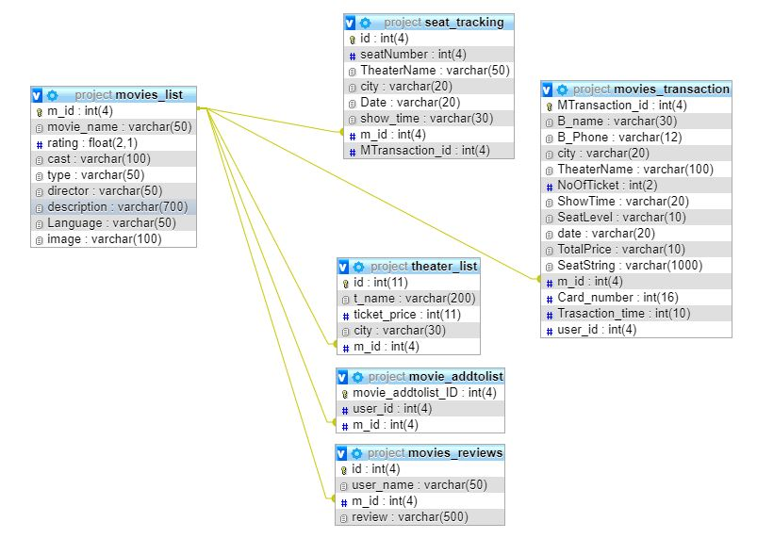
Entity Relationship Diagram (cont.)

Slide 20
