Slide 1
TA1 – Introduction
Operating Systems Course
The Hebrew University
Spring 2021

Slide 2
Today’s Plan
Administrations
Nand Review
Valgrind
GDB
Clion
Virtualization
Strace

Slide 3
Administrations

Slide 4
צוות הקורס
דוד חי – מרצה
נטע רוזן-שיף - מרצה
איתן ליפשיץ – מתרגל
עידן רפאלי – מתרגל
איהאב זחאיקה – מתרגל
רון אבוטבול - מתרגל
אנאל בן-סימון – צאר
אלירן אלישע - צאר

Slide 5
מנהלות
4 תרגילי חובה – חובה לקבל לפחות 60 בממוצע התרגילים.
ייתכן תרגיל רשות.
התרגילים יכללו שאלות תאורטיות ומשימות תכנותיות.
לוודא שהתרגילים מתקמפלים.
ייתכן שיהיו ראיונות על תרגילים 2-4.
כנסו לאתר הקורס ועיינו בנהלים בקפידה.
אפס סובלנות להעתקות
שימוש ב-moodle לצורך הודעות, שאלות, פורום תלמידים, הגשות וכו'.
כתובת הדואר של הקורס os@cs.huji.ac.il

Slide 6
Course Motivation (1)
How can you play music, scan for viruses and read a document with a single processor?
What happens when you press a button?
What happens when you use “write” or “read” of a file?
Reading a file is extremely slow, how does the computer keep being responsive?
What does “segmentation fault” mean?

Slide 7
Course Motivation (2)
How can we run programs that use more memory than we actually have?
How can you speed up programs by using multi-core system?
There are a few main problems that arise from this, we will study how to solve them.
Sending messages between computers (communication)

Slide 8
Course Motivation (3)
THE MOST IMPORTANT COURSE FOR THE INDUSTRY

Slide 9
Computer Hardware

Slide 10
CPU (Central Processing Unit)
CPU contains registers.
Important registers are:
IR – Instruction Register
PC – Program Counter
SP – Stack Pointer
Executes a set of instructions:
Data handling – set a register, store , load
Arithmetic operations - Bitwise operations, compare, and basic mathematics operations.
Control flow – branch, conditional branch
Each instruction is represented by an unique binary number (a ‘word’). For example, the following 32-bit word: 00000010000100010100000000100000 means: add $8, $16, $17
Notes:
Word structure:
Black – opcode (command type: I-type, R-type, etc.)
Red – first register for computation (10000 = 16)
Brown – second register for computation (10001 = 17)
Green – register to stored the computation result (01000 = 8)
Blue – not in used for this type of command
Purple – the computation function to execute (add)

Slide 11
CPU Instruction Life-Cycle
Instruction fetch
Decode instruction and registers fetch
ALU operation
Memory access if required (lw, sw)
Register write-back (lw, add)
For Example:
add $8, $16, $17 → Reg[8]=Reg[16]+Reg[17]
lw $1, 32($2) → Reg[1] = M[Reg[2]+32]
sw $3, 12($4) → M[Reg[4]+12] = Reg[3]
Notes:
The instructions syntax can vary from one CPU to another.
How does the program know which instruction to fetch?
PC register.

Slide 12
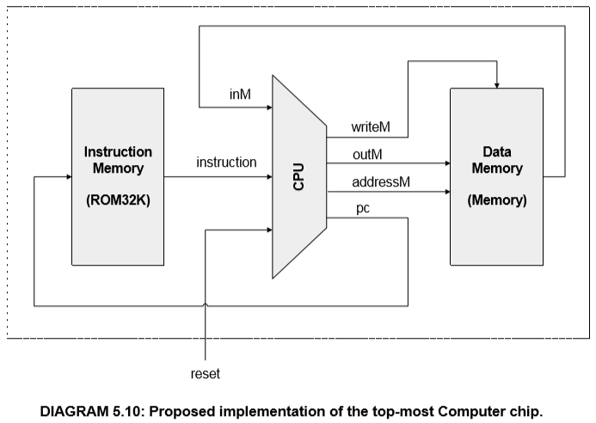
CPU Instruction Life-Cycle
The diagram is taken from “The elements of computing systems”, Nisan & Schoken, ch. 5

Slide 13
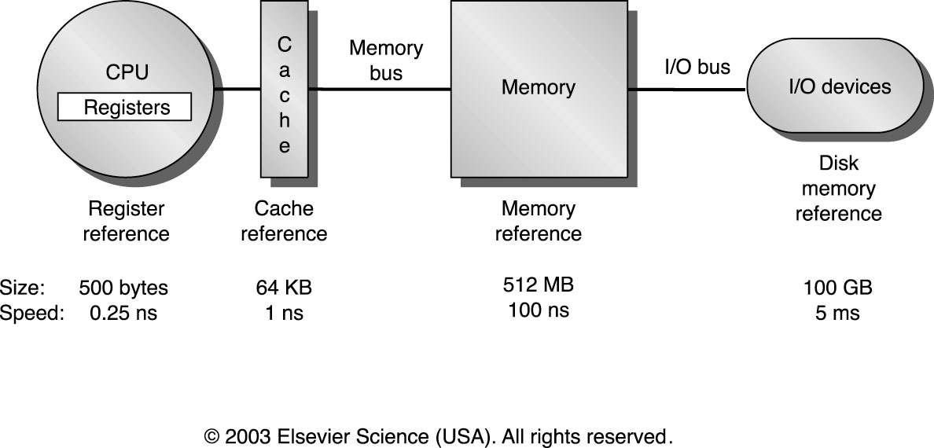
Typical Memory Hierarchy
Current
Size
8MB
8GB
2TB
~same

Slide 14
Memory Hierarchy
Main Memory - located on chips inside the computer (outside CPU).
The program instructions and the process data are kept in main memory.
External Memory - disk. Information stored on a disk is not deleted when the computer turned off.
The main memory has less storage capacity than the hard disk. The hard disk can write and read information to and from the main memory. The access speed of main memory is much faster than a hard disk.
Programs are stored on the disk until they are loaded into memory, then they use the disk as both the source and destination of the information for their processing.

Slide 15
Valgrind (Debugging)

Slide 16
Valgrind
Framework debugging and profiling code on Linux system.
The most used tool is Memcheck, which can detect memory errors.

Slide 17
Ex1.c
#include<stdlib.h>
#include<stdio.h>
typedef struct Foo {
int arr[3];
int bar;
} Foo;
int main(int argc, char *argv[]) {
Foo t;
int i;
printf("start\n");
t.bar = 6;
printf("t.bar = %d\n", t.bar);
for (i=0; i<3; i++) {
t.arr[i] = i+1;
}
t.arr[i] += t.arr[0] + t.arr[1];
printf("t.arr[2] = %d\n", t.arr[2]);
printf("t.bar = %d\n", t.bar);
return 0;
}

Slide 18
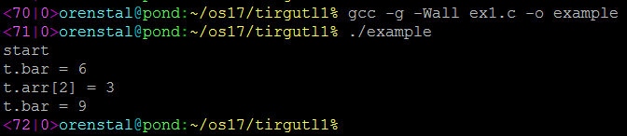
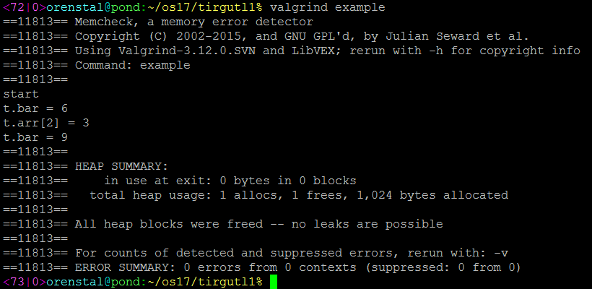
Ex1.c

Slide 19
Ex2.c
#include<stdlib.h>
#include<stdio.h>
void foo(int n) {
int i;
int *a = (int*) malloc(n*sizeof(int));
a[0] = 1;
printf("a[0] = 1\n");
a[1] = 1;
printf("a[1] = 1\n");
for (i=2; i<=n; i++) {
a[i] = a[i-1] + a[i-2]; printf("a[%d] = %d\n", i, a[i]);
}
free(a);
}
int main(int argc, char *argv[]) {
foo(10);
return 0;
}

Slide 20
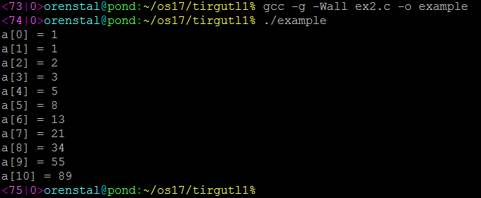
Ex2.c

Slide 21
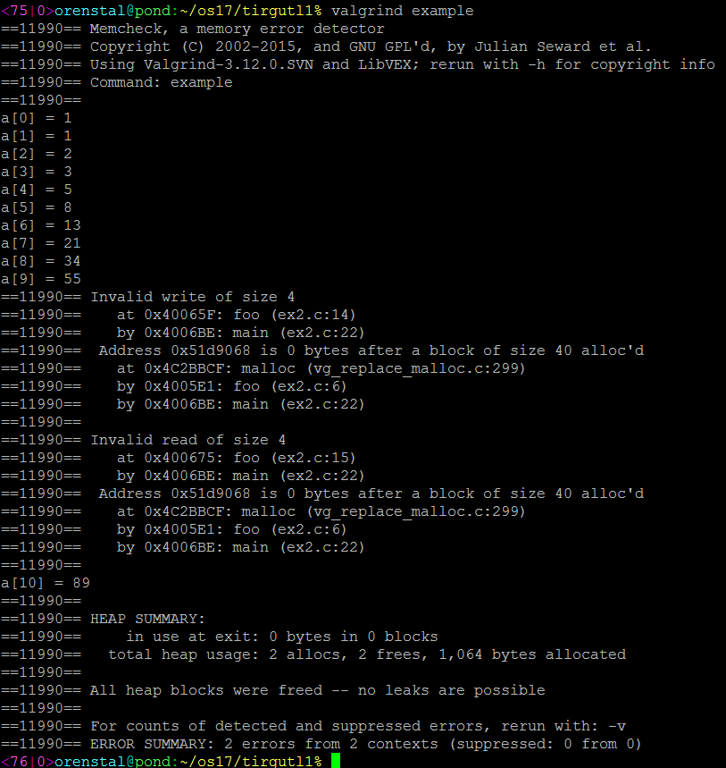
Ex2.c

Slide 22
Ex3.c
#include<stdlib.h>
#include<stdio.h>
void foo(int n) {
int *a = (int*) malloc(n*sizeof(int));
int i;
for (i=0; i<n; i++) {
a[i] = i*i;
printf("a[%d] = %d\n", i, a[i]);
}
}
int main(int argc, char *argv[]) {
foo(10);
return 0;
}

Slide 23
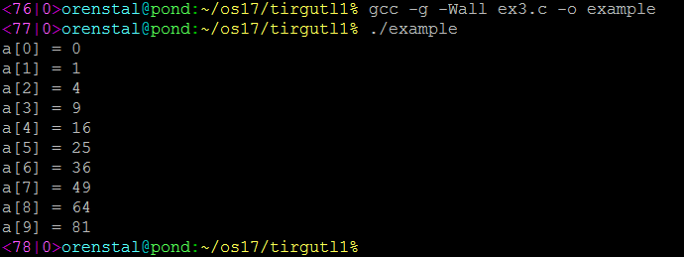
Ex3.c

Slide 24
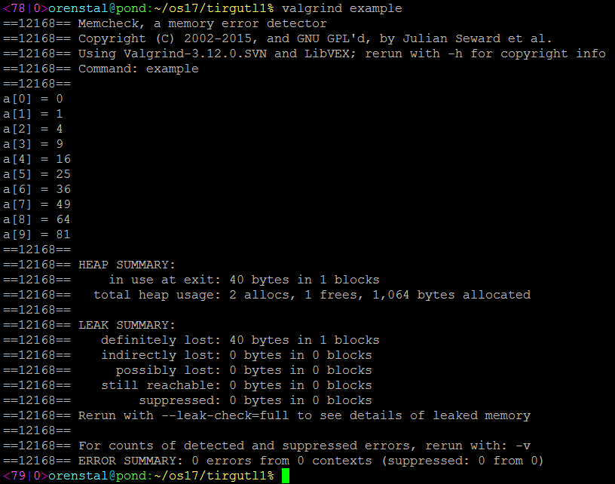
Ex3.c

Slide 25
Ex4.c
#include<stdlib.h>
#include<stdio.h>
#define DIM 1000000
int main(int argc, char *argv[]) {
float *a;
int i;
a = (float*) malloc(DIM*sizeof(float));
for (i=0; i<DIM; i++) {
a[i] = i;
if (i == DIM-1000) { printf("i == %d", (DIM-1000)); a[DIM+i] = a[i]; a[DIM-1] = a[i];
}
}
printf("Done");
free(a);
return 0;
}

Slide 26

Ex4.c

Slide 27
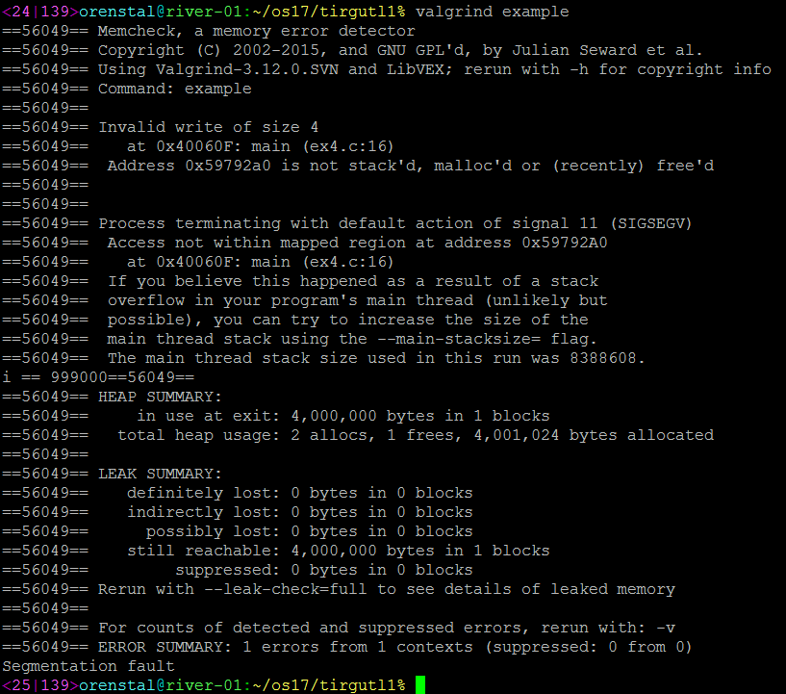
Ex4.c

Slide 28
Ex5.c
#include<stdlib.h>
#include<stdio.h>
#define DIM 1000000
int main(int argc, char *argv[]) {
float *a;
int i;
a = (float*) malloc(DIM*sizeof(float));
printf("~1 ");
for (i=0; i<DIM; i++) {
a[i] = i;
if (i == DIM-1000) { printf("i == %d", (DIM-1000)); a[DIM+i] = a[i]; a[DIM-1] = a[i]; printf(" ~2 ");
}
}
printf("a[0] = %f\n", a[0]);
printf("Done");
free(a);
return 0;
}

Slide 29

Ex5.c

Slide 30
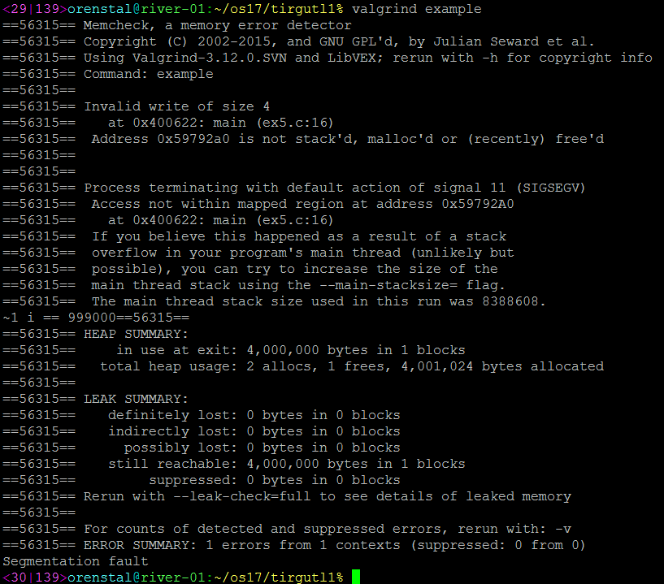
Ex5.c

Slide 31
Ex6.c
#include<stdlib.h>
#include<stdio.h>
#define DIM 1000000
int main(int argc, char *argv[]) {
float *a;
int i;
a = (float*) malloc(DIM*sizeof(float));
printf("~1 "); fflush(stdout);
for (i=0; i<DIM; i++) {
a[i] = i;
if (i == DIM-1000) { printf("i == %d", (DIM-1000)); fflush(stdout); a[DIM+i] = a[i]; a[DIM-1] = a[i]; printf(" ~2 "); fflush(stdout);
}
}
printf("a[0] = %f\n", a[0]); fflush(stdout);
printf("Done");
free(a);
return 0;
}

Slide 32

Ex6.c

Slide 33
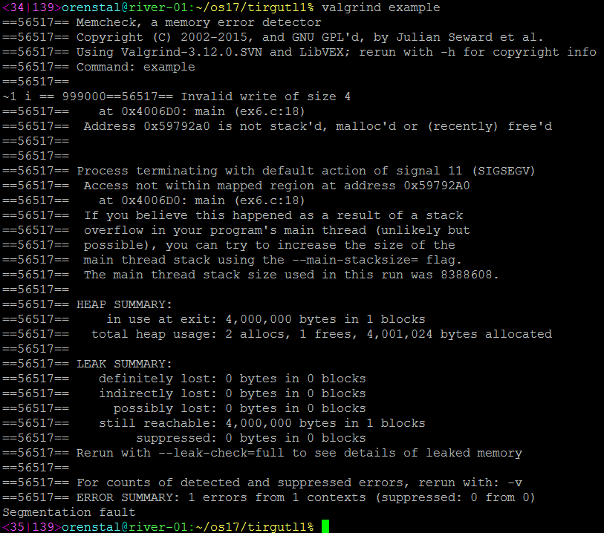
Ex6.c

Slide 34
Ex7.c
#include<stdlib.h>
#include<stdio.h>
#define DIM 1000000
int main(int argc, char *argv[]) {
float *a;
int i;
a = (float*) malloc(DIM*sizeof(float));
for (i=0; i<DIM; i++) {
a[i] = i;
if (i == DIM-1000) { printf("i == %d\n", (DIM-1000)); a[DIM+i] = a[i]; a[DIM-1] = a[i];
}
}
printf("Done\n");
free(a);
return 0;
}

Slide 35
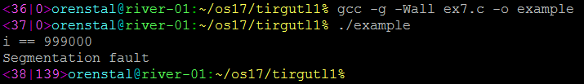
Ex7.c

Slide 36
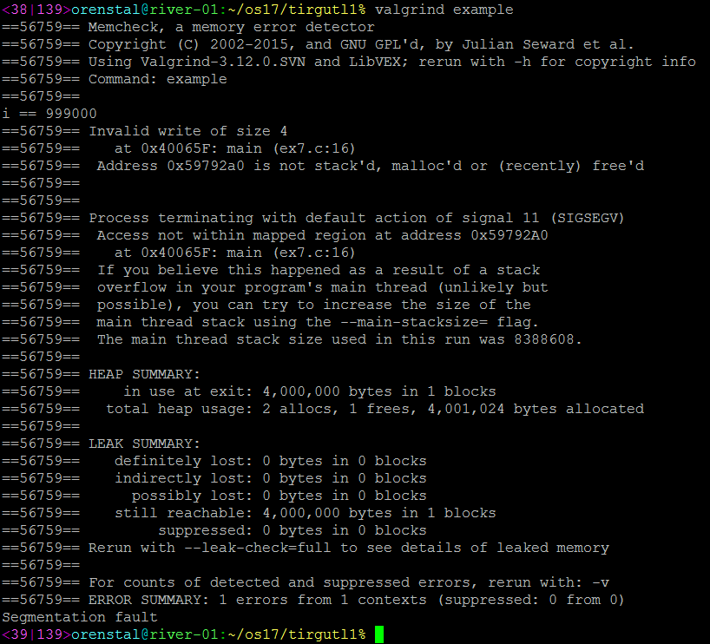
Ex7.c

Slide 37
Ex8.c
#include<stdlib.h>
#include<stdio.h>
int main(int argc, char *argv[]) {
int y;
y += 1;
printf("Done\n");
return 0;
}

Slide 38
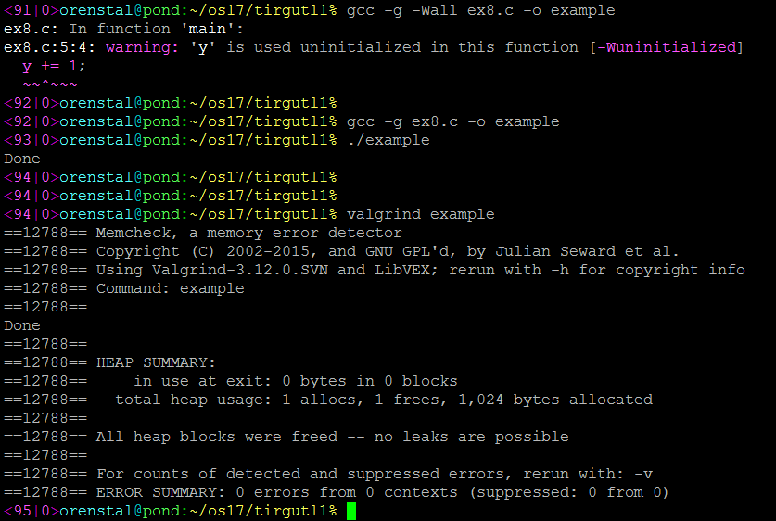
Ex8.c

Slide 39
Ex9.c
#include<stdlib.h>
#include<stdio.h>
int main(int argc, char *argv[]) {
int arrLen = 10;
int* arr;
int i;
arr = (int*) malloc(arrLen*sizeof(int));
for(i=0; i<arrLen; i++) {
arr[i] = i;
}
free(arr);
for(i=0; i<arrLen; i++) {
arr[i] = i*2;
}
printf("Done\n");
return 0;
}

Slide 40
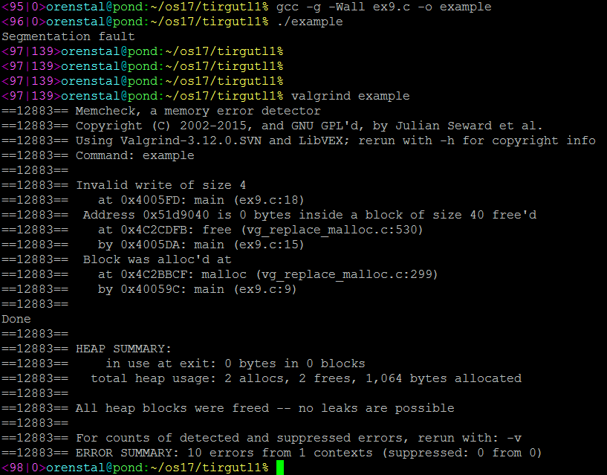
Ex9.c

Slide 41
Ex10.c
#include<stdlib.h>
#include<stdio.h>
int compute(int len, int* arr) {
int sum = 0, i;
for(i=0; i<len; i++) {
sum += arr[i];
}
free(arr);
return sum;
}
int main(int argc, char *argv[]) {
int arrLen = 10, sum, i;
int* arr;
arr = (int*) malloc(arrLen*sizeof(int));
for(i=0; i<arrLen; i++) {
arr[i] = i;
}
sum = compute(arrLen, arr);
free(arr);
printf("sum = %d", sum);
return 0;
}

Slide 42
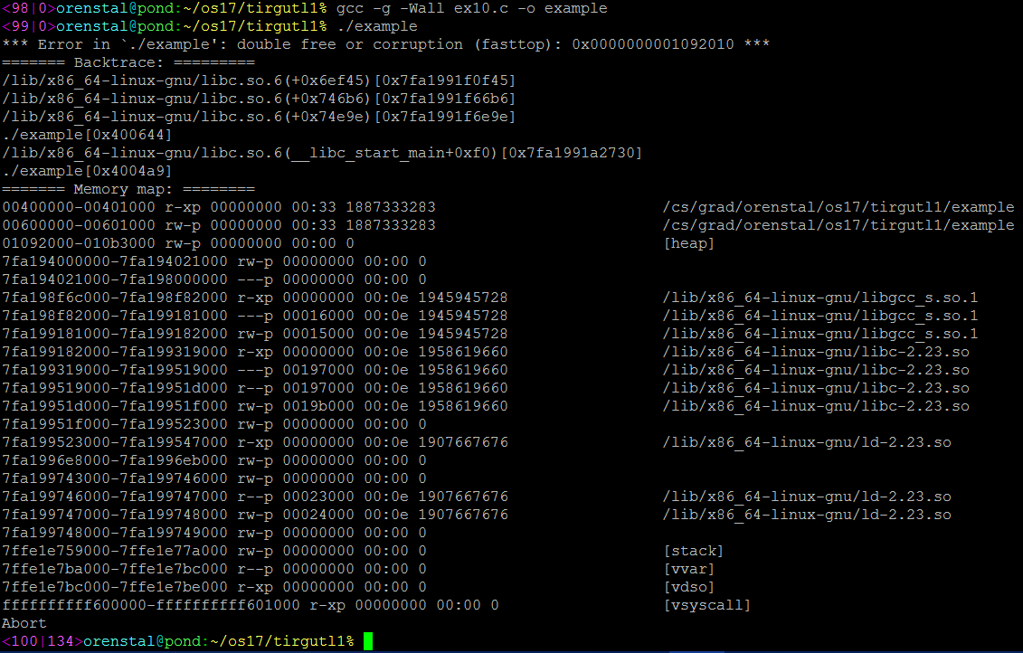
Ex10.c

Slide 43
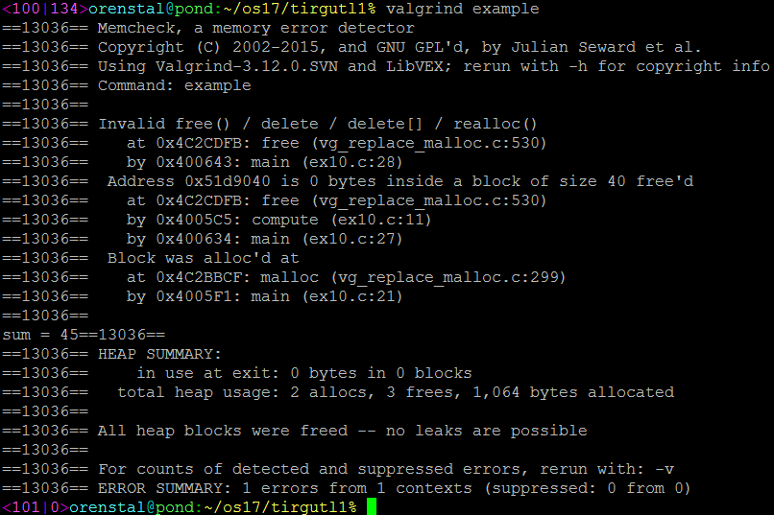
Ex10.c

Slide 44
Valgrind Summary
Valgrind can detect errors such as:
Memory leaks.
Wrong usage of memory-related functions (malloc, free, etc.).
Out of bounds error.
It may supply segmentation fault hint.
Use it!

Slide 45
GDB (GNU Debugger)

Slide 46
GDB (GNU Debugger)
Debugger that runs on many Unix-like systems and for many programming languages.
Compile c / c++ programs with ‘-g’ flag (enables debug symbols)
gcc –o myProg –g test.c
g++ -o myProg –g test.cpp
Then, load the program into gdb
gdb myProg

Slide 47
GDB – Basic Commands
run: starts executing the program.
break: insert breakpoint in which the execution will suspend.
next: executes the next line (even if it’s function call), unless there is a suspending execution event (later today)
step: steps into the next line.
cont : continues the execution till the next suspending execution event or end of execution.
print var: prints the value of var.

Slide 48
Ex1.c Reminder
#include<stdlib.h>
#include<stdio.h>
typedef struct Foo {
int arr[3];
int bar;
} Foo;
int main(int argc, char *argv[]) {
Foo t;
int i;
printf("start\n");
t.bar = 6;
printf("t.bar = %d\n", t.bar);
for (i=0; i<3; i++) {
t.arr[i] = i+1;
}
t.arr[i] += t.arr[0] + t.arr[1];
printf("t.arr[2] = %d\n", t.arr[2]);
printf("t.bar = %d\n", t.bar);
return 0;
}

Slide 49
Ex1.c

Slide 50
GDB (GNU Debugger)
Why does t.bar print wrong value?
Let’s debug it…

Slide 51
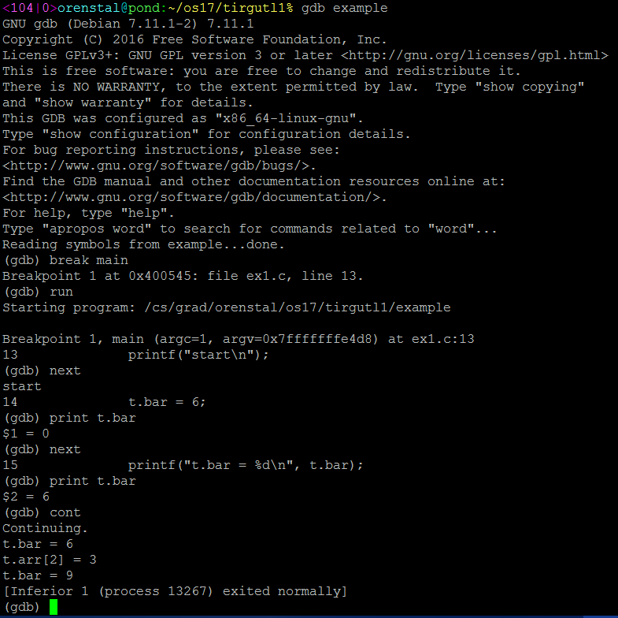

Slide 52
GDB (GNU Debugger)
We still didn’t find the root cause..
Break points:
break function (break main)
break <line_num> (break 4)
break filename:function (break temp.c:main)
break filename: <line_num> (break temp.c:2)
break *address (break *0x12345)
Etc.

Slide 53
GDB (GNU Debugger)
watch command: insert watch point that suspend the program execution upon watched point has changed.
Watch points:
watch var (watch arrSize)
watch condition (watch i==4)
watch *address (watch *0x12345)
But how watch can help us debugging our problem?

Slide 54
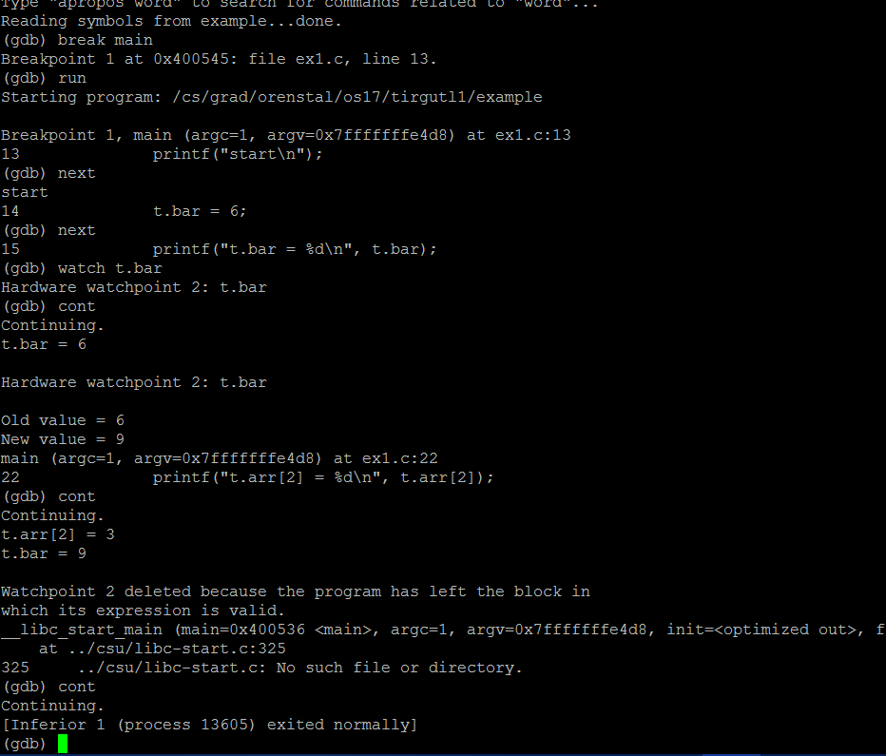

Slide 55
GDB (GNU Debugger)
Alternative way to catch it:
Print &t.bar (to get the address)
Watch *add_of_t.bar

Slide 56
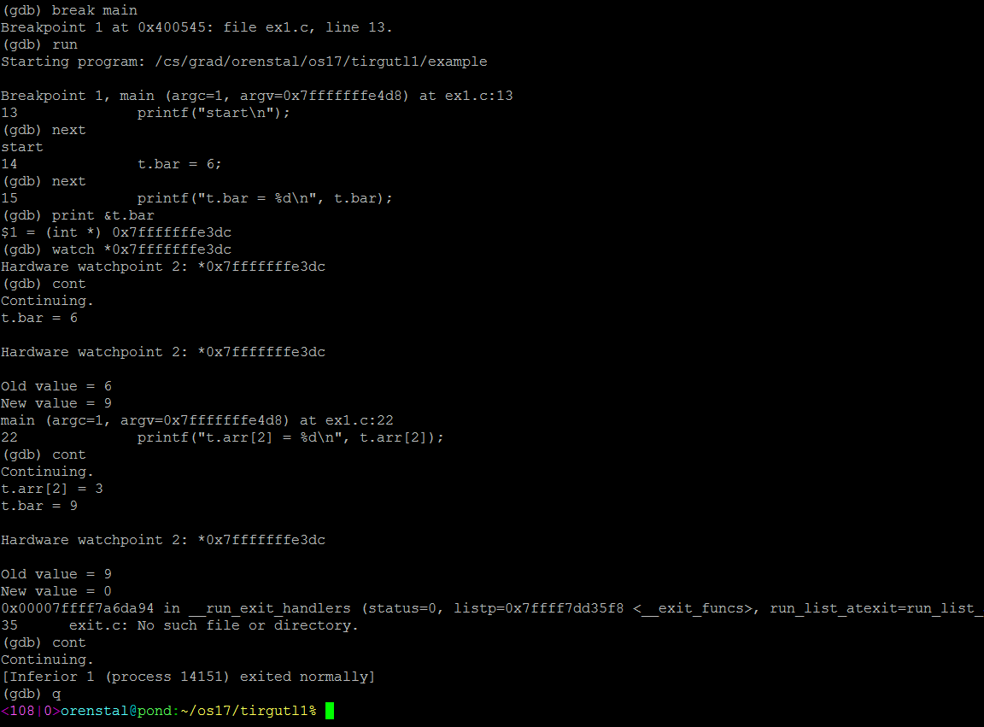

Slide 57
GDB (GNU Debugger)
More useful commands:
delete <break_num>: remove breakpoint
disable <watch_num>: remove watch point
help: help function
bt: prints the backtrace (in case the program crashed)
up: going to the calling function context (for example: to print variables values)
down: going back down the function stack, one function at a time.
info breakpoints prints a list of all the defined breakpoints and watches.

Slide 58
CLion

Slide 59
CLion
Based on GDB.
Has a lot of capabilities.
Easy to use (no command line), very intuitive.

Slide 60
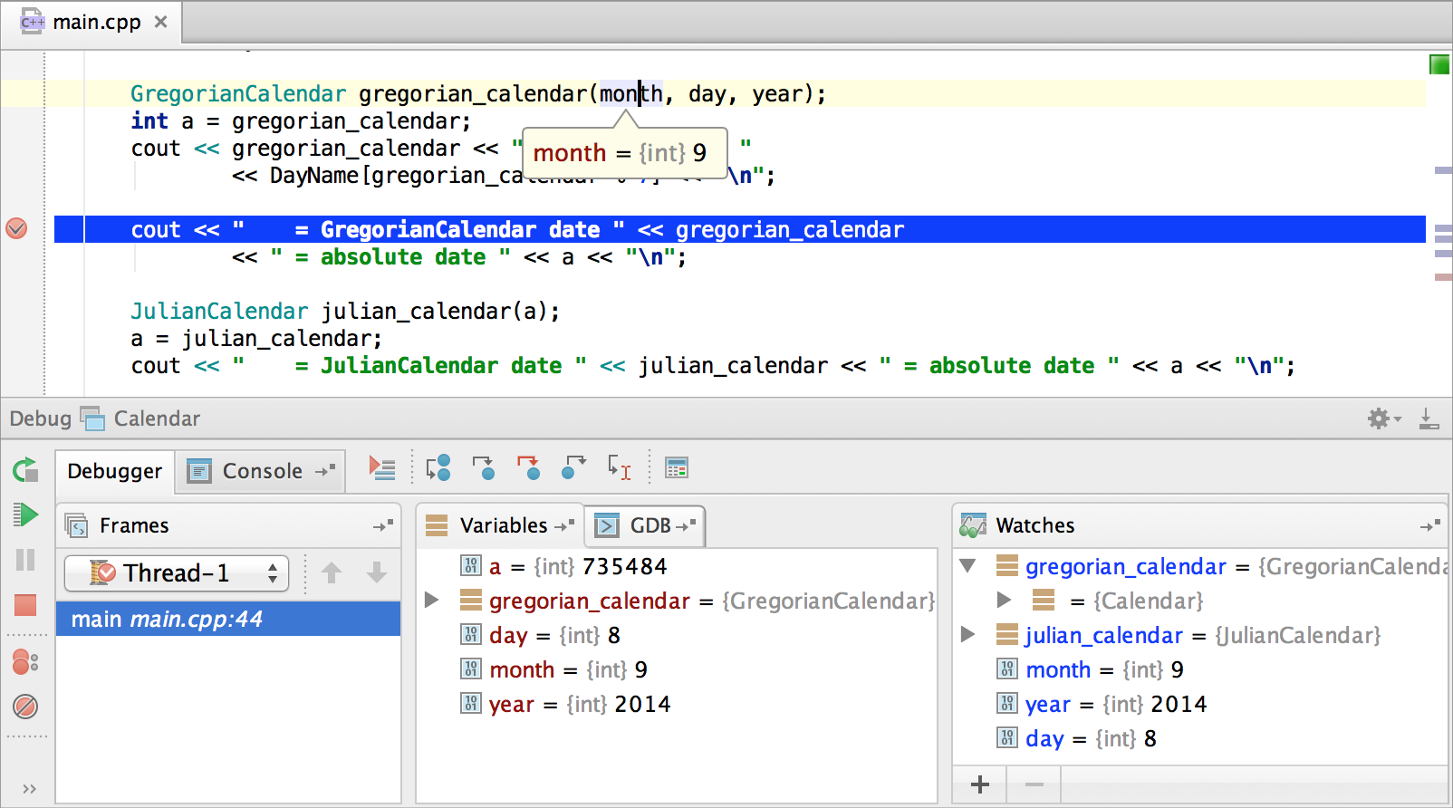
CLion

Slide 61

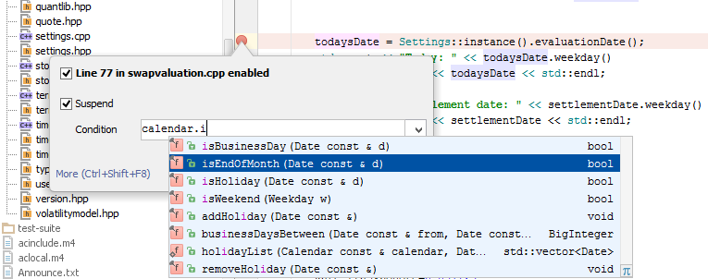
CLion
Breakpoints:
Traditional breakpoint:
Conditional breakpoint:
The figures are taken from: https://blog.jetbrains.com/clion/2015/05/debug-clion/

Slide 62
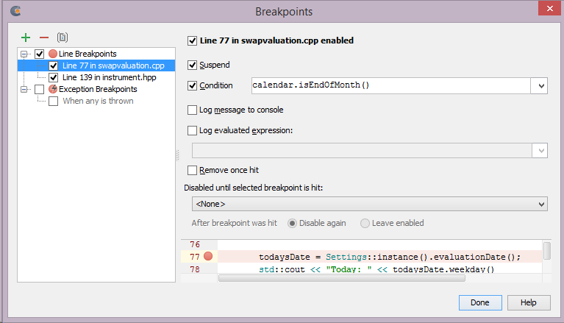
CLion
Breakpoints management:
Traditional breakpoint:
The figures are taken from: https://blog.jetbrains.com/clion/2015/05/debug-clion/

Slide 63
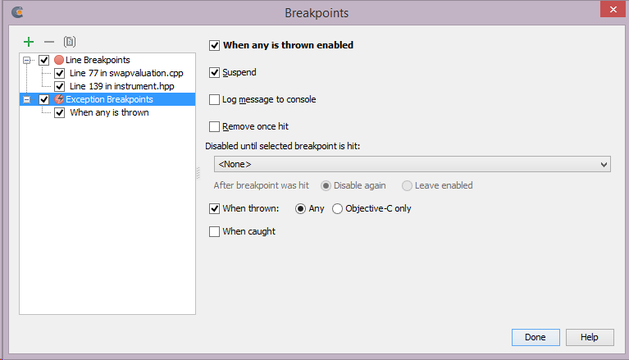
CLion
Breakpoints:
Exception breakpoint:
The figures are taken from: https://blog.jetbrains.com/clion/2015/05/debug-clion/

Slide 64
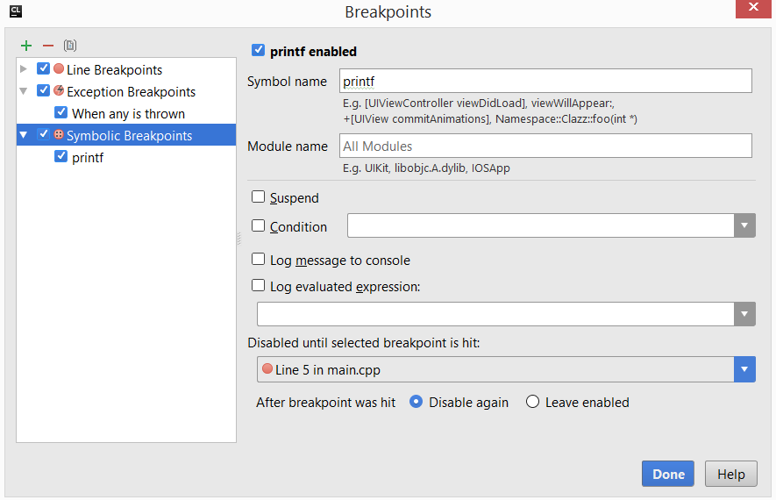
CLion
Breakpoints:
Symbolic breakpoint:
The figures are taken from: https://blog.jetbrains.com/clion/2015/05/debug-clion/

Slide 65
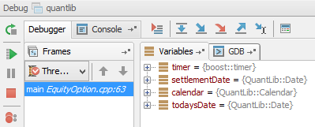
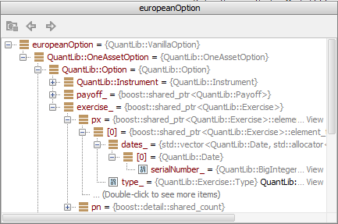
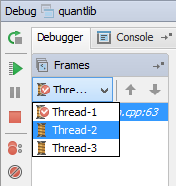
CLion
What happens when a debugger hits a breakpoint?
The figures are taken from: https://blog.jetbrains.com/clion/2015/05/debug-clion/

Slide 66
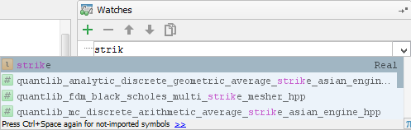
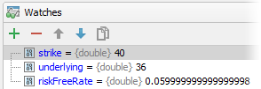
CLion
Watches:
The figures are taken from: https://blog.jetbrains.com/clion/2015/05/debug-clion/

Slide 67
Virtualization
Virtualization refers to the act of creating a virtual (rather than actual) version of something, including virtual computer hardware platforms, storage devices, and computer network resources (Wikipedia).
A virtual machine (VM) is an emulation of computer system. There can be many VMs on each physical computer system, and each VM may have its own “virtual” resources and operating system, so that it “feels” like working with physical machine.

Slide 68
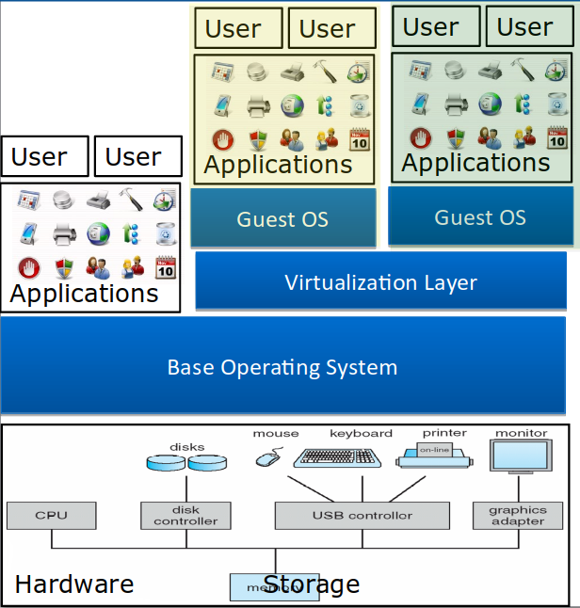
Virtualization

Slide 69
Virtualization
Running several VMs, each with its own OS, consumes many system resources of the physical machine – disk space, RAM, CPU cycles…
That’s a lot of overhead
Containers come to the rescue!

Slide 70
Virtualization
A container is an OS-level virtualization, that is an OS which allows the existence of multiple isolated user space instances.
A program running inside of a container can only see the container’s contents and devices assigned to the container.
Multiple containers can run on the same machine and share the OS kernel with other containers.

Slide 71
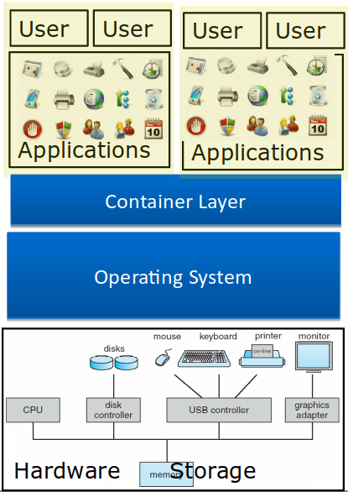
Virtualization

Slide 72
Ex1 Motivation

Slide 73
Ex1 Motivation
Different instructions have different running times
Function call - overhead of maintaining the working environment of each function
System call – extra overhead of switching to kernel space

Slide 74
Ex1 Motivation
In Ex1 you’ll compare the running times of different kind of operations:
Directly on the computer
Inside the VM
Inside the container

Slide 75
Debugging System Calls
Notes:
אני לא הולך להסביר כל פקודה קטנה...
אם משהו לא ברור, תסתכלו באינטרנט.

Slide 76
Debugging by Watching
strace is a debugging utility to monitor the system calls
Easy to use
Fast debugginng
strace command
Shows system calls, arguments, and return values
-t to display when each call is executed
-T to display the time spent in the call
-e to limit the types of calls
-o to redirect the output to a file
-s limit the length of print strings.

Slide 77
Background – basic commands
int open(const char *pathname, int flags);
Opens a file
Returns file descriptor (fd), which identifies the file in future operations
fd=0 -> standard input, fd=1 -> standard outpout, fd=2 -> standard error
ssize_t read(int fd, void *buf, size_t count);
Reads from fd to buf between 1 to count bytes
Returns the number of bytes that were read (zero for eof)
ssize_t write(int fd, const void *buf, size_t count);
Writes from buf to fd between 1 to count bytes
Returns the number of bytes that were written

Slide 78
Strace example: “strace ls /python/”
open("/usr/share/locale/en_GB/LC_MESSAGES/coreutils.mo", O_RDONLY) = -1 ENOENT (No such file or directory)
write(2, "ls: ", 4) = 4
write(2, "cannot access /python/", 22) = 22
open("/usr/share/locale/en_US/LC_MESSAGES/libc.mo", O_RDONLY) = -1 ENOENT (No such file or directory)
open("/usr/share/locale/en/LC_MESSAGES/libc.mo", O_RDONLY) = -1 ENOENT (No such file or directory)
open("/usr/share/locale/en_GB/LC_MESSAGES/libc.mo", O_RDONLY) = 3
fstat(3, {st_mode=S_IFREG|0644, st_size=1474, ...}) = 0
mmap(NULL, 1474, PROT_READ, MAP_PRIVATE, 3, 0) = 0x7f30b2df1000
close(3) = 0
write(2, ": No such file or directory", 27) = 27
write(2, "\n", 1) = 1
close(1) = 0

Slide 79
Strace example: “strace ls python/”
stat("python/", {st_mode=S_IFDIR|0755, st_size=4096, ...}) = 0
openat(AT_FDCWD, "python/", O_RDONLY|O_NONBLOCK|O_DIRECTORY|O_CLOEXEC) = 3
fcntl(3, F_GETFD) = 0x1 (flags FD_CLOEXEC)
getdents(3, /* 8 entries */, 32768) = 240
getdents(3, /* 0 entries */, 32768) = 0
close(3) = 0
fstat(1, {st_mode=S_IFCHR|0620, st_rdev=makedev(136, 0), ...}) = 0
mmap(NULL, 4096, PROT_READ|PROT_WRITE, MAP_PRIVATE|MAP_ANONYMOUS, -1, 0) = 0x79ac55f24000
write(1, "proj1 proj2 proj3 proj4 proj"..., 41) = 41
close(1) = 0

Slide 80
Strace example: “strace wc sample2.in”
stat("sample2.in", {st_mode=S_IFREG|0777, st_size=490, ...}) = 0
open("sample2.in", O_RDONLY) = 3
read(3, "\" The path of the righteous man "..., 16384) = 490
open("/usr/lib/x86_64-linux-gnu/gconv/gconv-modules.cache", O_RDONLY) = 4
fstat(4, {st_mode=S_IFREG|0644, st_size=26066, ...}) = 0
mmap(NULL, 26066, PROT_READ, MAP_SHARED, 4, 0) = 0x7f81a4c88000
close(4) = 0
read(3, "", 16384) = 0
fstat(1, {st_mode=S_IFCHR|0620, st_rdev=makedev(136, 4), ...}) = 0
mmap(NULL, 4096, PROT_READ|PROT_WRITE, MAP_PRIVATE|MAP_ANONYMOUS, -1, 0) = 0x7f81a4c87000
write(1, " 1 96 490 sample2.in\n", 23) = 23
close(3) = 0
close(1) = 0

