Slide 1
TA 2 - Interrupts
Operating Systems Course
The Hebrew University
Spring 2021

Slide 2
CPU (Central Processing Unit) - Reminder
Can use only data that is stored in registers (not memory)
Executes a set of instructions:
Data handling – set a register, store , load
Arithmetic operations - Bitwise operations, compare, and basic mathematics operations.
Control flow – branch, conditional branch
Each instruction is represented by a unique binary number.

Slide 3
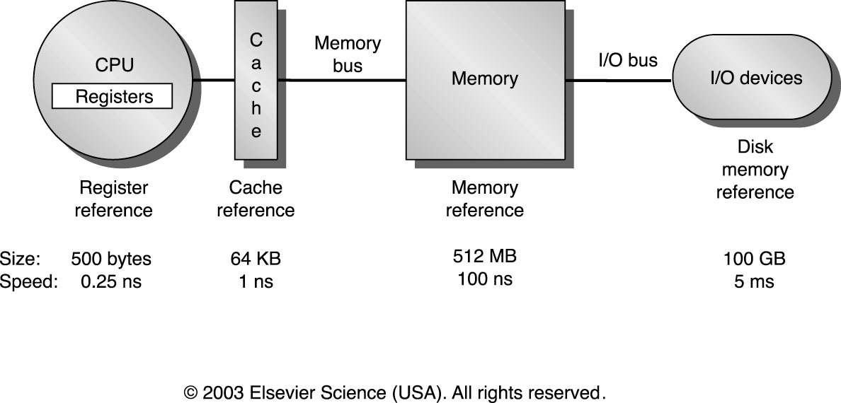
Typical Memory Hierarchy - Reminder
Current
Size
~same
8MB
8GB
2TB
Notes:
CPU= central processing unit
מעגל אלקטרוני דיגיטלי
מיליארד ns זה שנייה אחת
בין MEMORY לDISK: 200 (גודל(, פי 50,000 (זמן)
היום יש SSD, ההבדל ירד לפי 40-50
168*8

Slide 4
Memory Hierarchy - Reminder
Main Memory - located on chips inside the computer (outside CPU).
The program instructions and the processes’ data are kept in main memory.
External Memory - disk. Information stored on a disk is not deleted when the computer turned off.
The main memory has less storage capacity than the hard disk. The hard disk can write and read information to and from the main memory. The access speed of main memory is much faster than a hard disk.
Programs are stored on the disk until they are loaded into memory, and then use the disk as both the source and destination of the information for their processing.
Notes:
למחוק את הסוף???

Slide 5
The Differences between OS and DAST 1: Accessing an Image
Approach 1
Approach2
for (h=0; h<height; ++h){
for (w=0; w<width; ++w){
img[h][w] = 0;
}
}
for (w=0; w<width; ++w){
for (h=0; h<height; ++h){
img[h][w] = 0;
}
}
Which approach is better? And Why?

Slide 6
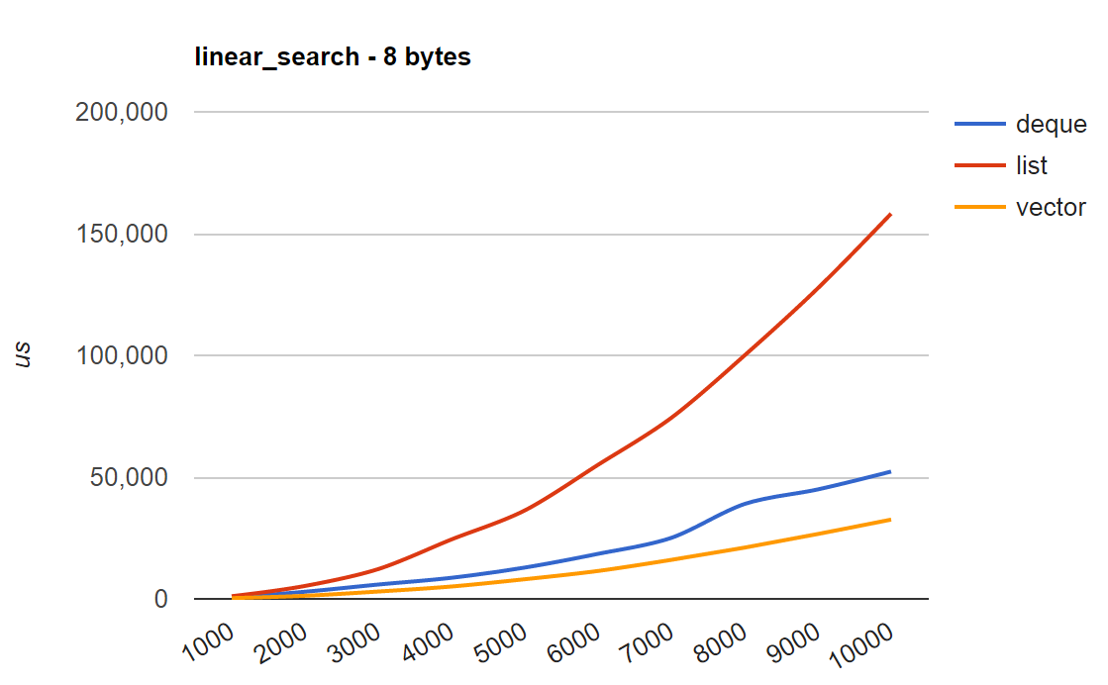
The Differences between OS and DAST 2: Searching for an element in different DSs

Slide 7
User Mode and Kernel Mode
Notes:
התרגולים יחולקו לתאורטיים ופרקטים.
זאת תהיה בעיקר חזרה תאורטית..

Slide 8
Definitions: process & IO
A program is an executable file
A process is an executing instance of a program.
An active process is a process that is currently advancing in the CPU (while other processes are waiting in memory for their turns to use the CPU).
Input/Output (I/O) is the collection of all programs, operations or devices that transfer data to or from a peripheral device (such as disk drives, keyboards, mice, printers and screens).

Slide 9
Kernel Mode & User Mode
The kernel is the core of the operating system and it has complete control over everything that happens in the system. The kernel is trusted software, but all other programs are considered untrusted software.
Notes:
מטרת מערכת ההפעלה: לאפשר הרצה של תוכנות, לתווך בין החומרה לתוכנות, לנהל את הדיסק
program= תוכנה ‘ process= תהליך
Program status word (PSW) - רגיסטר שבו יש בין היתר ביט שנקרא mode bit – 0 עבור kernel mode, 1 עבור user mode

Slide 10
Kernel Mode & User Mode
The CPU can be in kernel mode /user mode (mode bit).
User mode is a non-privileged mode, the program may execute “simple” commands
Can’t execute some commands, like halt
Can’t access all the memory, only its allocated memory (user memory)
No direct access to hardware
When the CPU is in kernel mode, it is assumed to be executing trusted software, and thus it can execute any instructions and reference any memory addresses.
The entire kernel, which is a controller of processes, executes only in kernel mode.
Notes:
מטרת מערכת ההפעלה: לאפשר הרצה של תוכנות, לתווך בין החומרה לתוכנות, לנהל את הדיסק
program= תוכנה ‘ process= תהליך
Program status word (PSW) - רגיסטר שבו יש בין היתר ביט שנקרא mode bit – 0 עבור kernel mode, 1 עבור user mode

Slide 11
OS & Processes Flow
OS goal: let processes run
However, processes may need service provided by the kernel (such as I/O).
When a user mode process wants to use a service that is provided by the kernel (e.g. a system call), the system must switch temporarily into kernel mode.
Thus, OS also needs to provide services via system calls.
A system call is a request to the kernel in an operating system by an active process for a service performed by the kernel.

Slide 12
System Call
A mechanism used by an application program to request service from the kernel.
Provide the interface between a process and the operating system itself.
Popular system calls are mmap, mumap, open, read, write, close, wait, exec, fork, exit, and kill.
Defines the programming environment.

Slide 13
Changing Modes
When a system call is requested:
Processor mode is switched from user to kernel
The request is executed
Processor mode is switched from kernel to user
Switching into user mode is easy (non-privileged instruction).
Switching into kernel mode is more complicated
(it should be done in controlled manner)

Slide 14

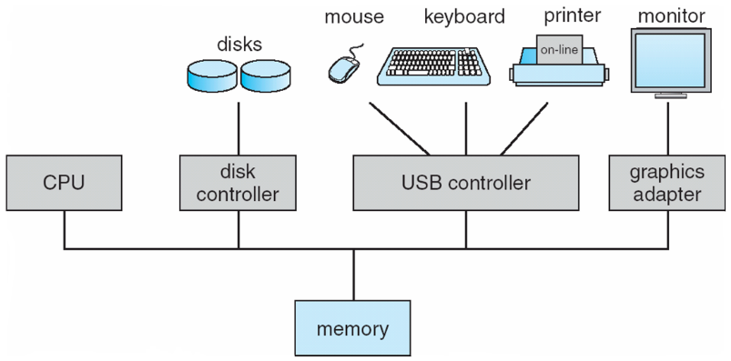
Simplified OS overview – lecture 2
User
User
User
User
Applications
System Calls
Operating System
Privileged instructions
Interrupts
Hardware Storage
Notes:
Kernal mode – OS
User mode - applications

Slide 15
Interrupt
Notes:
התרגולים יחולקו לתאורטיים ופרקטים.
זאת תהיה בעיקר חזרה תאורטית..

Slide 16
Interrupts: Motivation
Much of the functionality embedded inside a computer is implemented by hardware devices other than the processor.
Since each device operates at its own pace, a method is needed for synchronizing the operation of the processor with these devices.
For example, what would have happened if we tried to read a file and immediately use the information?

Slide 17
Interrupts: Motivation
One solution is for the processor to sit in a tight loop, asking each device about its current state.
When data is available in one of the devices, the processor can then read and process the incoming bytes.
This method works but it has two main disadvantages:
Wasteful in terms of processing power - the processor is constantly busy reading the status of the attached devices instead of executing useful code.
When the rate of data transfer is extremely high, the processor might lose data arriving from the hardware devices.
Notes:
נקרא busy waiting

Slide 18
Interrupts: Solution
Instead of polling hardware devices to wait for their response, each device is responsible for notifying the processor about its current state.
When a hardware device needs the processor's attention, it simply sends an electrical signal through a dedicated pin in the interrupt controller chip (located on the computer's motherboard).

Slide 19
The Interrupt Controller
The interrupt controller serves as an intermediate between the hardware devices and the processor.
The interrupt controller has several input lines that take requests from the different devices.
Its responsibility is to alert the processor when one of the hardware devices needs its immediate attention.
The controller passes the request to the processor, telling it which device issued the request (which interrupt number triggered the request, based on the interrupt vector).

Slide 20
Definition: Interrupts
An interrupt is a signal to the CPU indicating that an event has occurred, and it results in changes in the sequence of instructions that is executed by the CPU.
Interrupts are events which aren’t part of the running program's regular, pre-planned code.
Interrupt can also be characterized as an "asynchronous procedure call“ (APC)
The interrupt is asynchronous, as the program can’t control it.
The interrupt is effectively invisible to the interrupted program.

Slide 21
Interrupt Types
There are two types of interrupts:
External Interrupts – (a.k.a hardware interrupts) caused by an external hardware event
Internal Interrupts – (a.k.a software interrupts) occurs when the processor detects an error condition while executing an instruction
An interrupt may be Maskable Interrupt that can be ignored or Non-maskable Interrupt that can’t.

Slide 22
External Interrupts
External interrupts are caused by an external hardware event which typically needs routine attention.
For example:
User pressed a key on the keyboard.
User moved the mouse.
Disk drive has data that was requested 20 ms ago.
Timer (used by the OS as an alarm clock) expired. E.g., when several programs running simultaneously.

Slide 23
Dealing with External Interrupts
Interrupt handling is like dealing with a function call, with the hardware calling a function (“handler”) to deal with it. Hence, we need to save the state as it was when the interruption happened, handle the interruption, and then return to the state as it was.
Combination of hardware & software is necessary to deal with interrupts.

Slide 24
The basic mechanism
Similar to a function call:
Getting the interrupt
Saving current state
Transfer control & service the request
Previous state is restored
Return control

Slide 25
(1) Getting the Interrupt
External event interrupts the main program execution.
An electronic signal is provided to the processor - indicating the need to handle an interrupt request.
This signal is only recognized at the end of the instruction cycle loop (after the current instruction has been processed, but before the next instruction is "fetched" from memory).

Slide 26
(2) Saving Current State
Before an interrupt can be serviced, the processor must save its current status.
Servicing an interrupt is like performing a subroutine call.
One of the most critical pieces of information that must be saved is the value of the Program Counter (i.e. the location of the next instruction to be performed after servicing of the interrupt is complete).
Processing an interrupt request involves performing a series of instructions for that request. This tends to modify the contents of registers, so the registers also need to be saved.

Slide 27
(3) Transfer control & service the request
CPU checks which device sent the interrupt request.
The processor determines where to find the necessary instructions needed to service that specific request (typically handled using a "interrupt vector" which contains interrupt device numbers and the addresses of service subroutines for each interrupt number).
The interrupt vector is stored at a predefined memory location
00
Notes:
Psw=Program status word
מכיל למשל interrupt mask וגם privileged status

Slide 28
(4) Previous State is Restored
As a final step in each service routine, all register values must be restored to their original values as they were just before the interrupt occurred.

Slide 29
(5) Return control
Control is returned to the interrupted program
Back to user mode!
The next instruction is pointed by the program counter

Slide 30
External Interrupts - Example
Assume we run the following program:
add r1, r2, r3
sub r3, r4, r5
and r5, r3, r6
As execution reaches code above, a user moves the mouse → an interrupt is triggered.
Based on the time of the movement (in the middle of sub), hardware completes add and sub, but squashes and (for now).
The handler starts:
The screen pointer (the little arrow) is moved
The handler finishes
Execution resumes with and.
Notes:
קוד אסמבלי

Slide 31
Internal Interrupts
Internal interruption (exception) occurs when the processor detects an error condition while executing an instruction
Unlike external interrupts, which occur at random times during the execution of a program
Examples:
Division by zero
Segmentation fault
Privileged instruction
Invalid instruction
Page fault
Notes:
באחרון התהליך בכלל לא צריך לדעת

Slide 32
Internal Interrupts
When an exception occurs, the address of the instruction which generated the exception is saved.
Then the OS gives the exception handler a chance to fix the problem.
The exception handler may be owned by the process.
If there was an handler, the program is restarted at the address of the fault and continue normally
Otherwise, the program is aborted.

Slide 33
Dealing with Internal Interrupts
We handle internal interrupt in the same way, except the first step of getting the interrupt.
The CPU creates the interrupt.
The mechanism is therefore:
Saving current state
Transfer control & service the request
Previous state is restored
Return control

Slide 34
Internal Interrupts – Trap
A trap is a type of exception, which occurs in the usual run of the program, but unlike it, it is not product of some error.
The execution of an instruction that is intended for user programs and transfers control to the operating system. Such a request from the kernel is called a system call.
Trap causes switching to OS code and to kernel mode. Once in kernel mode, a trap handler is executed to service the request.
Restarted at the address following the address causing the trap.

Slide 35
Trap Example – int3 (breakpoint)
INT3 instruction is a one-byte-instruction defined for use by debuggers to temporarily replace an instruction in a running program in order to set a code breakpoint
Once the process execute the int3 instruction, the OS stops it
A simple usage in C may be:
__asm__("int3");

Slide 36
int3 (breakpoint) - GDB
\\breakpoint.c
int main() { int i; for(i=0; i<3;i++) {
__asm__("int3"); }
}
Compile: gcc -c breakpoint.c and start gdb a.out:
(gdb) run
Starting program: /tmp/a.out
Program received signal SIGTRAP, Trace/breakpoint trap. 0x00000000004004fb in main ()

Slide 37
Simplified OS overview – lecture 2
User
User
User
User
Applications
System Calls
Operating System
Privileged instructions
Interrupts
Hardware Storage
Notes:
חזרה על השקף הזה על מנת לסכם את ההבדלי בין interrupts ו- system call, מאחר ובשקף הבא מדברים על שניהם.

Slide 38
An Example open (“/tmp/foo”);
User:
Kernel:
“open” lib function:
store the system call number and the parameters in a predefined kernel memory location
trap(); (int #80 asm inst.)
retrieve the response from a predefined kernel memory location
return the response to the calling application
Trap handler: transfer to gate
Gate routine:
switch(sys_call_num) {
case OPEN: …
}
store response in a predifined memory location
Return to user
Interrupt vector [80]
Notes:
Int 80 = מעבר מ-user mode ל-kernel mode.
כשהמשתמש רוצה לפתוח קובץ, הוא לא יכול להגשת לדיסק – לכן הוא שומר את הפונקציה הנדרשת + הפרמטרים של הקובץ שאותו הוא רוצה לפתוח
לכן מבצע system call - (רוצה שמערכת ההפעלה תבצע עבורו פעולה) גורם ל- internal interrupt – נתפס על ידי trap handler בו מבוצע על ידי קוד ב=kernel (שמחפש את הקובץ ב-file system, מקצה פוינטר לקובץ וכו'). אחר כך הקוד של המשתמש ממשיך לרוץ אחרי שקיבל file descriptor.

Slide 39
Check return values!
#include <errno.h>
#include <stdio.h>
#include <string.h>
…
int fd;
fd=open(“/tmp/foo”);
if( fd < 0 ) {
perror( "Error opening file" );
//equivalent to:
//printf("Error opening file:
%s\n",strerror(errno));
}

Slide 40
Some Possible Values:
Error name | Error code (number) | Message
ENOENT | 2 | No such file or directory
EINTR | 4 | Interrupted system call
EIO | 5 | I/O error
EACCES | 13 | Permission denied
EBUSY | 16 | Device or resource busy
Notes:
Errno שרלוונטיים ל-open (עמודה אמצעית)
strerror(errno) – עמודה שלישית
ל-system call שונים יש ערכי שגיאה שונים

Slide 41
Working with System Calls
Notes:
אני לא הולך להסביר כל פקודה קטנה...
אם משהו לא ברור, תסתכלו באינטרנט.

Slide 42
“man” Command
An interface to a reference manuals
Divided into categories, the first three are: (provided by "man man")
Man 1 - Executable programs or shell commands
Man 2 - System calls (functions provided by the kernel)
Man 3 – C Library calls (functions within program libraries)

Slide 43
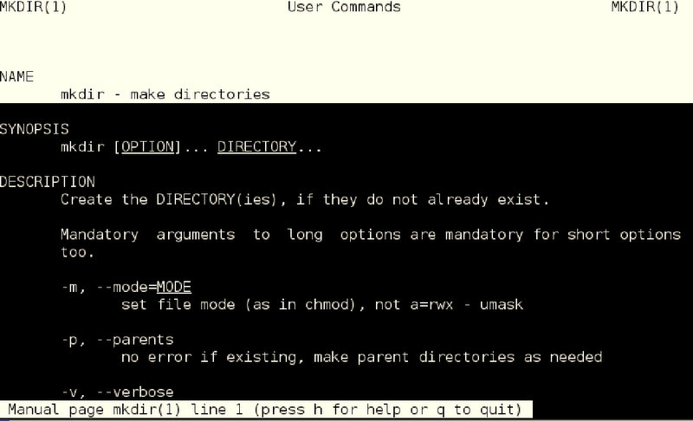
Example: “man 1 mkdir”
Notes:
קריאה מה-cmd

Slide 44
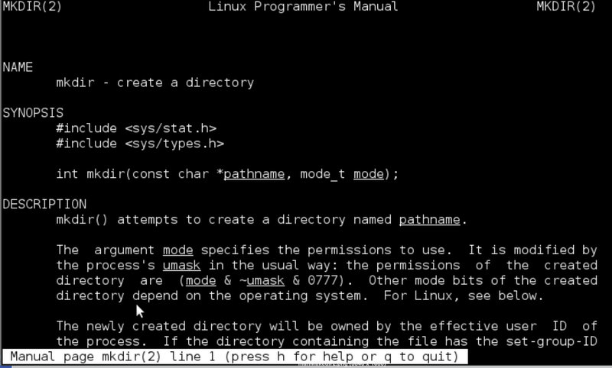
Example: “man 2 mkdir”
Notes:
Man 2 - קריאה מתוך קוד (צריך לעשות include לקובץ h ושהקוד מתקמפל מול אובייקט שמספקת מערכת ההפעלה).
דוגמא ל-man 3 – קריאה לפונקציה מספרייה math.h לפונקציה sin,log,sqrt

Slide 45
Q & A

Slide 46
Internal Interrupts - Page Fault Example
A program requests data that is not currently in real memory.
An exception triggers the operating system to fetch the data from the disk and load it into main memory.
The program gets its data without even knowing that an exception has occurred.
The program continue with the same instruction.

