Slide 1
TA3 – Unix Signals & Threads
Operating Systems Course
The Hebrew University
Spring 2021

Slide 2
Today’s Plan
Reminder: interrupts
Signals
Threads
User Level Threads
Kernel Level Threads
Ex2

Slide 3
Reminder from Last TA Class

Slide 4
Reminder: Kernel Mode
When the CPU is in kernel mode, it is assumed to be executing trusted software, and thus it can execute any instructions and reference any memory addresses.
The kernel is the core of the operating system and it has complete control over everything that occurs in the system.
The kernel is trusted software, all other programs are considered untrusted software.
Notes:
4

Slide 5
Some Definitions
A process is an executing instance of a program. An active process is a process that is currently advancing in the CPU (while other processes are waiting in memory for their turns to use the CPU).
The execution of a process can be interrupted by an interrupt.
An interrupt is a notification to the operating system that an event has occurred, which results in changes in the sequence of instructions that is executed by the CPU.
Notes:
5

Slide 6
Types of Interrupts
Hardware interrupts (also called external interrupts), are ones in which the notification originates from a hardware device such as a keyboard, mouse or system clock.
Software interrupts (also called internal interrupt) include aborts and traps
Aborts: similar to HW interrupt, but not caused by an external source, but during the program execution when errors occur (division by zero, access to paged memory, etc.)
Traps: occurs in the usual run of the program, but unlike abort, it is not product of some error.
The execution of an instruction that is intended for user programs and transfers control to the operating system. Such a request from the kernel is called a system call.
Notes:
6

Slide 7
Signals
Default handlers, setting personalized handlers, blocking signals

Slide 8
Signals
Signals are notifications sent to a process in order to notify it of various "important" events.
Signals cause the process to stop whatever it is doing (after it finishes executing the current CPU cycle), and force the process to handle them immediately
The process may configure how it handles a signal
(Except for some signals that it cannot configure)
Notes:
8

Slide 9
Signals, cont.
Signals are different from interrupts:
Signals are generated by the OS, and received and handled by a process
Interrupts are received and handled by the OS – HW interrupts are generated by the HW, Software interrupts are generated by the software
Signals in Unix have names and numbers
Use ‘man kill’ to see the types of signals.

Slide 10
Triggers for Signals
Some examples for signal triggers:
Asynchronous input from the user such as ^C (SIGINT), or typing ‘kill pid’ at the shell
The system or another process, for instance if an alarm set by the process has timed out (SIGALRM)
A software interrupt caused by an illegal instruction
The illegal instruction causes to a software interrupt.
The software interrupt is received by the OS.
The signal is generated by the OS and 'sent' to the process.

Slide 11
Sending Signals Using the Keyboard
The most common way of sending signals to processes is using the keyboard:
Ctrl-C: Causes the system to send an INT signal (SIGINT) to the running process.
Ctrl-\:causes the system to send a QUIT signal (SIGQUIT) to the running process.
Ctrl-Z: causes the system to send a TSTP signal (SIGTSTP) to the running process.
Notes:
SIGINT:
By default it terminates the process.
SIGQUIT:
By default it terminates the process and dump core.
SIGSTOP:
Pause the process execution, but in contrast to SIGTSTP this signal can’t be handled differently.
SIGKILL:
The signal can’t be handled differently (including ignored nor blocked).
Good references:
http://programmergamer.blogspot.co.il/2013/05/clarification-on-sigint-sigterm-sigkill.html
https://en.wikipedia.org/wiki/Unix_signal
http://stackoverflow.com/questions/11886812/whats-the-difference-between-sigstop-and-sigtstp#11888074]
11

Slide 12
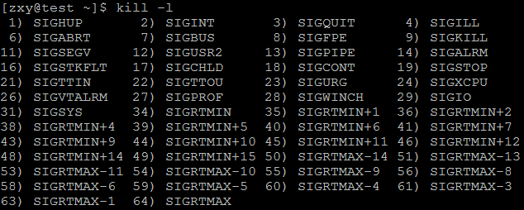
Sending Signals from the Command Line
Kill command sends the specified signal to the specified process. kill [option] pid.
use ‘kill –l’ to see list of all the signal you can send.
The ‘fg pid’ command resumes execution of a process (that was suspended with Ctrl-Z), by sending it a CONT signal.
Notes:
12
Instead of “fg pid” command we can use “kill –SIGCONT pid”.
The default signal sent by kill [pid] is SIGTERM which usually but not necessarily asks the process to terminate.
If you really want to kill a program you need to use the SIGKILL signal by doing kill -9 [pid].

Slide 13
Sending a Signal From One Process To Another
Signals can used to send messages from one process to another.
This is done by using
int kill(pid_t pid, int sig)
The messages that are sent in this manner are predefined
We cannot send any data
SIGUSR1, SIGUSR2
Notes:
להציג תוכנית שמורכבת משני processes. הראשון מייצר מידע וכותב אותו בשלב מסויים לתיקייה בדיסק (לשניהם יש גישה לדיסק זה).
השני בודק כל הזמן האם התיקייה ריקה. אם לא הוא קורא את הקובץ מהדיסק ומעבד את המידע (לוגיקה כלשהי).
פיתרון נאיבי: לבדוק כל הזמן האם התיקייה ריקה (בזבוז CPU. מע' ההפעלה לא יודעת מה הפרוסס השני עושה ולכן תקצה לו משאבים).
פיתרון אלגנטי: כשהפרוסס הראשון יסיים לכתוב לדיסק הוא ישלח סיגנל של sigusr1 לפרוסס השני. הפרוסס השני יכתוב סיגנל הנדלר עבור sigusr1 וידע שהקובץ קיים וניתן לקרוא אותו. בנוסף, הפרוסס השני יחכה ב- pause() עד שיזרק סיגנל כלשהו (פירוט בשקף 17). ומאחר ו- pause זה system call, מע' ההפעלה תדע לא להקצות זמן CPU לפרוסס השני (כי היא זאת שמייצרת סיגנל, ולכן היא יודעת שעד שהוא לא יקבל סיגנל, הוא נמצא במצב waiting – ראה שקף 32).

Slide 14
Reminder from Last Week - strace
strace is a debugging utility to monitor the system calls and signals
Easy to use.
Fast debugginng
strace command
Shows system calls, arguments, and return values
-t to display when each call is executed
-T to display the time spent in the call
-e to limit the types of calls
-o to redirect the output to a file
-s limit the length of print strings.

Slide 15
Handling Signals
A process must run to handle signals.
There are several types of handling for signals:
The process can exit, ignore, stop or continue execution (all options are default for some signals).
The process can execute a signal handler: signal(signum,newHandler);
Notes:
An example to ignore default handler:
CIGCHLD - Child process terminated, stopped, or continued.
15

Slide 16
Handling Signals (cont.)
There are some signals that the process cannot catch.
For example: KILL and STOP
If you install no signal handlers of your own, the runtime environment sets up a set of default signal handlers
For example:
The default signal handler for TERM calls exit().
The default handler for ABRT is to dump the process's memory image into a file, and then exit.
Notes:
16
One process that uses this signal is a system shutdown process. It first sends a TERM signal to all processes, waits a while, and after allowing them a "grace period" to shut down cleanly, it kills whichever are left using the KILL signal.

Slide 17
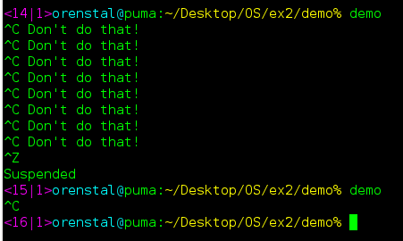
Signal Handlers - Example
#include<stdio.h>
#include <unistd.h>
#include <signal.h>
void catch_int(int sig_num) {
//install again!
signal(SIGINT, catch_int);
printf("Don't do that\n");
fflush(stdout);
}
int main(int argc, char* argv[]) {
signal(SIGINT, catch_int);
for ( ;; )
//wait for a signal
pause();
}
(Note: “signal” is deprecated!)
Return values check omitted due to space constraints
Notes:
17
Notes:
the pause() system call causes the process to halt execution, until a signal is received. it is surely better than a 'busy wait' infinite loop.
the name of a function in C/C++ is actually a pointer to the function, so when you're asked to supply a pointer to a function, you may simply specify its name instead.
On some systems (such as Linux), when a signal handler is called, the system automatically resets the signal handler for that signal to the default handler. Thus, we re-assign the signal handler immediately when entering the handler function. Otherwise, the next time this signal is received, the process will exit (default behavior for INT signals). Even on systems that do not behave in this way, it still won't hurt, so adding this line always is a good idea.
In the program, the first run includes this code (with our signal handler). The second run we didn’t set signal handler for this signal.

Slide 18
Pre-defined Signal Handlers
There are two pre-defined signal handler functions that we can use instead of writing our own:
SIG_IGN: Causes the process to ignore the specified signal.
signal(SIGINT, SIG_IGN);
SIG_DFL: Causes the system to set the default signal handler for the given signal.
signal(SIGTSTP, SIG_DFL);
Notes:
18

Slide 19
Intermediate Summary
Each signal may have a signal handler, which is a function that gets called when the process receives that signal.
If a signal is sent to the process, the next time the process runs, the operating system causes the process to run the signal handler, no matter what it was doing before.
When that signal handler function returns, the process continues execution from wherever it happened to be before the signal was received.
Notes:
19

Slide 20
Masking Signals - Motivation
Assume that a process performs a cleanup
deleting old data, etc.
If during the cleanup the program exits abruptly, some old files will remain
Data will be inconsistent/corrupted
In order to avoid this situation, signals that can cause us to exit (such as SIGINT) should be blocked during cleanup
During the cleanup only! Masking/blocking is intended for specific parts of the code

Slide 21
Masking Signals - Avoiding Signal Races
Because signals are handled asynchronously, race conditions can occur:
A signal may be received and handled in the middle of an operation that should not be interrupted
A second signal may occur before the current signal handler finished
The second signal may be of a different type or of the same type as the first one
Therefore we need to block signals from being processed when they are harmful
The blocked signal will be processed after the block is removed
Some signals cannot be blocked
Notes:
21

Slide 22
sigprocmask
Allows to specify a set of signals to block, and/or get the list of signals that were previously blocked
int sigprocmask(int how, const sigset_t *set, sigset_t *oldset)
int how:
Add (SIG_BLOCK)
Delete (SIG_UNBLOCK)
Set (SIG_SETMASK).
const sigset_t *set:
The set of signals
sigset_t *oldset:
If not NULL, the previous mask will be returned
sigset_t set;
sigemptyset(&set);
sigaddset(&set, SIGINT);
sigaddset(&set, SIGTERM);
sigprocmask(SIG_SETMASK, &set, NULL);
//blocked signals: SIGINT and SIGTERM
sigemptyset(&set);
sigaddset(&set, SIGINT);
sigaddset(&set, SIGALRM);
sigprocmask(SIG_BLOCK, &set, NULL);
//blocked signals: SIGINT, SIGTERM, SIGALRM
sigemptyset(&set);
sigaddset(&set, SIGTERM);
sigaddset(&set, SIGUSR1);
sigprocmask(SIG_UNBLOCK, &set, NULL);
//blocked signals: SIGINT and SIGALRM
Notes:
22

Slide 23
Handling Signals
So far we saw two system calls:
Signal
Installs a signal handler for a single use
Must reinstall each time we get a signal
Deprecated!
Sigprocmask
Defines which signals to block
Must be called in each signal handler to block and release signals.

Slide 24
sigaction
int sigaction(int sig,
struct sigaction *new_act, struct sigaction *old_act);
Allows the calling process to examine and/or specify the action to be associated with a specific signal.
action = signal handler+signal mask+flags
Notes:
24

Slide 25
sigaction cont.
The signal mask is calculated and installed only for the duration of the signal handler.
By default, the signal itself is also blocked when the signal occurs.
Once an action is installed for a specific signal using sigaction, it remains installed until another action is explicitly installed.
Notes:
25

Slide 26
Sigaction Example
#include<stdio.h>
#include <unistd.h>
#include <signal.h>
void catch_int(int sig_num) {
printf("Don't do that\n");
fflush(stdout);
}
int main(int argc, char* argv[]) {
// Install catch_int as the // signal handler for SIGINT.
struct sigaction sa; sa.sa_handler = &catch_int;
sigaction(SIGINT, &sa, NULL);
for ( ;; )
//wait until receives a signal
pause();
}
Return values check omitted due to space constraints
Notes:
26
Note: We don’t need to reinstall sigaction after every catch.

Slide 27
Signals: Summary
Signals are notifications sent to a process
The OS causes the process to handle a signal immediately the next time it runs
There are default signal handlers for processes
These handlers can be changed using sigaction
To avoid race conditions, one usually needs to block signals some of the time using sigprocmask and/or sigaction

Slide 28
Threads
Kernel and user level threads

Slide 29
The many CPUs illusion
Given a machine with one CPU, how can we efficiently execute number of tasks?
Each task lives in it’s own world.
Virtualizing the CPU.
Multitasking systems (Time sharing).
Notes:
Multitasking systems (also known as ‘Time Sharing’) refers to allocation of computer resources in time slots to several programs simultaneously.

Slide 30
What is a Process?
Definition: an instance of an application execution.
What defines a process?
registers (PC, SP etc.)
memory (data, heap, stack and text)
environment (files etc.)
But how does the OS know all this?

Slide 31
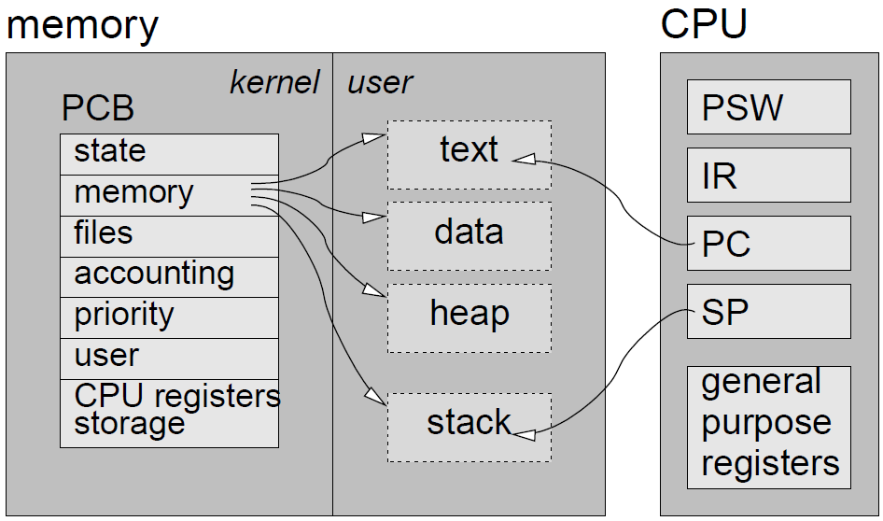
Process Control Block (PCB)
What is saved in the PCB?
Process data:
registers (PC, SP etc.)
memory (data, heap, stack and text)
environment (files etc.)
OS data:
priority-relevant data (time, priority, resources etc.)
the user - access rights
State
Notes:
State: as described in the next slide.
Memory management information: includes the information of page table, memory limits, Segment table depending on memory used by the operating system.
Accounting information: includes the amount of CPU used for process execution, time limits, execution ID etc.
Process privileges, in terms of allowed/disallowed access to system resources.

Slide 32
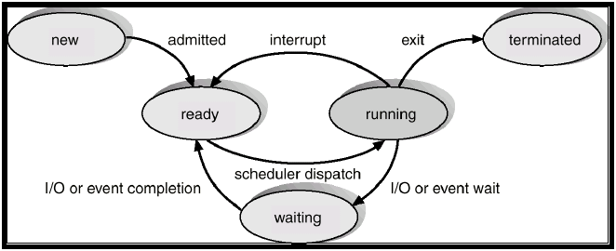
States
A process’s life cycle:
Scheduler? stay tuned!
Notes:
https://www.quora.com/In-process-states-under-what-conditions-do-the-following-occur-running-to-ready-running-to-waiting-and-waiting-to-ready
https://www.quora.com/What-kind-of-interrupts-can-cause-a-process-to-change-its-state-from-running-state-to-ready-state

Slide 33
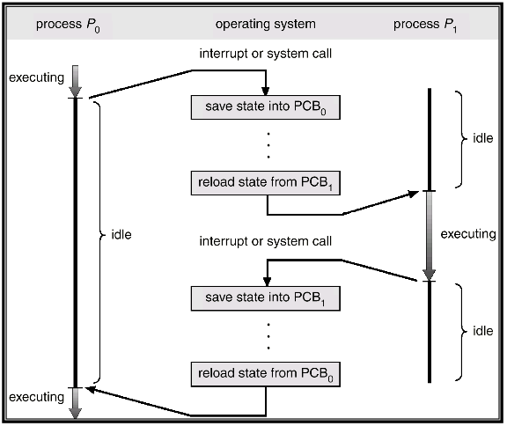
Context Switch

Slide 34
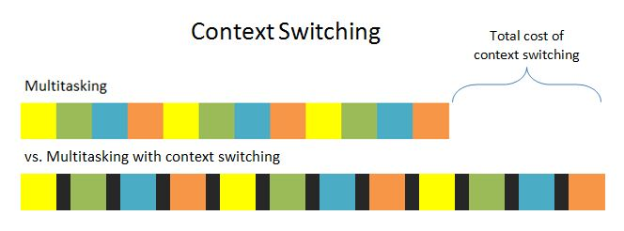
Context Switch
overhead

Slide 35
What is a Thread?
A thread lives within a process
A process can have several threads
A thread possesses an independent flow of control, and can be scheduled to run separately from other threads, because it maintains its own:
stack
registers (CPU state)
The other resources of the process are shared by all its threads:
code
memory
open files
and more...
Notes:
35

Slide 36
Thread Implementations
User level threads
Kernel unaware of threads
Kernel level threads (lightweight processes)
Thread management done by the kernel
Notes:
36

Slide 37
User Level Threads

Slide 38
User Level Threads
Implemented as a thread library, which contains the code for thread creation, termination, scheduling and switching.
Kernel sees one process and it is unaware of its thread activity.
Switching from thread to thread is done in user space
So the penalty for a context switch is lower than an operating system context switch
Scheduling depends on implementation
If one thread is blocked by the kernel (from read() for example), all the process is blocked.

Slide 39
Implementing a Thread Library
Only one thread can modify a shared resource at a time (if implemented correctly), so some of the locks required for threads may not be needed
Still, be careful!
Maintain a thread descriptor for each thread
Notes:
39

Slide 40
Implementing a Thread Library
Switch between threads:
Stop running current thread
Save current state of the thread
Jump to another thread
continue from where it stopped before, by using its saved state
This requires special functions: sigsetjmp and siglongjmp
sigsetjmp saves the current location, CPU state and signal mask
siglongjmp goes to the saved location, restoring the state and the signal mask
Notes:
40

Slide 41
sigsetjmp – save a “bookmark”
sigsetjmp(sigjmp_buf env, int savesigs)
Saves the stack context and CPU state in env for later use
If savesigs is non-zero, saves the current signal mask as well
We can later jump to this code location and state using siglongjmp
Return value:
0 if returning directly
A user-defined value if we have just arrived here using siglongjmp
Notes:
41

Slide 42
What is Saved in env?
Saved
Not Saved
Program counter (PC)
Location in the code
Stack pointer (SP)
Locations of local variables
Return address of called functions
Signal mask – if specified
Rest of environment (CPU state)
Calculations can continue from where they stopped
Global variables
Variables allocated dynamically
Values of local variables
Any other global resources
Notes:
42

Slide 43
siglongjmp – use a “bookmark”
siglongjmp(sigjmp_buf env, int val)
Jumps to the code location and restore CPU state specified by env
The jump will take us into the location in the code where the sigsetjmp has been called
If the signal mask was saved in sigsetjmp, it will be restored as well
The return value of sigsetjmp after arriving from siglongjmp, will be the user-defined val
Notes:
43

Slide 44
The Switch
Thread 0: void switchThreads() { static int curThread = 0; int ret_val = sigsetjmp(env[curThread],1); if (ret_val == 5) { return; } curThread = 1 - curThread; siglongjmp(env[curThread],5); } | Thread 1: void switchThreads() { static int curThread = 0; int ret_val = sigsetjmp(env[curThread],1); if (ret_val == 5) { return; } curThread = 1 - curThread; siglongjmp(env[curThread],5); }
Full demo code is available as part of exercise 2.
Notes:
The code is saved in the same memory place (but the SP register values are different).
44

Slide 45
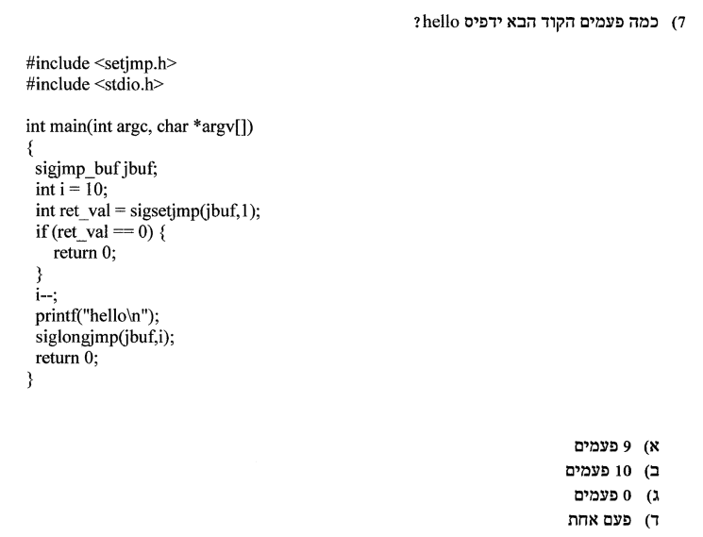
Exam Question
Taken from: http://www4.huji.ac.il/exams/67808_2012_2_2_1.pdf
Notes:
המבחן: http://www4.huji.ac.il/exams/67808_2012_2_2_1.pdf

Slide 46
Kernel Level Threads

Slide 47
Kernel Level Threads
The kernel has a threads table that keeps track of all the threads
Scheduling is done according to the OS’s scheduling algorithm
If one thread is blocked, the rest can keep on running.
Switching between kernel-level threads is more expensive than user-level threads
Involve more steps than just saving some registers.

Slide 48
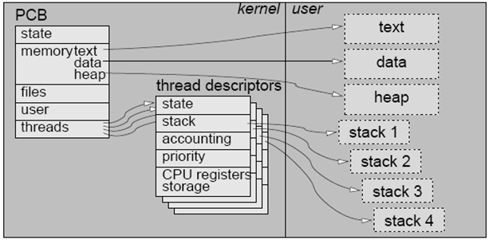
Kernel Level Threads
Kernel level threads (lightweight processes)
Thread management done by the kernel
Notes:
48

Slide 49
Not to be confused with Kernel Threads
Kernel threads are threads of the kernel running kernel code in kernel mode
Often called kernel daemons
They are used to perform some tasks of the kerel in parallel to other processes (and in parallel to the kernel itself)

Slide 50
User Level vs. Kernel Level Threads

Slide 51
Advantages
User Level Threads
Kernel Level Threads
Switching between threads is cheaper
Often don’t need to worry about concurrent access to data structures
Scheduling can be application-specific
Blocking is done on a thread level
Multiple threads can possibly be executed on different processors
Scheduler can make intelligent decisions amongst threads and processes

Slide 52
Disadvantages
User Level Threads
Kernel Level Threads
Can’t enjoy the benefits of a multi-core machine
One blocked thread blocks the entire process
Can suffer from poor OS scheduling
Greater cost for switch between threads
Need to pay more attention to shared resources

Slide 53
Which is Better?
When choosing the implementation, one must consider the specifications and needs of the application.
For an application that switches between threads often, user level threads may be better.
For an application that has many threads, or many that are I/O bound, kernel threads may be better.

Slide 54
Exam Question
הבדל אחד בין תהליך לבין kernel level thread הוא
עם ריבוי תהליכים ניתן לנצל ריבוי מעבדים, אבל kernel level threads לא
עם kernel level thread מונעים את הבעיה של חסימה כאשר אחד מבצע פעולת I/O, אבל הבעיה קיימת כשמשתמשים בריבוי תהליכים
תהליכים זקוקים לתיווך של מערכת ההפעלה כדי לתקשר, ו-kernel level threads לא
Kernel threads מריצים רק קוד של מערכת ההפעלה, ואילו תהליכים יכולים להריץ קוד משתמש
Taken from: http://www.cs.huji.ac.il/course/2009/os/test-10a-ans.pdf
Notes:
המבחן: 2010, מועד א'
פיתרון למבחן: http://www.cs.huji.ac.il/course/2009/os/test-10a-ans.pdf

Slide 55
Ex 2

Slide 56
Implement a User-Threads Library
The library should provide thread manipulation functions:
Init
Spawn
Terminate
Block
Resume
Mutex_lock
Mutex_unlock
Library users can create their own threads and use the library functions to manipulate them.
The library is in charge of thread management and scheduling.

Slide 57
Thread States
RUNNING – The thread is the active thread.
READY – The thread is allowed to run, but another thread is currently active.
BLOCKED – The thread is not allowed to run.
Becomes READY if user calls “resume” or if synced.

Slide 58
Thread States Diagram
terminated
spawn
READY
block
resume
Thread
is
deleted
BLOCKED
terminated
preempt
schedule
block
RUNNING
terminated

Slide 59
The Scheduler – Round Robin
Each thread is spawned into the READY state.
A list of READY threads is maintained:
Threads are added to this list once their state becomes READY.
Newly added threads are scheduled to run only after all prior READY threads.

Slide 60
The Scheduler – Time Allocation and Preemption
Every time a thread is transitioned to the RUNNING state it is allocated a predefined (virtual) time quantum to run.
The RUNNING thread is preempted when either:
Its quantum has expired (turns to READY state).
It is blocked.
It terminates.

Slide 61
The Scheduler (Cont.)
The scheduler decides which thread to run when:
The library is initialized (run the main thread).
The RUNNING thread is preempted/blocked.
Take extra care to avoid signal races by blocking and unblocking signals where necessary.
Use demo code for examples of:
Using interval timers and timer signals (SIGVTALRM).
Thread switching using sigsetjmp/siglongjmp.

Slide 62
This exercise is difficult,
so start early!
Good Luck!

