Slide 1
Working With Threads
Operating Systems Course
The Hebrew University
Spring 2021

Slide 2
Outline
2
Background – Threads and processes
Thread Pools
Threads Managements
Pthread
Mutex
Monitor

Slide 3
Multi-threads / Multi-processes motivations
Using multi-processors
Some operations are blocking (such as IO access), and we might use the processors meanwhile
We have several tasks that need to run

Slide 4
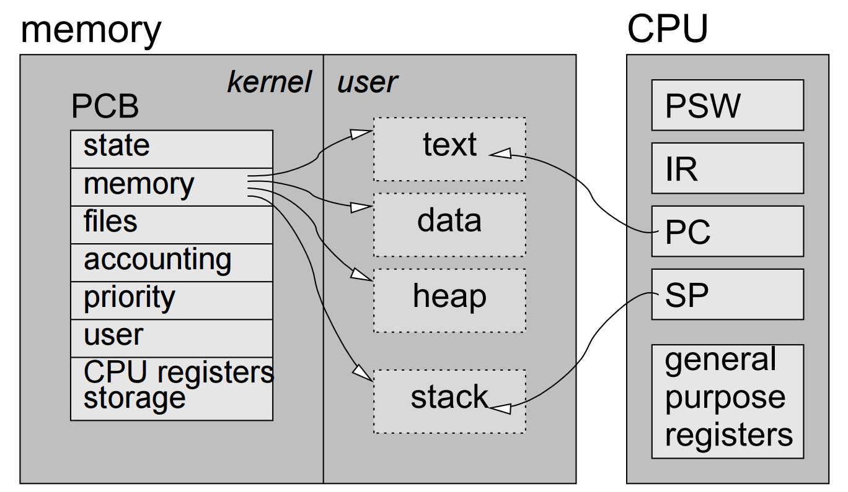
Process

Slide 5
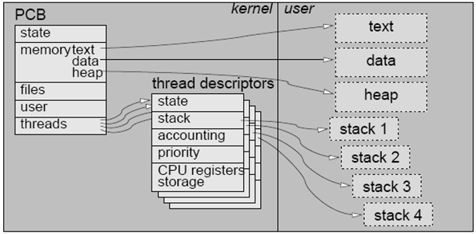
Kernel Level Threads
Notes:
5

Slide 6
User Level Thread
Notes:
6

Slide 7
 | Processes | Kernel Threads | User Threads
Interaction between instances | protected from each other, require operating system to communicate | share address space, simple communication, useful for application structuring
Context-switch overhead | high overhead: all operations require a kernel trap, significant work | medium overhead: operations require a kernel trap, but little work | low overhead: everything is done at user level
Blocking granuality | independent: if one blocks, this does not affect the others |  | if a thread blocks the whole process is blocked
Multi-core utilization | can run on different processors in a multiprocessor system |  | all share the same processor
OS dependency | system specific API, programs are not portable |  | the same thread library may be available on several systems
Scheduling | one size fits all |  | application-specific thread management is possible

Slide 8
Thread Pools
8

Slide 9
Working with Multiple Threads
Up until now we used threads to solve a single problem
This may include division of the problem into sub-problems
For example, sorting N elements by dividing them to 4 groups, sort each one of them in a single thread, and merge them
How do we handle multiple tasks?

Slide 10
A Thread Per Request
Why not to create a thread for each request?
Program
thread
thread
thread

Slide 11
Any problems?
11
Creating a thread per request has significant overhead, especially for short requests
The number of threads is dynamic (and theoretically boundless)
Creating too many threads can cause the system to run out of memory and crash
There is a need to limit the usage of system resources such as connections to a database and open files

Slide 12
Thread Pool Concept
12
A collection of threads that are created once (e.g. when a server starts)
No need to create a new thread for every client request
Instead, program uses an existing thread if there is a free one, or waits until there is a free thread

Slide 13
Thread Pools in Client-Server Applications
13
Client-Server model is a distributed application structure that partitions tasks or workloads between
Servers - providers of a resource or service
Clients - service requesters
Thread pools are very common in client-server applications
The number of requests is large
Server should not use more resources per request
The processing of each individual task is short-lived
Servers should not spend more time and consume more system resources creating and destroying threads than processing actual user requests
When too many requests arrive, threads pool allows the server to force clients to wait until threads are available

Slide 14
A Simple Implementation
14
There is a pool of threads
Each task asks for a thread when starting and returns the thread to the pool after finishing
When there are no available threads in the pool, the thread that initiates the task waits until the pool is not empty

Slide 15
A Simple Implementation The Main Thread Flow
15
While (true) {
Wait for request r
Wait for thread t in the pool to be available
Run r on t
}

Slide 16
A Simple Implementation is Problematic
16
When the pool is empty, the submitting thread has to wait for a thread to be available
We usually want to avoid blocking that thread
A program may want to perform some actions when too many tasks arrive
Technically, threads that finished running cannot run again

Slide 17
A Possible Solution
Every thread looks for tasks in the queue
wait()
Task Queue
Worker Threads
If Q is Empty
All the worker threads wait for tasks

Slide 18
A Possible Solution
Task
Task Queue
Worker Threads
“A-synchronized” model: “Launch and forget”
The number of worker threads
is fixed. When a task is inserted
to the queue, notify is called

Slide 19
A Possible Solution
Task
notify()
Task Queue
Worker Threads
The number of worker threads
is fixed. When a task is inserted
to the queue, notify is called

Slide 20
A Possible Solution
The task is executed by the thread
Task Queue
Worker Threads

Slide 21
A Possible Solution
The task is executed by the thread
Task Queue
Worker Threads
The remaining tasks are executed by the other threads

Slide 22
A Possible Solution
When a task ends, the thread is released
Task Queue
Worker Threads
While the Q is not empty, take the task from the Q and run it (if the Q was empty, wait() would have been called)

Slide 23
A Possible Solution
A new task is executed by the released thread
Task Queue
Worker Threads

Slide 24
Risks in Using Thread Pools
24
Threads can leak
What if a task throws an exception?
A thread can endlessly wait for an I/O operation to complete For example, the user may stop the interaction with a pipe without closing it properly
Solutions:
Bound I/O operations by timeouts using wait(time)
Catch possible runtime exceptions

Slide 25
Pool Size
25
What is better: to have a large pool or a small pool?
Big number of threads possible issues
Threads creation overhead (minor issue)
Each thread consumes resources (e.g. open files) and memory
Context switch overhead.
Depends on the number of cores available and the scheduling algorithm
Small number of threads possible issues
Reduced utilization
Short threads may wait for longer threads to terminate -> higher average wait times
Therefore, you have to tune the thread pool size according to the number and characterizations of expected tasks

Slide 26
Tuning the Pool Size
Change the number of threads during runtime
Most Thread Pools have minimum and maximum number of threads.
A common approach is to tune according to the load – in high load, increase the number of threads

Slide 27
Tuning the Pool Size Example
The main goal: Processing should continue while waiting for slow operations such as I/O
Blocked Time (BT) = estimated average blocked time
Service Time (ST) = estimated average processing time for a request (without the waiting time)
About BT/ST+1 threads will keep the processor fully utilized
For example, if BT is 20 ms and ST is 5 ms, we will need 5 threads to keep the processor busy

Slide 28
Thread management

Slide 29
Creating Threads
Initially, your main() program comprises a single, default thread. All other threads must be explicitly created by the programmer
int pthread_create (
pthread_t *thread,
const pthread_attr_t *attr=NULL,
void *(*start_routine) (void *),
void *arg) ;
Notes:
This routine creates a new thread and makes it executable. Typically, threads are first created from within main() inside a single process. Once created, threads are peers, and may create other threads.
Returns 0 when successful, an error number otherwise.
The pthread_create subroutine returns the new thread ID via the thread argument. The caller can use this thread ID to perform various operations on the thread. This ID should be checked to ensure that the thread was successfully created.
The attr parameter is used to set thread attributes. You can specify a thread attributes object, or NULL for the default values.
The start_routine is the C routine that the thread will execute once it is created an executed.
A single argument may be passed to start_routine via arg. It must be passed by reference as a pointer cast of type void.
On success, the identifier of the newly created thread is stored in the location pointed by the |thread| argument, and a 0 is
returned. On error, a non-zero error code is returned.

Slide 30
Terminating Thread Execution
A thread terminates in one of the following ways:
The thread makes a call to the pthread_exit(void *status) subroutine, specifying an exit status
This value will be available to a different thread in the same process that calls pthread_join
The thread returns from its start_routine
The thread is cancelled (via pthread_cancel).
The entire process is terminated due to a call to either
Exit subroutines
Return from the main thread
Note: exec subroutines has the same effect.

Slide 31
Example Creating 5 threads and exiting
#define NUM_THREADS 5
void *PrintHello(void *arg) {
int *index = arg;
printf("\nThread %d: Hello World!\n", *index);
pthread_exit(NULL);
}
int main(int argc, char *argv[]) {
pthread_t threads[NUM_THREADS];
int res, t;
for(t=0;t<NUM_THREADS;t++){
printf("Creating thread %d\n", t);
res = pthread_create(&threads[t], NULL, PrintHello, (void *)&t);
if (res<0){
printf("ERROR\n");
exit(-1);
} } }
Doesn’t work – the program may terminate before running all the threads
Notes:
שימו לב –
קל ליצור משתנה משותף בגלובלים
אם היינו מגדירים משתנה בstack של הפונקצייה – הוא איננו משותף ואיננו צריך הגנה

Slide 32
Joining Threads
int pthread_join(pthread_t thread, void **value_ptr);
The pthread_join() subroutine blocks the calling thread until the specified thread thread terminates
The programmer is able to obtain the target thread's termination return status if specified through pthread_exit(void *status)

Slide 33
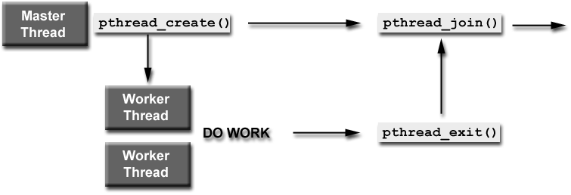
Working with Threads Flow

Slide 34
Example Cont.
// main thread waits for the other threads
for(t=0;t<NUM_THREADS;t++) {
res = pthread_join(threads[t], (void **)&status);
if (res<0) {
printf("ERROR \n");
exit(-1);
}
printf("Completed join with thread %d status= %d\n",t, *status);
}
Notes:
Join the two examples to see the entire process – it’s very similar to the example shown in the Wiki POSIX_Threads value.

Slide 35
Mutex
A mechanism designed to avoid race condition

Slide 36
Race Condition Example
Thread 1:
Thread 2:
int a = counter;
a++;
counter = a;
int b = counter;
b--;
counter = b;
Possible results: new counter = counter new counter = counter -1 new counter = counter +1

Slide 37
Reminder from class
Critical section is a peace of code that access shared resources.
Mutual exclusion algorithms are used to avoid the simultaneous execution of a critical section.
Pay attention we protect shared variables, not pieces of code!
Common protection mechanism – Mutex
We create a mutex to protect each shared variable.
Notes:
Mutual exclusion– מניעה הדדית

Slide 38
Mutex Work Flow
A typical sequence in the use of a mutex is as follows:
Create and initialize a mutex variable
Several threads attempt to lock the mutex
Only one succeeds and that thread owns the mutex
The owner thread performs some set of actions
The owner unlocks the mutex
Another thread acquires the mutex and repeats the process
Finally the mutex is destroyed

Slide 39
Creating and Destroying Mutex
Mutex variables must be declared with type pthread_mutex_t, and must be initialized before they can be used:
Statically, when it is declared - for example: pthread_mutex_t mymutex = PTHREAD_MUTEX_INITIALIZER;
Dynamically,
pthread_mutex_init(mutex, attr)
This allows setting mutex attributes (default settings use NULL)
pthread_mutex_destroy(mutex) should be used to free a mutex object when is no longer needed
Notes:
For those who don’t remember, static vs. dynamic allocation:
http://stackoverflow.com/questions/8385322/difference-between-static-memory-allocation-and-dynamic-memory-allocation
A simple example can be found here: http://publib.boulder.ibm.com/infocenter/iseries/v5r3/index.jsp?topic=%2Frzahw%2Frzahwe18rx.htm
pthread_mutex_init (mutex,attr)
pthread_mutex_destroy (mutex)
pthread_mutexattr_init (attr)
pthread_mutexattr_destroy (attr)

Slide 40
Locking a Mutex
The pthread_mutex_lock(*mutex) routine is used by a thread to acquire a lock on the specified mutex variable
If the mutex is already locked by another thread, this call will block the calling thread until the mutex is unlocked
Notes:
pthread_mutex_lock (mutex)
pthread_mutex_trylock (mutex)

Slide 41
Unlock a Mutex
pthread_mutex_unlock(*mutex) will unlock a mutex if called by the owning thread. Calling this routine is required after a thread has completed its use of protected data
An error will be returned if:
If the mutex was already unlocked
If the mutex is owned by another thread
Pay attention – it means that in pthread, mutex designed only for mutual exclusion.

Slide 42
Fixed Example
Thread 1:
Thread 2:
pthread_mutex_lock (&mut_counter);
int a = counter;
a++;
counter = a;
pthread_mutex_unlock (& mut_counter);
pthread_mutex_lock (& mut_counter);
int b = counter;
b--;
counter = b;
pthread_mutex_unlock (& mut_counter);
//Checking of return values omitted for brevity

Slide 43
Beware of Deadlocks!
Thread 1:
Thread 2:
lock(a_mutex)
lock(b_mutex)
a=b+a;
b=b*a;
unlock(b_mutex);
unlock(a_mutex);
lock(b_mutex)
lock(a_mutex)
b=a+b
a=b*a;
unlock(a_mutex);
unlock(b_mutex);
// Locking two different resources
Can’t lock, Thread 2 owns it!
Can’t lock, Thread 1 owns it!
// Calculations using both resources

Slide 44
Monitors (Conditional Variables)
A mechanism designed to synchronize between threads

Slide 45
Thread synchronization
pthread_mutexes_t was designed for a specific type of synchronization – mutual exclusion.
Many times other synchronization types are needed
Bounded-Buffer (Consumer-Producer)
Barrier
Reader-Writers
This can be implemented with pthread_mutex_t and a loop
Notes:
Mutexes allow you to avoid data races, unfortunately while they allow you to protect an operation, they don't permit you to wait until another thread completes an arbitrary activity – see http://stackoverflow.com/questions/12551341/when-is-a-conditional-variable-needed-isnt-a-mutex-enough for more details

Slide 46
Simple synchronization example – Thread 1 needs to use thread 2’s var
Thread 1:
Thread 2:
While (true){
mutex_lock (varMutex)
if (canUseVar){
//Use var;
canUseVar = false;
break;
}
mutex_unlock (varMutex)
}
mutex_lock(varMutex)
init(var);
canUseVar=true;
mutex_unlock (varMutex)
Complicated and inefficient (busy waiting)!

Slide 47
Using Monitors (Conditional Variables)
Monitors designs for threads synchronization
No need for bust waiting
Monitor also receives a mutex, and uses it to achieve mutual exclusion and synchronization simulatiously
Two main functions:
Wait(monitor , mutex) – that block the current thread (and unlocking the mutex)
Signal(monitor) – that releases a waiting thread (while locking the mutex again)
The concept is to use Signal when a certain condition is met
Therefore they are often called Conditional Variables (CV)
Notes:
Mutexes allow you to avoid data races, unfortunately while they allow you to protect an operation, they don't permit you to wait until another thread completes an arbitrary activity – see http://stackoverflow.com/questions/12551341/when-is-a-conditional-variable-needed-isnt-a-mutex-enough for more details

Slide 48
Simple synchronization example – Thread 1 needs to use thread 2’s var
Thread 1:
Thread 2:
mutex_lock (varMutex)
if (!canUseVar){
cv_wait(varCV, varMutex)
}
//Use var;
mutex_unlock (varMutex)
mutex_lock(varMutex)
init(var);
canUseVar=true;
cv_signal (varCV)
mutex_unlock (varMutex)

Slide 49
Conditional variables in Pthread
In pthreads, there are four relevant procedures involving condition variables:
pthread_cond_init(pthread_cond_t *cv, NULL);
pthread_cond_destroy(pthread_cond_t *cv);
pthread_cond_wait(pthread_cond_t *cv, pthread_mutex_t *mutex);
pthread_cond_signal(pthread_cond_t *cv);
pthread_cond_broadcast(pthread_cond_t *cv)

Slide 50
Creating and Destroying Conditional Variables
Condition variables must be declared with type pthread_cond_t, and must be initialized before they can be used
Statically, when it is declared. For example: pthread_cond_t myconvar = PTHREAD_COND_INITIALIZER;
Dynamically
pthread_cond_init(cond, attr);
Upon successful initialization, the state of the condition variable becomes initialized.
pthread_cond_destroy(cond) should be used to free a condition variable that is no longer needed
Notes:
pthread_cond_init (condition,attr)
pthread_cond_destroy (condition)
pthread_condattr_init (attr)
pthread_condattr_destroy (attr)

Slide 51
pthread_cond_wait
pthread_cond_wait(cv, mutex) is called by a thread when it wants to be blocked and wait for a condition to be true
The mutex is used to protect the actual evaluation of the condition
Should be protecting some shared state
It is assumed that the thread has locked the mutex indicated by the mutex, found that the condition does not occur, and therefore the thread needs to wait
wait causes the thread to release the mutex, and blocks until awakened by a pthread_cond_signal(cv) call from another thread
When it is awakened, it waits until it can acquire the mutex, and once acquired, it returns from the pthread_cond_wait(cv, mutex) call
Notes:
The CV is used as the mechanism to block and release threads according to need
The lock is used to protect the actual evaluation of the condition , which is part of the program, not the mechanism, and therefore the responsibility of the programmer

Slide 52
pthread_cond_signal
pthread_cond_signal(cv) checks to see if there are any threads waiting on the specified condition variable. If not, then it simply returns
If there are threads waiting, then one is awakened
There can be no assumption about the order in which threads are awakened by pthread_cond_signal(cv) calls
It is natural to assume that they will be awakened in the order in which they waited, but that may not be the case…
Use loop or pthread_cond_broadcast(cv) to awake all waiting threads
Notes:
Example for using the broadcast function can be found here:
http://pic.dhe.ibm.com/infocenter/iseries/v7r1m0/index.jsp?topic=%2Fapis%2Fusers_73.htm

Slide 53
Bounded Buffer Reader Using CV
Data strctures:
Queue<T> q
pthread_mutex_t qM,
pthread_cond_t qCV
Reader Flow:
pthread_mutex_lock (qM)
If (q.empty() )
Wait (qCV, qM); //waiting for an element to be written
Element e = q.pop(); //here we have both a lock and element
Pthread_mutex_unlock (qM)
….

Slide 54
Barrier Example (1)
#define NTHREADS 5
pthread_mutex_t *mutex;
pthread_cond_t *cv;
int ndone;
typedef struct {
int id;
} TStruct;
Notes:
The main (next slide) thread created 5 threads.
The ndone value is the value of which we want to check – our condition here is ts->ndone < NTHREADS.
Each reach the mutex, increases ndone by 1, and all except the last created thread goes into wait. Going into wait releases the mutex, allowing the next thread to lock the mutex and increase ndone.
When the 5th thread reaches the condition, *ts->ndone == NTHREADS, so it goes on to the loop, and signals all the threads waiting for that CV. At that point that thread still had the lock, so they can’t actually awake.
Once that thread releases the mutex (line before last), one of the blocked threads will grab the mutex (they can do that as we signaled all the awaiting threads that they can move forward), continue, and so on, until all of them are done.

Slide 55
Barrier Example (2)
main() { //Checking of return values omitted for brevity
TStruct ts[NTHREADS];
pthread_t tids[NTHREADS];
int i;
void *retval;
pthread_mutex_init(&mutex, NULL);
pthread_cond_init(&cv, NULL);
ndone = 0;
Notes:
The main – initialized the mutex, lock and the rest of the variables the threads need, and then creates them. The last loop will cause the main no to finish until all of the threads finished.

Slide 56
Barrier Example (3) - main cont
for (i = 0; i < NTHREADS; i++) {
ts[i].id = i;
}
for (i = 0; i < NTHREADS; i++)
pthread_create(tids+i, NULL, barrier, ts+i);
for (i = 0; i < NTHREADS; i++)
pthread_join(tids[i], &retval);
printf("done\n");
}

Slide 57
Barrier Example (4)
void *barrier(void *arg) { //Checking of return values omitted for brevity
TStruct *ts;
int i;
ts = (TStruct *) arg;
printf("Thread %d -- waiting for barrier\n", ts->id);
pthread_mutex_lock(lock);
ndone = ndone + 1;
if (ndone < NTHREADS) {
pthread_cond_wait(cv, lock);
}
else {
pthread_cond_broadcast(cv);
}
pthread_mutex_unlock(lock);
printf("Thread %d -- after barrier\n", ts->id);
}

Slide 58
Barrier example Output
Thread 0 -- waiting for barrier
Thread 1 -- waiting for barrier
Thread 2 -- waiting for barrier
Thread 3 -- waiting for barrier
Thread 4 -- waiting for barrier
Thread 4 -- after barrier
Thread 0 -- after barrier
Thread 1 -- after barrier
Thread 2 -- after barrier
Thread 3 -- after barrier
done

Slide 59
Semaphores
For allowing X threads to access a shared data structure

Slide 60
Semaphores
Semaphore can be initialized to any value
Can do increments and decrements of semaphore value
Thread blocks if semaphore value is equal to zero when a decrement is attempted
As soon as semaphore value is greater than zero, one of the blocked threads wakes up and continues (and decrements it to zero again)
no guarantees as to which thread this might be

Slide 61
Creating and Destroying Semaphores
Semaphores are created like other variables
sem_t semaphore;
Semaphores must be initialized
Prototype:
int sem_init(sem_t *sem, int pshared, unsigned int value);
sem: the semaphore value to initialize
pshared: share semaphore across processes – usually 0
value: the initial value of the semaphore
Semaphores must be released when they are not needed:
int sem_destroy(sme_t *sem);
Both functions return negative number on failure

Slide 62
Decrementing a Semaphore
Prototype:
int sem_wait(sem_t *sem);
sem: semaphore to try and decrement
If the semaphore value is greater than 0, the sem_wait call return immediately
otherwise it blocks the calling thread until the value becomes greater than 0

Slide 63
Incrementing a Semaphore
Prototype:
int sem_post(sem_t *sem);
sem: the semaphore to imcrement
Increments the value of the semaphore by 1
if any threads are blocked on the semaphore, one of them will be unblocked

