Slide 1
Operating Systems
David Hay

Slide 2
OS Course Objectives
To provide a grand tour of the major operating systems components
To provide coverage of basic computer system organization

Slide 3
Course material
Prof. Feitelson’s notes.
Modern Operating Systems, Tanenbaum
Operating Systems, Stallings
Operating Systems Concepts, Silberschatz, Galvin, Gagne
The Design of the UNIX Operating System, Bach
The lectures will cover more than what appears on the slides. Some slides are borrowed from
Anat Bremler-Barr, Danny Hendler, Idit Keidar, Tanenbaum and Silberschatz et. al.

Slide 4
מנהלות
Final Exam (65%)
Up to 5 Exercises (35%)
Should be written in C++
Will involve also theoretical questions on the material
Zero tolerance to cheating!!!
Pop-up questions in the beginning of the lectures
You must be present in the entire class in order to answer
Grade will be calculated by the formulas in the course’s website

Slide 5
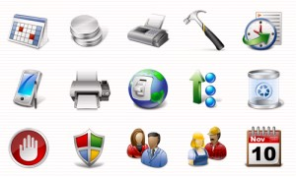
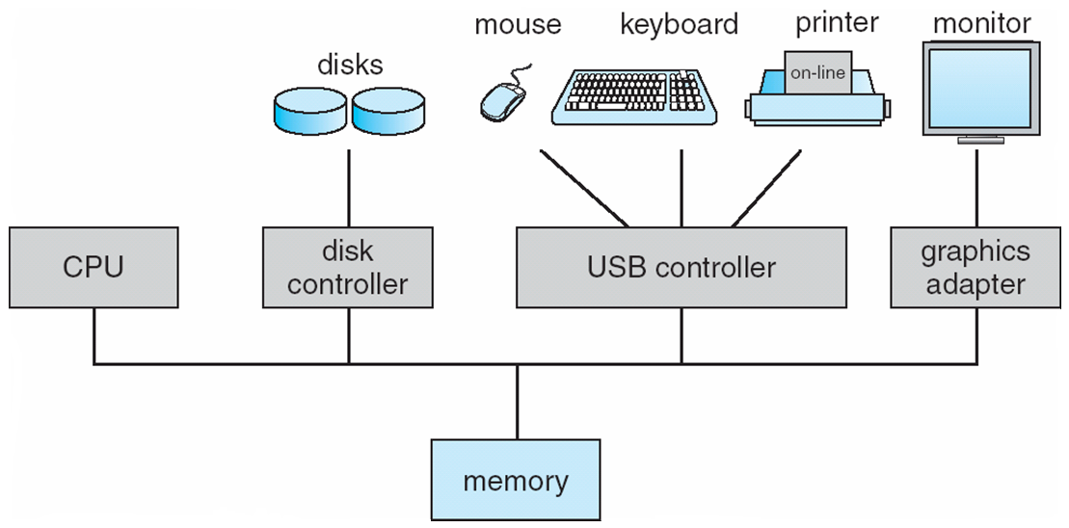
What is an Operating System?
But first, what is a Computer System?
Users
Applications (software programs)
Hardware
Data
User
User
User
User
Applications
Hardware Storage

Slide 6
What is an Operating System?
A program that provides an environment within which other programs can do useful work
Intermediary between the hardware and users
No useful work on its on!
Reacts to events (reactive program)
Always there to help (resident program)
Make the computer system convenient and safe to use
Use the computer hardware in an efficient manner
User
User
User
User
Applications
Operating System
Hardware Storage
6
Notes:
תמונה של משרת ותמונה של ממשלה

Slide 7
Actually, it is way more complicated
Sometimes more than one OS is running on the same hardware
Virtualization
Sometimes the OS is running on more than one CPU
Multi-core architectures
User
User
User
User
Applications
Operating System
Hardware Storage
7

Slide 8
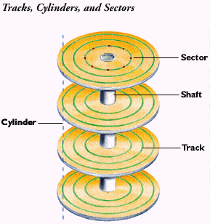
Life without an OS
Put your program in the first disk block
Need help with the mouse, monitors, file systems
No abstractions!
Your program is not portable
Your program controls the hardware without any limitations
Only one program is running…
Instead of:
return-code = read(fd, buf, nbytes)
One should take care of:
…
Read linear sector 17,403 from disk 2
Convert linear sector number to: cylinder, section, head (may be complicated – outer cylinders have more sectors, bad sectors remapped, etc.)
Move disk arm to requested cylinder
Wait for proper sector to appear
…
OS provides abstraction

Slide 9
A stroll down memory lane…
First generation (1945-1955)
vacuum tubes, plug boards – no operating system
Second generation (1955-1965)
transistors, batch systems – multiple programs on disk
GMOS for mainframes
Third generation (1965–1980)
Minicomputers (usage of Integrated Circuits)
multiprogramming/timesharing -user interaction (time-sharing)
Fourth generation (1980–present)
personal computers – graphic user-interface
Networks – file & computing services
Web-computing, Handheld devices , Cellular phones
Fifth Generation (Present)
Multiprocessor, Multicore
Virtualization, Cloud
Notes:
1955 IBM $6M
1965 PDP $120,000

Slide 10
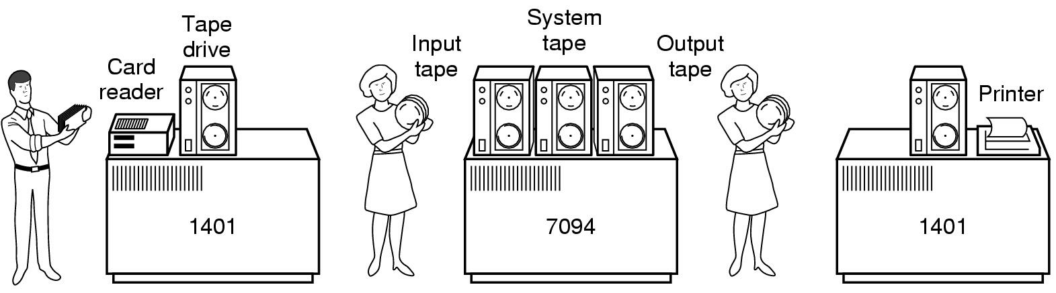
Second generation 1955-1965
Early batch system
bring cards to 1401
read cards to tape
put tape on 7094 which does computing
put tape on 1401 which prints output
Hire an operator
User ≠ operator
Add a card reader
Reduce setup time by batching similar jobs
Automatic job sequencing – automatically transfers control from one job to another.
Resident monitor
initial control in monitor
control transfers to job
when job completes control transfers back to monitor
Early batch system
bring cards to 1401
read cards to tape
put tape on 7094 which does computing
put tape on 1401 which prints output

Slide 11
Spooling: Simultaneous Peripheral Operation On-Line
Overlap I/O of one job with computation of another job
While executing one job, the OS:
Reads next job from card reader into a storage area on the disk (job queue)
Outputs printout of previous job from disk to printer
Job pool – data structure that allows the OS to select which job to run next in order to increase CPU utilization
Concept still is use today: print spooling
Notes:
להדגיש שמדובר ב-device חיצוני

Slide 12
Important Terms
Latency זמן השהייה: The time it takes to perform a job or process a data.
Units: seconds
Throughput תפוקה: The rate of work/production/processing.
Example: The amount of data processed in a time unit. Units: byte/second.
Utilization ניצולת: The fraction of time the CPU is performing useful tasks
Namely, the time the CPU is not idle
CPU Usage: The fraction of time the CPU is executing instructions
Overhead תקורה: Excess or indirect computation time, memory, bandwidth, or other resources that are required to attain a particular goal.
Notes:
לה

Slide 13
Third generation 1965–1980: Multiprogramming/Time sharing
Several jobs are kept in main memory at the same time, and the CPU is multiplexed among them.
Multi-programming: when the first program reached an instruction waiting for a peripheral, the second program in memory is given a chance to run
Time Sharing: switch program even if not waiting for peripheral
Goals: maximize resource utilization, good response time
Job 3
Job 2
Memory
partitions
Job 1
operating
system
Notes:
שקף לפני: הגדרה של תפוקה וoverhead וresponse time

Slide 14
Multi-programming/Time-sharing
Assumptions
CPU is always there, and therefore, not using it is a waste
CPU is much faster than I/O
Memory is large enough to host many programs
Direct memory access (DMA)
More than one task to do at a time
Required OS Features
I/O primitives
Memory management
Memory protection
Scheduler
Manages flow of jobs in and out of the CPU
Spooler
Manages slower I/O devices (e.g. printer Spooler)

Slide 15
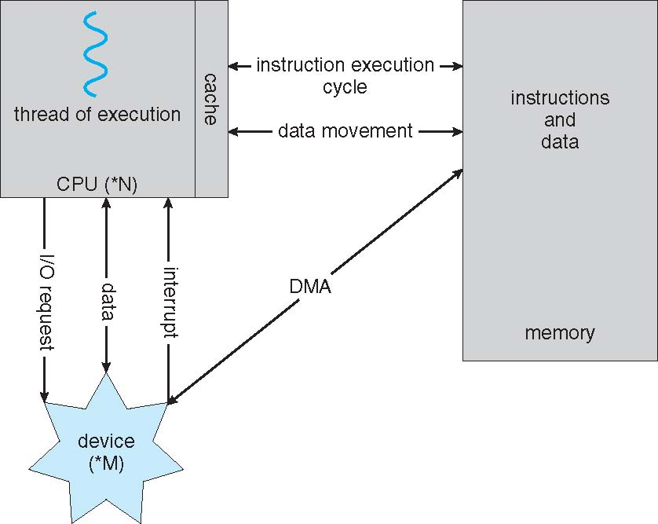
Single Process Architecture (von-Neumann Architecture)
Notes:
1945

Slide 16
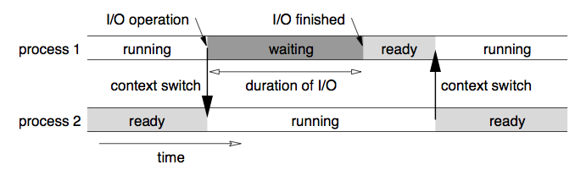
Multiprogramming/Time Sharing: Pictorial Flow

Slide 17
Main Components of today’s OS
Program Execution
Process management
Memory management
I/O and device drivers
File System
Command interpreter/ Shell / (G)UI
Networking
(Protection and Security; Error Detection; Accounting; Resource Allocation)

Slide 18
Today
Architectural Changes:
Multi-core
Virtualization
New Applications:
The cloud
Mobile computing

Slide 19
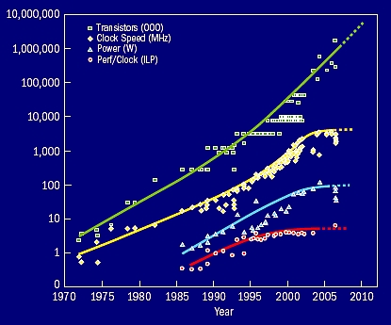
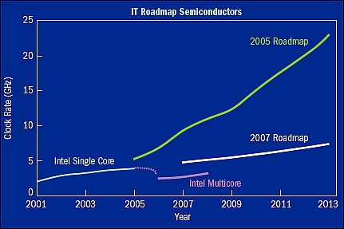
Multi-core
Processors cannot keep up with demands
Solution: Parallelism. Computer system with multiple processors/cores
Even mobile phones have dual core nowadays
Many challenges for OS
Some resources are shared, some not
Complex management
Many architectural options to achieve parallelism: many processors, many cores, hardware/hyper-threads

Slide 20
Virtualization (one example)
User
User
User
User
User
User
User
User
Applications
Applications
Applications
Operating System
Operating System
OS controls the hardware and is tightly coupled with it
Operating System
Virtualization layer/platform
Physical Hardware
OS-2013 -DD - Intro
Hardware Storage
Hardware Storage

Slide 21
Other Virtualization Flavors
User
User
User
User
Applications
Applications
User
User
User
User
Applications
Applications
User
User
Applications
Guest OS
Guest OS
Virtualization Layer
Container Layer
Base Operating System
Operating System
21
21
Hardware Storage
21
Hardware Storage

Slide 22
Virtualization: Some Features
VM Snapshot: freeze a copy of virtual machine with the specific state of the virtual machine
VM Migration: move a VM to another host
Scaling: Add/remove more VM to cope with demand
Very important for the cloud
Isolation: Even when running on the same hardware, the operation of one VM are (almost) completely isolated from the others → Added security
However, there might be an overhead in performance.

Slide 23
The Cloud
Provides computing resources over the Internet
No need of HW computer per application → just browser
Many flavors: Software as a Service, Infrastructure as a Service, and many more
Delivers a hosting environment that is immediate, flexible, scalable, secure, and available – while saving corporations money, time and resources
Uses virtualization for resource sharing (many VMs on the same server),

Slide 24
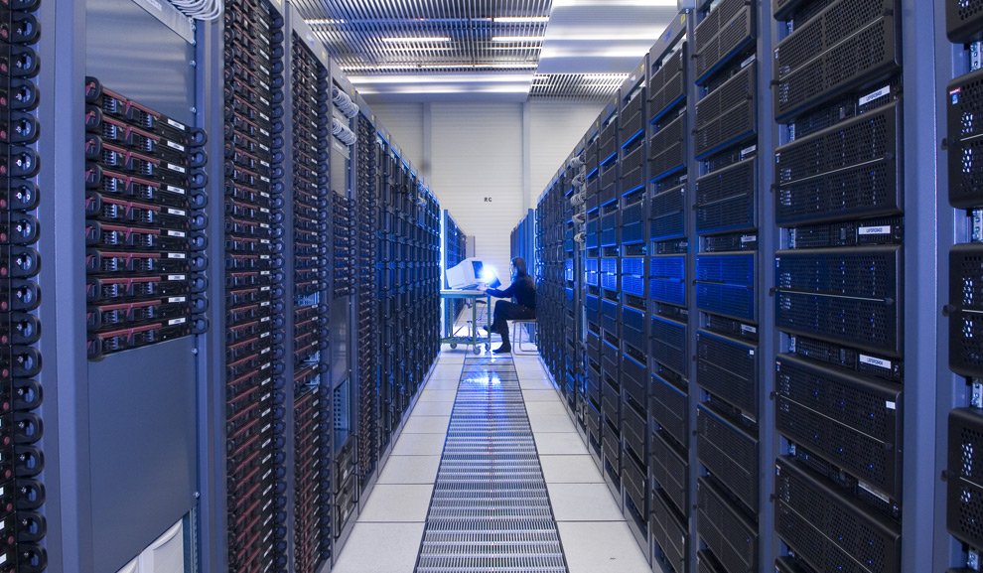
The Cloud
Assumptions:
1. HW and maintenance are cheaper for big companies (Amazon, Microsoft, Google ).
2. Big companies have more experience and infrastructure (home-made protocols).
https://www.youtube.com/watch?v=avP5d16wEp0
Maximilien Brice, © CERN

Slide 25
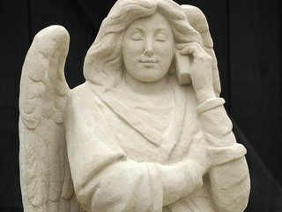
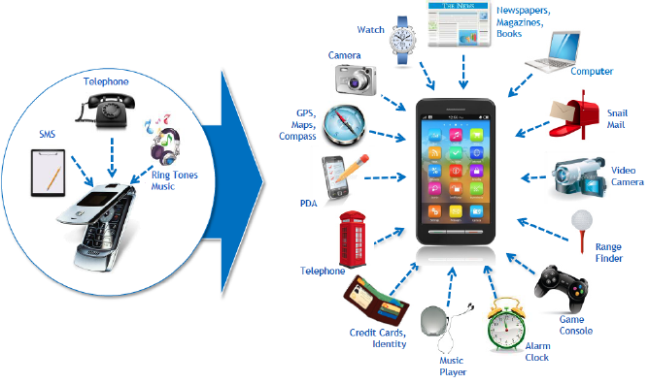
Mobile Computing
Mobile Computing
Cellular/IPad
Statue of an angel holding a mobile phone at St. John's Cathedral in Den Bosch, Netherlands

Slide 26
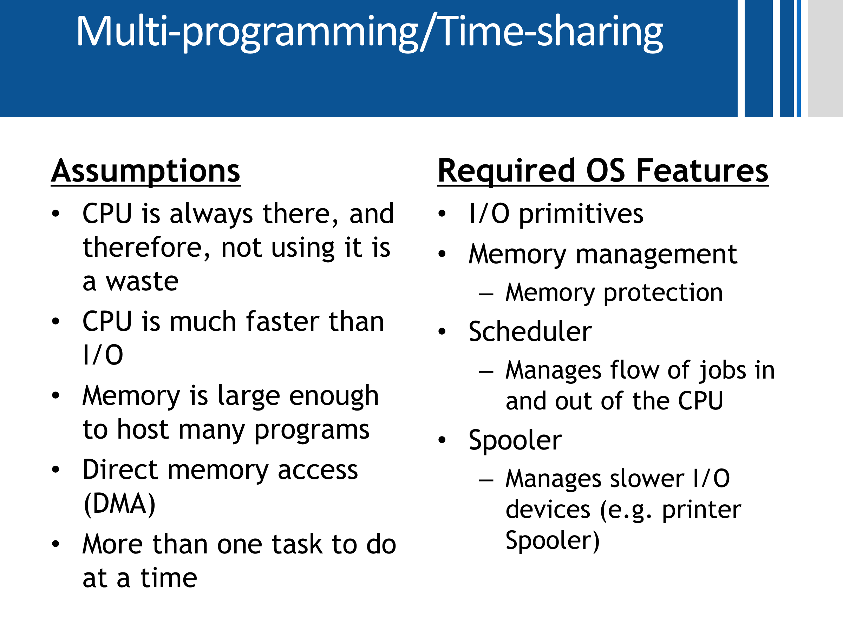
What’s the difference?
Mobile Computing | Desktop
Battery | Electricity | Power
WiFi / Cellular | LAN | Network
3GB | 8-64GB RAM | Main Memory
8/16/64 GB Flash Memory | TB HardDisk 512GB SSD | Disk
Slower and Smaller CPU & Cores | Multiple Processors Cores | CPU
Touch Screen | Mouse / Keyboard | Input
Concern | No main concern | Weight
✗
✓
✗
Kilo=10³, Mega=10⁶ Giga=10⁹, Tera=10¹²
✓
✗

Slide 27

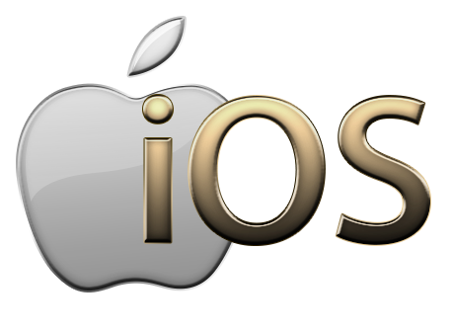
Some Requirements for successful Mobile OS
Easy and consistent for app developers
Inconsistent hardware (different screen size, different camera, different CPUs)
Two main players: iOS, Android,
Responsive, fast
Users with limited attention time span
Efficient – Battery efficient
Every single CPU cycle consumes battery power.
The more time the CPU can spend sleeping the longer the battery life will be→ Less Multitasking
Secure
Lots of personal data on phones. Mobile is easy to lose or steal.
Run with limited RAM
“Being a Responsible Background App”

Slide 28
More types of OS (the OS zoo)
Mainframe operating systems
VM (IBM), VMS(Compaq)
Server operating systems
Multiprocessor operating systems
Personal computer operating systems
Real-time operating systems
VxWorks
Embedded operating systems
VxWorks
Smart card operating systems
Network OS
OS for smart devices
Notes:
I got until here 21/2

