Slide 1
Operating Systems
David Hay

Slide 2
Lecture 2
In general, which paradigm has lower
overhead in computation time?
Multiprogramming
Time-Sharing
Both have the same overhead
None have any overhead
Overhead תקורה: Excess or indirect computation time, memory, bandwidth, or other resources that are required to attain a
particular goal.

Slide 3
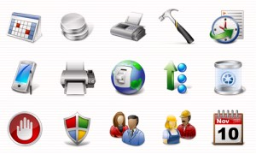
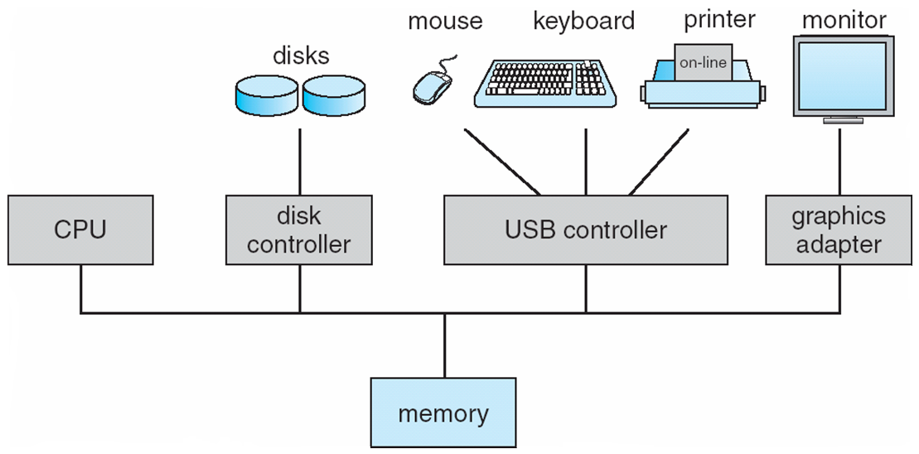
Simplified View of the OS
User Mode
User
User
User
User
Applications
System Calls
Kernel Mode
Operating System
Privileged instructions
Interrupts
Hardware Storage

Slide 4
Two Modes of Operation
Kernel mode (also called “privileged mode”)
The running mode of the OS
Can run hardware assembly commands
User mode
Can not access hardware, etc.

Slide 5
System Calls
The user process gets the OS services thru system calls
System calls are functions that can be called from the user programs
Not like a regular function calls!
User programs cannot access/alter internal OS data structures, only thru system calls (protection!)
System calls check the validity of the parameters (unlike other internal OS functions)
System calls = portable interface and protection

Slide 6
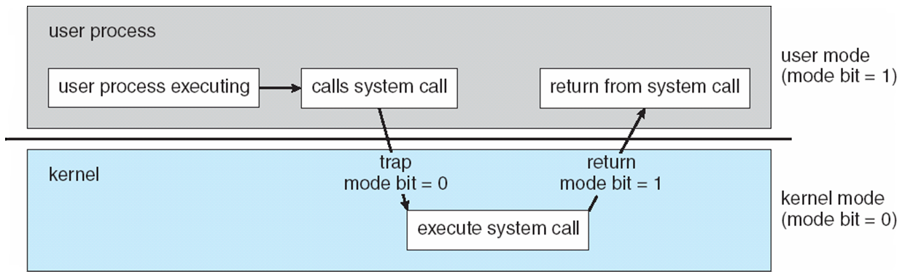
Transition from User to Kernel Mode
The process of switching between user and kernel mode is called a trap
Mode bit provided and protected by hardware
Provides ability to distinguish when system is running user code or kernel code
Some instructions designated as privileged, only executable in kernel mode
System call changes mode to kernel, return from call resets it to user

Slide 7
Transition from User to Kernel Mode
Sometimes happens because something wrong happened: exception (e.g., division by 0)
Exception handling is part of the CPU architecture (hardware)

Slide 8
Types of System Calls
Process Control
File management
Device management
Information maintenance
Communications
Protection

Slide 9
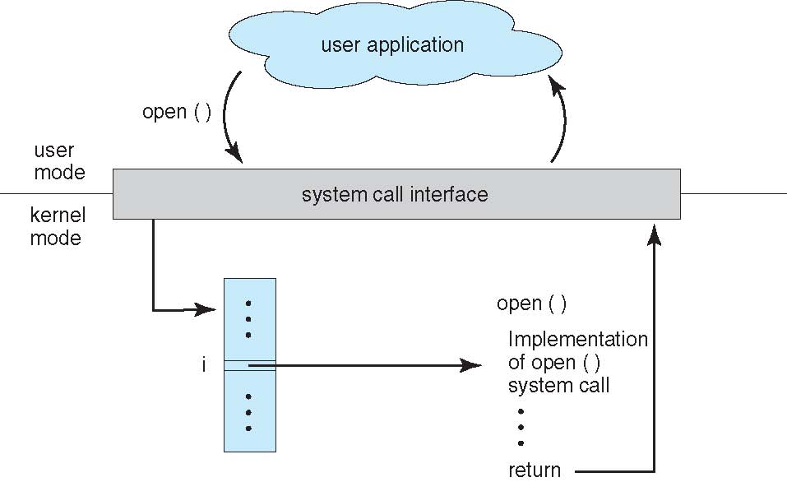
Application Programming Interface (API)
System calls are mostly accessed by programs via a high-level Application Programming Interface (API) rather than directly.
Portability
Abstraction
Security
Notes:
לקחת דוגמה ב-JAVA

Slide 10
System Programs (or System Utilities)
Modern OS comes along with system programs
Often an interface to a system call
Sometimes more complex
Designed to provide service to other software
Not to be confused with application programs
Sometimes also provided by the OS, but are not considered part of the OS
Run by users. Uses system programs to complete their operation
Example: Web browser
Notes:
Grep, cat …

Slide 11
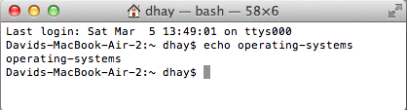
Example: echo system program
echo: write argument to the standard output
Linux implementation: 274 lines in c
Uses fputs, putchar (multiple times)
… which in turn uses fwrite_unlocked
… which in turn uses write – system call 0x80, which only understands bytes
The write system call switches to kernel-mode, the rest is in user-mode
Possibly several switches between the modes
Notes:
printf API: vprintf() → vfprintf() → _IO_padn() → write()

Slide 12
Simplified view of OS
User
User
User
User
Applications
Operating System
Hardware Storage

Slide 13
The reality is much more complicated…
User interface
Make OS mechanisms available to user
psychological issues are important
Apps
Apps
Apps
Apps
Shell
Windows
Libraries
OS Abstractions
Drivers
Is a web browser part of an Operating System ?
Hardware

Slide 14
Layers of System
Libraries
Usually language specific
java.io.*, java.net.*
stdio.h; stdlib.h
Often higher level abstractions
Apps
Apps
Apps
Apps
Shell
Windows
Libraries
OS Abstractions
Drivers
Hardware

Slide 15
Layers of System
Apps
Apps
Apps
Apps
OS Abstractions
provide lower level abstractions and mechanisms
Storage
File systems
Computation
processes
Communications
sockets
Shell
Windows
Libraries
OS Abstractions
Drivers
Hardware

Slide 16
Layers of System
Hardware drivers
provide usable interface to hardware
Apps
Apps
Apps
Apps
Shell
Windows
Libraries
OS Abstractions
Drivers
Hardware

Slide 17
Simplified view of OS
User
User
User
User
Applications
System Calls
Operating System
Privileged instructions
Interrupts
Hardware Storage

Slide 18
How to connect I/O devices? Bus
Advantages:
Versatility:
New devices can be added easily
Peripherals can be moved between computer systems that use the same bus standard
Low Cost:
A single set of wires is shared in multiple ways
Hardware Storage

Slide 19
How to connect I/O devices? Bus
Disadvantages:
It creates a communication bottleneck
The bandwidth of that bus can limit the maximum I/O throughput
The maximum bus speed is largely limited by:
The length of the bus
The number of devices on the bus
The need to support a range of devices with:
Widely varying latencies
Widely varying data transfer rates
Hardware Storage

Slide 20
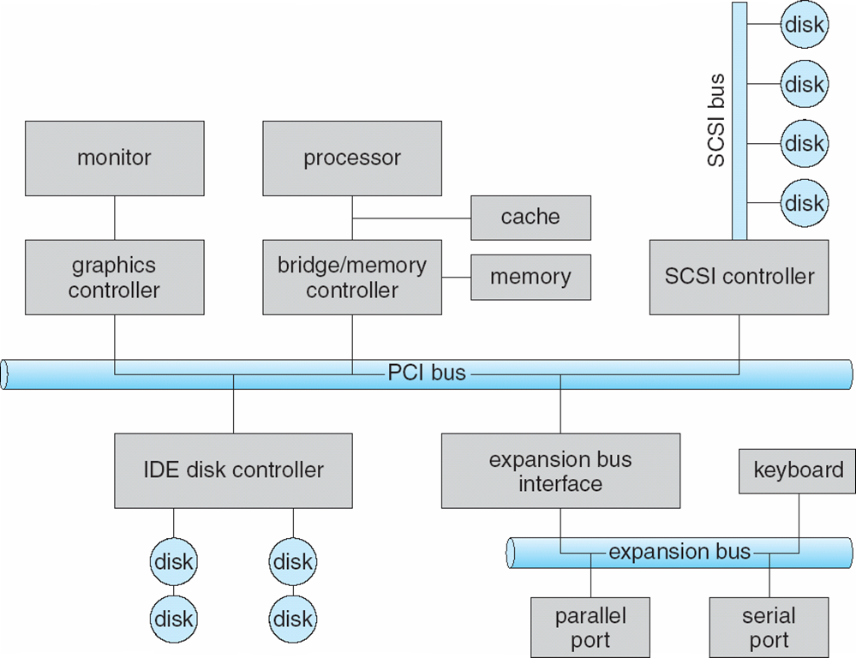
Again, the reality is more complicated

Slide 21
How to communicate with I/O devices? Interrupts
Interrupts are like system calls but
The caller may have no control over when they occur
Regular application cannot disable interrupt
Examples:
Requests for service by hardware
I/O Devices
Page faults (more about this later in the course…)
Hardware support is needed to implement interrupts
Interrupt Request Lines (IRQ)

Slide 22
Common Functions of Interrupts
Interrupt transfers control to the interrupt service routine in the CPU typically through the interrupt vector table (or interrupt description table), which contains the addresses of all the service routines
Interrupt architecture must save the address of the interrupted instruction
So it can be resumed…
Incoming interrupts are generally disabled while another interrupt is being processed to prevent a lost interrupt
But few interrupts should cannot be delayed…
An operating system is interrupt driven
Notes:
To omit

Slide 23
Summary: Three ways to communicate with OS
Interrupts (a.k.a. hardware interrupts)
System calls
that cause traps (a.k.a. software interrupts)
Exceptions (when something wrong happens, also considered software interrupts)
Sometimes hardware interrupts, traps and exceptions are collectively called interrupts

Slide 24
Classifications of Interrupts
Software vs. Hardware
Software: causes by a software, this includes traps and exceptions.
Hardware: caused by hardware, this includes interrupts from external devices.
Internal vs. External
Generally: Internal=Software, External=Hardware
Synchronous vs. Asynchronous
Synchronous: happens with the clock ticks (software, timer/clock interrupts).
Maskable vs. Non-maskable
Maskable: hardware interrupts that can be delayed if more important interrupts is currently handled.
Periodic vs. Aperiodic

Slide 25
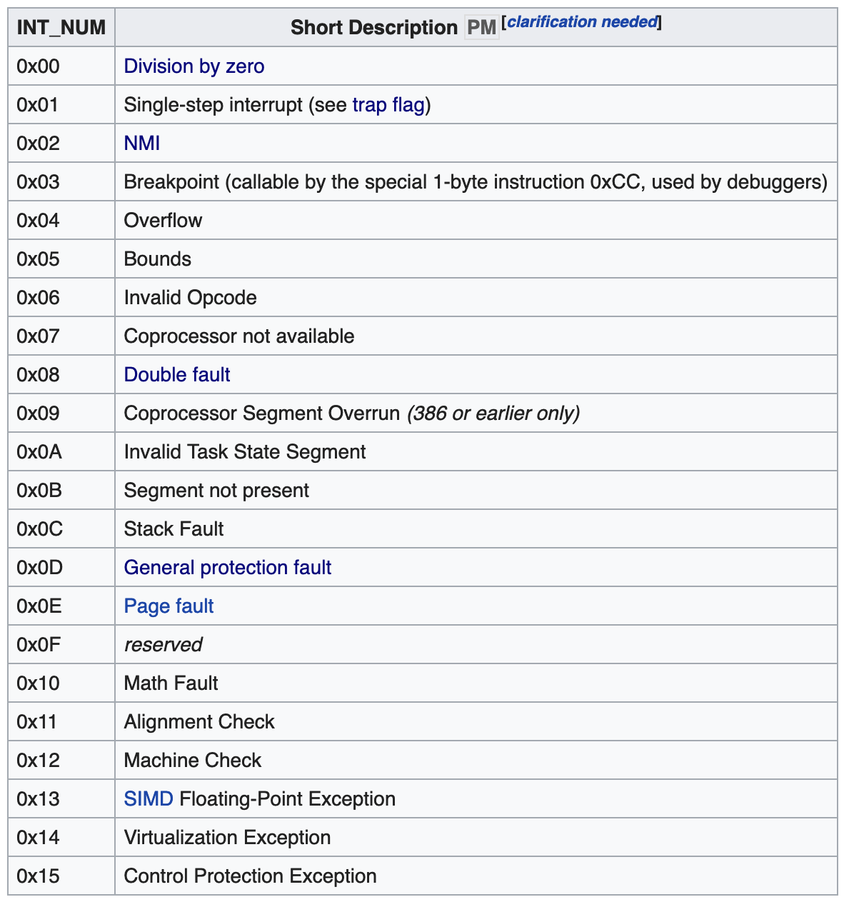
Examples of Interrupts
x86 Architecture:
there are 256 interrupt vectors
First 32 are reserved
Some examples
0x80 is used for system calls’ traps

Slide 26
Kernel and User Modes revisited
User Mode
User
User
User
User
Applications
System Calls
Kernel Mode
Operating System
Privileged instructions
Interrupts
Hardware Storage

Slide 27
Kernel and User Modes revisited
User Mode
User
User
User
User
Applications
System Calls
Operating System
Privileged instructions
Kernel Mode
Interrupts
Hardware Storage

Slide 28


Trade-offs
Smaller kernel:
Less traps → less overhead → higher throughput
Less protection
Smaller kernel → smaller memory footprint
Smaller kernel → more functions outside kernel → if they change, no need to recompile the kernel

Slide 29
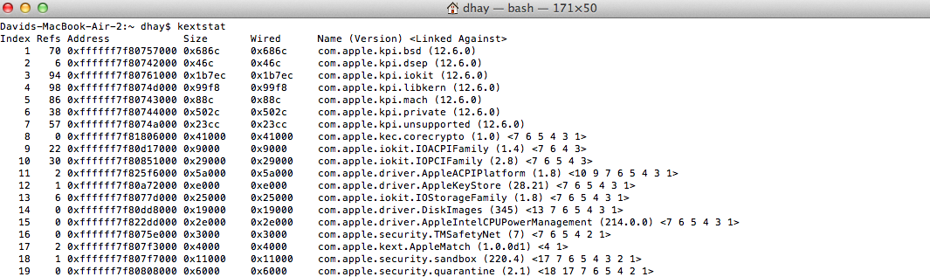
Type of Kernels
Monolithic:
MS-DOS, (Old) Unix
Modular Monolithic (Loadable Kernel Modules):
Mac OS X, Windows, Linux, Solaris, (modern) Unix
Microkernels:
Mach
Notes:
The main difference between modular and micro is whether they run in the same address space. Hybrid also exists.

Slide 30
NEXT SUBJECT: PROCESS MANAGEMENT

