Slide 1
Operating Systems
David Hay

Slide 2
Lecture 3
In multiprogramming/time-sharing, can the CPU distinguish between the programs it runs
No
Can only distinguish between running a user program or OS code
Yes

Slide 3
NEXT SUBJECT: PROCESS MANAGEMENT

Slide 4

How does OS Run Programs?
0xFFF…
Executable
Program Source
OS
int main()
{ … ;
}
compiler
data
Load
stack
editor
Memory
instructions
heap
a.out
data
foo.c
instructions

Slide 5
A CPU capable of R-type & lw/sw instructions
4
MemWrite
Adder
[31:26]
6
add
RegWrite
[5:0]=funct
6
ALU
control
Reg File
Instruction
Memory
[25:21]=Rs
5
Data
Memory
PC
ALU
[20:16]=Rt
5
Address
D. Out
5
Rd
D.In
ck
ck
[15:0]
16
Sext
16->32
Notes:
Rd=Rs,Rt
Add R8, R17, R18 : 0, 32, 17, 18, 8, 0

Slide 6
Where is the CPU?
Instruction
Memory
CPU
PC
Data
Memory

Slide 7
What happens during program execution?
Addr 2³²-1
R0
…
R31
F0
…
F30
PC
…
Data1
Data0
Inst237
Inst236
…
Inst5
Inst4
Inst3
Inst2 Inst1
Inst0
Fetch
Exec
Execution sequence:
Fetch Instruction at PC and save it in IR
Decode instruction in IR
Execute (possibly using registers)
Write results to registers/mem
PC = Next Instruction(PC)
Repeat
Addr 0
Notes:
PC: PROGRAM COUNTER; IR: INSTRUCTION REGISTER

Slide 8
Example: x=x+y
Suppose x is in location 100, y is in location 104 in the data memory
lw r1, 100
lw r2, 104
add r3, r1, r2
sw r3,100

Slide 9
Example: Suppose x=5, y=8
Addr 2³²-1
R0
R1: …
R2: …
R3: …
…
PC: …
…
8 (y)
5 (x)
…
sw r3,100
add r3,r1,r2 lw r2, 104
lw r1, 100
Fetch
Exec
104
100
Execution sequence:
Fetch Instruction at PC save it in IR
Decode instruction in IR
Execute (possibly using registers)
Write results to registers/mem
PC = Next Instruction(PC)
Repeat
12
8
4
0
Addr
Notes:
PC: PROGRAM COUNTER; IR: INSTRUCTION REGISTER

Slide 10
Example: Suppose x=5, y=8
Addr 2³²-1
R0
R1: …
R2: …
R3: …
…
PC: 0
…
8 (y)
5 (x)
…
sw r3,100
add r3,r1,r2 lw r2, 104
lw r1, 100
5
Fetch
Exec
104
100
4
Execution sequence:
Fetch Instruction at PC save it in IR
Decode instruction in IR
Execute (possibly using registers)
Write results to registers/mem
PC = Next Instruction(PC)
Repeat
12
8
PC
4
PC
0
Addr
Notes:
PC: PROGRAM COUNTER; IR: INSTRUCTION REGISTER

Slide 11
Example: Suppose x=5, y=8
Addr 2³²-1
R0
R1: 5
R2: 8
R3: …
…
PC: 8
…
8 (y)
5 (x)
…
sw r3,100
add r3,r1,r2 lw r2, 104
lw r1, 100
Fetch
Exec
104
100
Execution sequence:
Fetch Instruction at PC save it in IR
Decode instruction in IR
Execute (possibly using registers)
Write results to registers/mem
PC = Next Instruction(PC)
Repeat
12
PC
8
4
0
Addr
Notes:
PC: PROGRAM COUNTER; IR: INSTRUCTION REGISTER

Slide 12
Example: Suppose x=5, y=8
Addr 2³²-1
R0
R1: 5
R2: 8
R3: 13
…
PC: 12
…
8 (y)
5 (x)
…
sw r3,100
add r3,r1,r2 lw r2, 104
lw r1, 100
Fetch
Exec
104
100
Execution sequence:
Fetch Instruction at PC save it in IR
Decode instruction in IR
Execute (possibly using registers)
Write results to registers/mem
PC = Next Instruction(PC)
Repeat
PC
12
8
4
0
Addr
Notes:
PC: PROGRAM COUNTER; IR: INSTRUCTION REGISTER

Slide 13
Example: Suppose x=5, y=8
Addr 2³²-1
R0
R1: 5
R2: 8
R3: 13
…
PC: 16
…
8 (y)
13 (x)
…
sw r3,100
add r3,r1,r2 lw r2, 104
lw r1, 100
Fetch
Exec
104
100
Execution sequence:
Fetch Instruction at PC save it in IR
Decode instruction in IR
Execute (possibly using registers)
Write results to registers/mem
PC = Next Instruction(PC)
Repeat
PC
12
8
4
0
Addr
Notes:
PC: PROGRAM COUNTER; IR: INSTRUCTION REGISTER

Slide 14
Context (of Execution)
In CPU
The value of the registers:
Program Counter
All other registers in the CPU
There are other “special” registers in the CPU
Stack pointer, heap pointer, etc.
Generally points only to the “root” of the data
What’s written in the memory:
Code/text, Data, Stack, Heap
Some Internal data in the OS relevant to the program
E.g., user, priority, etc.
In Memory

Slide 15
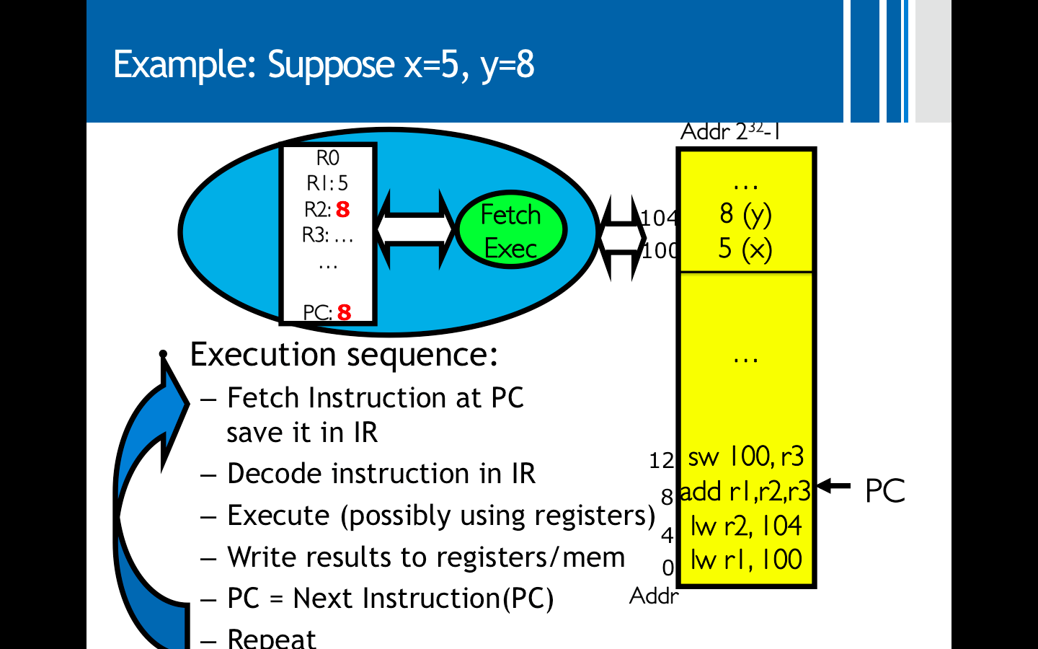
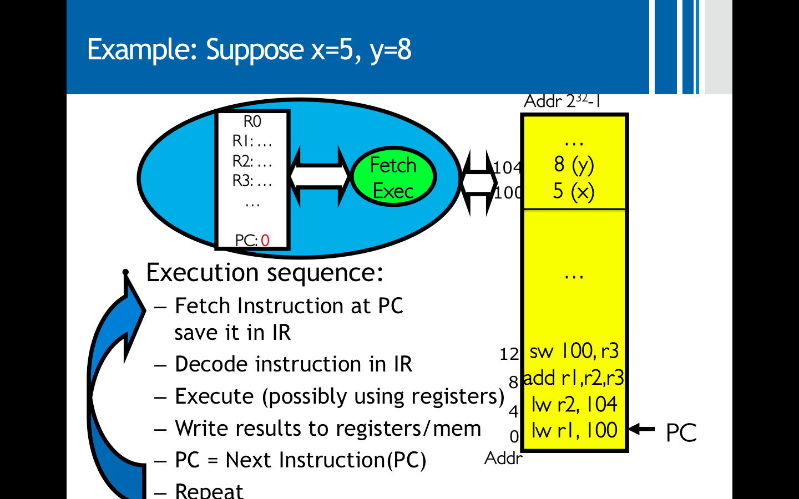



Different Contexts in the Example

Slide 16
Processes תהליכים
A process is a dynamic instance of an application execution
an abstraction of “an individual computer”
Processes provide context of execution
A process is executing on a CPU when it is resident in the CPU registers.
For non-resident processes, the context part that was “in CPU” is stored in a special location in memory

Slide 17
Process vs. Program
Program is passive entity, process is active
Program becomes process when executable file loaded into memory
Done by the loader, which is a component of the OS
More to a process than just a program:
Program is just part of the process state
Less to a process than a program:
A program can invoke more than one process
main () {
…;
}
A() {
.. }
main () {
…;
}
A() {
.. }
Heap
Stack
A
main
Program
Process
Baking | Analogy
Program | Recipe
CPU/Processor | Baker
Data | Ingredients
Process | Baking the cake

Slide 18
Address Space of Process (Simplified)
Address space ⇒ the set of accessible addresses in the memory by the process
Given by two parameters: base and bound. This imply that the process can access addresses only in [base,base+bound]. Verified by the CPU in hardware.
Is PC in [base,base+bound]?
Protection/Isolation: processes cannot access each other memory
Address translation: when a process specifies address x it actually means base+x
Same pointer address in different processes point to different memory
OS address space is called kernel memory, the rest is user memory
Notes:
More complicated (Virtual memory, pages, etc.) – but we will discuss it when we will talk about memory.

Slide 19
Multiple Processes
0000…
Proc 1
Proc 2
Proc n
code
…
Static Data
heap
OS
stack
1000…
code
sysmode
1
Process 2 is resident in the CPU
Static Data
Base
1000 …
heap
Bound
0100…
stack
1100…
uPC
xxxx…
code
3000…
PC
0001…
Static Data
regs
heap
00FF…
…
stack
3080…
FFFF…

Slide 20
Multiple Processes
0000…
Proc 1
Proc 2
Proc n
code
…
Static Data
heap
OS
stack
Process 1 is resident in the CPU
1000…
code
sysmode
1
Static Data
Base
3000…
heap
Bound
0080…
stack
1100…
uPC
xxxx…
code
3000…
PC
0032…
Static Data
regs
heap
003F…
…
stack
3080…
FFFF…

Slide 21
What should be saved when switching between process 1 to process 2?
Process 2 context
Everything in memory stays in memory (no need to do anything)
Everything in CPU should be copied
Example: save PC but not code, save SP but not entire stack

Slide 22
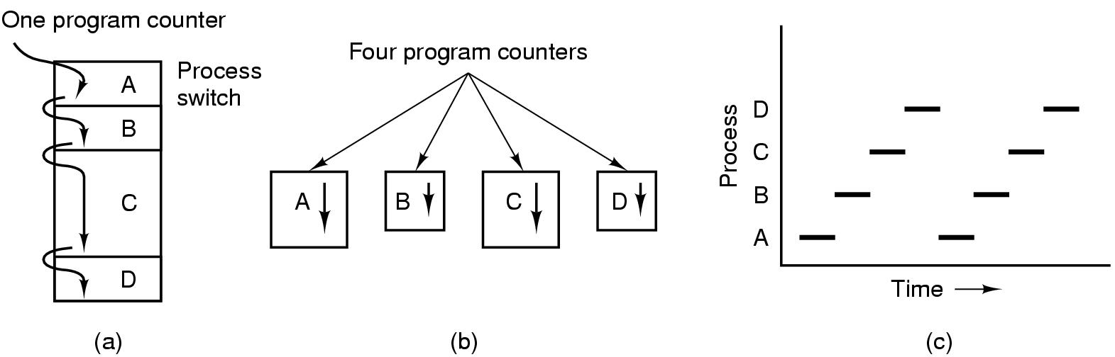
A process is a program in execution
(a) Multiprogramming of four programs
(b) Conceptual model of 4 independent, sequential processes
(c) Only one program active at any instant

Slide 23
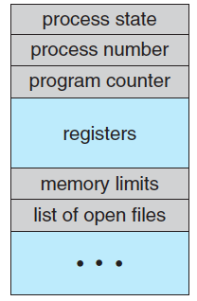
Process Control Block (PCB)
How the process is represented in the OS
Context
Additional OS information needed:
Memory management
Accounting information
I/O status information

Slide 24
The Rest of the Process’s State
PCB (Process Control Block)
Process ID
Process state data
Including a snapshot of all the CPU registers the last time the process was running
Information for calculating the process’s priority relative to other processes
Information about the user running the process, used to decide the process’s access rights
Can be many more, and can be listed in other operating system tables:
GUI parameters
Open files that are used for input and output
Communication channels to other processes / machines

Slide 25
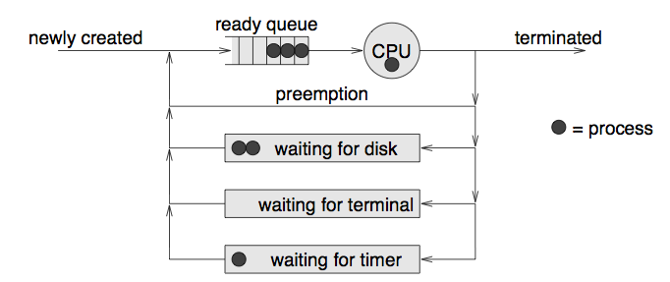
The Life-cycle of a Process
As a process executes, it changes state
new: The process is being created
running: Instructions are being executed
waiting: The process is waiting for some event to occur
ready: The process is waiting to be assigned to a processor
terminated: The process has finished execution

Slide 26
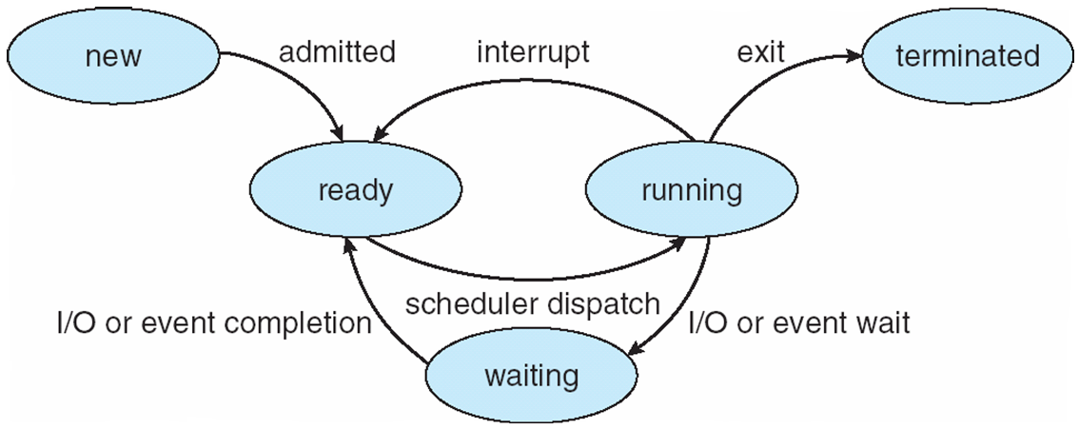
Diagram of Process State
a.k.a. Blocked

Slide 27
Scheduling
Which process should get to run on the CPU and for how long?

Slide 28
A Scheduler and a Dispatcher
CPU Scheduler: Decide which process should run on the CPU (and sometimes for how long)
“Short-term scheduling”; tens/hundreds times a second
Dispatcher: The module responsible on executing the CPU scheduler decisions:
Context switch
Switching back to user mode
Notes:
Dispatcher needs to be as fast as possible.

Slide 29
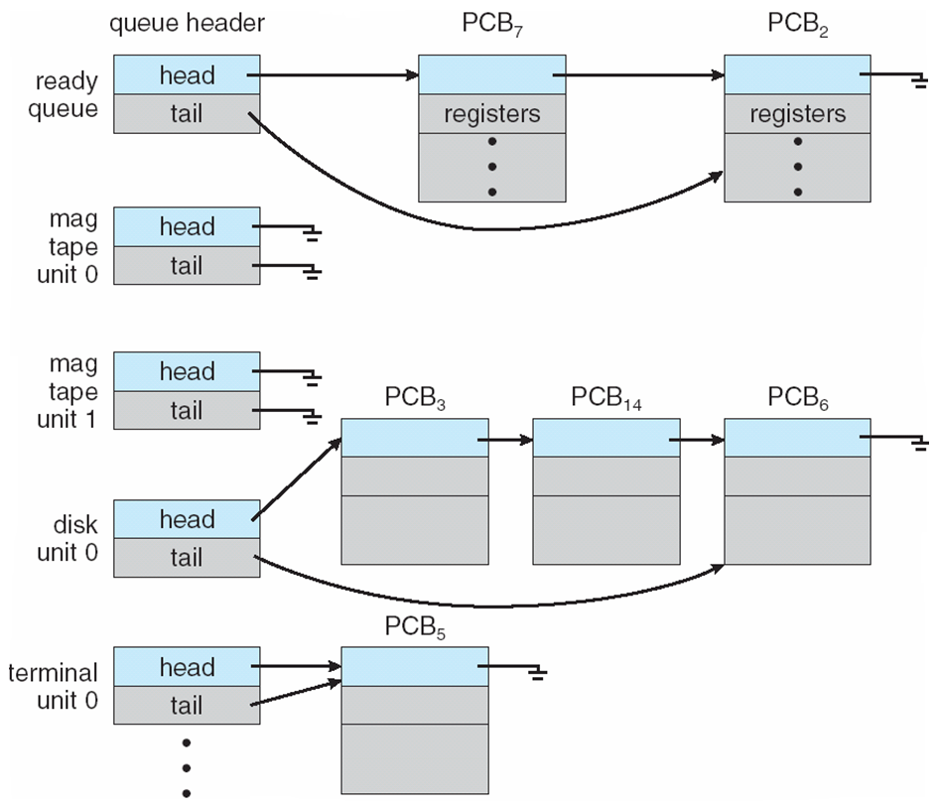
Ready Queue And Various I/O Device Queues
IO
Dev
IO
Dev

Slide 30
Context Switch between Processes
Save processor context, including program counter and other registers
Update the PCB with the new state and any accounting information
Move PCB to appropriate queue - ready, blocked/waiting
Select another process for execution
Update the PCB of the process selected
Update memory-management data structures
Restore context of selected process

Slide 31
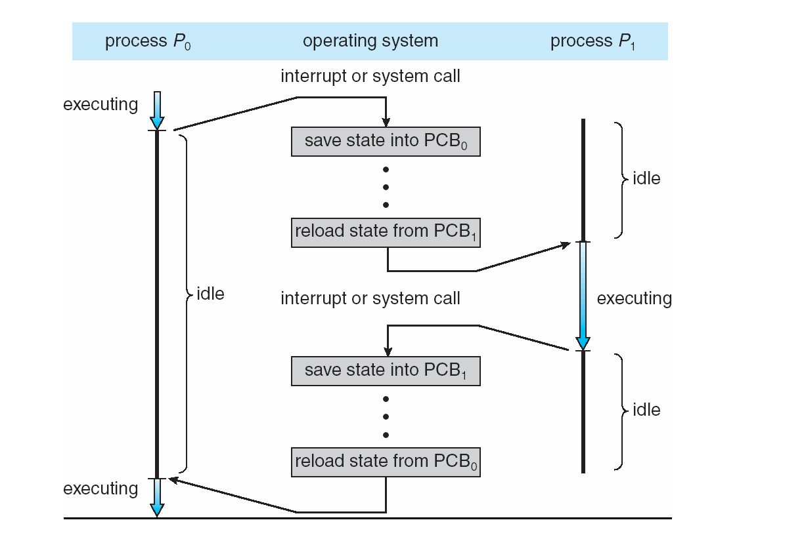
Context Switch between Processes

Slide 32
When to Switch a Process
Interrupts
Clock → process has executed a full time-slice
I/O
Memory fault
memory address is in virtual memory
More on this later
System call
Exception
When error occurred

Slide 33
Process Creation
System initialization
Execution of a process creation system call
fork()
User request to create a new process
Double click on an icon, typing a command
Initiation of a batch job

Slide 34
Example: Process Creation using fork()
A new process is created by the fork() call
Child and parent are identical
child returns a 0
parent returns child process id (nonzero)
Both parent and child execute next line
int pid;
int status = 0;
pid = fork()
if (pid != 0)
{
/* parent */
…..
}
else
{
/* child */
…..
}

Slide 35
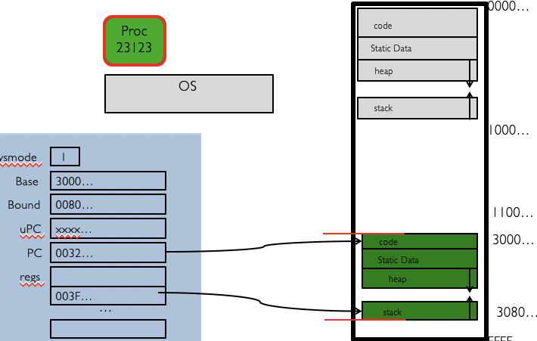
Simple Example
Process state = Running
Process number = 23123
Program counter
registers
Memory limits
List of open files
….
int pid;
int status = 0;
pid = fork()
if (pid != 0)
{
/* parent */
printf(“a”);
}
else
{
/* child */
printf(“b”);
}
1
1

Slide 36
Simple Example
Process state = Running
Process number = 23123
Program counter
registers
Memory limits
List of open files
….
Process state = Ready
Process number = 23123
Program counter
registers
Memory limits
List of open files
….
int pid;
int status = 0;
pid = fork()
if (pid != 0)
{
/* parent */
printf(“a”);
}
else
{
/* child */
printf(“b”);
}
1
1

Slide 37
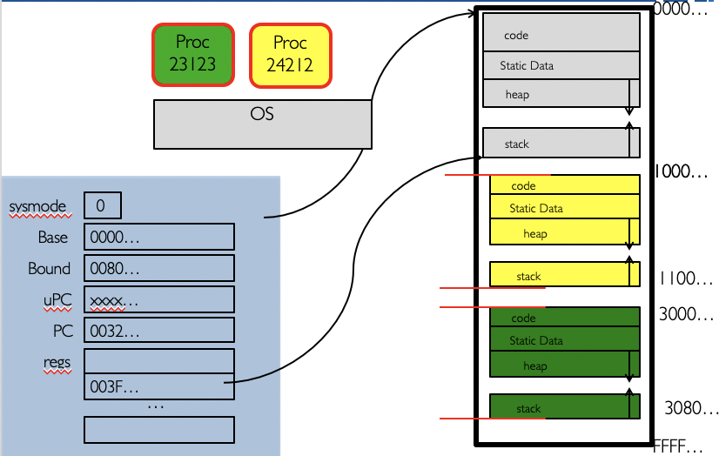
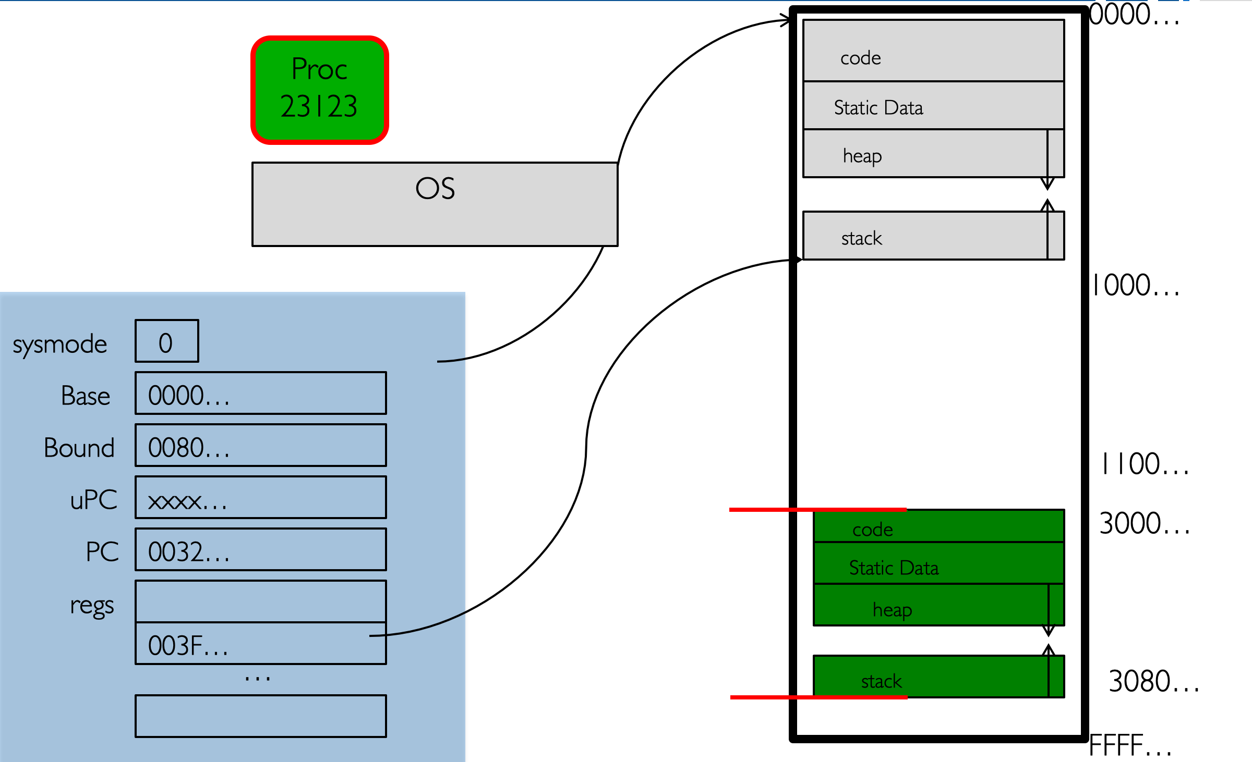
Simple Example
Process state = Running
Process number = 23123
Program counter
registers
Memory limits
List of open files
….
Process state = Ready
Process number = 23123
Program counter
registers
Memory limits
List of open files
….
Process state = Ready
Process number = 23123
Program counter
EAX = 24212 registers
Memory limits
List of open files
….
int pid;
int status = 0;
pid = fork()
if (pid != 0)
{
/* parent */
printf(“a”);
}
else
{
/* child */
printf(“b”);
}
Process state = Ready
Process number = 24212
Program counter
EAX = 0 registers
Memory limits
List of open files
….
Process state = Ready
Process number = 24212
Program counter
registers
Memory limits
List of open files
….
1
1

Slide 38
Simple Example
Process state = Running
Process number = 23123
Program counter
registers
Memory limits
List of open files
….
Process state = Ready
Process number = 23123
Program counter
EAX = 24212 registers
Memory limits
List of open files
….
int pid;
int status = 0;
pid = fork()
if (pid != 0)
{
/* parent */
printf(“a”);
}
else
{
/* child */
printf(“b”);
}
Process state = Ready
Process number = 24212
Program counter
EAX = 0 registers
Memory limits
List of open files
….
1
1
printf(“a”);
printf(“b”);
Two possible outputs:
ab ba

