Slide 1
Operating Systems
David Hay

Slide 2
Process Termination
Normal exit (voluntary)
Error exit (voluntary)
The process discover a fatal error :
cc foo.c when no file foo.c
Fatal error (involuntary)
Dividing by zero
Killed by another process (involuntary)
Using signals, as you have seen in the tutorial

Slide 3
Communication between Processes
Sometimes processes want to cooperate with each other:
E.g. share information, break large task into multiple tasks
On the other hand, processes should be protected from each other
→ Inter-process communication (IPC) is provided by the OS, through specific system calls → very high overhead

Slide 4
Inter-process Communication (IPC)
Many ways to achieve that:
Specify a segment in the memory that is shared, and all processes can access it
Many times implemented through the file system
One writes to a file, one reads from it
Exchanging messages through communication channel (e.g., the socket interface)
Sometimes classified to either shared-memory or message-passing systems
Create many synchronization problems.

Slide 5
NEXT CONCEPT: THREADS

Slide 6
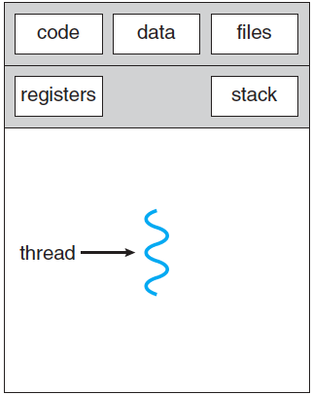
Thread of Control
Thread: Single unique path of execution
Up until now, each process had one thread of control

Slide 7
Examples of Concurrent Tasks
Many applications need to perform more than one task at once
Web browser: retrieve data from the network; display images of data already retrieved
Word processing: process keystrokes; display graphics; perform spell check on the background
Web server: process many requests while listening to new requests

Slide 8
How to do these tasks concurrently?
No concurrency: the word processor will wait on a keystroke → evicting the CPU → No other of its tasks will run until the keystroke is processed after a keyboard interrupt
Each task as a process:
A lot of IPC → Very clumsy, expensive, slow.
The code of the program is in memory again and again (e.g., for each web request)

Slide 9
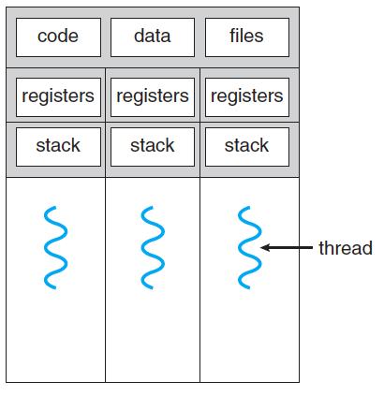
Multi-threaded Processes
Each thread has its own registers (including PC) and stack
All threads share
The code of the program
All other data (global variables and the heap)
Files

Slide 10
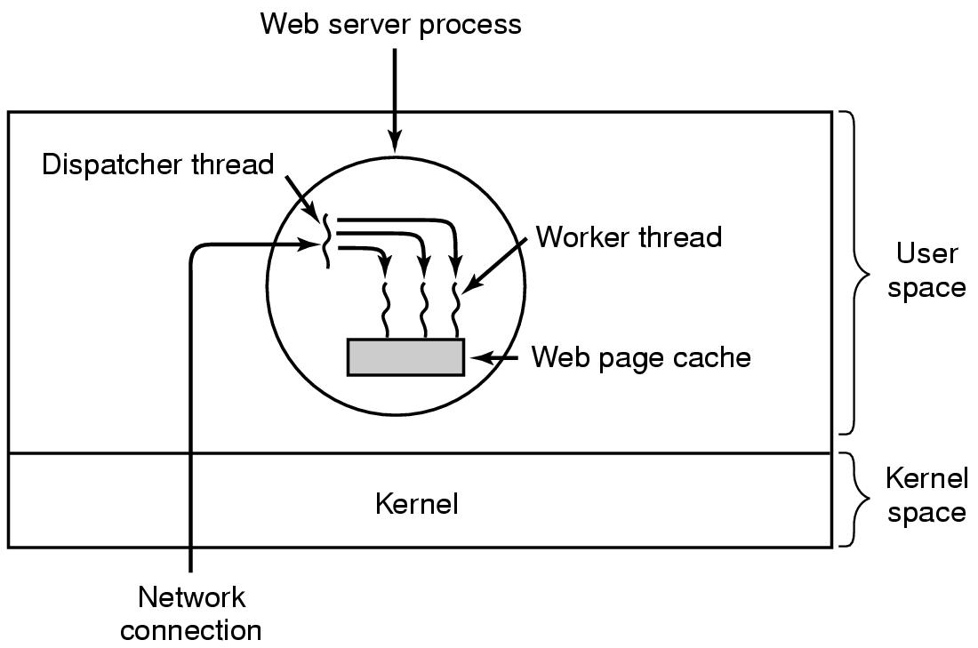
Example: A Multi-threaded Web Server

Slide 11
User-Level Threads
All thread management is done by the user application/user (in user-mode)
The kernel is not aware of the existence of threads
Thread switching does not require kernel mode privileges
Scheduling is application specific
Major Problems:
System calls (including I/O) by threads block the process
A single thread can monopolize the time-slice thus starving the other threads within the task

Slide 12
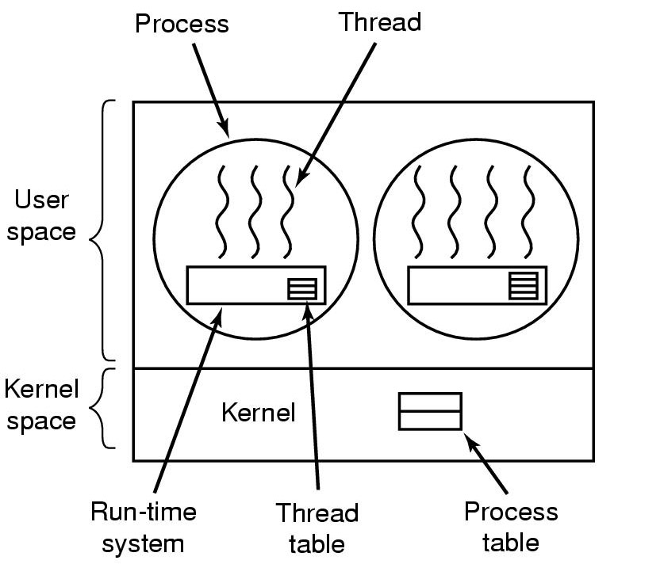
Implementing Threads in User Space
A user-level threads package

Slide 13
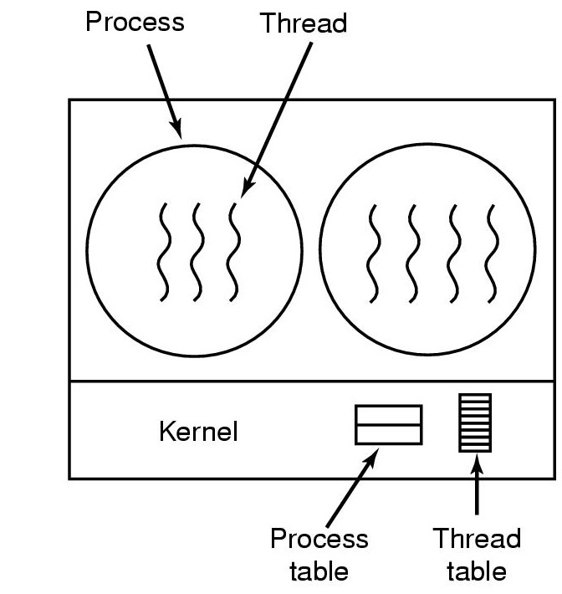
Implementing Threads by the Kernel
A threads package managed by the kernel
(very similar to processes)
The threads of a process appear in the process’s PCB

Slide 14
Kernel-level Threads
Kernel maintains context information for the process and the threads
Blocking a thread does not have to block the process
Disadvantage: Switching between threads requires the kernel
Terminology:
Kernel-level threads are managed by the kernel but run in user space
Kernel threads are managed by the kernel and run in kernel space

Slide 15
Summary: Benefits of Threads
30-100 times faster to create a new thread than a process
Less time to terminate a thread than a process
~5 times faster to switch between two threads within the same process
Threads within the same process share memory and files ➔ they can communicate without invoking the kernel

Slide 16
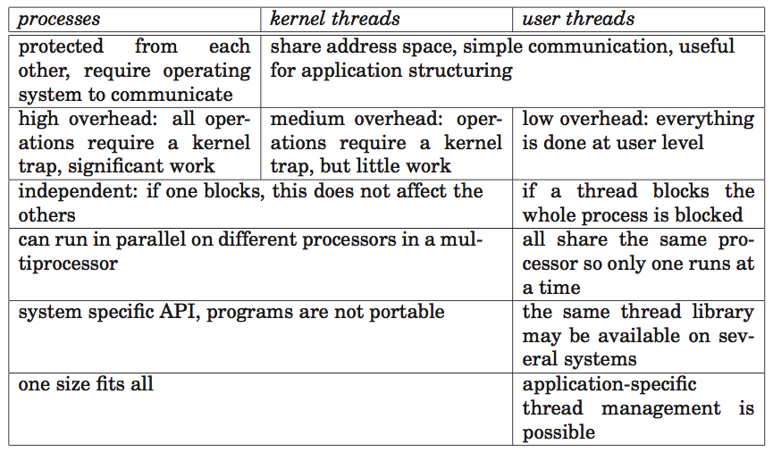
Summary: Threads vs. Processors
Kernel-level threads
User-level threads

Slide 17
Is the CPU aware of the existence of:
User-level threads
kernel-level threads
Both user- and kernel-level threads
Neither user- nor kernel-level threads

Slide 18

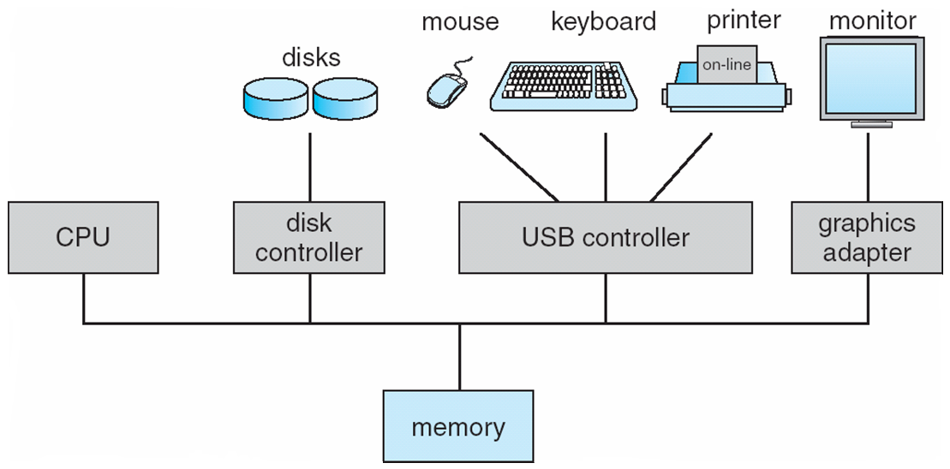
User- and Kernel Level-Threads
User
User
User
User
USER-LEVEL
KERNEL-LEVEL
Applications
Operating System

Slide 19
Real Parallelism in Hardware: Multi-processors and multi-core
Up until now, we showed a single CPU capable of performing a single instruction at a time
In modern CPU sometimes there is some parallelism in HW
One can put more than one CPU on the same motherboard to achieve real parallelism
But a lot of over-head
Exists mostly in servers nowadays
Lighter version (and the most popular): multi-core CPU

Slide 20
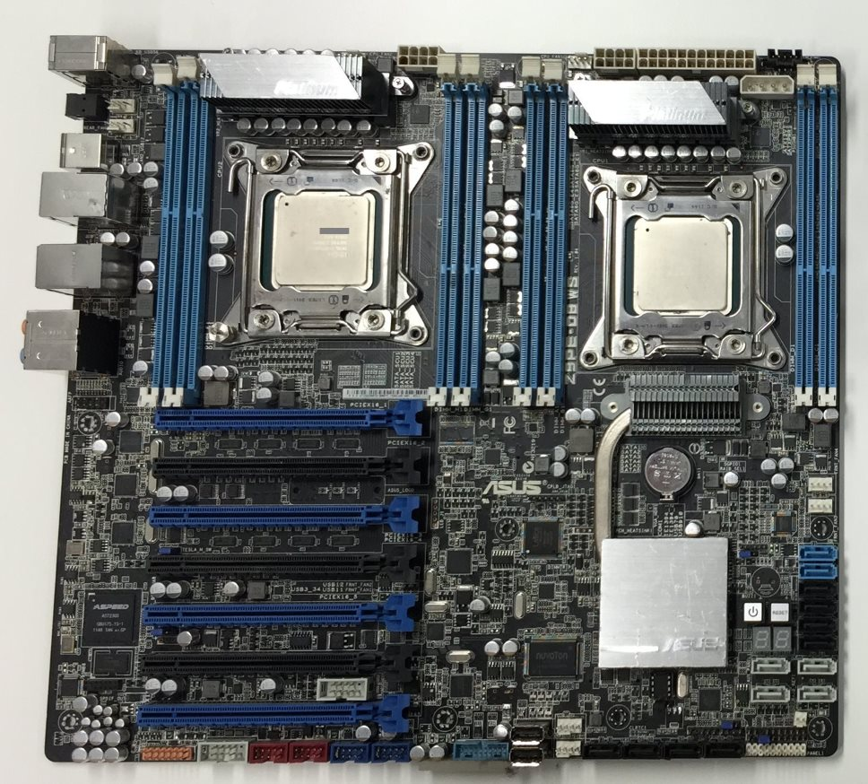

Multiprocessors / Multicores

Slide 21
Multi-core processors
Processor 1 Processor 2
The OS must be aware on the number of processors and cores
Each core executes a different, independent instruction
Logically, cores and processors differ in the level of memory they share and the cost of communication between them
Physically, there are more differences
Core
Core
Core
Core
L1
L1
L1
L1
Switch
Switch
L2
L2
Memory
Two processors with two cores and shared memory

Slide 22
“Hardware-Level” Threads: Hyper-Threading
Intel’s technology since Pentium 4 (2002)
Single-core, single-processor
Appears to the OS as if there are several CPUs, although there is one
Management, switching between the hyper-threads is done by the CPU in hardware
More efficient than kernel-level threads (and user-level threads)
Today, usually hyper-threading provide 2 hyper-thread for each core
4-core machine with hyper-threading appears to the OS as 8-core machine

Slide 23
SYNCHRONIZATION

Slide 24
Motivation: Two processes (or threads) want to print
Both processors write their job to the spooler – the (shared) queue from which the printer extracts job to print.
NULL: No job to print
OUT: Next job to print
IN: End of queue, write new job here
Code for each process (adding jobs): Spooler[IN] = job IN++
IN and Spooler[] are shared among all processes
1
A
2
B
2
3
C
OUT
4
NULL
5
NULL
6
NULL
4
7
NULL
IN

Slide 25
Possible Outcomes 1/2
Process 1: Spooler[IN] = JOB1
Process 1: IN++
<Context Switch by OS>
Process 2: Spooler[IN] = JOB2
Process 2: IN++
1
A
2
B
2
3
C
NULL
OUT
4
JOB1
NULL
5
JOB2
6
NULL
6
7
NULL
5
4
IN

Slide 26
Possible Outcomes 2/2
Process 1: Spooler[IN] = JOB1
<Context Switch by OS>
Process 2: Spooler[IN] = JOB2
<Context Switch by OS>
Process 1: IN++
<Context Switch by OS>
Process 2: IN++
→ JOB1 is lost; all jobs after JOB2 may not be printed as well, because of the gap
1
A
2
B
2
3
C
NULL
JOB2
OUT
4
JOB1
5
NULL
6
NULL
6
7
NULL
5
4
IN

Slide 27
Further Motivation
100-1000
Global variable IN is in address 100
IN++
lw r1, 100
inc r1
sw 100, r1

Slide 28
Further Motivation
100: 2
100: 1
100: 0
100: 1
100: 0
Thread 1: lw r1,100
Thread 1: inc r1
Thread 1: sw 100,r1
<Context Switch>
Thread 2: lw r1, 100
Thread 2: inc r1
Thread 2: sw 100, r1
Thread 1: lw r1,100
Thread 1: inc r1
<Context Switch>
Thread 2: lw r1, 100
Thread 2: inc r1
Thread 2: sw 100, r1
<Context Switch>
Thread 1: sw 100,r1
lw r1, 100
inc r1
sw 100, r1
r1: 1
r1: 0
r1: 2
r1: 1
r1: 0
→ IN = 2
→ IN = 1

Slide 29

“Too Much Milk”…
Time | You | Your Roommate
3:00 | Arrive Home
3:05 | Look in fridge; no milk
3:10 | Leave for grocery
3:15 |  | Arrive home
3:20 | Arrive at grocery | Look in fridge; no milk
3:25 | Buy milk | Leave for grocery
3:35 | Arrive home; put milk in fridge
3:45 |  | Buy milk
3:50 |  | Arrive home; oh no!
Notes:
להוסיף פתק

Slide 30

What’s happening here?
The Problem: Uncoordinated access to a shared resource (data structure or device)
By multiple threads, by multiple processes, by multiple cores/processors
Where: Critical section is a piece of code that accesses the shared resource.
Can be one instruction or very large code
Correctness: must not be concurrently executed by more than one thread process.
Solution: Mutual exclusion algorithms are used to avoid the simultaneous execution of a critical section
Important: Sometimes it is not enough to ensure mutual exclusion (e.g., when the order of execution matters)
More on this later
In HUJI:
67520 Distributed Algorithms course
Given by Prof. Danny Dolev
(Usually in Semester A)

Slide 31
Modeling the Mutual Exclusion Problem [First modeling by Dijkstra, 1965]
Remainder Code
The Problem: Write entry and exit code to
ensure the following properties
Mutual Exclusion: No two processes are in their critical section at the same time.
Progress: If a process in trying to enter the critical section then some process must eventually enter the critical section.
Starvation freedom: If a process in trying to enter the critical section then this process must eventually enter the critical section.
Generality: no assumptions may be made about speeds or the number of participants (threads/processes/cores/CPUs)
No blocking in the reminder No process running outside its critical section may block other process
Entry Code
Critical Section
Exit Code

Slide 32
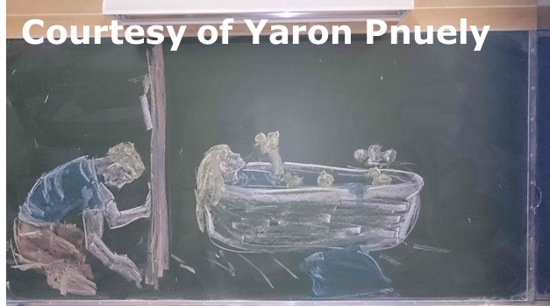
Critical Section
Remainder Code
Entry Code
Critical Section
Exit Code

Slide 33
First Try: Disabling interrupts
Satisfies Properties 1,2,3,5 but:
Does not solve the problem in a multi-processor system (where real parallelism exists)→ Property 4 is violated
And:
User processes should not be allowed to disable interrupts
Disabling interrupts should be done for a very short period of time
Remainder Code
Entry Code:
Disable Interrupts
Hidden assumption for all algorithms: Processes never terminate in the critical section and finish it in finite time
Critical Section
Exit Code:
Enable Interrupts
33

Slide 34
No “Cheating” – First Try
Reminder
Reminder
Algorithm for 2 threads/processes
Uses global variable (1 bit) named turn. Cannot be used in the reminder/critical
(Slightly) different code for each thread
while(turn==1);
while(turn==0);
Critical
Critical
turn=1;
turn=0;
Code for Thread 0
Code for Thread 1

Slide 35
No “Cheating” – First Try
Reminder
Reminder
Bad News:
Progress / no blocking in the reminder does not hold. Thread 1 can simply stay in its reminder and never get to its entry (and therefore exit) code → Starvation Freedom does not hold
while(turn==1);
while(turn==0);
Critical
Critical
turn=1;
turn=0;
Code for Thread 0
Code for Thread 1
√ Mutual Exclusion: Assume that the two of the processes are in the critical condition, and then w.l.o.g. thread 0 left its entry section (and entered the
critical section) first → At that point, turn≠1→turn=0. The only place turn can be changed to 1 is when thread 0 exits the critical section, thus turn=0 throughout the entire execution of the critical section by Thread 0→Thread 1 is in its entry code when Thread 0 is the critical section → Contradiction.

Slide 36
Remainder
Remainder
Algorithm for 2 threads/processes
Uses global two global variables
(1 bit), named flag[0], flag[1]. Cannot be used in the remainder/critical section
(Slightly) different code for each thread
flag[0] = true;
while(flag[1]);
flag[1]=true;
while(flag[0]);
Critical
Critical
flag[0]=false;
flag[1]=false
Code for Thread 0
Code for Thread 1

Slide 37
No “Cheating” – Second Try
Remainder
Remainder
No Blocking in the Remainder: A thread can block another thread only if its flag is true, implying it is either in its entry, critical, or exit section.
flag[0] = true;
while(flag[1]);
flag[1]=true;
while(flag[0]);
Critical
Critical
flag[0]=false;
flag[1]=false
But still Progress does not hold
→ Starvation Freedom does not hold
Deadlock!
Code for Thread 0
Code for Thread 1
√ Mutual Exclusion: Assume that the two of the processes are in the critical section, and then w.l.o.g. thread 0 left its entry section (and entered the
critical section) first → At that point, flag[0]=true → The only place flag[0] can be changed to false is when thread 0 exits the critical section, thus flag[0]=true throughout the entire execution of the critical section by Thread 0→Thread 1 is in its entry code when Thread 0 is the critical section → Contradiction.

Slide 38
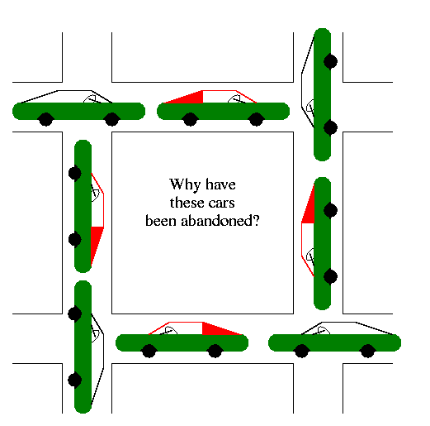
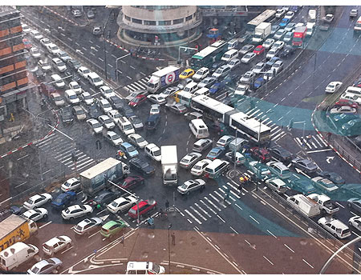
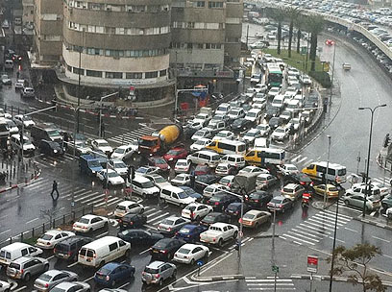
Illustration of Deadlocks
Tel Aviv, Winter 2011

Slide 39
No “Cheating” – Third Try
Remainder
Remainder
turn=1;
flag[0] = true;
while(flag[1] and turn==1);
turn=0;
flag[1] = true;
while(flag[0] and turn==0);
Critical
Critical
flag[0]=false;
flag[1]=false
Code for Thread 0
Code for Thread 1
Mutual Exclusion does not hold

Slide 40
Peterson’s Algorithm - 1981
Remainder
Remainder
Remainder
flag[i] = true;
turn=1-i;
while(flag[1-i] and turn==1-i);
flag[1] = true;
turn=0;
while(flag[0] and turn==0);
flag[0] = true;
turn=1;
while(flag[1] and turn==1);
Critical
Critical
Critical
Flag[i]=false;
flag[1]=false
flag[0]=false;
Code for Thread i
Code for Thread 1
Code for Thread 0
√ Mutual Exclusion: Assume that the two processes are in the critical section, and then w.l.o.g. thread 0 left its entry section (and entered the
critical section) first → At that point, flag[1]=false or turn=0.
Case 1: flag[1]=false → Thread 1 has not executed Line 1 of it’s entry code → When it will eventually get to Line 3, it will set turn to 0, and wait. The only place turn is set to 1, is in Thread’s 0 entry code, after it left the critical section → Contradiction.
Case 2: turn=0→Thread 1 executed Line 2 between Thread 0 Line 2 and 3→
40

Slide 41
Peterson’s Algorithm - 1981
Remainder
√ No blocking in the Remainder
√ Starvation Free: Assume Thread 1 tries to get into the critical section but blocked (on Line 3) for infinite time → Thread 0 enters the critical section infinite number of times → The second time Thread 0 will execute the entry, flag[0]=true, turn=1 and it will block → The next time Thread 1 gets the CPU, the while condition does not hold and Thread 1 enters the critical section → Contradiction.
flag[i] = true;
turn=1-i;
while(flag[1-i] and turn==1-i);
Critical
Flag[i]=false;
Two threads only cannot be easily extended to more
Busy wait (spinning)
Code for Thread i
√ Mutual Exclusion: Assume that the two processes are in the critical section, and then w.l.o.g. thread 0 left its entry section (and entered the
critical section) first → At that point, flag[1]=false or turn=0.
Case 1: flag[1]=false → Thread 1 has not executed Line 1 of it’s entry code → When it will eventually get to Line 3, it will set turn to 0, and wait. The only place turn is set to 1, is in Thread’s 0 entry code, after it left the critical section → Contradiction.
Case 2: turn=0→Thread 1 executed Line 2 between Thread 0 Line 2 and 3→
41

Slide 42
Three Concepts We’ve Covered
Race Condition: A situation in which the scheduling of processes/threads (the order of who is getting the CPU) changes the final result
Different order → different results
Typical scenario: Most of the time everything is OK, but sometime not → very hard to debug
Atomic Instruction: instruction that completes in a single step relative to other threads
x=x+1 was not atomic
Read (lw) and write (sw) were atomic
Sometimes this doesn’t hold (wide words that spans more than one memory address)

Slide 43
Three Concepts We’ve Covered
Busy-waiting (spinning, busy-looping): technique in which a process repeatedly checks to see if a condition is true
“do nothing” loops: while(flag[1-i] and turn==1-i);
Usually, should be avoided as it wastes CPU cycles and yields large overhead
Polling vs. interrupts
We will discuss alternative later

