Slide 1
Operating Systems
David Hay

Slide 2
Modeling the Mutual Exclusion Problem [First modeling by Dijkstra, 1965]
The Problem: Write entry and exit code. We will examine the code against the following properties (the goal is to ensure all of them)
Remainder Code
Mutual Exclusion: No two processes are in their critical section at the same time.
Progress: If a process in trying to enter the critical section then some process must eventually enter the critical section.
Starvation freedom: If a process in trying to enter the critical section then this process must eventually enter the critical section.
Generality: no assumptions may be made about speeds or the number of participants (threads/processes/cores/CPUs)
No blocking in the remainder No process running outside its critical section may block other process
Entry Code
Critical Section
Exit Code

Slide 3
No “Cheating” – First Try
Reminder
Reminder
Bad News:
Progress / no blocking in the remainder does not hold. Thread 1 can simply stay in its reminder and never get to its entry (and therefore exit) code → Starvation Freedom does not hold
while(turn==1);
while(turn==0);
Critical
Critical
turn=1;
turn=0;
Code for Thread 0
Code for Thread 1
√ Mutual Exclusion: Assume that the two of the processes are in the critical condition, and then w.l.o.g. thread 0 left its entry section (and entered the
critical section) first → At that point, turn≠1→turn=0. The only place turn can be changed to 1 is when thread 0 exits the critical section, thus turn=0 throughout the entire execution of the critical section by Thread 0→Thread 1 is in its entry code when Thread 0 is the critical section → Contradiction.

Slide 4
Starvation Freedom → Progress → No blocking in the remainder
Blocking in the remainder → No Progress → No Starvation Freedom →

Slide 5
No “Cheating” – Second Try
Remainder
Remainder
No Blocking in the Remainder: A thread can block another thread only if its flag is true, implying it is either in its entry, critical, or exit section.
flag[0] = true;
while(flag[1]);
flag[1]=true;
while(flag[0]);
Critical
Critical
flag[0]=false;
flag[1]=false
But still Progress does not hold
→ Starvation Freedom does not hold
Deadlock!
Code for Thread 0
Code for Thread 1
√ Mutual Exclusion: Assume that the two of the processes are in the critical section, and then w.l.o.g. thread 0 left its entry section (and entered the
critical section) first → At that point, flag[0]=true → The only place flag[0] can be changed to false is when thread 0 exits the critical section, thus flag[0]=true throughout the entire execution of the critical section by Thread 0→Thread 1 is in its entry code when Thread 0 is the critical section → Contradiction.

Slide 6
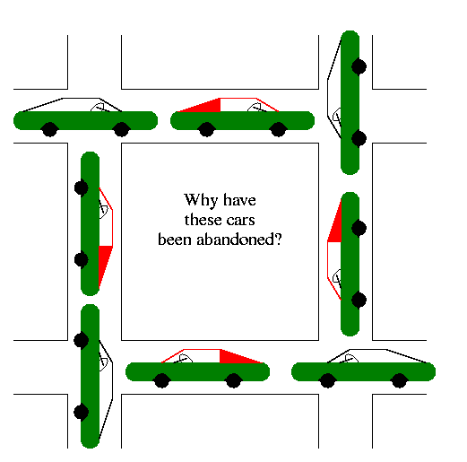
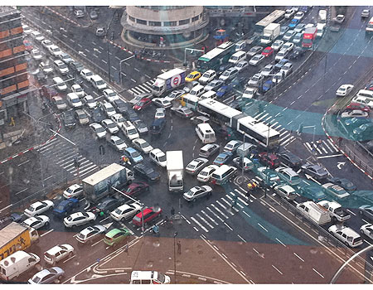
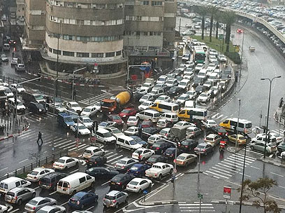
Illustration of Deadlocks
Tel Aviv, Winter 2011

Slide 7
No “Cheating” – Third Try
Remainder
Remainder
turn=1;
flag[0] = true;
while(flag[1] and turn==1);
turn=0;
flag[1] = true;
while(flag[0] and turn==0);
Critical
Critical
flag[0]=false;
flag[1]=false
Code for Thread 0
Code for Thread 1
Mutual Exclusion does not hold

Slide 8
Peterson’s Algorithm - 1981
Remainder
Remainder
Remainder
flag[i] = true;
turn=1-i;
while(flag[1-i] and turn==1-i);
flag[1] = true;
turn=0;
while(flag[0] and turn==0);
flag[0] = true;
turn=1;
while(flag[1] and turn==1);
Critical
Critical
Critical
Flag[i]=false;
flag[1]=false
flag[0]=false;
Code for Thread i
Code for Thread 1
Code for Thread 0
√ Mutual Exclusion: Assume that the two processes are in the critical section, and then w.l.o.g. thread 0 left its entry section (and entered the
critical section) first → At that point, flag[1]=false or turn=0.
Case 1: flag[1]=false → Thread 1 has not executed Line 1 of it’s entry code → When it will eventually get to Line 3, it will set turn to 0, and wait. The only place turn is set to 1, is in Thread’s 0 entry code, after it left the critical section → Contradiction.
Case 2: turn=0→Thread 1 executed Line 2 between Thread 0 Line 2 and 3→
8

Slide 9
Peterson’s Algorithm - 1981
Remainder
√ No blocking in the Remainder
√ Starvation Free: Assume Thread 1 tries to get into the critical section but blocked (on Line 3) for infinite time → Thread 0 enters the critical section infinite number of times → The second time Thread 0 will execute the entry, flag[0]=true, turn=1 and it will block → The next time Thread 1 gets the CPU, the while condition does not hold and Thread 1 enters the critical section → Contradiction.
flag[i] = true;
turn=1-i;
while(flag[1-i] and turn==1-i);
Critical
Flag[i]=false;
Two threads only cannot be easily extended to more
Busy wait (spinning)
Code for Thread i
√ Mutual Exclusion: Assume that the two processes are in the critical section, and then w.l.o.g. thread 0 left its entry section (and entered the
critical section) first → At that point, flag[1]=false or turn=0.
Case 1: flag[1]=false → Thread 1 has not executed Line 1 of it’s entry code → When it will eventually get to Line 3, it will set turn to 0, and wait. The only place turn is set to 1, is in Thread’s 0 entry code, after it left the critical section → Contradiction.
Case 2: turn=0→Thread 1 executed Line 2 between Thread 0 Line 2 and 3→
9

Slide 10
Three Concepts We’ve Covered
Race Condition: A situation in which the scheduling of processes/threads (the order of who is getting the CPU) changes the final result
Different order → different results
Typical scenario: Most of the time everything is OK, but sometime not → very hard to debug
Atomic Instruction: instruction that completes in a single step relative to other threads
x=x+1 was not atomic
Read (lw) and write (sw) were atomic
Sometimes this doesn’t hold (wide words that spans more than one memory address)

Slide 11
Three Concepts We’ve Covered
Busy-waiting (spinning, busy-looping): technique in which a process repeatedly checks to see if a condition is true
“do nothing” loops: while(flag[1-i] and turn==1-i);
Usually, should be avoided as it wastes CPU cycles and yields large overhead
Polling vs. interrupts
We will discuss alternative later

Slide 12





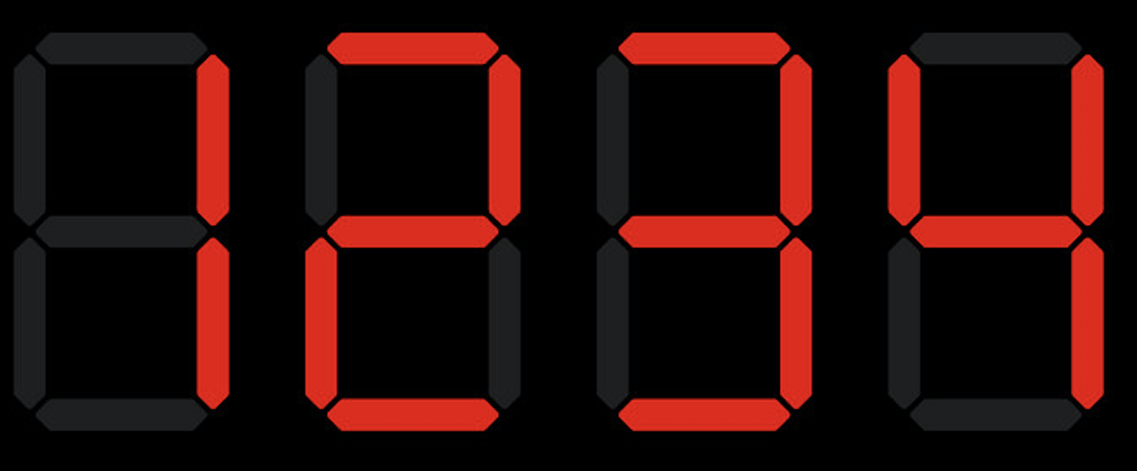
Lamport’s Bakery Algorithm - 1974
1
2
3
4
5
n
0
0
0
0
0
0
0
Remainder
0
0
1
3
2
Take a number
4
entry
Wait your turn
1
2
3
2
4
Critical
1
2
time
exit
1
2

Slide 13
Not quite…
1
2
3
4
5
n
0
0
Remainder
0
0
0
0
0
Take a number
1
2
2
entry
Wait your turn
1
2
2
Critical
1
2
2
time
exit
1

Slide 14
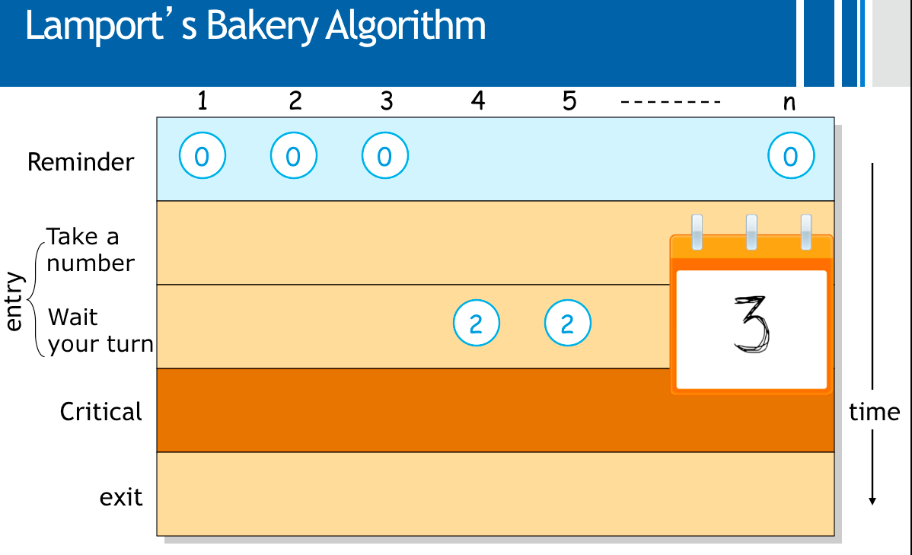
Implementation 1
Remainder
number[i] = 1+max_{j∈ {1,…,n}}{number[j]};
for j=1 to n {
while(i≠j and number[j]>0 and number[j]<number[i]);
}
No mutual exclusion
Critical
number[i]=0;
Code for Thread i (out of n threads)

Slide 15
Implementation 1.1
Remainder
number[i] = 1+max_{j∈ {1,…,n}}{number[j]};
for j=1 to n {
while(i≠j and number[j]>0 and number[j]<=number[i]);
}
Deadlock!
Critical
number[i]=0;
Code for Thread i (out of n threads)

Slide 16
Implementation 2
Remainder
Read all values
Compute maximum
Store value
number[i] = 1+max_{j∈ {1,…,n}}{number[j]};
for j=1 to n {
while(i≠j and number[j]>0 and (number[j],j)<(number[i],i));
}
Critical
Lexicographic order
number[i]=0;
Code for Thread i (out of n threads)

Slide 17
Bakery Algorithm – Implementation 2
1
2
3
4
5
n
0
0
0
0
0
0
Remainder
0
0
0
0
Take a number
0
2
0
entry
2
2
time
Wait your turn
2
Computes number: 2 but still doesn’t write to memory.
2
Critical
2
2
exit

Slide 18
Correct Implementation (1974)
Remainder
Choosing[i]=true;
Number[i] = 1+max_{j∈ {1,…,n}}{number[j]};
Choosing[i]=false;
for j=1 to n {
while(Choosing[j]);
while(i≠j and number[j]>0 and (number[j],j)<(number[i],i));
}
Critical
number[i]=0;
Also ensures a notion of First-In-First-Out:
If a process i is waiting (somewhere in the for loop) and thread j has not yet started the entry, then j will not enter the CS before i.
Code for Thread i (out of n threads)
Notes:
Also ensures a notion of FIFO: if process i is waiting and thread j has not yet started the entry, then j will not enter the CS before i.

Slide 19
Read-Modify-Write Instructions
Up until now we assume that read (load) and write (store) are atomic instructions
There might be a context switch between a read and its corresponding write
Modern CPUs support in hardware some RMW instructions:
Test&Set(&lock):
{i=*lock; *lock=1; return i;}
Fetch&Add(&p,inc):
{val=*p; *p=val+inc; return val}
Compare&Swap(&p,old,new):
{if(*p≠old) return false; *p=new; return true;}

Slide 20
Mutual Exclusion with Test&Set
Remainder
while(test&set(lock));
Critical
lock=0;
Code for Thread i
Not so fast: Starvation Freedom condition does not hold!

Slide 21
Burn’s Algorithm
Remainder
waiting[i]=true;
key[i]=1;
while(waiting[i] and key[i]) { key[i]=test&set(lock) };
waiting[i]=false;
Critical
j=i+1 mod n;
while(j≠i and not waiting[j]) {
j=j+1 mod n };
if(j≠i) { waiting[j]=false;}
else {lock=0;}
Code for Thread i out of n

Slide 22
Up until now…
We saw several solutions for the mutual exclusion problem in different settings
All the solutions perform busy-waiting:
Waste of CPU resources
Mutual exclusion is only one synchronization problem. There are many more
Contention → coordination
Some were and will be covered in the tutorials

Slide 23
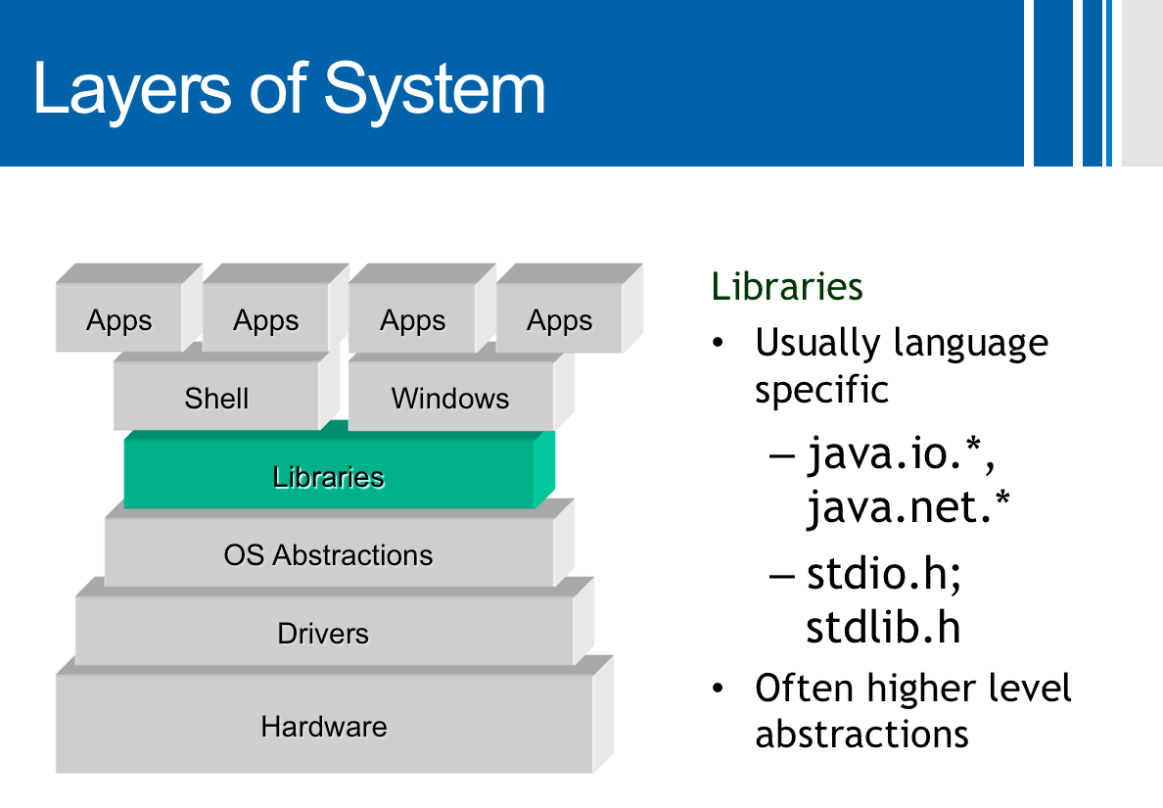
Next: Synchronization Primitives
We will define abstract data types used to provide synchronization
Clear interface to the data type
The data type (and its inner variables) cannot be accessed in any other way
Usually provide by the programming language with some support of the OS
The abstract data type may have many implementations

Slide 24

First Data Type: Semaphore
Record with two fields:
- value
List (L)
Two operations:
The operations are executed atomically
How? Implementation is orthogonal to the definition
In literature, the operations are often called P(s) and V(s).
In the book, wait(s), signal(s)
Some variations bound the maximum and minimum value (e.g., binary semaphores)
In literature, the operations are often called P(s) and V(s)
Down(S)
S.value= S.value - 1
if S.value < 0 then
{ add this thread to S.L;
sleep();}
Up(S)
S.value= S.value + 1
if S.value≤0 then
{remove a thread T from S.L; Wakeup(T);}
Init(S,v)
S.value= v

Slide 25
Mutual Exclusion w/ Semaphore
Remainder
Assume lock is a shared semaphore
Initially lock is 1
Value:
Cannot be more than 1
0: one process in Critical Section
(-x): x processes are waiting
All properties hold
If L is a FIFO queue
lock.value= lock.value - 1
if lock.value < 0 then
{ add this thread to S.L;
sleep();}
down(lock)
Critical
up(lock)
lock.value= lock.value + 1
If lock.value≤0 then
{remove a thread T from S.L; Wakeup(T);}
Code for Thread i
0/1 (binary) semaphore suffices → Binary semaphores data type are often called Mutex objects

Slide 26
“Execute B after A”
A different synchronization problem
Coordination rather than contention
One process needs to execute code A, before another process executes code B
….
….
down(flag)
A
B
Semaphore flag, initialized to 0
up(flag)
….
….
Process 1
Process 2

Slide 27
Semaphores are not Silver Bullets
Although it is much easier to work with semaphore than read/write operations, it is still possible to cause problems (e.g., deadlocks, starvation, incorrectness)
Thread 1 moves money from account A to B, Thread 2 moved money from B, A

Slide 28
Semaphores are not Silver Bullets
Although it is much easier to work with semaphore than read/write operations, it is still possible to cause problems (e.g., deadlocks, starvation, incorrectness)
Thread 1 moves money from account A to B, Thread 2 moved money from B, A
….
….
Deadlock!
down(SA)
down(SB)
down(SB)
down(SA)
Move A→B
Move B→A
Semaphore SA, initialized to 1
Semaphore SB, initialized to 1
up(SA)
….
up(SB)
….
up(SB)
up(SA)
Thread 1
Thread 2

Slide 29
Semaphores are not Silver Bullets
Although it is much easier to work with semaphore than read/write operations, it is still possible to cause problems (e.g., deadlocks, starvation, incorrectness)
Thread 1 moves money from account A to B, Thread 2 moved money from B, A
….
….
down(SA)
down(SA)
down(SB)
down(SB)
Move A→B
Move B→A
Semaphore SA, initialized to 1
Semaphore SB, initialized to 1
up(SB)
….
up(SB)
….
up(SA)
up(SA)
Thread 1
Thread 2

