Slide 1
Operating Systems
David Hay

Slide 2


Semaphores
Record with two fields:
- value
List (L)
Two operations:
The operations are executed atomically
How? Implementation is orthogonal to the definition
Down(S)
S.value= S.value - 1
if S.value < 0 then
{ add this thread to S.L;
sleep();}
Up(S)
S.value= S.value + 1
if S.value≤0 then
{remove a thread T from S.L; Wakeup(T);}
Init(S,v)
S.value= v

Slide 3
Two problems easily solved by semaphores
Mutual Exclusion:
Execute B after A:
Remainder
….
….
down(lock)
down(flag)
A
B
Critical
up(flag)
….
….
up(lock)
Code for Thread i
Code for Thread 0
Code for Thread 1
lock is a shared semaphore, initially 1
Starvation freedom holds only if L is FIFO queue סמפור הוגן
flag is a shared semaphore, initially 0

Slide 4
Another Problem: Moving Money Between Accounts
Thread 1 transfers money from account A to B, Thread 2 transfers money from B to AIf executed simultaneously, some errors might occur (e.g., Thread 1 executes A--, while Thread 2 executes A++)
….
….
down(lock)
down(lock)
Move A→B
Move B→A
Semaphore lock, initialized to 1
Mutual exclusion, where the Move is the critical section
up(lock)
….
up(lock)
….
Thread 1
4
Thread 2

Slide 5
Another Problem: Moving Money Between Accounts
Three Threads
Solution 1: mutual exclusion
But why Thread 1 and Thread 3 cannot be executed concurrently?
….
….
….
down(lock)
down(lock)
down(lock)
Move A→B
Move B→C
Move C→D
up(lock)
….
up(lock)
….
….
up(lock)
Thread 1
Thread 2
Thread 3
5

Slide 6
Another Problem: Moving Money Between Accounts
Solution 2: Lock each account separately
Semaphore for each account: SA, SB, SC, SD. All initialized to 1.
SA: 1 SB: 1 SC: 1 SD: 1
0
0
0
0
….
….
….
down(SA)
down(SB)
down(SC)
down(SB)
down(SC)
down(SD)
Move A→B
Move B→C
Move C→D
up(SA)
….
up(SB)
….
….
up(SC)
up(SB)
up(SC)
up(SD)
Thread 1
Thread 2
waiting on SB
Thread 3
6

Slide 7
Semaphores are not Silver Bullets
Although it is much easier to work with semaphores than read/write operations, it is still possible to cause problems (e.g., deadlocks, starvation, incorrectness)
SA: 1 SB: 1 SC: 1 SD: 1
0
0
0
0
….
Deadlock!
….
….
….
down(SA)
down(SB)
down(SC)
down(SD)
down(SB)
down(SC)
down(SD)
down(SA)
Move A→B
Move B→C
Move C→D
Move D→A
up(SA)
up(SB)
….
….
….
up(SC)
….
up(SD)
up(SB)
up(SC)
up(SD)
up(SA)
waits SA
waits SB
waits SD
Thread 4
Thread 1
Thread 2
Thread 3
waits SC

Slide 8
Semaphores are not Silver Bullets
This specific deadlock scenario can happen also with two threads…
….
….
down(SA)
down(SB)
down(SB)
down(SA)
Move A→B
Move B→A
Semaphore SA, initialized to 1
Semaphore SB, initialized to 1
up(SA)
….
up(SB)
….
up(SB)
up(SA)
Thread 1
Thread 2

Slide 9
Semaphores are not Silver Bullets
Solution: down(SA) always before down(SB)
….
….
down(SA)
down(SA)
down(SB)
down(SB)
Move A→B
Move B→A
Semaphore SA, initialized to 1
Semaphore SB, initialized to 1
up(SB)
….
up(SB)
….
up(SA)
up(SA)
Thread 1
Thread 2

Slide 10
Dining Philosophers
Philosophers spend their life alternating between eating and thinking
Eating requires 2 chopsticks:
take chopsticks
eat
put chopsticks
think
Problem setting:
Philosophers sit in the circle, chopsticks between them
Pick one adjacent chopstick at a time
Two philosophers cannot hold a chopstick together.

Slide 11
Code that reaches a deadlock
P0
down(chopstick[(i+1)mode 6])
P5
down(chopstick[(i])
P1
Eat
c[0]
c[1]
up(chopstick[(i+1)mode 6])
up(chopstick[(i])
Think
c[5]
c[2]
Code for philosopher i
c[4]
c[3]
P4
P2
chopstick[0]…chopstick[5] are shared semaphores, all initialized to 1
P3

Slide 12
Code that reaches a deadlock
P0
down(chopstick[(i+1)mode 6])
P5
down(chopstick[(i])
P1
Eat
c[0]
c[1]
up(chopstick[(i+1)mode 6])
up(chopstick[(i])
c[5]
Think
Deadlock!
c[2]
Code for philosopher i
c[4]
c[3]
P4
P2
( means “first chopstick taken”)
( means “waiting for this chopstick”)
P3

Slide 13
One More Setting
Same code for philosophers 0,…,4
(left before right)
P0
down(chopstick[(i+1)mod 6])
P5
down(chopstick[(i])
Eat
P1
up(chopstick[(i+1)mod 6])
up(chopstick[i])
Think
down(chopstick[5])
down(chopstick[0])
Eat
P4
P2
Code for philosopher 5 (right before left)
up(chopstick[0])
up(chopstick[5])
P3
Think
Notes:
שולחן נשיאותי, 5 מת, 5 הפוך, מה בעצם קורה כאן – דדלוק.
מקביליות.

Slide 14
Progress
If a philosopher tries to take a chopstick, then eventually some philosopher will eat.
Assume philosopher i tries to take a chopstick but no philosopher will be eating → no philosopher was able to grab the second chopstick.
down(chopstick[(i+1)mod 6])
down(chopstick[(i])
Eat
up(chopstick[(i+1)mod 6])
up(chopstick[i])
Think
down(chopstick[5])
down(chopstick[0])
Eat
up(chopstick[0])
up(chopstick[5])
Think

Slide 15
Progress
i is either 0,1,2, or 3
i tries to takes the chopstick i+1, but does not succeed → philosopher i+1 took chopstick i+1(its second one) → Contradiction.
i took chopstick i+1 and wait for chopstick i → philosopher i-1 took chopstick i and wait for i-1 → … → philosopher 0 took 1 and wait for 0 → philosopher 5 took 0 → philosopher 5 will eat
down(chopstick[(i+1)mod 6])
down(chopstick[(i])
Eat
up(chopstick[(i+1)mod 6])
up(chopstick[i])
Think
down(chopstick[5])
down(chopstick[0])
Eat
up(chopstick[0])
up(chopstick[5])
Think

Slide 16
Progress
i = 4
Philosopher 4 tries to takes the chopstick 5, but does not succeed → philosopher 5 took chopstick 5 and wait for 0 → philosopher 0 took chopstick 0 (his second one). Contradiction.
i took chopstick i+1 and wait for chopstick i → philosopher i-1 took chopstick i and wait for i-1 → … → philosopher 0 took 1 and wait for 0 → philosopher 5 took 0 → philosopher 5 will eat
down(chopstick[(i+1)mod 6])
down(chopstick[(i])
Eat
up(chopstick[(i+1)mod 6])
up(chopstick[i])
Think
down(chopstick[5])
down(chopstick[0])
Eat
up(chopstick[0])
up(chopstick[5])
Think

Slide 17
Progress
i = 4
Philosopher 4 tries to takes the chopstick 5, but does not succeed → philosopher 5 took chopstick 5 and wait for 0 → philosopher 0 took chopstick 0 (his second one). Contradiction.
i took chopstick i+1 and wait for chopstick i → philosopher i-1 took chopstick i and wait for i-1 → … → philosopher 0 took 1 and wait for 0 → philosopher 5 took 0 → philosopher 5 will eat
down(chopstick[(i+1)mod 6])
down(chopstick[(i])
Eat
up(chopstick[(i+1)mod 6])
up(chopstick[i])
Think
down(chopstick[5])
down(chopstick[0])
Eat
up(chopstick[0])
up(chopstick[5])
Think

Slide 18
Progress
i = 5
Philosopher 5 tries to takes the chopstick 0, but does not succeed → philosopher 0 took chopstick 0 (his second one). Contradiction.
Philosopher 5 tries to takes the chopstick 5, but does not succeed → philosopher 4 took chopstick 5 and wait for 4 → … → philosopher 0 took chopstick 1 and waits for 0, but 0 cannot be taken as philosopher 5 still waits on chopstick 5 → philosopher 0 will grab chopstick 0. Contradiction.
down(chopstick[(i+1)mod 6])
down(chopstick[(i])
Eat
up(chopstick[(i+1)mod 6])
up(chopstick[i])
Think
down(chopstick[5])
down(chopstick[0])
Eat
up(chopstick[0])
up(chopstick[5])
Think

Slide 19
(Necessary) Conditions for Deadlock (Coffman Conditions)
Mutual Exclusion
At least one resource must be held in a non-shareable mode
Hold and Wait
A thread is holding one resource and is requesting a resource that is held by another thread
Non-Preemptive Allocation
A resource can be released only voluntarily by the process holding it
Circular Wait
Thread holds a resource
Thread waits for a resource

Slide 20
Dinning Philosophers’ Circular Wait
5
4
0
0
1
4
3
5
1
3
5
5
2
2
2
4
2
1
1
4
3
3
0
0

Slide 21
Better Solution: Breaking Symmetry (a.k.a. the LR solution)
Odd threads
Even threads
down(chopstick[(i+1)mode 6])
down(chopstick[(i+1)mod 6])
down(chopstick[(i])
down(chopstick[(i])
down(chopstick[(i])
down(chopstick[(i+1)mod 6])
Eat
Eat
up(chopstick[(i+1)mod 6])
up(chopstick[(i+1)mod 6])
up(chopstick[(i])
up(chopstick[(i])
Think
Think
Provides better concurrency (2 philosophers can always eat concurrently, instead of just one)

Slide 22
Final word about deadlocks
Usually, cannot be detected by the OS
Do not happen in every execution
Very tricky bug!
Good practice:
Order the resources
Always lock the resources in the same order
E.g. from high to low
Release resources in reverse order

Slide 23
The Philosophers in the Kibbutz
If Semaphore chopsticks is initialized to 6, does the solution provide:
Progress | Starvation Freedom
down(chopsticks)
a
✗
✗
down(chopsticks)
Eat
b
✗
✓
up(chopsticks)
✓
✗
up(chopsticks)
c
Think
d
✓
✓

Slide 24
The Philosophers in the Kibbutz
If Semaphore chopsticks is initialized to 6, gate is initialized to 3, chopsticks is fair and we don’t have info how the wait queue in gate is implemented.
Does the solution provide:
Progress | Starvation Freedom
down(gate)
a
✗
✗
down(chopsticks)
down(chopsticks)
✗
✓
up(gate)
b
Eat
up(chopsticks)
c
✓
✗
up(chopsticks)
Think
d
✓
✓

Slide 25
The Philosophers in the Kibbutz
If Semaphore chopsticks is initialized to 6, gate is initialized to 5, chopsticks is fair and we don’t have info how the wait queue in gate is implemented. Does the solution provide:
Progress | Starvation Freedom
down(gate)
a
✗
✗
down(chopsticks)
down(chopsticks)
✗
✓
up(gate)
b
Eat
up(chopsticks)
c
✓
✗
up(chopsticks)
Think
d
✓
✓

Slide 26
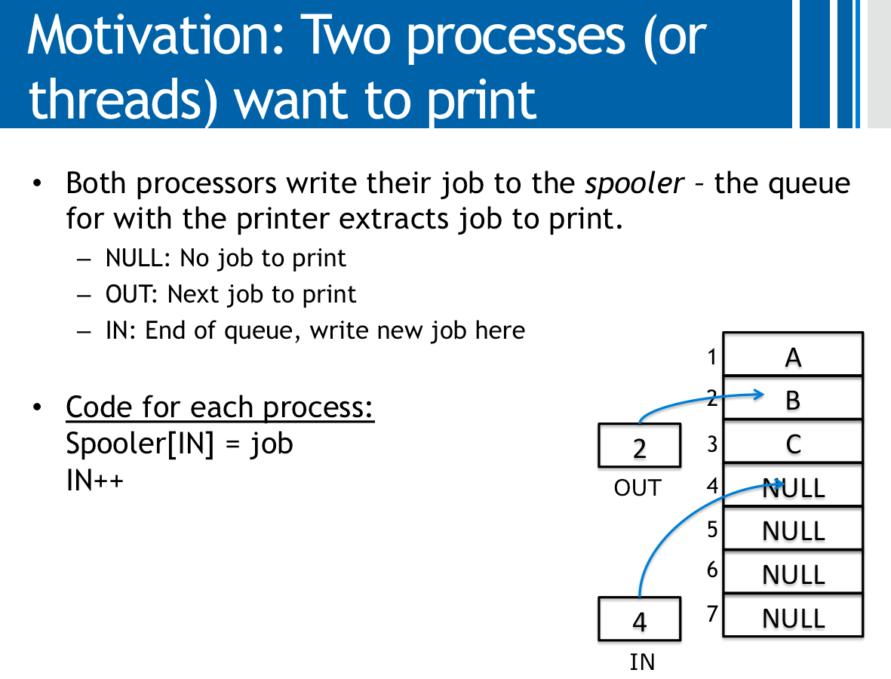
Next Problem: Producer-Consumer
We already saw that half of the problem:
A contention between two printing processes (producers) on the IN
counter can lead to overriding jobs and gaps in the array (buffer)
Problems also arise in a single-producer single-consumer setting
Similar situations can
happen on the OUT variables in case there is more than one printer process (consumers)
In case the buffer is of bounded size, how it is managed (cyclic operation) and how empty/full buffers are handled.

Slide 27
Cyclic Buffers
0
A
0
A
0
A
1
B
1
B
1
B
1
2
C
1
2
C
1
2
C
OUT
3
NULL
OUT
3
D
OUT
3
D
4
NULL
4
E
4
E
5
NULL
5
F
5
F
4
6
NULL
7
6
NULL
0
6
G
IN
IN
IN

Slide 28
Cyclic Buffers
H
0
A
0
0
H
B
1
B
1
1
B
C
1
C
1
2
2
1
2
C
D
3
D
OUT
3
OUT
OUT
3
D
E
4
E
4
4
E
5
F
5
F
5
F
G
6
G
1
6
0
1
6
G
IN
IN
IN
Buffer is full
Buffer is empty

Slide 29
Single Producer - Single Consumer Code
Producer (e.g., sending printing job)
Consumer (e.g., printer)
while ((IN+1 mod n)==OUT);
buffer [IN]=job;
IN=IN+1 mod n;
while (IN==OUT);
job=buffer [OUT];
OUT=OUT+1 mod n;
Buffer is full, wait until a job is consumed
Buffer is empty, wait until a job is produced

Slide 30
Cyclic Buffers
7
0
COUNT
0
H
COUNT
0
H
1
B
1
B
1
2
C
1
2
C
OUT
3
D
OUT
3
D
4
E
4
E
5
F
5
F
1
6
G
1
6
G
IN
IN
Buffer is full
Buffer is empty

Slide 31
Single Producer- Single Consumer Code
Producer (e.g., sending printing job)
Consumer (e.g., printer)
while (COUNT==n);
buffer [IN]=job;
IN=IN+1 mod n;
COUNT++;
while (COUNT==0);
job=buffer [OUT];
OUT=OUT+1 mod n;
COUNT--;
Must be atomic

Slide 32
Alternative Solution: Producers-Consumers w/ Semaphores
Producer (e.g., sending printing job)
Consumer (e.g., printer)
down(empty)
down(mutex)
buffer [IN]=job;
IN=IN+1 mod n;
COUNT++;
up(mutex)
up(full)
down(full)
down(mutex)
job=buffer [OUT];
OUT=OUT+1 mod n;
COUNT--;
up(mutex)
up(empty)
Initial values:
mutex | 1
empty | n
full | 0
Notes:
What happened if we do in the consumer: down(mutex), down(isEmpty)?

Slide 33
One More Approach: Monitors
A monitor is a programming language construct that supports controlled access to shared data
synchronization code is added by the compiler
why does this help?
A monitor encapsulates:
shared data structures
procedures that operate on the shared data
synchronization between concurrent threads that invoke those procedures
Data can only be accessed from within the monitor, using the provided procedures
protects the data from unstructured access
Addresses the key usability issues that arise with semaphores

Slide 34
A monitor
shared data
waiting queue of threads trying to enter the monitor
at most one thread in monitor at a time
operations (methods)

Slide 35
Monitor facilities
“Automatic” mutual exclusion
only one thread can be executing inside at any time
thus, synchronization is implicitly associated with the monitor – it “comes for free”
if a second thread tries to execute a monitor procedure, it blocks until the first has left the monitor
more restrictive than semaphores
but easier to use (most of the time)
But, there is a problem…

Slide 36
Producers/Consumers Monitor
COUNT
0
H
1
B
1
2
C
OUT
3
D
4
E
5
F
1
6
G
JAVA: The methods need to be defined as synchrnoized
IN
Produce()
Consume()

Slide 37
Producers/Consumers Monitor
0
COUNT
0
H
1
B
1
2
C
OUT
3
D
4
E
P
P
C
C
5
F
1
6
G
IN
Produce()
Consume()

Slide 38
Producers/Consumers Monitor
0
COUNT
0
H
1
B
1
2
C
OUT
3
D
4
E
P
P
C
5
F
Monitor allows only one thread at a time → Producers are blocked
COUNT==0 → Consumer is blocked
1
6
G
IN
Produce()
Consume()

Slide 39
Condition variables (a.k.a. Rendezvous Points)
“A place to wait”
“Required” for monitors
So useful they’re often provided even when monitors aren’t available
Three operations on condition variables
wait(c) – java: c.wait()
release monitor lock, so somebody else can get in
wait for somebody else to signal condition
thus, condition variables have associated wait queues
signal(c) – java: c.notify()
wake up at most one waiting thread
if no waiting threads, signal is lost
this is different than semaphores: no history!
broadcast(c) – java: c.NofityAll()
wake up all waiting threads
Notes:
Hoare monitor: Signal immediately wakes up a waiter. Mesa Monitor: Signal only put a waiter in ready queue. Still complete the monitor and then someone is ready to leave

Slide 40
Producers/Consumers Monitor
1
0
C
Not_Empty
COUNT
0
H
Not_Full
1
B
1
2
C
OUT
3
D
4
E
P
P
5
F
Singal(not_empty)
1
6
G
Wait(not_empty)
IN
Produce()
C
Consume()

Slide 41
Pseudo-Code with one condition variable
Public class buffer
public synchronized char consume()
{
while (COUNT== 0)
wait();
ch = store[OUT]; OUT=(OUT+1)%BufferSize;
COUNT--;
notifyAll();
return ch;
}
public synchronized void produce(char ch)
{
while (COUNT == BufferSize)
wait();
store[IN] = ch;
IN=(IN+1)%BufferSize;
COUNT++;
notifyAll();
}

Slide 42
Shared Memory vs. Message Passing Models
In the course we assume two threads or two processes are communicating through shared resources – mostly shared memory
Another way to communicate: send and receive messages
Similar problems arise, but the solutions are quite different
More about it in the “Distributed Algorithms” course

