Slide 1
Mohammadmahdi
Ghahramanibozandan
2041608
Knowledge Representation and Learning Project
Porf. Luciano Serafini
University of Padova

Slide 2
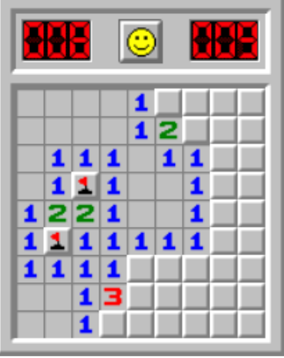
Introduction
Minesweeper is a game where mines are hidden
in a grid of squares. The objective is to discover all
the mines by opening the cells. At each iteration
you have to open a cell if the cell contains a mine
you have lost, otherwise you will discover the
number of mines in the surrounding cells, which
can be used to decide the next cell to be opened.

Slide 3
The Problem to be Solved
Encode any game state in a set of formulas S and use a SAT to decide for every cell i, j if:
i, j is safe i.e., S |= ¬mine ij
i, j is unsafe i.e., S |= mine ij
If you cannot decide if i, j is safe or not.
And then select the best safe cell and generate the next configuration.

Slide 4
Project Taxonomy
Part1: Logic Implementation
In this part, the variables are defined and the game axioms are implemented using Minisat22 from the solver module of pysat. The result is tested on a real test case.
Part2: Automatic Playing
Since automatic playing requires to access to the game, in this part the game environment is simulated and then we make the playing automatic.
Part3: Scalability Testing
In this part, the whole steps are put in a function and by changing the size of the game, we check the scalability of the game.

Slide 5
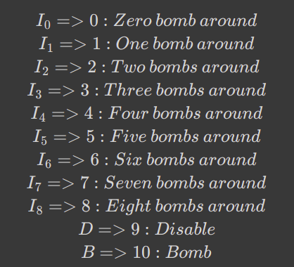
Part 1: Logic Implementation
- Define Binary Variables: For each cell,
there are 11 possible states to take. Note
that in order to encode the game easier,
two extra rows and two extra columns are
considered whose status are Disable and
they are unchangeable during the game.
The reason is that it makes the coding for
edge cells easier.

Slide 6
Part1: Logic Implementation
- Number of Variables: We define the game size as the number of rows, or the number of columns, of the game. If the size of the game is n, then we have (n+2)*(n+2) cells in our table. To understand it better, note that we considered extra rows and columns in the previous definition. Now, since each cell can take 11 possible states, overally, the number of variables are 11*(n+2)*(n+2). In the first part, in which our aim is just to check the correctness of the implementation, we set n=8 and consequently we have 1100 binary variables.

Slide 7
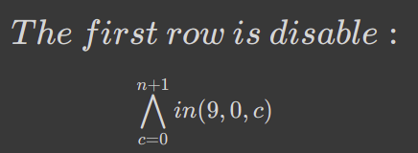
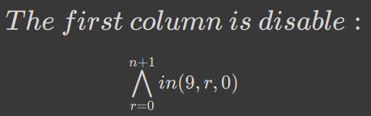
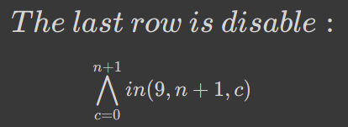
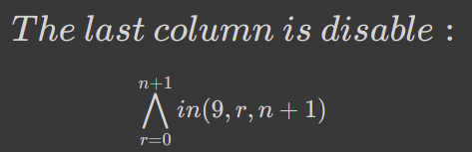
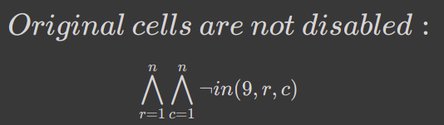
Part1: Logic Implementation
- Axioms:

Slide 8
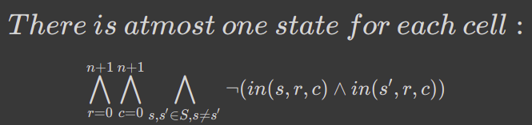
Part1: Logic Implementation
To make the implantation capable of assigning “Unknown” status for those cells which are not yet surely safe or unsafe, we consider this axiom. Actually, we do not force each cell to have one state. However, they cannot take more than one values at the time.

Slide 9
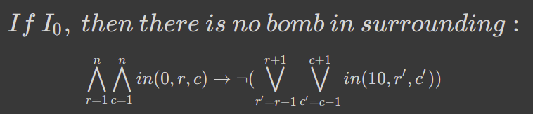
Part1: Logic Implementation
If a cell’s status is I_0, then there must be no bomb in its surrounding (8 adjacent cells).

Slide 10
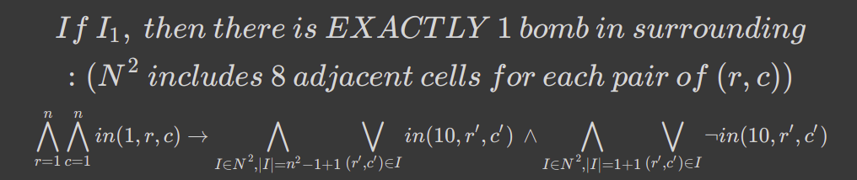
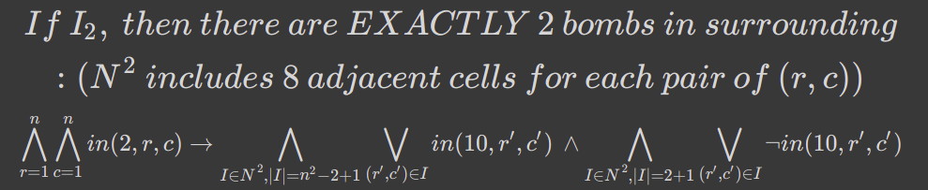
Part1: Logic Implementation

Slide 11
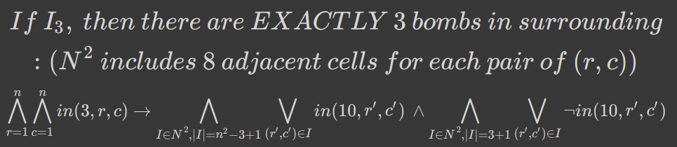
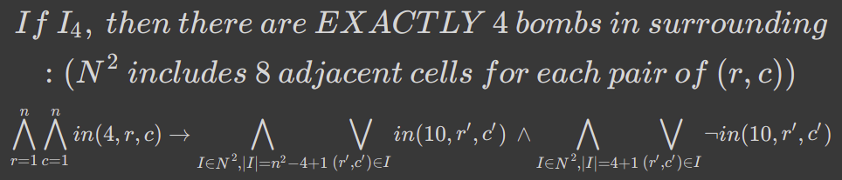
Part1: Logic Implementation

Slide 12
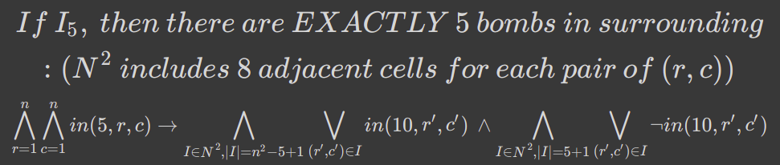
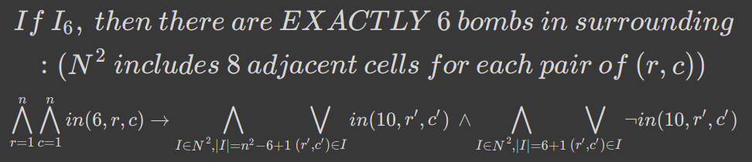
Part1: Logic Implementation

Slide 13
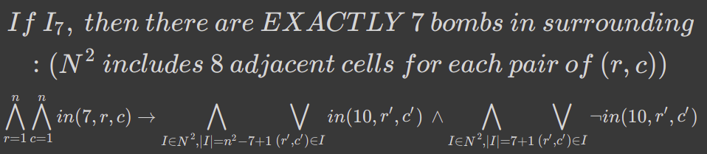
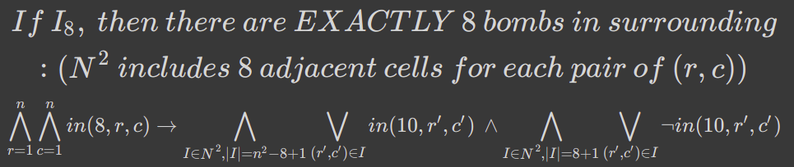
Part1: Logic Implementation

Slide 14
Part1: Logic Implementation
- How to assign “Safe”, “Bomb” and “Unknown” to cells?
Consider the previously written axioms and the game configuration as a
knowledge base(KB). Then for a given cell, i,j:
- If KB ^ Bomb(i,j) is UNSAT, then i,j is Safe.
- If KB ^ ¬Bomb(i,j) is UNSAT, then i,j is Bomb.
- If None of the above, then i,j is Unknown.

Slide 15
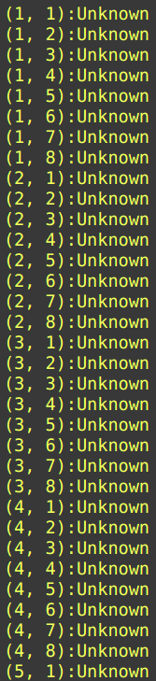
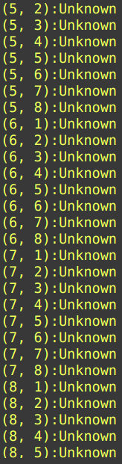
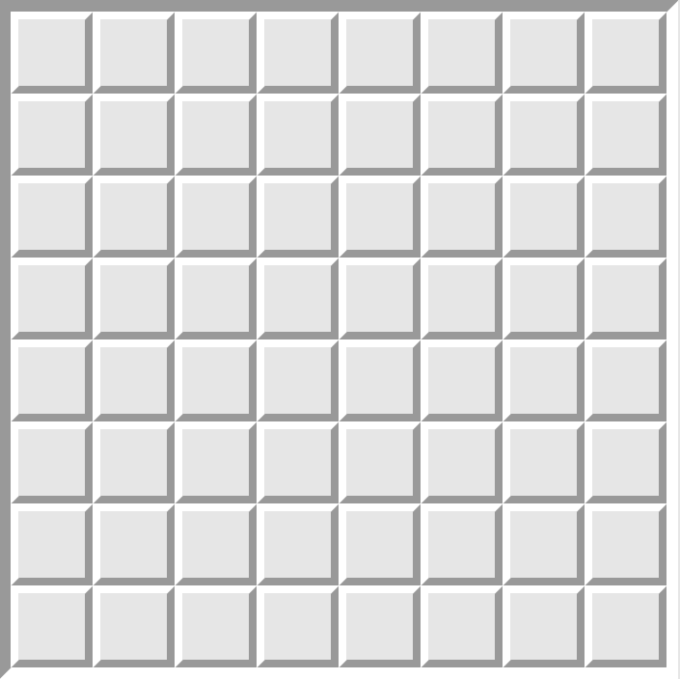
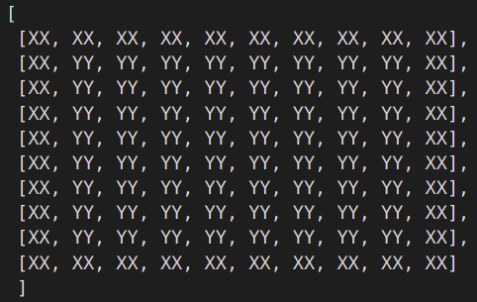
Part1: Logic Implementation
-Test on a real test case:

Slide 16
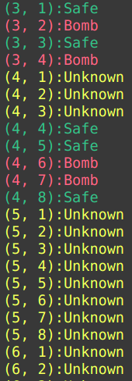
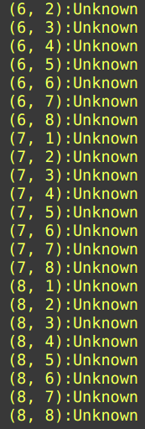
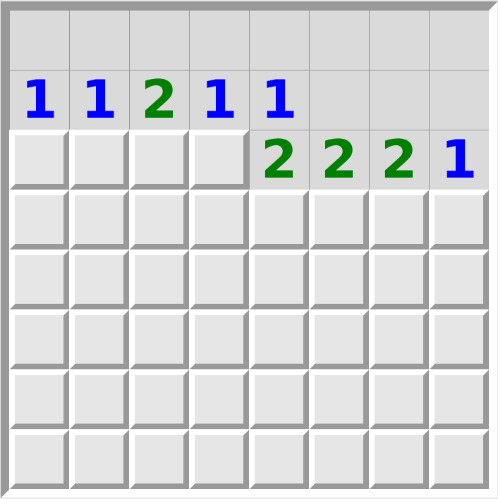
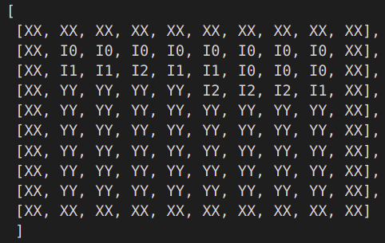
Part1: Logic Implementation
Let’s randomly choose the cell (1,1):

Slide 17
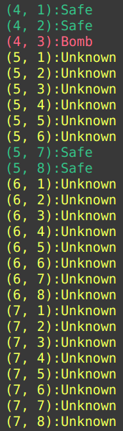
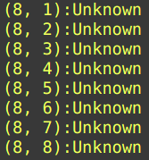
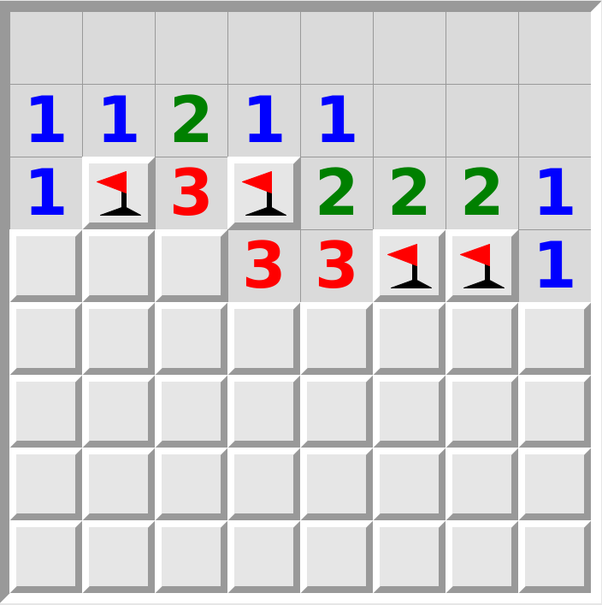
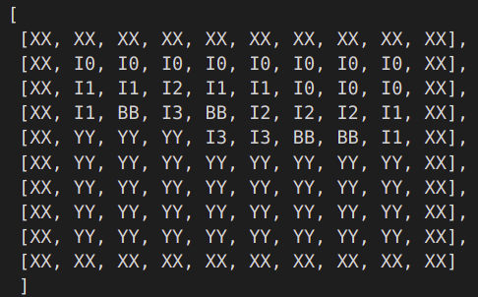
Part1: Logic Implementation
Flag the Bombs and select the Safe cells:

Slide 18
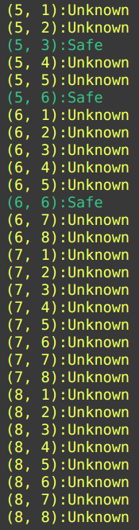
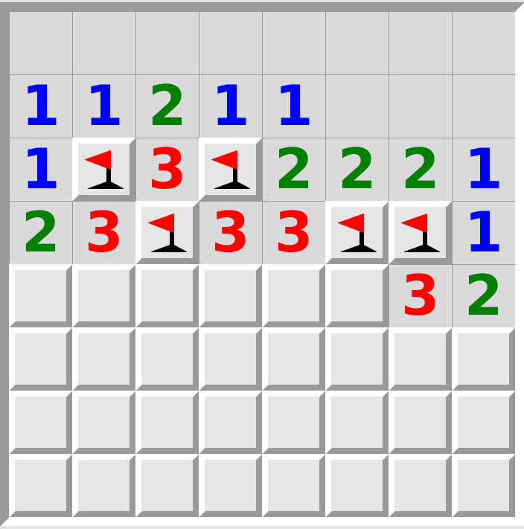
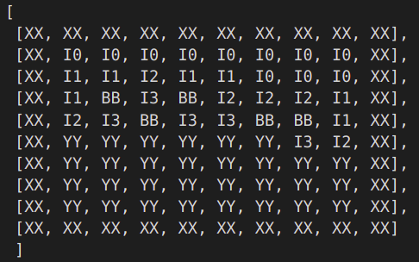
Part1: Logic Implementation
Flag the Bombs and select the Safe cells:

Slide 19
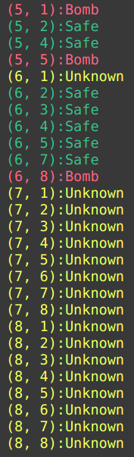
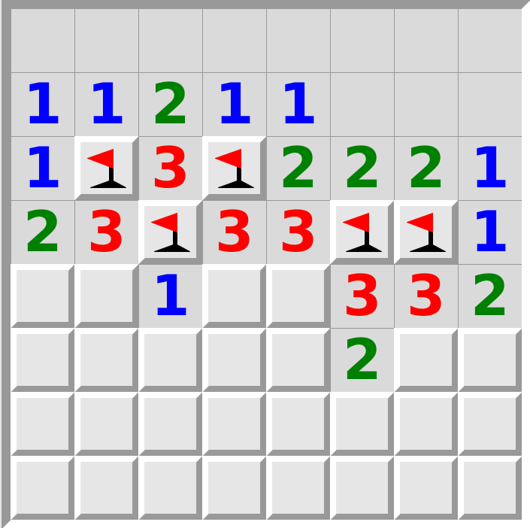
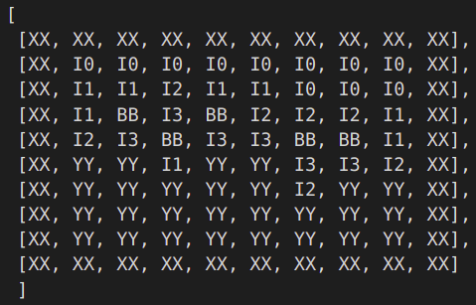
Part1: Logic Implementation
Flag the Bombs and select the Safe cells:

Slide 20
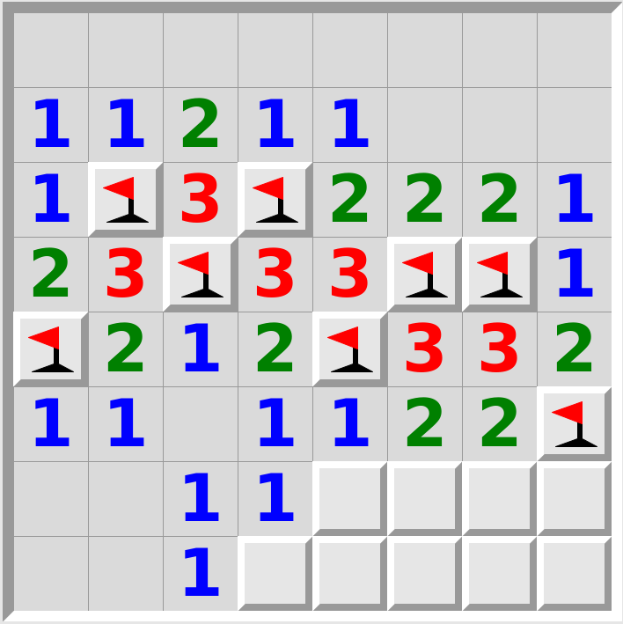
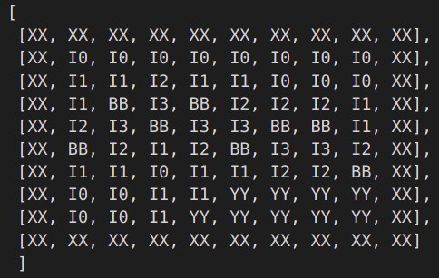
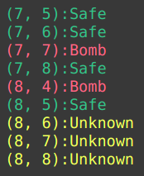
Part1: Logic Implementation
Flag the Bombs and select the Safe cells:

Slide 21
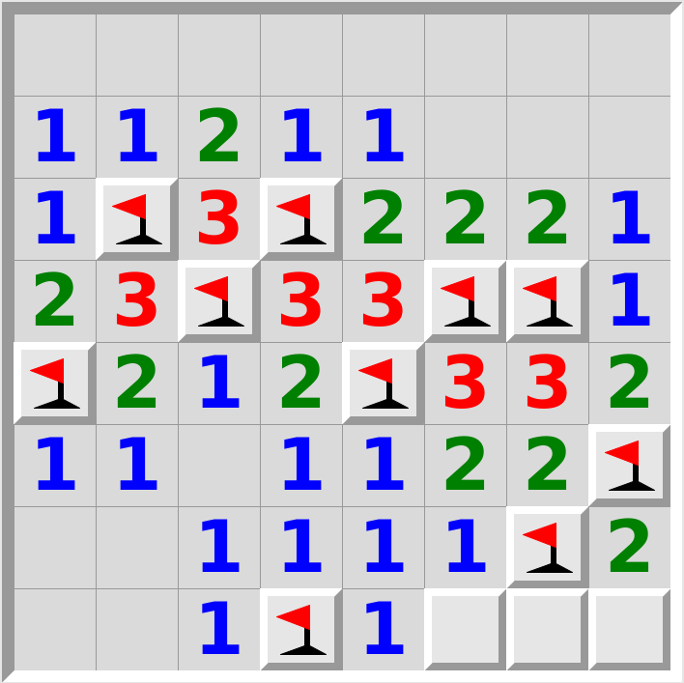
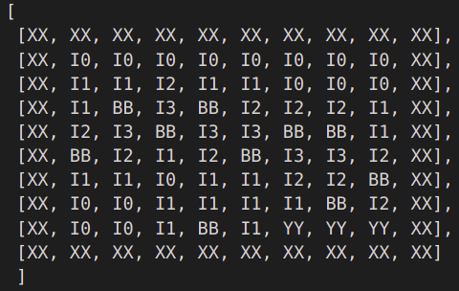

Part1: Logic Implementation
Flag the Bombs and select the Safe cells:

Slide 22
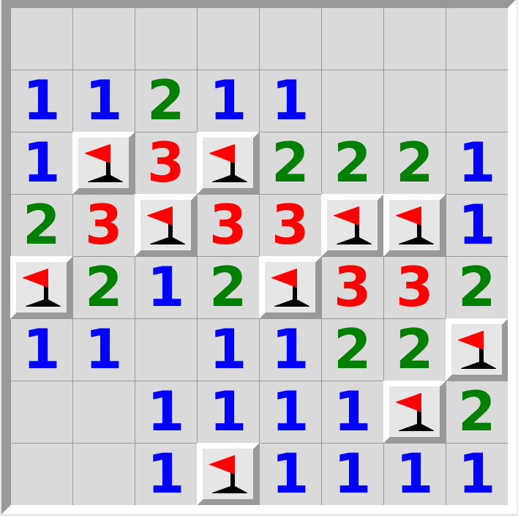
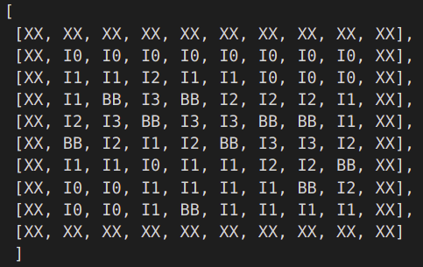

Part1: Logic Implementation
Flag the Bombs and select the Safe cells:

Slide 23
Part1: Logic Implementation
- Results:
The implementation is correct and it never makes mistake.
We may lose the game, since somewhere we need to make a random choice.
Updating the configuration manually is time-consuming.

Slide 24
Part2: Automatic Playing
We concluded that updating the game configuration manually is time-consuming and avoid us analysing the implementation. One would suggest to automatically flag bombs and select safe cells. However, it first requires to simulate the game environment. Using applications to play this game, the environment is semi-observable for us and we cannot make the game automatic. By game simulation we deal with this issue.

Slide 25
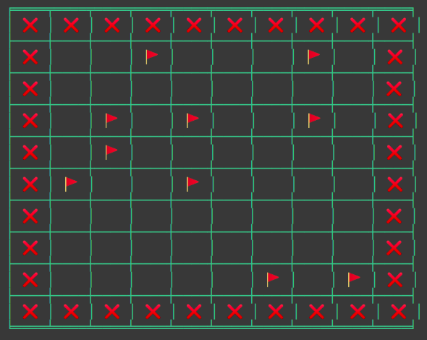
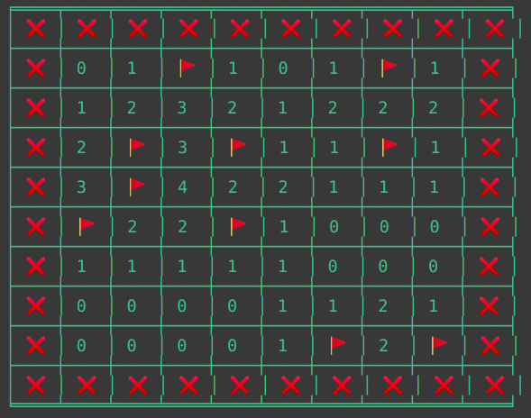
Part2: Automatic Playing
- Game Environment Simulation: We randomly distribute the specific number of bombs in the cells and then, accordingly assigne the real state to each cell. Then, we claim that this environment is our game and our implementation should reconstruct it from an empty configuration, using axioms and the current configuration of the game.

Slide 26
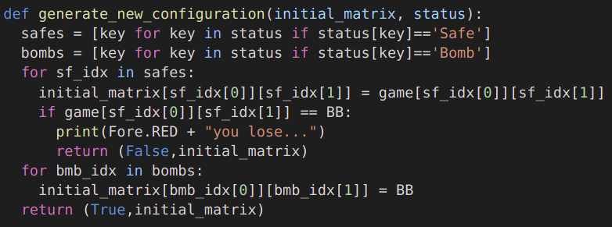
Part2: Automatic Playing
- Generate the Next Configuration: By flagging bombs and reveal the status of safe cells, we generate the next configuration of the game.

Slide 27
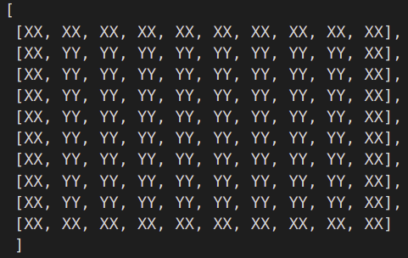
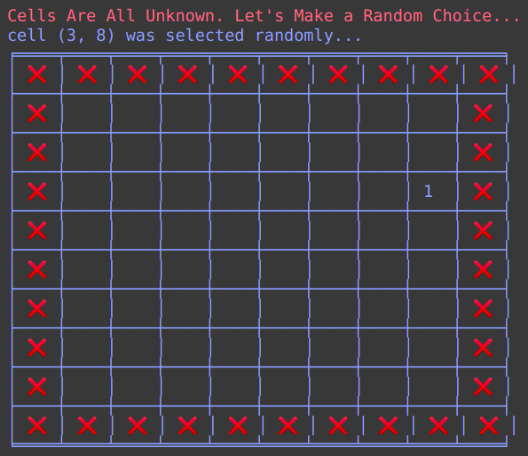
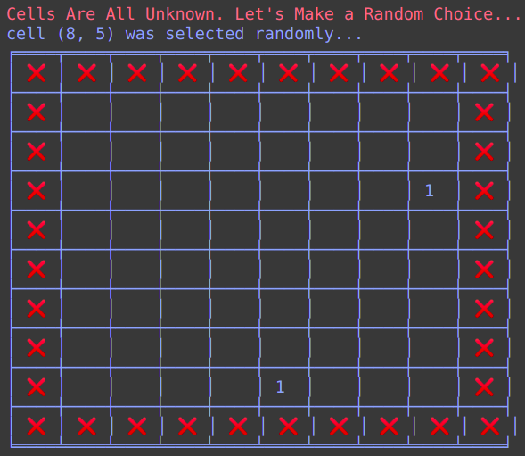
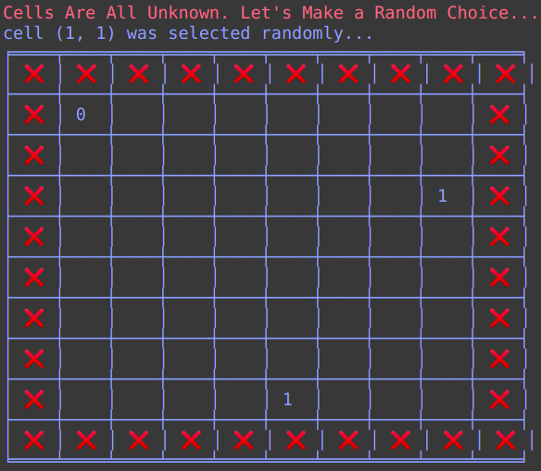
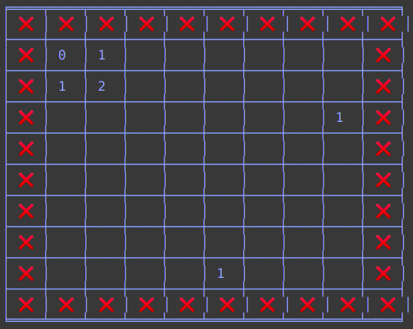



Part2: Automatic Playing

Slide 28






Part2: Automatic Playing

Slide 29



Part2: Automatic Playing

Slide 30


Part2: Automatic Playing
We then test the automatic playing on a real game. Below, you can see the one taken from an application and its solution obtained by our implementation. We skip showing the step-by-step changing and report only the final state obtained by our implementation:

Slide 31

Part3: Scalability Testing
In this part we put everything into a function and attempt
to call it on nine games which are different in size to test
the scalability of our implementation. The size of these
games are 4x4, 5x5, 6x6, 7x7, 8x8, 9x9, 10x10, 15x15, 20x20.
In the next slide, we will see the results for 15x15 and
20x20 games.

Slide 32


Part3: Scalability Testing

Slide 33


Part3: Scalability Testing
Here we plot the change in the number of clauses with respect to the game size:

Slide 34

Part3: Scalability Testing
According to the results, we can approximate the curve for the change in the number of clauses versus the game size:
It means that for a 100x100 game, we will have approximately 11 Million clauses. This amount of clauses would be handled easily by Pysat package and we can expand our game to such a dimension. The reason this project avoids testing the model on such a huge game environment is that Colab Notebook cannot visualize the result properly and there is no purpose of doing this.

Slide 35

Thank for your attention

