Slide 1
Network security course
Zeinab Movahedi

Slide 2
Course objectives
The art of war teaches us to rely not on the likelihood of the enemy's not coming, but on our own readiness to receive him; not on the chance of his not attacking, but rather on the fact that we have made our position unassailable.
—The Art of War, Sun Tzu

Slide 3
Course objectives
The combination of space, time, and strength that must be considered as the basic elements of this theory of defense makes this a fairly complicated matter. Consequently, it is not easy to find a fixed point of departure..
— On War, Carl Von Clausewitz

Slide 4
Course objectives
Cryptographic algorithms and protocols
Network and Internet security
Theoretical part
Practical part
Implementation of security attacks
Evaluations of impacts of security attacks
Notes:
This book focuses on two broad areas: cryptographic algorithms and protocols, which
have a broad range of applications; and network and Internet security, which rely
heavily on cryptographic techniques.

Slide 5
Course handbooks
English books
Cryptography and Network Security, Pearson, 7th edition, William Stallings
Network Security Essentials, Prentice Hall, 4th edition, William Stallings
منبع فارسی
امنیت داد‌ها‏، انتشارات نص، چاپ سوم
دکتر علی ذاکرحسینی، مهندس احسان ملکیان

Slide 6
Course Policies (approximated)
Quizzes (each 0. 5 pt)
2 unpredictable quizzes (1 before holidays and 1 after)
Midterm (each 2.5 pts)
Theoretical Midterm (10th of Ordibehesht)
Practical midterm (22th Ordibehesht)
Final exam (8 pts)
Only theoretical
Final seminar (2 pts)
Voice recorded slides
Oral presentation 15 minutes
Long-term evaluations (5 pts)
Attendance
Homework
Practical exercises

Slide 7

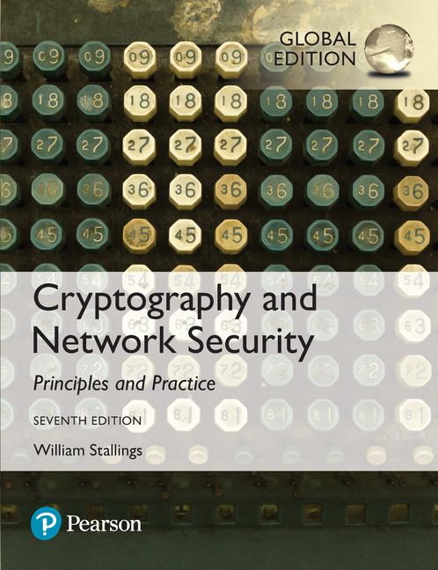
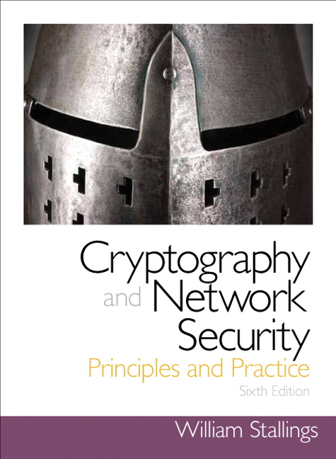
Seventh Edition, Global Edition
by William Stallings
Notes:
Lecture slides prepared for “Cryptography and Network Security”, 7/e, by William Stallings. Chapter 1, “Computer and Network Security Concepts”.

Slide 8
Chapter 1
Computer and Network Security Concepts

Slide 9
Cryptographic algorithms and protocols can be grouped into four main areas:
Symmetric encryption
Used to conceal the contents of blocks or streams of data of any size, including messages, files, encryption keys, and passwords
Asymmetric encryption
Used to conceal small blocks of data, such as encryption keys and hash function values, which are used in digital signatures
Data integrity algorithms
Used to protect blocks of data, such as messages, from alteration
Authentication protocols
Schemes based on the use of cryptographic algorithms designed to authenticate the identity of entities
Notes:
Cryptographic algorithms and protocols can be grouped into four main areas:
• Symmetric encryption: Used to conceal the contents of blocks or streams of
data of any size, including messages, files, encryption keys, and passwords.
• Asymmetric encryption: Used to conceal small blocks of data, such as encryption
keys and hash function values, which are used in digital signatures.
• Data integrity algorithms: Used to protect blocks of data, such as messages,
from alteration.
• Authentication protocols: These are schemes based on the use of cryptographic
algorithms designed to authenticate the identity of entities.

Slide 10
The field of network and Internet security consists of:
measures to deter, prevent, detect, and correct security violations that involve the transmission of information
Notes:
The field of network and Internet security consists of measures to deter, prevent,
detect, and correct security violations that involve the transmission of information.
That is a broad statement that covers a host of possibilities.

Slide 11
Examples of security violations
Example 1
User A transmits a file containing sensitive information (e.g., payroll records) to user B.
User C, who is not authorized to read the file, is able to monitor the transmission and capture a copy of the file during its transmission.

Slide 12
Examples of security violations
Example 2
A network manager, D, transmits a message to a computer, E, under its management to update an authorization file to include the identities of a number of new users who are to be given access to that computer.
User F intercepts the message, alters its contents to add or delete entries, and then forwards the message to computer E
Computer E accepts the message as coming from manager D and updates its authorization file accordingly.

Slide 13
Examples of security violations
Example 3
User F constructs its own message with the desired entries and transmits that message to computer E as if it had come from manager D.
Computer E accepts the message as coming from manager D and updates its authorization file accordingly.

Slide 14
Examples of security violations
Example 4
The personnel manager sends a message to a server system to invalidate a fired employee’s account.
The server is to post a notice to the employee’s file as confirmation of the action.
The employee intercepts the message and delays it long enough to make a final access to the server to retrieve sensitive information.
The message is then forwarded, the action taken, and the confirmation posted.

Slide 15
Examples of security violations
Example 5
A message is sent from a customer to a stockbroker with instructions for various transactions.
Subsequently, the investments lose value and the customer denies sending the message.

Slide 16
Computer Security
The NIST Computer Security Handbook defines the term computer security as:
“the protection afforded to an automated information system in order to attain the applicable objectives of preserving the integrity, availability and confidentiality of information system resources” (includes hardware, software, firmware, information/ data, and telecommunications)
Notes:
The NIST Computer Security Handbook [NIST95] defines the term computer security
as follows:
Computer Security: The protection afforded to an automated information system
in order to attain the applicable objectives of preserving the integrity, availability,
and confidentiality of information system resources (includes hardware, software,
firmware, information/data, and telecommunications).

Slide 17
Computer Security Objectives
Confidentiality
Data confidentiality
Assures that private or confidential information is not made available or disclosed to unauthorized individuals
Privacy
Assures that individuals control or influence what information related to them may be collected and stored and by whom and to whom that information may be disclosed
Integrity
Data integrity
Assures that information and programs are changed only in a specified and authorized manner
System integrity
Assures that a system performs its intended function in an unimpaired manner, free from deliberate or inadvertent unauthorized manipulation of the system
Availability
Assures that systems work promptly and service is not denied to authorized users
Notes:
This definition introduces three key objectives that are at the heart of computer
security:
• Confidentiality: This term covers two related concepts:
Data confidentiality: Assures that private or confidential information is
not made available or disclosed to unauthorized individuals.
Privacy: Assures that individuals control or influence what information
related to them may be collected and stored and by whom and to whom
that information may be disclosed.
•Integrity: This term covers two related concepts:
Data integrity: Assures that information and programs are changed only in
a specified and authorized manner.
System integrity: Assures that a system performs its intended function in
an unimpaired manner, free from deliberate or inadvertent unauthorized
manipulation of the system.
• Availability: Assures that systems work promptly and service is not denied to
authorized users.

Slide 18
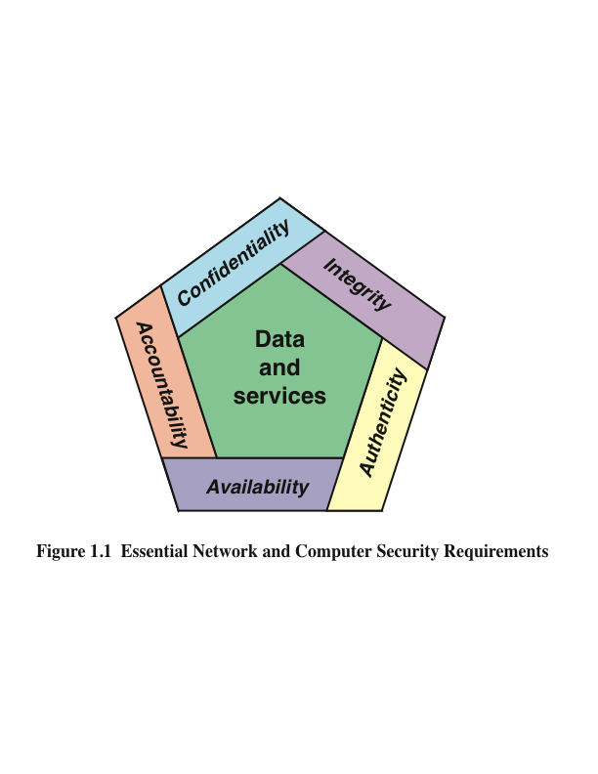
Notes:
These three concepts form what is often referred to as the CIA triad . The three
concepts embody the fundamental security objectives for both data and for information
and computing services. For example, the NIST standard FIPS 199 (Standards
for Security Categorization of Federal Information and Information Systems ) lists
confidentiality, integrity, and availability as the three security objectives for information
and for information systems. FIPS 199 provides a useful characterization of
these three objectives in terms of requirements and the definition of a loss of security
in each category:
• Confidentiality: Preserving authorized restrictions on information access
and disclosure, including means for protecting personal privacy and proprietary
information. A loss of confidentiality is the unauthorized disclosure of
information.
• Integrity: Guarding against improper information modification or destruction,
including ensuring information nonrepudiation and authenticity. A loss
of integrity is the unauthorized modification or destruction of information.
• Availability: Ensuring timely and reliable access to and use of information.
A loss of availability is the disruption of access to or use of information or an
information system.
Although the use of the CIA triad to define security objectives is well established,
some in the security field feel that additional concepts are needed to present
a complete picture. Two of the most commonly mentioned are as follows:
• Authenticity: The property of being genuine and being able to be verified and
trusted; confidence in the validity of a transmission, a message, or message
originator. This means verifying that users are who they say they are and that
each input arriving at the system came from a trusted source.
• Accountability: The security goal that generates the requirement for actions
of an entity to be traced uniquely to that entity. This supports nonrepudiation,
deterrence, fault isolation, intrusion detection and prevention, and after action
recovery and legal action. Because truly secure systems are not yet an
achievable goal, we must be able to trace a security breach to a responsible
party. Systems must keep records of their activities to permit later forensic
analysis to trace security breaches or to aid in transaction disputes.

Slide 19
Breach of Security Levels of Impact FIPS PUB 199
High
The loss could be expected to have a severe or catastrophic adverse effect on organizational operations, organizational assets, or individuals
Moderate
The loss could be expected to have a serious adverse effect on organizational operations, organizational assets, or individuals
Low
The loss could be expected to have a limited adverse effect on organizational operations, organizational assets, or individuals
Notes:
We use three levels of impact on organizations or
individuals should there be a breach of security (i.e., a loss of confidentiality, integrity,
or availability). These levels are defined in FIPS PUB 199:
• Low: The loss could be expected to have a limited adverse effect on organizational
operations, organizational assets, or individuals. A limited adverse
effect means that, for example, the loss of confidentiality, integrity, or availability
might (i) cause a degradation in mission capability to an extent and
duration that the organization is able to perform its primary functions, but the
effectiveness of the functions is noticeably reduced; (ii) result in minor damage
to organizational assets; (iii) result in minor financial loss; or (iv) result in
minor harm to individuals.
• Moderate: The loss could be expected to have a serious adverse effect on
organizational operations, organizational assets, or individuals. A serious
adverse effect means that, for example, the loss might (i) cause a significant
degradation in mission capability to an extent and duration that the
organization is able to perform its primary functions, but the effectiveness
of the functions is significantly reduced; (ii) result in significant damage to
organizational assets; (iii) result in significant financial loss; or (iv) result in
significant harm to individuals that does not involve loss of life or serious,
life-threatening injuries.
• High: The loss could be expected to have a severe or catastrophic adverse
effect on organizational operations, organizational assets, or individuals.
A severe or catastrophic adverse effect means that, for example, the loss might
(i) cause a severe degradation in or loss of mission capability to an extent and
duration that the organization is not able to perform one or more of its primary
functions; (ii) result in major damage to organizational assets; (iii) result
in major financial loss; or (iv) result in severe or catastrophic harm to individuals
involving loss of life or serious, life-threatening injuries.

Slide 20
Breach of Security Levels of Impact Examples
Confidentiality
Students grade (high)
Integrity
Hospital patient’s allergy information (high)
Availability
Authentication services for critical systems, applications, and devices (high)
A website offering a forum to discuss some specific topic (moderate)
Anonymous online poll (low)
Students enrollment information (moderate)
Public Web site for a university (moderate)
List of students (low)
Online telephone directory lookup application (low)
Notes:
This definition introduces three key objectives that are at the heart of computer
security:
• Confidentiality: This term covers two related concepts:
Data confidentiality: Assures that private or confidential information is
not made available or disclosed to unauthorized individuals.
Privacy: Assures that individuals control or influence what information
related to them may be collected and stored and by whom and to whom
that information may be disclosed.
•Integrity: This term covers two related concepts:
Data integrity: Assures that information and programs are changed only in
a specified and authorized manner.
System integrity: Assures that a system performs its intended function in
an unimpaired manner, free from deliberate or inadvertent unauthorized
manipulation of the system.
• Availability: Assures that systems work promptly and service is not denied to
authorized users.

Slide 21
Computer Security Challenges
Security is not simple
Potential attacks on the security features need to be considered
Procedures used to provide particular services are often counter-intuitive
It is necessary to decide where to use the various security mechanisms
Requires constant monitoring
Is too often an afterthought
Security mechanisms typically involve more than a particular algorithm or protocol
Security is essentially a battle of wits between a perpetrator and the designer
Little benefit from security investment is perceived until a security failure occurs
Strong security is often viewed as an impediment to efficient and user-friendly operation
Notes:
Computer and network security is both fascinating and complex. Some of the
reasons follow:
1. Security is not as simple as it might first appear to the novice. The requirements
seem to be straightforward; indeed, most of the major requirements
for security services can be given self-explanatory, one-word labels: confidentiality,
authentication, nonrepudiation, or integrity. But the mechanisms used
to meet those requirements can be quite complex, and understanding them
may involve rather subtle reasoning.
2. In developing a particular security mechanism or algorithm, one must always
consider potential attacks on those security features. In many cases, successful
attacks are designed by looking at the problem in a completely different way,
therefore exploiting an unexpected weakness in the mechanism.
3. Because of point 2, the procedures used to provide particular services are
often counterintuitive. Typically, a security mechanism is complex, and it is
not obvious from the statement of a particular requirement that such elaborate
measures are needed. It is only when the various aspects of the threat are
considered that elaborate security mechanisms make sense.
4. Having designed various security mechanisms, it is necessary to decide where
to use them. This is true both in terms of physical placement (e.g., at what points
in a network are certain security mechanisms needed) and in a logical sense
(e.g., at what layer or layers of an architecture such as TCP/IP [Transmission
Control Protocol/Internet Protocol] should mechanisms be placed).
5. Security mechanisms typically involve more than a particular algorithm or
protocol. They also require that participants be in possession of some secret
information (e.g., an encryption key), which raises questions about the creation,
distribution, and protection of that secret information. There also may
be a reliance on communications protocols whose behavior may complicate
the task of developing the security mechanism. For example, if the proper
functioning of the security mechanism requires setting time limits on the transit
time of a message from sender to receiver, then any protocol or network
that introduces variable, unpredictable delays may render such time limits
meaningless.
6. Computer and network security is essentially a battle of wits between a perpetrator
who tries to find holes and the designer or administrator who tries to
close them. The great advantage that the attacker has is that he or she need
only find a single weakness, while the designer must find and eliminate all
weaknesses to achieve perfect security.
7. There is a natural tendency on the part of users and system managers to perceive
little benefit from security investment until a security failure occurs.
8. Security requires regular, even constant, monitoring, and this is difficult in
today’s short-term, overloaded environment.
9. Security is still too often an afterthought to be incorporated into a system
after the design is complete rather than being an integral part of the design
process.
10. Many users and even security administrators view strong security as an impediment
to efficient and user-friendly operation of an information system or use of
information.

Slide 22
OSI Security Architecture ITU-T Recommendation X.800
Security attack
Any action that compromises the security of information owned by an organization
Security mechanism
A process (or a device incorporating such a process) that is designed to detect, prevent, or recover from a security attack
Security service
A processing or communication service that enhances the security of the data processing systems and the information transfers of an organization
Intended to counter security attacks, and they make use of one or more security mechanisms to provide the service
Notes:
To assess effectively the security needs of an organization and to evaluate and
choose various security products and policies, the manager responsible for security
needs some systematic way of defining the requirements for security and characterizing
the approaches to satisfying those requirements. This is difficult enough in a
centralized data processing environment; with the use of local and wide area networks,
the problems are compounded.
ITU-T Recommendation X.800, Security Architecture for OSI , defines such a
systematic approach. The OSI security architecture is useful to managers as a way
of organizing the task of providing security. Furthermore, because this architecture
was developed as an international standard, computer and communications vendors
have developed security features for their products and services that relate to this
structured definition of services and mechanisms.
For our purposes, the OSI security architecture provides a useful, if abstract,
overview of many of the concepts that this book deals with. The OSI security architecture
focuses on security attacks, mechanisms, and services. These can be defined
briefly as
• Security attack: Any action that compromises the security of information
owned by an organization.
• Security mechanism: A process (or a device incorporating such a process) that
is designed to detect, prevent, or recover from a security attack.
• Security service: A processing or communication service that enhances the
security of the data processing systems and the information transfers of an
organization. The services are intended to counter security attacks, and they
make use of one or more security mechanisms to provide the service.

Slide 23
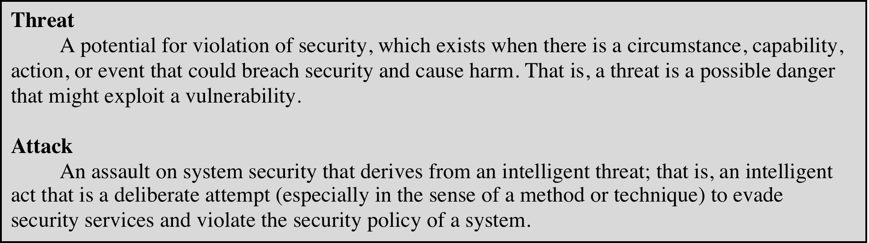
Table 1.1 Threats and Attacks (RFC 4949)
Notes:
In the literature, the terms threat and attack are commonly used to mean more
or less the same thing. Table 1.1 provides definitions taken from RFC 4949, Internet
Security Glossary.

Slide 24
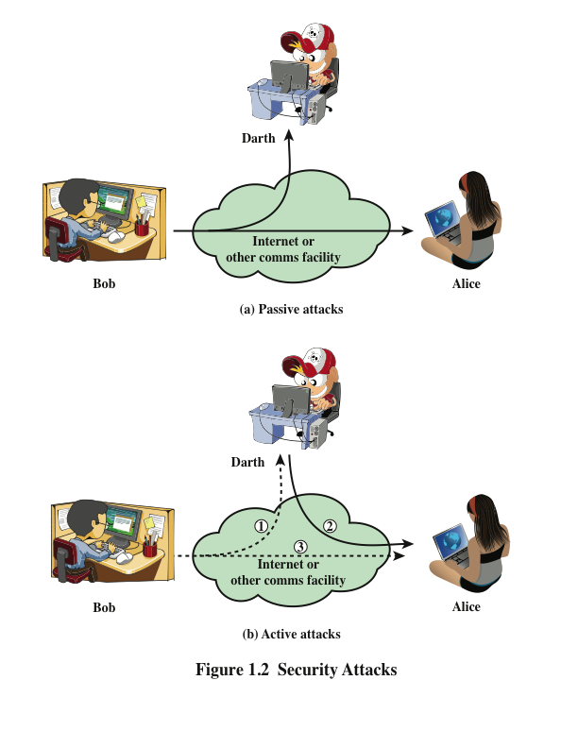
Security Attacks x.800 & RFC4949
A passive attack attempts to learn or make use of information from the system but does not affect system resources
An active attack attempts to alter system resources or affect their operation
Notes:
A useful means of classifying security attacks, used both in X.800 and RFC 4949, is in
terms of passive attacks and active attacks (Figure 1.2). A passive attack attempts to
learn or make use of information from the system but does not affect system resources.
An active attack attempts to alter system resources or affect their operation.

Slide 25
Passive Attacks
Are in the nature of eavesdropping on, or monitoring of, transmissions
Goal of the opponent is to obtain information that is being transmitted
Two types of passive attacks are:
The release of message contents
Traffic analysis
prevention rather than detection
Notes:
Passive attacks (Figure 1.2a) are in the nature of eavesdropping on, or monitoring
of, transmissions. The goal of the opponent is to obtain information that is being
transmitted. Two types of passive attacks are the release of message contents and
traffic analysis.
The release of message contents is easily understood. A telephone conversation,
an electronic mail message, and a transferred file may contain sensitive or
confidential information. We would like to prevent an opponent from learning the
contents of these transmissions.
A second type of passive attack, traffic analysis , is subtler. Suppose that we
had a way of masking the contents of messages or other information traffic so that
opponents, even if they captured the message, could not extract the information
from the message. The common technique for masking contents is encryption. If we
had encryption protection in place, an opponent might still be able to observe the
pattern of these messages. The opponent could determine the location and identity
of communicating hosts and could observe the frequency and length of messages
being exchanged. This information might be useful in guessing the nature of the
communication that was taking place.
Passive attacks are very difficult to detect, because they do not involve any
alteration of the data. Typically, the message traffic is sent and received in an apparently
normal fashion, and neither the sender nor receiver is aware that a third party
has read the messages or observed the traffic pattern. However, it is feasible to prevent
the success of these attacks, usually by means of encryption. Thus, the emphasis
in dealing with passive attacks is on prevention rather than detection.

Slide 26
Active Attacks
Involve some modification of the data stream or the creation of a false stream
Difficult to prevent because of the wide variety of potential physical, software, and network vulnerabilities
Goal is to detect attacks and to recover from any disruption or delays caused by them
Masquerade
Takes place when one entity pretends to be a different entity
Usually includes one of the other forms of active attack
Replay
Involves the passive capture of a data unit and its subsequent retransmission to produce an unauthorized effect
Modification of messages
Some portion of a legitimate message is altered, or messages are delayed or reordered to produce an unauthorized effect
Denial of service
Prevents or inhibits the normal use or management of communications facilities
Notes:
Active attacks (Figure 1.2b) involve some modification of the data stream or the
creation of a false stream and can be subdivided into four categories: masquerade,
replay, modification of messages, and denial of service.
A masquerade takes place when one entity pretends to be a different entity
(path 2 of Figure 1.2b is active). A masquerade attack usually includes one of the
other forms of active attack. For example, authentication sequences can be captured
and replayed after a valid authentication sequence has taken place, thus enabling an
authorized entity with few privileges to obtain extra privileges by impersonating an
entity that has those privileges.
Replay involves the passive capture of a data unit and its subsequent retransmission
to produce an unauthorized effect (paths 1, 2, and 3 active).
Modification of messages simply means that some portion of a legitimate
message is altered, or that messages are delayed or reordered, to produce an
unauthorized effect (paths 1 and 2 active). For example, a message meaning “Allow
John Smith to read confidential file accounts ” is modified to mean “Allow Fred
Brown to read confidential file accounts. ”
The denial of service prevents or inhibits the normal use or management of
communications facilities (path 3 active). This attack may have a specific target; for
example, an entity may suppress all messages directed to a particular destination
(e.g., the security audit service). Another form of service denial is the disruption
of an entire network, either by disabling the network or by overloading it with
messages so as to degrade performance.
Active attacks present the opposite characteristics of passive attacks. Whereas
passive attacks are difficult to detect, measures are available to prevent their success.
On the other hand, it is quite difficult to prevent active attacks absolutely
because of the wide variety of potential physical, software, and network vulnerabilities.
Instead, the goal is to detect active attacks and to recover from any disruption
or delays caused by them. If the detection has a deterrent effect, it may also
contribute to prevention.

Slide 27
Security Services
Defined by X.800 as:
A service provided by a protocol layer of communicating open systems and that ensures adequate security of the systems or of data transfers
Defined by RFC 4949 as:
A processing or communication service provided by a system to give a specific kind of protection to system resources
Notes:
X.800 defines a security service as a service that is provided by a protocol layer of
communicating open systems and that ensures adequate security of the systems
or of data transfers. Perhaps a clearer definition is found in RFC 4949, which
provides the following definition: a processing or communication service that is
provided by a system to give a specific kind of protection to system resources;
security services implement security policies and are implemented by security
mechanisms.

Slide 28
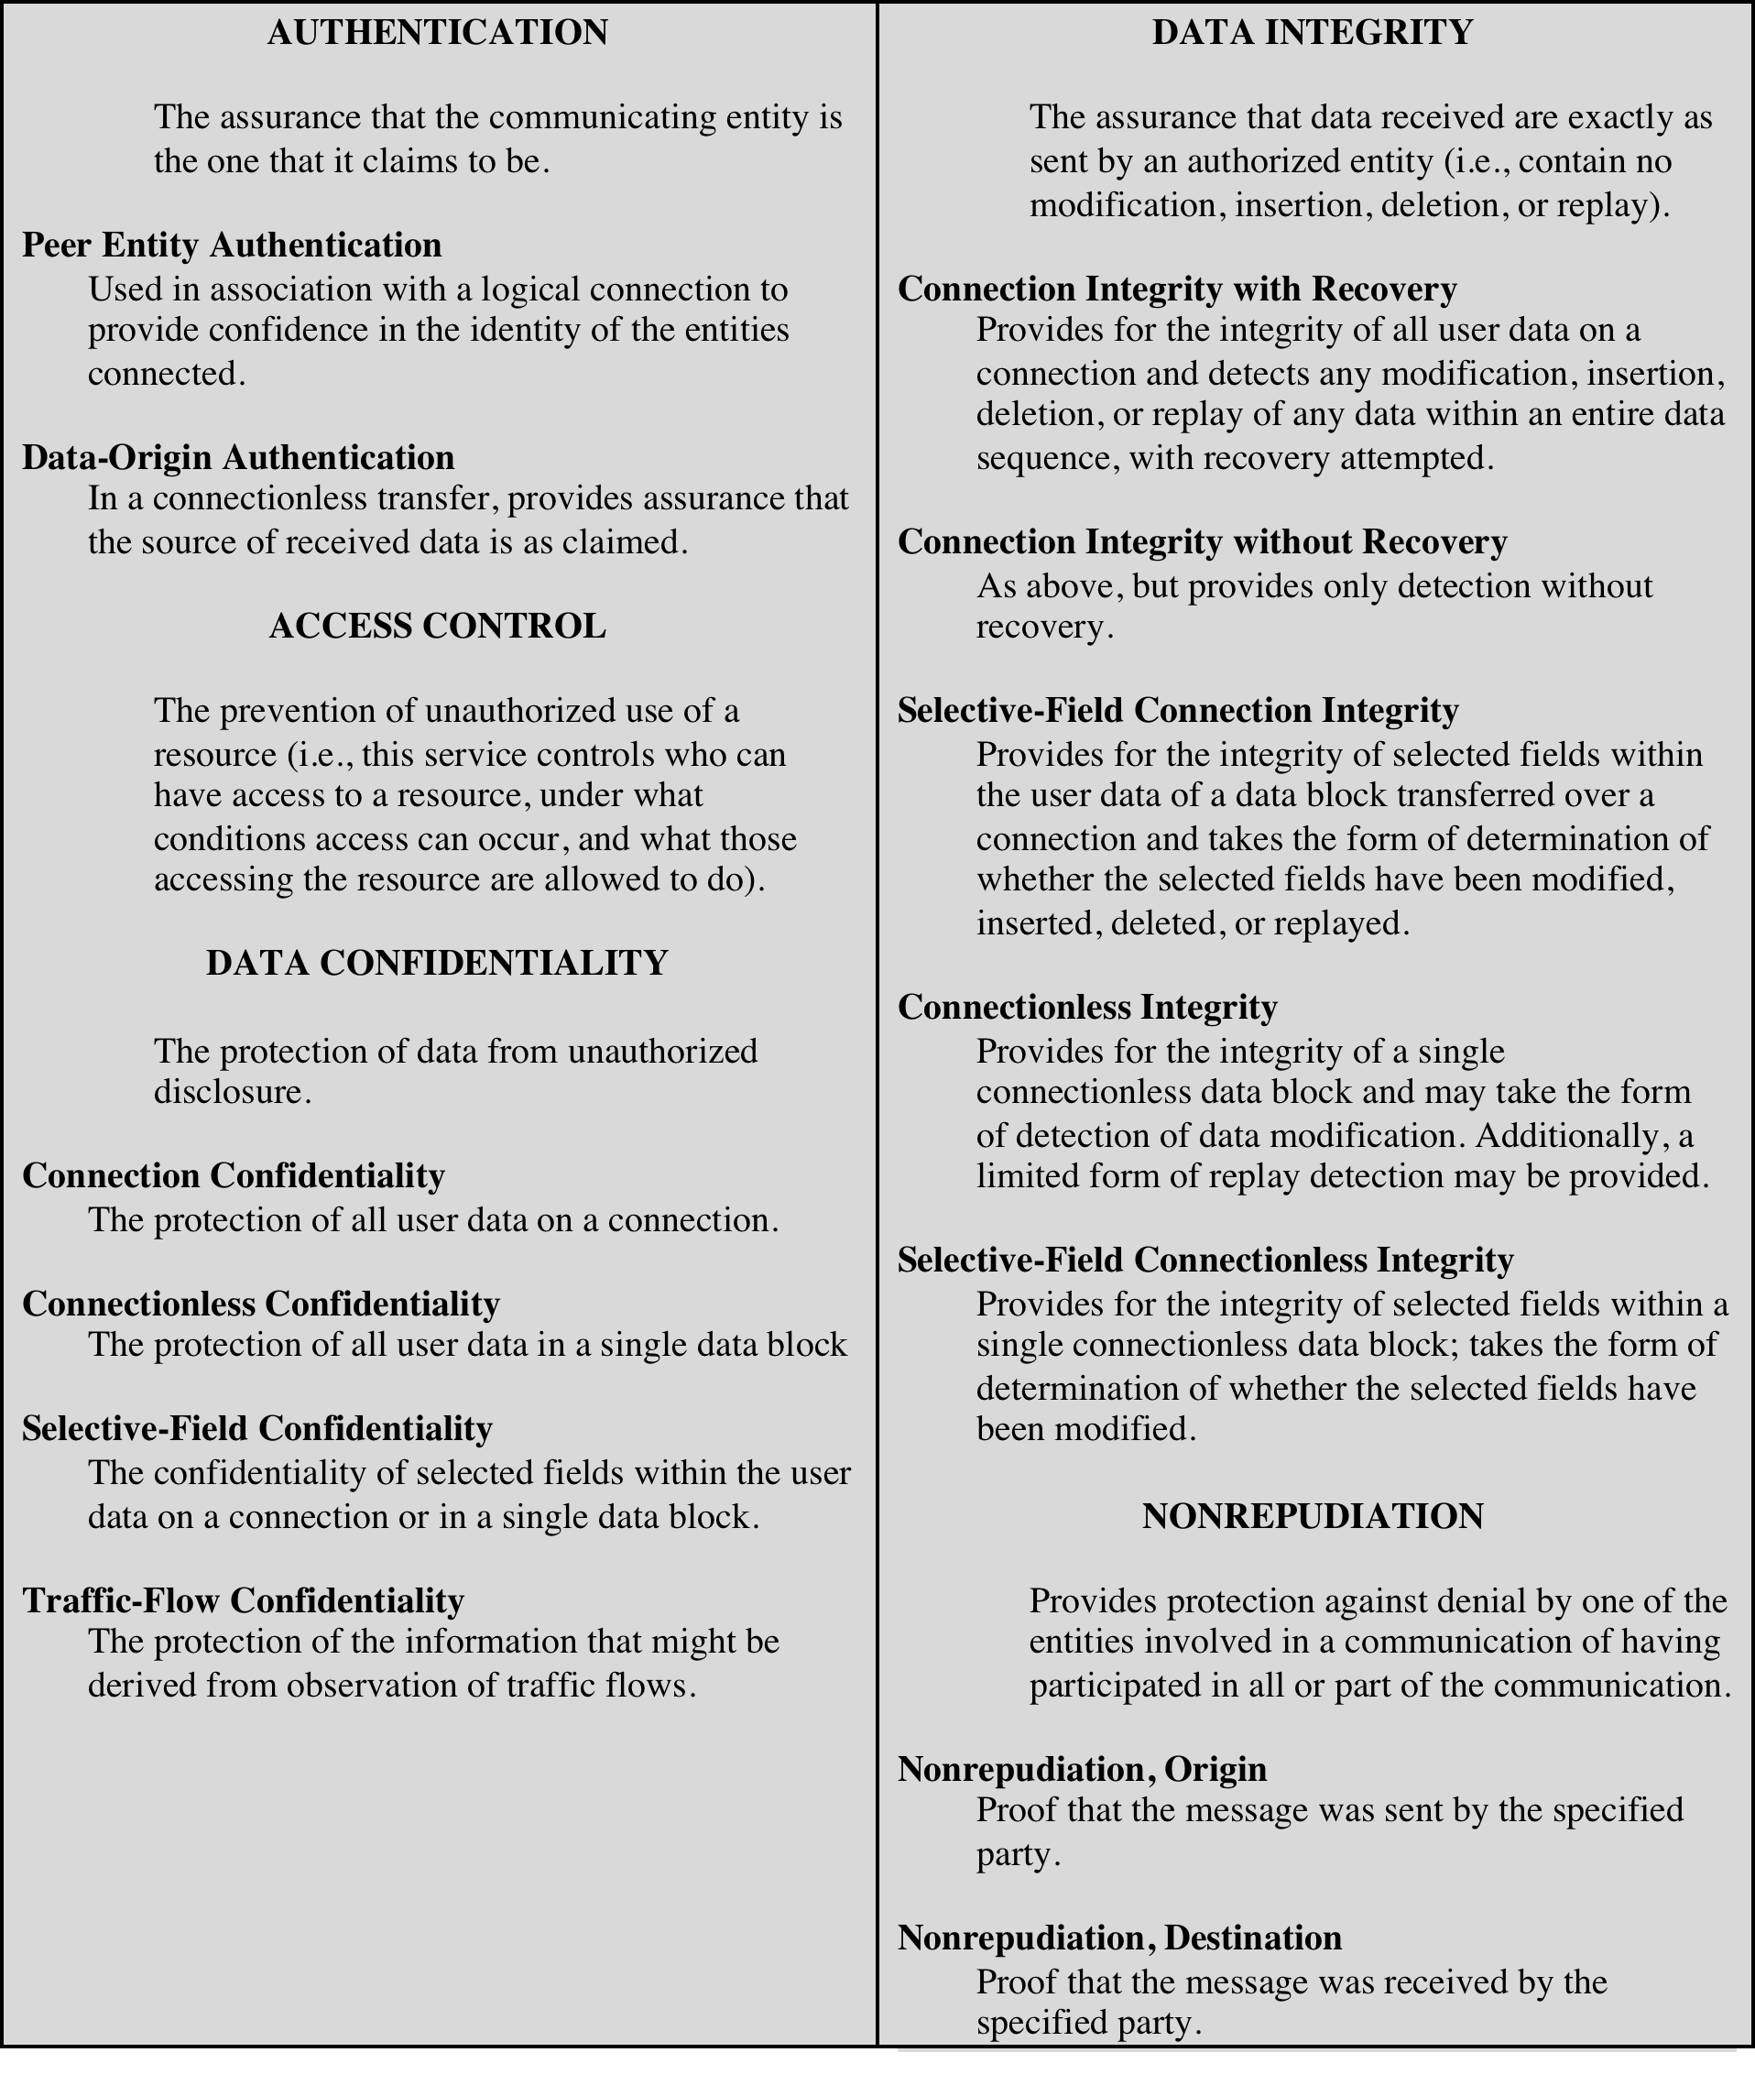
Table 1.2
Security Services
(X.800)
(This table is found on page 30 in textbook)
+ availability service
Notes:
X.800 divides these services into five categories and fourteen specific services
(Table 1.2).

Slide 29
Authentication
Concerned with assuring that a communication is authentic
In the case of a single message, assures the recipient that the message is from the source that it claims to be from
In the case of ongoing interaction, assures the two entities are authentic and that the connection is not interfered with in such a way that a third party can masquerade as one of the two legitimate parties
Two specific authentication services are defined in X.800:
Peer entity authentication
Data origin authentication
Notes:
The authentication service is concerned with assuring that a communication is
authentic. In the case of a single message, such as a warning or alarm signal, the
function of the authentication service is to assure the recipient that the message
is from the source that it claims to be from. In the case of an ongoing interaction,
such as the connection of a terminal to a host, two aspects are involved. First,
at the time of connection initiation, the service assures that the two entities are
authentic, that is, that each is the entity that it claims to be. Second, the service
must assure that the connection is not interfered with in such a way that a third
party can masquerade as one of the two legitimate parties for the purposes of
unauthorized transmission or reception.
Two specific authentication services are defined in X.800:
• Peer entity authentication: Provides for the corroboration of the identity
of a peer entity in an association. Two entities are considered peers if they
implement to same protocol in different systems; for example two TCP modules
in two communicating systems. Peer entity authentication is provided for
use at the establishment of, or at times during the data transfer phase of, a
connection. It attempts to provide confidence that an entity is not performing
either a masquerade or an unauthorized replay of a previous connection.
• Data origin authentication: Provides for the corroboration of the source of a
data unit. It does not provide protection against the duplication or modification
of data units. This type of service supports applications like electronic mail,
where there are no prior interactions between the communicating entities.

Slide 30
Access Control
The ability to limit and control the access to host systems and applications via communications links
To achieve this, each entity trying to gain access must first be indentified, or authenticated, so that access rights can be tailored to the individual
Notes:
In the context of network security, access control is the ability to limit and control
the access to host systems and applications via communications links. To achieve
this, each entity trying to gain access must first be identified, or authenticated, so
that access rights can be tailored to the individual.

Slide 31
Data Confidentiality
The protection of transmitted data from passive attacks
Broadest service protects all user data transmitted between two users over a period of time
Narrower forms of service includes the protection of a single message or even specific fields within a message
The protection of traffic flow from analysis
This requires that an attacker not be able to observe the source and destination, frequency, length, or other characteristics of the traffic on a communications facility
Notes:
Confidentiality is the protection of transmitted data from passive attacks. With
respect to the content of a data transmission, several levels of protection can be
identified. The broadest service protects all user data transmitted between two
users over a period of time. For example, when a TCP connection is set up between
two systems, this broad protection prevents the release of any user data transmitted
over the TCP connection. Narrower forms of this service can also be defined,
including the protection of a single message or even specific fields within a message.
These refinements are less useful than the broad approach and may even be more
complex and expensive to implement.
The other aspect of confidentiality is the protection of traffic flow from analysis.
This requires that an attacker not be able to observe the source and destination, frequency,
length, or other characteristics of the traffic on a communications facility.

Slide 32
Data Integrity
Can apply to a stream of messages, a single message, or selected fields within a message
Connection-oriented integrity service, one that deals with a stream of messages, assures that messages are received as sent with no duplication, insertion, modification, reordering, or replays
A connectionless integrity service, one that deals with individual messages without regard to any larger context, generally provides protection against message modification only
Notes:
As with confidentiality, integrity can apply to a stream of messages, a single message,
or selected fields within a message. Again, the most useful and straightforward
approach is total stream protection.
A connection-oriented integrity service, one that deals with a stream of messages,
assures that messages are received as sent with no duplication, insertion,
modification, reordering, or replays. The destruction of data is also covered under
this service. Thus, the connection-oriented integrity service addresses both message
stream modification and denial of service. On the other hand, a connectionless integrity
service, one that deals with individual messages without regard to any larger
context, generally provides protection against message modification only.
We can make a distinction between service with and without recovery.
Because the integrity service relates to active attacks, we are concerned with detection
rather than prevention. If a violation of integrity is detected, then the service
may simply report this violation, and some other portion of software or human
intervention is required to recover from the violation. Alternatively, there are
mechanisms available to recover from the loss of integrity of data, as we will review
subsequently. The incorporation of automated recovery mechanisms is, in general,
the more attractive alternative.

Slide 33
Nonrepudiation
Prevents either sender or receiver from denying a transmitted message
When a message is sent, the receiver can prove that the alleged sender in fact sent the message
When a message is received, the sender can prove that the alleged receiver in fact received the message
Notes:
Nonrepudiation prevents either sender or receiver from denying a transmitted message.
Thus, when a message is sent, the receiver can prove that the alleged sender in
fact sent the message. Similarly, when a message is received, the sender can prove
that the alleged receiver in fact received the message.

Slide 34
Availability Service
Protects a system to ensure its availability
This service addresses the security concerns raised by denial-of-service attacks
It depends on proper management and control of system resources and thus depends on access control service and other security services
Notes:
Both X.800 and RFC 4949 define availability to be the property of a system or a
system resource being accessible and usable upon demand by an authorized system
entity, according to performance specifications for the system (i.e., a system is available
if it provides services according to the system design whenever users request
them). A variety of attacks can result in the loss of or reduction in availability. Some
of these attacks are amenable to automated countermeasures, such as authentication
and encryption, whereas others require some sort of physical action to prevent
or recover from loss of availability of elements of a distributed system.
X.800 treats availability as a property to be associated with various security
services. However, it makes sense to call out specifically an availability service. An
availability service is one that protects a system to ensure its availability. This service
addresses the security concerns raised by denial-of-service attacks. It depends
on proper management and control of system resources and thus depends on access
control service and other security services.

Slide 35
Security Mechanisms (X.800)
Specific Security Mechanisms
Encipherment
Digital signatures
Access controls
Data integrity
Authentication exchange
Traffic padding
Routing control
Notarization
Pervasive Security Mechanisms
Trusted functionality
Security labels
Event detection
Security audit trails
Security recovery
Notes:
X.800 security mechanisms.

Slide 36
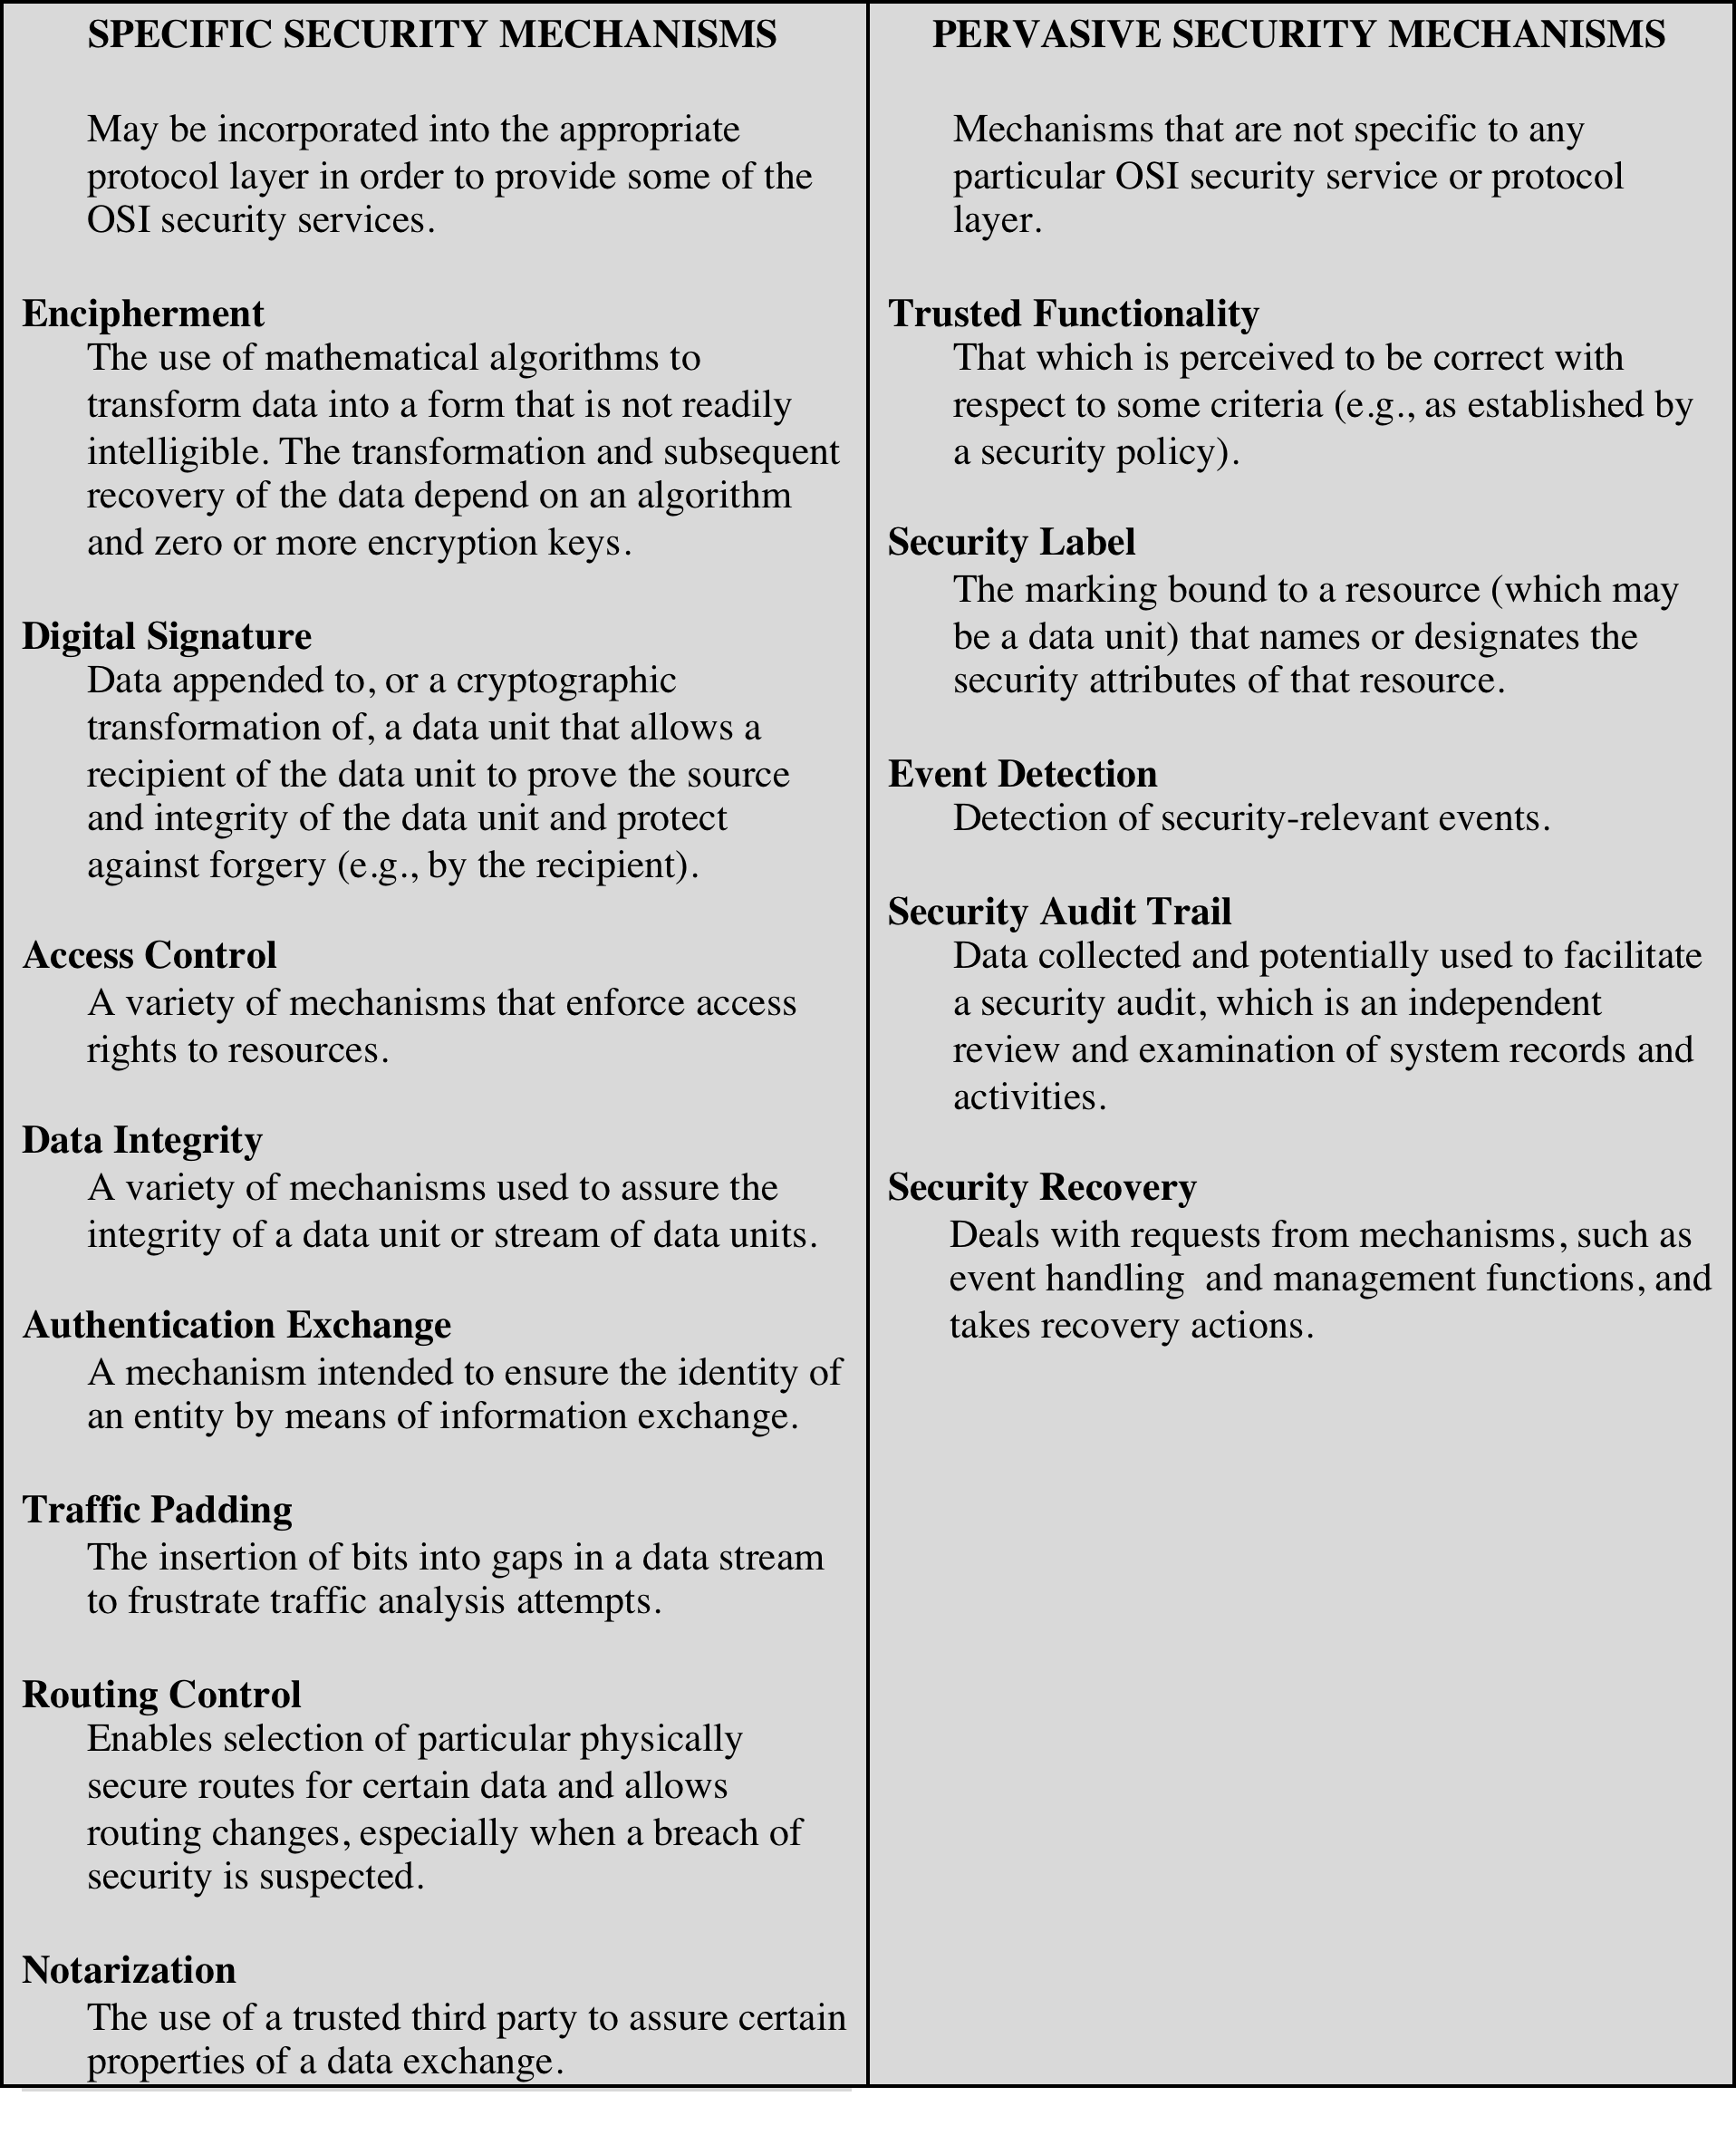
Table 1.3
Security Mechanisms
(X.800)
(This table is found on pages 32-33 in textbook)
Reversible vs. irreversible encipherement
Notes:
Table 1.3 lists the security mechanisms defined in X.800. The mechanisms are
divided into those that are implemented in a specific protocol layer, such as TCP
or an application-layer protocol, and those that are not specific to any particular
protocol layer or security service. These mechanisms will be covered in the
appropriate places in the book. So we do not elaborate now, except to comment
on the definition of encipherment. X.800 distinguishes between reversible encipherment
mechanisms and irreversible encipherment mechanisms. A reversible
encipherment mechanism is simply an encryption algorithm that allows data to
be encrypted and subsequently decrypted. Irreversible encipherment mechanisms
include hash algorithms and message authentication codes, which are used in digital
signature and message authentication applications.

Slide 37
Relationship between security services & mechanisms

Slide 38
Fundamental Security Design Principles
Least common mechanism
Psychological acceptability
Isolation
Encapsulation
Modularity
Layering
Least astonishment
Economy of mechanism
Fail-safe defaults
Complete meditation
Open design
Separation of privilege
Least privilege
Notes:
Despite years of research and development, it has not been possible to develop
security design and implementation techniques that systematically exclude security
flaws and prevent all unauthorized actions. In the absence of such foolproof techniques,
it is useful to have a set of widely agreed design principles that can guide
the development of protection mechanisms. The National Centers of Academic
Excellence in Information Assurance/Cyber Defense, which is jointly sponsored by
the U.S. National Security Agency and the U.S. Department of Homeland Security,
list the following as fundamental security design principles [NCAE13]:
■■ Economy of mechanism
■■ Fail-safe defaults
■■ Complete mediation
■■ Open design
■■ Separation of privilege
■■ Least privilege
■■ Least common mechanism
■■ Psychological acceptability
■■ Isolation
■■ Encapsulation
■■ Modularity
■■ Layering
■■ Least astonishment
The first eight listed principles were first proposed in [SALT75] and have withstood
the test of time.

Slide 39
Fundamental Security Design Principles
Economy of mechanism
Fail-safe defaults
Means that the design of security measures embodied in both hardware and software should be as simple and small as possible
Relatively simple, small design is easier to test and verify thoroughly
With a complex design, there are many more opportunities for an adversary to discover subtle weaknesses to exploit that may be difficult to spot ahead of time
Means that access decisions should be based on permission rather than exclusion
The default situation is lack of access, and the protection scheme identifies conditions under which access is permitted
Most file access systems and virtually all protected services on client/server use fail-safe defaults
Notes:
Economy of mechanism means that the design of security measures embodied
in both hardware and software should be as simple and small as possible.
The motivation for this principle is that relatively simple, small design is easier
to test and verify thoroughly. With a complex design, there are many more
opportunities for an adversary to discover subtle weaknesses to exploit that may
be difficult to spot ahead of time. The more complex the mechanism, the more
likely it is to possess exploitable flaws. Simple mechanisms tend to have fewer
exploitable flaws and require less maintenance. Further, because configuration
management issues are simplified, updating or replacing a simple mechanism
becomes a less intensive process. In practice, this is perhaps the most difficult
principle to honor. There is a constant demand for new features in both hardware
and software, complicating the security design task. The best that can be
done is to keep this principle in mind during system design to try to eliminate
unnecessary complexity.
Fail-safe defaults means that access decisions should be based on permission
rather than exclusion. That is, the default situation is lack of access, and the protection
scheme identifies conditions under which access is permitted. This approach
exhibits a better failure mode than the alternative approach, where the default is
to permit access. A design or implementation mistake in a mechanism that gives
explicit permission tends to fail by refusing permission, a safe situation that can
be quickly detected. On the other hand, a design or implementation mistake in a
mechanism that explicitly excludes access tends to fail by allowing access, a failure
that may long go unnoticed in normal use. Most file access systems and virtually all
protected services on client/server systems use fail-safe defaults.

Slide 40
Fundamental Security Design Principles
Complete mediation
Open design
Means that every access must be checked against the access control mechanism
Systems should not rely on access decisions retrieved from a cache
To fully implement this, every time a user reads a field or record in a file, or a data item in a database, the system must exercise access control
This resource-intensive approach is rarely used
Means that the design of a security mechanism should be open rather than secret
Although encryption keys must be secret, encryption algorithms should be open to public scrutiny
Is the philosophy behind the NIST program of standardizing encryption and hash algorithms
Notes:
Complete mediation means that every access must be checked against the
Access control mechanism. Systems should not rely on access decisions retrieved
from a cache. In a system designed to operate continuously, this principle requires
that, if access decisions are remembered for future use, careful consideration be
given to how changes in authority are propagated into such local memories. File
access systems appear to provide an example of a system that complies with this
principle. However, typically, once a user has opened a file, no check is made to see
if permissions change. To fully implement complete mediation, every time a user
reads a field or record in a file, or a data item in a database, the system must exercise
access control. This resource-intensive approach is rarely used.
Open design means that the design of a security mechanism should be open
rather than secret. For example, although encryption keys must be secret, encryption
algorithms should be open to public scrutiny. The algorithms can then be reviewed
by many experts, and users can therefore have high confidence in them. This is the
philosophy behind the National Institute of Standards and Technology (NIST)
Program of standardizing encryption and hash algorithms, and has led to the widespread
adoption of NIST-approved algorithms.

Slide 41
Fundamental Security Design Principles
Separation of privilege
Least privilege
Defined as a practice in which multiple privilege attributes are required to achieve access to a restricted resource
Multifactor user authentication is an example which requires the use of multiple techniques, such as a password and a smart card, to authorize a user
Means that every process and every user of the system should operate using the least set of privileges necessary to perform the task
An example of the use of this principle is role-based access control; the system security policy can identify and define the various roles of users or processes and each role is assigned only those permissions needed to perform its functions
Notes:
Separation of privilege is defined in [SALT75] as a practice in which multiple
privilege attributes are required to achieve access to a restricted resource.
A good example of this is multifactor user authentication, which requires the use of
multiple techniques, such as a password and a smart card, to authorize a user. The
term is also now applied to any technique in which a program is divided into parts
that are limited to the specific privileges they require in order to perform a specific
task. This is used to mitigate the potential damage of a computer security attack.
One example of this latter interpretation of the principle is removing high privilege
operations to another process and running that process with the higher privileges
required to perform its tasks. Day-to-day interfaces are executed in a lower privileged
process.
Least privilege means that every process and every user of the system should
operate using the least set of privileges necessary to perform the task. A good
example of the use of this principle is role-based access control. The system security
policy can identify and define the various roles of users or processes. Each role is
assigned only those permissions needed to perform its functions. Each permission
specifies a permitted access to a particular resource (such as read and write access
to a specified file or directory, connect access to a given host and port). Unless a
permission is granted explicitly, the user or process should not be able to access the
protected resource. More generally, any access control system should allow each
user only the privileges that are authorized for that user. There is also a temporal
aspect to the least privilege principle. For example, system programs or administrators
who have special privileges should have those privileges only when necessary;
when they are doing ordinary activities the privileges should be withdrawn. Leaving
them in place just opens the door to accidents.

Slide 42
Fundamental Security Design Principles
Least common mechanism
Psychological acceptability
Means that the design should minimize the functions shared by different users, providing mutual security
This principle helps reduce the number of unintended communication paths and reduces the amount of hardware and software on which all users depend, thus making it easier to verify if there are any undesirable security implications
Implies that the security mechanisms should not interfere unduly with the work of users, while at the same time meeting the needs of those who authorize access
Where possible, security mechanisms should be transparent to the users of the system or, at most, introduce minimal obstruction
In addition to not being intrusive or burdensome, security procedures must reflect the user’s mental model of protection
Notes:
Least common mechanism means that the design should minimize the functions
shared by different users, providing mutual security. This principle helps
reduce the number of unintended communication paths and reduces the amount of
hardware and software on which all users depend, thus making it easier to verify if
there are any undesirable security implications.
Psychological acceptability implies that the security mechanisms should not
interfere unduly with the work of users, while at the same time meeting the needs of
those who authorize access. If security mechanisms hinder the usability or accessibility
of resources, then users may opt to turn off those mechanisms. Where possible,
security mechanisms should be transparent to the users of the system or at most
introduce minimal obstruction. In addition to not being intrusive or burdensome,
security procedures must reflect the user’s mental model of protection. If the protection
procedures do not make sense to the user or if the user must translate his image
of protection into a substantially different protocol, the user is likely to make errors.

Slide 43
Fundamental Security Design Principles
Isolation
Encapsulation
Applies in three contexts:
Public access systems should be isolated from critical resources to prevent disclosure or tampering
Processes and files of individual users should be isolated from one another except where it is explicitly desired
Security mechanisms should be isolated in the sense of preventing access to those mechanisms
Can be viewed as a specific form of isolation based on object-oriented functionality
Protection is provided by encapsulating a collection of procedures and data objects in a domain of its own so that the internal structure of a data object is accessible only to the procedures of the protected subsystem, and the procedures may be called only at designated domain entry points
Notes:
Isolation is a principle that applies in three contexts. First, public access systems
should be isolated from critical resources (data, processes, etc.) to prevent disclosure
or tampering. In cases where the sensitivity or criticality of the information
is high, organizations may want to limit the number of systems on which that data is
stored and isolate them, either physically or logically. Physical isolation may include
ensuring that no physical connection exists between an organization’s public access
information resources and an organization’s critical information. When implementing
logical isolation solutions, layers of security services and mechanisms should be
established between public systems and secure systems responsible for protecting
critical resources. Second, the processes and files of individual users should be isolated
from one another except where it is explicitly desired. All modern operating
systems provide facilities for such isolation, so that individual users have separate,
isolated process space, memory space, and file space, with protections for preventing
unauthorized access. And finally, security mechanisms should be isolated in the
sense of preventing access to those mechanisms. For example, logical access control
may provide a means of isolating cryptographic software from other parts of the
host system and for protecting cryptographic software from tampering and the keys
from replacement or disclosure.
Encapsulation can be viewed as a specific form of isolation based on object-oriented
functionality. Protection is provided by encapsulating a collection of procedures
and data objects in a domain of its own so that the internal structure of a
data object is accessible only to the procedures of the protected subsystem, and the
procedures may be called only at designated domain entry points.

Slide 44
Fundamental Security Design Principles
Modularity
Layering
Refers both to the development of security functions as separate, protected modules and to the use of a modular architecture for mechanism design and implementation
Refers to the use of multiple, overlapping protection approaches addressing the people, technology, and operational aspects of information systems
The failure or circumvention of any individual protection approach will not leave the system unprotected
Notes:
Modularity in the context of security refers both to the development of security
functions as separate, protected modules and to the use of a modular architecture for
mechanism design and implementation. With respect to the use of separate security
modules, the design goal here is to provide common security functions and services,
such as cryptographic functions, as common modules. For example, numerous protocols
and applications make use of cryptographic functions. Rather than implementing
such functions in each protocol or application, a more secure design is provided
by developing a common cryptographic module that can be invoked by numerous
protocols and applications. The design and implementation effort can then focus on
the secure design and implementation of a single cryptographic module and including
mechanisms to protect the module from tampering. With respect to the use of a
modular architecture, each security mechanism should be able to support migration
to new technology or upgrade of new features without requiring an entire system
redesign. The security design should be modular so that individual parts of the security
design can be upgraded without the requirement to modify the entire system.
Layering refers to the use of multiple, overlapping protection approaches
addressing the people, technology, and operational aspects of information systems.
By using multiple, overlapping protection approaches, the failure or circumvention
of any individual protection approach will not leave the system unprotected.
We will see throughout this book that a layering approach is often used to provide
multiple barriers between an adversary and protected information or services. This
technique is often referred to as defense in depth .

Slide 45
Fundamental Security Design Principles
Least astonishment
Means that a program or user interface should always respond in the way that is least likely to astonish the user
The mechanism for authorization should be transparent enough to a user that the user has a good intuitive understanding of how the security goals map to the provided security mechanism
Notes:
Least astonishment means that a program or user interface should always
respond in the way that is least likely to astonish the user. For example, the mechanism
for authorization should be transparent enough to a user that the user has a good intuitive
understanding of how the security goals map to the provided security mechanism.

Slide 46
Attack Surfaces
An attack surface consists of the reachable and exploitable vulnerabilities in a system
Examples:
Open ports on outward facing Web and other servers, and code listening on those ports
Services available on the inside of a firewall
Code that processes incoming data, email, XML, office documents, and industry-specific custom data exchange formats
Interfaces, SQL, and Web forms
An employee with access to sensitive information vulnerable to a social engineering attack
Notes:
An attack surface consists of the reachable and exploitable vulnerabilities in a system
[MANA11, HOWA03]. Examples of attack surfaces are the following:
■ Open ports on outward facing Web and other servers, and code listening on
those ports
■ Services available on the inside of a firewall
■ Code that processes incoming data, email, XML, office documents, and industry-
specific custom data exchange formats
■ Interfaces, SQL, and Web forms
■ An employee with access to sensitive information vulnerable to a social
Engineering attack

Slide 47
Attack Surface Categories
Network attack surface
Refers to vulnerabilities over an enterprise network, wide-area network, or the Internet
Software attack surface
Refers to vulnerabilities in application, utility, or operating system code
Human attack surface
Refers to vulnerabilities created by personnel or outsiders
Notes:
Attack surfaces can be categorized as follows:
■ Network attack surface: This category refers to vulnerabilities over an enterprise
network, wide-area network, or the Internet. Included in this category are network
protocol vulnerabilities, such as those used for a denial-of-service attack,
disruption of communications links, and various forms of intruder attacks.
■ Software attack surface: This refers to vulnerabilities in application, utility,
or operating system code. A particular focus in this category is Web server
Software.
■ Human attack surface: This category refers to vulnerabilities created by
personnel or outsiders, such as social engineering, human error, and trusted
insiders.

Slide 48
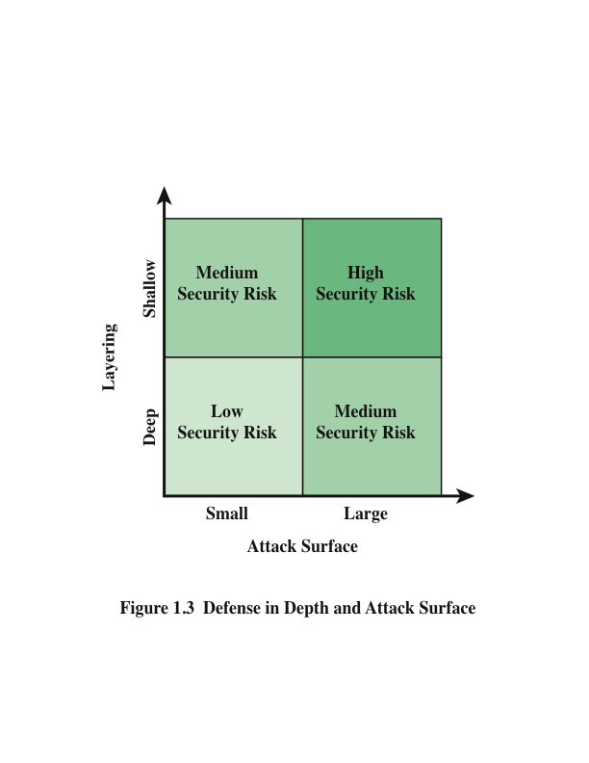
Notes:
An attack surface analysis is a useful technique for assessing the scale and
severity of threats to a system. A systematic analysis of points of vulnerability
makes developers and security analysts aware of where security mechanisms are
required. Once an attack surface is defined, designers may be able to find ways to
make the surface smaller, thus making the task of the adversary more difficult. The
attack surface also provides guidance on setting priorities for testing, strengthening
security measures, and modifying the service or application.
As illustrated in Figure 1.3, the use of layering, or defense in depth, and attack
surface reduction complement each other in mitigating security risk.

Slide 49
Attack Tree
A branching, hierarchical data structure that represents a set of potential techniques for exploiting security vulnerabilities
The security incident that is the goal of the attack is represented as the root node of the tree, and the ways that an attacker could reach that goal are represented as branches and subnodes of the tree
The final nodes on the paths outward from the root, (leaf nodes), represent different ways to initiate an attack
The motivation for the use of attack trees is to effectively exploit the information available on attack patterns
Notes:
An attack tree is a branching, hierarchical data structure that represents a set of potential
techniques for exploiting security vulnerabilities [MAUW05, MOOR01, SCHN99].
The security incident that is the goal of the attack is represented as the root node of
the tree, and the ways that an attacker could reach that goal are iteratively and incrementally
represented as branches and subnodes of the tree. Each subnode defines a
subgoal, and each subgoal may have its own set of further subgoals, and so on. The
final nodes on the paths outward from the root, that is, the leaf nodes, represent different
ways to initiate an attack. Each node other than a leaf is either an AND-node or an
OR-node. To achieve the goal represented by an AND-node, the subgoals represented
by all of that node’s subnodes must be achieved; and for an OR-node, at least one of
the subgoals must be achieved. Branches can be labeled with values representing difficulty,
cost, or other attack attributes, so that alternative attacks can be compared.
The motivation for the use of attack trees is to effectively exploit the information
available on attack patterns. Organizations such as CERT publish security
advisories that have enabled the development of a body of knowledge about both
general attack strategies and specific attack patterns. Security analysts can use the
attack tree to document security attacks in a structured form that reveals key vulnerabilities.
The attack tree can guide both the design of systems and applications,
and the choice and strength of countermeasures.

Slide 50
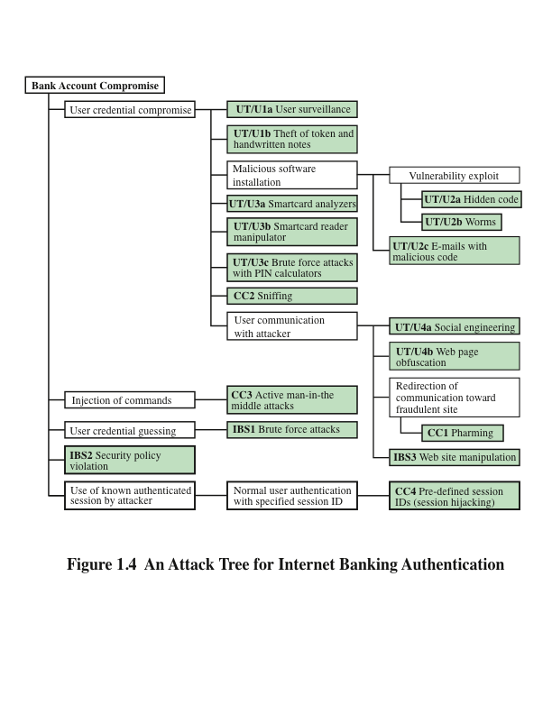
Notes:
Figure 1.4, based on a figure in [DIMI07], is an example of an attack tree
analysis for an Internet banking authentication application. The root of the tree is
the objective of the attacker, which is to compromise a user’s account. The shaded
boxes on the tree are the leaf nodes, which represent events that comprise the
attacks. Note that in this tree, all the nodes other than leaf nodes are OR-nodes.
The analysis to generate this tree considered the three components involved in
authentication:
■ User terminal and user (UT/U): These attacks target the user equipment,
including the tokens that may be involved, such as smartcards or other password
generators, as well as the actions of the user.
■ Communications channel (CC): This type of attack focuses on communication
links.
■ Internet banking server (IBS): These types of attacks are offline attacks against
the servers that host the Internet banking application.
Five overall attack strategies can be identified, each of which exploits one or
more of the three components. The five strategies are as follows:
■ User credential compromise: This strategy can be used against many elements
of the attack surface. There are procedural attacks, such as monitoring
a user’s action to observe a PIN or other credential, or theft of the user’s
token or handwritten notes. An adversary may also compromise token
information using a variety of token attack tools, such as hacking the smartcard
or using a brute force approach to guess the PIN. Another possible
strategy is to embed malicious software to compromise the user’s login and
password. An adversary may also attempt to obtain credential information
via the communication channel (sniffing). Finally, an adversary may use
various means to engage in communication with the target user, as shown
in Figure 1.4.
■ Injection of commands: In this type of attack, the attacker is able to intercept
communication between the UT and the IBS. Various schemes can be used
to be able to impersonate the valid user and so gain access to the banking
system.
■ User credential guessing: It is reported in [HILT06] that brute force attacks
against some banking authentication schemes are feasible by sending random
usernames and passwords. The attack mechanism is based on distributed
zombie personal computers, hosting automated programs for username- or
password-based calculation.
■ Security policy violation: For example, violating the bank’s security policy
in combination with weak access control and logging mechanisms, an employee
may cause an internal security incident and expose a customer’s
account.
■ Use of known authenticated session: This type of attack persuades or forces
the user to connect to the IBS with a preset session ID. Once the user authenticates
to the server, the attacker may utilize the known session ID to send
packets to the IBS, spoofing the user’s identity.
Figure 1.4 provides a thorough view of the different types of attacks on an
Internet banking authentication application. Using this tree as a starting point, security
analysts can assess the risk of each attack and, using the design principles outlined
in the preceding section, design a comprehensive security facility. [DIMO07]
provides a good account of the results of this design effort.

Slide 51
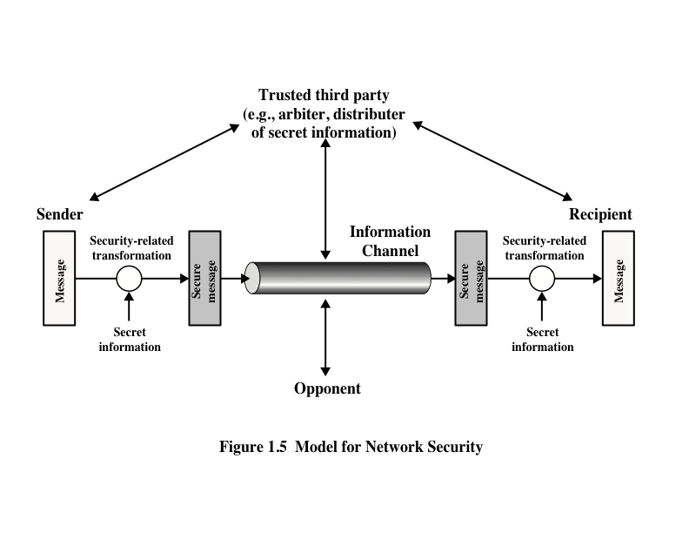
Model for Network Security
Notes:
A model for much of what we will be discussing is captured, in very general terms, in
Figure 1.5. A message is to be transferred from one party to another across some sort
of Internet service. The two parties, who are the principals in this transaction, must
cooperate for the exchange to take place. A logical information channel is established
by defining a route through the Internet from source to destination and by the cooperative
use of communication protocols (e.g., TCP/IP) by the two principals.
Security aspects come into play when it is necessary or desirable to protect the
information transmission from an opponent who may present a threat to confidentiality,
authenticity, and so on. All the techniques for providing security have two components:
■ A security-related transformation on the information to be sent. Examples
include the encryption of the message, which scrambles the message so that it
is unreadable by the opponent, and the addition of a code based on the contents
of the message, which can be used to verify the identity of the sender.
■ Some secret information shared by the two principals and, it is hoped,
Unknown to the opponent. An example is an encryption key used in conjunction
with the transformation to scramble the message before transmission and unscramble it on reception.
A trusted third party may be needed to achieve secure transmission. For
example, a third party may be responsible for distributing the secret information
to the two principals while keeping it from any opponent. Or a third party may be
needed to arbitrate disputes between the two principals concerning the authenticity
of a message transmission.
This general model shows that there are four basic tasks in designing a particular
security service:
1. Design an algorithm for performing the security-related transformation. The
algorithm should be such that an opponent cannot defeat its purpose.
2. Generate the secret information to be used with the algorithm.
3. Develop methods for the distribution and sharing of the secret information.
Specify a protocol to be used by the two principals that makes use of the
security algorithm and the secret information to achieve a particular security
service.

Slide 52
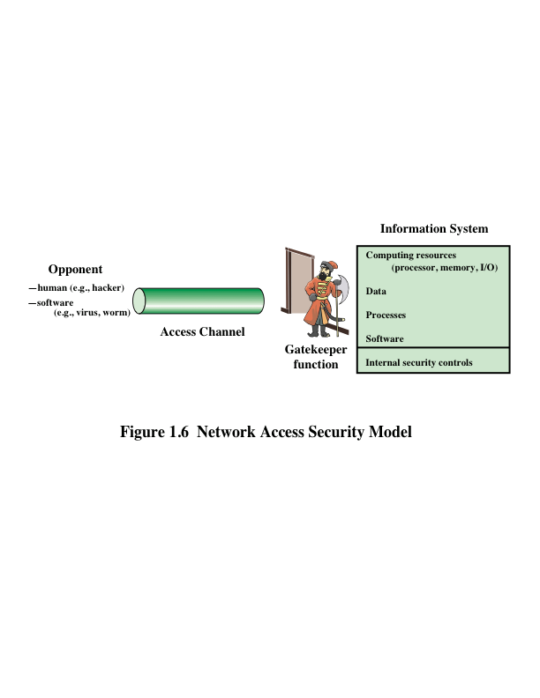
Network Access Security Model
Notes:
Parts One through Five of this book concentrate on the types of security mechanisms
and services that fit into the model shown in Figure 1.5. However, there are
other security-related situations of interest that do not neatly fit this model but are
considered in this book. A general model of these other situations is illustrated in
Figure 1.6, which reflects a concern for protecting an information system from unwanted
access. Most readers are familiar with the concerns caused by the existence
of hackers, who attempt to penetrate systems that can be accessed over a network.
The hacker can be someone who, with no malign intent, simply gets satisfaction
from breaking and entering a computer system. The intruder can be a disgruntled
employee who wishes to do damage or a criminal who seeks to exploit computer
assets for financial gain (e.g., obtaining credit card numbers or performing illegal
money transfers).

Slide 53
Unwanted Access
Placement in a computer system of logic that exploits vulnerabilities in the system and that can affect application programs as well as utility programs such as editors and compilers
Programs can present two kinds of threats:
Information access threats
Intercept or modify data on behalf of users who should not have access to that data
Service threats
Exploit service flaws in computers to inhibit use by legitimate users
Notes:
Another type of unwanted access is the placement in a computer system
of logic that exploits vulnerabilities in the system and that can affect application
programs as well as utility programs, such as editors and compilers. Programs can
present two kinds of threats:
• Information access threats: Intercept or modify data on behalf of users who
should not have access to that data.
• Service threats: Exploit service flaws in computers to inhibit use by legitimate
users.
Viruses and worms are two examples of software attacks. Such attacks can be
introduced into a system by means of a disk that contains the unwanted logic concealed
in otherwise useful software. They can also be inserted into a system across a
network; this latter mechanism is of more concern in network security.
The security mechanisms needed to cope with unwanted access fall into
two broad categories (see Figure 1.6). The first category might be termed a gatekeeper
function. It includes password-based login procedures that are designed
to deny access to all but authorized users and screening logic that is designed
to detect and reject worms, viruses, and other similar attacks. Once either an
unwanted user or unwanted software gains access, the second line of defense
consists of a variety of internal controls that monitor activity and analyze stored
information in an attempt to detect the presence of unwanted intruders. These
issues are explored in Part Six.

Slide 54
Standards
National Institute of Standards and Technology
NIST is a U.S. federal agency that deals with measurement science, standards, and technology related to U.S. government use and to the promotion of U.S. private-sector innovation
Despite its national scope, NIST Federal Information Processing Standards (FIPS) and Special Publications (SP) have a worldwide impact
Internet Society
ISOC is a professional membership society with world-wide organizational and individual membership
Provides leadership in addressing issues that confront the future of the Internet and is the organization home for the groups responsible for Internet infrastructure standards
ITU-T
The International Telecommunication Union (ITU) is an international organization within the United Nations System in which governments and the private sector coordinate global telecom networks and services
The ITU Telecommunication Standardization Sector (ITU-T) is one of the three sectors of the ITU and whose mission is the development of technical standards covering all fields of telecommunications
ISO
The International Organization for Standardization is a world-wide federation of national standards bodies from more than 140 countries
ISO is a nongovernmental organization that promotes the development of standardization and related activities with a view to facilitating the international exchange of goods and services and to developing cooperation in the spheres of intellectual, scientific, technological, and economic activity
Notes:
Many of the security techniques and applications described in this book have been
specified as standards. Additionally, standards have been developed to cover management
practices and the overall architecture of security mechanisms and services.
Throughout this book, we describe the most important standards in use or that are
being developed for various aspects of cryptography and network security. Various
organizations have been involved in the development or promotion of these standards.
The most important (in the current context) of these organizations are as
follows:
■ National Institute of Standards and Technology: NIST is a U.S. federal agency
that deals with measurement science, standards, and technology related to
U.S. government use and to the promotion of U.S. private-sector innovation.
Despite its national scope, NIST Federal Information Processing Standards
(FIPS) and Special Publications (SP) have a worldwide impact.
■ Internet Society: ISOC is a professional membership society with worldwide
organizational and individual membership. It provides leadership in
addressing issues that confront the future of the Internet and is the organization
home for the groups responsible for Internet infrastructure standards,
including the Internet Engineering Task Force (IETF) and the Internet
Architecture Board (IAB). These organizations develop Internet standards
and related specifications, all of which are published as Requests for
Comments (RFCs).
■ ITU-T: The International Telecommunication Union (ITU) is an international
organization within the United Nations System in which governments
and the private sector coordinate global telecom networks and services. The
ITU Telecommunication Standardization Sector (ITU-T) is one of the three
sectors of the ITU. ITU-T’s mission is the development of technical standards
covering all fields of telecommunications. ITU-T standards are referred to as
Recommendations.
■ ISO: The International Organization for Standardization (ISO) is a worldwide
federation of national standards bodies from more than 140 countries,
one from each country. ISO is a nongovernmental organization that promotes
the development of standardization and related activities with a view to facilitating
the international exchange of goods and services and to developing
cooperation in the spheres of intellectual, scientific, technological, and economic
activity. ISO’s work results in international agreements that are published
as International Standards.

Slide 55
Summary
Computer security concepts
Definition
Examples
Challenges
The OSI security architecture
Security attacks
Passive attacks
Active attacks
Attack surfaces and attack trees
Security services
Authentication
Access control
Data confidentiality
Data integrity
Nonrepudiation
Availability service
Security mechanisms
Fundamental security design principles
Network security model
Standards
Notes:
Chapter 1 summary.

