Slide 1
Network Security Essentials
Chapter 3
Fourth Edition
by William Stallings
Lecture slides by Lawrie Brown
Notes:
Lecture slides by Lawrie Brown for “Network Security Essentials”, 4/e, by William Stallings, Chapter 9 – “Public Key Cryptography and Message Authentication”.

Slide 2
Chapter 9 – Public Key Cryptography and RSA
Every Egyptian received two names, which were known respectively as the true name and the good name, or the great name and the little name; and while the good or little name was made public, the true or great name appears to have been carefully concealed.
—The Golden Bough, Sir James George Frazer
Notes:
Opening quote.

Slide 3
Message Authentication
message authentication is concerned with:
  protecting the integrity of a message
  validating identity of originator
  non-repudiation of origin (dispute resolution)
  In some cases, message timeliness and sequencing
the three alternative functions used:
  message encryption
  hash function
  message authentication code (MAC)
Notes:
One of the most fascinating and complex areas of cryptography is that of message authentication and the related area of digital signatures. We now consider how to protect message integrity (ie protection from modification), as well as confirming the identity of the sender. Generically this is the problem of message authentication, and in eCommerce applications is arguably more important than secrecy. Message Authentication is concerned with: protecting the integrity of a message, validating identity of originator, & non-repudiation of origin (dispute resolution). There are three types of functions that may be used to produce an authenticator: a hash function, message encryption, message authentication code (MAC). Hash functions, and how they may serve for message authentication, are discussed in Chapter 11. The remainder of this section briefly examines the remaining two topics. The remainder of the chapter elaborates on the topic of MACs.

Slide 4
Message Authentication Using Conventional Mechanisms
Conventional encryption
  Reordering of blocks of ciphertext in Electronic Code Book Mode (ECB)
Sequence number
  Can be used in some level (e.g. IP packet) but not a separate sequence number for each b-bit block of plaintext
Error Detection Code
Timestamp

Slide 5
Message Authentication Without Message Encryption
Authentication tag appended to each message
The message itself is not encrypted
Situations message authentication without confidentiality is preferable:
  Applications with a same message broadcasted to a number of destinations (e.g. notification of network unavailable and alarm signal in a control center)
  Exchanges in which one side has heavy load
  Computer programs

Slide 6
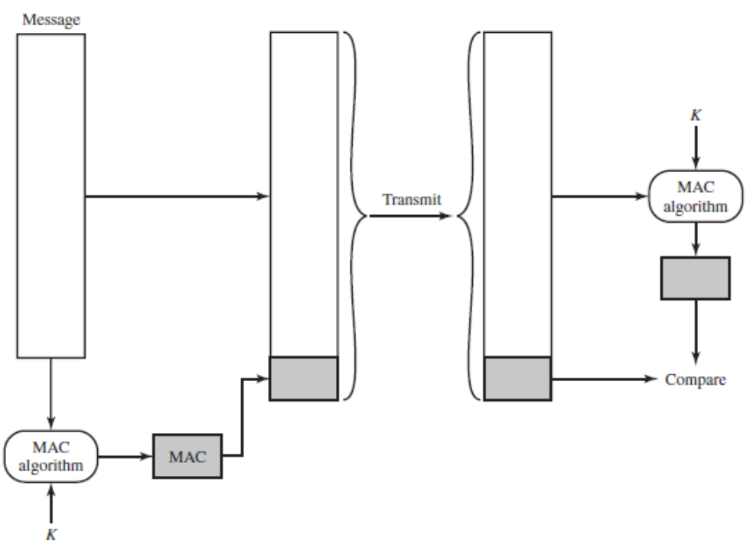
Message Authentication Code (MAC)
Message not altered
  If so, the receiver’s
  calculation of code will differ
  from received code
Message comes from
the alleged source
  No one else could prepare a message with a proper code
If message contains sequence number, the sequence is proper
    An attacker can not alter the sequence number

Slide 7
Message Authentication Code (MAC)
NIST specification, FIPS PUB 113
  Recommends DES to generate an encrypted message and so that last number of bits used as the code
  Typically 16- or 32-bit code

Slide 8
Hash Functions
condenses arbitrary message to fixed size
  h = H(M)
usually assume hash function is public
hash used to detect changes to message
want a cryptographic hash function
  computationally infeasible to find data mapping to specific hash (one-way property)
  computationally infeasible to find two data to same hash (collision-free property)
Notes:
A hash function H accepts a variable-length block of data M as input and produces a fixed-size hash value h = H(M). A "good" hash function has the property that the results of applying the function to a large set of inputs will produce outputs that are evenly distributed, and apparently random. In general terms, the principal object of a hash function is data integrity. A change to any bit or bits in M results, with high probability, in a change to the hash code. The kind of hash function needed for security applications is referred to as a cryptographic hash function. A cryptographic hash function is an algorithm for which it is computationally infeasible (because no attack is significantly more efficient than brute force) to find either (a) a data object that maps to a pre-specified hash result (the one-way property) or (b) two data objects that map to the same hash result (the collision-free property). Because of these characteristics, hash functions are often used to determine whether or not data has changed.

Slide 9
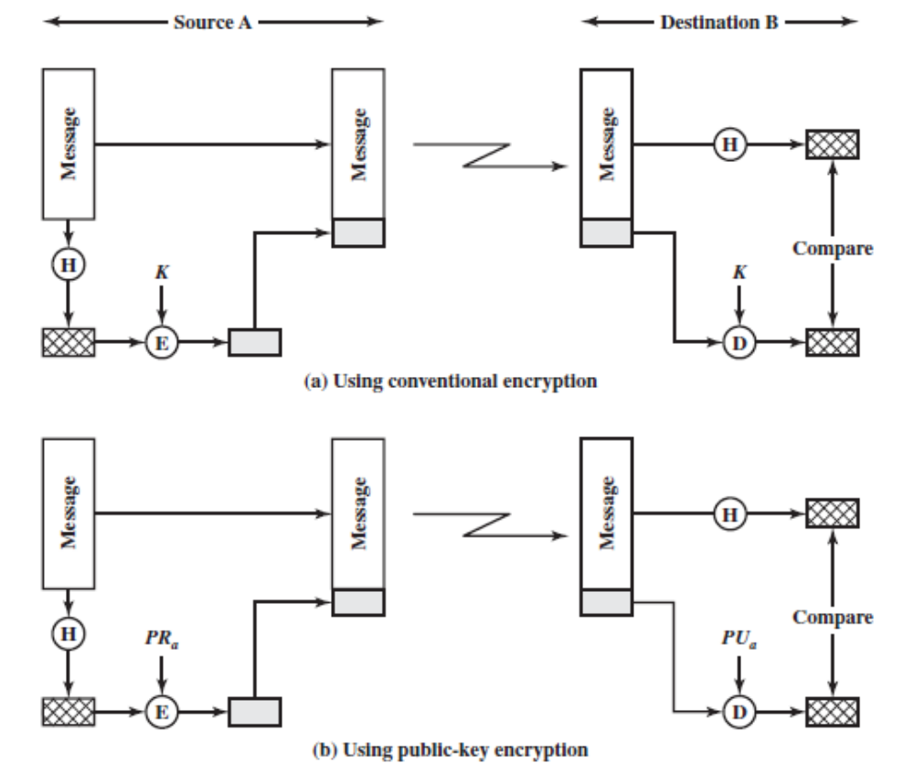
Hash Functions
Notes:
A hash function H accepts a variable-length block of data M as input and produces a fixed-size hash value h = H(M). A "good" hash function has the property that the results of applying the function to a large set of inputs will produce outputs that are evenly distributed, and apparently random. In general terms, the principal object of a hash function is data integrity. A change to any bit or bits in M results, with high probability, in a change to the hash code. The kind of hash function needed for security applications is referred to as a cryptographic hash function. A cryptographic hash function is an algorithm for which it is computationally infeasible (because no attack is significantly more efficient than brute force) to find either (a) a data object that maps to a pre-specified hash result (the one-way property) or (b) two data objects that map to the same hash result (the collision-free property). Because of these characteristics, hash functions are often used to determine whether or not data has changed.

Slide 10
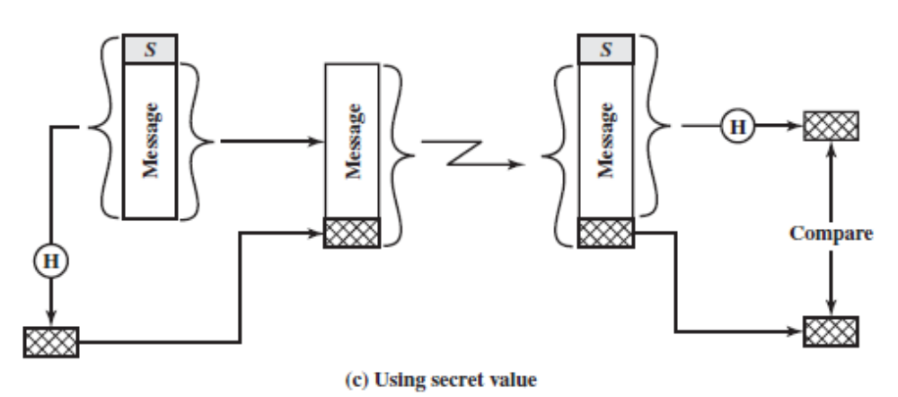
Hash Functions
Advantages to avoid encryption:
  Encryption software is quite slow
  Encryption hardware costs
  Encryption hardware optimized toward large data sizes
  Encryption algorithm may be protected by a patent
Notes:
A hash function H accepts a variable-length block of data M as input and produces a fixed-size hash value h = H(M). A "good" hash function has the property that the results of applying the function to a large set of inputs will produce outputs that are evenly distributed, and apparently random. In general terms, the principal object of a hash function is data integrity. A change to any bit or bits in M results, with high probability, in a change to the hash code. The kind of hash function needed for security applications is referred to as a cryptographic hash function. A cryptographic hash function is an algorithm for which it is computationally infeasible (because no attack is significantly more efficient than brute force) to find either (a) a data object that maps to a pre-specified hash result (the one-way property) or (b) two data objects that map to the same hash result (the collision-free property). Because of these characteristics, hash functions are often used to determine whether or not data has changed.

Slide 11
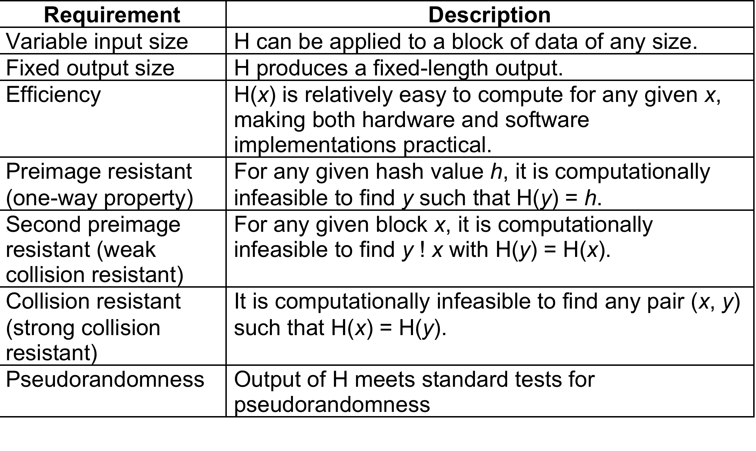
Hash Function Requirements
Notes:
This slide lists the generally accepted requirements for a cryptographic hash function. The first three properties are requirements for the practical application of a hash function. The fourth property, preimage (for a hash value h = H(x), we say that x is the preimage of h) resistant, is the one-way property: it is easy to generate a code given a message, but virtually impossible to generate a message given a code. This property is important if the authentication technique involves the use of a secret value. The fifth property, second preimage resistant, guarantees that it is impossible to find an alternative message with the same hash value as a given message. This prevents forgery when an encrypted hash code is used). A hash function that satisfies the first five properties in Table 11.1 is referred to as a weak hash function. If the sixth property, collision resistant, is also satisfied, then it is referred to as a strong hash function. A strong hash function protects against an attack in which one party generates a message for another party to sign. The final requirement, pseudorandomness, has not traditionally been listed as a requirement of cryptographic hash functions, but is more or less implied.

Slide 12
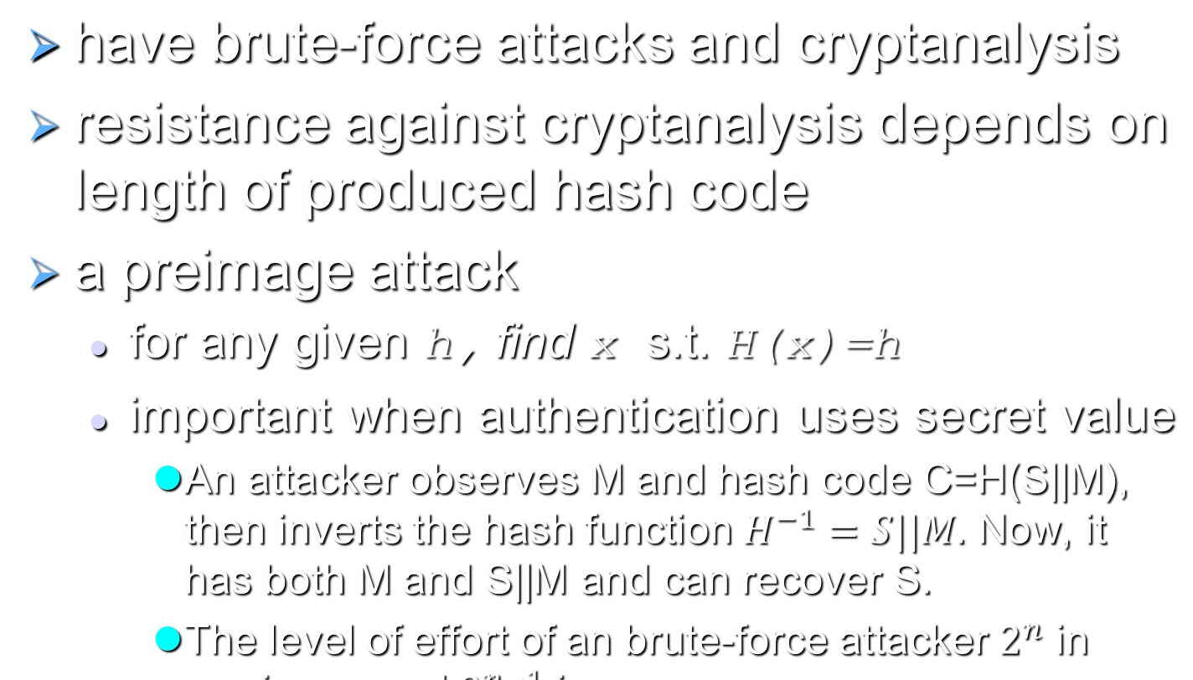
Attacks on Hash Functions
Notes:
As with encryption algorithms, there are two categories of attacks on hash functions: brute-force attacks and cryptanalysis. A brute-force attack does not depend on the specific algorithm but depends only on bit length. In the case of a hash function, a brute-force attack depends only on the bit length of the hash value. A cryptanalysis, in contrast, is an attack based on weaknesses in a particular cryptographic algorithm.
For a preimage or second preimage attack, an adversary wishes to find a value y such that H(y) is equal to a given hash value h. The brute force method is to pick values of y at random and try each value until a collision occurs. For an m-bit hash value, the level of effort is proportional to 2^{m}. Specifically, the adversary would have to try, on average, 2^{m–1} values of y to find one that generates a given hash value h.
For a collision resistant attack, an adversary wishes to find two messages or data blocks, x and y, that yield the same hash function: H(x) = H(y). This requires much less effort than a preimage or second preimage attack. The effort required is explained by a mathematical result referred to as the birthday paradox (next slide).
If collision resistance is required, then the value 2^{m/2} determines the strength of the hash code against brute-force attacks. Van Oorschot and Wiener presented a design for a $10 million collision search machine for MD5, which has a 128-bit hash length, that could find a collision in 24 days. Thus a 128-bit code may be viewed as inadequate. The next step up, if a hash code is treated as a sequence of 32 bits, is a 160-bit hash length. With a hash length of 160 bits, the same search machine would require over four thousand years to find a collision. With today's technology, the time would be much shorter, so that 160 bits now appears suspect.

Slide 13
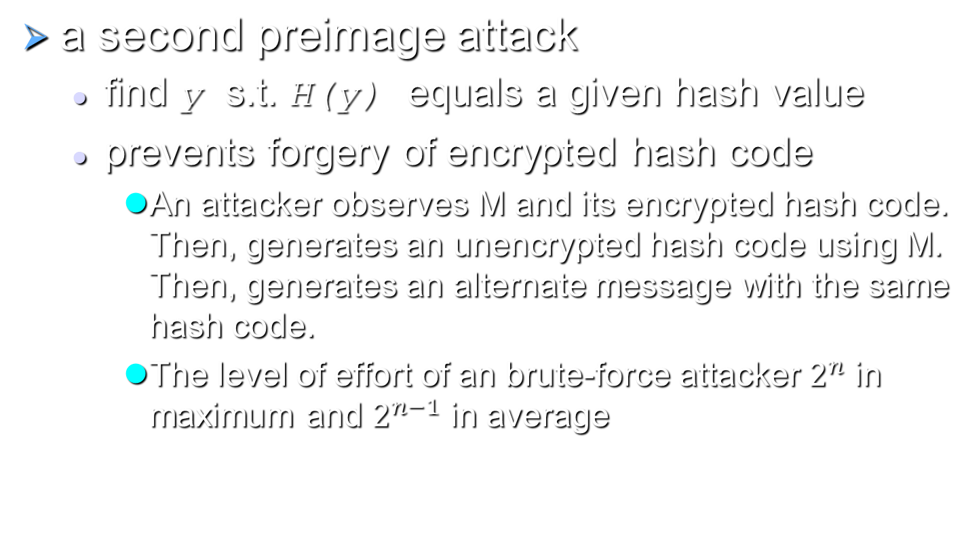
Attacks on Hash Functions
Notes:
As with encryption algorithms, there are two categories of attacks on hash functions: brute-force attacks and cryptanalysis. A brute-force attack does not depend on the specific algorithm but depends only on bit length. In the case of a hash function, a brute-force attack depends only on the bit length of the hash value. A cryptanalysis, in contrast, is an attack based on weaknesses in a particular cryptographic algorithm.
For a preimage or second preimage attack, an adversary wishes to find a value y such that H(y) is equal to a given hash value h. The brute force method is to pick values of y at random and try each value until a collision occurs. For an m-bit hash value, the level of effort is proportional to 2^{m}. Specifically, the adversary would have to try, on average, 2^{m–1} values of y to find one that generates a given hash value h.
For a collision resistant attack, an adversary wishes to find two messages or data blocks, x and y, that yield the same hash function: H(x) = H(y). This requires much less effort than a preimage or second preimage attack. The effort required is explained by a mathematical result referred to as the birthday paradox (next slide).
If collision resistance is required, then the value 2^{m/2} determines the strength of the hash code against brute-force attacks. Van Oorschot and Wiener presented a design for a $10 million collision search machine for MD5, which has a 128-bit hash length, that could find a collision in 24 days. Thus a 128-bit code may be viewed as inadequate. The next step up, if a hash code is treated as a sequence of 32 bits, is a 160-bit hash length. With a hash length of 160 bits, the same search machine would require over four thousand years to find a collision. With today's technology, the time would be much shorter, so that 160 bits now appears suspect.

Slide 14
Attacks on Hash Functions
Strong collision resistance
  find two messages x & y with same hash so H(x) = H(y)
  Prevents birthday attacks
hence value 2^{n/2} determines strength of hash code against brute-force attacks
  128-bits inadequate, 160-bits suspect
Notes:
As with encryption algorithms, there are two categories of attacks on hash functions: brute-force attacks and cryptanalysis. A brute-force attack does not depend on the specific algorithm but depends only on bit length. In the case of a hash function, a brute-force attack depends only on the bit length of the hash value. A cryptanalysis, in contrast, is an attack based on weaknesses in a particular cryptographic algorithm.
For a preimage or second preimage attack, an adversary wishes to find a value y such that H(y) is equal to a given hash value h. The brute force method is to pick values of y at random and try each value until a collision occurs. For an m-bit hash value, the level of effort is proportional to 2^{m}. Specifically, the adversary would have to try, on average, 2^{m–1} values of y to find one that generates a given hash value h.
For a collision resistant attack, an adversary wishes to find two messages or data blocks, x and y, that yield the same hash function: H(x) = H(y). This requires much less effort than a preimage or second preimage attack. The effort required is explained by a mathematical result referred to as the birthday paradox (next slide).
If collision resistance is required, then the value 2^{m/2} determines the strength of the hash code against brute-force attacks. Van Oorschot and Wiener presented a design for a $10 million collision search machine for MD5, which has a 128-bit hash length, that could find a collision in 24 days. Thus a 128-bit code may be viewed as inadequate. The next step up, if a hash code is treated as a sequence of 32 bits, is a 160-bit hash length. With a hash length of 160 bits, the same search machine would require over four thousand years to find a collision. With today's technology, the time would be much shorter, so that 160 bits now appears suspect.

Slide 15
Two Simple Insecure Hash Functions
bit-by-bit exclusive-OR (XOR) of every block
  C_{i} = b_{i1} xor b_{i2} xor . . . xor b_{im}
  a longitudinal redundancy check
  reasonably effective as data integrity check
  each n-bit hash value is equally likely
  probability that a data error will result in an unchanged hash value is 2^{–n}
  less effective for more predictably formatted data
    e.g. when the high-order bit of each octet is 0 (effectiveness of 2^{–112} instead of 2^{–128})
Notes:
To get some feel for the security considerations involved in cryptographic hash functions, we present two simple, insecure hash functions in this section. One of the simplest hash functions is the bit-by-bit exclusive-OR (XOR) of every block, which can be expressed as shown. This operation produces a simple parity for each bit position and is known as a longitudinal redundancy check. It is reasonably effective for random data as a data integrity check. Each n-bit hash value is equally likely. Thus, the probability that a data error will result in an unchanged hash value is 2^{–n}. With more predictably formatted data, the function is less effective. For example, in most normal text files, the high-order bit of each octet is always zero. So if a 128-bit hash value is used, instead of an effectiveness of 2^{–128}, the hash function on this type of data has an effectiveness of 2^{–112}.
A simple way to improve matters is to perform a one-bit circular shift, or rotation, on the hash value after each block is processed. Although this second procedure provides a good measure of data integrity, it is virtually useless for data security when an encrypted hash code is used with a plaintext message. Given a message, it is an easy matter to produce a new message that yields that hash code: Simply prepare the desired alternate message and then append an n-bit block that forces the new message plus block to yield the desired hash code.

Slide 16
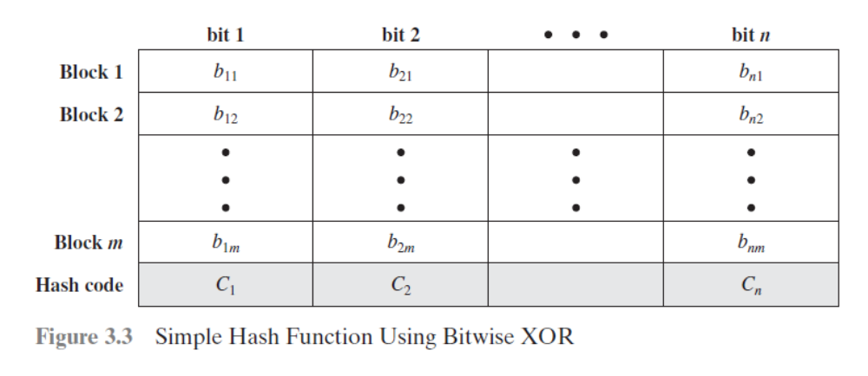

Slide 17
Two Simple Insecure Hash Functions
one-bit circular shift/rotation hash value
  for each successive n-bit block
    rotate current hash value to left by1bit and XOR block
  good for data integrity but useless for security when encrypted hash code is used with plaintext
Notes:
To get some feel for the security considerations involved in cryptographic hash functions, we present two simple, insecure hash functions in this section. One of the simplest hash functions is the bit-by-bit exclusive-OR (XOR) of every block, which can be expressed as shown. This operation produces a simple parity for each bit position and is known as a longitudinal redundancy check. It is reasonably effective for random data as a data integrity check. Each n-bit hash value is equally likely. Thus, the probability that a data error will result in an unchanged hash value is 2^{–n}. With more predictably formatted data, the function is less effective. For example, in most normal text files, the high-order bit of each octet is always zero. So if a 128-bit hash value is used, instead of an effectiveness of 2^{–128}, the hash function on this type of data has an effectiveness of 2^{–112}.
A simple way to improve matters is to perform a one-bit circular shift, or rotation, on the hash value after each block is processed. Although this second procedure provides a good measure of data integrity, it is virtually useless for data security when an encrypted hash code is used with a plaintext message. Given a message, it is an easy matter to produce a new message that yields that hash code: Simply prepare the desired alternate message and then append an n-bit block that forces the new message plus block to yield the desired hash code.

Slide 18
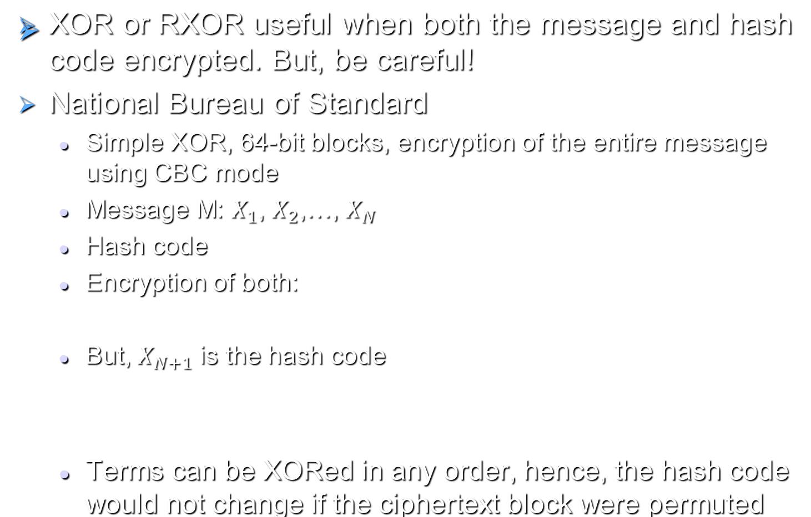

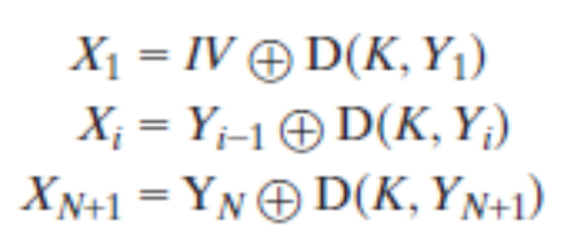
Two Simple Insecure Hash Functions
Notes:
To get some feel for the security considerations involved in cryptographic hash functions, we present two simple, insecure hash functions in this section. One of the simplest hash functions is the bit-by-bit exclusive-OR (XOR) of every block, which can be expressed as shown. This operation produces a simple parity for each bit position and is known as a longitudinal redundancy check. It is reasonably effective for random data as a data integrity check. Each n-bit hash value is equally likely. Thus, the probability that a data error will result in an unchanged hash value is 2^{–n}. With more predictably formatted data, the function is less effective. For example, in most normal text files, the high-order bit of each octet is always zero. So if a 128-bit hash value is used, instead of an effectiveness of 2^{–128}, the hash function on this type of data has an effectiveness of 2^{–112}.
A simple way to improve matters is to perform a one-bit circular shift, or rotation, on the hash value after each block is processed. Although this second procedure provides a good measure of data integrity, it is virtually useless for data security when an encrypted hash code is used with a plaintext message. Given a message, it is an easy matter to produce a new message that yields that hash code: Simply prepare the desired alternate message and then append an n-bit block that forces the new message plus block to yield the desired hash code.

Slide 19
Secure Hash Algorithm
SHA originally designed by NIST & NSA in 1993
was revised in 1995 as SHA-1
US standard for use with DSA signature scheme
  standard is FIPS 180-1 1995, also Internet RFC3174
  nb. the algorithm is SHA, the standard is SHS
based on design of MD4 with key differences
produces 160-bit hash values
recent 2005 results on security of SHA-1 have raised concerns on its use in future applications
Notes:
In recent years, the most widely used hash function has been the Secure Hash Algorithm (SHA). The Secure Hash Algorithm (SHA) was developed by the National Institute of Standards and Technology (NIST) and published as a federal information processing standard (FIPS 180) in 1993; a revised version was issued as FIPS 180-1 in 1995 and is generally referred to as SHA-1. The actual standards document is entitled Secure Hash Standard. SHA is based on the hash function MD4 and its design closely models MD4. SHA-1 produces a hash value of 160 bits. In 2005, a research team described an attack in which two separate messages could be found that deliver the same SHA-1 hash using 2^69 operations, far fewer than the 2^80 operations previously thought needed to find a collision with an SHA-1 hash [WANG05]. This result has hastened the transition to newer, longer versions of SHA.

Slide 20
Revised Secure Hash Standard
NIST issued revision FIPS 180-2 in 2002
adds 3 additional versions of SHA as SHA-2
  SHA-256, SHA-384, SHA-512
  FIPS 180-3, RFC 4634
designed for compatibility with increased security provided by the AES cipher
structure & detail is similar to SHA-1
hence analysis should be similar
but security levels are rather higher
Notes:
In 2002, NIST produced a revised version of the standard, FIPS 180-2, that defined three new versions of SHA, with hash value lengths of 256, 384, and 512 bits, known as SHA-256, SHA-384, and SHA-512. Collectively, these hash algorithms are known as SHA-2. These new versions have the same underlying structure and use the same types of modular arithmetic and logical binary operations as SHA-1, hence analyses should be similar. A revised document was issued as FIP PUB 180-3 in 2008, which added a 224-bit version. SHA-2 is also specified in RFC 4634, which essentially duplicates the material in FIPS 180-3, but adds a C code implementation.
In 2005, NIST announced the intention to phase out approval of SHA-1 and move to a reliance on the other SHA versions by 2010.

Slide 21

SHA Versions
Notes:
Stallings Table 3.1 provides a comparison of the various parameters for the SHA hash functions.

Slide 22
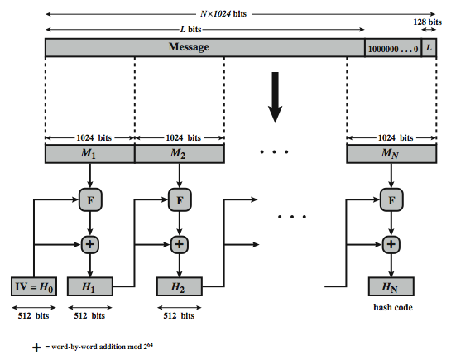
SHA-512 Overview
Notes:
Now examine the structure of SHA-512, noting that the other versions are quite similar.
SHA-512 follows the structure depicted in Stallings Figure 3.4. The processing consists of the following steps:
• Step 1: Append padding bits, consists of a single 1-bit followed by the necessary number of 0-bits, so that its length is congruent to 896 modulo 1024
• Step 2: Append length as an (big-endian) unsigned 128-bit integer
• Step 3: Initialize hash buffer to a set of 64-bit integer constants (see text)
• Step 4: Process the message in 1024-bit (128-word) blocks, which forms the heart of the algorithm. Each round takes as input the 512-bit buffer value H_{i}, and updates the contents of that buffer.
• Step 5: Output the final state value as the resulting hash
See text for more details.

Slide 23
SHA-512 Compression Function
heart of the algorithm
processing message in 1024-bit blocks
consists of 80 rounds
  updating a 512-bit buffer
  using a 64-bit value Wt derived from the current message block
  and a round constant based on cube root of first 80 prime numbers
Notes:
The SHA-512 Compression Function is the heart of the algorithm. In this Step 4, it processes the message in 1024-bit (128-word) blocks, using a module that consists of 80 rounds, labeled F in Stallings Figure 11.8, and is shown in detail in Figure 11.9. Each round takes as input the 512-bit buffer value, and updates the contents of the buffer. At input to the first round, the buffer has the value of the intermediate hash value. Each round t makes use of a 64-bit value Wt derived using a message schedule from the current 1024-bit block being processed. Each round also makes use of an additive constant Kt, based on the fractional parts of the cube roots of the first eighty prime numbers. The constants provide a “randomized” set of 64-bit patterns, which should eliminate any regularities in the input data. The output of the eightieth round is added to the input to the first round to produce the final hash value for this message block, which forms the input to the next iteration of this compression function, as shown on the previous slide.

Slide 24
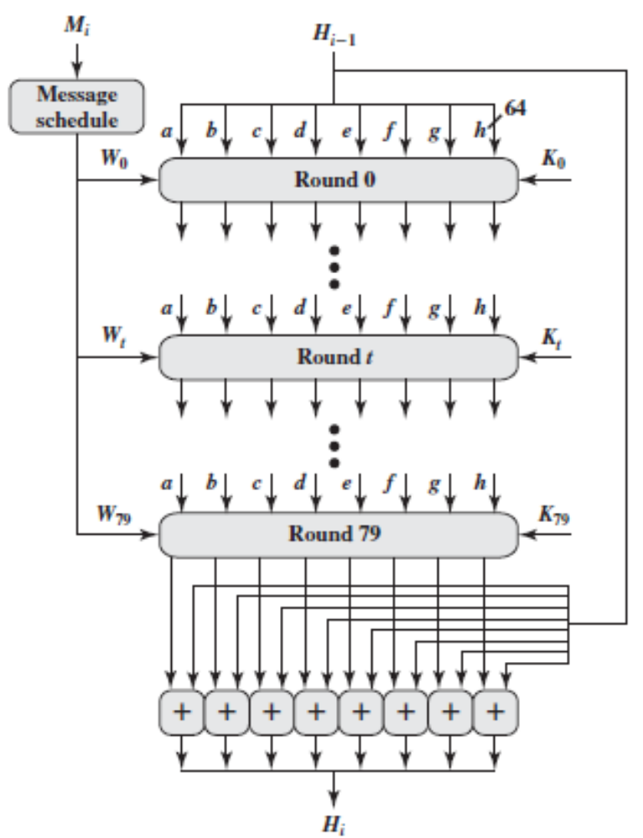
SHA-512 Compression Function
Notes:
The SHA-512 Compression Function is the heart of the algorithm. In this Step 4, it processes the message in 1024-bit (128-word) blocks, using a module that consists of 80 rounds, labeled F in Stallings Figure 11.8, and is shown in detail in Figure 11.9. Each round takes as input the 512-bit buffer value, and updates the contents of the buffer. At input to the first round, the buffer has the value of the intermediate hash value. Each round t makes use of a 64-bit value Wt derived using a message schedule from the current 1024-bit block being processed. Each round also makes use of an additive constant Kt, based on the fractional parts of the cube roots of the first eighty prime numbers. The constants provide a “randomized” set of 64-bit patterns, which should eliminate any regularities in the input data. The output of the eightieth round is added to the input to the first round to produce the final hash value for this message block, which forms the input to the next iteration of this compression function, as shown on the previous slide.

Slide 25
Keyed Hash Functions as MACs
want a MAC based on a hash function
  because hash functions are generally faster
  crypto hash function code is widely available
hash includes a key along with message
original proposal:
  KeyedHash = Hash(Key|Message)
  some weaknesses were found with this
eventually led to development of HMAC
  RFC 2104
  IP Security, Transport Layer Security (TLS), Secure Electronic Transaction (SET)
Notes:
In recent years, there has been increased interest in developing a MAC derived from a cryptographic hash function, because they generally execute faster in software than symmetric block ciphers, and because code for cryptographic hash functions is widely available. A hash function such as SHA was not designed for use as a MAC and cannot be used directly for that purpose because it does not rely on a secret key. There have been a number of proposals for the incorporation of a secret key into an existing hash algorithm, originally by just pre-pending a key to the message. Problems were found with these earlier, simpler proposals, but they resulted in the development of HMAC.

Slide 26
HMAC Design Objectives
use, without modifications, hash functions
allow for easy replaceability of embedded hash function
preserve original performance of hash function without significant degradation
use and handle keys in a simple way
have well understood cryptographic analysis of authentication mechanism strength
Notes:
RFC 2104 lists the following design objectives for HMAC:
• To use, without modifications, available hash functions. In particular, hash functions that perform well in software, and for which code is freely and widely available.
• To allow for easy replaceability of the embedded hash function in case faster or more secure hash functions are found or required.
• To preserve the original performance of the hash function without incurring a significant degradation.
• To use and handle keys in a simple way.
• To have a well understood cryptographic analysis of the strength of the authentication mechanism based on reasonable assumptions about the embedded hash function.

Slide 27
HMAC
uses hash function on the message:
  HMAC_{K}(M)= Hash[(K⁺ XOR opad) ||
  Hash[(K⁺ XOR ipad) || M)] ]
  where K⁺ is the key padded out to size
  opad, ipad are specified padding constants
overhead is just 3 more hash calculations than the message needs alone
any hash function can be used
  eg. MD5, SHA-1, RIPEMD-160, Whirlpool
Notes:
The idea of a keyed hash evolved into HMAC, designed to overcome some problems with the original proposals. It involves hashing padded versions of the key concatenated with the message, and then with another outer hash of the result prepended by another padded variant of the key. The hash function need only be used on 3 more blocks than when hashing just the original message (for the two keys + inner hash). HMAC can use any desired hash function, and has been shown to have the same security as the underlying hash function. Can choose the hash function to use based on speed/security concerns.

Slide 28
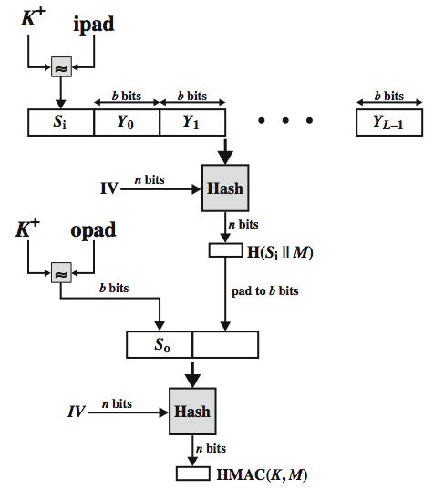
HMAC Overview
Notes:
Stallings Figure 3.6 illustrates the overall operation of HMAC:
HMAC_{K} = Hash[(K⁺ XOR opad) || Hash[(K⁺ XOR ipad) || M)]
where:
K⁺ is K padded with zeros on the left so that the result is b bits in length
ipad is a pad value of 36 hex repeated to fill block
opad is a pad value of 5C hex repeated to fill block
M is the message input to HMAC (including the padding specified in the embedded hash function)
Note that the XOR with ipad results in flipping one-half of the bits of K. Similarly, the XOR with opad results in flipping one-half of the bits of K, but a different set of bits. In effect, pseudorandomly generated two keys from K. HMAC should execute in approximately the same time as the embedded hash function for long messages. HMAC adds three executions of the hash compression function (for Si, So, and the block produced from the inner hash). A more efficient implementation is possible by precomputing the internal hash function on (K⁺ XOR opad) and (K⁺ XOR ipad) and inserting the results into the hash processing at start & end. With this implementation, only one additional instance of the compression function is added to the processing normally produced by the hash function. This is especially worthwhile if most of the messages for which a MAC is computed are short.

Slide 29
HMAC Security
proved security of HMAC relates to that of the underlying hash algorithm
attacking HMAC requires either:
  brute force attack on key used
  birthday attack (but since keyed would need to observe a very large number of messages)
choose hash function used based on speed verses security constraints
Notes:
The appeal of HMAC is that its designers have been able to prove an exact relationship between the strength of the embedded hash function and the strength of HMAC. The security of a MAC function is generally expressed in terms of the probability of successful forgery with a given amount of time spent by the forger and a given number of message-MAC pairs created with the same key. Have two classes of attacks: brute force attack on key used which has work of order 2^n; or a birthday attack which requires work of order 2^(n/2) - but which requires the attacker to observe 2^n blocks of messages using the same key - very unlikely. For a hash code length of 128 bits, this requires 2⁶⁴ observed blocks (2⁷² bits) generated using the same key. On a 1-Gbps link, one would need to observe a continuous stream of messages with no change in key for about 150,000 years in order to succeed. So even MD5 is still secure for use in HMAC given these constraints.

Slide 30
CMAC
previously saw the DAA (CBC-MAC)
widely used in govt & industry
but has message size limitation
can overcome using 2 keys & padding
thus forming the Cipher-based Message Authentication Code (CMAC)
adopted by NIST SP800-38B
Notes:
The Data Authentication Algorithm cipher-based MAC has been widely adopted in government and industry. Has been shown to be secure, with the following restriction. Only messages of one fixed length of mn bits are processed, where n is the cipher block size and m is a fixed positive integer. This limitation can be overcome using multiple keys, which can be derived from a single key. This refinement has been adopted by NIST as the cipher-based message authentication code (CMAC) mode of operation, for use with AES and triple DES. It is specified in NIST Special Publication 800-38B.

Slide 31
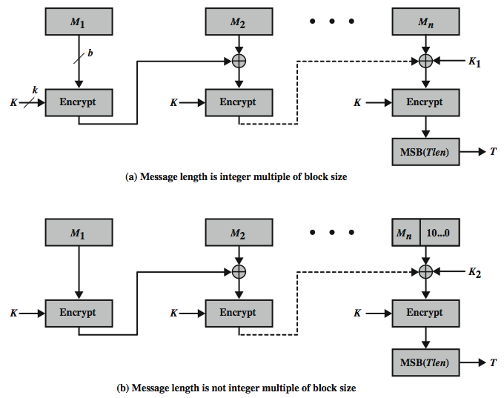
CMAC Overview
Notes:
Stallings Figure 3.7 shows the structure of CMAC. It uses the blocksize of the underlying cipher (ie 128-bits for AES or 64-bits for triple-DES). The message is divided into n blocks M1..Mn, padded if necessary. The algorithm makes use of a k-bit encryption key K and an n-bit constant K1 or K2 (depending on whether the message was padded or not). For AES, the key size k is 128,192, or 256 bits; for triple DES, the key size is 112 or 168 bits. The two constants K1 & K2 are derived from the original key K using encryption of 0 and multiplication in GF(2^n), as detailed in the text.

Slide 32
Authenticated Encryption
simultaneously protect confidentiality and authenticity of communications
  often required but usually separate
approaches
  Hash-then-encrypt: E(K, (M || H(M))
  MAC-then-encrypt: E(K2, (M || MAC(K1, M))
  Encrypt-then-MAC: (C=E(K2, M), T=MAC(K1, C)
  Encrypt-and-MAC: (C=E(K2, M), T=MAC(K1, M)
decryption /verification straightforward
but security vulnerabilities with all these
Notes:
Authenticated encryption (AE) is a term used to describe encryption systems that simultaneously protect confidentiality and authenticity (integrity) of communications. Many applications and protocols require both forms of security, but until recently the two services have been designed separately. [BLAC05] discussed four common approaches to providing both confidentiality and encryption for a message M:
• HtE: Hash-then-encrypt. First compute the cryptographic hash function over M as h = H(M). Then encrypt the message plus hash function: E(K, (M || h)
• MtE: MAC-then-encrypt. Use two keys. First authenticate the plaintext by computing the MAC value as T = MAC(K1, M). Then encrypt the message plus tag: E(K2, (M || T) cf SSL/TLS
• EtM: Encrypt-then-MAC. Use two keys. First encrypt the message to yield the ciphertext C = E(K 2, M). Then authenticate the ciphertext with T = MAC(K1, C) to yield the pair (C, T) cf IPsec
• E&M: Encrypt-and-MAC. Use two keys. Encrypt the message to yield the ciphertext C = E(K 2, M). Authenticate the plaintext with T = MAC(K1, M) to yield the pair (C, T). These operations can be performed in either order. cf SSH
Both decryption and verification are straightforward for each approach. There are security vulnerabilities with all of these approaches.

Slide 33
Counter with Cipher Block Chaining-Message Authentication Code (CCM)
NIST standard SP 800-38C for WiFi
variation of encrypt-and-MAC approach
algorithmic ingredients
  AES encryption algorithm
  CTR mode of operation
  CMAC authentication algorithm
single key used for both encryption & MAC
Notes:
The CCM mode of operation was standardized by NIST specifically to support the security requirements of IEEE 802.11 WiFi wireless local area networks (Chapter 17), but can be used in any networking application requiring authenticated encryption. CCM is a variation of the encrypt-and-MAC approach to authenticated encryption. It is defined in NIST SP 800-38C. The key algorithmic ingredients of CCM are the AES encryption algorithm (Chapter 5), the CTR mode of operation (Chapter 6), and the CMAC authentication algorithm (Section 12.6). A single key K is used for both encryption and MAC algorithms.

Slide 34
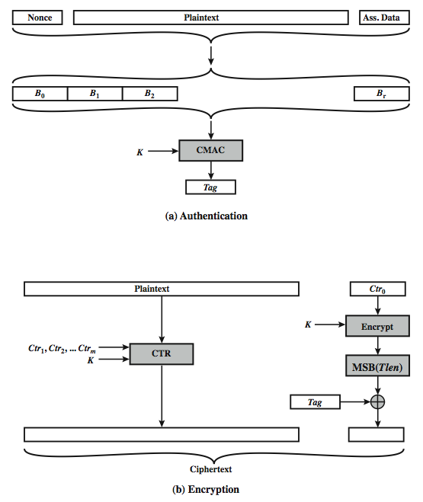
CCM Operation
Notes:
Stallings Figure 3.8 illustrates the operation of CCM. For authentication, the input includes the nonce, the associated data, and the plaintext. This input is formatted as a sequence of blocks B0 through Br. The first block contains the nonce plus some formatting bits that indicate the lengths of the N, A, and P elements. This is followed by zero or more blocks that contain A, followed by zero of more blocks that contain P. The resulting sequence of blocks serves as input to the CMAC algorithm, which produces a MAC value with length Tlen, which is less than or equal to the block length (Figure 3.8a). For encryption, a sequence of counters is generated that must be independent of the nonce. The authentication tag is encrypted in CTR mode using the single counter Ctr0. The Tlen most significant bits of the output are XORed with the tag to produce an encrypted tag. The remaining counters are used for the CTR mode encryption of the plaintext (Figure 6.7). The encrypted plaintext is concatenated with the encrypted tag to form the ciphertext output (Figure 3.8b). CCM is a relatively complex algorithm. Note that it requires two complete passes through the plaintext, once to generate the MAC value, and once for encryption. Further, the details of the specification require a tradeoff between the length of the nonce and the length of the tag, which is an unnecessary restriction. Also note that the encryption key is used twice with the CTR encryption mode, once to generate the tag and once to encrypt the plaintext plus tag. Whether these complexities add to the security of the algorithm is not clear. In any case, two analyses of the algorithm conclude that CCM provides a high level of security.

Slide 35
Private-Key Cryptography
traditional private/secret/single key cryptography uses one key
shared by both sender and receiver
if this key is disclosed communications are compromised
also is symmetric, parties are equal
hence does not protect sender from receiver forging a message & claiming is sent by sender
Notes:
The development of public-key cryptography is the greatest and perhaps the only true revolution in the entire history of cryptography. From its earliest beginnings to modern times, virtually all cryptographic systems have been based on the elementary tools of substitution and permutation, and can be classed as private/secret/single key (symmetric) systems. All classical, and modern block and stream ciphers are of this form.

Slide 36
Public-Key Cryptography
probably most significant advance in the 3000 year history of cryptography
uses two keys – a public & a private key
asymmetric since parties are not equal
uses clever application of number theoretic concepts to function
complements rather than replaces private key crypto
Notes:
Will now discuss the radically different public key systems, in which two keys are used. Public-key cryptography provides a radical departure from all that has gone before. The development of public-key cryptography is the greatest and perhaps the only true revolution in the entire history of cryptography. It is asymmetric, involving the use of two separate keys, in contrast to symmetric encryption, that uses only one key. Anyone knowing the public key can encrypt messages or verify signatures, but cannot decrypt messages or create signatures, counter-intuitive though this may seem. The use of two keys has profound consequences in the areas of confidentiality, key distribution, and authentication. It works by the clever use of number theory problems that are easy one way but hard the other. Note that public key schemes are neither more nor less secure than private key (security depends on the key size for both), nor do they replace private key schemes (they are too slow to do so), rather they complement them. Both also have issues with key distribution, requiring the use of some suitable protocol.

Slide 37
Why Public-Key Cryptography?
developed to address two key issues:
  key distribution – how to have secure communications in general without having to trust a KDC with your key
  digital signatures – how to verify a message comes intact from the claimed sender
public invention due to Whitfield Diffie & Martin Hellman at Stanford Uni in 1976
  known earlier in classified community
Notes:
The concept of public-key cryptography evolved from an attempt to attack two of the most difficult problems associated with symmetric encryption: key distribution and digital signatures. The first problem is that of key distribution, which under symmetric encryption requires either (1) that two communicants already share a key, which somehow has been distributed to them; or (2) the use of a key distribution center. This seemed to negated the very essence of cryptography: the ability to maintain total secrecy over your own communication. The second was that of "digital signatures." If the use of cryptography was to become widespread, not just in military situations but for commercial and private purposes, then electronic messages and documents would need the equivalent of signatures used in paper documents.
The idea of public key schemes, and the first practical scheme, which was for key distribution only, was published in 1976 by Diffie & Hellman. The concept had been previously described in a classified report in 1970 by James Ellis (UK CESG) - and subsequently declassified [ELLI99]. Its interesting to note that they discovered RSA first, then Diffie-Hellman, opposite to the order of public discovery! There is also a claim that the NSA knew of the concept in the mid-60’s [SIMM93].

Slide 38
Public-Key Cryptography
public-key/two-key/asymmetric cryptography involves the use of two keys:
  a public-key, which may be known by anybody, and can be used to encrypt messages, and verify signatures
  a related private-key, known only to the recipient, used to decrypt messages, and sign (create) signatures
infeasible to determine private key from public
is asymmetric because
  those who encrypt messages or verify signatures cannot decrypt messages or create signatures
Notes:
Asymmetric algorithms rely on one key for encryption and a different but related key for decryption. These algorithms have the following important characteristic:
• It is computationally infeasible to determine the decryption key given only knowledge of the cryptographic algorithm and the encryption key.
In addition, some algorithms, such as RSA, also exhibit the following characteristic:
• Either of the two related keys can be used for encryption, with the other used for decryption.
Anyone knowing the public key can encrypt messages or verify signatures, but cannot decrypt messages or create signatures, thanks to some clever use of number theory.

Slide 39
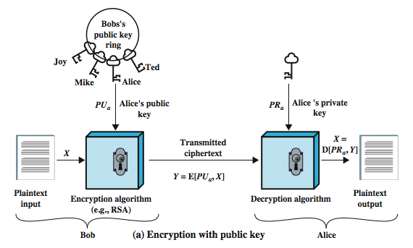
Public-Key Cryptography
Notes:
Stallings Figure 3.9a “Public-Key Cryptography”, shows that a public-key encryption scheme has six ingredients:
• Plaintext: the readable message /data fed into the algorithm as input.
• Encryption algorithm: performs various transformations on the plaintext.
• Public and private keys: a pair of keys selected so that if one is used for encryption, the other is used for decryption. The exact transformations performed by the algorithm depend on the public or private key that is provided as input.
• Ciphertext: the scrambled message produced as output. It depends on the plaintext and the key. For a given message, two different keys will produce two different ciphertexts.
• Decryption algorithm: accepts the ciphertext and matching key and produces the original plaintext.
Consider the following analogy using padlocked boxes: traditional schemes involve the sender putting a message in a box and locking it, sending that to the receiver, and somehow securely also sending them the key to unlock the box. The radical advance in public key schemes was to turn this around, the receiver sends an unlocked box (their public key) to the sender, who puts the message in the box and locks it (easy - and having locked it cannot get at the message), and sends the locked box to the receiver who can unlock it (also easy), having the (private) key. An attacker would have to pick the lock on the box (hard).

Slide 40
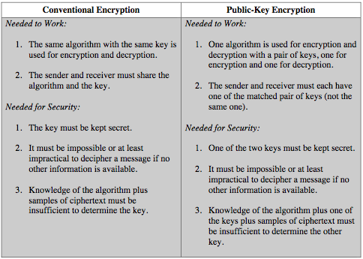
Symmetric vs Public-Key
Notes:
This table summarizes some of the important aspects of symmetric and public-key encryption. To discriminate between the two, we refer to the key used in symmetric encryption as a secret key. The two keys used for asymmetric encryption are referred to as the public key and the private key. Invariably, the private key is kept secret, but it is referred to as a private key rather than a secret key to avoid confusion with symmetric encryption.

Slide 41
RSA
by Rivest, Shamir & Adleman of MIT in 1977
best known & widely used public-key scheme
based on exponentiation in a finite (Galois) field over integers modulo a prime
  nb. exponentiation takes O((log n)³) operations (easy)
uses large integers (eg. 1024 bits)
security due to cost of factoring large numbers
  nb. factorization takes O(e ^{log n log log n}) operations (hard)
Notes:
RSA is the best known, and by far the most widely used general public key encryption algorithm, and was first published by Rivest, Shamir & Adleman of MIT in 1978 [RIVE78]. The Rivest-Shamir-Adleman (RSA) scheme has since that time reigned supreme as the most widely accepted and implemented general-purpose approach to public-key encryption. It is based on exponentiation in a finite (Galois) field over integers modulo a prime, using large integers (eg. 1024 bits). Its security is due to the cost of factoring large numbers.

Slide 42
RSA En/decryption
to encrypt a message M the sender:
  obtains public key of recipient PU={e,n}
  computes: C = Me mod n, where 0≤M<n
to decrypt the ciphertext C the owner:
  uses their private key PR={d,n}
  computes: M = C^{d} mod n
note that the message M must be smaller than the modulus n (block if needed)
Notes:
The scheme developed by Rivest, Shamir, and Adleman makes use of an expression with exponentials. Plaintext is encrypted in blocks, with each block having a binary value less than some number n. The actual RSA encryption and decryption computations are each simply a single exponentiation mod (n). Both sender and receiver must know the value of n. The sender knows the value of e, and only the receiver knows the value of d. Thus, this is a public-key encryption algorithm with a public key of PU = {e, n} and a private key of PR = {d, n}. Note that the message must be smaller than the modulus. The “magic” is in the choice of the modulus and exponents which makes the system work.

Slide 43
RSA Key Setup
each user generates a public/private key pair by:
selecting two large primes at random: p, q
computing their system modulus n=p.q
  note ø(n)=(p-1)(q-1)
selecting at random the encryption key e
  where 1<e<ø(n), gcd(e,ø(n))=1
solve following equation to find decryption key d
  e.d=1 mod ø(n) and 0≤d≤n
publish their public encryption key: PU={e,n}
keep secret private decryption key: PR={d,n}
Notes:
The required moduls and exponent values are chosen during key setup. RSA key setup is done once (rarely) when a user establishes (or replaces) their public key, using the steps as shown. The exponent e is usually fairly small, just must be relatively prime to ø(n). Need to compute its inverse mod ø(n) to find d. It is critically important that the factors p & q of the modulus n are kept secret, since if they become known, the system can be broken. Note that different users will have different moduli n.

Slide 44
Why RSA Works
because of Euler's Theorem:
  a^{ø(n)}mod n = 1 where gcd(a,n)=1
in RSA have:
  n=p.q
  ø(n)=(p-1)(q-1)
  carefully chose e & d to be inverses mod ø(n)
  hence e.d=1+k.ø(n) for some k
hence :
C^{d} = M^{e.d} = M^{1+k.ø(n)} = M¹.(M^{ø(n)})^{k}
= M¹.(1)^{k} = M¹ = M mod n
Notes:
For this algorithm to be satisfactory for public-key encryption, it must be possible to find values of e, d, n such that Med mod n = M for all M < n. We need to find a relationship of the form M^{ed} mod n = M The preceding relationship holds if e and d are multiplicative inverses modulo ø (n), where ø (n) is the Euler totient function. This is a direct consequence of Euler’s Theorem, so that raising a number to power e then d (or vica versa) results in the original number!

Slide 45
RSA Example - Key Setup
Select primes: p=17 & q=11
Calculate n = pq =17 x 11=187
Calculate ø(n)=(p–1)(q-1)=16x10=160
Select e: gcd(e,160)=1; choose e=7
Determine d: de=1 mod 160 and d < 160 Value is d=23 since 23x7=161= 10x160+1
Publish public key PU={7,187}
Keep secret private key PR={23,187}
Notes:
Stallings provides an example of RSA key generation using “trivial” sized numbers.
Selecting primes requires the use of a primality test.
Finding d as inverse of e mod ø(n) requires use of Euclid’s Inverse algorithm (see Ch4)

Slide 46
RSA Example - En/Decryption
sample RSA encryption/decryption is:
given message M = 88 (nb. 88<187)
encryption:
  C = 88⁷ mod 187 = 11
decryption:
  M = 11²³ mod 187 = 88
Notes:
Then show that the encryption and decryption operations are simple exponentiations mod 187.
Rather than having to laborious repeatedly multiply, can use the "square and multiply" algorithm with modulo reductions to implement all exponentiations quickly and efficiently (see next).

Slide 47
Diffie-Hellman Key Exchange
first public-key type scheme proposed
by Diffie & Hellman in 1976 along with the exposition of public key concepts
  note: now know that Williamson (UK CESG) secretly proposed the concept in 1970
is a practical method for public exchange of a secret key
used in a number of commercial products
Notes:
This chapter continues our overview of public-key cryptography systems (PKCSs), and begins with a description of one of the earliest and simplest PKCS, Diffie-Hellman key exchange. This first published public-key algorithm appeared in the seminal paper by Diffie and Hellman that defined public-key cryptography [DIFF76b] and is generally referred to as Diffie-Hellman key exchange. The concept had been previously described in a classified report in 1970 by Williamson (UK CESG) - and subsequently declassified in 1987, see [ELLI99]. The purpose of the algorithm is to enable two users to securely exchange a key that can then be used for subsequent encryption of messages. The algorithm itself is limited to the exchange of secret values. A number of commercial products employ this key exchange technique.

Slide 48
Diffie-Hellman Key Exchange
a public-key distribution scheme
  cannot be used to exchange an arbitrary message
  rather it can establish a common key
  known only to the two participants
value of key depends on the participants (and their private and public key information)
based on exponentiation in a finite (Galois) field (modulo a prime or a polynomial) - easy
security relies on the difficulty of computing discrete logarithms (similar to factoring) – hard
Notes:
The purpose of the algorithm is to enable two users to securely exchange a key that can then be used for subsequent encryption of messages. The algorithm itself is limited to the exchange of secret values, which depends on the value of the public/private keys of the participants. The Diffie-Hellman algorithm uses exponentiation in a finite (Galois) field (modulo a prime or a polynomial), and depends for its effectiveness on the difficulty of computing discrete logarithms.

Slide 49
Diffie-Hellman Setup
all users agree on global parameters:
  large prime integer or polynomial q
  a being a primitive root mod q
each user (eg. A) generates their key
  chooses a secret key (number): x_{A} < q
  compute their public key: y_{A} = a^{xA} mod q
each user makes public that key y_{A}
Notes:
In the Diffie-Hellman key exchange algorithm, there are two publicly known numbers: a prime number q and an integer a that is a primitive root of q. The prime q and primitive root a can be common to all using some instance of the D-H scheme. Note that the primitive root a is a number whose powers successively generate all the elements mod q. Users Alice and Bob choose random secrets x's, and then "protect" them using exponentiation to create their public y's. For an attacker monitoring the exchange of the y's to recover either of the x's, they'd need to solve the discrete logarithm problem, which is hard.

Slide 50
Diffie-Hellman Key Exchange
shared session key for users A & B is K_{AB}:
  K_{AB} = a^{xA.xB} mod q
  = y_{A}^{xB} mod q (which B can compute)
  = y_{B}^{xA} mod q (which A can compute)
K_{AB} is used as session key in private-key encryption scheme between Alice and Bob
if Alice and Bob subsequently communicate, they will have the same key as before, unless they choose new public-keys
attacker needs an x, must solve discrete log
Notes:
The actual key exchange for either party consists of raising the others "public key' to power of their private key. The resulting number (or as much of as is necessary) is used as the key for a block cipher or other private key scheme. For an attacker to obtain the same value they need at least one of the secret numbers, which means solving a discrete log, which is computationally infeasible given large enough numbers. Note that if Alice and Bob subsequently communicate, they will have the same key as before, unless they choose new public-keys.

Slide 51
Diffie-Hellman Example
users Alice & Bob who wish to swap keys:
agree on prime q=353 and a=3
select random secret keys:
  A chooses x_{A}=97, B chooses x_{B}=233
compute respective public keys:
  y_{A}=3⁹⁷ mod 353 = 40 (Alice)
  y_{B}=3²³³ mod 353 = 248 (Bob)
compute shared session key as:
  K_{AB}= y_{B}^{xA} mod 353 = 248⁹⁷ = 160 (Alice)
  K_{AB}= y_{A}^{xB} mod 353 = 40²³³ = 160 (Bob)
Notes:
Here is an example of Diffie-Hellman from the text using prime q=353, showing how each computes its public key, and then how after they exchange public keys, each can compute the common secret key.I n this simple example, it would be possible by brute force to determine the secret key 160. In particular, an attacker E can determine the common key by discovering a solution to the equation 3ª mod 353 = 40 or the equation 3^{b} mod 353 = 248. The brute-force approach is to calculate powers of 3 modulo 353, stopping when the result equals either 40 or 248. The desired answer is reached with the exponent value of 97, which provides 3⁹⁷ mod 353 = 40. With larger numbers, the problem becomes impractical.

Slide 52
Key Exchange Protocols
users could create random private/public D-H keys each time they communicate
users could create a known private/public D-H key and publish in a directory, then consulted and used to securely communicate with them
both of these are vulnerable to a meet-in-the-Middle Attack
authentication of the keys is needed
Notes:
Now consider a simple protocol that makes use of the Diffie-Hellman calculation. Suppose that user A wishes to set up a connection with user B and use a secret key to encrypt messages on that connection. User A can generate a one-time private key X_{A}, calculate Y_{A}, and send that to user B. User B responds by generating a private value X_{B}, calculating Y_{B}, and sending Y_{B} to user A. Both users can now calculate the key. The necessary public values q and a would need to be known ahead of time. Alternatively, user A could pick values for q and a and include those in the first message.

Slide 53
Man-in-the-Middle Attack
Darth prepares by creating two private / public keys
Alice transmits her public key to Bob
Darth intercepts this and transmits his first public key to Bob. Darth also calculates a shared key with Alice
Bob receives the public key and calculates the shared key (with Darth instead of Alice)
Bob transmits his public key to Alice
Darth intercepts this and transmits his second public key to Alice. Darth calculates a shared key with Bob
Alice receives the key and calculates the shared key (with Darth instead of Bob)
Darth can then intercept, decrypt, re-encrypt, forward all messages between Alice & Bob
Notes:
The protocol described on the previous slide is insecure against a man-in-the-middle attack. Suppose Alice and Bob wish to exchange keys, and Darth is the adversary. The attack proceeds as follows:
Darth prepares for the attack by generating two random private keys X_{D1} and X_{D2} and then computing the corresponding public keys Y_{D1} and Y_{D2}
Alice transmits Y_{A} to Bob.
Darth intercepts Y_{A} and transmits Y_{D1} to Bob. Darth also calculates K2 = (Y_{A} )^ X_{D2} mod q
Bob receives Y_{D1} and calculates K1=(Y_{D1} )^ X_{B} mod q
Bob transmits Y_{B} to Alice.
Darth intercepts Y_{B} and transmits Y_{D2} to Alice. Darth calculates K1=(Y_{B} )^ X_{D1} mod q
Alice receives Y_{D2} and calculates K2=(Y_{D2} )^ X_{A} mod q .
At this point, Bob and Alice think that they share a secret key, but instead Bob and Darth share secret key K1 and Alice and Darth share secret key K2. All future communication between Bob and Alice is compromised in the following way:
Alice sends an encrypted message M: E(K2, M).
Darth intercepts the encrypted message and decrypts it, to recover M.
Darth sends Bob E(K1, M) or E(K1, M'), where M' is any message. In the first case, Darth simply wants to eavesdrop on the communication without altering it. In the second case, Darth wants to modify the message going to Bob. The key exchange protocol is vulnerable to such an attack because it does not authenticate the participants. This vulnerability can be overcome with the use of digital signatures and public- key certificates.

Slide 54
Digital Signatures
have looked at message authentication
  but does not address issues of lack of trust
digital signatures provide the ability to:
  verify author, date & time of signature
  authenticate message contents
  be verified by third parties to resolve disputes
hence include authentication function with additional capabilities
Notes:
The most important development from the work on public-key cryptography is the digital signature. Message authentication protects two parties who exchange messages from any third party. However, it does not protect the two parties against each other either fraudulently creating, or denying creation, of a message. A digital signature is analogous to the handwritten signature, and provides a set of security capabilities that would be difficult to implement in any other way. It must have the following properties:
• It must verify the author and the date and time of the signature
• It must to authenticate the contents at the time of the signature
• It must be verifiable by third parties, to resolve disputes
Thus, the digital signature function includes the authentication function.

Slide 55
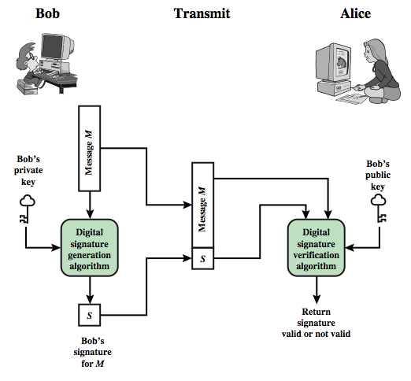
Digital Signature Model
Notes:
This Figure is a generic model of the process of making and using digital signatures. Bob can sign a message using a digital signature generation algorithm. The inputs to the algorithm are the message and Bob's private key. Any other user, say Alice, can verify the signature using a verification algorithm, whose inputs are the message, the signature, and Bob's public key.

Slide 56
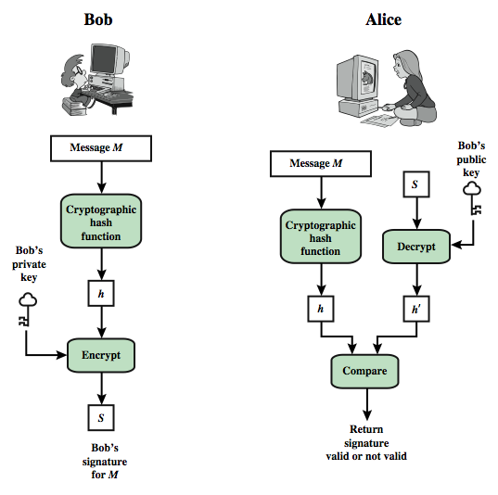
Digital Signature Model
Notes:
In simplified terms, the essence of the digital signature mechanism is shown in this figure.

