Slide 1
How to install Network Simulator (NS2) for windows
-Prepared by Changyong Jung

Slide 2
How to Install
-Window XP-
Go to Website:
http://nsnam.isi.edu/nsnam/index.php/Running_Ns_and_Nam_Under_Windows_9x/2000/XP_Using_Cygwin
Read “Requirements and Installation Tips” Carefully.
Download cygwin.exe from http://www.cygwin.com/
Click the “cygwin.exe”

Slide 3
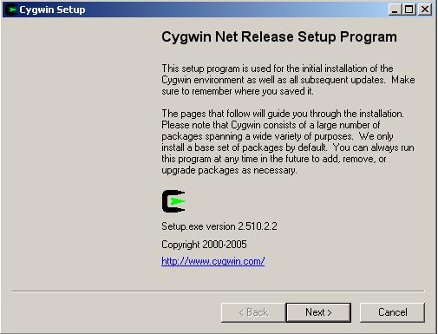
How to Install
Cygwin Installation

Slide 4
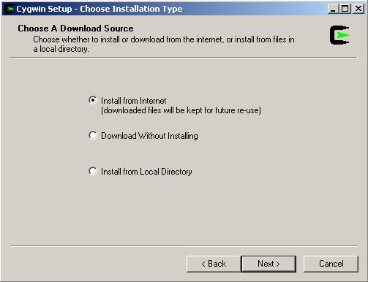
How to Install

Slide 5
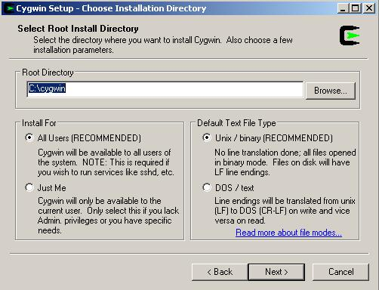
How to Install
Select browse for “cygwin” file( I selected as “default”)

Slide 6
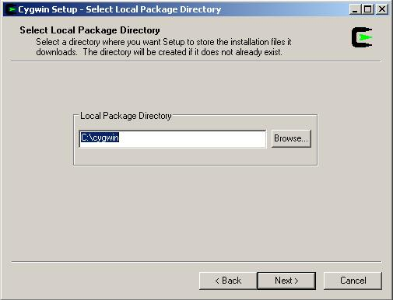
How to Install
Local package directory (I recommend c:\cygwin).

Slide 7
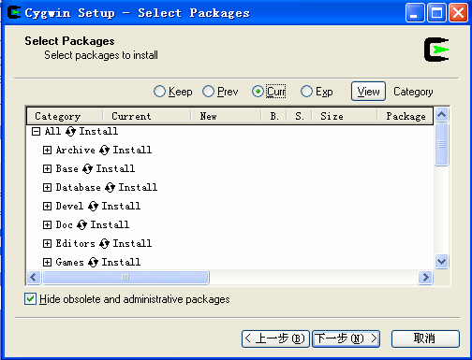
How to Install
Select to Install all ( I recommend it)
You can select “install”, “default”, “uninstall”, “install”, and “reinstall” behind the first line “all”. If you select “install”, then all sub items will be automatically selected. Otherwise you may lose some items.

Slide 8
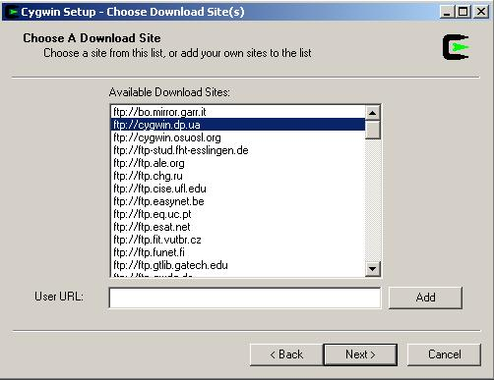
How to Install
Select download site

Slide 9
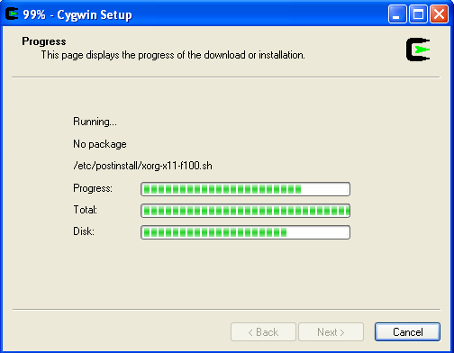
How to Install
Installing

Slide 10
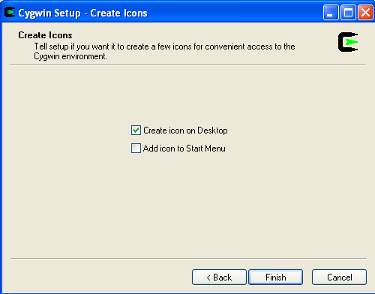
How to Install
Finishing Installing

Slide 11
How to Install
NS2 Installation
Download ns-allinone-2.29.2.tar.gz from Website and Save it to the c:/cygwin /usr/local
Unpack it: tar xvfz ns-allinone-2.29.2.tar.gz
Click on desktop icon “cygwin”

Slide 12
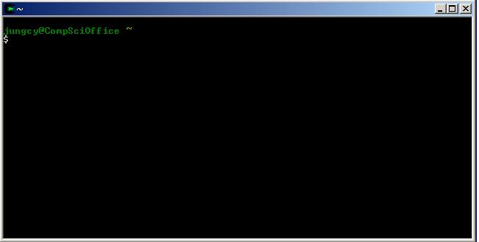
How to Install

Slide 13
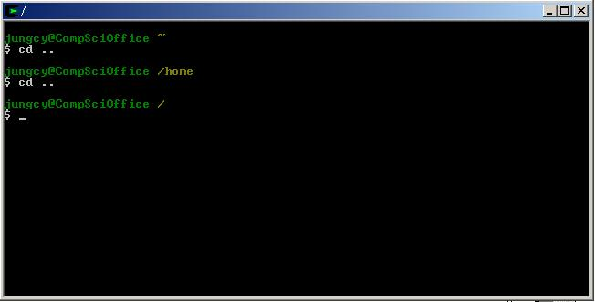
How to Install
Type “cd ..” to go to the upper folder(“cd” must be low case. And there is one space between “d” and “.”)
Type “cd ..” again.

Slide 14
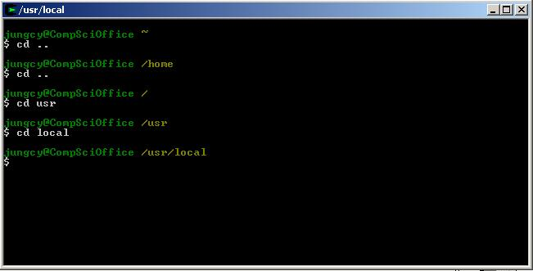
How to Install
“cd usr”, go to folder “usr”
“cd local”, go to folder “local”

Slide 15
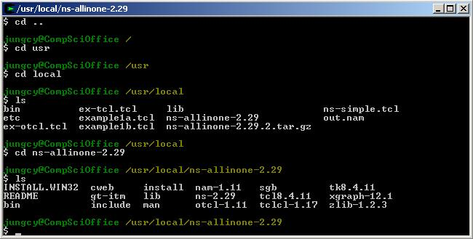
How to Install
Find “install.exe”

Slide 16
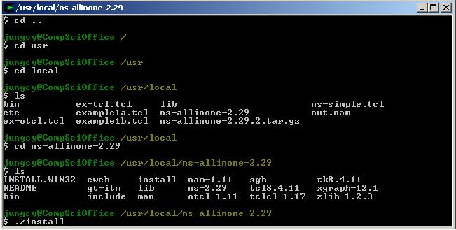
How to Install
Start to run the installation “./install”

Slide 17
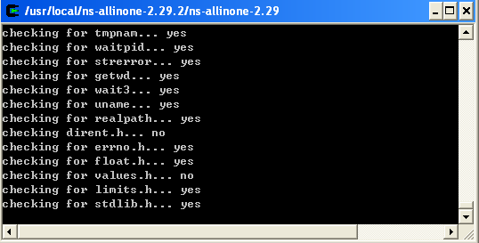
How to Install
Installing

Slide 18
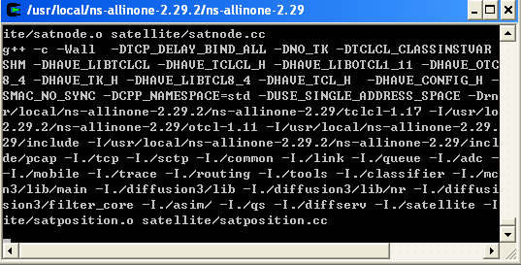
How to Install
Installing

Slide 19
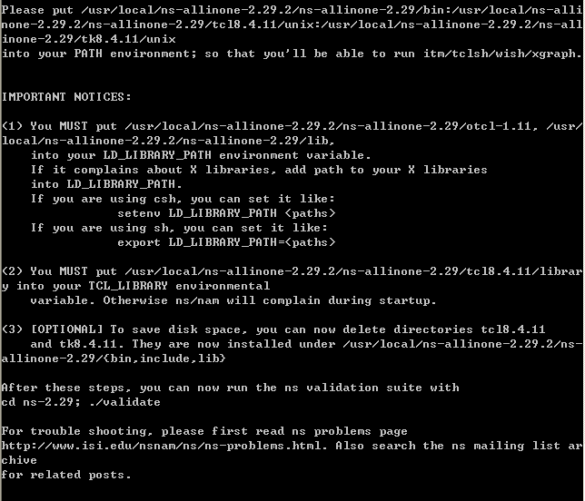
How to Install
Configure system variables and library paths
After finishing installing, following window appears

Slide 20
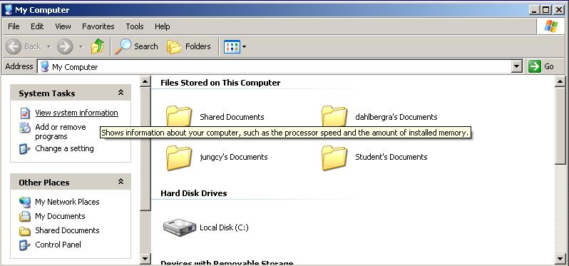
How to Install
Configure system variables
Go to “My computer” and click “view system information”

Slide 21
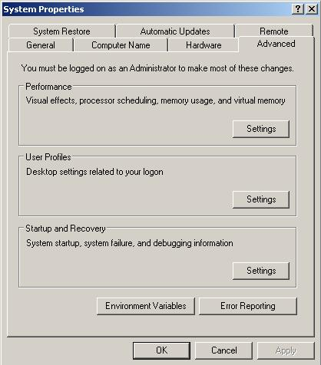
How to Install
Go to “advanced” Tab and Click “Environmental variables”

Slide 22
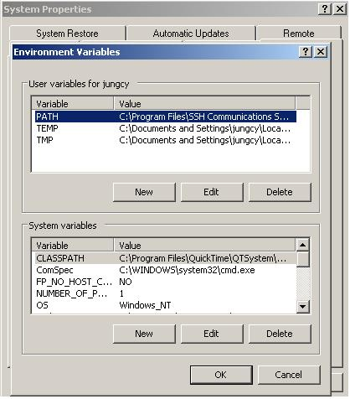
How to Install

Slide 23
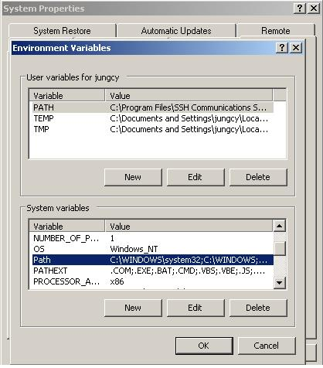
How to Install
Highlight “path” which is “system variable” box and press the “Edit” button.

Slide 24
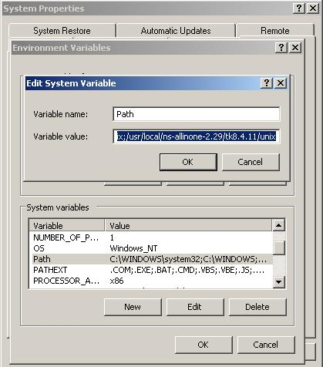
How to Install

Slide 25
How to Install
Add the following path separated with “;” make sure to not change the existing path.
/usr/local/ns-allinone-2.29.2/bin
/usr/local/ns-allinone-2.29.2/tcl8.4.11/unix
/usr/local/ns-allinone-2.29.2/tk8.4.11/unix

Slide 26
How to Install
Go to cygwin and type the following content
Export LD_LIBRARY_PATH=/usr/local/ns-allinone-2.29/otcl-1.11
Export LD_LIBRARY_PATH=/usr/local/ns-allinone-2.29/lib
Export TCL_LIBRARY_PATH=/usr/local/ns-allinone-2.29/tcl8.4.11/library

Slide 27
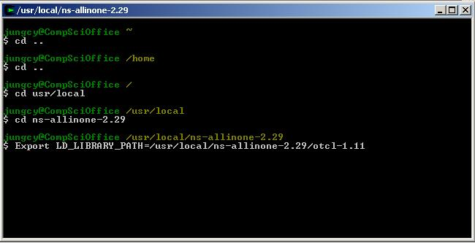
How to Install

Slide 28
Simple Simulation Implement
Click on desktop icon “cygwin”
Make sure to put the exe files under C:\cygwin\usr\local
Do the following steps to execute example.

Slide 29
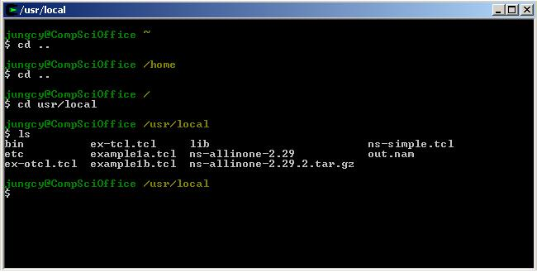
Simple Simulation Implement

Slide 30
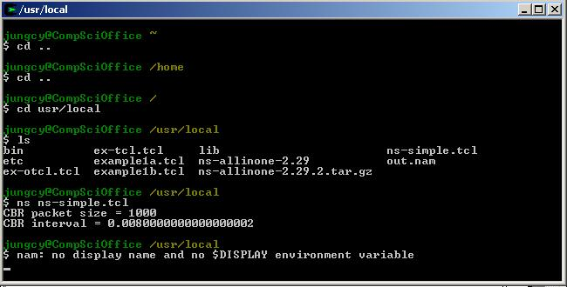
Simple Simulation Implement
However you will fail to run the “ns-simple.tcl” with the displayed notice. This is because you did not open “XWin” yet

Slide 31
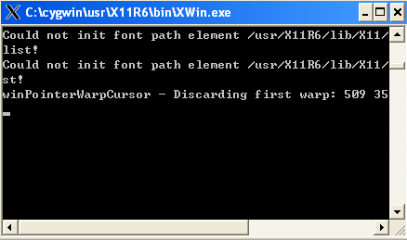
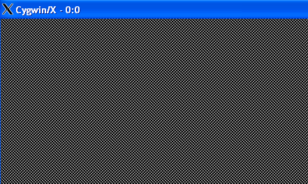
Simple Simulation Implement
Open “Xwin” from “C:\cygwin\usr\X11R6\bin”. If everything is fine, you will then get the following figures.

Slide 32
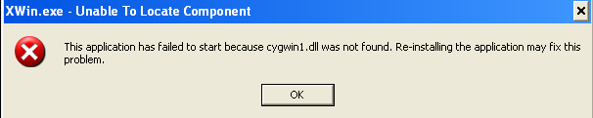
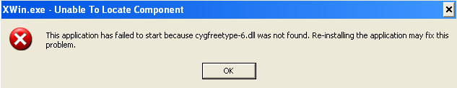
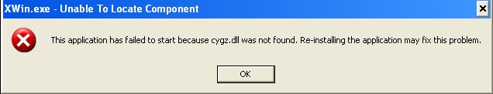
Simple Simulation Implement
Yet you may get the following warning messages:

Slide 33
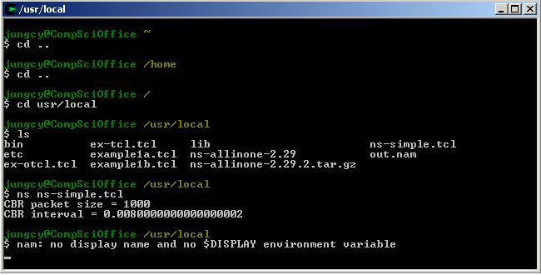
Simple Simulation Implement
That means some components missed. You can then copy these files from “C:\cygwin\bin” to “C:\cygwin\usr\X11R6\bin”
After you open X11, you may still can not run “ns-simple.tcl”

Slide 34
Simple Simulation Implement
The following command can solve this issue
export DISPLAY=:0.0

Slide 35
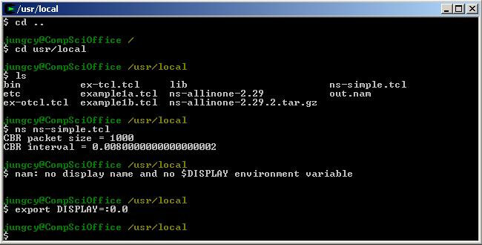
Simple Simulation Implement

Slide 36
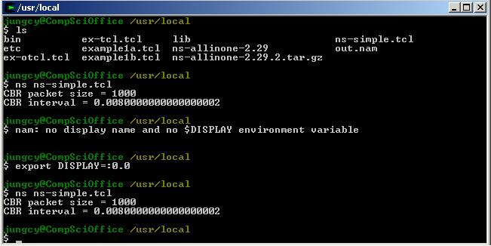
Simple Simulation Implement
Run “ns-simple.tcl”

Slide 37
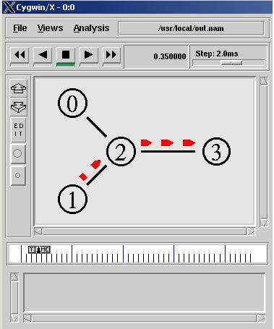
Simple Simulation Implement
DONE !!!

Slide 38
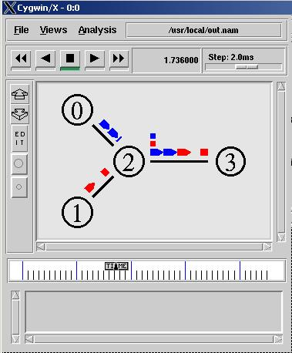
Simple Simulation Implement

