Slide 1
FROM POSTERIOR SAMPLING
TO MEANINGFUL DIVERSITY
IN IMAGE RESTORATION
Author: Houman Jafari, Mohammad Parsa Dini
Mentor: Arash Hajian nezhad
1

Slide 2
Acknowledgments
Houman Jafari
B.Sc.E.E.
jhooman82@gmail.com
Mohammad Parsa Dini
B.Sc.E.E.
mohammadparsadinithefirst@gmail.com
2

Slide 3
Introduction to
Definitions & Motivations
1
2
Problem &
Why is it
Happening?
Key idea &
Solutions for
Diversity
3
4
Our contribution
& Experiments
5
Conclusion
3

Slide 4
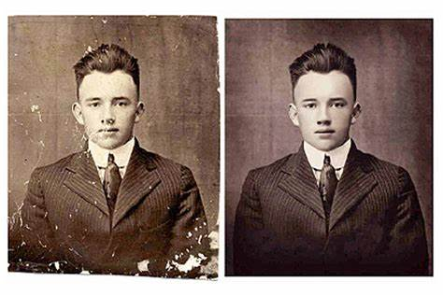
Definition:
Image restoration attempts to
restore Images that have been degraded
by using a prior knowledge of
the degradation phenomena
4

Slide 5
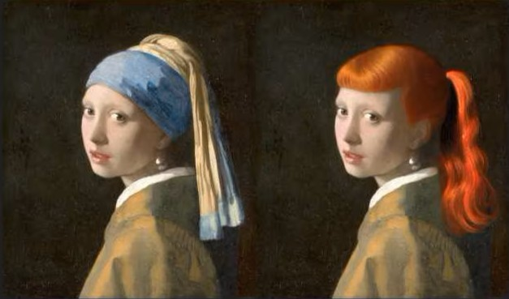
Inpainting:
Inpainting is art of reconstructing the missing portion of images in order to make it more legible and restore its unity.
5

Slide 6
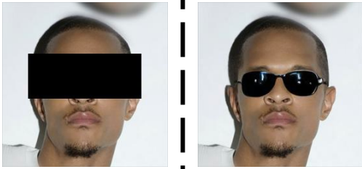
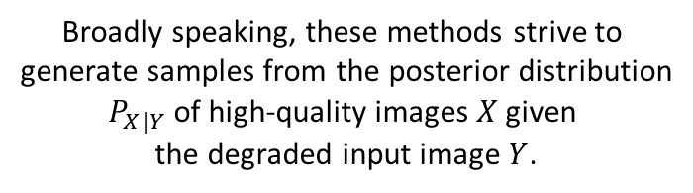
How it generates samples:
Broadly speaking, these methods strive to
generate samples from the posterior distribution
$P_{X|Y}$ of high-quality images $X$ given
the degraded input image $Y$.
6

Slide 7
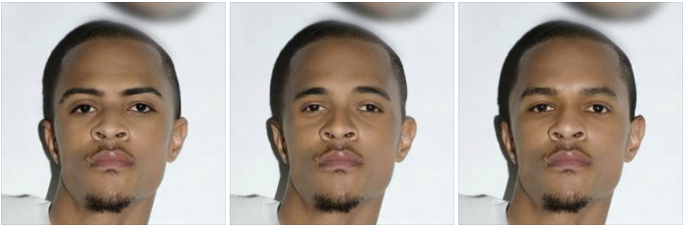
What about diversity:
sampling from the posterior distribution is
the optimal strategy for achieving meaningful
solution diversity in image restoration.
7

Slide 8
Introduction to
Definitions & Motivations
1
2
Problem &
Why is it
Happening?
Key idea &
Solutions for
Diversity
3
4
Our contribution
& Experiments
5
Conclusion
8

Slide 9
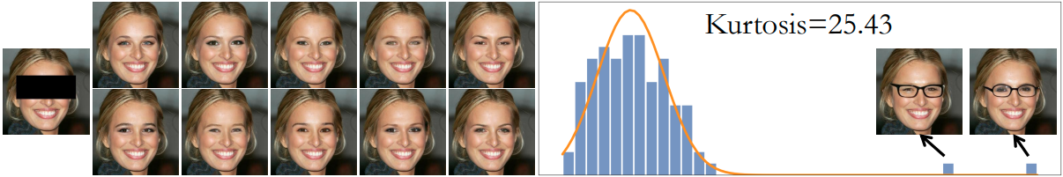
Meaningful Diversity
We argue that this phenomenon stems from the fact that the posterior distribution is often heavy tailed along semantically interesting directions. Heavy-tailed distributions assign a non-negligible probability to distinct “outliers”.
As can be seen, none of the 10 completions corresponding to the eye region
depict glasses, yet, when examining 100 samples from the model, it is evident that such completions are possible; they are simply rare (2 out of 100 samples).
9

Slide 10
Introduction to
Definitions & Motivations
1
2
Problem &
Why is it
Happening?
Key idea &
Solutions for
Diversity
3
4
Our contribution
& Experiments
5
Conclusion
10

Slide 11
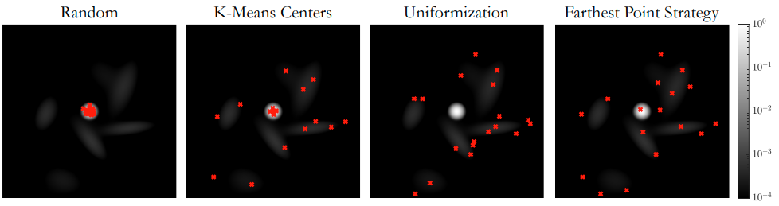
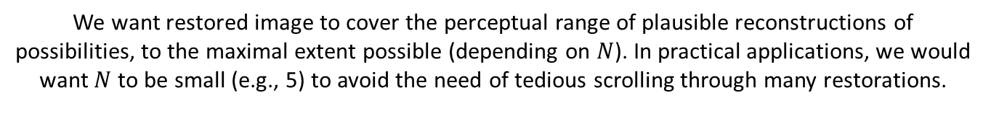
What is the solution?
We want restored image to cover the perceptual range of plausible reconstructions of possibilities, to the maximal extent possible (depending on $N$). In practical applications, we would
want $N$ to be small (e.g., 5) to avoid the need of tedious scrolling through many restorations.
11

Slide 12
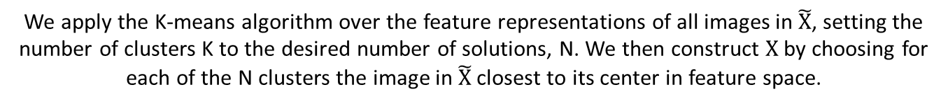


$\tilde{X}$: set of Solutions
What is the solution?
$X$ : representative set
We apply the K-means algorithm over the feature representations of all images in $\tilde{X}$, setting the number of clusters K to the desired number of solutions, N. We then construct $X$ by choosing for each of the N clusters the image in $\tilde{X}$closest to its center in feature space.
12

Slide 13
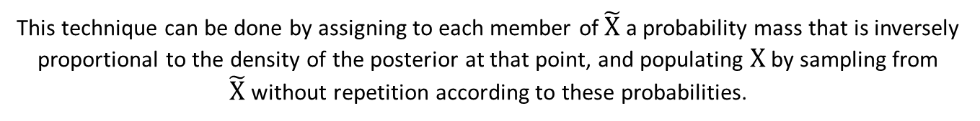
$\tilde{X}$: set of Solutions
What is the solution?
$X$ : representative set
This technique can be done by assigning to each member of $\tilde{X}$a probability mass that is inversely proportional to the density of the posterior at that point, and populating $X$ by sampling from $\tilde{X}$without repetition according to these probabilities.
13

Slide 14
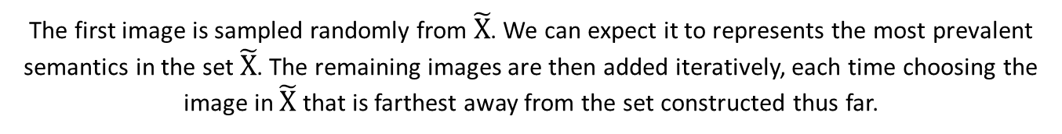
$\tilde{X}$: set of Solutions
What is the solution?
$X$ : representative set
The first image is sampled randomly from $\tilde{X}$. We can expect it to represents the most prevalent semantics in the set $\tilde{X}$. The remaining images are then added iteratively, each time choosing the image in $\tilde{X}$that is farthest away from the set constructed thus far.
14

Slide 15
Introduction to
Definitions & Motivations
1
2
Problem &
Why is it
Happening?
Key idea &
Solutions for
Diversity
3
4
Our contribution
& Experiments
5
Conclusion
15

Slide 16
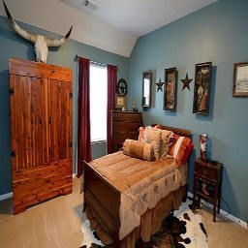
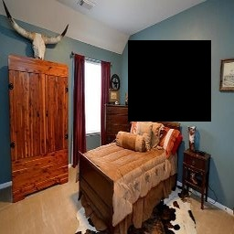
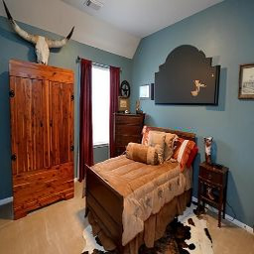
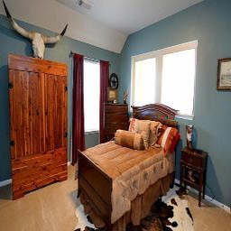
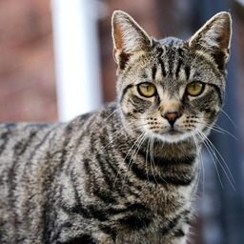
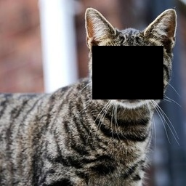
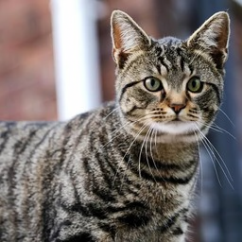
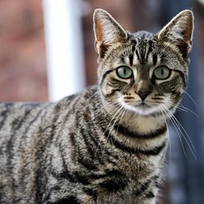
Guidance_eta: 0.3
Early experiments
Guidance_dist: 0.003
Ground truth
Masked
Generated #1
Generated #2
First, we implement different guided diffusion models from different datasets and perform previous methods on their posterior distribution and inpaint different images that are similar to their respective trained dataset with variety of masks.
16

Slide 17
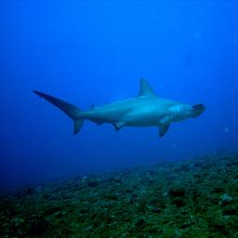
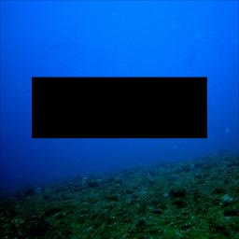
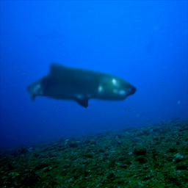
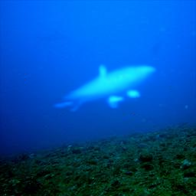
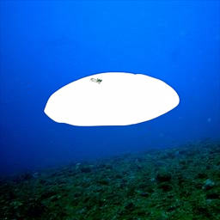
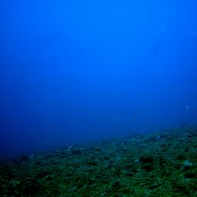
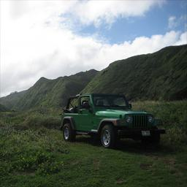
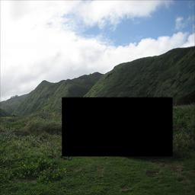
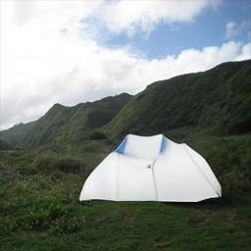
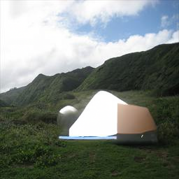
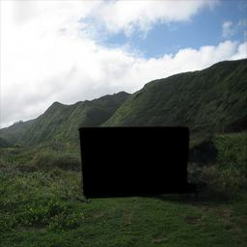
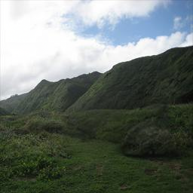
Guidance_eta increasing
Early experiments
Guidance_dist: 0.003
Ground truth
Masked
η = 0.3
η = 0.5
η = 0.8
η = 1.0
With different η and monitoring samples as it is increasing, in the original paper they discussed that η is directly related to diversity, and samples won’t be stable if it is too large, as we can see that is the case even for different datasets and masks.
17

Slide 18
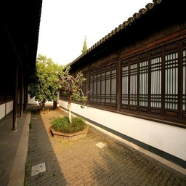
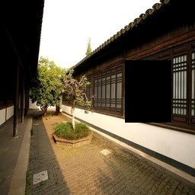
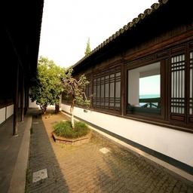
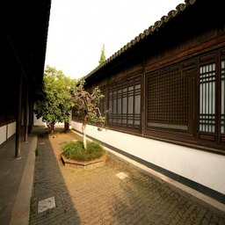
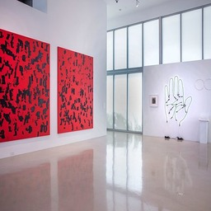
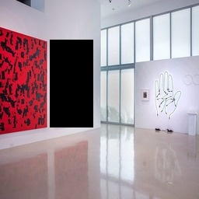
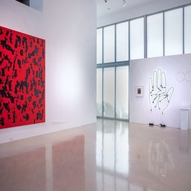
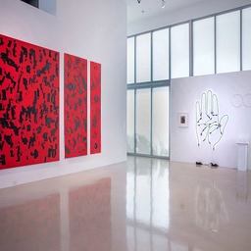
Guidance_eta: 0.3
Are they meaningful?
Guidance_dist: 0.003
Ground truth
Masked
Generated #1
Generated #2
As we can see from above even though model trained on bedroom images but still can inpaint images from other places and tries to capture concepts that are looking familiar to it and utilize them to inpaint the images; Is this creativity?
18

Slide 19
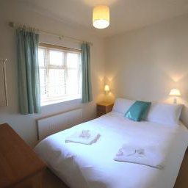
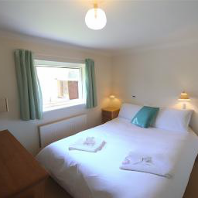
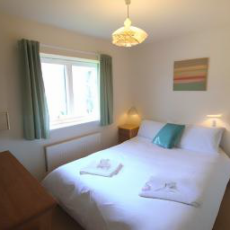
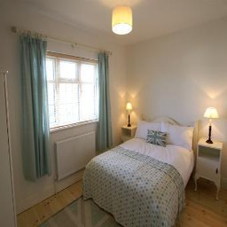
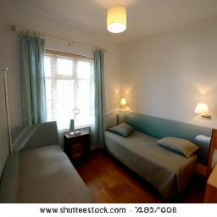
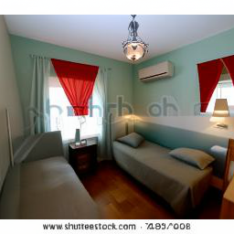
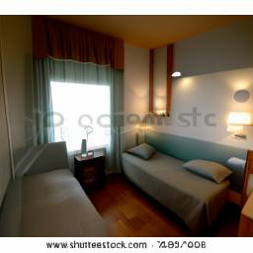
Guidance_eta: 0.3
Generating new images:
Guidance_dist: 0.003
If it really is diverse, why not create new images from our old ones by using complement masks?
As you can see from above it seems like final images are in the same room and same angle, but with different stuff and setting from original image.
19

Slide 20
Introduction to
Definitions & Motivations
1
2
Problem &
Why is it
Happening?
Key idea &
Solutions for
Diversity
3
4
Our contribution
& Experiments
5
Conclusion
20

Slide 21
Conclusion
In the original paper they achieved their objective which was achieving meaningful diversity, but they didn’t monitor their method for different scenarios.
Their strategy to reach meaningfulness is working pretty good under
variety of masks and images.
For structural difference images it can adapt itself and have creativity.
By utilizing their method on can even generate samples that is
semantically similar to their own images.
21

Slide 22
References
Main Sources
Prafulla Dhariwal, Alex Nichol. Diffusion Models Beat GANs on Image Synthesis. Jun 2021.
arXiv:2310.16047
Noa Cohen , Hila Manor , Yuval Bahat ,
Tomer Michaeli. From Posterior Sampling to
Meaningful Diversity in Image Restoration. In
The Twelfth International Conference on Learning
Representations, ICLR 2024. Feb 2024.
arXiv:2310.16047
Additional Resources
itinerai/us_places. https://huggingface.co/datasets/itinerai/us_places.
pcuenq/lsun-bedrooms.
https://huggingface.co/datasets/pcuenq/lsun-bedrooms.
Yaron Cruz, Image Processing, Aug 2024. https://www.slideserve.com/yaron/image-processing.
22

